Slide 1
Constitutional Underpinnings-The Philosophy Behind a National Government
Mr. Winchell
AP GoPo
Unit 1: Foundations of American Democracy

Slide 2
Classical Origins
Ancient Greece
Athenian Democracy
The Assembly
Citizenship
Ancient Rome
Republic in Rome
The Senate
The Consuls

Slide 3
English Heritage
Magna Carta (1215)
Nobles vs. King John
Limited monarchy to guarantee nobles rights and protections
Parliament
House of Lords
House of Commons
Petition of Right (1628)
Applied protections of the Magna Carta to rest of the English citizens
Restricted the monarchy further
English Bill of Rights (1689)
Free parliamentary elections, speedy trials, prohibit cruel and unusual punishment, petition the monarch, no taxation without consent of Parliament
Notes:
Petition of Rights (1628): challenged the idea of divine right and said the monarch had to obey the laws of the land.
English Bill of Rights (1688): William and Mary of Orange signed this and made representative govt. supreme

Slide 4
The Enlightenment 16th-18th Centuries
Age of Reason
Inspired by the Scientific Revolution
Empiricism and Logic applied to human behavior
Break from tradition, heredity, fundamentalism
Natural Laws applied to society - Natural Rights
Each individual born with natural rights such as life, liberty, property
Could never be denied like the laws of nature
Social Contracts
Established relationships between individuals/citizens and governments
Based on mutual consent

Slide 5
The Enlightenment from England
Thomas Hobbes
Leviathan (1651)
State of nature
“the war of all against all”
Social contract theory
People submit to a strong, undivided government
John Locke
Second Treatise on Civil Government (1689)
In a state of nature - life, liberty, property
Consent of the governed
Right to revolution
Notes:
Hobbes
People naturally fight so need govt for protection (stability)
Social Contract (expanded upon by Rousseau)
Locke:
Govt’s purpose is to reserve and protect people’s inalienable rights/property
Separation of Powers

Slide 6
John Locke’s Second Treatise on Government
“The state of nature has a law of nature to govern it, which obliges every one: and reason, which is that law, teaches all mankind … that, being all equal and independent, no one ought to harm another in his life, health, liberty, or possessions”
“Men being, as has been said, by nature, all free, equal, and independent, no one can be put out of this estate, and subjected to the political power of another, without his own consent.”
“Whensoever therefore the legislative shall transgress this fundamental rule of society; and either by ambition, fear, folly or corruption, endeavour to grasp themselves, or put into the hands of any other, an absolute power over the lives, liberties, and estates of the people; by this breach of trust they forfeit the power the people had put into their hands for quite contrary ends, and it devolves to the people, who have a right to resume their original liberty, and, by the establishment of a new legislative, (such as they shall think fit) provide for their own safety and security, which is the end for which they are in society.”

Slide 7
The Philosophes
Baron de Montesquieu
Spirit of the Laws (1748)
Separation of powers
Checks and balances
Voltaire
Advocated individual freedoms; criticized traditional institutions
Candide
Rousseau
On the Social Contract
Based on the General Will
Notes:
Montesquieu:
Separation of Powers

Slide 8
Colonial America
House of Burgesses (1619)
Representative form of government in Virginia
Mayflower Compact (1620)
Social contract for common good/survival
Fundamental Orders of Connecticut (1639)
First written constitution
Outlined individual rights

Slide 9
Colonial Resistance
Navigation Acts
Proclamation of 1763, Sugar Act (1764), Stamp Act (1765)
Ideological Arguments
Taxation without representation
Virtual representation
First Continental Congress
Declaration of Rights and Grievances
Petition to the King
Second Continental Congress
Olive Branch Petition
Declaration of Independence (1776)
Articles of Confederation (1777, 1781)

Slide 10
Declaration of Independence
Primarily written by Thomas Jefferson
Based largely on Locke’s ideas
Political theory, list of grievances, colonial unity for independence
“We hold these truths to be self-evident, that all men are created equal, that they are endowed by their Creator with certain unalienable Rights, that among these are Life, Liberty and the pursuit of Happiness. That to secure these rights, Governments are instituted among Men, deriving their just powers from the consent of the governed, That whenever any Form of Government becomes destructive of these ends, it is the Right of the People to alter or to abolish it, and to institute new Government, laying its foundation on such principles and organizing its powers in such form, as to them shall seem most likely to effect their Safety and Happiness.”

Slide 11
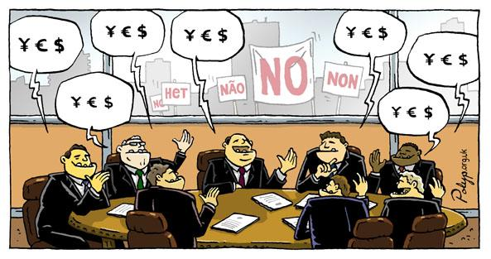
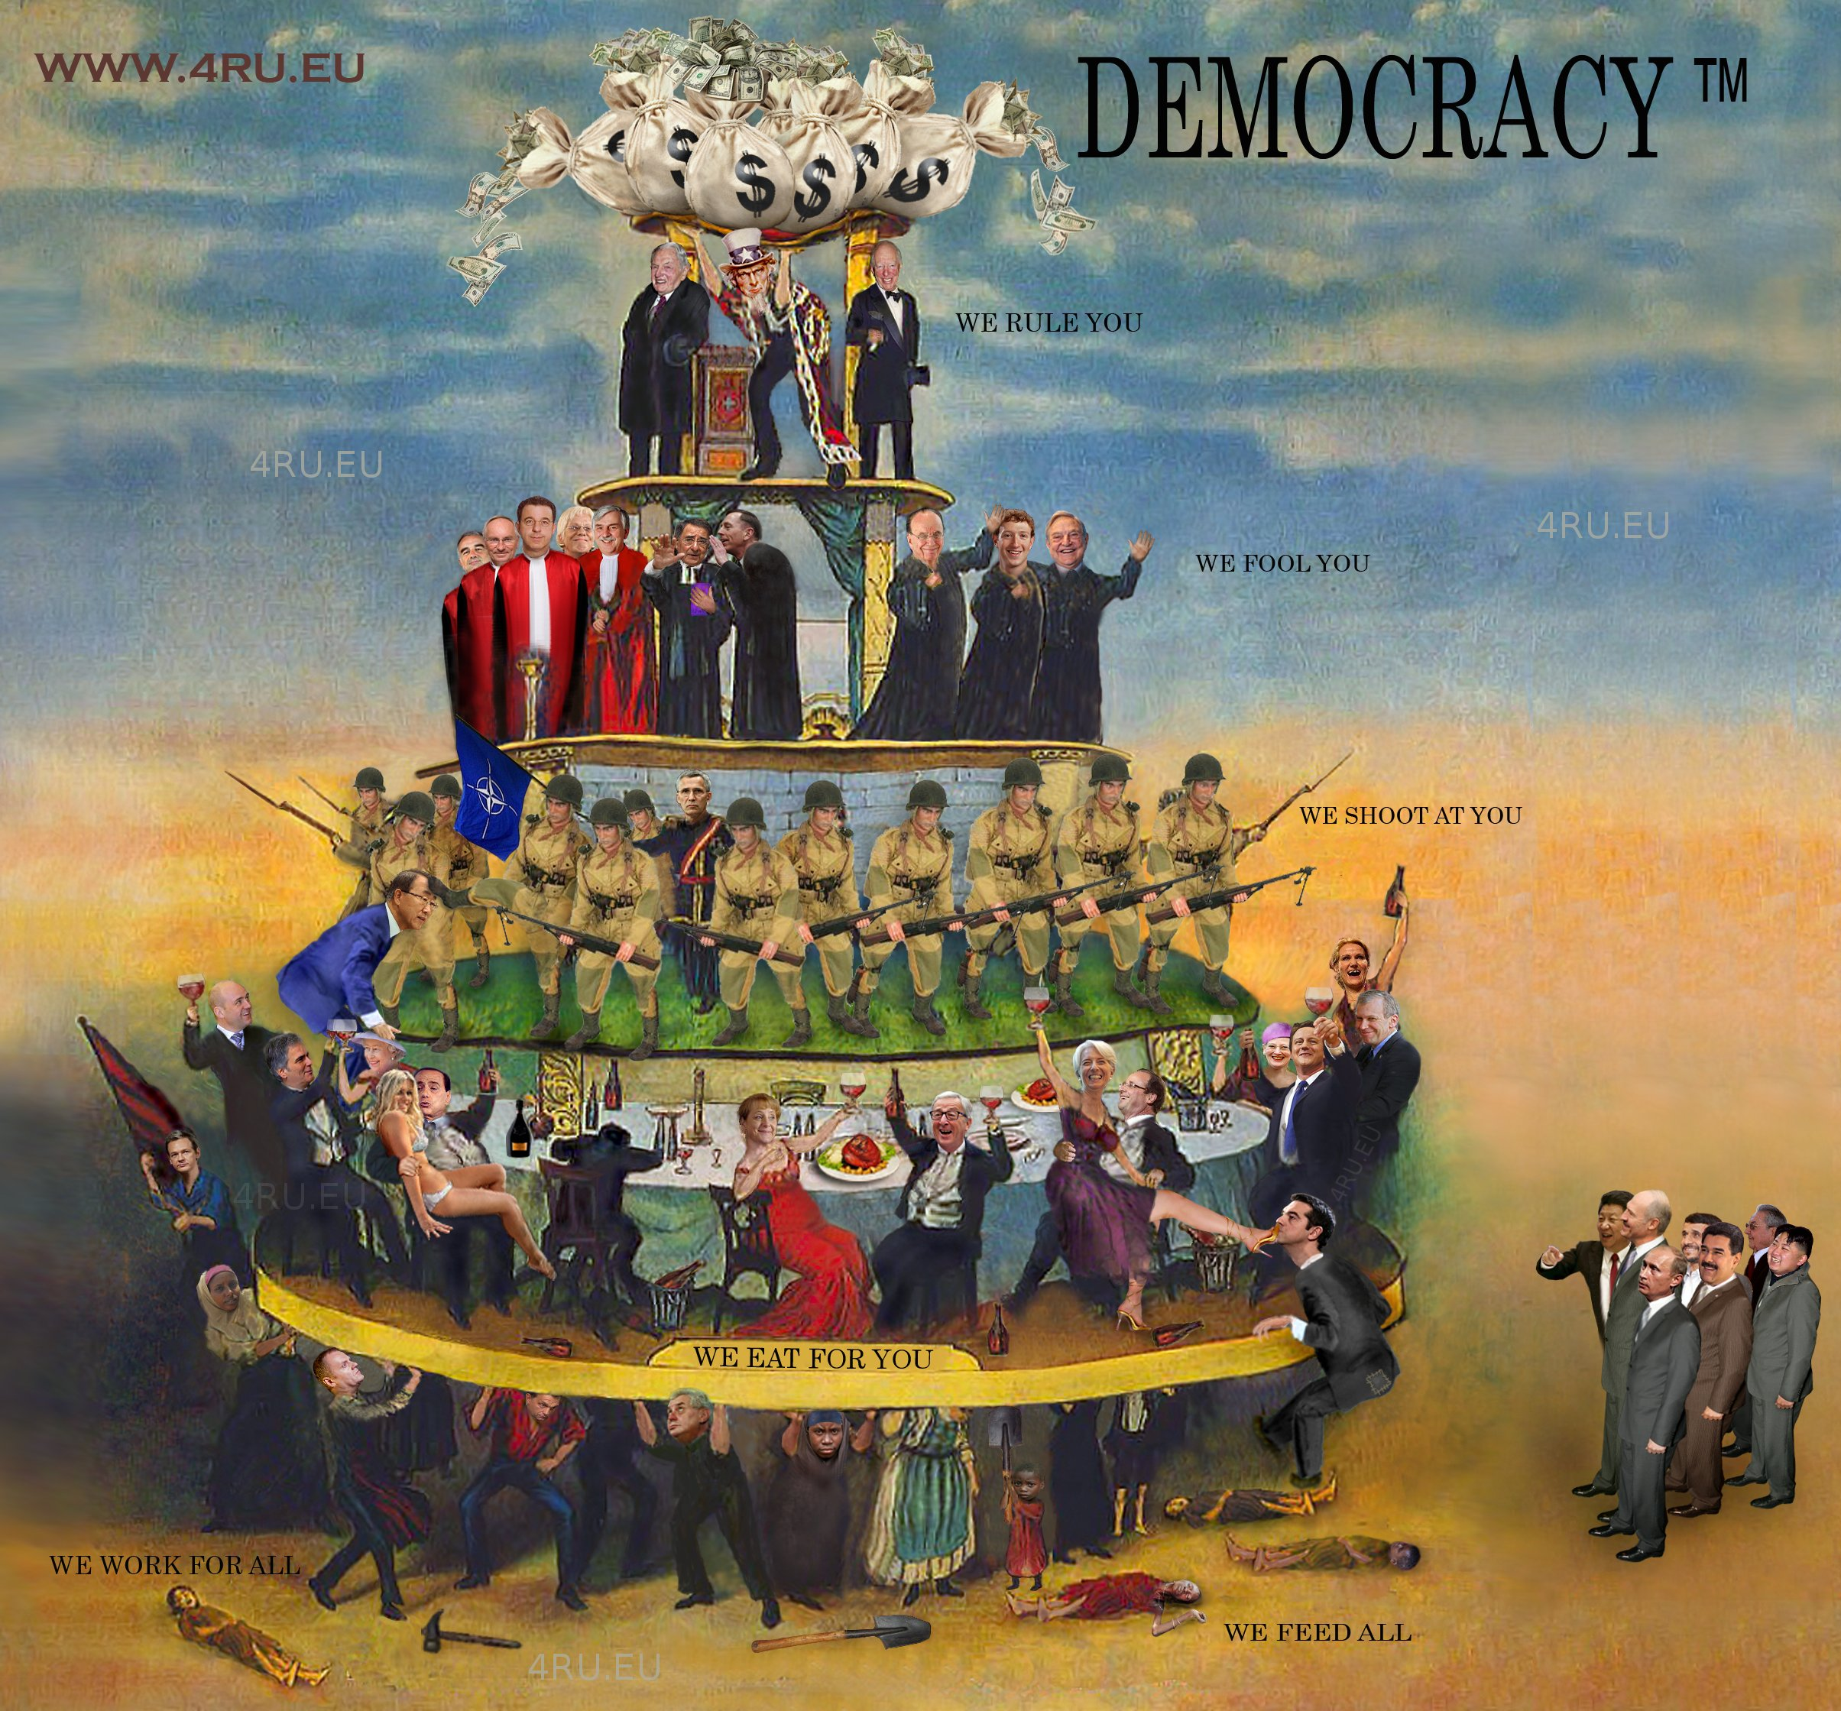
Elite Theory of Democracy
=
Notes:
Emphasizes limited participation in politics and civil society

Slide 12
Pluralist Theory of Democracy
Notes:
Recognizes group-based activism by nongovernmental interests striving for impact on political decision making

Slide 13
Participatory Theory of Democracy
Notes:
Emphasizes broad participation in politics and civil society

