Slide 1
The US Constitution
Mr. Winchell
AP GoPo
Unit 1: Foundations of American Democracy

Slide 2
Do Now
The relationship between the government and the people is called a ‘social contract’?
What is the government’s obligation in this relationship?
What is the citizen’s relationship in this relationship?

Slide 3
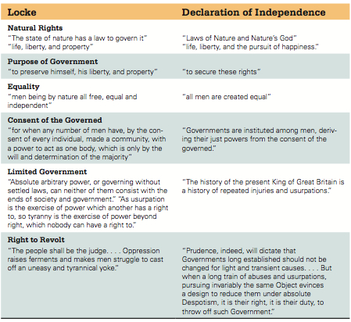
Locke and the Declaration of Independence: Some parallels

Slide 4
Constitutional Convention
Shays’ Rebellion and the Articles of Confederation
Annapolis Convention
55 delegates from all states
no Rhode Island
Well-educated men of means
Designed to modify or rectify the Articles of Confederation
Or…

Slide 5
Purpose of the United States Constitution
Created:
September 17, 1787

Slide 6
Constitutional Breakdown
Article I - Congress
Article II - President
Article III - Judiciary
Article IV - The States
Article V - Amendments
Article VI - Supremacy
Article VII - Ratification

Slide 7
Article I, Article II, Article III

Slide 8
Checks and Balances

Slide 9
Article I - Congress
Structure and Election
House of Representatives
Senate
Qualifications
House
Senate
Presentment Clause
Powers
Limits
Habeas Corpus
No bills of attainder
No ex post facto laws
No export taxes
No title of nobility

Slide 10
Necessary and Proper Clause- Elastic Clause Article I, Section 8
The Congress shall have Power ... To make all Laws which shall be necessary and proper for carrying into Execution the foregoing Powers, and all other Powers vested by this Constitution in the Government of the United States, or in any Department or Officer thereof.

Slide 11
Article II – Executive Branch
President and Vice-President
Qualifications and Terms
At least 35 years old
Natural-born citizen
14-year residency
Four-year terms
Electoral College
Advice and Consent Clause*
Impeachment
Powers
Commander-in-Chief
Request opinions of executive department heads
Grant pardons and reprieves
Make treaties*
Appointments*
Executive and foreign officers
Judicial
Responsibilities
State of the Union address
Recommendations
Call special sessions of Congress
Receive foreign representatives
“…take Care that the Laws be faithfully executed…”

Slide 12
Article III – National Judiciary
Structure
U.S. Supreme Court
Inferior federal courts
Established by Congress
Judiciary Act of 1789
Life terms and Good Behavior
Appointed by President
Jurisdiction
Original
Appellate
Treason

Slide 13
The States Article IV
Full Faith and Credit Clause
“Full Faith and Credit shall be given in each State to the public Acts, Records, and judicial Proceedings of every other State.” - Section 1
Privileges and Immunities Clause
“The Citizens of each State shall be entitled to all Privileges and Immunities of Citizens in the several States.” - Section 2
Guarantee Clause
“The United States shall guarantee to every State in this Union a Republican Form of Government, and shall protect each of them against Invasion; and on Application of the Legislature, or of the Executive (when the Legislature cannot be convened), against domestic Violence.” - Section 4

Slide 14
Amendment Process Article V

Slide 15
Informal Amendment Process
Changing the Constitution without changing the Constitution
Passing laws
Executive actions
Judicial interpretations
Custom and tradition

Slide 16
Constitutional Supremacy Article VI
Supremacy Clause
“This Constitution, and the Laws of the United States which shall be made in Pursuance thereof; and all Treaties made, or which shall be made, under the Authority of the United States, shall be the supreme Law of the Land; and the Judges in every State shall be bound thereby, and Thing in the Constitution or Laws of any State to the Contrary notwithstanding.”
No Religious Test Clause
“…; but no religious Test shall ever be required as a Qualification to any Office or public Trust under the United States.”

Slide 17
A Stronger National Government
Articles Problems
Constitution Solution
No power to tax
No power to regulate interstate and foreign commerce
No executive branch
No judicial branch
Amendments need unanimous consent
Supermajority to pass laws
Lay and collect taxes
Interstate and foreign commerce clause
No export taxes
President
Electoral College
4 year terms
U.S. Supreme Court
Article V – Amendments
2/3 of both houses of Congress
¾ of state legislatures
Presentment Clause
Simple majority by both houses
President’s signature

Slide 18
Virginia Plan New Jersey Plan “Big State” “Small State”
Edmond Randolph
Bicameral Legislature
Lower house elected by people
Upper house chosen by lower house nominated by state legislatures
Proportional representation in each house
Single one-term executive chosen by Congress
Congress chose judges
Unicameral Legislature
State legislatures chose representatives
Equal representation
Congress chose executives
Executives appointed judges

Slide 19
The Great Compromise aka The Connecticut Compromise
Grand Committee
Elbridge Gerry (MA) (Chairman), William Paterson (NJ), Oliver Ellsworth (CT), Robert Yates (NY), Benjamin Franklin (PA), William Richardson Davie (NC), John Rutledge (SC), George Mason (VA), Gunning Bedford (DE), Luther Martin (MD), Abraham Baldwin (GA)
Bicameral Legislature
Lower House - House of Representatives
Proportional representation based on state’s population
Popularly elected
Upper House - Senate
Equal representation with two senators per state
Elected by state legislatures

Slide 20
North and South Compromises
Three-Fifths Compromise (Article I, Section 2, Clause 3)
Slaves counted as 3/5ths a person
“Representatives and direct taxes shall be apportioned among the several States…which shall be determined by adding to the whole Number of free Persons, including those bound to Service for a Term of Years, and excluding Indians not taxed, THREE FIFTHS OF ALL OTHER PERSONS”
Slave Trade Compromise (Article I, Section 9, Clause 1)
International slave trade/importation of slaved would be banned after 20 years in 1808
“The Migration or Importation of such Persons as any of the States now existing shall think proper to admit, shall not be prohibited by the Congress prior to the Year one thousand eight hundred and eight, but a Tax or duty may be imposed on such Importation, not exceeding ten dollars for each Person.”

Slide 21
Electoral College Compromise
One executive or board of three?
How to elect a president?
Direct popular vote?
Selected by Congress?
State legislatures?
Electoral College
Indirect election of president and vice-president
Each state elected Electors
Number of electors based on representation
# of House + # of Senators
Majority of electoral votes
House chooses President, if no majority
Senate chooses Vice President, if no majority
Ratification Debate
Anti-federalist 72
Questions the ability of the electors and criticizes how the people do not have a direct say
Federalist 68
Preserve the sense of the people but chosen by more qualified people with better political understanding
Winner-take all system
Congressional district method
Maine and Nebraska
12th Amendment (1804)
In response to Election of 1800
Faithless electors

Slide 22
Thwarting Tyranny of the Majority
Limiting majority control
James Madison’s system
Separating powers
Creating checks and balances
Establishing a federal system
Notes:
Madison devised a system to prevent the tyranny of factions in the government. To thwart tyranny of the majority, much of the government’s power was kept beyond its reach. Only members of the House of Representatives were directly elected by the people.
Madison’s scheme separated the powers of government into three branches, which shared the limited powers of the government among them.
The system of checks and balances system served Madison’s goal of constraining government action. One faction would be unlikely to control all three branches of government at the same time.
Finally, the Framers established a federal system of government that divided power between a national government and the states. Most government activity occurred in the states so the Framers saw the federal system as an additional check on the national government.
Activity: For an alternative discussion, ask students why minority rights are important. What type of minorities was Madison concerned about? Are minority rights still important in U.S. politics? Ask students to provide specific historical and contemporary examples of “minorities” seeking to protect their rights. How is the political system structured to “balance” minority and majority rights? What values are served by this balance: efficiency, equality, representation?

Slide 23
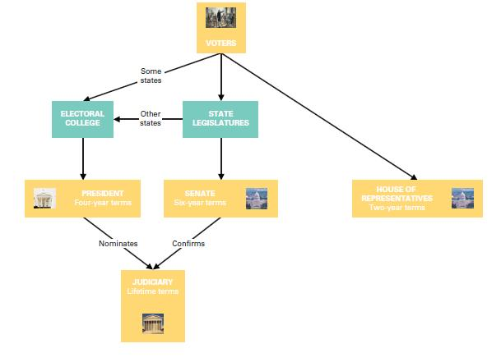
The Constitution and the electoral process: Original plan
Notes:
Madison’s plan allowed both direct and indirect elections. Voters directly elected only the House of Representatives. Senators were elected by state legislatures, and presidents by the electoral college, whose members were usually chosen by state legislatures rather than by voters. The president nominated judges.
Over the years, Madison’s original model has been substantially democratized. In 1913 the Seventeenth Amendment established direct election of senators by popular majorities. Today, the electoral college has become largely a rubber stamp, voting the way the popular majority in each state votes.

Slide 24
Anti-Federalists and Federalists
Notable Anti-Federalists
Notable Federalists
George Clinton
Robert Yates
Patrick Henry
Mercy Otis Warren
Melancton Smith
George Mason
Alexander Hamilton
James Madison
John Jay
Gouverneur Morris
Edmund Randolph

Slide 25
Marbury v. Madison (1803)
The Marshall Court under Chief Justice John Marshall, a Federalist
Judicial question of an Act of Congress (Judiciary Act of 1789) and the Constitution (Article III)
Marshall ruled an Act of Congress cannot trump the Constitution
Established the concept of JUDICIAL REVIEW
Supreme Court determines the constitutionality of a law or official act
Judicial Review is nowhere found in Article III regarding the Judicial Branch nor anywhere else in the Constitution

