Slide 1
Constitutional Ratification
Mr. Winchell
AP GoPo
Unit 1: Foundations of American Democracy

Slide 2
Why the Constitution?
To create a society that was less rigid than that of Europe……
BUT: Still protected property rights and exerted control over the general public.

Slide 3
THE CONSTITUTION THAT’S CREATED
1. Virginia Plan vs. NJ Plan
-Great Compromise / Conn. Plan
3. Slavery Compromises (3/5)/ 20 Year Trade
4. Electoral College
5. Separation of Power
6. Checks and Balances
7. Federal System (Federalism)
8. Articles 1, 2, 3
9. Supremacy Clause (article 6)
10. Revenue Bills originate in the house of representatives (Presentment Clause)
11. Enumerated Powers (aka express powers or formal powers) vs. Implied Powers (aka informal powers)

Slide 4
Ratification Article VII
Ratification of the Constitution required 9 of 13 states
To be legitimate, needed Virginia and New York
Federalists and the Anti-Federalists
Constitution will be ratified on June 21, 1788
Delaware, Pennsylvania, New Jersey, Georgia, Connecticut, Massachusetts, Maryland, South Carolina, New Hampshire, Virginia, New York, North Carolina, Rhode Island

Slide 5
Anti-Federalists and Federalists
Notable Anti-Federalists
Notable Federalists
George Clinton
Robert Yates
Patrick Henry
Mercy Otis Warren
Melancton Smith
George Mason
Alexander Hamilton
James Madison
John Jay
Gouverneur Morris
Edmund Randolph

Slide 6
Anti-Federalist and Federalist Arguments
Anti-Federalist
Federalist
Constitution and Nature of Republican Government
Constitution would destroy the states
Preferred a confederacy of small republics closer to the people
Delegate power to a central authority to preserve the union
House of Representatives
Disagreement between small-state and large-state Anti-Federalists
Too small a body to represent all diverse interests
Preferred one-year terms
Senate
Denounced aristocratic nature
Advice and consent violated separation of powers
Presidency
Could easily become a king and subject to special interest
Too much influence on legislation and treaties
National Judiciary
Possessed too broad a power, especially over state courts and jurisdictions
Bill of Rights
States offered no protections against the potential abuses of rights of the federal government
Constitution and Nature of Republican Government
A large republic necessary to secure the public good and private rights from tyranny of the majority
House of Representatives
House would grow over time but House must maintain such growth
Two-terms allowed for more understanding of complexity of government
Senate
Equality of states was essential to passage of the Constitution
To pass legislation, both the Senate and the House must agree
Presidency
Limited power and subject to the will of the people (election) and Congress (impeachment)
Necessary to enforce federal laws
National Judiciary
Act as an intermediary between the people and Congress; protected the people
Bill of Rights
Unnecessary and potentially dangerous

Slide 7
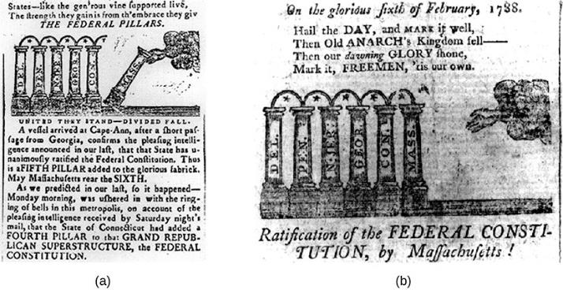
This Massachusetts Sentinel cartoon (a) encourages the state’s voters to join Georgia and neighboring Connecticut in ratifying the Constitution. Less than a month later, on February 6, 1788, Massachusetts became the sixth member of the newly formed federal union (b).

Slide 8
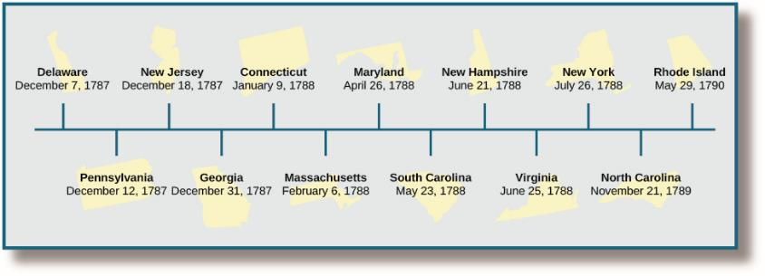
This timeline shows the order in which states ratified the new Constitution. Small states that would benefit from the protection of a larger union ratified the Constitution fairly quickly, such as Delaware and Connecticut. Larger, more populous states like Virginia and New York took longer. The last state to ratify was Rhode Island, a state that had always proven reluctant to act alongside the others.

Slide 9
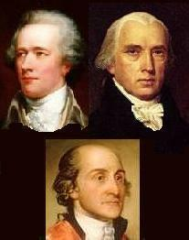
Federalists Papers
Alexander Hamilton, James Madison, John Jay
Federalist #10
factions
Federalist #51
Checks and balances
Federalist #70
Chief executive
Federalist #78
National judiciary
Federalist #84
Bill of Rights unnecessary

Slide 10
Centinel I (Anti-Federalist Paper) October 5, 1787
The late Convention have submitted to your consideration a plan of a new federal government–The subject is highly interesting to your future welfare–Whether it be calculated to promote the great ends of civil society, viz. the happiness and prosperity of the community; it behoves you well to consider, uninfluenced by the authority of names… All the blessings of liberty and the dearest privileges of freemen, are now at stake and dependent on your present conduct…
The wealthy and ambitious, who in every community think they have a right to lord it over their fellow creatures, have availed themselves, very successfully, of this favorable disposition; for the people thus unsettled in their sentiments, have been prepared to accede to any extreme of government; all the distresses and difficulties they experience, proceeding from various causes, have been ascribed to the impotency of the present confederation, and thence they have been led to expect full relief from the adoption of the proposed system of government, and in the other event, immediately ruin and annihilation as a nation. These characters flatter themselves…and now triumphantly exult in the completion of their long meditated schemes of power and aggrandisement.
Mr. Adams’s sine qua non of a good government is three balancing powers, whose repelling qualities are to produce an equilibrium of interests, and thereby promote the happiness of the whole community. He asserts that the administrators of every government, will ever be actuated by views of private interest and ambition, to the prejudice of the public good; that therefore the only effectual method to secure the rights of the people and promote their welfare, is to create an opposition of interests between the members of two distinct bodies, in the exercise of the powers of government, and balanced by those of a third. This hypothesis supposes human wisdom competent to the task of instituting three co-equal orders in government, and a corresponding weight in the community to enable them respectively to exercise their several parts, and whose views and interests should be so distinct as to prevent a coalition of any two of them for the destruction of the third.
If such an organization of power were practicable, how long would it continue? not a day–for there is so great a disparity in the talents, wisdom and industry of mankind, that the scale would presently preponderate to one or the other body, and with every accession of power the means of further increase would be greatly extended… the only operative and efficient check, upon the conduct of administration, is the sense of the people at large.
It is the opinion of the greatest writers, that a very extensive country cannot be governed on democratical principles, on any other plan, than a confederation of a number of small republics, possessing all the powers of internal government, but united in the management of their foreign and general concerns.
If one general government could be instituted and maintained on principles of freedom, it would not be so competent to attend to the various local concerns and wants, of every particular district, as well as the peculiar governments, who are nearer the scene, and possessed of superior means of information, besides, if the business of the whole union is to be managed by one government, there would not be time. Do we not already see, that the inhabitants in a number of larger states, who are remote from the seat of government, are loudly complaining of the inconveniencies and disadvantages they are subjected to on this account, and that, to enjoy the comforts of local government, they are separating into smaller divisions.
From this investigation into the organization of this government, it appears that it is devoid of all responsibility or accountability to the great body of the people, and that so far from being a regular balanced government, it would be in practice a permanent ARISTOCRACY.

Slide 11
Brutus I (Anti-Federalist Paper) October 18, 1787
It is insisted, indeed, that this constitution must be received, be it ever so imperfect. If it has its defects, it is said, they can be best amended when they are experienced. But remember, when the people once part with power, they can seldom or never resume it again but by force. Many instances can be produced in which the people have voluntarily increased the powers of their rulers; but few, if any, in which rulers have willingly abridged their authority. This is a sufficient reason to induce you to be careful, in the first instance, how you deposit the powers of government.
This government is to possess absolute and uncontroulable power, legislative, executive and judicial, with respect to every object to which it extends, for by the last clause of section 8th, article Ist, it is declared “that the Congress shall have power to make all laws which shall be necessary and proper for carrying into execution the foregoing powers, and all other powers vested by this constitution, in the government of the United States; or in any department or office thereof.” And by the 6th article, it is declared “that this constitution, and the laws of the United States, which shall be made in pursuance thereof, and the treaties made, or which shall be made, under the authority of the United States, shall be the supreme law of the land; and the judges in every state shall be bound thereby, any thing in the constitution, or law of any state to the contrary notwithstanding.” It appears from these articles that there is no need of any intervention of the state governments, between the Congress and the people, to execute any one power vested in the general government, and that the constitution and laws of every state are nullified and declared void, so far as they are or shall be inconsistent with this constitution, or the laws made in pursuance of it, or with treaties made under the authority of the United States.
The judicial power of the United States is to be vested in a supreme court, and in such inferior courts as Congress may from time to time ordain and establish. The powers of these courts are very extensive; their jurisdiction comprehends all civil causes, except such as arise between citizens of the same state; and it extends to all cases in law and equity arising under the constitution…It is easy to see, that in the common course of things, these courts will eclipse the dignity, and take away from the respectability, of the state courts. These courts will be, in themselves, totally independent of the states, deriving their authority from the United States, and receiving from them fixed salaries; and in the course of human events it is to be expected, that they will swallow up all the powers of the courts in the respective states.
The territory of the United States is of vast extent; it now contains near three millions of souls, and is capable of containing much more than ten times that number. Is it practicable for a country, so large and so numerous as they will soon become, to elect a representation, that will speak their sentiments, without their becoming so numerous as to be incapable of transacting public business? It certainly is not…The laws and customs of the several states are, in many respects, very diverse, and in some opposite; each would be in favor of its own interests and customs, and, of consequence, a legislature, formed of representatives from the respective parts, would not only be too numerous to act with any care or decision, but would be composed of such heterogenous and discordant principles, as would constantly be contending with each other.
A free republic will never keep a standing army to execute its laws. It must depend upon the support of its citizens. But when a government is to receive its support from the aid of the citizens, it must be so constructed as to have the confidence, respect, and affection of the people. Men who, upon the call of the magistrate, offer themselves to execute the laws, are influenced to do it either by affection to the government, or from fear; where a standing army is at hand to punish offenders, every man is actuated by the latter principle, and therefore, when the magistrate calls, will obey:

Slide 12
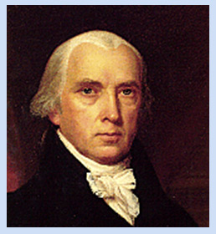
Federalist 10 November 29, 1787
“Among the numerous advantages promised by a well constructed Union, none deserves to be more accurately developed than its tendency to break and control the violence of factions.”
“By a faction, I understand a number of citizens, whether amounting to a majority or a minority of the whole, who are united and actuated by some common impulse of passion, or of interest, adversed to the rights of other citizens, or to the permanent and aggregate interests of the community.”
“There are two methods of curing the mischiefs of faction: the one, by removing its causes; the other, by controlling its effects.”
“There are again two methods of removing the causes of faction: the one, by destroying the liberty which is essential to its existence; the other, by giving to every citizen the same opinions, the same passions, and the same interests.”
“Liberty is to faction what air is to fire, an aliment without it instantly expires. But it could not be less folly to abolish liberty, which is essential to political life, because it nourishes faction, than it would be to wish the annihilation of air, which is essential to animal life, because it imparts to fire its destructive agency.”
“But the most common and durable source of factions has been the various and unequal distribution of property. Those who hold and those who are without property have ever formed distinct interests in society. ”
“…the smaller the number of individuals composing a majority, and the smaller the compass within which they are placed, the more easily will they concert and execute their plans of oppression. Extend the sphere, and you take in a greater variety of parties and interests; you make it less probable that a majority of the whole will have a common motive to invade the rights of other citizens.”

Slide 13
Federalist 51 February 8, 1788
“But the great security against a gradual concentration of the several powers in the same department, consists in giving those who administer each department the necessary constitutional means and personal motives to resist encroachments of the others. The provision for defense must in this, as in all other cases, be made commensurate to the danger of attack. Ambition must be made to counteract ambition.”
“If men were angels, no government would be necessary. If angels were to govern men, neither external nor internal controls on government would be necessary. In framing a government which is to be administered by men over men, the great difficulty lies in this: you must first enable the government to control the governed; and in the next place, oblige it to control itself. A dependence on the people is, no doubt, the primary control on the government; but experience has taught mankind the necessity of auxiliary precautions.”
“But it is not possible to give each department an equal power of self-defense. In republican government, the legislative authority necessarily predominates. The remedy for this inconveniency is to divide the legislature into different branches; and to render them, by different modes of election and different principles of action, as little connected with each other as the nature of their common functions and their common dependence on the society will admit.”
“It is of great importance in a republic, not only to guard the society against the oppression of its rulers; but to guard one part of the society against injustice of the other part. Different interests necessarily exist in different classes of citizens. If a majority be united by a common interest, the rights of the minority will be insecure…

Slide 14
Old Whig V (Anti-Federalist Paper) November 1, 1787
“In the first place the office of President of the United States appears to me to be clothed with such powers as are dangerous. To be the fountain of all honors in the United States, commander in chief of the army, navy and militia, with the power of making treaties and of granting pardons, and to be vested with an authority to put a negative upon all laws, unless two thirds of both houses shall persist in enacting it, and put their names down upon calling the yeas and nays for that purpose, is in reality to be a KING as much a King as the King of Great Britain, and a King too of the worst kind;—an elective King. —If such powers as these are to be trusted in the hands of any man, they ought for the sake of preserving the peace of the community at once to be made hereditary.—Much as I abhor kingly government, yet I venture to pronounce where kings are admitted to rule they should most certainly be vested with hereditary power. The election of a King whether it be in America or Poland, will be a scene of horror and confusion;
“Let us suppose this man to be a favorite with his army, and that they are unwilling to part with their beloved commander in chief; or to make the thing familiar, let us suppose, a future President and commander in chief adored by his army and the militia to as great a degree as our late illustrious commander in chief; and we have only to suppose one thing more, that this man is without the virtue, the moderation and love of liberty which possessed the mind of our late general, and this country will be involved at once in war and tyranny. So far is it from its being improbable that the man who shall hereafter be in a situation to make the attempt to perpetuate his own power, should want the virtues of General Washington; that it is perhaps a chance of one hundred millions to one that the next age will not furnish an example of so disinterested a use of great power. We may also suppose, without trespassing upon the bounds of probability, that this man may not have the means of supporting in private life the dignity of his former station; that like Caesar, he may be at once ambitious and poor, and deeply involved in debt.—Such a man would die a thousand deaths rather than sink from the heights of splendor and power into obscurity and wretchedness.”

Slide 15
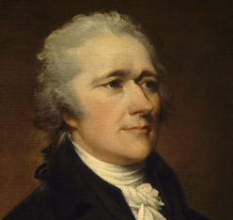
Federalist 70 March 15, 1788
“Energy in the Executive is a leading character in the definition of good government. It is essential to the protection of the community against foreign attacks; it is not less essential to the steady administration of the laws; to the protection of property against those irregular and high-handed combinations which sometimes interrupt the ordinary course of justice; to the security of liberty against the enterprises and assaults of ambition, of faction, and of anarchy.”
“The ingredients which constitute energy in the Executive are, first, unity; secondly, duration; thirdly, an adequate provision for its support; fourthly, competent powers.”
“[But one of the weightiest objections to a plurality in the Executive, and which lies as much against the last as the first plan, is, that it tends to conceal faults and destroy responsibility.]…A council to a magistrate, who is himself responsible for what he does, are generally nothing better than a clog upon his good intentions, are often the instruments and accomplices of his bad and are almost always a cloak to his faults.”

Slide 16
Brutus XI (Anti-Federalist Paper) January 31, 1788
And the courts of law, which will be constituted by it, are not only to decide upon the constitution and the laws made in pursuance of it, but by officers subordinate to them to execute all their decisions. The real effect of this system of government, will therefore be brought home to the feelings of the people, through the medium of the judicial power. It is, moreover, of great importance, to examine with care the nature and extent of the judicial power, because those who are to be vested with it, are to be placed in a situation altogether unprecedented in a free country. They are to be rendered totally independent, both of the people and the legislature, both with respect to their offices and salaries. No errors they may commit can be corrected by any power above them, if any such power there be, nor can they be removed from office for making ever so many erroneous adjudications.
The judicial power will operate to effect, in the most certain, but yet silent and imperceptible manner, what is evidently the tendency of the constitution: – I mean, an entire subversion of the legislative, executive and judicial powers of the individual states. Every adjudication of the supreme court, on any question that may arise upon the nature and extent of the general government, will affect the limits of the state jurisdiction. In proportion as the former enlarge the exercise of their powers, will that of the latter be restricted.
That the judicial power of the United States, will lean strongly in favour of the general government, and will give such an explanation to the constitution, as will favour an extension of its jurisdiction, is very evident from a variety of considerations.

Slide 17
Federalist 78 May 28, 1788
“The standard of good behavior for the continuance in office of the judicial magistracy, is certainly one of the most valuable of the modern improvements in the practice of government…in a republic it is a no less excellent barrier to the encroachments and oppresions of the representative body.”
“Whoever attentively considers the different departments of power must perceive, that, in government in which they are separated from each other, the judiciary, from the nature of its functions, will always be the least dangerous to the political rights of the Constitution; because it will be least in a capacity to annoy or injure them.”
“The Judiciary…has no influence over either the sword or the purse; no direction either of the strength or of the wealth of the society, and can take no active resolution whatever. It may truly be said to have neither force nor will.”
“…[The Judicial Branch] may truly be said to have neither FORCE nor WILL, but merely judgment; and most ultimately depend upon the aid of the executive arm even for the efficacy of its judgments.”
“The interpretation of the laws is the proper and peculiar province of the courts. A constitution is, in fact, and must be regarded by the judges, as a fundamental law. It therefore belongs to them to ascertain its meaning, as well as the meaning of any particular act proceeding from the legislative body.”

Slide 18
Brutus II (Anti-Federalist Paper) November 1, 1787
“I flatter myself that my last address established this position, that to reduce the Thirteen States into one government, would prove the destruction of your liberties.”
“The constitution proposed to your acceptance, is designed not for yourselves alone, but for generations yet unborn. The principles, therefore, upon which the social compact is founded, ought to have been clearly and precisely stated, and the most express and full declaration of rights to have been made - But on this subject there is almost an entire silence.”
“Those who have governed, have been found in all ages ever active to enlarge their powers and abridge the public liberty. This has induced the people in all countries…to fix barriers against the encroachments of their rules…Their magna carta and bill of rights… I need say no more…to an American, than, that this principle is a fundamental one, in all the constitutions of our own states; there is not one of them but what is either founded on a declaration or bill of rights, or has certain express reservation of rights interwoven in the body of them.. It is therefore the more astonishing, that this grand security, to the rights of the people, is not found in this constitution.”
“…it is evident, that the reason here assigned was not the true one, why the framers of this constitution omitted a bill of rights; if it had been, they would not have made certain reservations, while they totally omitted others of more importance. We find they have, in the 9th section of the 1st article…If every thing which is not given is reserved, what propriety is there in these exceptions?”

Slide 19
Federalist 84 May 28, 1788
“Here, in strictness, the people surrender nothing; and as they retain everything they have no need of particular reservations. “WE, THE PEOPLE of the United States, to secure the blessings of liberty to ourselves and our posterity, do ordain and establish this Constitution for the United States of America.” Here is a better recognition of popular rights than volumes of those aphorisms which make the principal figure in several of our State bills of rights and which would sound much better in a treatise of ethics than in a constitution of government.”
“But a minute detail of particular rights is certainly far less applicable to a Constitution like that under consideration, which is merely intended to regulate the general political interests of the nation, than to a constitution which has the regulation of every species of personal and private concerns.”
“I go further and affirm that bills of rights, in the sense and to the extent in which they are contended for, are not only unnecessary in the proposed Constitution but would even be dangerous. They would contain various exceptions to powers not granted; and, on this very account, would afford a colorable pretext to claim more than were granted. For why declare that things shall not be done which there is no power to do? Why, for instance, should it be said that the liberty of the press shall not be restrained, when no power is given by which restrictions may be imposed? I will not contend that such a provision would confer a regulating power; but it is evident that it would furnish, to men disposed to usurp, a plausible pretense for claiming that power. They might urge with a semblance of reason that the Constitution ought not to be charged with the absurdity of providing against the abuse of an authority which was not given, and that the provision against restraining the liberty of the press afforded a clear implication that a power to prescribe proper regulations concerning it was intended to be vested in the national government. This may serve as a specimen of the numerous handles which would be given to the doctrine of constructive powers, by the indulgence of an injudicious zeal for bills of rights.”
“There remains but one other view of this matter to conclude the point. The truth is, after all the declamations we have heard, that the Constitution is itself, in every rational sense, and to every useful purpose, A BILL OF RIGHTS. The several bills of rights in Great Britain form its Constitution, and conversely the constitution of each State is its bill of rights. And the proposed Constitution, if adopted, will be the bill of rights of the Union. Is it one object of a bill of rights to declare and specify the political privileges of the citizens in the structure and administration of the government? This is done in the most ample and precise manner in the plan of the convention; comprehending various precautions for the public security which are not to be found in any of the State constitutions.”

