Slide 1
The Bill of Rights and the Foundation of Federalism
Mr. Winchell
AP GoPo
Unit 1: Foundations of American Democracy

Slide 2
Learning Objective
Students will be able to explain how societal needs affect the constitutional allocation of power between the national and state governments

Slide 3
Anti-Federalist Arguments
Claimed to Constitution gave the Federal Government too much power.
Gives power to government that states don’t even currently have
Criticisms of key Clauses: Necessary and Proper Clause & Supremacy Clause…Why?
NO BILL OF RIGHTS
Power to suspend Habeas Corpus with invasion/insurrection
No protection of Free Speech
Lacks protection for Basic Rights even states protect
Congress
Senate
Too much power; No Term Limits
Controls presidential appointments/treaties; executive will be a puppet of Senate
Small States Over-represented
Will lead to Elitist rule
Negatives of Large Republic
Leaders too far removed from the people
Population growth will make large republic inefficient
Too many different econ systems between states; each state had own specialties; won’t work to combine slave/agr. South with industrial north

Slide 4
Federalist Arguments
A.o.C. too weak/inefficient…impossible to control factions
Control of Factions (Federalist 10)
Republic: Efficient, people have a voice but w/ filter (govt. by the “wise”)
Large Republics…
Check unworthy candidates…larger number of voters
Smaller the # in a majority…more likely to have oppression
Factions may kindle flames in states…but not at nat’l. level
Federalism is best
Limited Government (Federalist 51)
Separation of Power & Checks and Balances (helps insure individual rights)
Protection of Minority Rights from Majority
Presidential veto; Supreme Court checks 2 branches;
Legislature protected from itself (bicameral)
Judges insulated (not elected/life terms)
Power to control economy, standard currency and common foreign policy
Notes:
Unequal distribution of wealth primary cause of political conflict…wealthy v. propertyless majority…neither faction to be trusted…thus both must be checked.

Slide 5
Bill of Rights
1st 10 Amendments added to the Constitution
Bill of Rights
Added to the Constitution to get key states of New York and Virginia to ratify the Constitution
Protects political rights
1st Amendment: Free speech, press, petition, assemble, religion
Protects the rights of the accused
Protection from illegal search and seizure
Right to a trial by jury, right to an attorney, right to be free from self-incrimination

Slide 6
Bill of Rights –civil liberties to the people
Read and analyze each amendment…what does each guarantee?

Slide 7
Amendment Process: Example of Federalism?
“Flexible, Living, Breathing Document”
Formal Amendment: Actually changing wording of document (27 Amendments)
Proposal: National Level
2/3 of each House of Congress
National Convention @ Request of 2/3 of States
Ratification: State Level
Approve by ¾ State Legislatures;
Approve by State Convention of ¾ States
How else can Constitution be changed?
Informal Amendments
Tradition/Custom, Legislative/Presidential Action, Precedent, Supreme Court Decisions
Notes:
Informal Amendments: Legislative Action; Executive Action; Judicial Action-Supreme Ct. Decisions; Tradition; Precedent

Slide 8
Federalism
A Piece of Cake

Slide 9
What is Federalism?
The Constitution established a federal republic
Division of powers between the national government and the states
Supreme authority rests with the national government, but some powers are reserved to the states (10TH AMENDMENT)

Slide 10
Article IV: Federalism
Full Faith and Credit Clause (Section 1)
“Full Faith and Credit shall be given in each State to the public Acts, Records, and judicial Proceedings of every other State.”
Privileges and Immunities Clause (Section 2)
“The Citizens of each State shall be entitled to all Privileges and Immunities of Citizens in the several States”
Interstate Rendition Clause/Extradition (Section 3)
“A Person charged in any State with Treason, Felony, or other Crime, who shall flee from Justice, and be found in another States, shall on Demand of the executive Authority of the State from which he fled, be delivered up, to be removed to the State having Jurisdiction of the Crime”

Slide 11
Key Federalism Clauses
Necessary & Proper Clause (Elastic Clause)
Intro. Concept of Implied Powers
Congress has any power necessary to carry out its responsibilities (expressed powers)
Supremacy Clause
Constitution: Supreme Law of the Land
National takes precedent over state law
Supreme Court: umpire of federalism
McCulloch v. Maryland

Slide 12
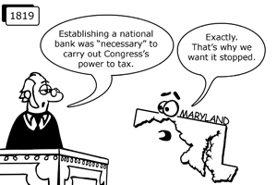
Supremacy/Necessary & Proper Clause (Elastic Clause): McCulloch v. Maryland
Notes:
Impact: Grants congress implie powers for implementing the constitutions express powers in order to create a functional government
State actions may not impede valid constitutional exercises of power by federal government
Established supremacy of national government over state.15,000 tax…James McCulloch refuses to pay…state court upholds tax, mcculloch challenges in supreme ct.
Opposed by Jefferson…state of MD
Print money, make loans, collect taxes, engage in many banking tasks

Slide 13
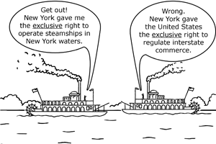
Commerce Clause
Congress ability to regulate interstate commerce
Gibbons v.
Ogden
Colbert-If At First You Don't Secede

Slide 14
Impact of the Elastic and Commerce Clauses
Civil Rights Act of 1964
Food & Drug Administration (FDA)
Building of the Interstate Highway System
Federal Controlled Substances Act
Clean Air Act/EPA
U.S. v. Lopez
Temporarily invalidated Gun Free School Zone Act as an overextension of Commerce Clause
This was the first time in over half a century that the Supreme Court limited Congressional authority to legislate under the Commerce Clause.
Notes:
[I]n all matters having such a close and substantial relation to interstate commerce [and when] the interstate and intrastate transactions of carriers are so related that the government of the one involves the control of the other, it is Congress, and not the State, that is entitled to prescribe the final and dominant rule, for otherwise Congress would be denied the exercise of its constitutional authority and the State, and not the Nation, would be supreme within the national field” Houston at 351.
This, of course, is quite similar to the reasoning in Gibbons. Crucial here are the words "substantial relation," as we are now on the verge of a rule of law: When intrastate commerce has a substantial economic effect on interstate commerce, Congress may regulate the activity pursuant to the Commerce Clause.
EXAMPLE: Frank operates a fireworks store in Southernstate. The fireworks he purchases from his suppliers are made entirely within Southernstate from materials found locally in the state. Despite the modern trend toward even the smallest of shop owners selling online across state lines, Frank sells only from his storefront. In other words, everything Frank does is intrastate. In an effort to end the increasingly heated price war among fireworks retailers, Congress passes a law establishing minimum prices for fireworks. Frank is fined for violating the law, and defends himself claiming the law exceeds Congress’ constitutional powers as the activity regulated is entirely intrastate.
What would be the result in the Frank’s Fireworks case above? The view taken by the Court today would be that Congress is fully within the bounds of the Commerce Clause.

Slide 15
Know the Types of Powers
Enumerated Powers
Specifically written/given to national government
i.e. Declare war, coin money
Delegated Powers
Powers granted to agency/executive to facilitate duties
Implied Powers
Powers based on open interpretation
Necessary and Proper Clause (Elastic Clause)
i.e. Bank of the United States
Inherent Powers
Powers granted based on the sovereignty of the government
In order to facilitate a working government
i.e. Preamble; acquire territory; not recognize foreign governments
Concurrent Powers
Shared powers between the national government and the states
i.e. Levy taxes; establish federal and state judicial systems
Reserved Powers
Powers limited to the states
i.e. Education, welfare, intrastate commerce, elections

Slide 16
Why Federalism?
Benefits of Federalism
Check Government Power/Protect Personal Liberty
Power Concentrated in Single entity → Tyranny
Under A.o.C. → Nat’l Govt Too Dependent on States
Provide Balance between Nat’l & State Govt.
STATES = TESTING GROUNDS
Large Countries; Diverse Regions
Allows for local action—local concerns
More access points/ways to participate
Notes:
N. Dakota..doesn’t force residents to register to cast ballots; 1/3 of states directly involved in liquor business…monopolies
States regulate businesses within the state

Slide 17
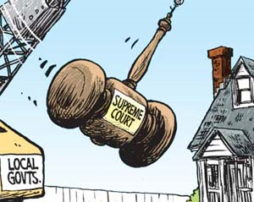
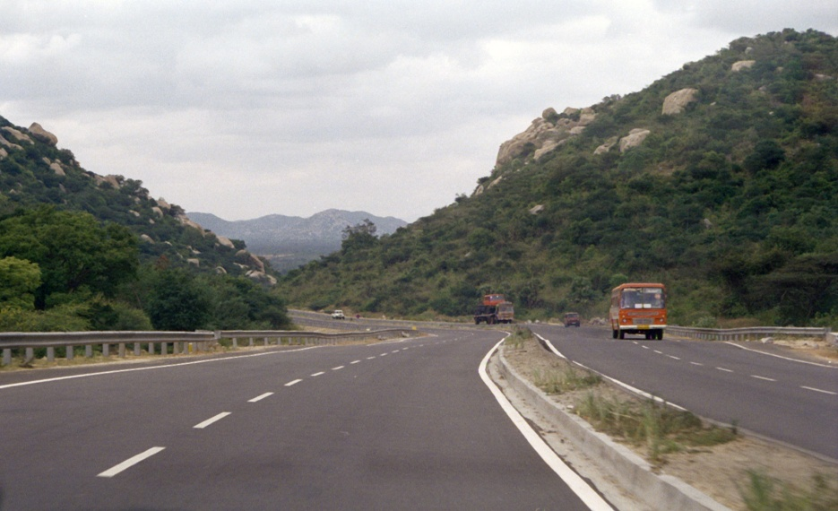
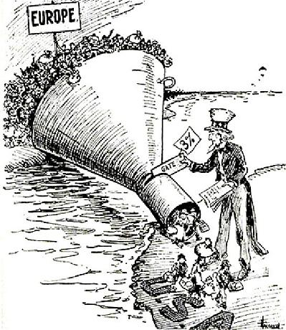
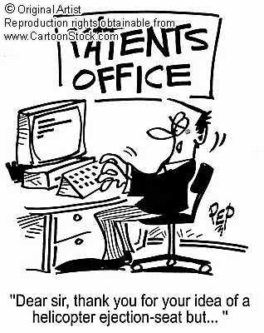

Slide 18
States: Reserved Powers
10th Amendment: “Those powers not delegated to the federal government, nor prohibited to the states, are reserved for the states.” (AKA Reserved Powers)
State Obligations to Each Other:
Full Faith & Credit Clause; Extradition

Slide 19
Exclusive v. Concurrent Powers
National Government | State Governments
Print money Regulate interstate (between states) and international trade Make treaties and conduct foreign policy Declare war Provide an army and navy Establish post offices Make laws necessary and proper to carry out the these powers | Issue licenses Regulate intrastate (within the state) businesses Conduct elections Establish local governments Ratify amendments to the Constitution Take measures for public health and safety May exert powers the Constitution does not delegate to the national government or prohibit the states from using
Concurrent Powers: Collect taxes; Build roads; Borrow money; Establish courts; Make and enforce laws; Charter banks and corporations; Spend money for the general welfare; Eminent Domain
Notes:
Take private property for public purposes, with just compensation

Slide 20
Powers Denied to National Government
National Government | State Governments
May not violate the Bill of Rights May not impose export taxes among states May not use money from the Treasury without the passage and approval of an appropriations bill May not change state boundaries | May not enter into treaties with other countries May not print money May not tax imports or exports May not Impair obligations of contracts May not suspend a person's rights without due process 13th, 14th, 15th Amendment

Slide 21
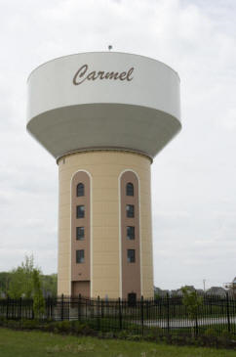
Local Government
Created by the States, and can only do those things States give it the power to do
Provide Services/activities, collect taxes, trash pickup

Slide 22
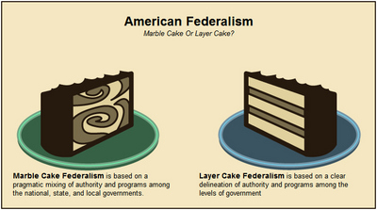
Theories of Federalism
Dual Federalism
Layer Cake Federalism
States/Nat’l Govt Remain Separate in own spheres
Cooperative Federalism
Marble Cake Federalism
States/Nat’l Govt Share powers & policy responsibilities
Devolution (New Federalism—Nixon/Reagan)
Transfer of Responsibilities from Federal Government back to States
Notes:
What are the advantages/disadvantages of each?
http://www.ucs.louisiana.edu/~ras2777/conlaw/federalism.html

Slide 23
Federalism: Good and Bad
Best for large nation
Avoids concentration of power
Preserved state sovereignty
States are training/testing grounds
Government close to the people
Limits of the Constitution
Too many governments
Duplication of powers and functions
Conflicts of authority

Slide 24
History and Development of Federalism
Dual Federalism
Cooperative Federalism
Creative Federalism
New Federalism/Competitive Federalism
Fiscal Federalism

Slide 25
Dual Federalism
Form of federalism from 1789-1932
National government and state governments retain separate powers and jurisdiction
aka layer-cake federalism
Sovereignty and limits of national government and state governments expressly upheld
Sharing of powers extremely limited

Slide 26
Cooperative Federalism
Form of federalism from 1932-1960s
aka marble-cake federalism
National government and state governments sharing more powers and cooperating on issues
New Deal programs and laws
Social Security Act
National Labor Relations Board
Federal Deposit and Insurance Corporation (FDIC)
Securities and Exchange Commission (SEC)

Slide 27
Creative Federalism
Form of federalism of the 1960s under President Lyndon Johnson
Enhanced form of cooperative federalism
National government broadly expanded its power and influence in states and local governments
Great Society programs and laws
Civil Rights Act of 1964
Voting Rights Act of 1965
Medicare
Medicaid
Economic Opportunity Act
Elementary and Secondary Education Act
Housing and Urban Development Act
Highway Safety Act

Slide 28
New Federalism
Form of federalism from 1970s to 2000s
aka Competitive Federalism
aka Our Federalism
Nixon, Reagan, W. Bush policies
Devolution
National government reduced its influence
States assumed more responsibility
Block grants for welfare, health, jobs

Slide 29
Fiscal Federalism
Grants-In-Aid
Federal funds and resources provided to states and local governments
Categorical Grants
Federal funds for specific programs and projects
Project grant - competitive application
Research project
Formula grant - awarded on established formula
Medicaid
Block Grants
Federal funds for a broad category
States assume power to appropriate funds in category
Revenue Sharing
Federal tax revenue granted to states/local governments with limited restrictions on spending
Mandates
Federal requirements applied to states and local governments
Unfunded mandates impose federal requirements at state/local expense

Slide 30
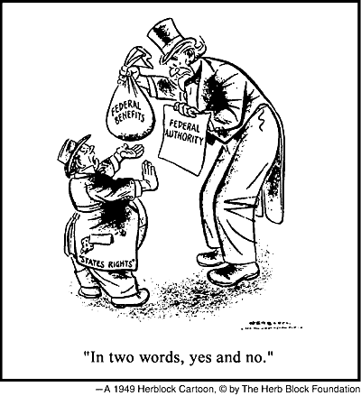
Fiscal Federalism
Taxing & Spending
Grants-in-Aid:
Fed. Funds appropriated by Congress for distr. to st./local govt. (way to infl. State govt.)
Notes:
States want national government out of their affairs, but more than happy to take govt. $

Slide 31
Fiscal Federalism (Grants-in-Aid)
Categorical Grants:
Main source of federal aid…
Have a narrowly defined/ specific purpose…
Usually comes w/ conditions (matching)
Two Types:
Project Grant—specific purpose…based on merit of application
Formula Grant—based on formula in legislation
Examples?
Federal Highway Act Funding,
Requires Drinking Age of 21 to receive highway funding from federal government
Head Start, Food Stamps, Medicaid
Notes:
Mandates: requirements that direct states to comply with federal rules under threat of penalties or as a condition of receipt of federal grant…often fed. Govt. doesn’t provide enough $ to fund mandates…example No Child Left Behind

Slide 32
Fiscal Federalism (Grants-in-Aid)
Block Grants:
Given to states/local govt. to support broad programs
Community Development, Law Enforcement, Social Services
Less strings attached…
Examples
Temporary Assistance to Needy Families (TANF): Welfare
How do block grants go along with devolution?
How does the Federal Government use categorical and block grants to impact state policy?

Slide 33
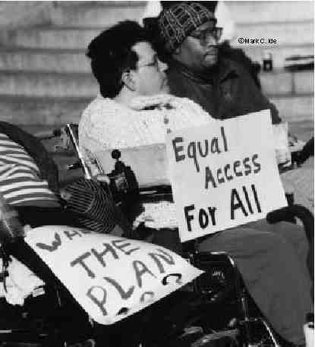
Federal Mandate
Federal Mandate
Rules telling states what they must do to comply w/ federal guidelines
Must comply with regardless of whether federal funding provided
Amer. w/ Disabilities Act (1990)
How do mandates increase the power of the federal government over states?

Slide 34
60 Minutes: Medicinal Marijuana… A Conflict in Federalism
http://www.youtube.com/watch?v=DA-Emy7sZzg
Discussion Questions
Why have states turned towards legalizing medical marijuana?
What constitutional clauses are involved in this discussion and how?
What federal and state laws are in conflict? How is this a conflict in federalism?
Why have the dispensaries in Colorado been allowed to operate despite violating federal law?
How has Justice Department decided to limit the operations of dispensaries?

