Slide 1
Do Now
Using your text responses from Albert Beveridge’s “March of the Flag,” evaluate the arguments he presents regarding US foreign policy

Slide 2
1. American Imperialism
Mr. Winchell
APUSH 19-20
Period 7

Slide 3
AP PROMPT
Evaluate the extent to which America’s Imperial ventures from 1898 to 1910 demonstrated change in American foreign policy.

Slide 4
Outline
Origins of American Imperialism
Reasons/Causes for Imperialism
Spanish American War
Philippine American War
Imperialist Policies and Arguments
Assessment: Thesis Statement w/ Context

Slide 5
U.S. Foreign Policy (1789-1850)
Washington’s Farewell Address
Avoid permanent alliances, but defend American interests
Jefferson’s Empire of Liberty
Model of republicanism and democracy
Louisiana Purchase (1803)
Monroe Doctrine
Prevention of European intervention in Western Hemisphere
Manifest Destiny
Adams-Onis Treaty
Webster-Ashburton Treaty
Oregon Territory
Texas
Mexican-American War – Mexican Cession
Limited Involvement
Domestic economic expansion
Protective tariffs
Economic dependency on European powers
Immigration
Mass wave during 1830s-1840s

Slide 6
Origins of American Imperialism
The US was not part of Europe’s Imperialistic expansion in the mid 1800s
Still expansionist however.
Louisiana Purchase/Monroe Doctrine
Annexation of Texas
Mexican American War
GADSDEN PURCHASE!!
1867: Seward’s purchase of Alaska for $7.2 million from Russia
1898: ‘Annexation’ of Hawaii

Slide 7
Why Hawaii?

Slide 8
Reasons for Imperialism
Social
"white-man’s burden" & Manifest Destiny
Anglo-Saxon Christians have the duty to "civilize" the rest of the world
Frontier ‘closed’
Economic
US needed raw materials and markets (customers) for trade
Panic of 1893 exposed need
Economic competition with Europe
Military
All great empires need a navy (and islands for friendly refueling stations)
Alfred Thayer Mahan ‘Influence of Sea Power Upon History’

Slide 9
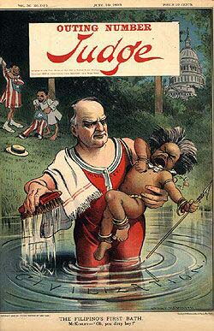
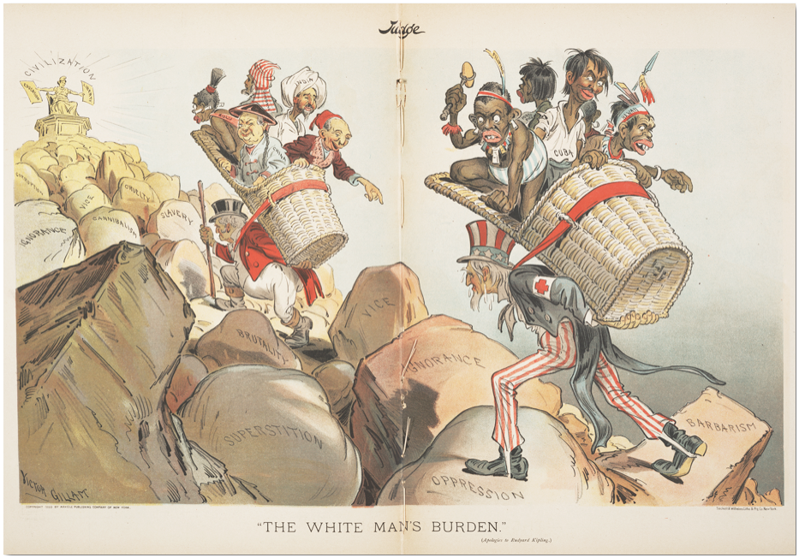
American Social Darwinism
Civilization
Vice
Ignorance
Barbarism
Superstition
Oppression
Which nations is England “hauling up the hill”? What about the U.S.?

Slide 10
Cuban Revolt: America to the Rescue?
Cuba vs. Spain: Cubans revolt against Spanish rule. Spain responds harshly, sends the military. Cubans placed in concentration camps.
America Backs Cuba:
Sentimental-Cuba is the underdog.
Economic- American business trade over $100 mil/year.
Political- Spain is a dying empire in America’s sphere of influence. Whoever controls Cuba controls Western trade and a potential Panama Canal.
Yellow Journalism: Hearst vs. Pulitzer. 2 main newspapers in NYC. Each report on the atrocities in Cuba. Sensationalized news equals more readers.

Slide 11
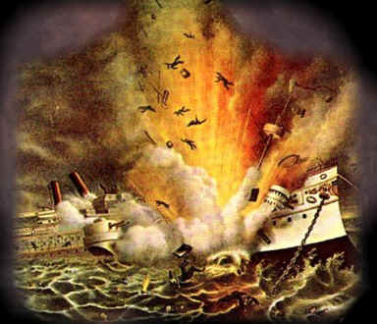
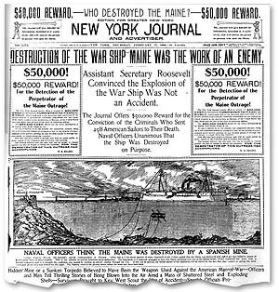
Why does the US get involved?
The USS Maine Explosion
Yellow Journalists make a big deal out of it and blame Spain.
“Remember the Maine – to hell with Spain!”

Slide 12
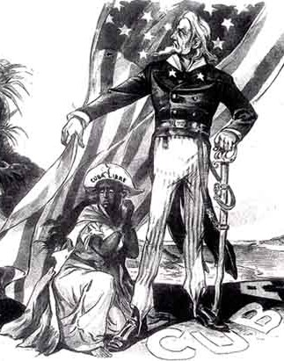
April 20, 1898: McKinley gave in to public pressure and asked Congress to declare war on Spain
Teller Amendment

Slide 13
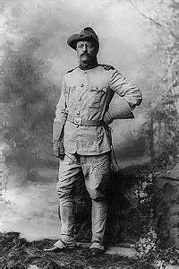
The War in Cuba
Volunteers rush to enlist.
Poorly trained and equipped
TR’s Rough Riders
The war in Cuba lasts only 3 months
460 die from battle
5200 die from disease

Slide 14
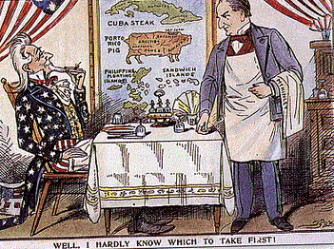
Despite opposition, the Treaty of Paris (1898) passed by a narrow margin with some Democratic support
The U.S. was on the way to being an empire
Treaty of Paris (1898):
Ended the war
Cuba gains independence from Spain
U.S. gives $20 million to Spain for purchase of
-Philippines
-Puerto Rico
-Guam

Slide 15
Outcomes of the Spanish-American War
Pre-war- Teller Amendment: US will have nothing to do with Cuba after ‘freeing’ them from the Spanish.
The US takes Spanish possessions
Annexes the Philippines, Puerto Rico, and Guam
Annex – to take control of
The US does NOT annex Cuba, but claims the right to intervene in Cuban affairs
The Platt Amendment says Cuba can’t sign treaties, the US can intervene anytime, and the US gets a permanent naval base –Guantanamo.

Slide 16
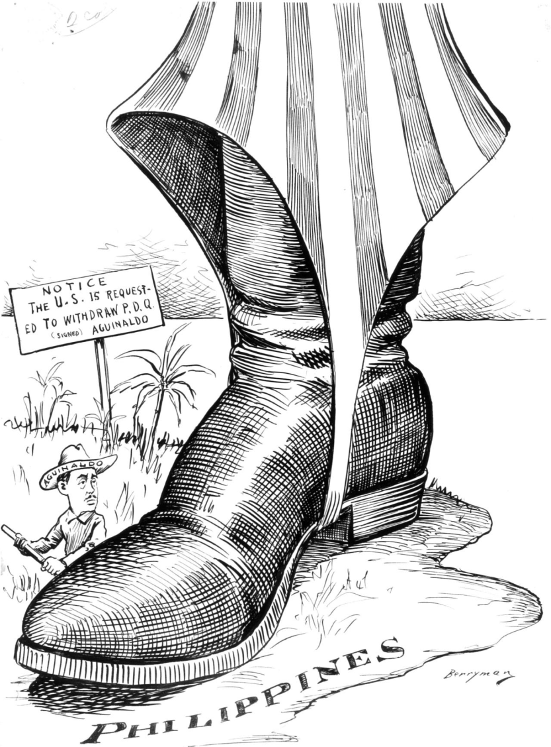
The War in the Philippines
The US destroys the Spanish fleet in the Philippines and helps Filipino rebels fight the Spanish
But after the war, the US stays….and ends up fighting the Filipino rebels for another 3 years in a brutal and bloody war.

Slide 17
To Imperial or not to Imperial…that is the Question
William McKinley
William Sumner

Slide 18
Imperialists and Anti-Imperialists
Proponents
Most from GOP
Theodore Roosevelt (R)
John Hay (R)
James G. Blaine (R)
Reasons
Economic expansion
Political security
International prestige
Humanitarian efforts
Capt. Alfred Thayer Mahan
The Influence of Sea Power upon History (1890)
Social Darwinism
Jingoism
“White Man’s Burden”
Insular Cases (1901-1903)
Supreme Court ruled constitutional guarantees granted only by Congress to U.S. territories
“Constitution does not necessarily follow the flag”
Opponents
Mostly from Democratic Party
Anti-Imperialist League
Grover Cleveland (D)
William Jennings Bryan (D)
Senator Ben Tillman (D-SC)
Samuel Gompers (AFL)
Mark Twain
Andrew Carnegie
Jane Addams
Reasons
Undemocratic
Violated republicanism
“consent of the governed”
Prevent influx of “inferior races”

Slide 19
McKinley Assassinated
Sept. 6, 1901-Shot by Leon Czolgosz, an anarchist.
Dies of gangrene!
Assassin lost his job during Panic of 1893 and turned to anarchism, viewed McKinley as a symbol of oppression.
Vice President Teddy Roosevelt takes over

Slide 20
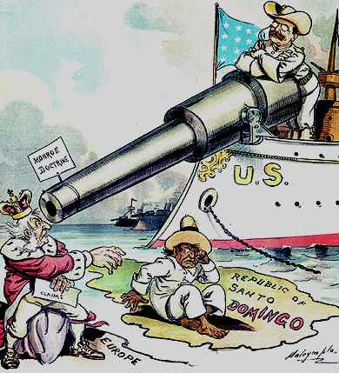
Theodore Roosevelt (1901-1909) Big Stick Policy
The Americas
Roosevelt Corollary
U.S. right to intervene if:
Incapable of protecting American interests
Stabilize economies to prevent European influence
Panama Canal
Panamanian Revolution (1903)
Panama Canal opened 1914
Asian Policy
Treaty of Portsmouth (1904)
“Gentleman’s Agreement” (1907)
Great White Fleet (1907-1909)

Slide 21
Examples of “Big Stick” Policy
Roosevelt Corollary to the Monroe Doctrine (1900): US can act as an international police power in Latin America.
Used to justify intervention in Dominican Republic, Panama, Cuba, Nicaragua, Honduras, Mexico and Haiti.
Panama Canal: The US wants a canal, but Colombia will not agree…..so the US “supports” a Panamanian revolt….and gets rights to build and use the Panama Canal.

Slide 22
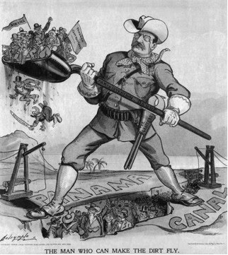

Slide 23
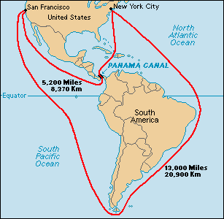

Slide 24
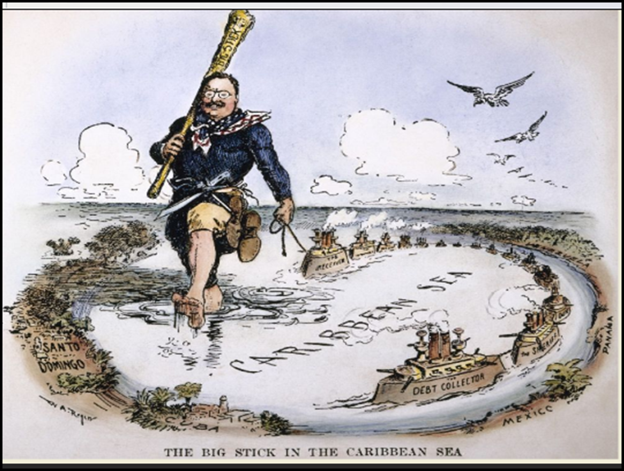

Slide 25
Roosevelt Corollary
“Chronic wrongdoing… may in America, as elsewhere, ultimately require intervention by some civilized nation, and in the Western Hemisphere the adherence of the United States to the Monroe Doctrine may force the United States, however reluctantly, in flagrant cases of such wrongdoing or impotence, to the exercise of an international police power.”

Slide 26
Examples of “Big Stick” Policy
“Open Door” policy— ensures China would keep its door open to all countries for trade.
Roosevelt sent troops to suppress the Chinese Boxers (Boxer Rebellion), rebels who opposed opening up China to foreign trade.

Slide 27
William Howard Taft (1909-1913) Dollar Diplomacy
Encourage economic development infrastructure in Latin America and abroad
Administration of loans and financing
Railroad investments in China
Lodge Corollary (1912)
Henry Cabot Lodge
Forbade any significant foreign acquisition in Western Hemisphere

Slide 28
Taft’s “Dollar Diplomacy” (1909)
Encouraged US to invest $$ in foreign nations
Dollars, not bullets, would advance US authority and ensure stability.
Ordered troops to Haiti, the Dominican Republic, and Mexico to protect investments.
Use of force was a way to teach other nations how to establish law and order.

Slide 29
Woodrow Wilson (1913-1921) Moral Diplomacy
Pursuit of non-expansionist policies and promote democratic governments
Despite military intervention in Haiti, Nicaragua, Dominican Republic, and Mexico
Mexico Revolution
Tampico Affair (1914)
Pancho Villa Expedition (1916-1917)
General John J. Pershing
World War I
Fourteen Points

Slide 30
Wilson’s “Moral Diplomacy” (1912)
US should champion democracy around the globe and help maintain world peace.
Emphasized American ideals like democracy, believed America should help spread those ideals.
Caused US to meddle in affairs in Latin America and Asia.

Slide 31
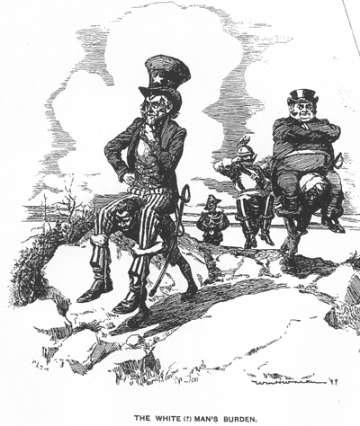

Slide 32
