Slide 1
Do Now
Thesis Practice: Evaluate the extent to which the French & Indian War was a turning point in relations between the British and the American colonists.
WINCHELL PASS OUT: Revolution Timeline PDF

Slide 2
Becoming The United States: Road to Revolution & Declaring Independence
Mr. Winchell
APUSH
Period 3 Day 1

Slide 3
AP Prompt
What were the short term effects of the new British colonial policy on the colonies politically and socially?

Slide 4
Key Concepts

Slide 5
The Situation in 1763
British Problems after the French & Indian War
Should Colonists be allowed to settle in the Ohio River Valley?
Native Americans?
The British War Debt?
British solutions to these problems
Allowed the colonists to settle beyond the Appalachian Mts.
Mistreatment of Native Americans
Have the colonists help pay war debts

Slide 6
What resulted
Pontiac’s Rebellion
A reaction to colonial settlement in the Ohio River Valley
The Proclamation Line of 1763
Restricted colonial settlement
Passage of the Sugar Act (1764)
To help pay for the War

Slide 7
The Road to Revolution (1763-1776)
The end of the French & Indian War (1763), marked the start of the road towards the American Revolution:
1763: Beginning of parliamentary sovereignty & Proclamation Line
1765-67: Stamp & Townshend Acts
1773-75: Boston Tea Party, Intolerable Acts, Lexington & Concord
1776: Declaration of Independence

Slide 8
The relationship between England and her colonies became more tense when Prime Minister George Grenville began a New Imperial Policy in 1763 by ordering the British navy to strictly enforce the Navigation Laws.
The Sugar Act was passed in 1764, which was the first law ever passed by Parliament for raising tax revenue in the colonies for the crown.
It was strictly enforced.

Slide 9
The Quartering Act of 1765 required certain colonies to provide food and quarters for British troops.
After the French and Indian War and Pontiac’s Rebellion were over, the colonists saw no need for the presence of a standing army in the colonies, and that the real reason for their presence was to oppress them.

Slide 11
Many colonies refused to quarter troops and didn’t comply with the new laws.
Violators of the Sugar Act and the Stamp Act were tried in British admiralty courts, not by juries, the burden of proof was on the defendant, not the prosecution (so no “innocent until proven guilty”)

Slide 12
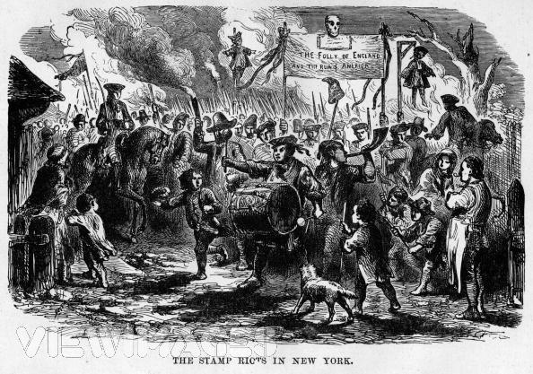
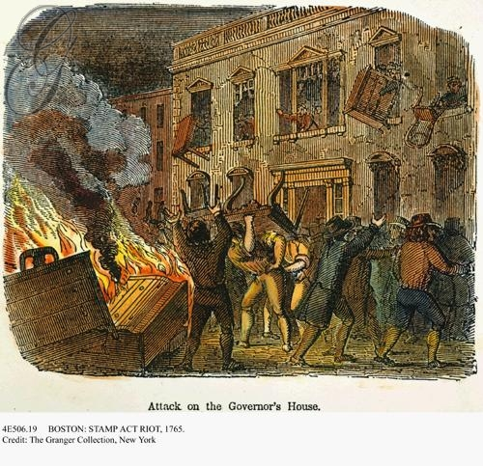
The “Sons of Liberty” & “Daughters of Liberty” were formed to protest British restrictions & became the leaders of colonial resistance
Mob reaction to the Stamp Act
For the 1st time, many colonists refer to fellow boycotters as “patriots”
The colonial boycotts were effective & Britain repealed the Stamp Act

Slide 13
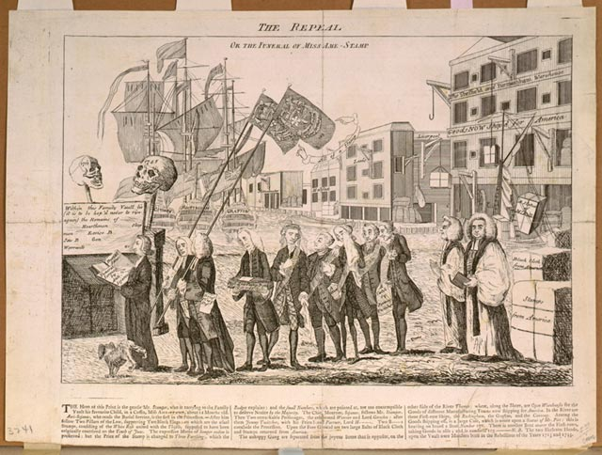
The Stamp Act Congress
27 delegates from 9 colonies met in N.Y. to denounce the Stamp Act in 1765.
Drew up a statement of their rights and asked the King and Parliament to repeal the Stamp Act.
It was important in that it brought together different and rival colonies for the same purpose.
A tiny step toward colonial unity.
Nonimportation agreements worked great to combat the Stamp Act.
The American colonists were united against a common problem.
Home woven handicrafts were encouraged and popular over British imports.

Slide 14
Many colonists argued that the new imperial policy was instituting “taxation without representation.”
Americans believed that only their colonial legislatures had any legal right to impose taxes on their people.
P.M. Grenville dismissed the Americans’ complaints and stated enjoyed virtual representation in that Parliament represented all British subjects all over the empire.
Representation in Parliament would actually have not benefited the American colonists because they would have almost always been outvoted by the more populous regions of the empire, namely England.

Slide 15
3 Reasons for Resistance
English Common Law
Centuries old body of legal rules and procedures.
Magna Carta
Liberties and Privileges
Natural Rights
Enlightenment
Separation of Powers
Glorious Revolution
Constitutional Monarchy took away power from the King to just levy taxes at will.

Slide 16
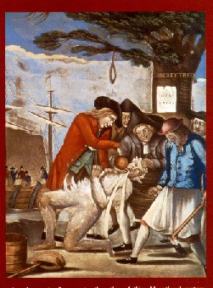
The Sons of Liberty and Daughters of Liberty worked hard to harass British officials, encourage support of boycotts and did an occasional tar and feathering of customs officials.
All of the stamp agents had been forced to resign out of harassment and intimidation so the Stamp Act was effectively nullified.
The Declaratory Act was passed on the heels of the Stamp Act being repealed and stated Parliament’s right “to bind the colonies in all cases whatsoever.”

Slide 17
Boycotts and non importation agreements hit Britain’s economy hard.
America, prior to the Revolution bought 25% of all British exports.
50% of all British shipping was devoted to the American trade.
Many Britons were angry at the fact that 2 million colonists refused to pay for only 1/3 of the cost of their own defense and 7.5 million Britons had to make up the slack with very heavy taxes.

Slide 18
This was a series of “indirect” taxes on lead, glass, paper, tea, etc.

Slide 19
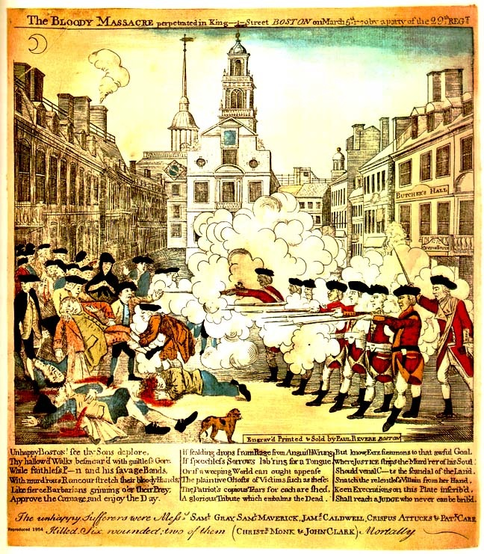
The Boston Massacre
March 5, 1770
60 people moved in on 10 redcoats pelting them with snowballs, rocks, and oyster shells.
After being clubbed and one being knocked down the soldiers opened fire wounding or killing 11 (only 5 died)
John Adams served as the defense lawyer and only 2 were convicted of manslaughter and branded on the hand.

Slide 20
Boston Massacre

Slide 21
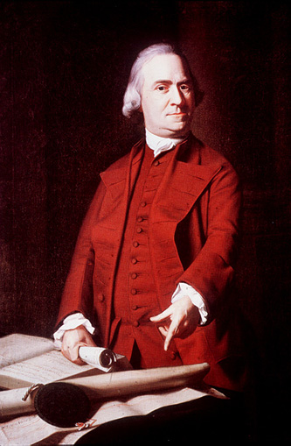
Samuel Adams, of Boston was a failure at pretty much everything but politics.
He organized the Massachusetts Committees of Correspondence.
After Boston formed theirs in 1772, 80 more sprung up in neighboring communities.
Spread ideas of resistance to British authority through interchanging letters

Slide 22
1773 Tea Act
British Action:
Britain gives the East India Company special concessions (prices) in the colonial tea business and shuts out colonial tea merchants.
Colonial Reaction:
Colonists in Boston rebel, dumping 18,000 pounds of East India Company tea into Boston Harbor

Slide 23
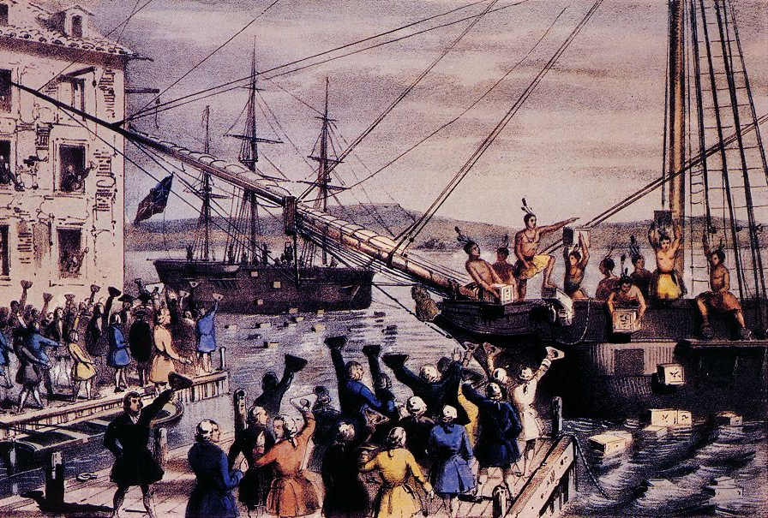
Boston Tea Party

Slide 25
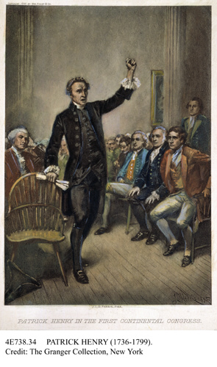
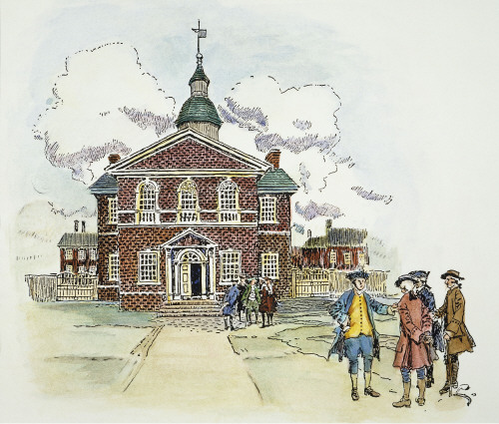
First Continental Congress
“We have to help Boston”

Slide 26
