Slide 1
Cold War America-Containing Communism Abroad & Fighting Communism at Home
Mr. Winchell
APUSH
Period 8

Slide 2
Outline
Containment in Europe and the Middle East
Truman Doctrine
Marshall Plan
Berlin crisis
NATO
Revolution in China
Limited war: Korea, MacArthur

Slide 3
Presidents and the Cold War
Truman-(1945-1953)
Containment Policy
Truman Doctrine
Marshall Plan
Berlin Airlift
NATO
Korean War
Firing of MacArthur
H-Bomb
Eisenhower- (1953-1961)
Korean War peace
Guatemala
Cuban Revolution
Vietnam support
Arms Race/Space Race
Kennedy (1961-1963)
Vietnam escalation (Military advisors and equipment sent)
Cuban Missile Crisis (the closest the US will come to Nuclear War)
Johnson (1963-1969)
Escalates Vietnam involvement (500K troops 1968)
Nixon (1969-1974)
Massive Bombing of North Vietnam and Cambodia
Negotiated Settlement of Vietnam
Visits China and begins Détente with Mao Tse Tong
Ford (1974-1977)
Carter (1977-1981)
Russians invade Afghanistan
Aides Mujhadeen fighting Russians
Communists take over in Nicaragua
Reagan (1981-1989)
Focuses American in building “Star Wars” anti-missile program and defense spending to counter Soviets
Causes Soviet economy to suffer-
Gorbachev begins Perestroika- opens frustrations created by Communist economy and peaceful revolution is begun
Bush (41) (1989-1993)
1991 the Soviet Union is ended and chain reaction reverberates across Europe (Essentially communism and extreme socialism as an economic system is proven ineffective)
Nationalism takes over in formerly communist controlled regions of Europe

Slide 4
Difference in post-war world visions
Distrust between US & USSR
German Problem
Cold War Begins
Yalta Conference
Berlin Airlift

Slide 5
Communism: Second Red Scare
Truman’s Executive Order 9835-Federal Employee Loyalty Program
Dismissal from jobs in government for being associated with Communism
HUAC
Hollywood Ten
Labor movement
McCarthyism
Eisenbergs
First American civilians to be killed for espionage
Alger Hiss

Slide 6
The Cold War: An Ideological Struggle (1945-1991)
Sides: Soviet & Eastern Bloc Nations ‘Iron Curtain’ vs. US & Western Democracies
Goals: Spread world-wide Communism vs. Contain Communism until collapse
Espionage: KGB vs. CIA
Arms Race: Atomic Bomb/Hydrogen Bomb/Space Race
Communist government/command economy vs. democratic government/capitalist economy ➔ Proxy Wars
Bi-Polarization of Europe (NATO vs. Warsaw Pact)

Slide 7
Cold War Origins: Distrust
General Distrust of One Another
Capitalism v. Communism
US refused to recognize the Soviets for 16 years
US/British delayed opening up a 2nd front
US/British opted for North Africa/Italy front
US refused to give loans to the Soviets after the war

Slide 8
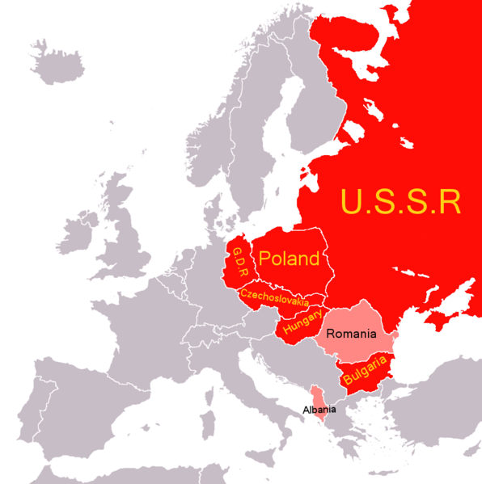
Cold War Origins: Post-War World Vision
Soviet Goals
With tens of millions killed in both world wars the Soviets main goal was… “NEVER AGAIN!”
Soviets wanted buffer states of “friendly” governments to protect them from future invasion
Exact revenge/reparations from Germany
US Goals
Rebuild Europe/Germany
“Wilsonian” Peace
Self-determination or free elections
Decolonization
Disarmament

Slide 9
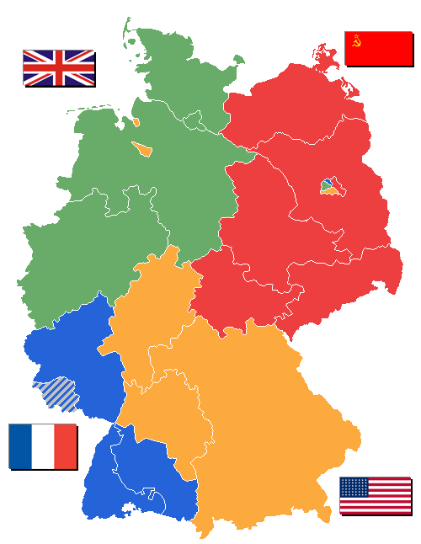
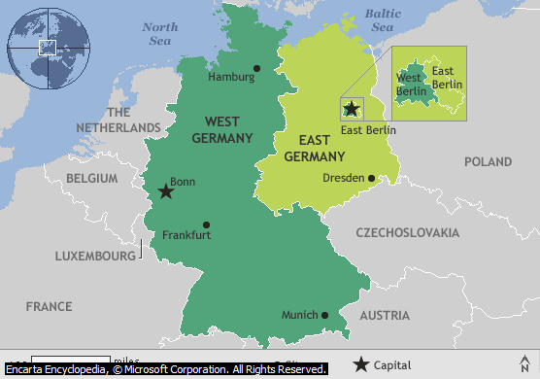
Cold War Origins: the German Problem
Potsdam Conference (1945)
Treatment of Germany
US = Rebuild
USSR = Punish
Nuremberg Trials
High ranking Nazis are tried
Partition of Germany
France was given part of Germany as long as it came out of the Allies part
Berlin is also split into sectors
Germany gets split into two (West and East)
Truman informs Stalin of the atomic bomb in an effort to intimidate him

Slide 10
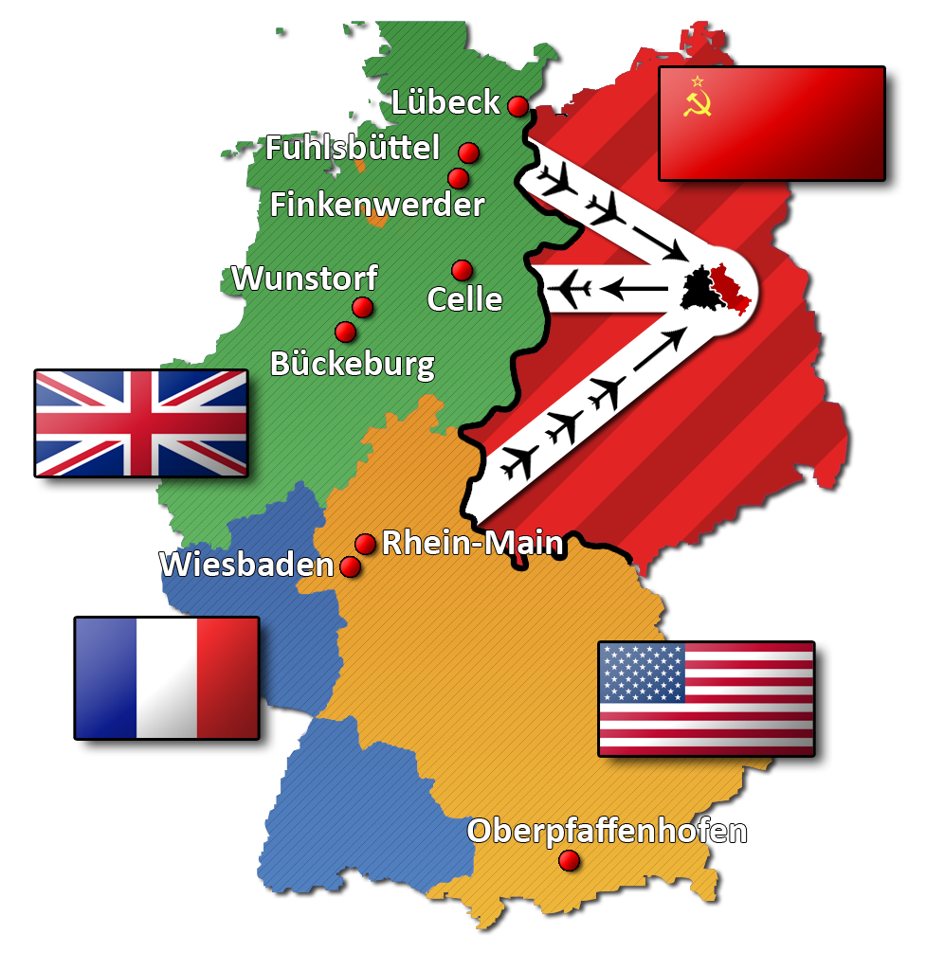
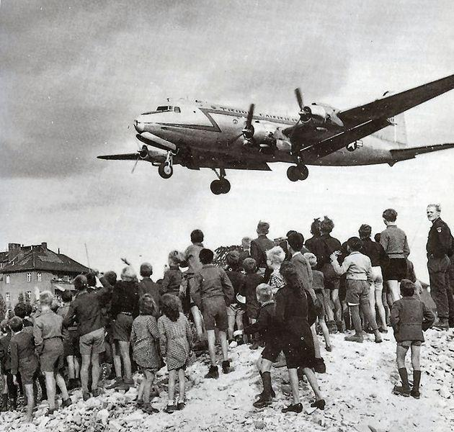
Cold War Begins: Berlin Airlift (1948-1949)
Stalin wants Berlin all to himself
All roads leading into west Berlin
Hopes to starve West Berlin and gain control of city
US led airlift supplies Berlin and embarrasses USSR
1 plane lands every 30 seconds!!!!!
After a year Stalin stops the blockade

Slide 11
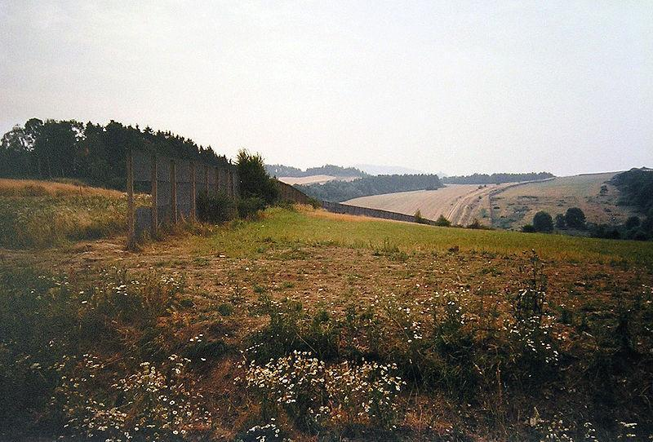
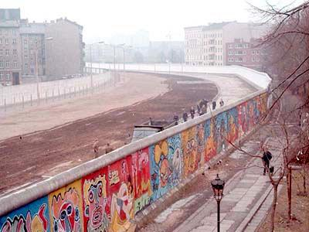
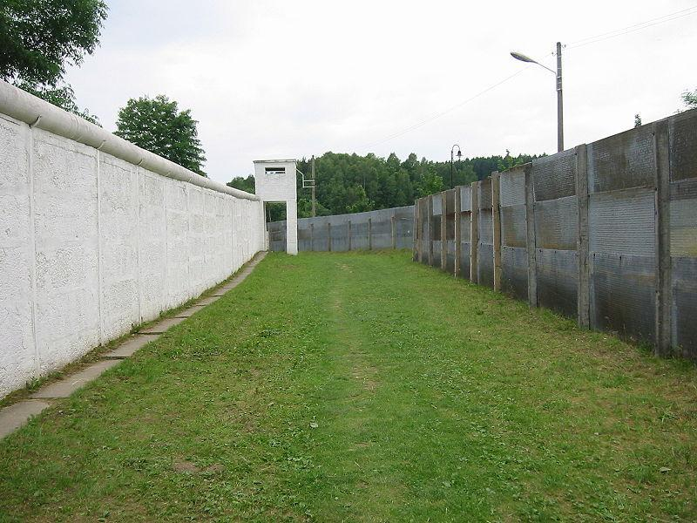
Iron Curtain Drops- Symbolic and physical separation of Western and Eastern Europe

Slide 12
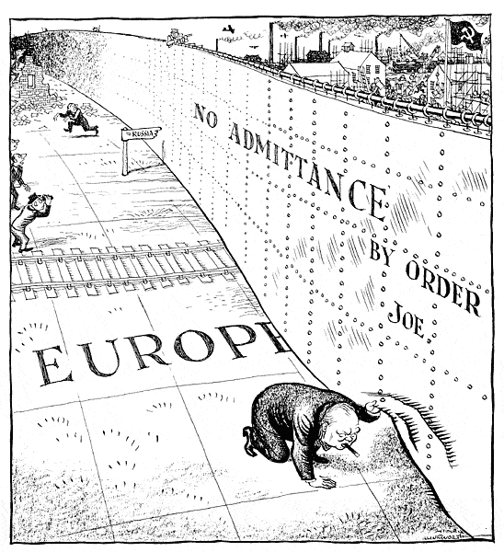

Slide 13
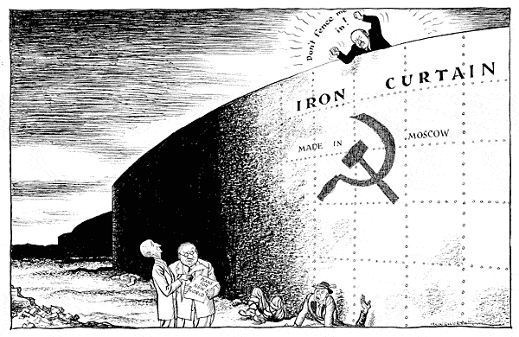

Slide 14
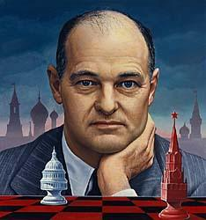
Truman Doctrine
Greece is the verge of collapse to Communism and Truman is forced to make a momentous decision
Truman Doctrine
Policy of Containment is introduced (Kennan)
Communism is evil, and it must not be allowed to spread
Marshall Plan: billions of dollars given to European nations to help them rebuild and survive
Help keep communism isolated

Slide 15
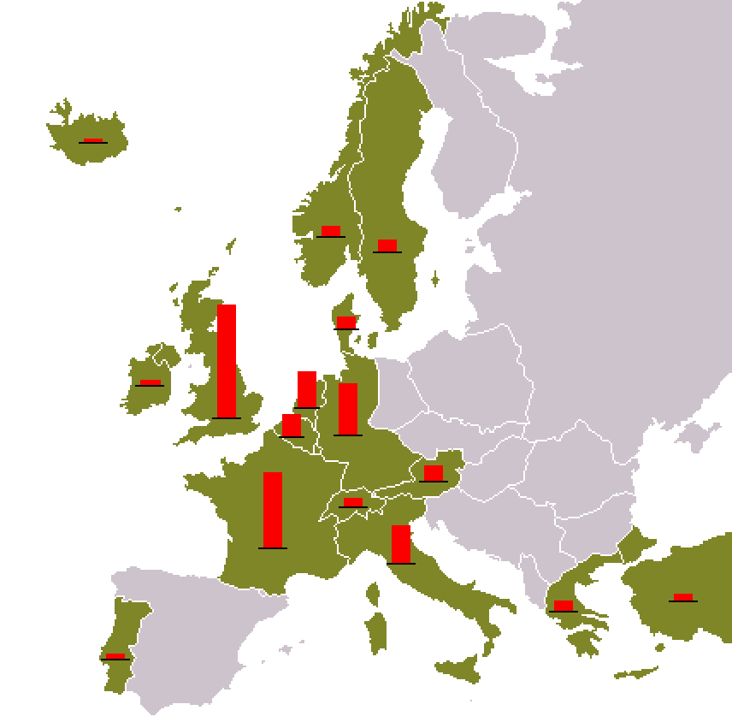

Slide 16
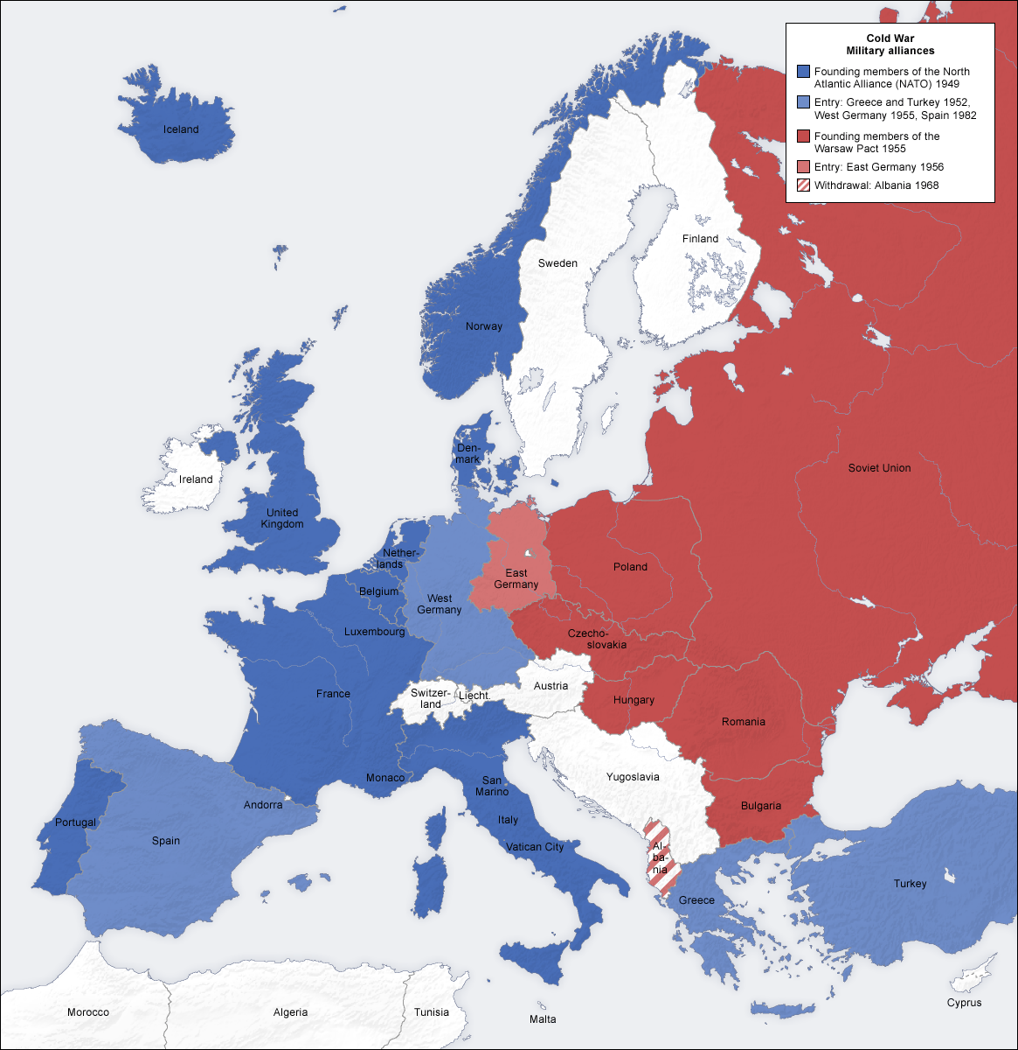
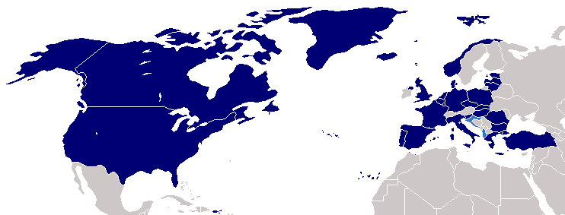
US Guarantees Peace By Readying for War
National Security Act of 1947 creates the Department of Defense
Pentagon is built
National Security Council is created to advise the President
NSC-68: allowed for the President to quadruple military spending
Peacetime draft is created
US gets entangled in a foreign alliance
NATO (1949): a defensive alliance to protect from Soviet aggression
An attack on one is an attack on all
Warsaw Pact is the Soviet response to NATO

Slide 17
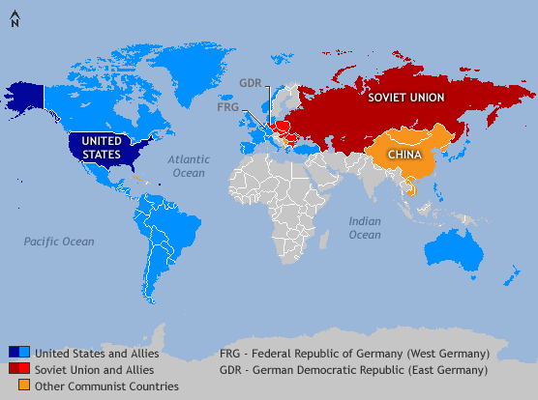
Cold War in Asia
Japan
Gen. MacArthur rebuilt Japan into a peaceful and thriving democracy (that loves baseball)
China Falls (1949)
China became Communist (25% of the world)
Soviets detonated an atomic bomb in 1949
US responded by developing the H-Bomb
Arms Race began

Slide 18
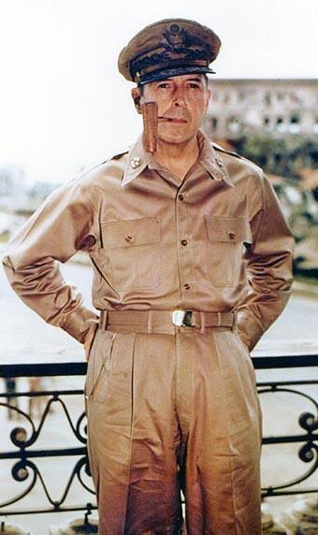
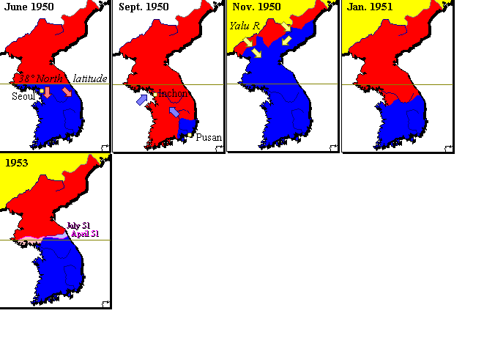
Containment Put to the Test:
Korean War: 1950-1953
Korea separated in two after WWII
With USSR backing North Korea invaded South Korea
US led coalition come to South Korea’s aid
Containment Policy: do not allow communism to spread
Back and Forth war
China eventually enters the war
General MacArthur wants to nuke China and end this war quickly
War never officially ended
Koreas are still technically at war

Slide 19
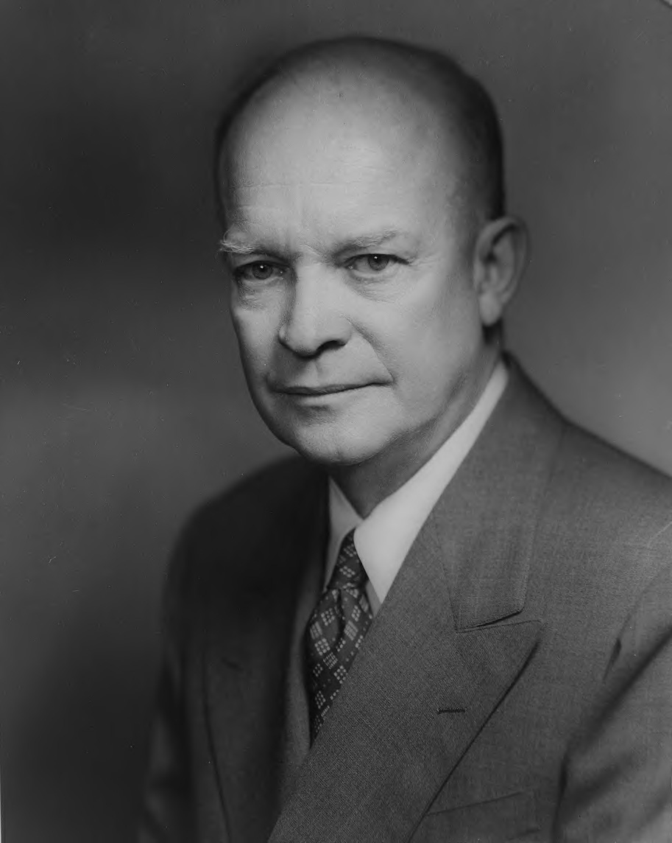
Massive Retaliation
President Eisenhower
1952-1960
Not a fan of containment
Promised to liberate captive people
Massive Retaliation
Mess with us or our allies and we will use our nukes…
Use of nuclear weapons as a first strike option
Smaller army and smaller price tag
Brinksmanship: go to the brink of war to show strength
Nuclear war is not something to get into over minor conflicts
Hungarian Revolt of 1956
Americans did nothing to assist the revolt

Slide 20
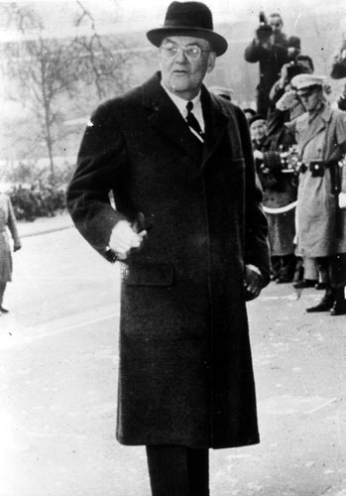
Eisenhower and Brinkmanship
Strong
Wilsonian- moral leadership, anti-communist
Created the idea of Massive Retaliation-
Using Nuclear weapons instead of conventional forces to counter Communist threats throughout the world
Supported the Arms Race- build up of Atomic weapons and the missile program to deliver weapons
All used as a Deterrence to soviet Aggression and surprise attack (Idea was to deter any attack against the US)
Covert Operations
Iran and Guatemala

Slide 21
Truman vs. Eisenhower
Containment:
(George Kennan)
Marshall Plan
Truman Doctrine
Berlin Airlift
NATO
NSC #68
Korean War
Brinkmanship:
John Foster Dulles
Mutual Security Agreements
Massive retaliation
MAD
Domino Theory
CIA
Eisenhower Doctrine
$ Diplomacy Part II

Slide 22
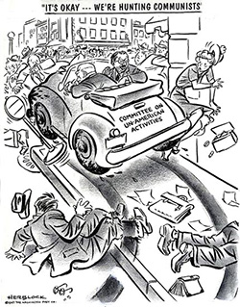

Slide 23
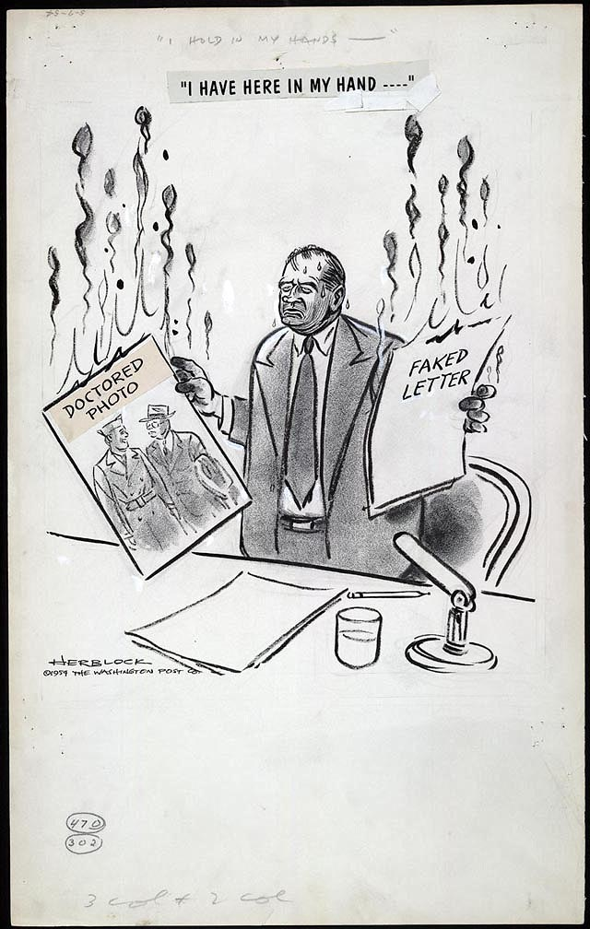

Slide 24
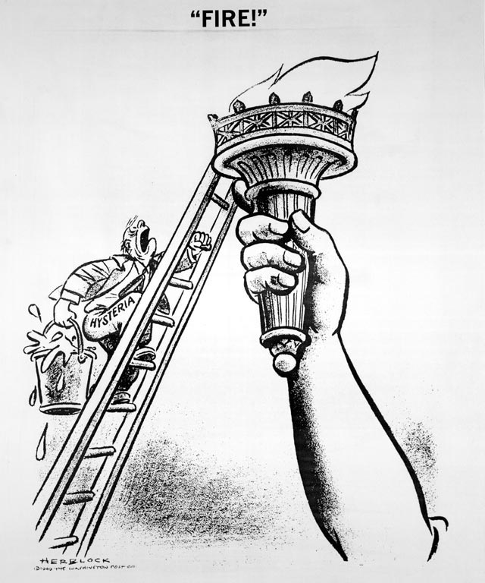
-June 1949-
What is the Washington Post cartoonist portraying in his drawing?

Slide 25
