Slide 1
Do Now
2 Column Brainstorm:
Factors that PULLED people TO the Americas/New World
Factors that PUSHED people out of Europe

Slide 2
1. Cultural Interactions: The Columbian Exchange and Native Societies
Mr. Winchell
APUSH 2019-2020
Period 1-2

Slide 3
AP Prompt
Evaluate the short term effects of European exploration and colonization on the Americas.

Slide 4
Outline
Natives Before Colonization
Europe Before Colonization
Early Colonization
Comparison: European Nations and Colonization
Effects of the Columbian Exchange

Slide 5
Locations of Major Native American Groups and Culture Areas in the 1600s
Notes:
4
4
4
04/06/98
4

Slide 6
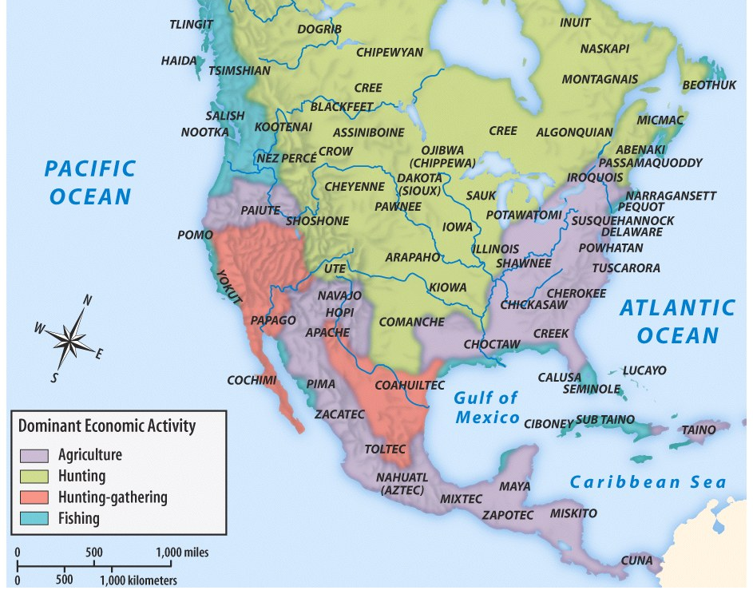

Slide 7
Europe Before Exploration
Renaissance
Technological innovations
Growth of Nation-States
England, France, Spain, Portugal, Holland
Protestant Reformation and Religious Wars
Lutheranism
Calvinism
Predestination
Church of England aka Anglican Church
Catholic Counter-Reformation
Notes:
Key Concepts 1.2.I.A, 1.2.I.C

Slide 8
Motives For European Exploration & Colonization
Crusades → by-pass intermediaries to get to Asia.
Renaissance → curiosity about other lands and peoples.
Reformation → refugees & missionaries.
Monarchs seeking new sources of revenue.
Technological advances.
Fame and fortune.

Slide 9
Direct Causes = 3 G’s
Political: Become a world power through gaining wealth and land. (GLORY)
Economic: Search for new trade routes with direct access to Asian/African luxury goods would enrich individuals and their nations (GOLD)
Religious: spread Christianity and weaken Middle Eastern Muslims. (GOD)
The 3 motives reinforce each other

Slide 10
Thus began the move from the Old World to the New World

Slide 11
Both Britain and Spain in general…
Motivated by Mercantilist goals (Gold, Glory, God!)
Used slavery and exploited native populations
Had hostile relationships with native populations
The French & Dutch: a hybrid approach
Maintained a much looser hold on their colonies (different from above)
Few Europeans came over
Used trade alliances and intermarriage with American Indians to acquire furs, etc. for export.

Slide 12
The French in America
Royal Colonies
Jesuits and Catholic Conversion
Fur Trade
Coureurs de Bois (runner of the woods)
Native Relations
Trade Networks
Alliances
Intermarriage
Notes:
Key Concepts 1.2.III.A, 1.2.III.B, 1.2.III.C, 2.1.I.B

Slide 13
Comparing the Colonization Process
SPANISH
BRITISH
Funded by crown
Very direct control
Strong Catholic missionary impulse
More complex socio-political system (race based hierarchy where intermingling of races common)
Relatively few women over to colonize
Joint Stock Companies raised funds & were granted charters (later the crown takes over more directly)
Economic development more independent from Mother Country
More variance in background, motivation, etc. of colonists
Little intermixing with native population - very rigid racial hierarchy
Relatively more women come over, as aim was to acquire land and populate colonies rather than simply turn a profit

Slide 14
The Spanish in America
Royal Colonies
Council of Indies
Viceroys
Relations with Natives
Catholic Conversion and Missions
Pueblo Revolt (1680)
Labor
Encomienda System
Asiento System
Spanish Caste System
Notes:
Key Concept 1.2.II.A, 1.2.II.B, 1.2.II.C, 1.2.II.D, 2.1.I.A

Slide 15
The Spanish in America
De Las Casas
Sepulveda
They are by nature the most humble, patient, and peaceable, holding no grudges, free from embroilments, neither excitable nor quarrelsome… They are also poor people, for they not only possess little but have no desire to possess worldly goods. For this reason they are not arrogant, embittered, or greedy... They are very clean in their person, with alert, intelligent minds, docile and open to doctrine, very apt to receive our holy Catholic faith... And once they begin to hear the tidings of the Faith, they are so insistent on knowing more and on taking the sacraments of the Church and on observing the divine cult that...the missionaries who are here need to be endowed by God with great patience in order to cope with such eagerness... Yet into this sheepfold, into this land of meek outcasts there came some Spaniards who immediately behaved like ravening beasts, wolves, tigers, or lions that had been starved for many days...”
The Spanish have a perfect right to rule these barbarians of the New World…who in prudence, skill, virtues, and humanity are as inferior to the Spanish as children to adults, or women to men, for there exists between the two as great a difference as...I might even say, between apes and men. ...you will barely find the vestiges of humanity, who not only do not possess any learning at all, but are not even literate or in possession of any monument to their history...;nor do they have written laws, but barbarian institutions and customs. Well, then, if we are dealing with virtue, what temperance or mercy can you expect from men who committed to all types of intemperance and base frivolity, and eat human flesh? And do not believe that before the arrival of the Christians they lived in that pacific kingdom of Saturn which the poets invented; for, on the contrary, they waged continual and ferocious war upon one another with such fierceness that they did not consider a victory at all worthwhile unless they sated their monstruous hunger with the flesh of their enemies...

Slide 16
Pueblo Revolt
Spanish tight control over New Mexico
Resistance=Increased Cruelty
Encomienda System (Native Slavery)
Forced Catholicism
1680: Response by Pueblo Natives (Popé) successful
Independence from Spanish for approx. 12 years.
Notes:
The Pueblo Revolt was the largest and most successful Native American uprising in North American history. It pointed to problems inherent in the Spanish style of colonization, as well as to the power that Native Americans could wield through collective resistance. Popé is still regarded as a hero among the tribes of New Mexico today.

Slide 17
The English in America
Charters and Joint-Stock Companies
Population Growth
Indentured Servants
Native Relations
Early Native Assistance
Animosity and Exclusion
Anglo-Powhatan Wars
Pequot Wars (1636-1638)
King Philip’s War (1675-1678)
“Our fathers had plenty of deer and skins, our plains were full of deer, as also our woods, and of turkies, and our coves full of fish and fowl. But these English have gotten our land, they with scythes cut down the grass, and with axes fell the trees; their cows and horses eat the grass, and their hogs spoil our clam banks, and we shall all be starved.” – Miantonomi, Narragansett sachem, 1642.
Notes:
Key Concepts 1.2.III.A, 1.2.III.B, 1.2.III.C, 2.1.I.C

Slide 18
Who Came, and Where did They Settle?
Spanish | built settlements in the Caribbean, South America and Central America
English | settled in North America (present day United States)
French | settled in present-day Canada/Mississippi Valley
Dutch | settled in present-day New York (New Amsterdam)
Africans | were brought to work on large plantations in the Caribbean and Southern English colonies

Slide 19
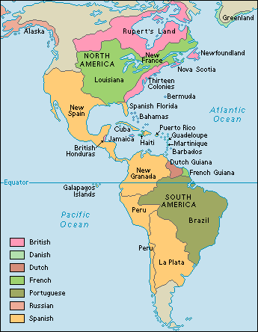
European Colonies
Notes:
Key Concepts 1.2.I.A, 1.2.I.C

Slide 20
Impact of Discovery
Colonization: The establishment of distant settlements controlled by parent country.
Often times natives were forced into work on plantations
An exchange begins between the old world and the new.

Slide 21
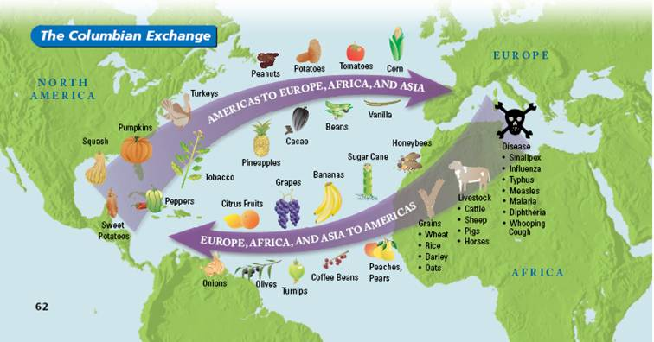
The Columbian Exchange
An exchange of living things between the Old World (Europe, Asia, Africa) and the New World (the Americas)

Slide 22
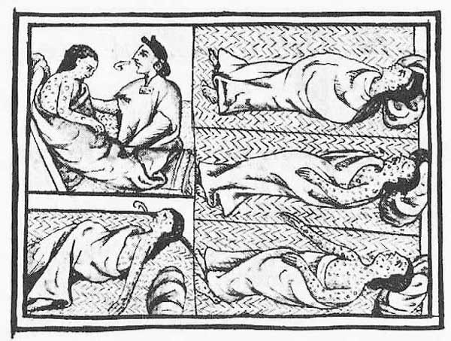
Trading Food is Good… Trading Disease is BAD!
Population decrease estimates between 1/3 and 1/2 of native population.
Decrease in population means decrease in workforce.
What will the Europeans do???

Slide 23
Slave Trade Begins
With so many Natives dying of disease, Europeans turned to the slave trade to replenish labor force.
Africans were more resistant to Old World disease and less familiar with New World (less likely to escape).
Europeans began using these slaves in the New World.

Slide 24
AP Prompt
Evaluate the short term effects of European exploration and colonization on the Americas.

