Slide 1
European Exploration and Early Colonization
Mr. Winchell
APUSH
Period 1-2

Slide 2
AP Prompt
Evaluate the short term effects of European Exploration and Colonization on the Americas.

Slide 3
Key Concepts-REFERENCE KC REVIEW
2.1.I: Spanish, French, Dutch, and British colonizers had different economic and imperial goals involving land and labor that shaped the social and political development of their colonies as well as their relationships with native populations.

Slide 4
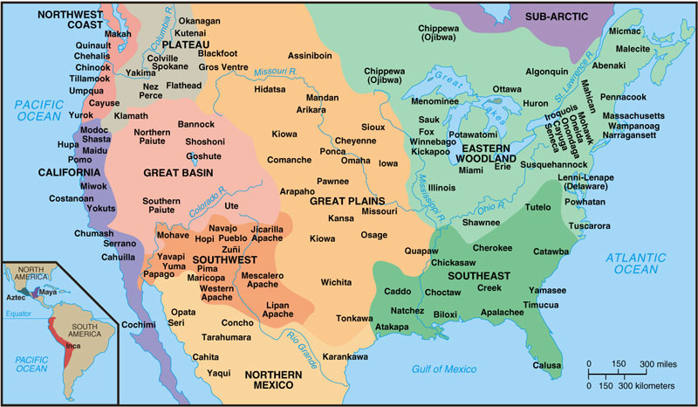
Locations of Major Native American Groups and Culture Areas in the 1600s
Notes:
4
4
4
04/06/98
4

Slide 5
Motives for European Exploration
Crusades → by-pass intermediaries to get to Asia.
Renaissance → curiosity about other lands and peoples.
Reformation → refugees & missionaries.
Monarchs seeking new sources of revenue.
Technological advances.
Fame and fortune.

Slide 6
Direct Causes = 3 G’s
Political: Become a world power through gaining wealth and land. (GLORY)
Economic: Search for new trade routes with direct access to Asian/African luxury goods would enrich individuals and their nations (GOLD)
Religious: spread Christianity and weaken Middle Eastern Muslims. (GOD)
The 3 motives reinforce each other

Slide 7
European Exploration
1400s to 1600s
Effects
Europeans reach and settle Americas
Expanded knowledge of world geography
Growth of trade, mercantilism and capitalism
Indian conflicts over land and impact of disease on Indian populations
Introduction of the institution of slavery
Columbian Exchange

Slide 8
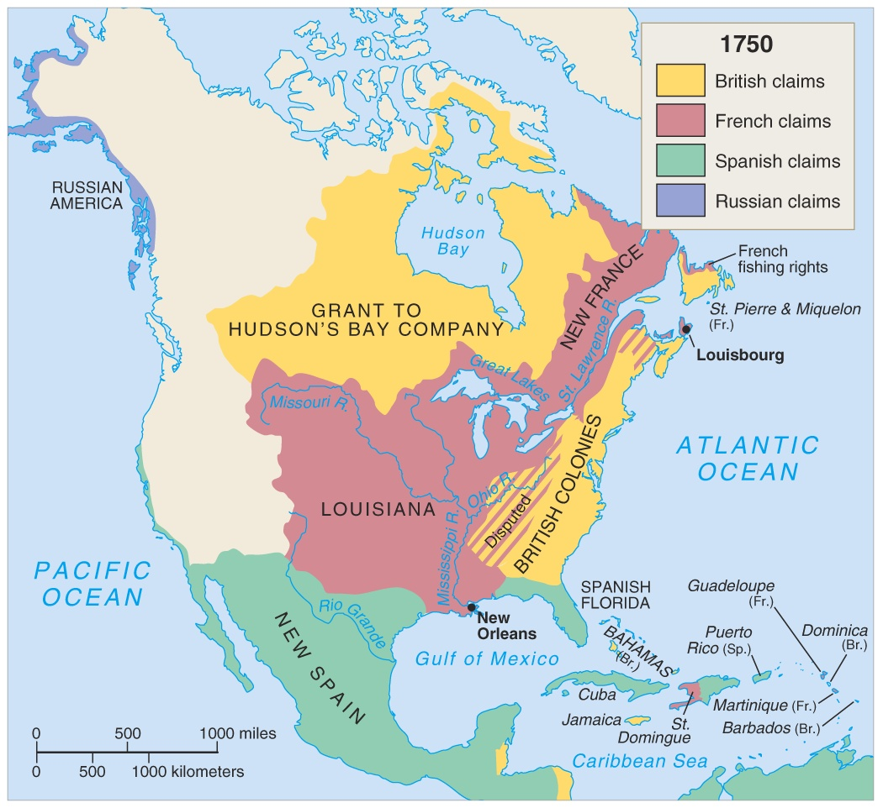
F/I War 1750

Slide 9
Comparing the Colonization Process
SPANISH
BRITISH
Funded by crown
Very direct control
Strong Catholic missionary impulse
More complex socio-political system (race based hierarchy where intermingling of races common)
Relatively few women over to colonize
Joint Stock Companies raised funds & were granted charters (later the crown takes over more directly)
Economic development more independent from Mother Country
More variance in background, motivation, etc. of colonists
Little intermixing with native population- very rigid racial hierarchy
Relatively more women over, as aim was to acquire land and populate colonies rather than simply turn a profit

Slide 10
Both Britain and Spain in general…
Motivated by Mercantilist goals (Gold, Glory, God!)
Used slavery and exploited native populations
Had hostile relationships with native populations
The French & Dutch: a hybrid approach
Maintained a much looser hold on their colonies (diff from above)
Few Europeans came over
Used trade alliances and intermarriage with American Indians to acquire furs, etc. for export.

Slide 11
Thus began the move from the Old World to the New World

Slide 12
Who Came, and Where did They Settle?
Spanish | built settlements in the Caribbean, South America and Central America
English | settled in North America (present day United States)
French | settled in present-day Canada
Dutch | settled in present-day New York
Africans | were brought to work on large plantations in the Caribbean and Southern English colonies

Slide 13
Comparing Three Worlds
 | American Indians | Europeans | West Africans
What were their religious beliefs? | Nature-based Spiritual relationship between man and Earth | Spread Christianity Everyone should be Christian | A mix: Islam (in some areas); Nature-based (in other places)
What was their government? | tribes (simple) confederations empires (complex) | nations and kings beginning to have ideas about individual rights | Kingdoms w/ rulers Council of elders
What were their economic systems? | Communal ownership of land Live in harmony with land -- use it to sustain life and not to create wealth | Private ownership of property Labor + land = wealth | Communal ownership of land Extensive trade in a variety of goods
What kind of technology did they have? | Bows, arrows, spears and tomahawks Simple farming and hunting tools | Advanced weapons, including guns, cannons and armor Navigational abilities | Depends on area – simple farming tools or complex trading equipment

Slide 14
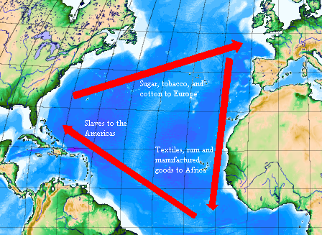

Slide 15
The English Colonies
In the 1600s, English settlers arrived in North America
English colonization differed from Spanish & French because the English government had no desire to create a centralized empire in the New World
Different motivations by English settlers led to different types of colonies

Slide 16
Migrating to the English Colonies
17th century England faced major social changes:
The most significantly was a boom in population; Competition for land, food, jobs led to a large mobile population (vagrants?)
People had choices: could move to cities, Ireland, Netherlands, or America (but this was most expensive & dangerous)

Slide 17
Migrating to the English Colonies
Motives for migration to America:
Religious: purer form of worship
Economic: Escape poverty or the threat of lifelong poverty
Personal: to escape bad marriages or jail terms
Migration to America was facilitated by the English Civil War & Glorious Revolution

Slide 18
Four Colonial Subcultures
The values of the migrants dictated the “personality” of the newly created colonies; led to distinct (not unified) colonies
The Chesapeake
New England
Middle Colonies
The Carolinas & Georgia

Slide 19
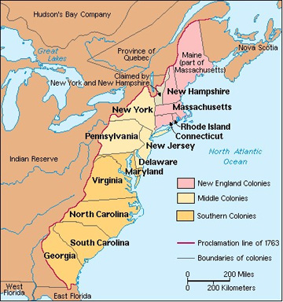

Slide 20
Impact of Discovery
Colonization: The establishment of distant settlements controlled by parent country.
Often times natives were forced into work on plantations
An exchange begins between the old world and the new.

Slide 21
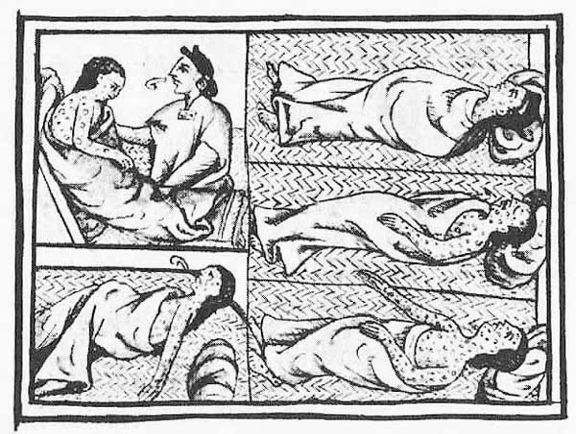
Trading Food is Good… Trading Disease is BAD!
Population decrease estimates between 1/3 and 1/2 of native population.
Decrease in population means decrease in workforce.
What will the Europeans do???

Slide 22
Slave Trade Begins
With so many Natives dying of disease, Europeans turned to the slave trade to replenish labor force.
Africans were more resistant to Old World disease and less familiar with New World (less likely to escape).
Europeans began using these slaves in the New World.

Slide 23
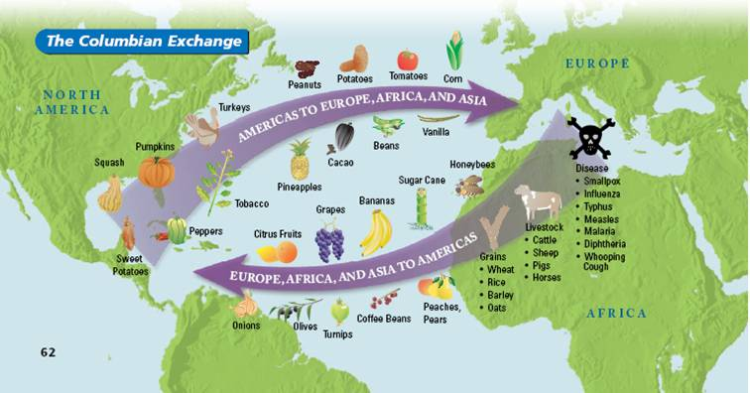
The Columbian Exchange
An exchange of living things between the Old World (Europe, Asia, Africa) and the New World (the Americas)

