Slide 1
Do Now-DISCUSS
-What is salutary neglect? How did the French and Indian War impact this British policy?

Slide 2
French and Indian War
Mr. Winchell
APUSH
Period 3 Day 1

Slide 3
Questions to Consider
Politics and Power: What factors led to the outbreak of war between the French and British in both Europe and North America?
America in the World: How did events in Europe exacerbate the tensions between the British and the American colonists in the years between 1754 and 1776?
Identity: What accounted for the emergence of an American identity in the years between the French and Indian War and the beginning of the American Revolution?

Slide 4
Quote to Consider
“The People, even to the lowest Ranks, have become more attentive to their Liberties, more inquisitive about them, and more determined to defend them, than they were ever before known or had occasion to be.”
John Adams, 1865
Read, Pair-Share, Class Discuss

Slide 5
Setting the Stage
End of 17th century – America is valuable real estate
People in Canada and America were pawns in a larger chess game.
Between 1689 and the American Revolution, European powers, fought for territory.
King William’s War - 1689-97
Queen Anne’s War - 1702-13
King George’s War - 1740-48
French and Indian War - 1756-63
Colonist not involved much with first three.
England and France left standing as two major powers.

Slide 6
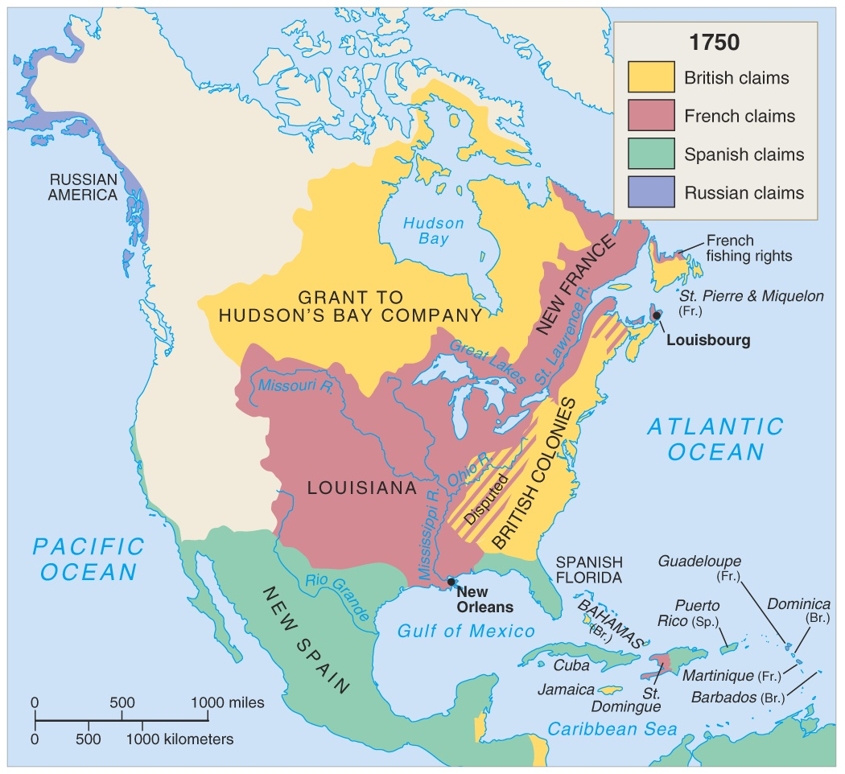
North America in 1750

Slide 7
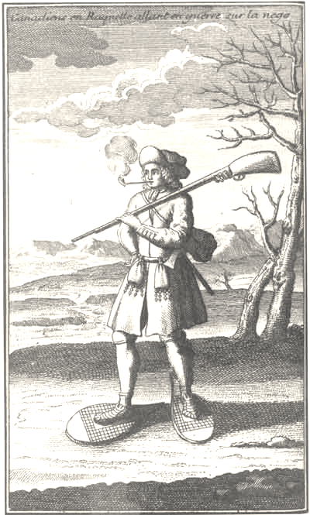
The Battle of Two Colonies
New France
New England
Region:
Ohio River Valley
Economy:
Lucrative Fur Trade
Relationship w/Natives:
Mutually beneficial & Friendly
Ruling Body:
French Throne
Permanent Settlements:
Very few, mainly trading posts/forts
Religion:
Catholic
Region:
Massachusetts Bay
Economy:
Commerce, agriculture
Relationship w/Natives:
Removal of Indians
Ruling Body:
Self-Governing, Royal
Permanent Settlements:
Towns/Villages, communal
Religion:
Puritan - Congregationalist

Slide 8
Why?
Overlapping claims between the French and British. (Ohio)
French forts built to counter British expansion.
Britain didn’t like this, sent GW on expedition.
Shots fired, war starts.

Slide 9
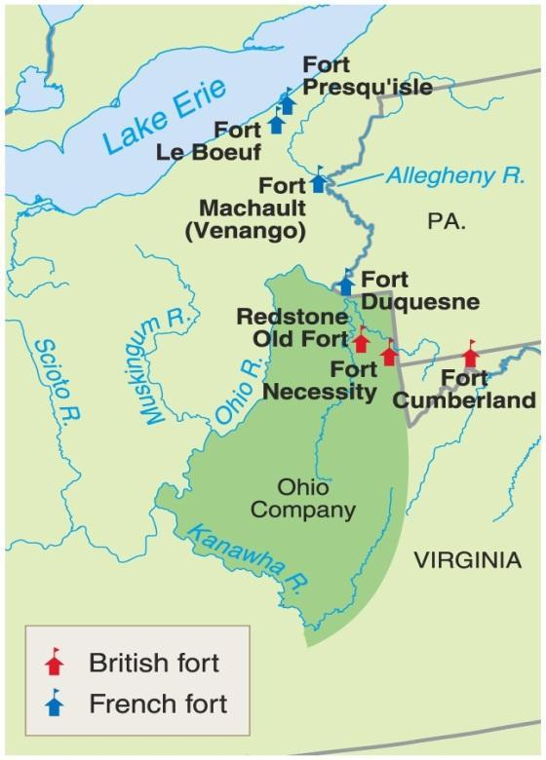
The Ohio Valley & the French and Indian War
The Ohio Valley was very important real estate to three major North American powers
Iroquois
Wanted to extend their power to this region
Colonial Americans
Logical area for expansion as land became scare on the east coast
French
Link their Canadian holdings to their holdings west of the Mississippi
George Washington’s family has a 500,000 acre claim in this region
Washington marches troops out to a French fort in this region and attacks it (1754)
He is eventually defeated, but the first shots have been fired

Slide 10
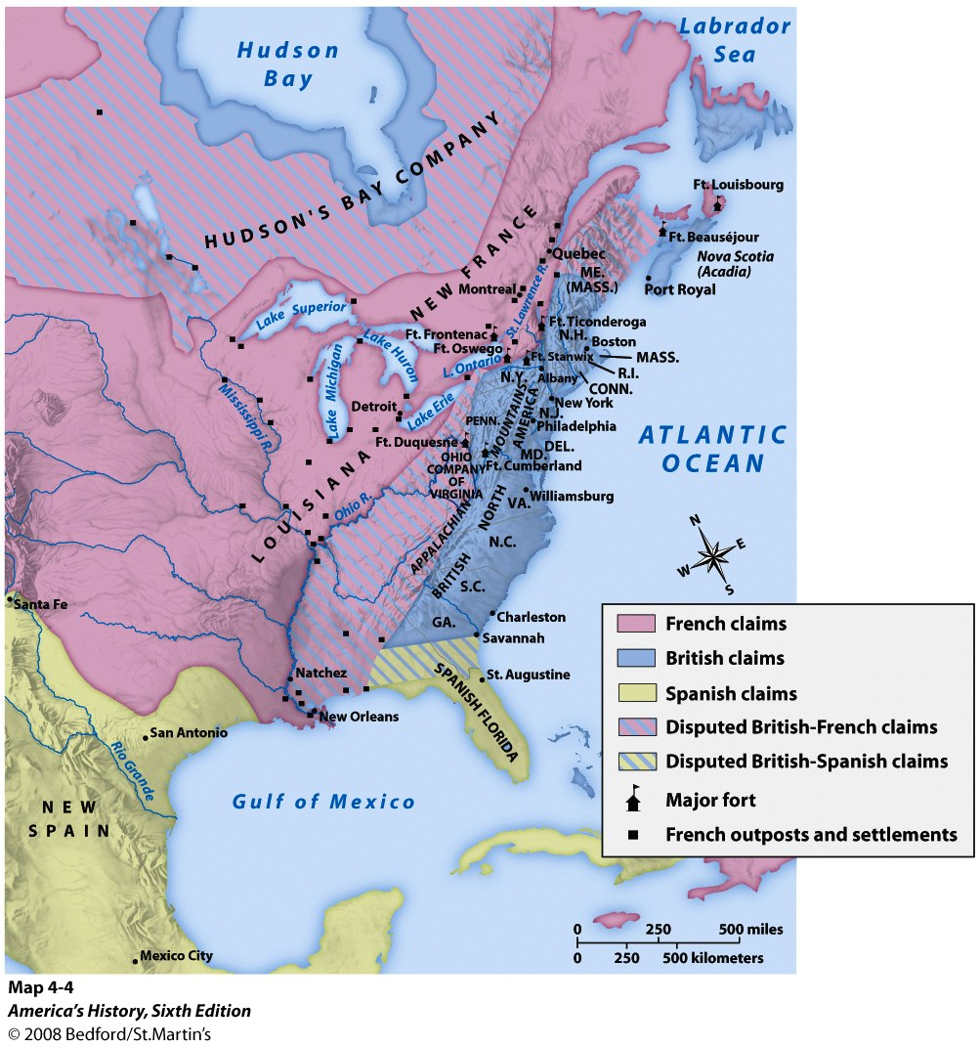

Slide 11
Albany Plan
The war was going poorly for England.
The British Government recognized the need for more coordination and called for representatives from the colonies to meet in Albany in 1754.
The Albany Plan of Union—designed by Benjamin Franklin—provided an intercolonial government to recruit troops and collect taxes from the colonies for the common defense.
Colonies didn’t accept it (didn’t want someone else taxing them), but it was significant in that was an early example of the colonies attempting to come together under ‘one roof.’

Slide 13
British Victory
War ends in the Treaty of Paris, 1763.
Great Britain acquires French Canada and Spanish Florida.
France gives Spain the territory of Louisiana and all land west of the Mississippi.
Britain now controls ½ of North American and France has none. Sucks to be France.

Slide 14
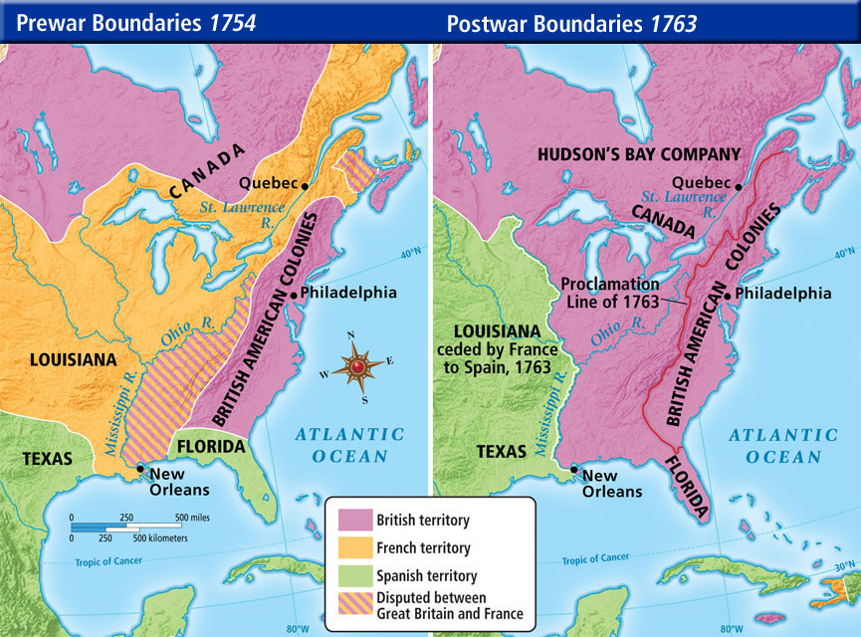

Slide 15
Major Effects of the French and Indian War
France gets booted out of North America
British rack up a HUGE debt
Soon the British will look for the colonists to pay for their own defense…
Colonials start pouring into this newly won territory
This leads to Pontiac’s Uprising
Indians attack settlements and forts throughout Ohio Valley
Several thousand settlers are killed and most of the British forts are burned
British respond brutally by attacking villages and spreading smallpox on purpose

Slide 16
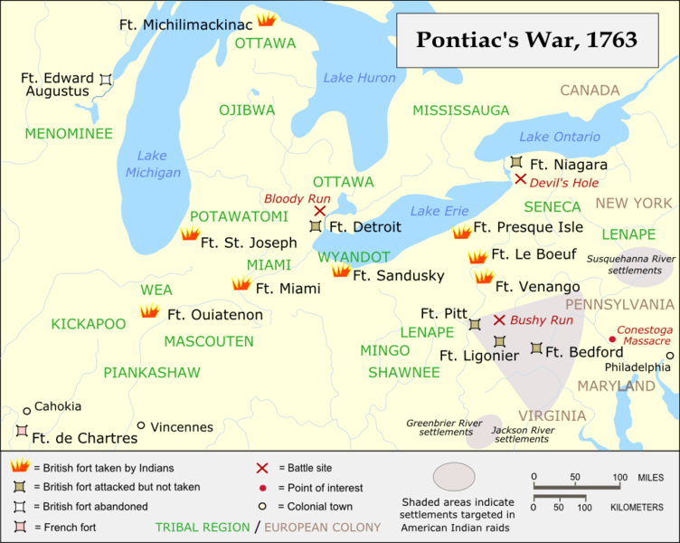

Slide 17
Proclamation of 1763
Because of this huge debt the British do not want anymore conflict
Proclamation Act of 1763: prohibited colonial settlement west of the Appalachians
This angers the colonials
Proclamation is completely ignored by the colonials

Slide 19
The Proclamation of 1763
In your Frame of Reference Who is the friction between because of the Proclamation Line of 1763?
Why does it make the colonist angry?
The Indians agree to stop attacking the colonies.
The Indians continue to attack the colonies.
The colonists will remain on the coast where the king can use the navy to keep them under control.
Parliament passes the
Proclamation of 1763
The king is concerned that as colonists move inland, he will have less control over their actions.
Makes the Colonist angry at King George III!
Put in your frame of Reference: The king believes the colonists will be happy about the Proclamation, because it will stop the attacks from the Indians.

