Slide 1
Do Now
Why is this time period often referred to by historians as the ‘Gilded Age?’ From your reading, to what extent is that title accurate?
Review Handout” Politics of the Gilded Age’

Slide 2
1. Gilded Age Political Issues and Parties
Mr. Winchell
APUSH 19-20
Period 6

Slide 3
AP PROMPT
Evaluate the extent of change in political party platforms from the Antebellum Era through the Gilded Age.

Slide 4
Main Gilded Age Political Issues
Gold Standard
Civil Service Reform
Tariffs
Business Regulation

Slide 5
Third Party System (1860-1896)
Antebellum and Post War Issues(1854-1877)
Slavery and Emancipation
Reconstruction policies
Post Reconstruction Issues (1877-1896)
Civil Service Reform
Tariffs and Protectionism
Gold Standard and Silver
Populist Party
Democrats
Platform
Pro-slavery
States’ rights; laissez-faire
Factions
Bourbon Democrats
Pro-business Democrats
Supported civil service reforms
Redeemer Democrats
Coalition
White Southerners, Catholics, Lutherans, Jews, Immigrants, working class
Solid South
Republicans
Platform
Radical Reconstruction
Pro-business; tariffs; protectionism
Factions
Stalwarts
Preserve spoils system and machine politics
Half-Breeds
Pursued civil service reform
Mugwumps
Independents discouraged with corrupt GOP
Coalition
Business, upper-class, middle-class, Northern WASPs, reformers, blacks, scalawags, carpetbaggers
Northeast and West

Slide 6
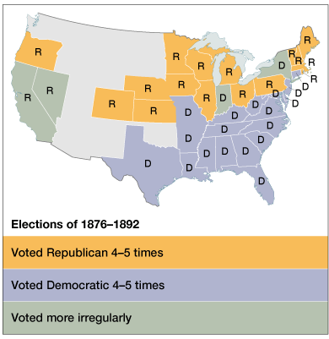
A Two-Party Stalemate

Slide 7
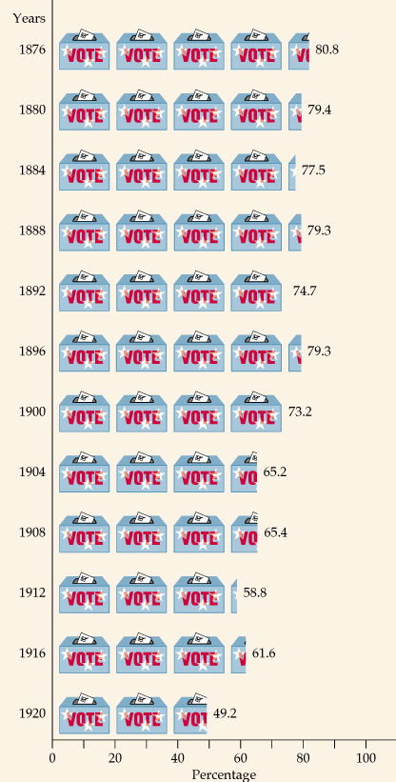
Intense Voter Loyalty to the Two Major Political Parties

Slide 8
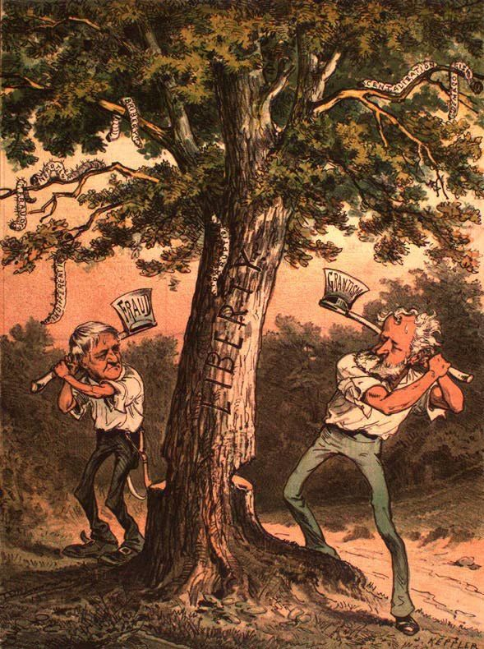

Slide 9
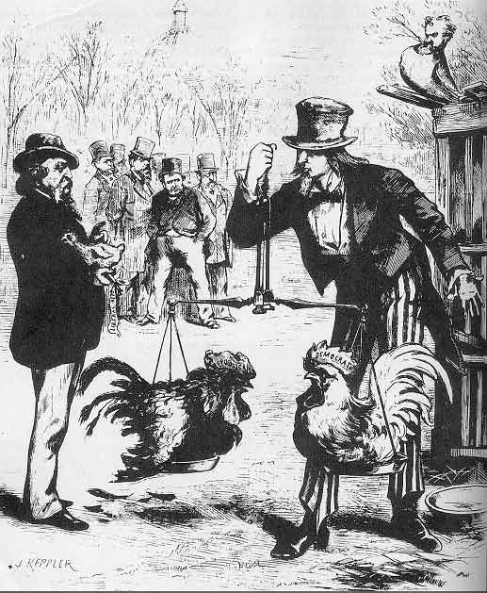

Slide 10
Well-Defined Voting Blocs
Democratic Bloc
Republican Bloc
White southerners (preservation of white supremacy)
Catholics
Recent immigrants (esp. Jews)
Urban working poor (pro-labor)
Most farmers
Northern whites (pro-business)
African Americans (non-disenfranchised)
Northern Protestants
Old WASPs (support for anti-immigrant laws)
Most of the middle class

Slide 11
Very Laissez Faire Federal Govt.
From 1870-1900 → Govt. did very little domestically.
Main duties of the federal govt.:
Deliver the mail.
Maintain a national military.
Collect taxes & tariffs.
Conduct a foreign policy.
Exception → administer the annual Civil War veterans’ pension.

Slide 12
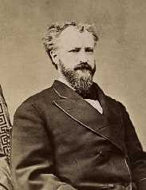
The Presidency as a Symbolic Office
Party bosses ruled.
Presidents should avoid offending any factions within their own party.
The President just handed out federal jobs. (PATRONAGE)
1865 → 53,000 people worked for the federal govt.
1890 → 166,000 people worked for the federal govt
Senator Roscoe Conkling

Slide 13
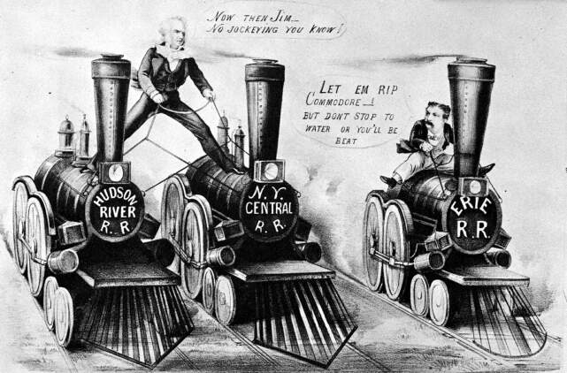
The Era of Good Stealings
Despite the Civil War, population still mushroomed, due to incoming immigration, but during this time, politics became very corrupted.
Railroad promoters cheated gullible customers.
Stock-market investors were a cinder in the public eye.
Too many judges and legislators put their power up for hire.

Slide 14
