Slide 1
Last West, New South, and Gilded Age Politics
Mr. Winchell
APUSH Period 6-Industrialization, Immigration, and Urbanization

Slide 2
Respond to the following quote:
“The external glitter of wealth conceals a corrupt political core that reflects the growing gap between the very few rich and the very many poor.” - Mark Twain

Slide 3
What is the Gilded Age???
Era of rapid economic and population growth in the United States during the post-Civil War and post-Reconstruction eras of the late 19th century (1869-1896).
Known for the creation of a modern industrial economy.
U.S. economy grew at the fastest rate in its history, with real wages, wealth, GDP, and capital formation.
A national transportation and communication network was created.
The corporation became the dominant form of business organization.
A managerial revolution transformed business operations.
By the beginning of the 20th century, per capita income and industrial production in the United States led the world.
However, during the same period, farmers, immigrants, the poor struggled throughout the U.S
So….Why is it called the Gilded Age???
Ever heard the saying “Not all that glitters is gold.”?

Slide 4
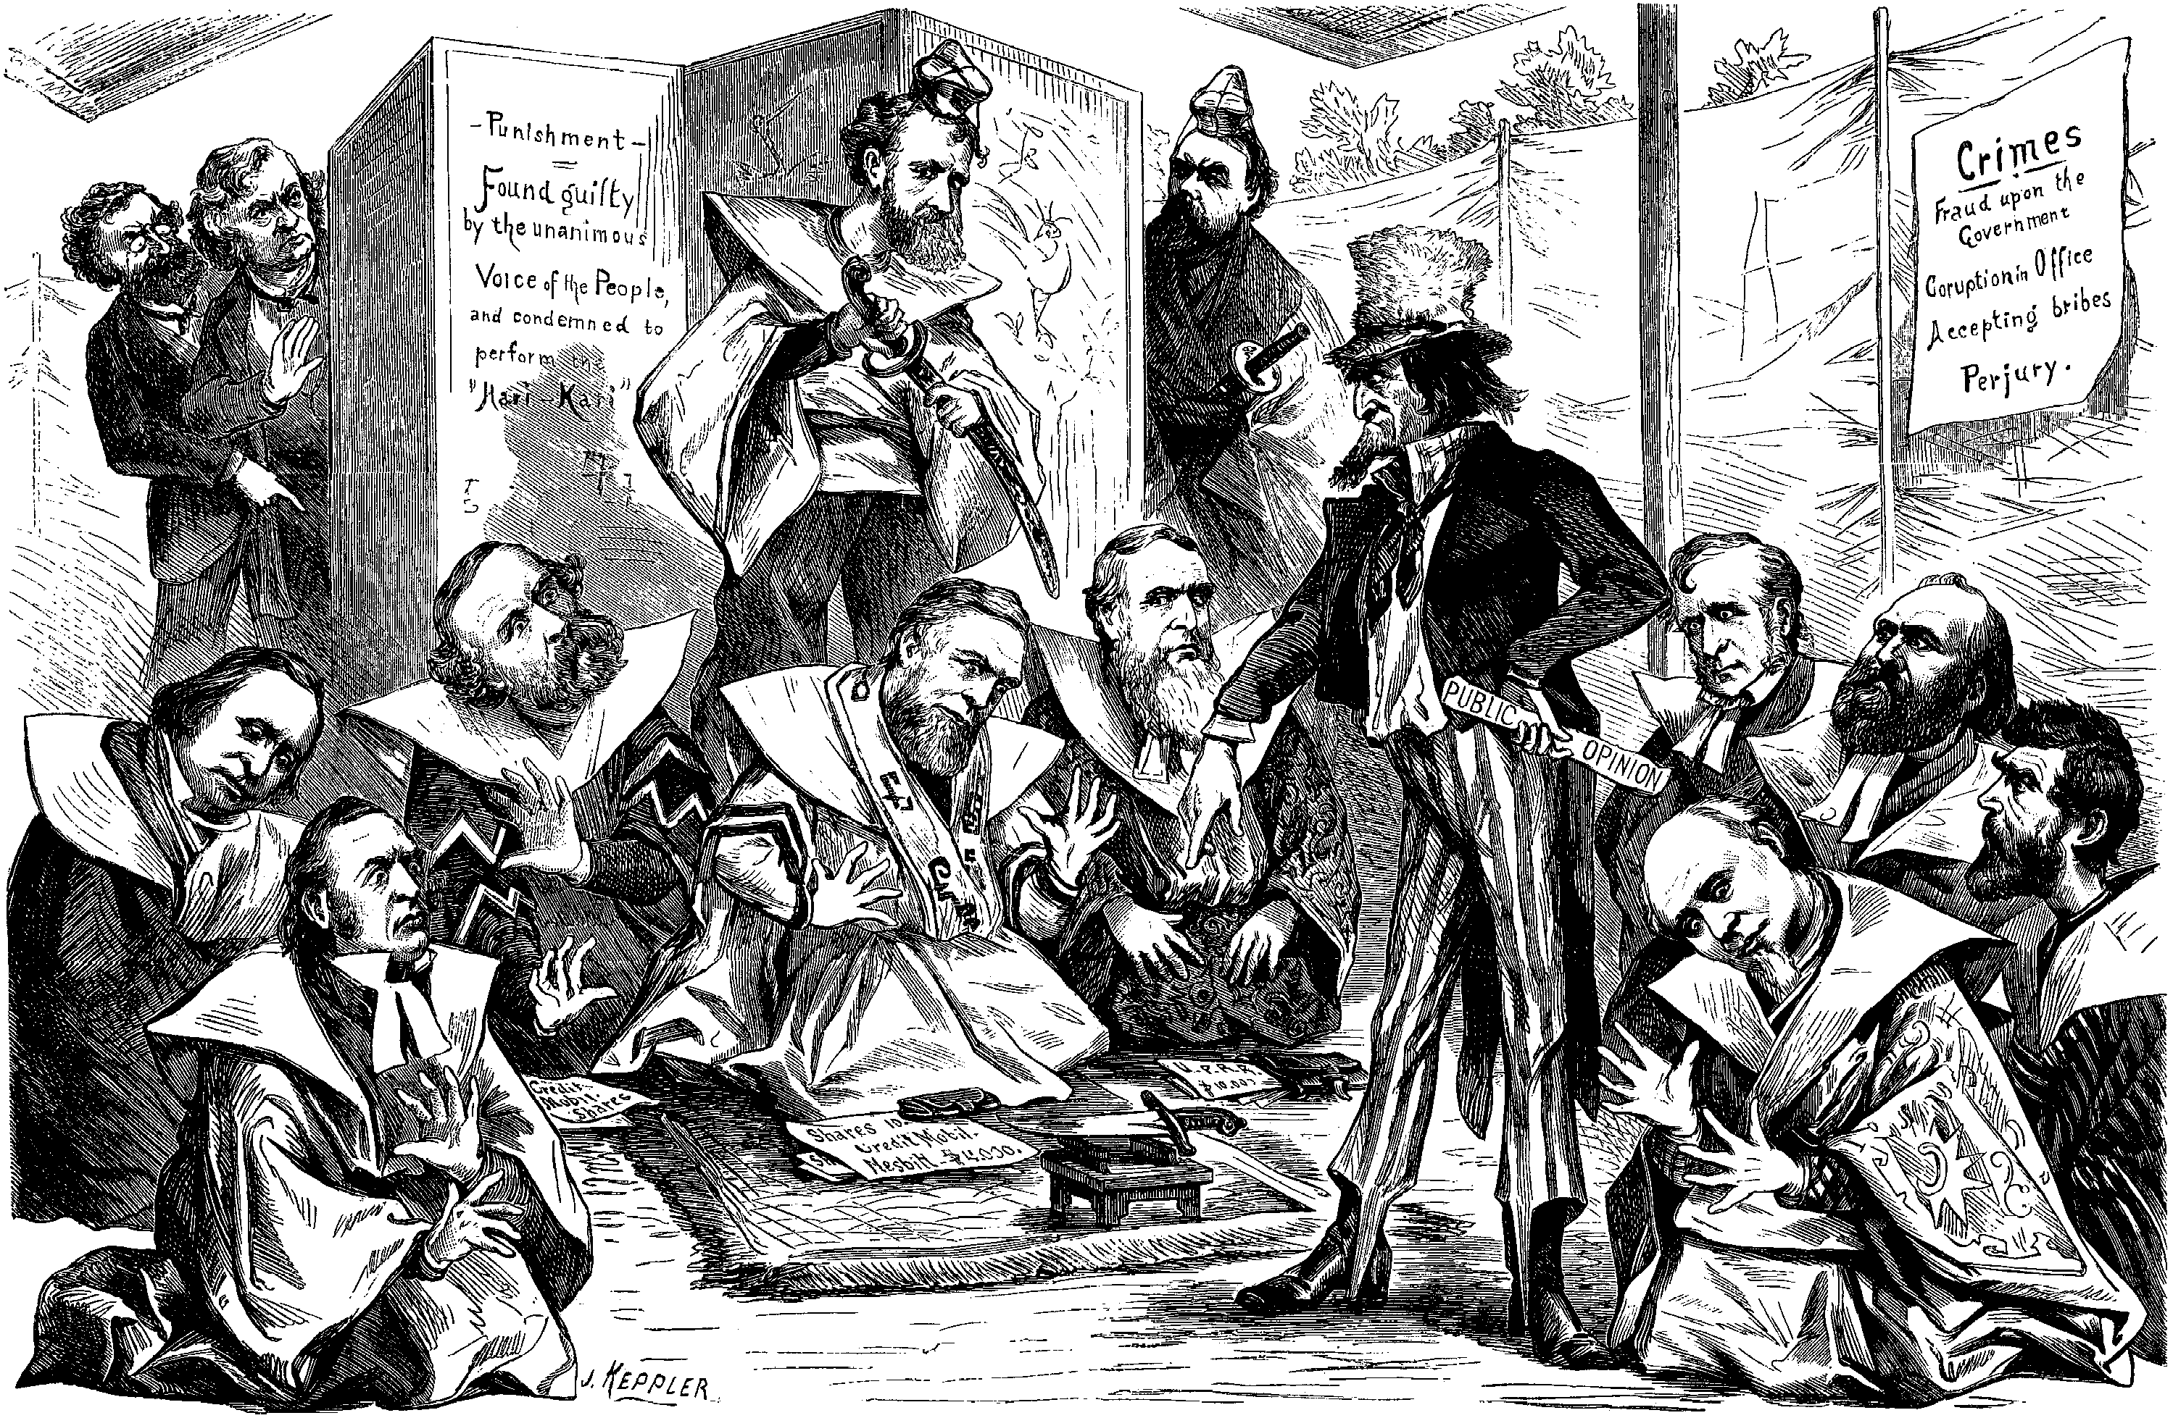
Grant’s Administration – Corruption Abounds!
Elected due to his role in the war – “waving the bloody shirt” campaign strategy works!
No political experience – known for his corrupt administrations (his friends mostly).
Credit Mobilier Scandal (Railroad company made large profits off the government control to build the Union Pacific Railroad.
Whiskey Ring – Officials accepted bribes from Whiskey producers to avoid paying taxes.
Re-elected in 1872 - scandal continued throughout his second term.
Grant won’t run for a third term in the election of 1876.

Slide 5
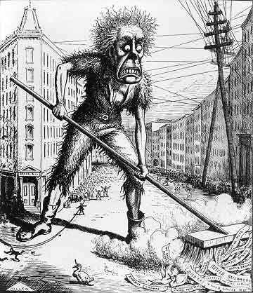
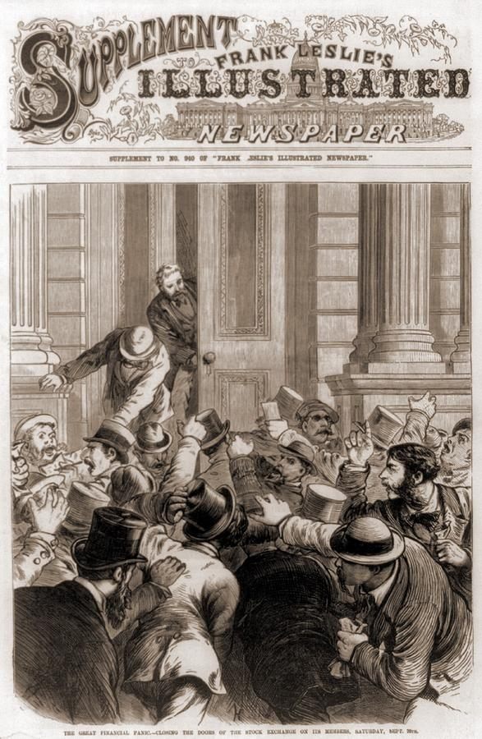
Economic Instability
Economy is growing! - investors poured money into business opportunities. (Many took on more debt than they should have).
Panic of 1873 – banker invested too much in Railroads and went under, causing other banks and railroads to go under too.
Main economic dispute: greenbacks (paper money with low value) vs. currency backed by specie (gold).
1875 – congress decides to use specie to back the money – hurts the little guy and helps the rich.

Slide 6
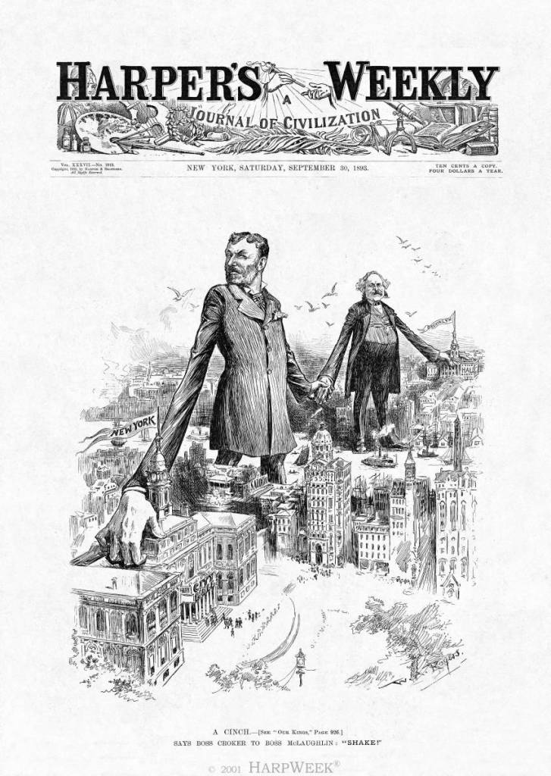
Political Machines
Cities are growing fast! - organized groups began to control the politics of cities. – such as Political Machines.
Offered services to business and people in exchange for political or financial support.
Controlled political party activities in a city – pyramid: city boss, ward boss, and captains.
City bosses influenced all aspects of society to help gain support of the poor.
Captains were 1-2 generation immigrants – spoke their language and helped them start off in exchange for votes.
Used Graft (use political power for personal gain) when votes weren’t enough (kickbacks).
These groups worked to achieve electoral victory.
City Boss: One per city
Ward Boss: One per ward/
city district
Captains: Several per ward

Slide 7
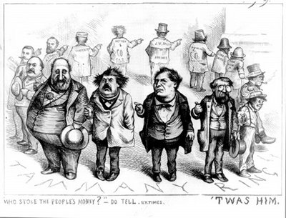
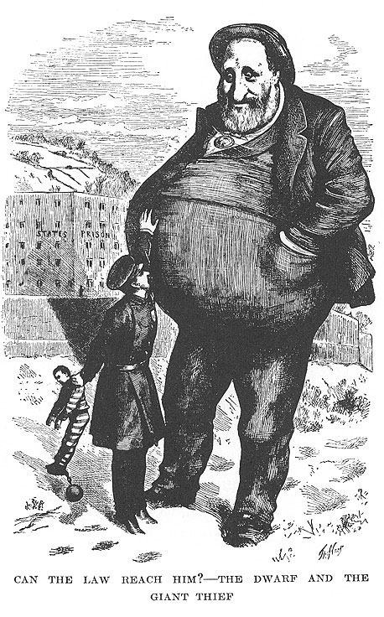
Political Machines – Boss Tweed
William M Tweed (Boss Tweed) - head of a Tammany Hall (political machine that controlled New York City. From 1868 to 1871), he and the
“Tweed Ring” (corrupt politicians) - defrauded the taxpayers of NYC.
One scheme, construction of the New York City Courthouse, cost taxpayers $13 million, while the actual construction cost $3million. The rest went to Boss Tweed and the Tweed Ring.
Thomas Nast (political cartoonist) – aroused public outrage against Boss Tweed and Tammany Hall.
Tweed was arrested and sentenced to jail in 1871

Slide 8
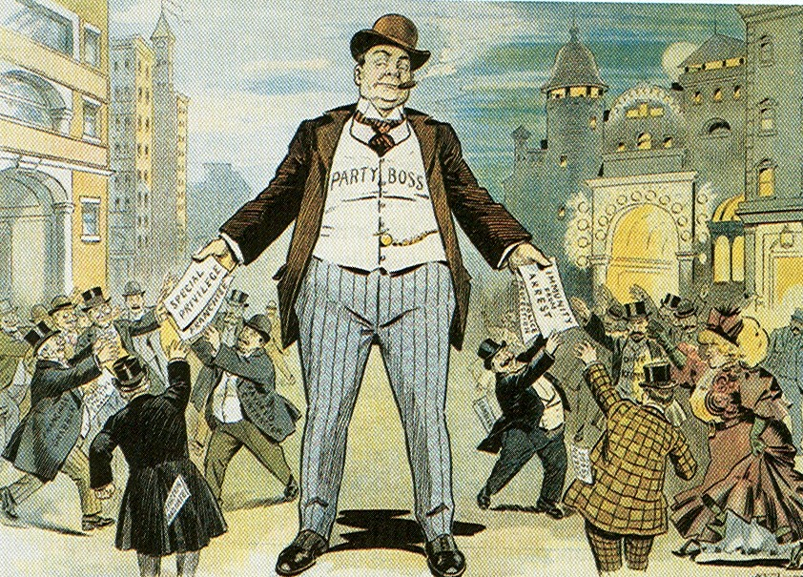
The Gilded Age – Patronage vs. Merit
Patronage - the giving of gov’t jobs to friends or supporters of gov’t officials.
Common practice through most of the 1800’s - Under Andrew Jackson…remember the Spoils System?
Supported by Political Machines!
vs.
Many officials wanted to remove patronage – use a merit system - hiring for jobs in civil service (government admin).
Supported by Rutherford B Hayes and James Garfield.

Slide 9
Disenfranchisement of the African Americans
Voting:
Poll taxes – annual voting tax (if you were poor, you couldn’t pay to vote)
literacy tests – reading test in order to vote (more difficult for Afams as they are not provided good education)
Grandfather clause – if your grandfather can vote=you vote (made sure former slaves ancestors couldn’t vote)
Separation:
Plessy v. Ferguson – ruled that Black and White populations could be “separate but equal” – legalized racial segregation for almost 60 years.
Violence:
Lynching's (with no punishment) were very common!

Slide 10
Gilded Age Presidents
Grant: covered him
Rutherford B. Hayes: Ineffective. Wanted patronage reform but his own election was corrupt
James Garfield: Wanted reform for the Civil Service-so he got shot.
Chester Arthur: Supported the Pendleton Civil Service Act of 1883 (merit system for all gov. civil service jobs)
SUPER UNINTENDED CONSEQUENCE: drove politicians and businesses together (money/influence)
Leads to a new era where politics are controlled by business

Slide 11
Gilded Age Presidents Cont’d
Grover Cleveland round 1: First Democrat to be president since James Buchanan.
Laissez-faire capitalism: no government invovlement in the economy.
Against public bills and army pensions due to abuse post-Civil War
Supported lower tariffs
Benjamin Harrison: Billion dollar Congress
Sherman Silver Purchase Act
McKinley Tariff Bill of 1890: Highest tariff since the war. Hurts Western Farmers and Southerners
Leads to hostility
Grover Cleveland round 2: Panic of 1893. Thanks to loss of value of dollar. JP Morgan bails out the government. Angers Westerners who view as government ‘selling out’ to Wall Street.

Slide 12
Gilded Age Politics
The American Presidents who resided in the White House from the end of the Civil War until the 1890s are sometimes called "the forgettable Presidents.”
Congress strong, but tied to corporate interests.
Local politics (state, city, county) stronger, but controlled by political machines.

Slide 13
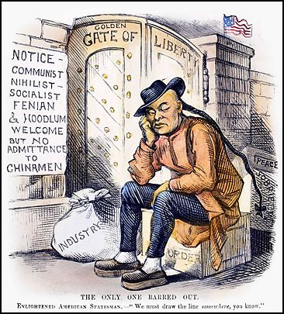
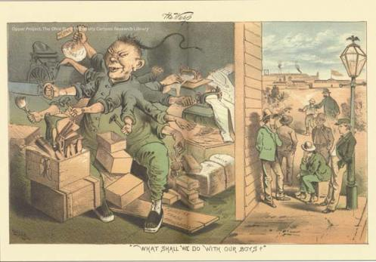
Western Discrimination
Western population continues to grow – RR’s, military presence to create order, Asian immigration, etc.
As Chinese communities grew larger - anti-Chinese sentiment all along the Pacific Coast.
1882 - Congress passed the Chinese Exclusion Act (banned immigration from China for 10 years).
Renewed in 1892 - made permanent in 1902.
Schools were segregated – the Chinese were treated worse than most every other immigrant population!
Despite massive campaigns, protests, and - better treatment were ignored.

Slide 14
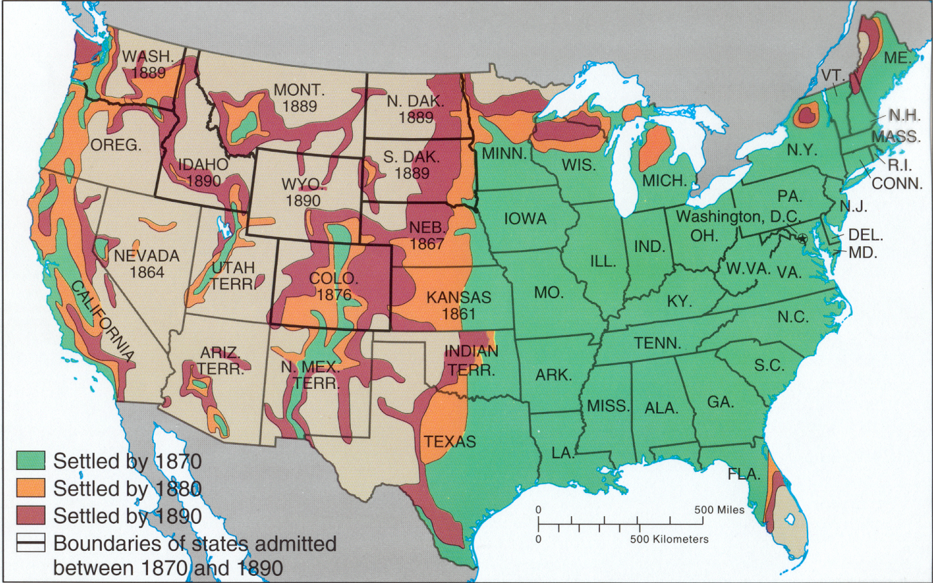
The Great West
“The existence of an area of free land, its continuous recession, and the advance of American settlement westward explain American development." - Frederick Jackson Turner
Settlement impact American Indians
The importance of Buffalo
Conflict!
Western Frontiersmen (and women)
Mining, Ranching, Farming
Homesteaders
Populism
The Grange through 1896 Election

Slide 15
Why Move West???
The Transcontinental Railroad – easier to move west
Army/Gov’t – stop NA conflicts and gain land
Cattle industry – send meat to the east
Exodusters, Sodbusters, and Homesteaders – settlers to the prairie drawn by free land!
The Gold Rush – attracted settlers to the west
Had a very negative impact on American Indians and created conflict between settler groups!
Native Americans
Buffalo Hunters Railroads U. S. Government
Cattlemen
Sheep Herders
Ranchers
Farmers

Slide 16
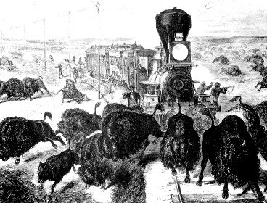
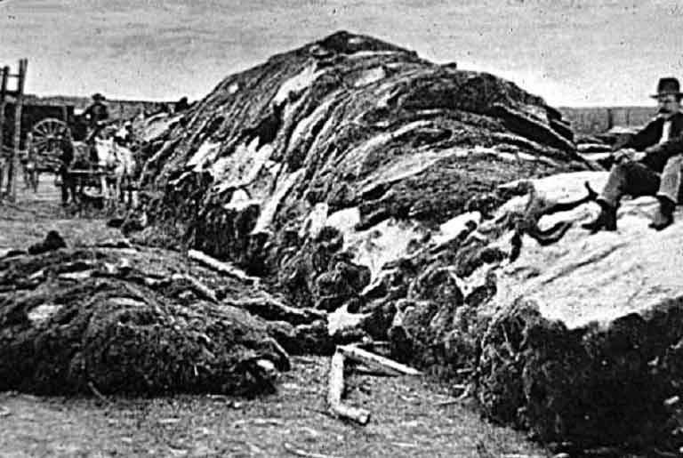
Western Settlement Impacts American Indians
Primary Tribes – Sioux and Cheyenne live with the use of horses and buffalo for survival.
Nomadic living - Buffalo provided food, shelter, and tools – their lifeline!
No sense of land ownership – would follow buffalo into “unsettled American territory”.
Government supported fur traders and hunters of Buffalo – by 1900 only one herd of buffalo survived.
The Plains Indians inability to unite against white expansion - serious weakness!

Slide 17
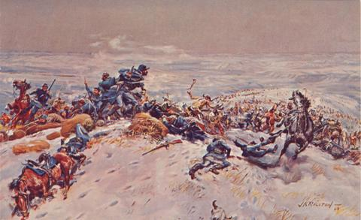
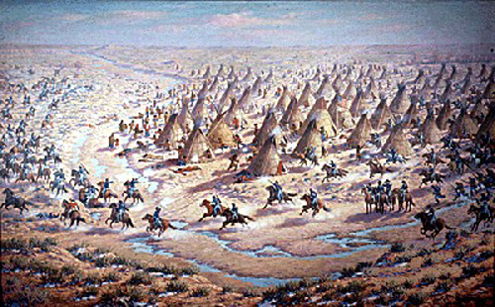
Indian/Settler Conflict
Massacre at Sand Creek – Cheyenne tribe went to Sand Creek reserve for the winter peacefully – Col. Chivington attacked and killed 150, mostly women and children.
Treaty of Fort Laramie – temporary peace, but Sioux were forced to live along the Missouri River – not signed by leader Sitting Bull.
1876 - Sitting Bull and Crazy Horse attacked Gen. George Custer and wiped out his Calvary – known as Custer’s Last Stand and the Battle of Little Big Horn.
Starving Sioux performed a Ghost Dance to bring back their fortune – soldiers see this as a threat and take them to Wounded Knee, SD and killed 300 unarmed Indians.
Sioux eventually lost and fled to Canada – Sitting Bull surrendered in 1881 to save his ppl.
Chief Joseph’s famous quote “I will fight no more forever” and marked the end of conflicts among settlers and NA’s.

Slide 18
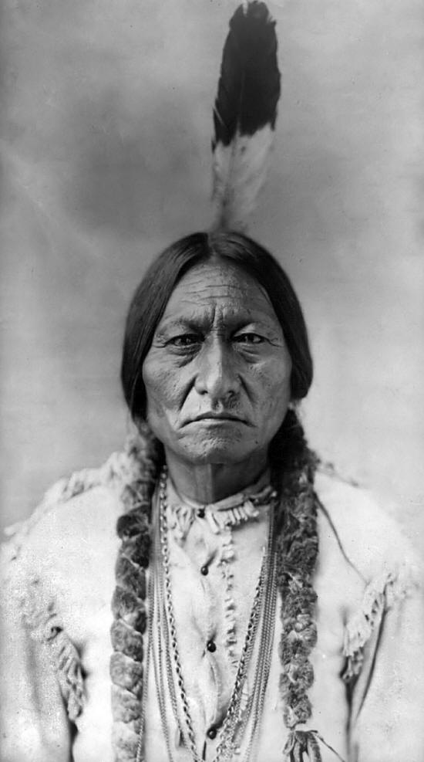
The West-Settlement of
the Last Frontier
Removal of Native Americans
Reservationist Policy
President Andrew Jackson Removed Eastern Native Americans to Lands West of the Mississippi
Broken as Transcontinental Railroad was Planned, Wagons increased, and Reservations were Increasingly Assigned
Plains Tribes Refused to Cooperate
Indian Wars
Increased Migration of Miners, Cattlemen, and Homesteaders
Fighting Broke Out Between Indians and U.S. Troops
Sioux Wars
Sand Creek, CO
Little Big Horn
Treaties Made and Broken
Most of Buffalo Slaughtered

Slide 19
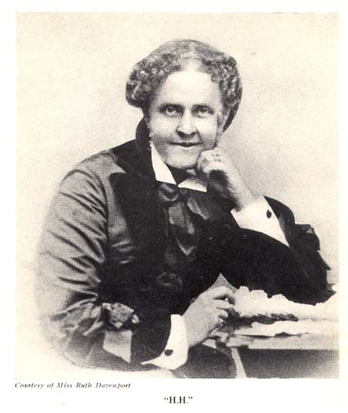
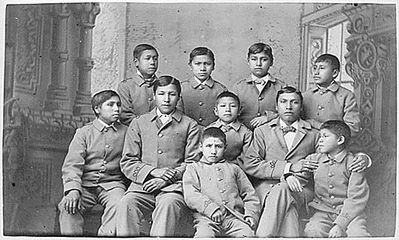
American Indian Restrictions
Official “reservization” of American Indians!
Some people thought NA killings were wrong – Helen Hunt Jackson wrote A Century of Dishonor to expose Indian treatment.
Some thought Am. Indians should assimilate (Americanize).
Passed the Dawes Act (160 acres to each NA family to promote land ownership ideals).
Sent to schools to learn white culture.
Reservations were eventually taken without pay to NA’s.

Slide 20
The Homesteader
Migration to the west skyrocketed after the Civil War. – mostly native settlers but some German and Irish immigrants.
The Homestead Act (1862) = 160 acres if you live on the land for 5 years
Other land opportunities: Oklahoma Land Rush – sooner state!
In theory…good! – but little rain and no trees = very hard life!
Most new at farming…often picked one crop (called Bonanza farms) - tied to the crop the same way southerners were tied to cotton.
Reliant upon good growing conditions and high prices…which collapsed in the 1880’s and 1890’s.
Settled so fast…the frontier ended (essay by Fredrick Jackson Turner).
Happened a good time…cities in the east are crowded!
Settlers’ conditions – very hard (esp. for women), lived in Soddy Homes (sod created houses - sodbusters).
Who is coming for this land?…Mostly immigrants who want access to free land and freed slaves (known as Exodusters).

Slide 21
Exodusters in the West

Slide 22
Changes in Agriculture
Increasingly commercialized and specialized
Falling Prices
Increased production + global competition
Static money supply
Debt and foreclosure
Rising Costs
Farmers victimized
Corporations and monopolistic trusts
Unfair taxes
Railroad monopolies

Slide 23
Rising costs
Monopolistic corporations kept prices high
Middlemen took profit before selling to farmers
Railroads, warehouses, and elevators charges high rates for transportation and storage
Heavy taxes on property and land, but did not tax income from stocks and bonds
Unfair tariffs

Slide 24
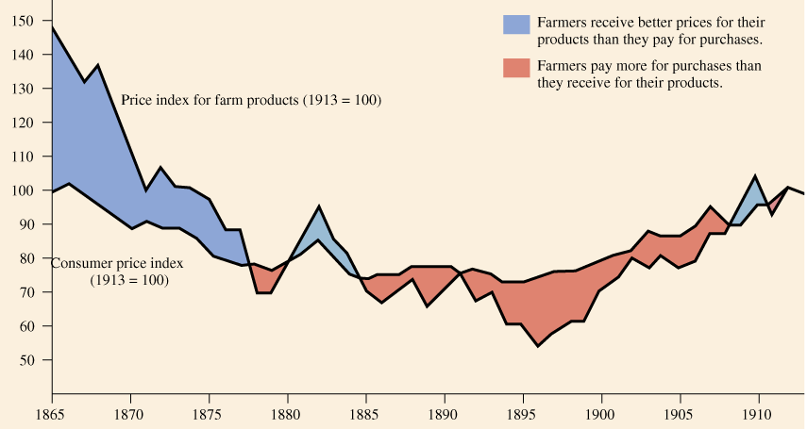
Price Indexes for Consumer & Farm Products: 1865-1913

Slide 25
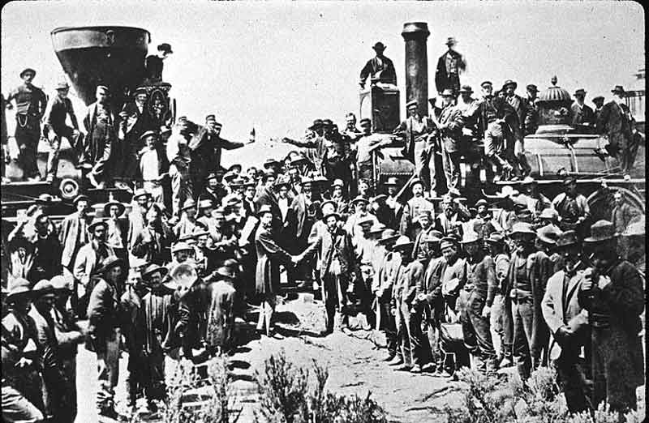
The Grange
Farmer in DEBT! - had to pay for equipment such as John Deere’s steel plow and McCormick’s Mechanical Reaper –
created Bonanza Farms (big one-crop farm) – folded when their one crop price dropped and under high RR prices.
Deflated prices hurt farmers - having to repay at unfair rates for their land.
As crop prices fell, they had to sell more of that crop to make the same amount of money.
Greenbacks - little value (not = to hard money) and were eliminated (ppl had to pay back more than they borrowed).
Farmers made up over 50% the population, but they were unorganized.
Oliver Hudson Kelley – started a reform group called the Grange to call for Farmer reform (at first was a social outlet org).
Led to other orgs like the Farmers Alliance – grew to 4m members. (other groups were also the Southern Alliance and Colored Farmers Alliance).

Slide 26
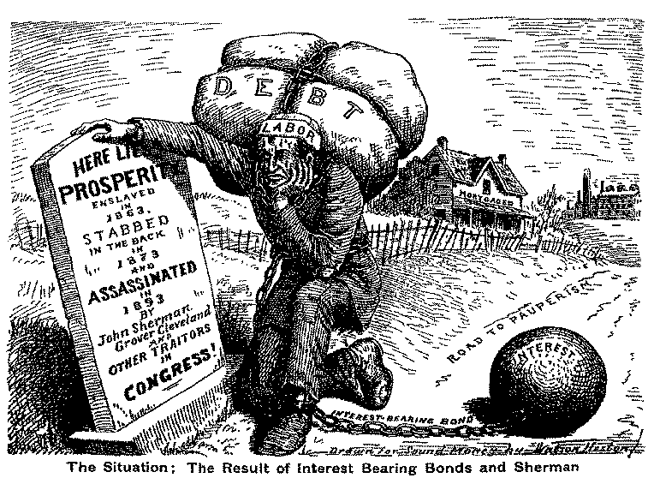

Slide 27
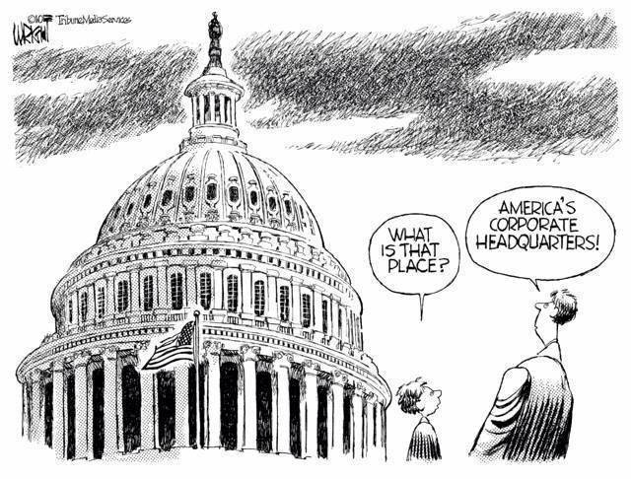
Synthesis?

Slide 28
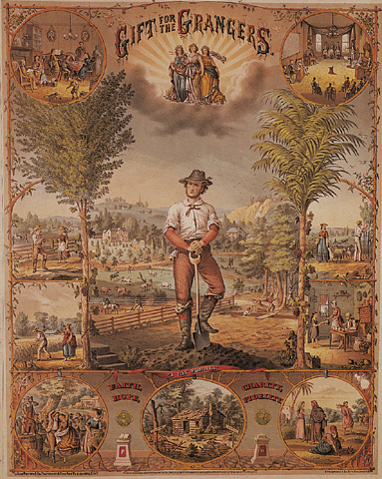
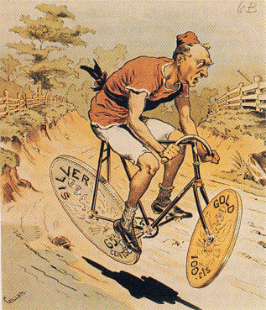
Populism is Born!
Leaders of the Alliances movements created the Populist political movement.
Omaha Platform – increase in money supply, graduated income tax, federal loan program, direct election of senators, single term presidencies, secret ballot voting.
Political strife happened over the Panic of 1893 (3M lost jobs) and divided the nation into two groups:
Gold Bugs or the Gold Standard – only use gold to hold paper money against.
Helped the business class and rich b/c they have all the gold!
Silverites and Bimetallism – Use gold and silver to hold paper money against.
Helped the farmers and working class.

Slide 29
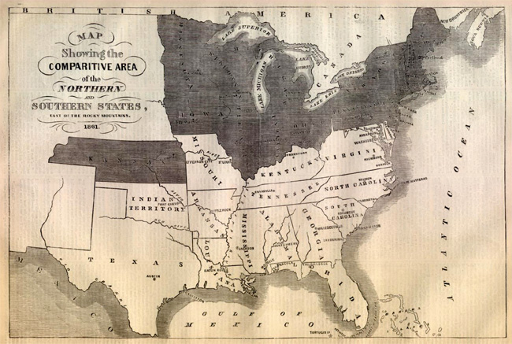
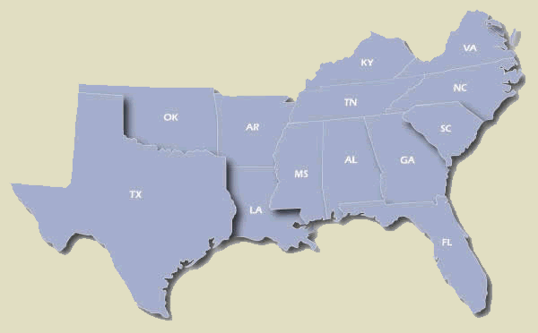
The New South
South was continuing to recover from the devastating Civil War
Some had the vision of a self-sufficient Southern economy
Henry Grady, a newspaper writer began to write articles for economic diversity, and laissez-faire capitalism

Slide 30
The New South: Economic Progress
Economic improvement
Birmingham, Alabama: Steel
Memphis, Tennessee: Lumber
Richmond, Virginia: Tobacco
Railroads
Tremendous postwar growth from1865-1900 in terms of population, industry, and railroads

Slide 31
The New South: Continued Poverty
BUT…still primarily agricultural
Controlled by the North economically
2 chief factors not related to northern capitalists
South’s late start at industrialization
Poorly educated workforce

Slide 32
The New South: Agriculture
Between 1870 and 1900 – acres planted in cotton more than doubled
BUT…increase in cotton supply means decease in cotton prices
By 1900, ½ of white farmers + ¾ of black famers become tenants/sharecroppers
Tied to debt
Formation of the Farmers Southern Alliance

Slide 33
The New South: Segregation
End of reconstruction = end of protection for freedman
Discrimination and the Supreme Court
Civil Rights Cases of 1883
Congress could not legislate against the racial discrimination practiced by private citizens
Plessy v. Ferguson
“separate but equal accommodations”

Slide 34
Responding to Segregation: Booker T. Washington

Slide 35
Responding to Segregation: W.E. Du Bois

