Slide 1
Do Now
IDENTIFY: Jefferson’s ideology on the role of government prior to becoming President.
COMPARE: Jefferson’s ideology on the role of government with that of Alexander Hamilton

Slide 2
Jeffersonian Democracy and Constitutional Interpretation
APUSH
Period 4
Mr. Winchell

Slide 3
AP Prompt
With respect to the federal Constitution, the Jeffersonian Republicans are usually characterized as strict constructionists who were opposed to the broad constructionism of the Federalists. Evaluate the extent to which this characterization of the two parties accurate during the presidency of Jefferson?

Slide 4
Key Concepts
4.1: The US began to develop a modern democracy and celebrated a new national culture, while Americans sought to define the nation’s democratic ideals and change their society and institutions to match them.

Slide 5
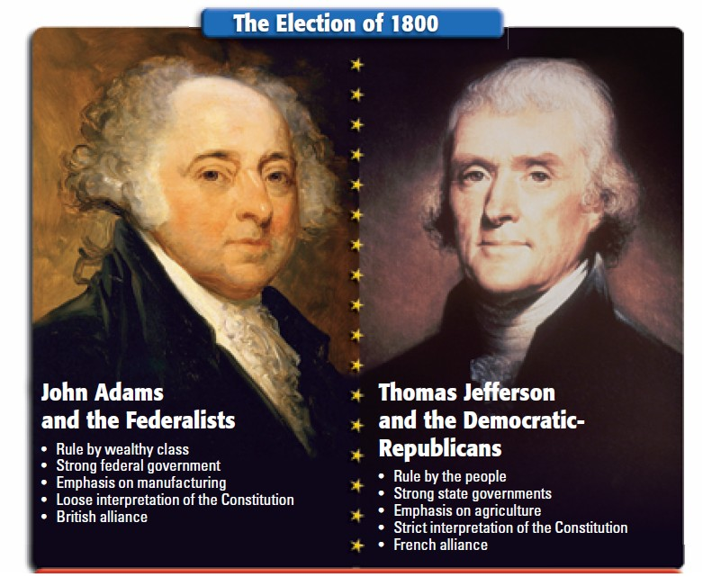
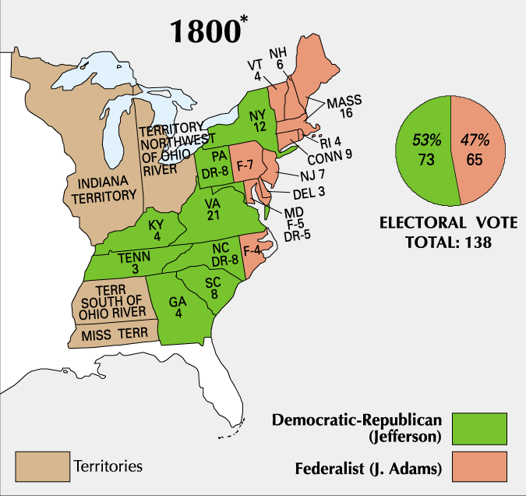
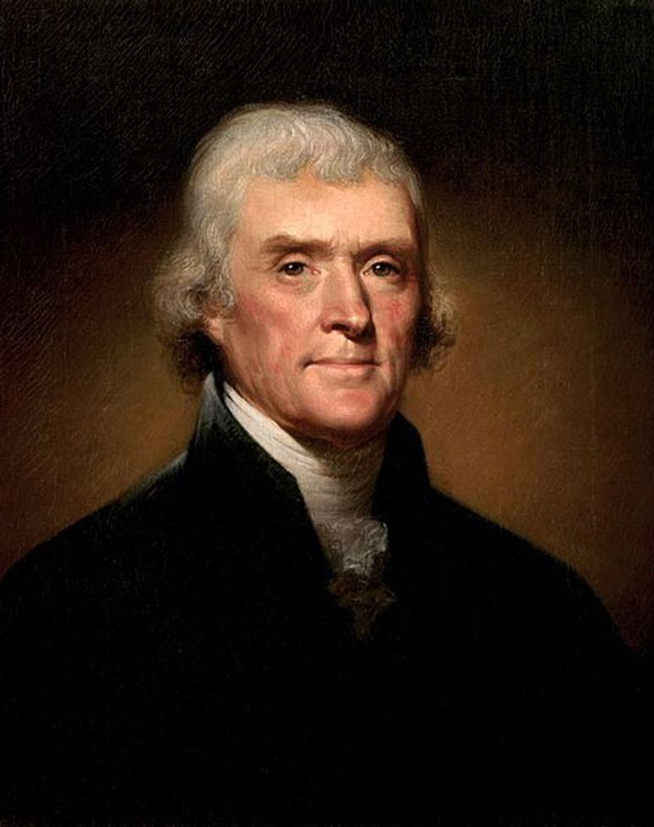
The election of 1800 was a turning point in U.S. history
This “Revolution of 1800” marked the first time in U.S. history when one political party transferred power to another
“We are all Republicans. We are all Federalists.”
Jefferson’s inaugural, 1801

Slide 6
12th Amendment (1804)
In response to Election of 1800
Electors must vote for one presidential candidate AND one vice president
Ensures that president and vice president will be from the SAME political party

Slide 7
“Revolution of 1800”
Significance
Jefferson called it a “Revolution”
A return to the “Spirit of 76” and true republican government
Revolutionary in that it was a peaceful transition of power from one party to the next
John Adams is the last Federalist president

Slide 8
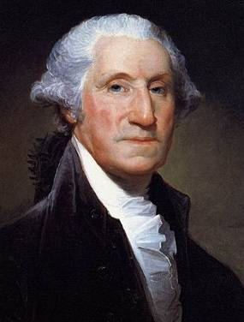
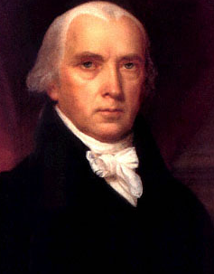
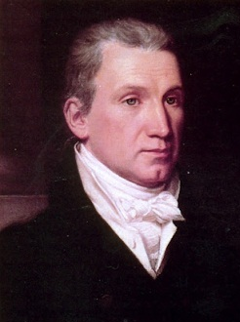
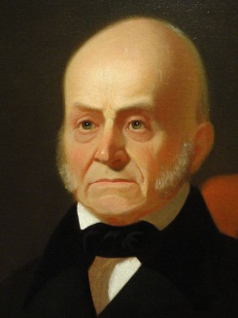
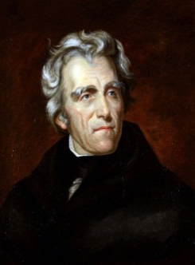
Jefferson’s presidency marked the start of nearly 30 years of dominance by the Democratic-Republicans
8 yrs
George Washington
(1789-1797)
4 yrs
John Adams
(1797-1801)
8 yrs
Thomas Jefferson
(1801-1809)
8 yrs
James
Madison
(1809-1817)
8 yrs
James Monroe
(1817-1825)
4 yrs
John Quincy Adams
(1825-1829)
8 yrs
Andrew Jackson
(1829-1837)
Federalist Party
Democratic-Republican Party
Democratic Party

Slide 9
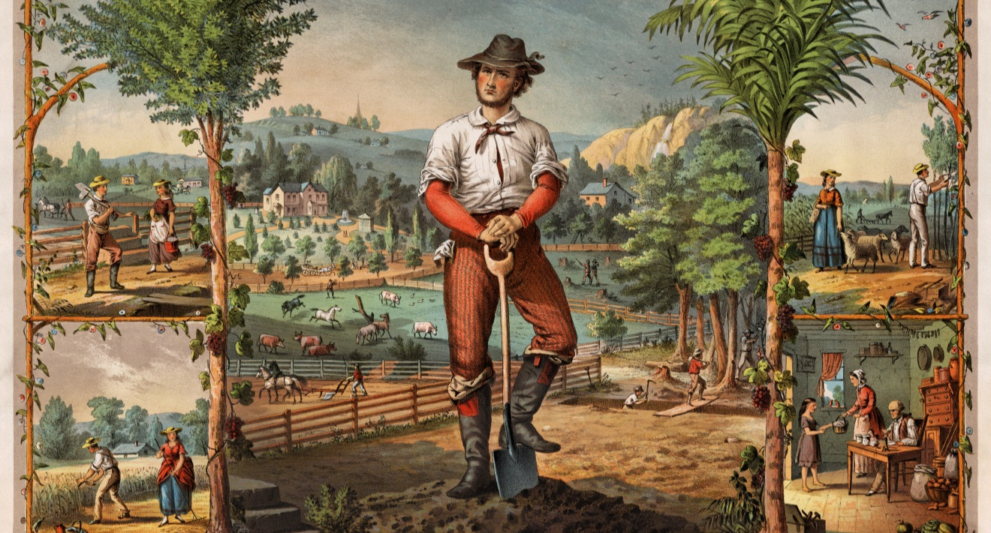
If this image captures Jefferson’s vision of an ideal America, what was his vision? What role did Jefferson want the government to play in this ideal America?

Slide 10
What is Jeffersonianism?
Republicanism and Civic Virtue
Civic duty
Voting and efficacy
Right to education
Natural Elites
Resist corruption
Federalism and States’ Rights
Ultimate sovereignty in the states and nullification
Strict constitutionalist
Dominant legislature, weak judiciary
Economic coercion over standing armies
Yeoman Farmers as Ideal Citizens
Educated landowners exemplified independence and virtue
Agriculture Over Manufacture/Industry
Responsibility of subsistence
Dependence led to class conflict
Empire of Liberty and Foreign Policy
America’s responsibility to spread democracy
Avoid entangling alliances
Society
Republican motherhood; absent from politics
Natives capable, just need to catch up (noble savages)
Black inferiority and white superiority
Separation of Church and State

Slide 11
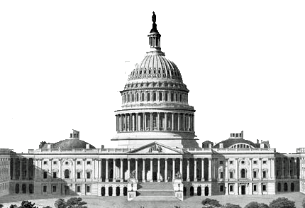
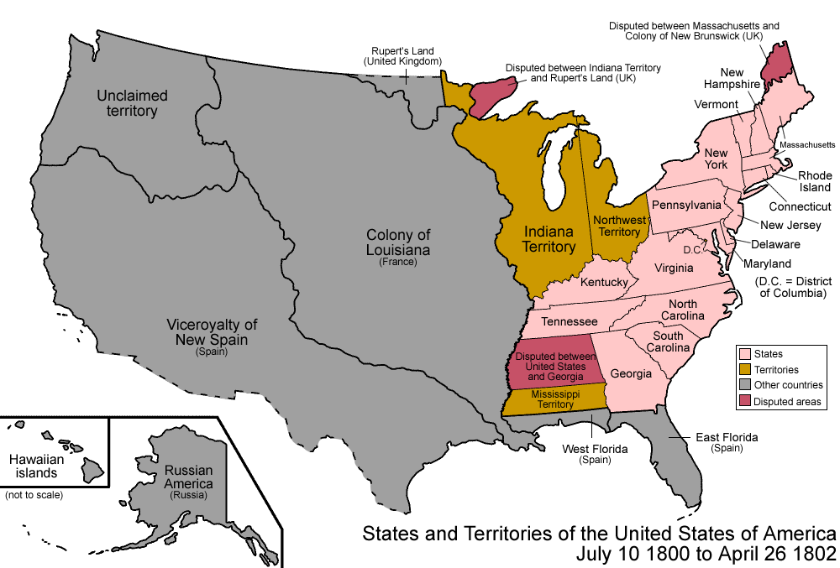
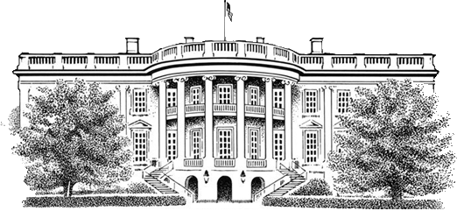
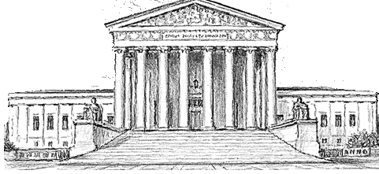
Jefferson wanted to reverse Federalist policies by reducing the size and cost of the national government
Jefferson believed the government had grown too large and powerful
Reduce the national government
He cut the size of the army
He eliminated taxes on whiskey, slaves, and property
He allowed the charter of the Bank of the U.S. to expire
Focused on paying down the federal government’s debt
Restore power to state gov’ts

Slide 12
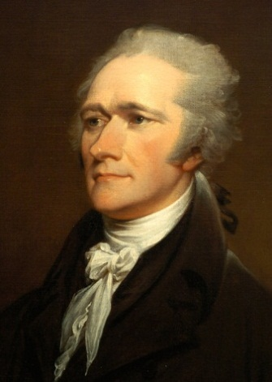
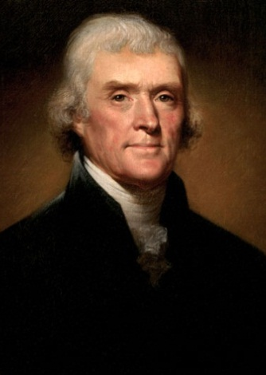
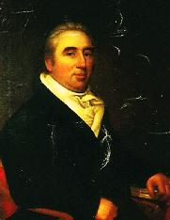
But, the Federalists did not want to see their policies destroyed by Jefferson and the Democratic-Republicans
In the months before leaving office, President Adams appointed numerous Federalists to become judges in federal courts
(the “Midnight Judges”)
Jefferson opposed these appointments and ordered his Secretary of State James Madison to deny some of these judge appointments
Hamilton
Jefferson
Marbury
One of these potential judges was William Marbury who sued Madison when he was deprived his position
Marbury v Madison (1803) was one of the most important Supreme Court cases in U.S. history
Adams
Madison

Slide 13
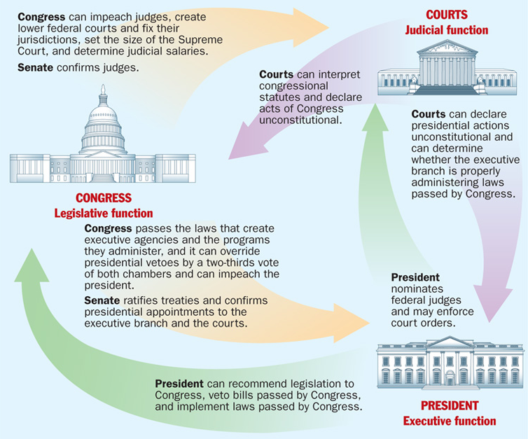
The Supreme Court ruled that President Jefferson’s decision to deny Marbury his judicial appointment did not violate the Judiciary Act or the Constitution
The Marbury v. Madison case established the principle of judicial review giving the Supreme Court the power to declare acts of Congress unconstitutional
Marbury: Congress created the Judiciary Act to create lower courts with judges!!
Jefferson and Madison: Yes, but the president can appoint (not deny) whoever he wants!!

Slide 14
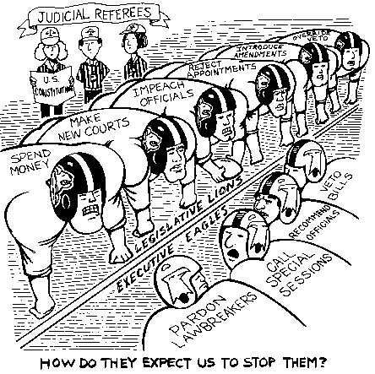

Slide 15
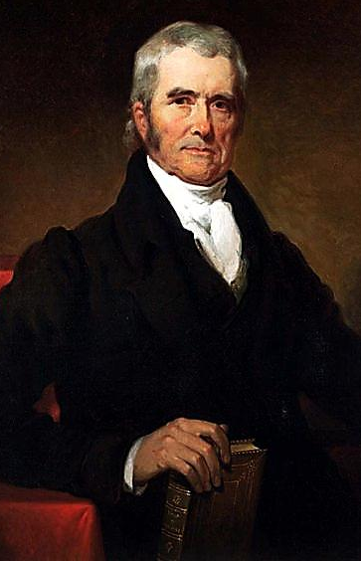
Chief Justice John Marshall served as Chief Justice of the Supreme Court from 1801 to 1835
Over three decades, Marshall’s ruling helped strengthen the power of the national gov’t over the states and protected the rights of citizens
Marbury v. Madison (1803)
McCulloch v. Maryland (1819)
Dartmouth College v. Woodward (1819)
Cohens v. Virginia (1821)
Gibbons v. Ogden (1824)
Cherokee Nation v. Georgia (1831)

Slide 16
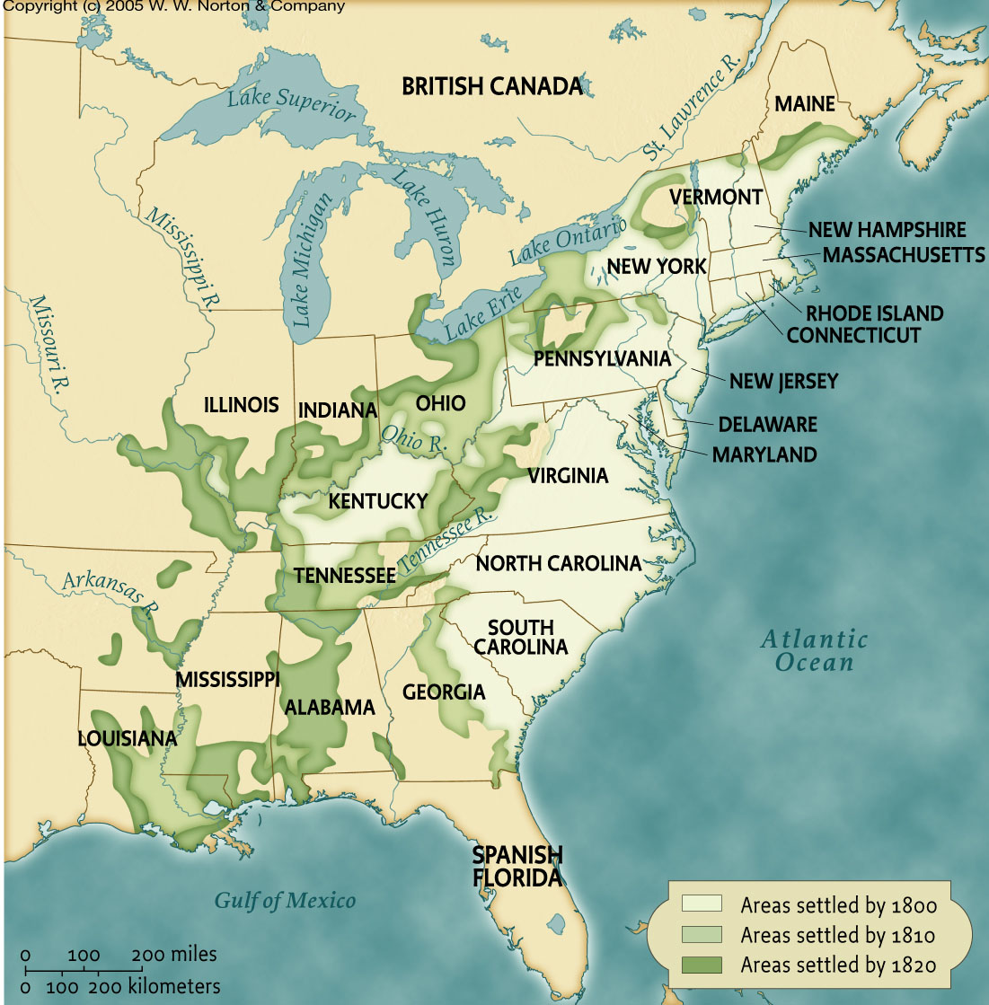
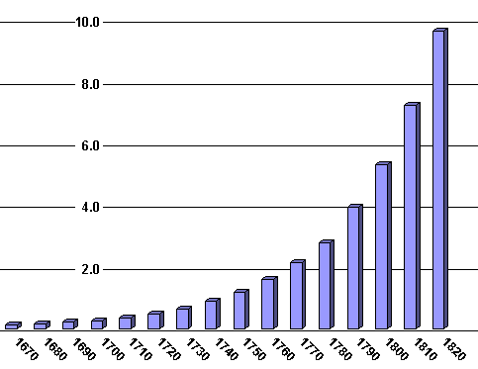
During Jefferson’s presidency, the U.S. population was growing and people were moving West
Jefferson was worried about French control of New Orleans and the Mississippi River
Ohio was added in 1803
From 1800 to 1810, the U.S. grew by two million people
Kentucky became a state in 1792
Tennessee was added in 1796

Slide 17
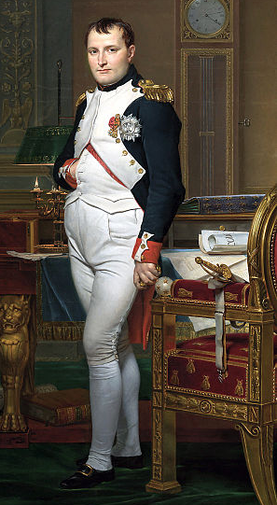
Jefferson sent a delegation to France to negotiate the purchase of New Orleans
Napoleon wanted to sell all French territories in America to fund his war

Slide 18
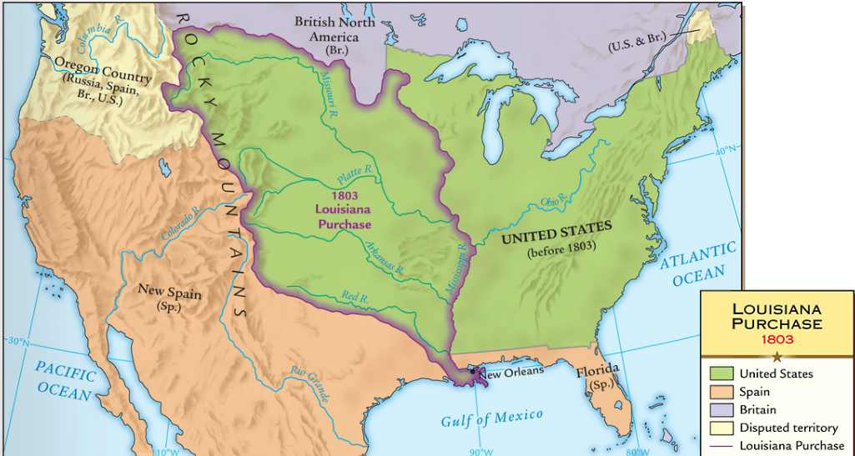
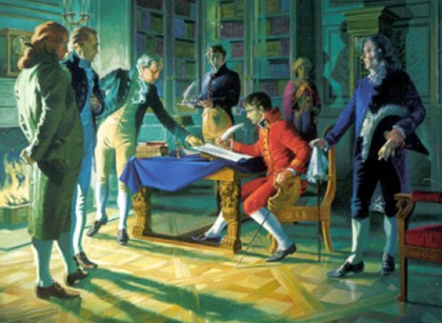
In 1803, Congress approved the purchase of Louisiana from the French for $15 million
The Louisiana Purchase doubled the size of the USA

Slide 19
Americans were excited about gaining new western lands, but the Louisiana Purchase presented problems
Was the purchase constitutional? Despite his belief in strict interpretation, Jefferson used the elastic clause to buy it
What about the French and Spaniards in New Orleans? Despite his belief in protecting liberty, Jefferson did not grant foreigners citizenship

Slide 20
Federalist Opposition
Used “strict construction” - president did not have power to purchase Louisiana.
Why? It would cost too much and cause the U.S. debt to soar. IRONY!!!
Real reason: worried that new western lands would be loyal to the Republicans.

Slide 21
The Louisiana Purchase Should Be Approved; The Louisiana Purchase Should Be Opposed
Jefferson argues FOR the Louisiana Purchase
White & Griswold argue AGAINST the Louisiana Purchase

Slide 22
Native American Resistance
The Louisiana Purchase increased tensions with Indians:
Americans rejected coexistence with Indians
Tecumseh swayed the Shawnee & other tribes to stop selling land & to avoid contact with whites
Jefferson hoped to “civilize” Indians into yeoman farmers & planned for a vast reservation west of the Mississippi River
Notes:
3

Slide 23
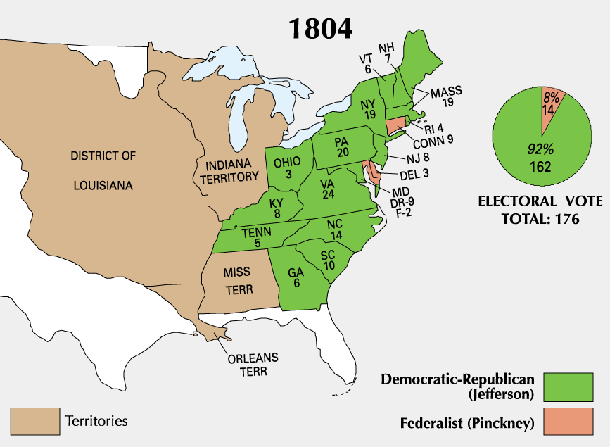
Jefferson was widely popular and easily won the election of 1804
But, Jefferson’s second term was plagued by foreign policy problems

Slide 24
Division in the Republican Party
The decline of the Federalists suspended the two-party system:
Led to Republican dominance in national politics from 1800-1820
But…without a clear party to oppose, many Republicans, began attacking Jefferson
The Tertium Quids (“nothings”), criticized Jefferson’s betrayal of strict construction & sacrifice of virtue to get results as president
The Jeffersonian & Quid factions became separate parties by 1824
Jacksonians became the Democratic Party
National Republicans were absorbed into the Whig Party
The “Virginia Dynasty” (Jefferson, Madison, Monroe) dominated the executive branch
Republicans controlled both houses of Congress
Notes:
15
By 1820, the Federalists were no longer acting as a national party; there was little to hold the Democratic-Republican Party together. William H. Crawford in 1824 was the last nominee by the Congressional nominating caucus; but the majority of the party boycotted the caucus. Henry Clay finished fourth in the election that year, behind John Quincy Adams, Andrew Jackson, and William Crawford. Their factions became separate parties after the election, of which the Jacksonians became the basis of the present Democratic Party; the National Republicans were absorbed into the Whig coalition which faded out before the American Civil War.
The tertium quids (sometimes shortened to quids) refers to different factions of the United States Democratic-Republican Party during the period 1804-1812. In Latin, the term means "a third something". Quid was a disparaging term that referred to cross-party coalitions of Federalists and moderate Democratic-Republicans. When Virginia Congressman John Randolph of Roanoke broke with Jefferson and James Madison in 1806, his Congressional faction was called "quids." Randolph was the leader of the "Old Republican" faction that insisted on strict adherence to the Constitution and opposed any innovations. He made no effort to align with either quid faction in the states and made no effort to build a third party at the federal level. Randolph supported James Monroe against Madison during the runup to the presidential election of 1808, but the state quids supported Madison. They were led by Randolph, who had started as Jefferson's leader in the House and became his bitterest enemy. Randolph denounced the Yazoo Purchase compromise of 1804 as totally corrupt. After Randolph failed in the impeachment of a Supreme Court justice in 1805, he became embittered with Jefferson and Madison, complaining, "Everything and everybody seem to be jumbled out of place, except a few men who are steeped in supine indifference, whilst meddling fools and designing knaves are governing the country. . . ." [Risjord 42]. He refused to help fund Jefferson's secret purchase of Florida from Spain. Increasingly, Randolph felt that Jefferson was adopting Federalist policies and betraying the true party spirit. He wrote to an ally that "the Administration....favors federal principles, and, with the exception of a few great rival characters, federal men.... The old {Democratic-) Republican party is already ruined, past redemption. New men and new maxims are the order of the day." [Risjord 47] Randolph's increasingly strident rhetoric limited his influence, and he was never able to build a coalition to stop Jefferson. However, many of his supporters lived on and, by 1824, looked to Andrew Jackson to resurrect what they called "Old Republicanism."

Slide 25
The Slave Trade
At the Philadelphia Convention, slavery was tabled until 1808
In Dec 1806, Jefferson urged Congress to prepare a slave law:
Southerners furiously argued against any slavery legislation
Congress passed a law that ended the slave trade in 1808, but smugglers were to be turned over to local authorities
Notes:
18

Slide 26
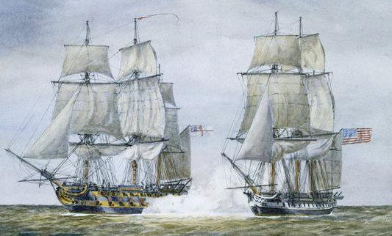
The war between England and France led to more attacks on U.S. trade ships
The British navy impressed more than 1,000 American merchant sailors per year from 1803 to 1807

Slide 27
Embargo Act 1807
Forbade export of all good from the US to any destination!
Proved disastrous to the economy
In 1807 U.S. exports = $108 million ; in 1808 = $22 million
Inadvertently sparked American industrialization!
Why did it fail?

Slide 28
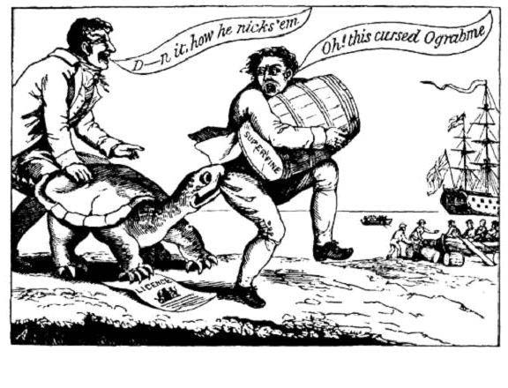
Federalist Opposition

Slide 29
Failure of the Embargo
Federalists gaining political ground because of failed embargo
Repub. dominated Congress repealed the embargo at end of J’s 2nd term
Embargo of 1807 replaced by Non-intercourse Act of 1809
prohibited trade w/ GB or FR until they recognized the maritime rights of neutrals
Commerce w/ all others permitted
Macon’s Bill No. 2 of 1810
Replaced N-A Act – offered trade to either GB or FR if they stopped attacks on US ships
Would continue to embargo other nation

Slide 30
Jefferson’s Legacy
Expansion
Strengthened executive branch through action
Non-aristocratic government created
Total defeat of the Federalists by 1816
Kept US out of war
Best known for Dec. of Independence
Also Virginia Statute of Religious Freedom & founding of U. of VA.
Notes:
How did Jefferson’s legacy differ from that of Adams?

Slide 31
Closure Activity: Jefferson’s Legacy
Jefferson came into office trying to reduce the size and power of the national government.
Did he accomplish his goal? Use your notes and knowledge of Jefferson to complete this chart
 | Jefferson’s ideal? | How Jefferson acted
Interpretation of the Constitution?
Powers of the president?
Size of the army and navy?
Citizenship and rights of the people?
Size of the national government?

