Slide 1
Do Now
Summer Homework Out!
Identify in the columns on your DQs…
Factors that PULLED people TO the Americas/New World
Factors that PUSHED people out of Europe

Slide 2
The Americas and European Exploration & Colonization
Mr. Winchell
APUSH 2018-2019
Period 1-2

Slide 3
AP Prompt
Evaluate the short term effects of European exploration and colonization on the Americas.

Slide 4
Key Concepts
1.1: As native populations migrated and settled across the vast expanse of North America over time, they developed distinct and increasingly complex societies by adapting to and transforming their diverse environments.
1.2: Contact among Europeans, Native Americans, and Africans resulted in the Columbian Exchange and significant social, cultural, and political changes on both sides of the Atlantic Ocean.
2.1.I: Spanish, French, Dutch, and British colonizers had different economic and imperial goals involving land and labor that shaped the social and political development of their colonies as well as their relationships with native populations.

Slide 5
Locations of Major Native American Groups and Culture Areas in the 1600s
Notes:
4
4
4
04/06/98
4

Slide 6
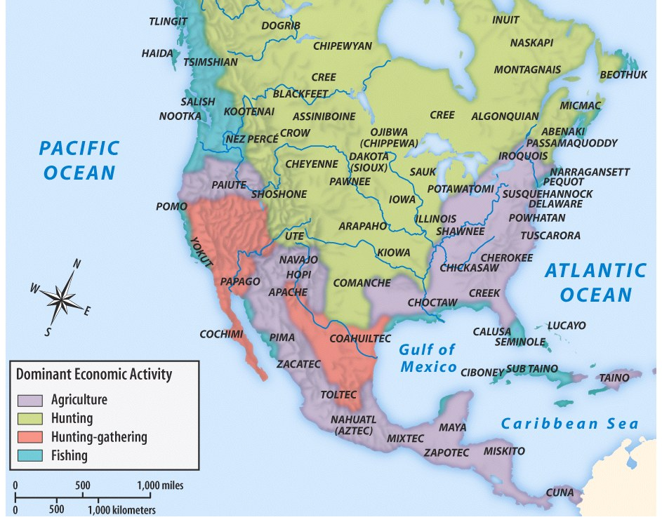

Slide 7
Motives For European Exploration & Colonization
Crusades → by-pass intermediaries to get to Asia.
Renaissance → curiosity about other lands and peoples.
Reformation → refugees & missionaries.
Monarchs seeking new sources of revenue.
Technological advances.
Fame and fortune.

Slide 8
Direct Causes = 3 G’s
Political: Become a world power through gaining wealth and land. (GLORY)
Economic: Search for new trade routes with direct access to Asian/African luxury goods would enrich individuals and their nations (GOLD)
Religious: spread Christianity and weaken Middle Eastern Muslims. (GOD)
The 3 motives reinforce each other

Slide 9
Comparing the Colonization Process
SPANISH
BRITISH
Funded by crown
Very direct control
Strong Catholic missionary impulse
More complex socio-political system (race based hierarchy where intermingling of races common)
Relatively few women over to colonize
Joint Stock Companies raised funds & were granted charters (later the crown takes over more directly)
Economic development more independent from Mother Country
More variance in background, motivation, etc. of colonists
Little intermixing with native population - very rigid racial hierarchy
Relatively more women come over, as aim was to acquire land and populate colonies rather than simply turn a profit

Slide 10
Both Britain and Spain in general…
Motivated by Mercantilist goals (Gold, Glory, God!)
Used slavery and exploited native populations
Had hostile relationships with native populations
The French & Dutch: a hybrid approach
Maintained a much looser hold on their colonies (different from above)
Few Europeans came over
Used trade alliances and intermarriage with American Indians to acquire furs, etc. for export.

Slide 11
The Spanish in America
Royal Colonies
Council of Indies
Viceroys
Relations with Natives
Catholic Conversion and Missions
Pueblo Revolt (1680)
Labor
Encomienda System
Asiento System
Spanish Caste System
Notes:
Key Concept 1.2.II.A, 1.2.II.B, 1.2.II.C, 1.2.II.D, 2.1.I.A

Slide 12
The Spanish in America
De Las Casas
Sepulveda
They are by nature the most humble, patient, and peaceable, holding no grudges, free from embroilments, neither excitable nor quarrelsome… They are also poor people, for they not only possess little but have no desire to possess worldly goods. For this reason they are not arrogant, embittered, or greedy... They are very clean in their person, with alert, intelligent minds, docile and open to doctrine, very apt to receive our holy Catholic faith... And once they begin to hear the tidings of the Faith, they are so insistent on knowing more and on taking the sacraments of the Church and on observing the divine cult that...the missionaries who are here need to be endowed by God with great patience in order to cope with such eagerness... Yet into this sheepfold, into this land of meek outcasts there came some Spaniards who immediately behaved like ravening beasts, wolves, tigers, or lions that had been starved for many days...”
The Spanish have a perfect right to rule these barbarians of the New World…who in prudence, skill, virtues, and humanity are as inferior to the Spanish as children to adults, or women to men, for there exists between the two as great a difference as...I might even say, between apes and men. ...you will barely find the vestiges of humanity, who not only do not possess any learning at all, but are not even literate or in possession of any monument to their history...;nor do they have written laws, but barbarian institutions and customs. Well, then, if we are dealing with virtue, what temperance or mercy can you expect from men who committed to all types of intemperance and base frivolity, and eat human flesh? And do not believe that before the arrival of the Christians they lived in that pacific kingdom of Saturn which the poets invented; for, on the contrary, they waged continual and ferocious war upon one another with such fierceness that they did not consider a victory at all worthwhile unless they sated their monstruous hunger with the flesh of their enemies...

Slide 13
Pueblo Revolt
Spanish tight control over New Mexico
Resistance=Increased Cruelty
Encomienda System (Native Slavery)
Forced Catholicism
1680: Response by Pueblo Natives (Popé) successful
Independence from Spanish for approx. 12 years.
Notes:
The Pueblo Revolt was the largest and most successful Native American uprising in North American history. It pointed to problems inherent in the Spanish style of colonization, as well as to the power that Native Americans could wield through collective resistance. Popé is still regarded as a hero among the tribes of New Mexico today.

Slide 14
Thus began the move from the Old World to the New World

Slide 15
Who Came, and Where did They Settle?
Spanish | built settlements in the Caribbean, South America and Central America
English | settled in North America (present day United States)
French | settled in present-day Canada
Dutch | settled in present-day New York
Africans | were brought to work on large plantations in the Caribbean and Southern English colonies

Slide 16
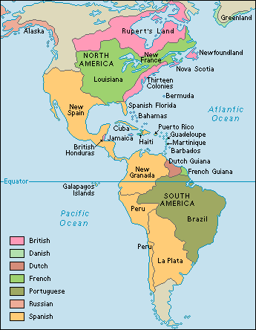
European Colonies
Notes:
Key Concepts 1.2.I.A, 1.2.I.C

Slide 17
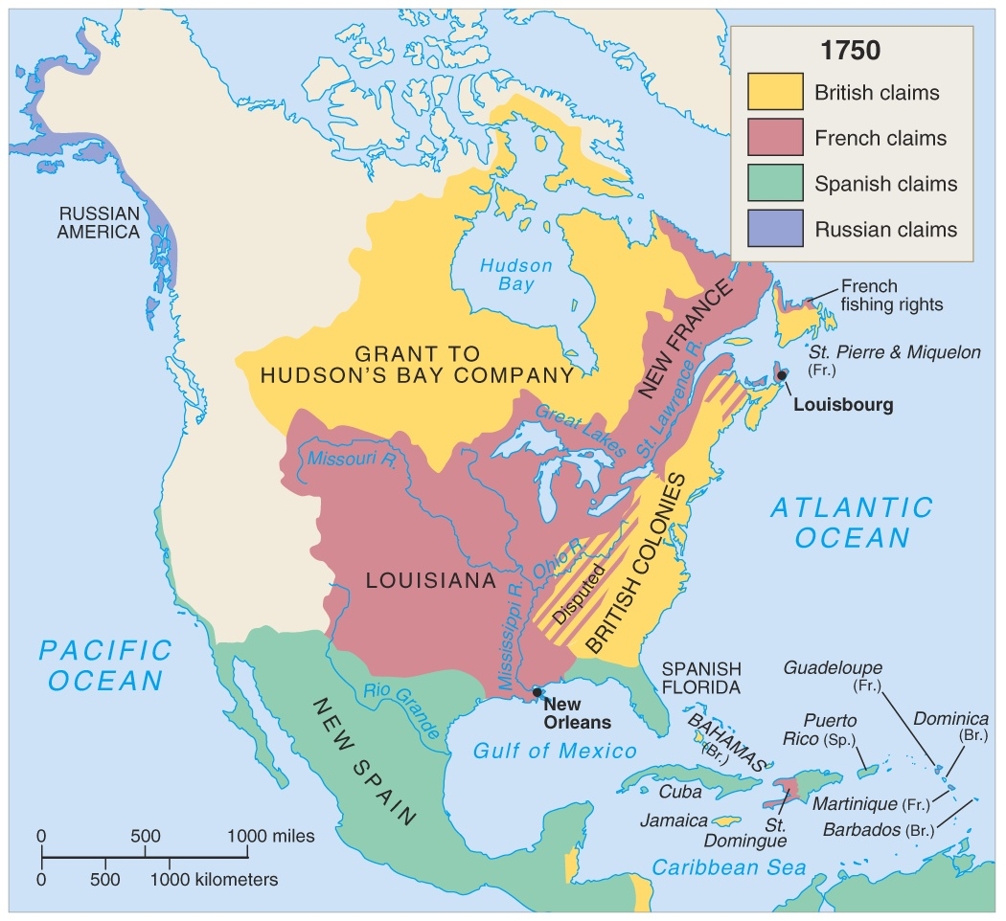

Slide 18
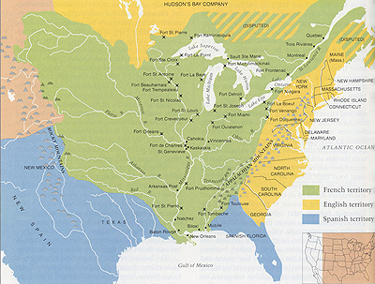
By the early 1600s, Spain, England, & France had large territorial claims in North America (but these colonies were not heavily populated, especially in Spanish & French claims)
These colonial claims came largely at the expense of the Native Americans already living there

Slide 19
Comparing Three Worlds
 | American Indians | Europeans | West Africans
What were their religious beliefs? | Nature-based Spiritual relationship between man and Earth | Spread Christianity Everyone should be Christian | A mix: Islam (in some areas); Nature-based (in other places)
What was their government? | tribes (simple) confederations empires (complex) | nations and kings beginning to have ideas about individual rights | Kingdoms w/ rulers Council of elders
What were their economic systems? | Communal ownership of land Live in harmony with land -- use it to sustain life and not to create wealth | Private ownership of property Labor + land = wealth | Communal ownership of land Extensive trade in a variety of goods
What kind of technology did they have? | Bows, arrows, spears and tomahawks Simple farming and hunting tools | Advanced weapons, including guns, cannons and armor Navigational abilities | Depends on area – simple farming tools or complex trading equipment

Slide 20
Impact of Discovery
Colonization: The establishment of distant settlements controlled by parent country.
Often times natives were forced into work on plantations
An exchange begins between the old world and the new.

Slide 21
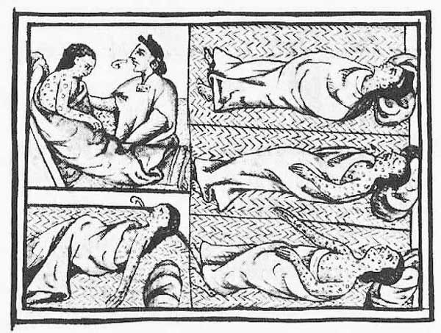
Trading Food is Good… Trading Disease is BAD!
Population decrease estimates between 1/3 and 1/2 of native population.
Decrease in population means decrease in workforce.
What will the Europeans do???

Slide 22
Slave Trade Begins
With so many Natives dying of disease, Europeans turned to the slave trade to replenish labor force.
Africans were more resistant to Old World disease and less familiar with New World (less likely to escape).
Europeans began using these slaves in the New World.

Slide 23
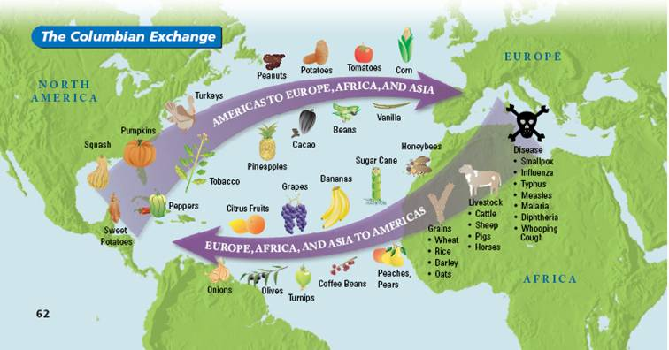
The Columbian Exchange
An exchange of living things between the Old World (Europe, Asia, Africa) and the New World (the Americas)

Slide 24
AP Prompt
Evaluate the short term effects of European exploration and colonization on the Americas.

