Slide 1
Do Now
IDENTIFY: Jefferson’s ideology on the role of government prior to becoming President.
COMPARE: Jefferson’s ideology on the role of government with that of Alexander Hamilton

Slide 2
The Election of 1800 and Jeffersonian Democracy
Mr. Winchell
APUSH 2018-2019
Period 4

Slide 3
AP Prompt
With respect to the federal Constitution, the Jeffersonian Republicans are usually characterized as strict constructionists who were opposed to the broad constructionism of the Federalists. Evaluate the extent to which this characterization of the two parties was accurate during the presidency of Jefferson.

Slide 4
Key Concepts
4.1: The US began to develop a modern democracy and celebrated a new national culture, while Americans sought to define the nation’s democratic ideals and change their society and institutions to match them.

Slide 5
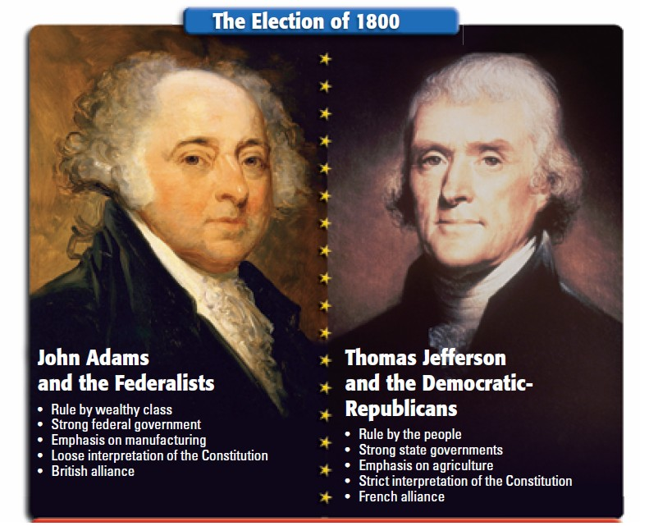
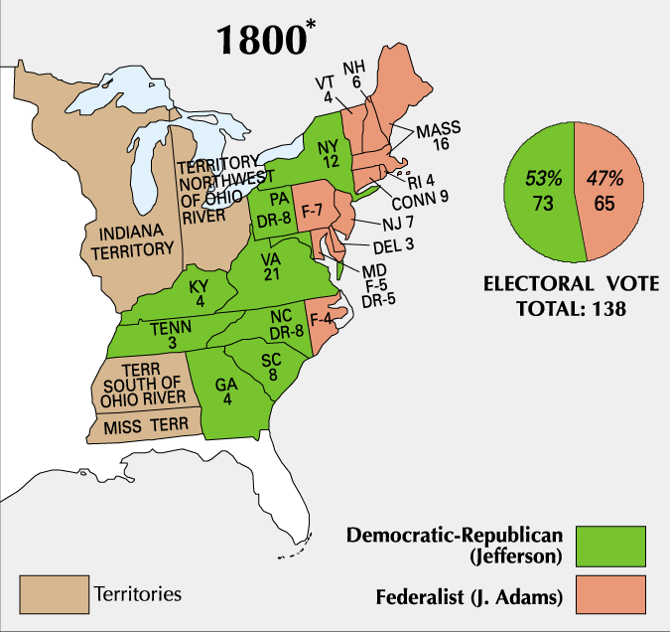
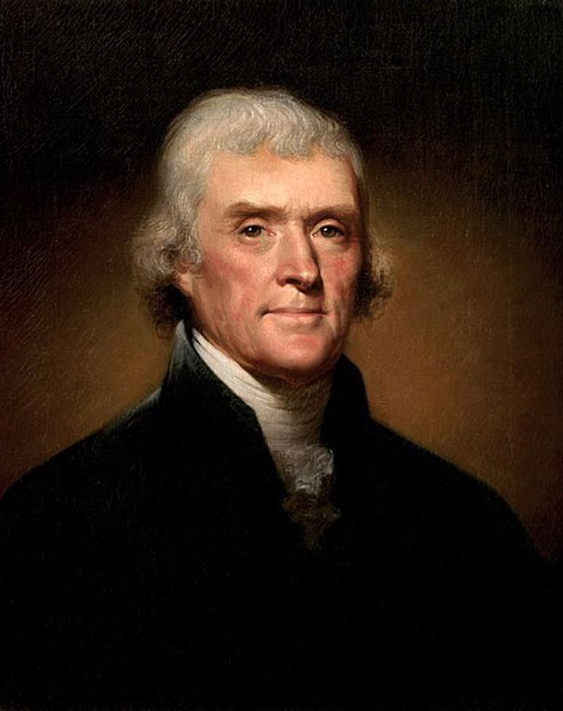
The election of 1800 was a turning point in U.S. history
This “Revolution of 1800” marked the first time in U.S. history when one political party transferred power to another
“We are all Republicans. We are all Federalists.”
Jefferson’s inaugural, 1801

Slide 6
“Revolution of 1800”
Significance
Jefferson called it a “Revolution”
A return to the “Spirit of 76” and true republican government
Revolutionary in that it was a peaceful transition of power from one party to the next
John Adams is the last Federalist president

Slide 7
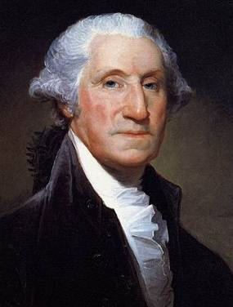
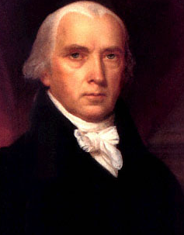
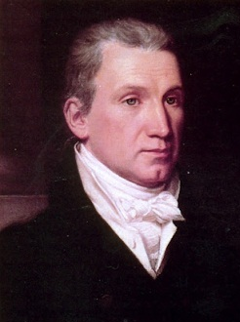
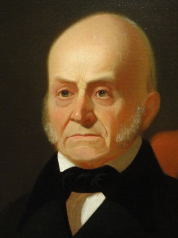
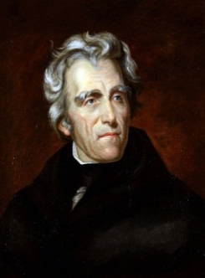
Jefferson’s presidency marked the start of nearly 30 years of dominance by the Democratic-Republicans
8 yrs
George Washington
(1789-1797)
4 yrs
John Adams
(1797-1801)
8 yrs
Thomas Jefferson
(1801-1809)
8 yrs
James
Madison
(1809-1817)
8 yrs
James Monroe
(1817-1825)
4 yrs
John Quincy Adams
(1825-1829)
8 yrs
Andrew Jackson
(1829-1837)
Federalist Party
Democratic-Republican Party
Democratic Party

Slide 8
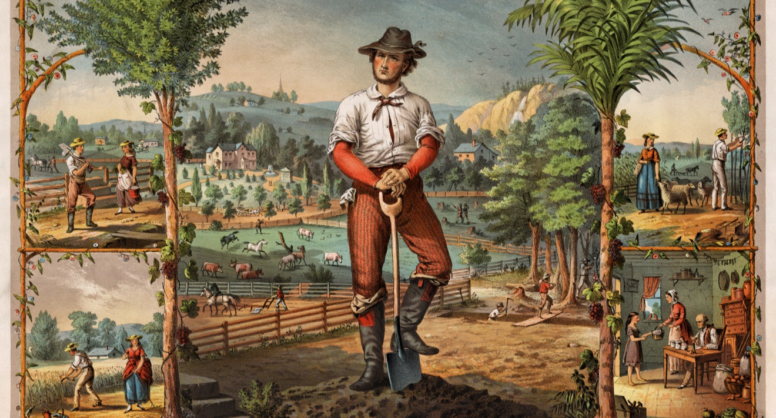
If this image captures Jefferson’s vision of an ideal America, what was his vision? What role did Jefferson want the government to play in this ideal America?

Slide 9
Jefferson as President
Jefferson entered office after the “revolution of 1800” with a clear political ideology & goals:
To reduce size & cost of gov’t & promote republican agrarianism
To repeal key Federalist policies (Alien & Sedition Acts & John Adams’ midnight appointments of key Federalist judges)
To maintain international peace
However, Jefferson would have to compromise many of his ideological principles to be an effective president
Notes:
5

Slide 10
What is Jeffersonianism?
Republicanism and Civic Virtue
Civic duty
Voting and efficacy
Right to education
Natural Elites
Resist corruption
Federalism and States’ Rights
Ultimate sovereignty in the states and nullification
Strict constitutionalist
Dominant legislature, weak judiciary
Economic coercion over standing armies
Yeoman Farmers as Ideal Citizens
Educated landowners exemplified independence and virtue
Agriculture Over Manufacture/Industry
Responsibility of subsistence
Dependence led to class conflict
Empire of Liberty and Foreign Policy
America’s responsibility to spread democracy
Avoid entangling alliances
Society
Republican motherhood; absent from politics
Natives capable, just need to catch up (noble savages)
Black inferiority and white superiority
Separation of Church and State

Slide 11
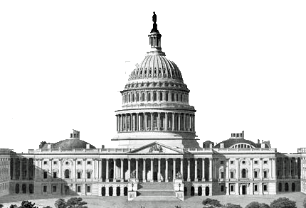
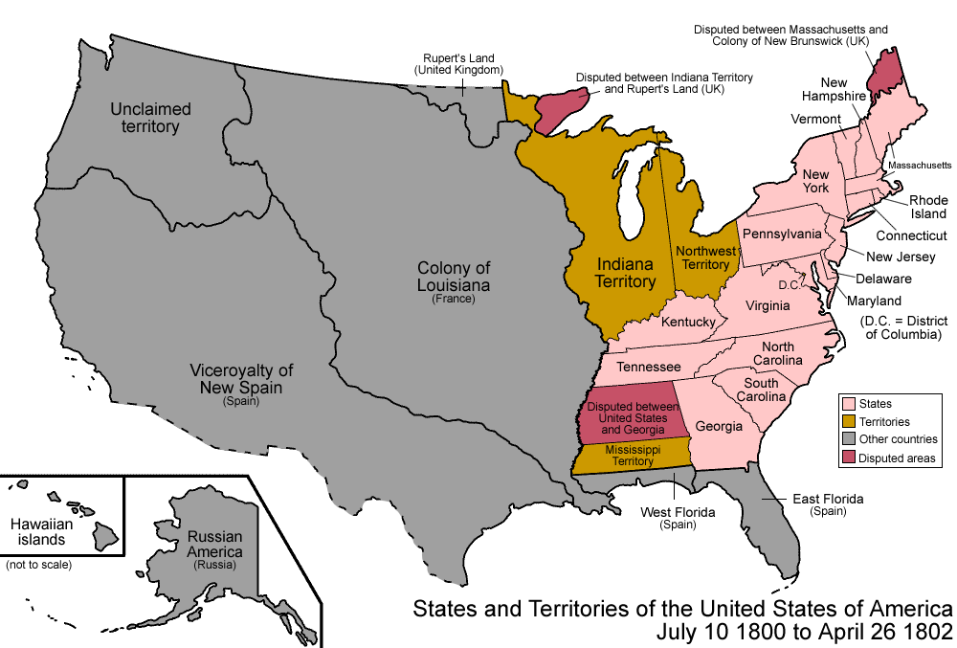
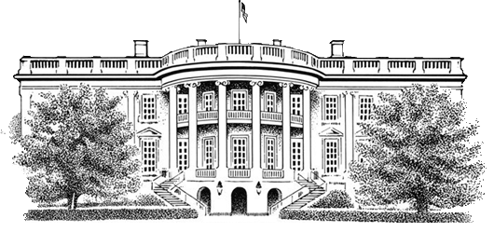
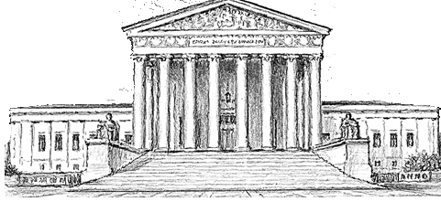
Jefferson wanted to reverse Federalist policies by reducing the size and cost of the national government
Jefferson believed the government had grown too large and powerful
Reduce the national government
He cut the size of the army
He eliminated taxes on whiskey, slaves, and property
He allowed the charter of the Bank of the U.S. to expire
Focused on paying down the federal government’s debt
Restore power to state gov’ts

Slide 12
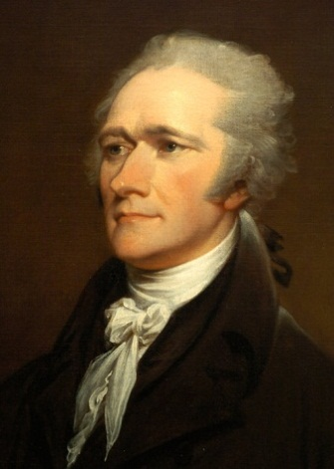
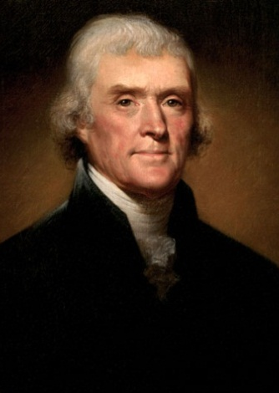
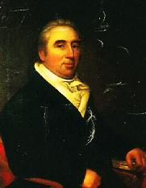
But, the Federalists did not want to see their policies destroyed by Jefferson and the Democratic-Republicans
In the months before leaving office, President Adams appointed numerous Federalists to become judges in federal courts through the Judiciary Act of 1801
(the “Midnight Judges”)
Jefferson opposed these appointments and ordered his Secretary of State James Madison to deny some of these judge appointments
Hamilton
Jefferson
Marbury
One of these potential judges was William Marbury who sued Madison when he was deprived his position
Marbury v Madison (1803) was one of the most important Supreme Court cases in U.S. history
Adams
Madison

Slide 13
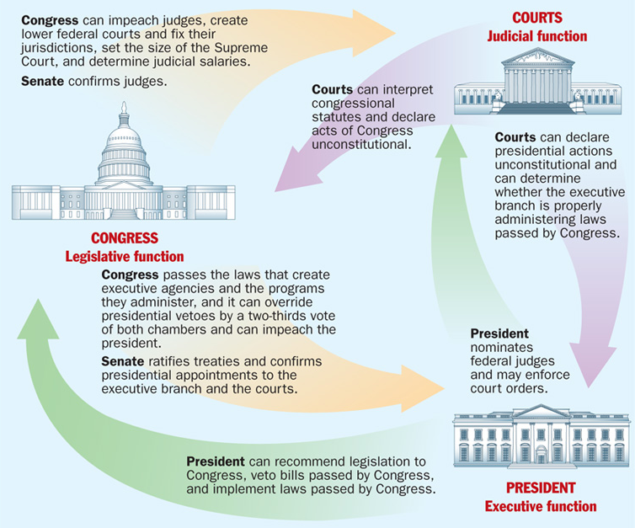
The Supreme Court ruled that President Jefferson’s decision to deny Marbury his judicial appointment did not violate the Judiciary Act or the Constitution
The Marbury v. Madison case established the principle of judicial review giving the Supreme Court the power to declare acts of Congress unconstitutional
Marbury: Congress created the Judiciary Act to create lower courts with judges!!
Jefferson and Madison: Yes, but the president can appoint (not deny) whoever he wants!!

Slide 14
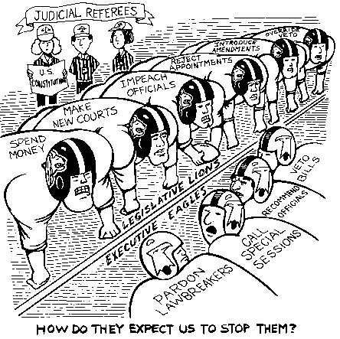

Slide 15
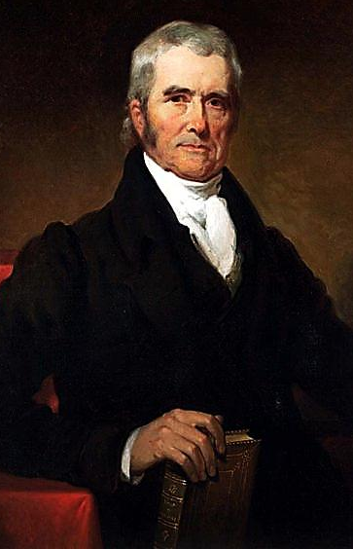
Chief Justice John Marshall served as Chief Justice of the Supreme Court from 1801 to 1835
Over three decades, Marshall’s ruling helped strengthen the power of the national gov’t over the states and protected the rights of citizens
Marbury v. Madison (1803)
McCulloch v. Maryland (1819)
Dartmouth College v. Woodward (1819)
Cohens v. Virginia (1821)
Gibbons v. Ogden (1824)
Cherokee Nation v. Georgia (1831)

Slide 16
Samuel Chase
Republican attempt at “judge-breaking”
Impeached by Democratic-Republican House
Senate failed to convict him
Independence of judiciary
Notes:
1804

Slide 17
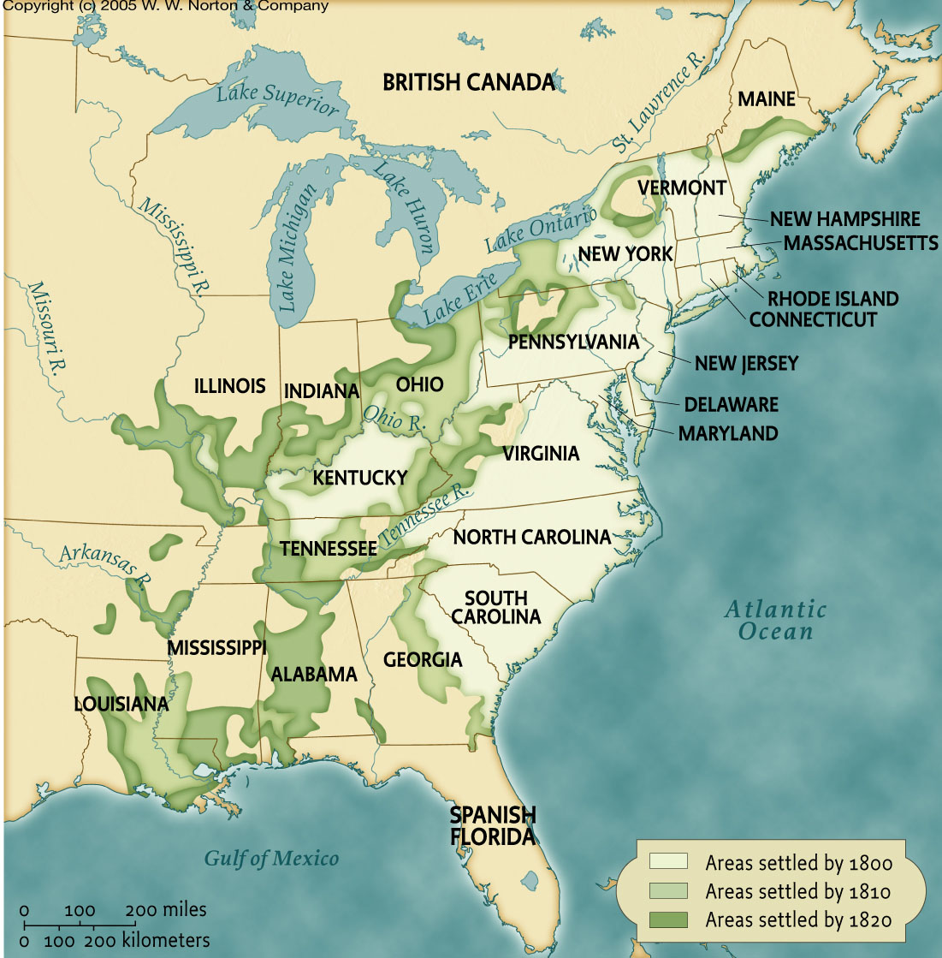
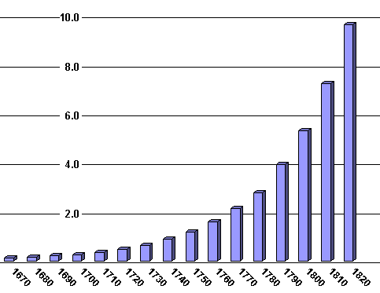
During Jefferson’s presidency, the U.S. population was growing and people were moving West
Jefferson was worried about French control of New Orleans and the Mississippi River
Ohio was added in 1803
From 1800 to 1810, the U.S. grew by two million people
Kentucky became a state in 1792
Tennessee was added in 1796

Slide 18
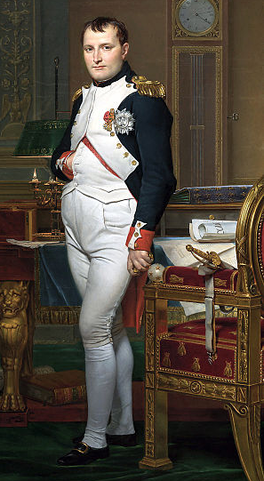
Jefferson sent a delegation to France to negotiate the purchase of New Orleans
Napoleon wanted to sell all French territories in America to fund his war

Slide 19
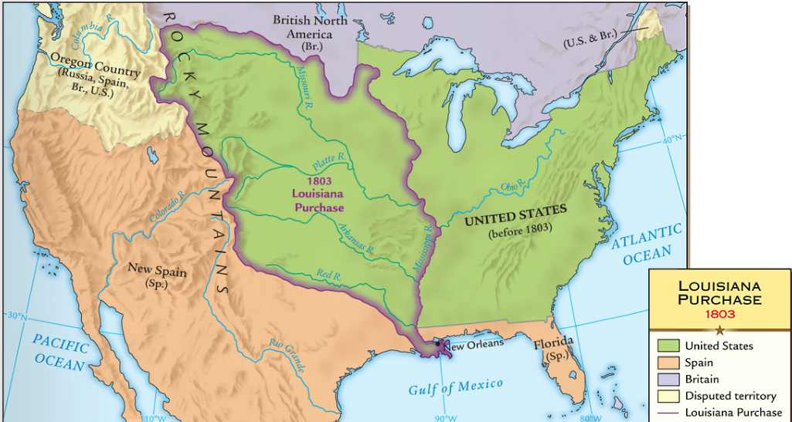
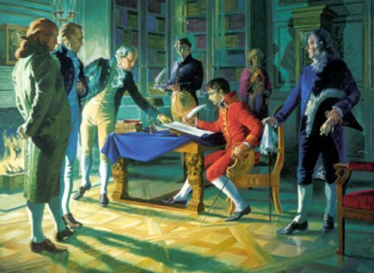
In 1803, Congress approved the purchase of Louisiana from the French for $15 million
The Louisiana Purchase doubled the size of the USA

Slide 20
Americans were excited about gaining new western lands, but the Louisiana Purchase presented problems
Was the purchase constitutional? Despite his belief in strict interpretation, Jefferson used the elastic clause to buy it
What about the French and Spaniards in New Orleans? Despite his belief in protecting liberty, Jefferson did not grant foreigners citizenship

Slide 21
Federalist Opposition
Used “strict construction” - president did not have power to purchase Louisiana.
Why? It would cost too much and cause the U.S. debt to soar. IRONY!!!
Real reason: worried that new western lands would be loyal to the Republicans.

Slide 22
The Louisiana Purchase Should Be Approved; The Louisiana Purchase Should Be Opposed
Thomas Jefferson – Letter to John Breckinridge and Third Annual Message to Congress (1803)
Samuel White – U.S. Senate Speech (1803)
The Constitution has made no provision for our holding foreign territory, still less for incorporating foreign nations into our Union. The executive, in seizing the fugitive occurrence which so much advances the good of their country, have done an act beyond the Constitution. The legislature, …risking themselves like faithful servants, must ratify and pay for it...
While the property and sovereignty of the Mississippi and its waters secure an independent outlet for the produce of the western States, and an uncontrolled navigation through their whole course, free from collision with other powers and the dangers to our peace from that source, the fertility of the country, its climate and extent, promise in due season important aids to our treasury, and ample provision for our posterity, and a widespread field for the blessings of freedom and equal laws.
Possession of [New Orleans; and of such other positions on the Mississippi] we must have…to secure to us forever the complete and uniterrupted navigation of that river. This I have ever been in favor of; I think it essential to the peace of the united States, and to the prosperity of our Western country. But as to Louisiana, this new, immense, unbounded world, if it ever be incorporated into this Union, which I have no idea can be done but by altering the Constitition, I believe it will be the greatest curse that could at present befall us...the settlement of this country will be highly injurious and dangerous to the United States...and of making the fertile regions of Louisiana a howling wilderness, never to be trodden by the foot of civilized man, it is impracticable...The inducements will be so strong that it will be impossible to restrain our citizens from crossing the river.

Slide 23
Effects of Louisiana Purchase
Short term
Constitutional crisis
Weak control over new land (Burr conspiracy)
Long term
Purchase, incorporation, equality of U.S. territory
Increased security
Laid foundations of American power & “Manifest Destiny”

Slide 24
Native American Resistance
The Louisiana Purchase increased tensions with Indians:
Americans rejected coexistence with Indians
Tecumseh swayed the Shawnee & other tribes to stop selling land & to avoid contact with whites
Jefferson hoped to “civilize” Indians into yeoman farmers & planned for a vast reservation west of the Mississippi River
Notes:
3

Slide 25
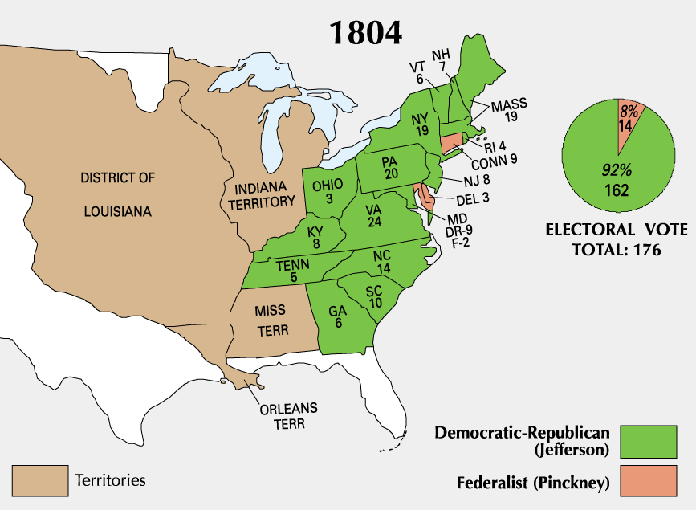
Jefferson was widely popular and easily won the election of 1804
But, Jefferson’s second term was plagued by foreign policy problems

Slide 26
The Yazoo Controversy
Jefferson endured heavy criticism due to the Yazoo Land Fraud:
Corrupt GA politicians sold 35 million acres of land to insiders at ridiculously low prices
Quids attacked Jefferson for allowing defrauded individuals to keep lands they bought
In Fletcher v. Peck (1810), the Supreme Court allowed purchasers to keep these lands
Together with Marbury v Madison, the Supreme Court defined itself as a legitimate 3rd branch of gov’t
The case established an important precedent:
Supreme Court can nullify any unconstitutional state laws
Again, it’s the Marshall Court
Notes:
massive fraud perpetrated by several Georgia governors and the state legislature from 1795 to 1803 by selling large tracts of land to insiders at ridiculously low prices.

Slide 27
Jefferson and the Barbary/Tripoli Pirates
Washington and Adams
Paid bribes to Barbary states to avoid piracy
Jefferson
Barbary states increase bribes
U.S. Navy and Marines dispatched
Treaty reached in American favor

Slide 28
The Slave Trade
At the Philadelphia Convention, slavery was tabled until 1808
In Dec 1806, Jefferson urged Congress to prepare a slave law:
Southerners furiously argued against any slavery legislation
Congress passed a law that ended the *Trans-Atlantic* slave trade in 1808, but smugglers were to be turned over to local authorities
Notes:
18

Slide 29
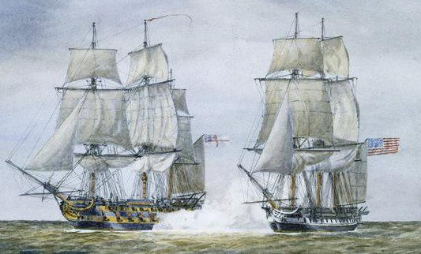
The war between England and France led to more attacks on U.S. trade ships
The British navy impressed more than 1,000 American merchant sailors per year from 1803 to 1807

Slide 30
Jefferson and the Embargo Act
Provisions
American goods and ships prohibited to sail for foreign ports
Post double bond for American cargo shipped to American ports
Later authorized executive branch to use military to enforce the law
Impact
Increased smuggling
American export spending fell from $108 million to $22 million
Agricultural prices fell
Shipping industry devastated
More reliance on domestic manufacturing
High unemployment
Little to no effect on British and French markets
Repeal
Non-Intercourse Act (1809)
The happy effects of that grand systom [sic] of shutting ports against the English!! October, 1808

Slide 31
Embargo Act 1807
Forbade export of all good from the US to any destination!
Proved disastrous to the economy
In 1807 U.S. exports = $108 million ; in 1808 = $22 million
Inadvertently sparked American industrialization!
Why did it fail?

Slide 32
Text Analysis-Embargo
Opposition
Support
"As to the hope that it may...induce England to treat us better, I think is entirely groundless...government prohibitions do always more mischief than had been calculated; and it is not without much hesitation that a statesman should hazard to regulate the concerns of individuals as if he could do it better than themselves.”…"In every point of view, privation, suffering, revenue, effect on the enemy, politics at home, I prefer war to a permanent embargo.” – Secretary of the Treasury Albert Gallatin to Thomas Jefferson
"To the Senate and House of Representatives of the United States: The communications now made, showing the great and increasing dangers with which our vessels, our seamen, and merchandise are threatened on the high seas and elsewhere, from the belligerent powers of Europe, and it being of great importance to keep in safety these essential resources, I deem it my duty to recommend the subject to the consideration of Congress, who will doubtless perceive all the advantages which may be expected from an inhibition of the departure of our vessels from the ports of the United States. Their wisdom will also see the necessity of making every preparation for whatever events may grow out of the present crisis.” – President Thomas Jefferson to the U.S. Senate

Slide 33
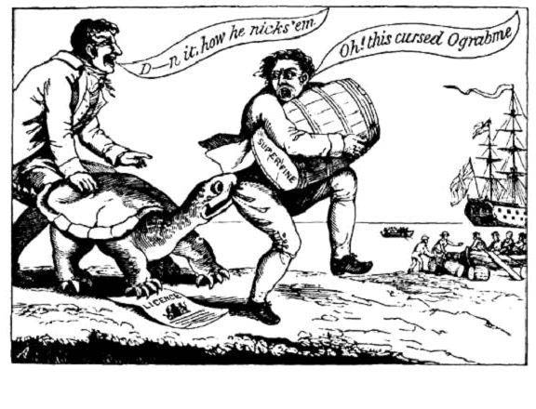
Federalist Opposition

Slide 34
Failure of the Embargo
Federalists gaining political ground because of failed embargo
Repub. dominated Congress repealed the embargo at end of J’s 2nd term
Embargo of 1807 replaced by Non-intercourse Act of 1809
prohibited trade w/ GB or FR until they recognized the maritime rights of neutrals
Commerce w/ all others permitted
Macon’s Bill No. 2 of 1810
Replaced N-A Act – offered trade to either GB or FR if they stopped attacks on US ships
Would continue to embargo other nation

Slide 35
Jefferson’s Legacy
Expansion (The U.S. doubled in size, saw huge population growth, & experienced western expansion)
Strengthened executive branch through action
The role of government shrank
Non-aristocratic government created
Total defeat of the Federalists by 1816
Kept US out of war
Best known for Dec. of Independence
Also Virginia Statute of Religious Freedom & founding of U. of VA.
Notes:
How did Jefferson’s legacy differ from that of Adams?

Slide 36
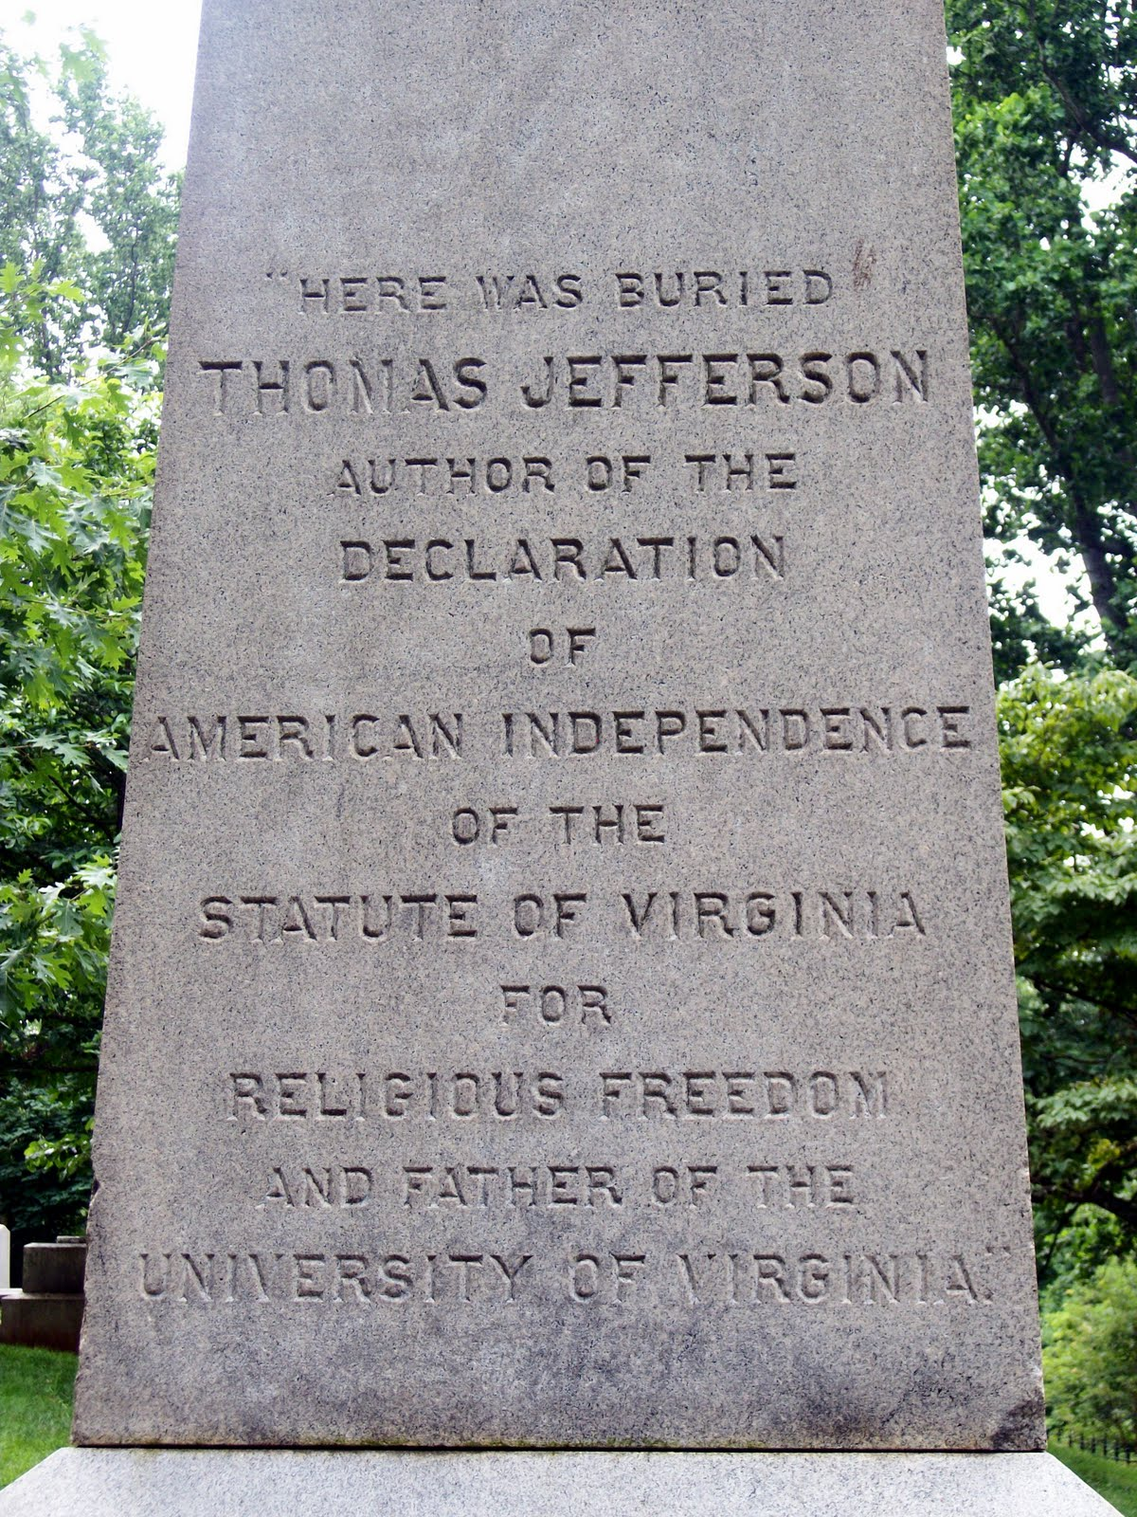

Slide 37
Closure Activity: Jefferson’s Legacy
Jefferson came into office trying to reduce the size and power of the national government.
Did he accomplish his goal? Use your notes and knowledge of Jefferson to complete this chart
 | Jefferson’s ideal? | How Jefferson acted
Interpretation of the Constitution?
Powers of the president?
Size of the army and navy?
Citizenship and rights of the people?
Size of the national government?

