Slide 1
Do Now
Why did the British government leave their colonists in America alone politically, economically (mostly), and socially?

Slide 2
1. The French & Indian War: The Turning Point in British-Colonial Relations
Mr. Winchell
APUSH 2019-2020
Period 3

Slide 3
AP Prompt
Evaluate the extent to which the French & Indian War caused a shift in British/Colonial Relations.

Slide 4
Outline

Slide 5
Refresher!
England has left the colonies alone, with few exceptions, from 1607-1754.
Navigation Acts of 1660/1663
All commerce coming to and from the colonies could only be on British ships
All European goods going to America must first dock in England
Certain American products must be shipped only to England
Any political measures? Social? Major economic?
SALUTARY NEGLECT

Slide 6
Big Picture
As part of their worldwide imperial rivalry, Great Britain and France fought numerous wars for colonial control of North America, culminating in the British victory in the French and Indian War (Seven Years’ War) that resulted in France’s removal from the continent

Slide 7
French & English Colonial Wars
A series of European conflicts involving England & France spilled over into colonial North America:
King William’s War (1689-1697)
Queen Anne’s War (1702-1713)
King George's War (1743-1748)
These wars were based on mercantilist competition & had little political significance, but…
Notes:
Queen Anne’s War was War of Spanish Succession; King George’s War was War of Austrian Succession
While the British colonies were militarily superior to New France, a lack of colonial unity & French alliances with Native Americans weakened colonial advantages

Slide 8
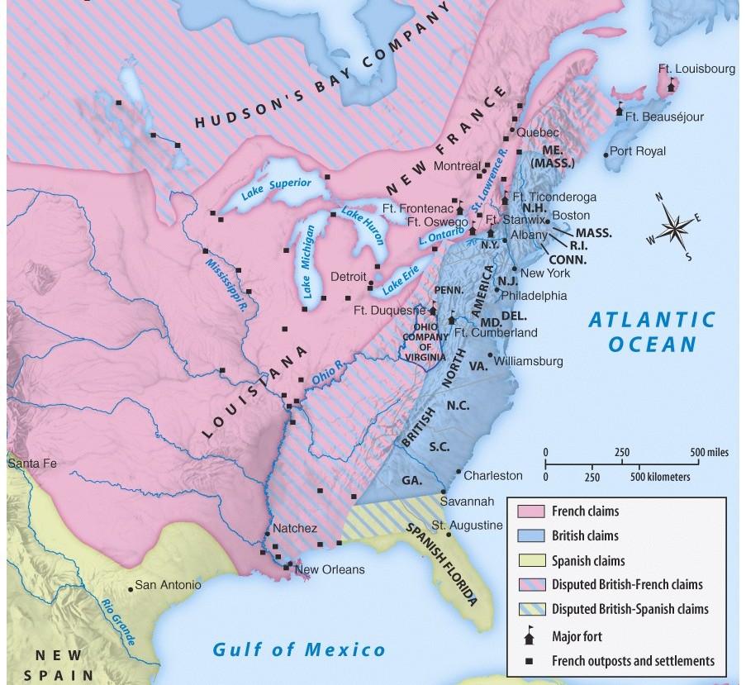
…these wars led to a land frenzy in the 1750s, among French & British colonists
Territorial disputes along the Ohio River sparked the French & Indian War

Slide 9
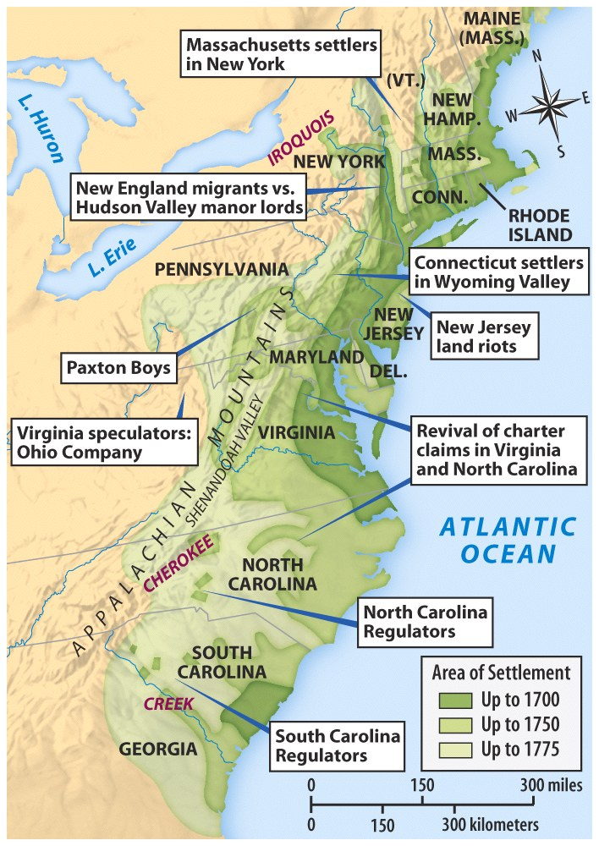
Westward Expansion & Land Conflicts, 1750-1775
Notes:
REFERENCE Revolutions Taylor for a text excerpt here?

Slide 10
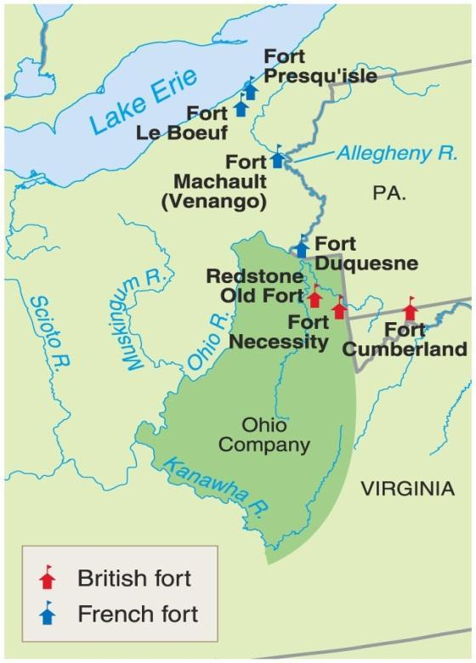
The Ohio Valley & the French and Indian War
The Ohio Valley was very important real estate to three major North American powers
Iroquois
Wanted to extend their power to this region
Colonial Americans
Logical area for expansion as land became scare on the east coast
French
Link their Canadian holdings to their holdings west of the Mississippi

Slide 11
Albany Plan
The war was going poorly for England.
The British Government recognized the need for more coordination and called for representatives from the colonies to meet in Albany in 1754.
The Albany Plan of Union—designed by Benjamin Franklin—proposed an Intercolonial government to recruit troops and collect taxes from the colonies for the common defense.
Colonies didn’t accept it (didn’t want someone else taxing them), but it was significant in that was an early example of the colonies attempting to come together under ‘one roof.’

Slide 12
In 1754, 7 of the 13 colonies met for an inter-colonial congress held in Albany, New York, known simply as The Albany Congress.
A month before the congress, Ben Franklin had published his famous “Join or Die” cartoon featuring a snake in pieces, symbolizing the colonies.
The immediate purpose was to keep the Iroquois tribes loyal to the British, but Franklin had even bigger ideas.
Franklin hoped to unite the colonists in Albany and did make inroads toward that cause, but his plan was ultimately rejected because the individual colonies felt it did not give them enough independence, and they were reluctant to give up their sovereignty or power.
Still, it was a first step, and the first real attempt, toward unity.

Slide 14
British Victory
War ends in the Treaty of Paris, 1763.
Great Britain acquires French Canada and Spanish Florida.
France gives Spain the territory of Louisiana and all land west of the Mississippi.
Britain now controls ½ of North American and France has none. Sucks to be France.

Slide 15
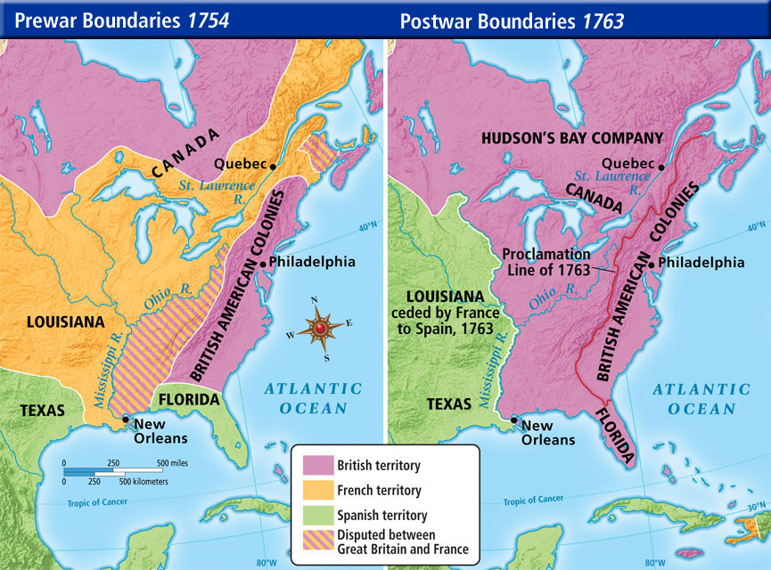

Slide 16
Perceptions of the War
Colonial views:
Colonies could be very strong when they worked together
Newly gained frontier presented opportunities for wealth & land
Colonists learned how to fight
English views:
Americans were slow to organize & balked at helping raise money even to protect their own lands

Slide 17
Text Analysis
Rev. Barnard Sermon in Massachusetts, 1763

Slide 18
Parliamentary Sovereignty
In 1760, George III became king & began a new colonial attitude: Parliamentary Sovereignty
English officials assumed that Parliament must have ultimate authority over ALL laws & taxes
The colonists tried to reserve the colonial authority for their own legislatures
Notes:
3
Suspicions in colonies & England that George wished to enlarge his powers (appt of chief minister Bute & others)
Bute was appointed Chief Minister of England because he got along with George, no other reason. Parliament was furious. Eventually Bute resigned & George was fickle in his appointments—often changing chief ministers leaving England with no clear plan for gov’t. Left England in precarious state & colonies largely ignored during this time.

Slide 19
Major Effects of the French and Indian War
British rack up a HUGE debt
Soon the British will look for the colonists to pay for their own defense…
Colonials start pouring into this newly won territory
This leads to Pontiac’s Uprising
Indians attack settlements and forts throughout Ohio Valley
Several thousand settlers are killed and most of the British forts are burned
British respond brutally by attacking villages and spreading smallpox on purpose
Brutal atrocities committed by Pontiac’s alliance and British troops

Slide 20
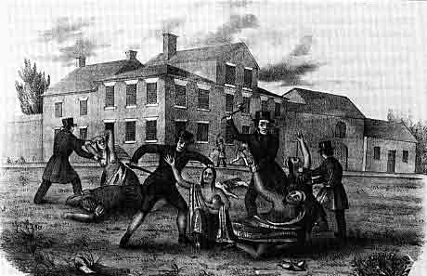
Retaliatory attacks by frontier colonists (like the Paxton Boys in Pennsylvania) were common

Slide 21
Proclamation of 1763
Because of their huge debt the British do not want anymore conflict
Proclamation Act of 1763: prohibited colonial settlement west of the Appalachians
This angers the colonials
Proclamation is completely ignored by the colonials
Colonists viewed the line as an ‘obstruction to their legitimate economic development’

Slide 22
In your perspective… Who does the Proclamation cause friction between? Who does it solve friction between?
Why does it make the colonist angry?
The Indians agree to stop attacking the colonies.
The Indians continue to attack the colonies.
The colonists will remain on the coast where the king can use the navy to keep them under control.
Parliament passes the
Proclamation of 1763
The king is concerned that as colonists move inland, he will have less control over their actions.
Makes the Colonist angry at King George III!
Put in your frame of Reference: The king believes the colonists will be happy about the Proclamation, because it will stop the attacks from the Indians.

Slide 23
British Colonial Control
“If no restrictions were placed on the colonies, they would flourish“ – Prime Minister Robert Walpole (Whig) (Prime Minister of GB 1721-1742)
“That this kingdom has the sovereign, the supreme legislative power over America, is granted. It cannot be denied; and taxation is a part of that sovereign power...The nation [Britain] has run itself into an immense debt to give them [the colonies] this protection; and now they are called upon to contribute a small share towards the public expense...” – George Grenville (Whig) (Prime Minister of GB 1763-1765)

Slide 25
The“Seeds of Revolution”
By 1763, the British Empire was the world’s “superpower”
Paying the substantial price of war and foreign affairs put the British economy on shaky ground.
The British Crown found itself looking for ways to charge taxes on its citizens, both at home and in its North American colonies.
Colonists felt entitled to the same rights of representation as their fellow citizens in the mother country. WHY?????
Colonists began to feel that they were being taken advantage of by Parliament since they were denied meaningful representation.

Slide 26
The Colonial Mindset: 1763
Andrew Burnaby Scoffs at Colonial Unity

Slide 27
Outcomes…TP or Naw?
Despite the mounting tensions between the English government & American colonists by 1763, most Americans were loyal “brothers” to England due to:
a shared British culture
dependence upon British consumer goods
shared nationalism after British military victories against France

Slide 28
AP Prompt
Contextualization AND Thesis

