Slide 1
Do Now
Why did the British government leave their colonists in America alone politically, economically, and socially?

Slide 2
The French and Indian War and Its’ Aftermath: An End to Salutary Neglect
Mr. Winchell
APUSH 2018-2019
Period 3

Slide 3
AP Prompt
Evaluate the impact of the French and Indian War on British policy towards the American colonies.

Slide 4
Refresher!
England has left the colonies alone, with few exceptions, from 1607-1754.
Navigation Law of 1650
All commerce coming to and from the colonies could only be on British ships
All European goods going to America must first dock in England
Certain American products must be shipped only to England
Any political measures? Social? Major economic?
SALUTARY NEGLECT

Slide 5
Big Picture
As part of their worldwide imperial rivalry, Great Britain and France fought numerous wars for colonial control of North America, culminating in the British victory in the French and Indian War (Seven Years’ War) that resulted in France’s removal from the continent

Slide 6
Setting the Stage
End of 17th century – America is valuable real estate
People in Canada and America were pawns in a larger chess game.
Between 1689 and the American Revolution, European powers, fought for territory.
King William’s War - 1689-97
Queen Anne’s War - 1702-13
King George’s War - 1740-48
French and Indian War - 1756-63
Colonists not involved much with first three.
England and France left standing as two major powers.

Slide 7
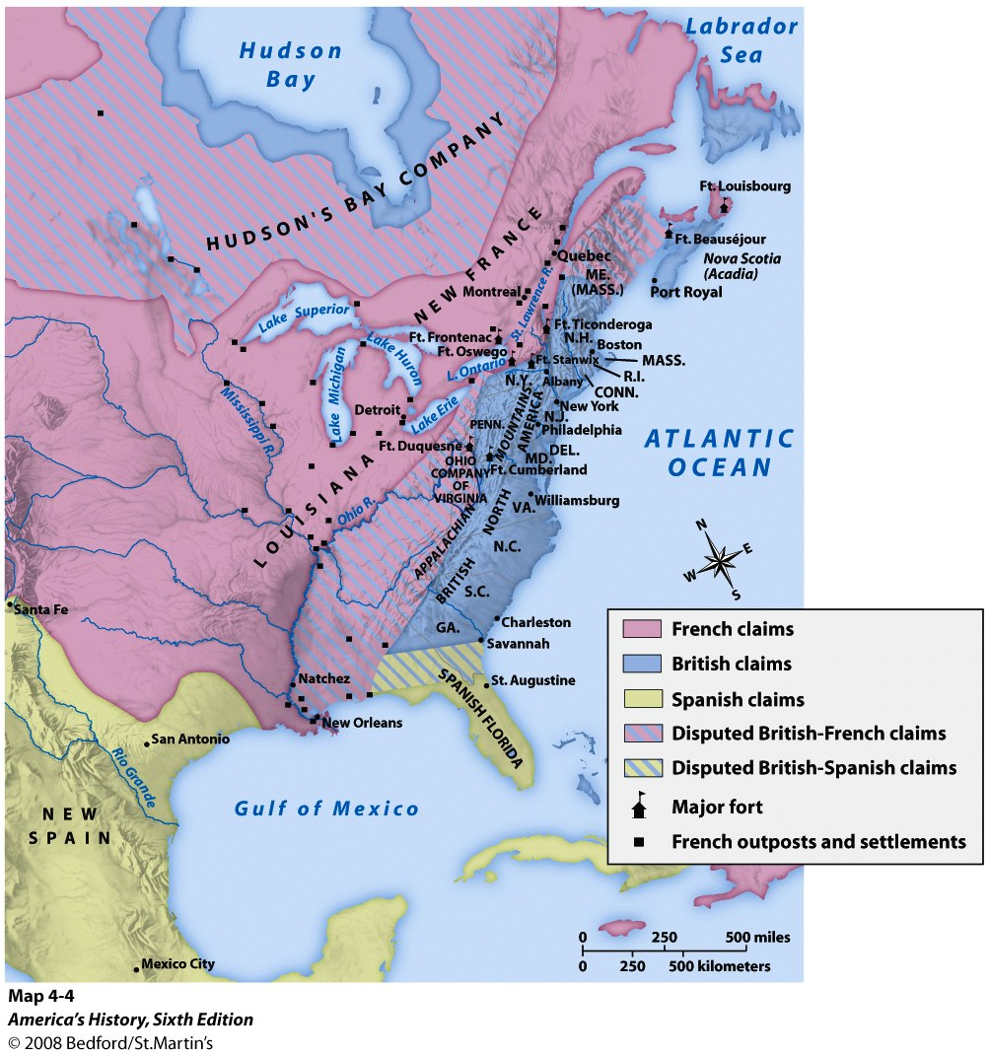

Slide 8
Why?
Overlapping claims between the French and British. (Ohio)
French forts built to counter British expansion.
Britain didn’t like this, sent GW on expedition.
Shots fired, war starts.

Slide 9
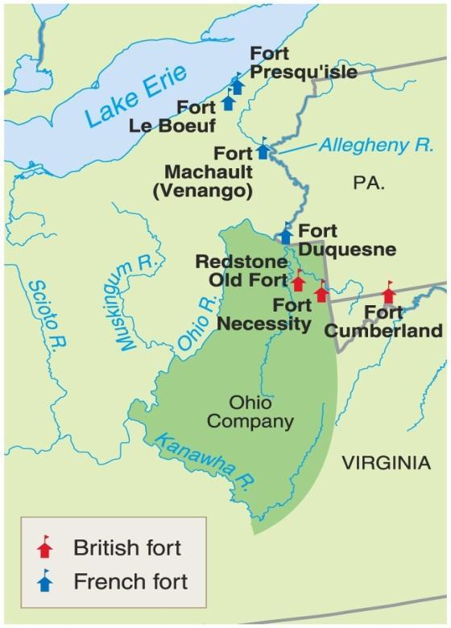
The Ohio Valley & the French and Indian War
The Ohio Valley was very important real estate to three major North American powers
Iroquois
Wanted to extend their power to this region
Colonial Americans
Logical area for expansion as land became scare on the east coast
French
Link their Canadian holdings to their holdings west of the Mississippi
George Washington’s family has a 500,000 acre claim in this region
Washington marches troops out to a French fort in this region and attacks it (1754)
He is eventually defeated, but the first shots have been fired

Slide 10
Albany Plan
The war was going poorly for England.
The British Government recognized the need for more coordination and called for representatives from the colonies to meet in Albany in 1754.
The Albany Plan of Union—designed by Benjamin Franklin—proposed an Intercolonial government to recruit troops and collect taxes from the colonies for the common defense.
Colonies didn’t accept it (didn’t want someone else taxing them), but it was significant in that was an early example of the colonies attempting to come together under ‘one roof.’

Slide 11
In 1754, 7 of the 13 colonies met for an inter-colonial congress held in Albany, New York, known simply as The Albany Congress.
A month before the congress, Ben Franklin had published his famous “Join or Die” cartoon featuring a snake in pieces, symbolizing the colonies.
The immediate purpose was to keep the Iroquois tribes loyal to the British, but Franklin had even bigger ideas.
Franklin hoped to unite the colonists in Albany and did make inroads toward that cause, but his plan was ultimately rejected because the individual colonies felt it did not give them enough independence, and they were reluctant to give up their sovereignty or power.
Still, it was a first step, and the first real attempt, toward unity.

Slide 13
British Victory
War ends in the Treaty of Paris, 1763.
Great Britain acquires French Canada and Spanish Florida.
France gives Spain the territory of Louisiana and all land west of the Mississippi.
Britain now controls ½ of North American and France has none. Sucks to be France.

Slide 14
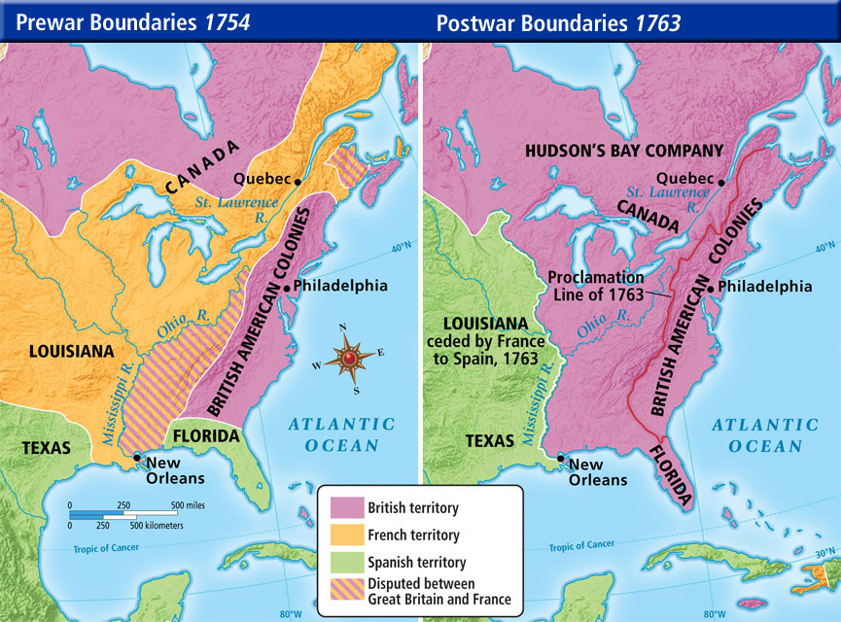

Slide 15
Text Analysis
Rev. Barnard Sermon in Massachusetts, 1763

Slide 16
Major Effects of the French and Indian War
France gets booted out of North America
British rack up a HUGE debt
Soon the British will look for the colonists to pay for their own defense…
Colonials start pouring into this newly won territory
This leads to Pontiac’s Uprising
Indians attack settlements and forts throughout Ohio Valley
Several thousand settlers are killed and most of the British forts are burned
British respond brutally by attacking villages and spreading smallpox on purpose
Text Analysis-British Order in Council

Slide 17
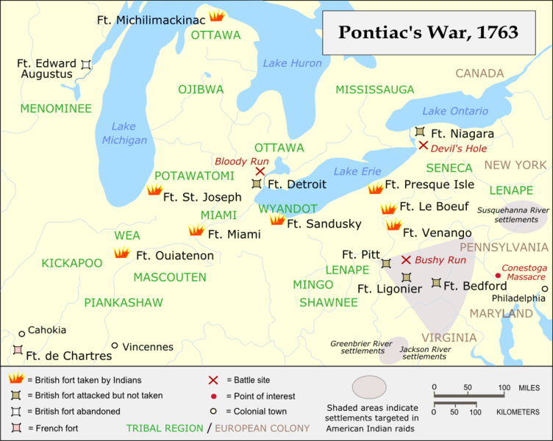

Slide 18
Quick Quiz!
“This land where ye dwell I have made for you and not for others. Whence comes it that ye permit the Whites upon your lands? Can ye not live without them? I know that those whom ye call the children of your Great Father supply your needs, but if ye were not evil, as ye are, ye could surely do without them. Ye could live as ye did live before knowing them—before those ye call your brothers had come upon your land.”
Pontiac, ‘Pontiac’s Vision’

Slide 19
Pontiac’s Goal was
A: To eliminate violent confrontation in America
B: To eliminate white people from the Ohio Valley
C: To create better trade relations with the English
D: To follow the British call for assimilation

Slide 20
After the French & Indian War, Native Americans and colonists
A: were more open to diplomacy and negotiation
B: worked together to remove French influence from North America
C: entered an era of hostility without warfare
D: engaged in additional violent conflicts

Slide 21
One impact of ‘Pontiac’s Vision’ and the rebellion it spurred was
A: closer relations between the French and their Native allies
B: lasting peace between colonists and Native Americans
C: Britain issuing the Proclamation of 1763
D: unity among Native American tribes opposed to white settlement

Slide 22
Proclamation of 1763
Because of their huge debt the British do not want anymore conflict
Proclamation Act of 1763: prohibited colonial settlement west of the Appalachians
This angers the colonials
Proclamation is completely ignored by the colonials

Slide 24
In your perspective… Who does the Proclamation cause friction between? Who does it solve friction between?
Why does it make the colonist angry?
The Indians agree to stop attacking the colonies.
The Indians continue to attack the colonies.
The colonists will remain on the coast where the king can use the navy to keep them under control.
Parliament passes the
Proclamation of 1763
The king is concerned that as colonists move inland, he will have less control over their actions.
Makes the Colonist angry at King George III!
Put in your frame of Reference: The king believes the colonists will be happy about the Proclamation, because it will stop the attacks from the Indians.

Slide 25
The“Seeds of Revolution”
By 1763, the British Empire was the world’s “superpower”
Paying the substantial price of war and foreign affairs put the British economy on shaky ground.
The British Crown found itself looking for ways to charge taxes on its citizens, both at home and in its North American colonies.
Colonists felt entitled to the same rights of representation as their fellow citizens in the mother country. WHY?????
Colonists began to feel that they were being taken advantage of by Parliament since they were denied meaningful representation.

Slide 26
The Colonial Mindset: 1763
Andrew Burnaby Scoffs at Colonial Unity

Slide 27
AP Prompt
Contextualization AND Thesis

