Slide 1
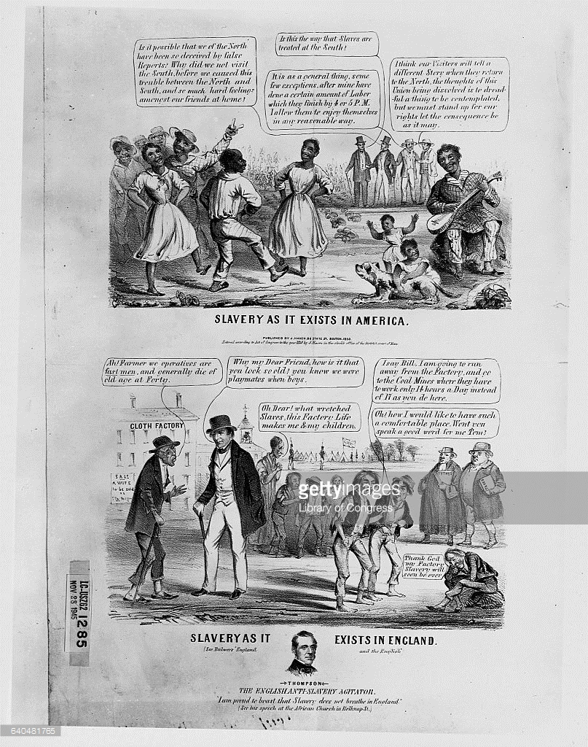
Do Now

Slide 2
1. The Growth of Slavery: Critiques and Defenses of the ‘Peculiar Institution’
Mr. Winchell
APUSH
Period 5

Slide 3
AP Prompt
Evaluate the causes and consequences of the growing opposition to slavery in the United States from 1776 to 1856.

Slide 5
Sectionalism & Compromise to 1850
Constitutional Convention
3/5 Compromise
Slave trade compromise
Early Republic
Formation of first two political parties
First Nullification Crisis (Alien & Sedition Acts)
Hartford Convention (War of 1812)
Missouri Compromise of 1820 (36°30’ line)
Jacksonian Era
Second Nullification Crisis (Tariff of Abominations of 1828, Force Bill & Compromise Tariff of 1833)
Jackson’s Bank War (“pet banks”)
Disagreements over federal funding of internal improvements (roads & canals)

Slide 6
The Beginnings of Sectionalism
As Americans expanded West in the 1840s, conflicts intensified between the North & the South regarding the issue of slavery
But…the existence of two strong political parties (Democrats & Whigs) that were both popular in the North, South, & West helped keep America from splitting apart
Notes:
2

Slide 7
The Slave Question Reemerges
The Constitution gave no definite authority to abolish slavery other than voluntary state action
Abolitionists knew it would be impossible to get enough votes to pass an amendment outlawing slavery (2/3 majority)
But, northerners in Congress could forbid slavery in new states as they were added to the Union
The slavery issue in the West had been settled by the Missouri Compromise in 1820…
New territory…new problems
Notes:
3

Slide 8
The Domestic Slave Trade
The cotton boom shifted the African American population to the South and West. By 1830, hundreds of thousands of slaves labored on the cotton and sugar lands of the Lower Mississippi Valley and on cotton plantations in Georgia and Northern Florida
3 decades later, the majority of blacks lived and worked along the Mississippi River and in an arc of fertile cotton lands-the ‘black belt’, sweeping from Mississippi through South Carolina!

Slide 9
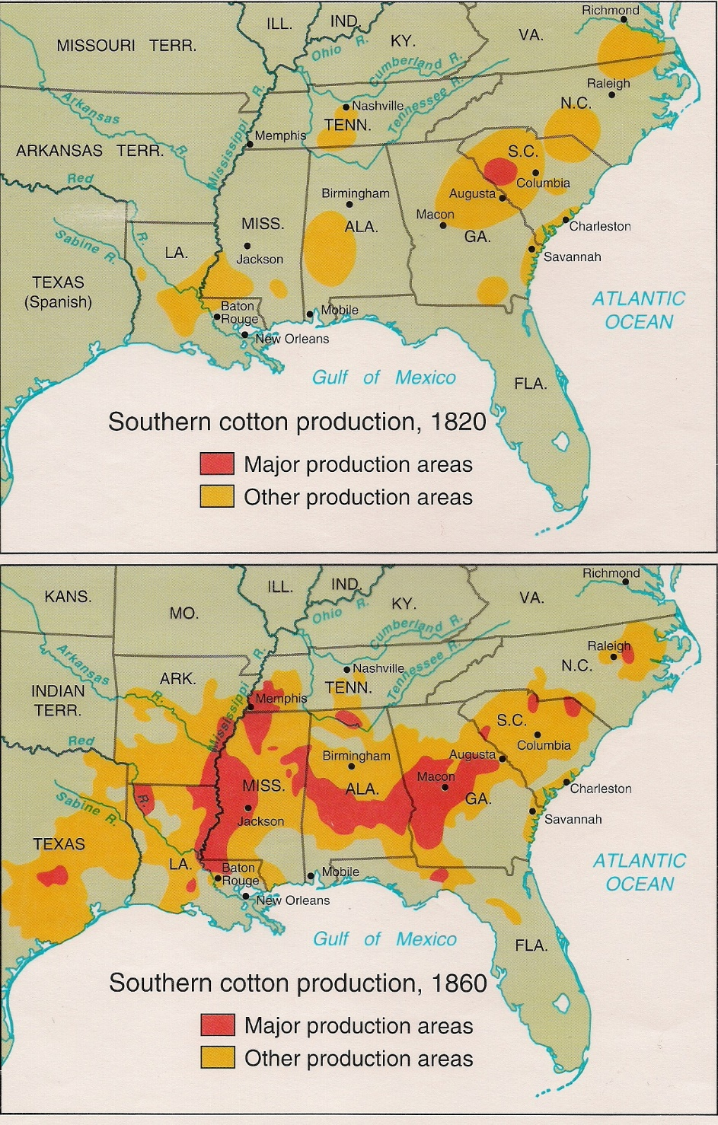
“Cotton is King”
Cheap cotton = the textile boom of both the North and Great Britain.
Southerners raced to grow more - created a HUGE demand for slave labor.
“King Cotton” -> economic growth in both the North and South (S. planters and N. shippers/manufacturers made huge profits).
Cotton production skyrocketed.
1840-60 - South produced over half of the world’s supply of cotton.
Cotton accounted for over half of all US exports.
75% of the cotton used in British textile mills came from the US South.

Slide 10
The Effect of the Cotton Gin

Slide 11
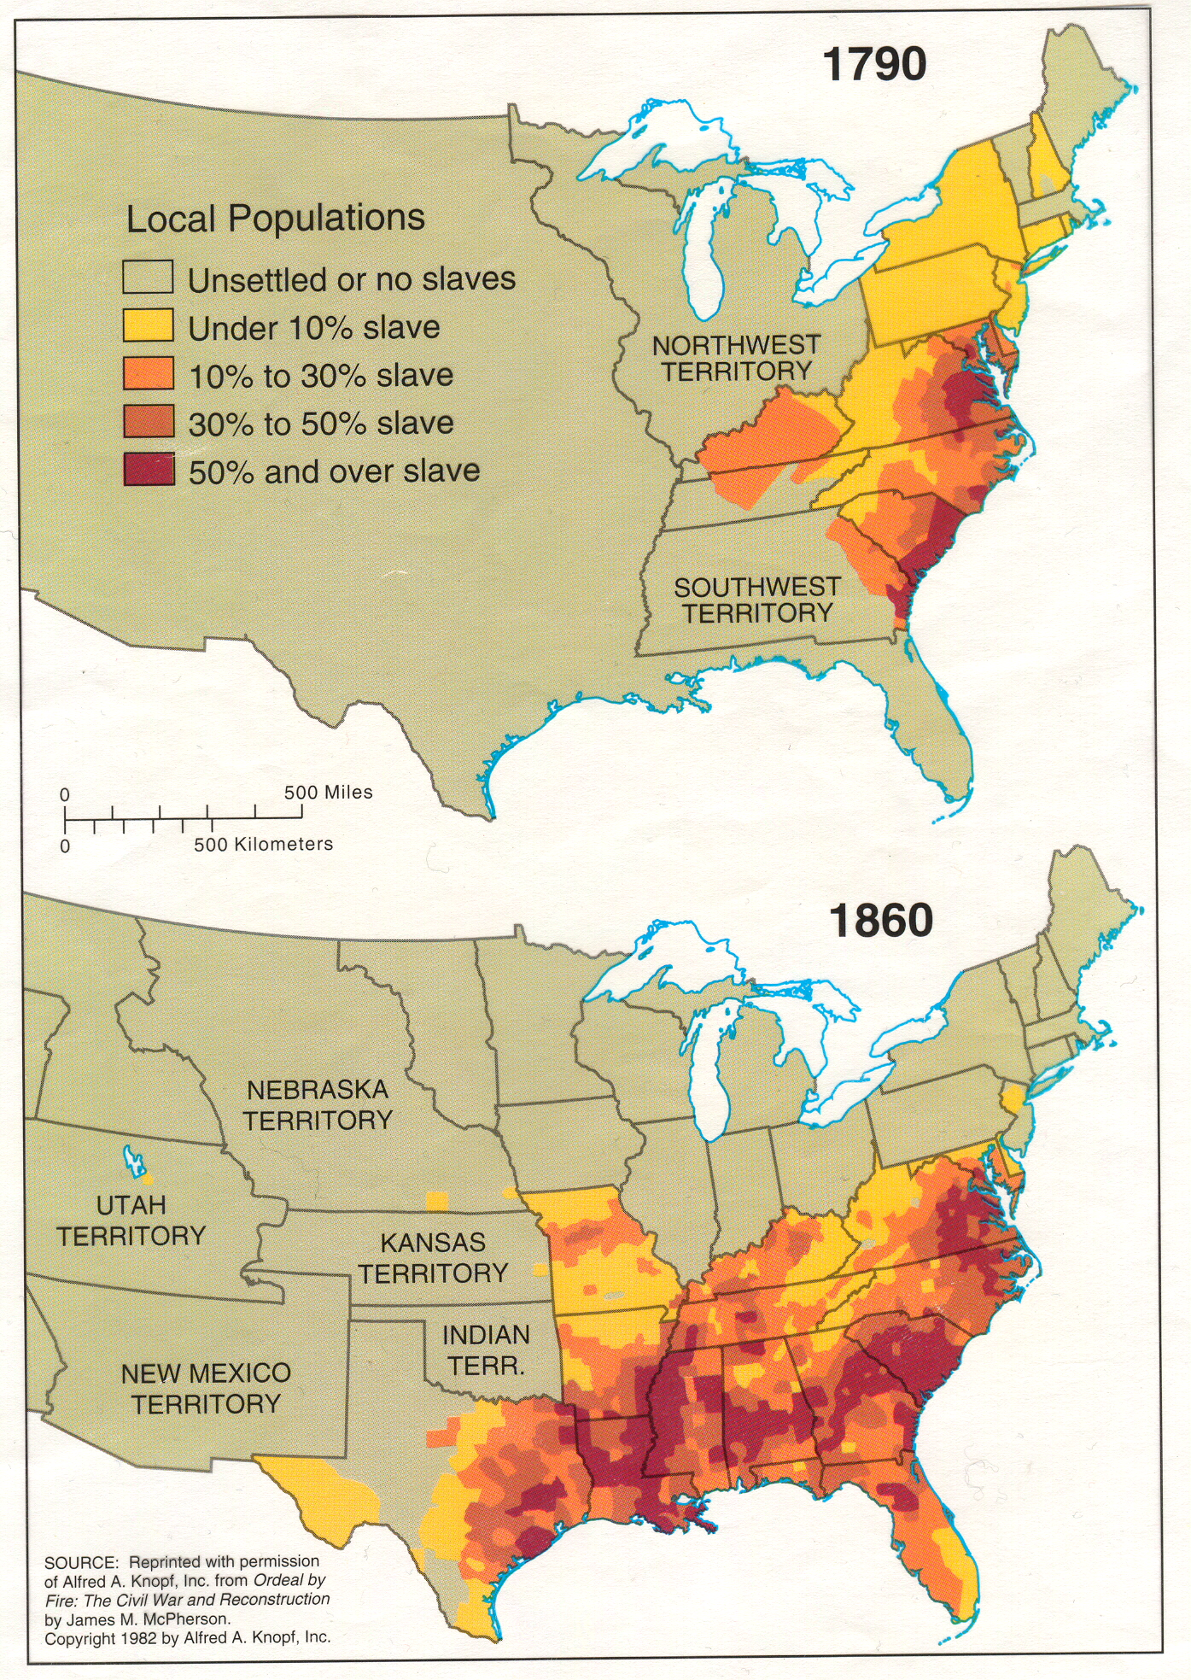

Slide 12
Notes:
http://lincolnmullen.com/projects/slavery/

Slide 13
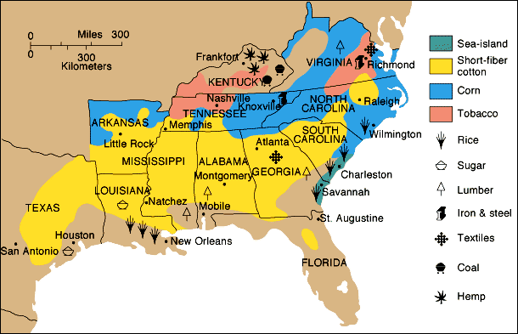
Southern Agriculture

Slide 14
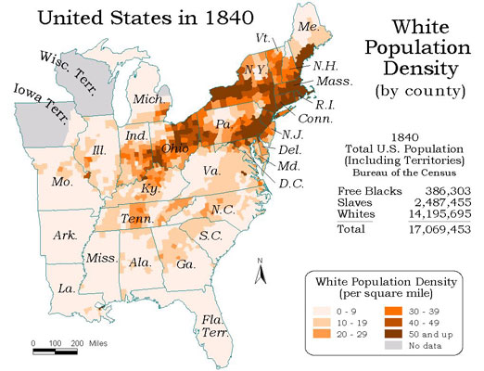
The Plantation System
Very unstable and unsustainable!
Relying on one crop was dangerous economically…if it goes under, the economy tanks.
A very small group of southerners controlled the money and power in the South – never good…
Led smaller farmers to sell land to huge plantations – land is finite…therefore your earnings are too.
The North make exponential profits off cotton production – the system is set up for the North to economically grow…the south is not.
Led to a mostly Anglo-Saxon (British descendants) , white population – immigrants were not used on plantations as laborers.

Slide 15
The South White Society
Planter Class
20 or more slaves
0.6% of Southern population
Small Slave owners
88% of slave owners; strived to be Planters
Usually worked in fields with slaves
Professionals
Lawyers, doctors, clergy, writers
Depended on planter class
Yeoman Farmers
Backbone of Southern society
Independent, self-sufficient, local commercial market
Poor Whites
10% of population
Pine barrens, pastoral farming
Perceived as lazy and uneducated

Slide 16
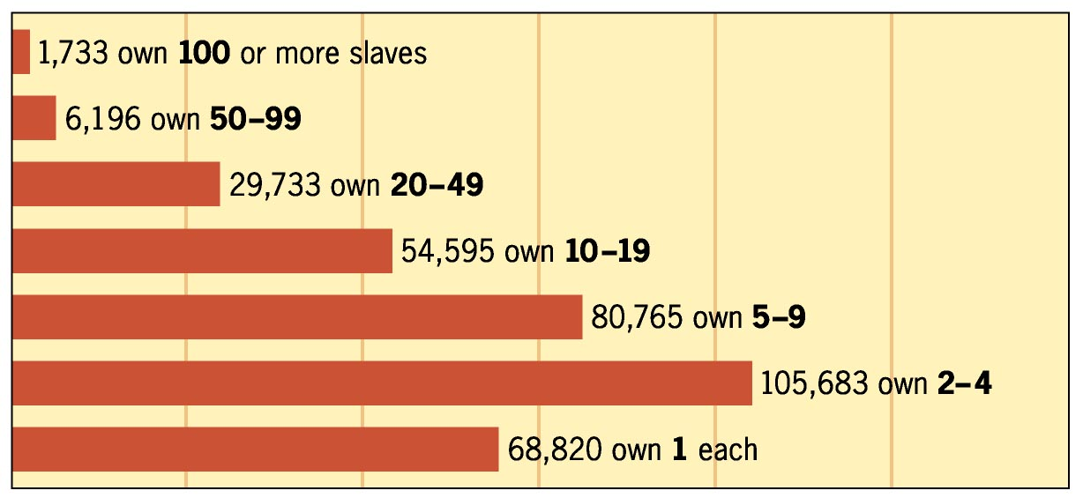
Slave-Owning Families (1850)

Slide 17
Thesis Practice
Evaluate the impact of the growth of slavery on the development of Southern society and culture.

Slide 18
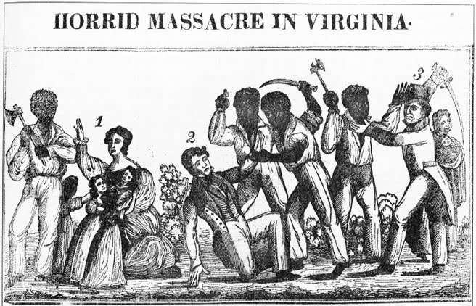
Slave Rebellion
Found ways to subvert the Plantation System.
Work slowly to slow production – gave the stereotype that Blacks are lazy.
Stole food from the owner’s home.
Sabotaged equipment.
Nat Turner’s rebellion (1831 in Virginia) - attacked several plantations and killed many white inhabitants.
A failure - he and his men captured and executed.
Had opposite effect - strengthened the resolve of southerners to control their slaves (made conditions worse for slaves).

Slide 19
Abolitionism and Antislavery Reforms
Causes
Second Great Awakening
Arguments
Slavery considered a sin (religious) and a violation of natural rights (ideological)
American Colonization Society (1816)
Founded by Quakers, abolitionists, former Upper South slave owners, Henry Clay, James Monroe
Colony in Liberia (1821-1822)

Slide 20
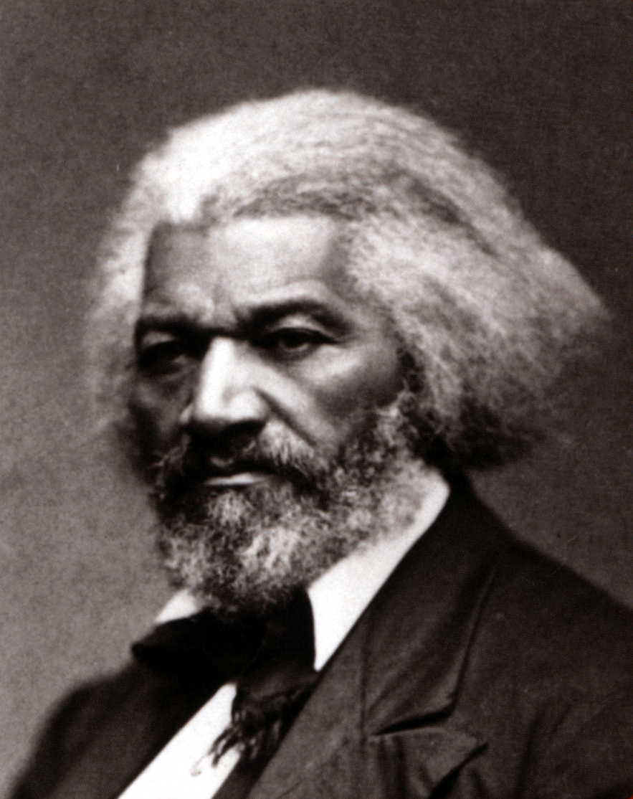
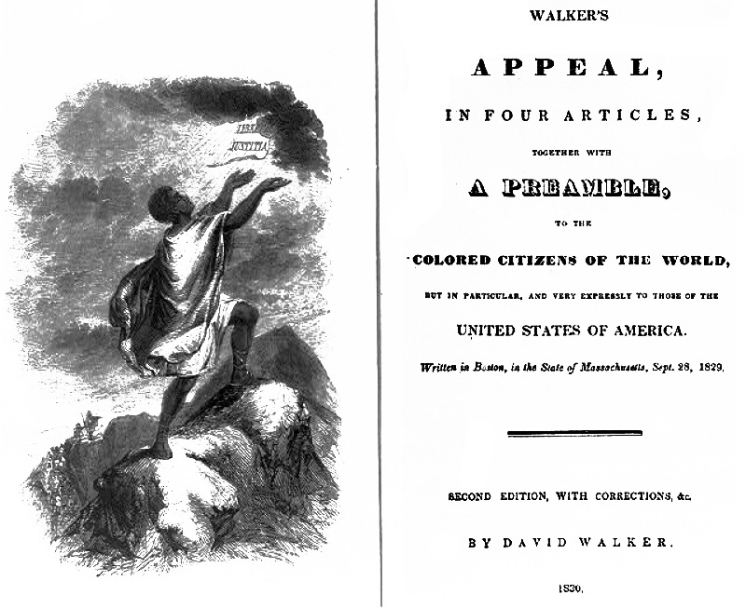
The Abolition Movement Grows
David Walker’s “Appeal to the Colored Citizens of the World” – called for violent uprising of slaves to overthrow white supremacy.
Fredrick Douglass’s “Narrative of the Life of a Slave” – self-educated to read and escaped slavery.
Used politics and more reasoned/practical – became the face of the movement.
Pro Abolition Political Parties - Liberty Party in 1840, the Free Soil Party in 1848, and eventually with the Republican Party during the 1850’s.

Slide 21
Response to Abolition
Southern
Northern
Until 1830’s – Abolition was unknown…then Nat Turner’s Rebellion and Nullification Crisis.
The South is terrified! - Tightened slave codes
Promoted religious activity – to combat the view that Slavery was un-Christian.
Contrasted the image of the Happy slave to the sweatshop working immigrant of the North.
Passed the Gag Resolution – tried to stop any debate over slavery in congress.
Mobs broke in Charleston – burned anti-slavery propaganda.
Manufacturing needed plantations to succeed – cotton production for textiles.
Bankers loaned money to plantation owners – needed them to repay!
Therefore…most people were anti-abolitionist efforts.
However…some northern citizens start to change their minds
See the south as immoral and hateful.
Leads to ideas about “Free Soil” in the Western territories.

Slide 22
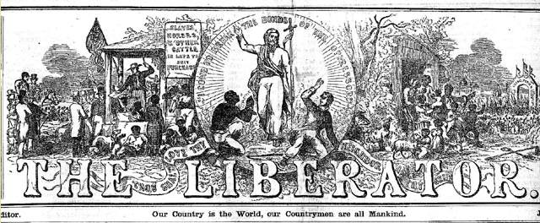
Abolitionist Publications and Speeches
The Liberator (1831) – William Lloyd Garrison
“During my recent tour for the purpose of exciting the minds of the people by a series of discourses on the subject of slavery, every place that I visited gave fresh evidence of the fact, that a greater revolution in public sentiment was to be effected in the free states – and particularly in New England – than at the south. I found contempt more bitter, opposition more active, detraction more relentless, prejudice more stubborn, and apathy more frozen, than among slave owners themselves.”
“…yea, till every chain be broken, and every bondman set free! Let Southern oppressors tremble – let their secret abettors tremble – let their Northern apologists tremble – let all the enemies of the persecuted blacks tremble.”
“I will be as harsh as truth, and as uncompromising as justice. On this subject, I do not wish to think, or speak, or write, with moderation. No! no! Tell a man whose house is on fire, to give a moderate alarm… but urge me not to use moderation in a cause like the present. I am in earnest – I will not equivocate – I will not excuse – I will not retreat a single inch – AND I WILL BE HEARD.”
The North Star – Frederick Douglass
“What To the Slave is the Fourth of July?” (1852)
“You boast of your love of liberty, your superior civilization, and your pure Christianity, while the whole political power of the nation (as embodied in the two great political parties), is solemnly pledged to support and perpetuate the enslavement of three millions of your countrymen…You invite to your shores fugitives of oppression from abroad, honor them with banquets, greet them with ovations, cheer them, toast them, salute them, protect them, and pour out your money to them like water; but the fugitives from your own land you advertise, hunt, arrest, shoot and kill. You glory in your refinement and your universal education yet you maintain a system as barbarous and dreadful as ever stained the character of a nation — a system begun in avarice, supported in pride, and perpetuated in cruelty…You are all on fire at the mention of liberty for France or for Ireland; but are as cold as an iceberg at the thought of liberty for the enslaved of America. You discourse eloquently on the dignity of labor; yet, you sustain a system which, in its very essence, casts a stigma upon labor. You can bare your bosom to the storm of British artillery to throw off a threepenny tax on tea; and yet wring the last hard-earned farthing from the grasp of the black laborers of your country. You profess to believe “that, of one blood, God made all nations of men to dwell on the face of all the earth,” and hath commanded all men, everywhere to love one another; yet you notoriously hate, (and glory in your hatred), all men whose skins are not colored like your own. You declare, before the world, and are understood by the world to declare, that you “hold these truths to be self evident, that all men are created equal; and are endowed by their Creator with certain inalienable rights; and that, among these are, life, liberty, and the pursuit of happiness;” and yet, you hold securely, in a bondage which, according to your own Thomas Jefferson, “is worse than ages of that which your fathers rose in rebellion to oppose,” a seventh part of the inhabitants of your country.

Slide 23
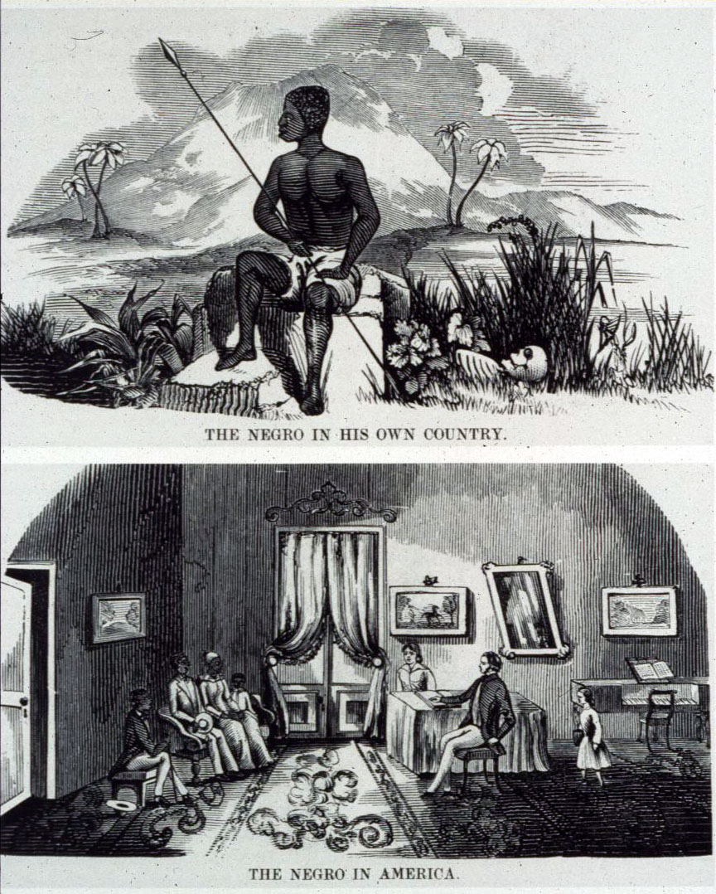

Slide 24
On the Reception of Abolition Petitions, John C. Calhoun (1837)
In one thing only are we inferior—the arts of gain; we acknowledge that we are less wealthy than the Northern section of this Union, but I trace this mainly to the fiscal action of this Government, which has extracted much from, and spent little among us. Had it been the reverse—if the exaction had been from the other section, and the expenditure with us, this point of superiority would not be against us now, as it was not at the formation of this Government.
But let me not be understood as admitting, even by implication, that the existing relations between the two races in the slaveholding States is an evil—far otherwise; I hold it to be a good, as it has thus far proved itself to be to both, and will continue to prove so if not disturbed by the fell spirit of abolition. I appeal to facts. Never before has the black race of Central Africa, from the dawn of history to the present day, attained a condition so civilized and so improved, not only physically, but morally and intellectually. It came among us in a low, degraded, and savage condition, and in the course of a few generations it has grown up under the fostering care of our institutions, as reviled as they have been, to its present comparatively civilized condition. This, with the rapid increase of numbers, is conclusive proof of the general happiness of the race, in spite of all the exaggerated tales to the contrary.
But I take higher ground. I hold that in the present state of civilization, where two races of different origin, and distinguished by color, and other physical differences, as well as intellectual, are brought together, the relation now existing in the slaveholding States between the two, is, instead of an evil, a good—a positive good.
I might well challenge a comparison between them and the more direct, simple, and patriarchal mode by which the labor of the African race is, among us, commanded by the European. I may say with truth, that in few countries so much is left to the share of the laborer, and so little exacted from him, or where there is more kind attention paid to him in sickness or infirmities of age. Compare his condition with the tenants of the poor houses in the more civilized portions of Europe—look at the sick, and the old and infirm slave, on one hand, in the midst of his family and friends, under the kind superintending care of his master and mistress, and compare it with the forlorn and wretched condition of the pauper in the poor house.
Be assured that emancipation itself would not satisfy these fanatics—that gained, the next step would be to raise the negroes to a social and political equality with the whites; and that being effected, we would soon find the present condition of the two races reversed. They and their northern allies would be the masters, and we the slaves;
We must meet the enemy on the frontier, with a fixed determination of maintaining our position at every hazard.

