Slide 1
Do Now
What existing tension (economic, political, social) existed between the US and Soviet Union before the end of WWII?

Slide 2
1: Truman’s Cold War-Containing Communism in the Post WWII World
Mr. Winchell
APUSH 2018-2019
Period 1-2

Slide 3
AP Prompt
Evaluate the extent to which Cold War foreign policy maintained continuity and fostered change in American foreign policy from 1945-1960.

Slide 4
Outline
Postwar Tension and Ideological Roots of the Cold War
Solutions: Economic, Military, Political
Tensions Blow Up-Cold War in Asia
Cold War Comes Home-McCarthyism

Slide 5
Restoration of U.S. Prosperity
World War II ended the Great Depression.
Factories run at full capacity
Ford Motor Company – one bomber plane per hour
People save money (rationing)
Army bases in South provide economic boom (most bases in South b/c of climate)
The national debt grew to $260 billion (6 times its size on Dec. 7, 1941)

Slide 6
Creating World Peace & Prosperity
U.S. leaders hoped to continue its trade dominance in Western Europe, Asia, & Latin America
At the end of WW2, the major world powers addressed the global economy & peace-keeping:
To rebuild war-torn Europe, the International Monetary Fund & World Bank were created
The United Nations replaced the League of Nations in 1945
The USA was the largest supplier of funds for both, so the USA had the greatest control over policy

Slide 7
Decolonization

Slide 8
War Conferences
Casablanca (Jan 1943)
Teheran (Nov 1943)
Agree to open western front against Germany (Operation Overlord)
Soviet invasion of eastern Germany
Unconditional surrender of Germany
Yalta (Feb 1945)
German occupation zones
Free elections in Soviet-occupied Eastern European nations
Soviet Union will attack Japan three months after defeat of Germany
New peace organization - United Nations
Security Council with veto power for P5
Potsdam (July-Aug 1945)
Japanese unconditional surrender or “prompt and utter destruction”
German and Berlin occupation zones
Nuremberg Trials and Purge of Nazism
Recognition of communist government in Poland
Partition of Vietnam at Da Nang

Slide 9
Wartime Agreements
Unlike WWI, there was no Peace of Paris to reshape Europe.
Instead, the Yalta agreement of February 1945, signed by Roosevelt, Churchill, and Stalin, turned the prevailing military balance of power into a political settlement.
Potsdam Conference, in suburban Berlin (July 1945)—Truman, Stalin, Churchill – Finalized plans on Germany. Germany would be demilitarized and would remain divided.

Slide 10
Postwar Reality: Soviet Control of Eastern Europe
Europe was politically cut in half; Soviet troops had overrun eastern Europe and penetrated into the heart of Germany.
During 1944-1945, Stalin starts shaping the post-war world by occupying SE Europe with Soviet troops that should have been on the Polish front pushing toward Berlin.
Roosevelt did not have postwar aims because he still had to fight Japan; Stalin did have postwar aims.

Slide 11
The Beginning of the Cold War
The USA supported the Russian White Army against Lenin’s Red Army
The Cold War was an era of distrust, threat of nuclear war, & ideological expansion between the superpowers, USA & USSR:
The first inkling of the Cold War began during the Russian Civil War (1917-1921) & Soviet pullout of WW1
But, American-Soviet tensions heightened at the Yalta & Potsdam WW2 conferences
Stalin agreed to allow self-determination in Eastern Europe…but never did

Slide 12
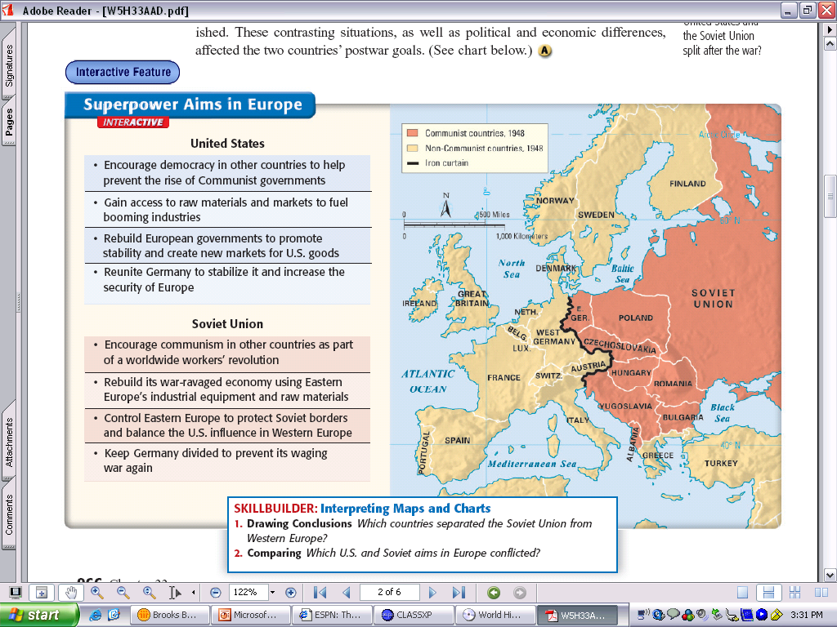
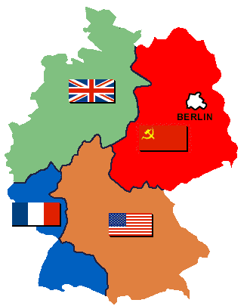
Cold War Divisions
At Yalta, Stalin agreed to allow self-determination in Eastern Europe
Potsdam was the conclusion of the American-Soviet alliance that brought an end to World War 2
By Potsdam, Stalin had extended his control over Eastern Europe to create a buffer zone between the USSR & its future enemies
Potsdam presented a major Cold War theme: Because they could not agree on how do govern Europe, Truman & Stalin divided it

Slide 13
Understanding the Cold War
Superpower nations after WWII
Soviet Union = communism, police state
United States = capitalism, democracy
Cold War meant a “war of words” rather than outright conflict
However, the Cold War includes episodes of “hot” conflicts in various regions around the world.

Slide 14
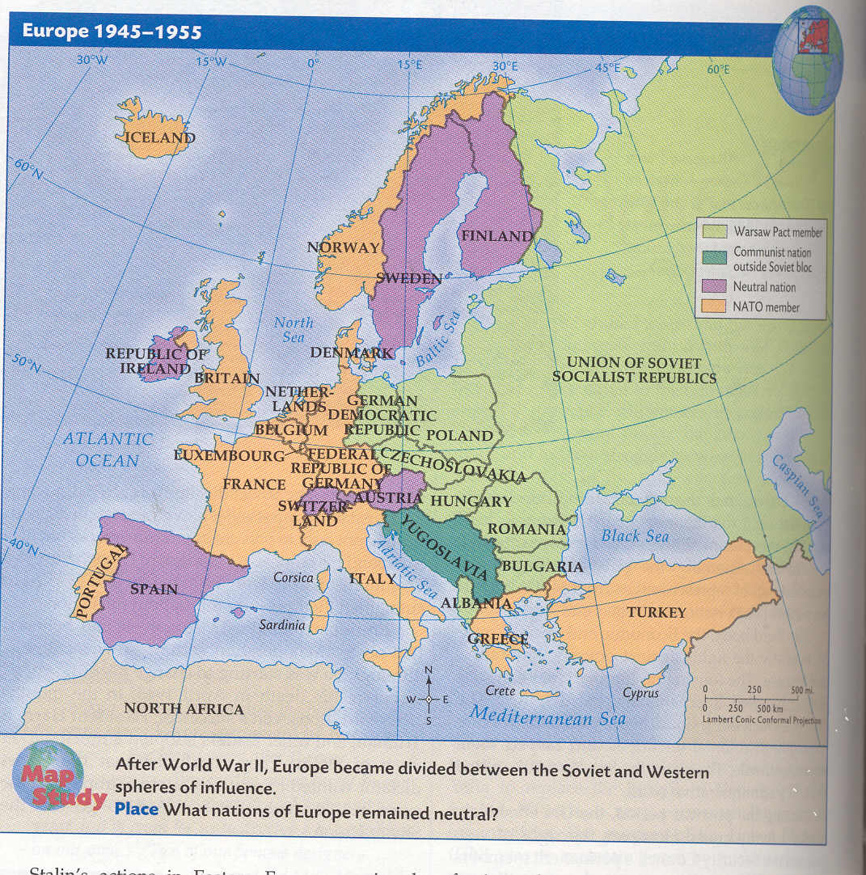
The Iron Curtain
Capitalism & Democracy
Communism & Totalitarianism
The USA began to view Stalin in the 1940s as a new Hitler—a dangerous threat & an aggressive dictator desiring world domination

Slide 15
Iron Curtain Speech
Churchill's Speech

Slide 16
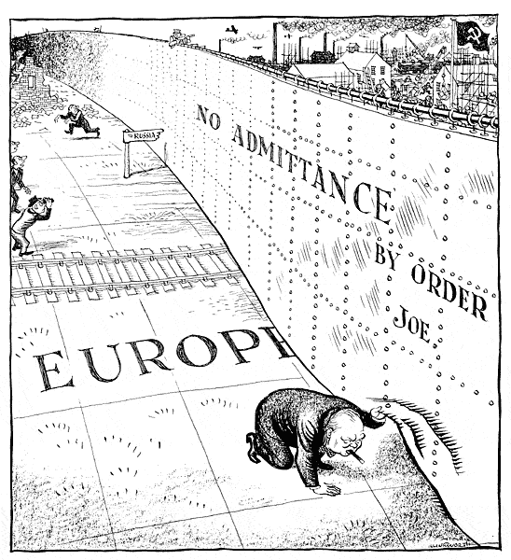

Slide 17
America Should Seek Peace with the Soviet Union; America Should Contain the Soviet Union
Henry A. Wallace – “Speech Delivered at Madison Square Garden” (1946)
George F. Kennan – “The Sources of Soviet Conduct” (1947)
The real peace treaty we now need is between the United States and Russia. On our part, we should recognize that we have no more business in the political affairs of Eastern Europe than Russia has in the political affairs of Latin America, Western Europe and the United States. We may not like what Russia does in Eastern Europe. Her type of land reform, industrial expropriation, and suppression of basic liberties offends the great majority of the people of the United States. But whether we like it or not the Russians will try to socialize their sphere of influence just as we try to democratize our sphere of influence… Under friendly peaceful competition the Russian world and the American world will gradually become more alike. The Russians will be forced to grant more and more personal freedoms; and we shall become more and more absorbed with the problems of social-economic justice.
In these circumstances it is clear that the main element of any United States policy toward the Soviet union must be that of a long-term, patient but firm and vigilant containment of Russian expansive tendencies… [I]t will be clearly seen that the Soviet pressure against the free institutions of the western world is something that can be contained by the adroit and vigilant application of counter-force at a series of constantly shifting geographical and political points, corresponding to the shifts and maneuvers of Soviet policy, but which cannot be charmed or talked out of existence. The Russians look forward to a duel of infinite duration, and they see that laready they have scored great successes. It must be borne in mind that there was a time when the Communist Party represented far more of a minority in the sphere of Russian national life than Soviet power today represents in the world community.

Slide 18
Containment
Truman’s Secretary of State, George Marshall, began a policy of Containment in 1947
Strong resistance to the USSR would stop Russian expansion & the spread of communism
The U.S. initiated containment in 3 phases: Truman Plan, Marshall Plan, & NATO
“A long-term, patient but firm, and vigilant containment of Russian expansionist policies… Will not lead to any immediate victory but will eventually force the USSR to live in peace with the West”

Slide 19
Critique of Containment
Walter Lippman
Textual Analysis

Slide 20
The Marshall Plan
European nations had difficulty recovering after WW2 which led to U.S. fears of Communist coups in Europe
The Marshall Plan offered aid to help Europe recover
Industry revived & Western Europe became a bonanza for U.S. trade & consumer goods
The “Communist threat” ended

Slide 21
Truman & Containment (1945-1953) Marshall Plan
European Recovery Program
$13 billion in grants
Rebuild and develop European infrastructure
Designed to prevent communist uprisings or infiltration in vulnerable nations

Slide 22
The Truman Doctrine
Soviet pressure on Greece & Turkey led to U.S. fears of Russian influence on 3 continents
Taking Greece might lead to communism in Iran & all of Asia
Then, into Egypt & all of Africa
Then, all of Europe through Italy
The Truman Doctrine offered U.S. assistance to any nation threatened by Communism
This commitment to stopping the spread of Communism was viewed by the Soviet Union as an informal declaration of a cold war

Slide 23
Truman & Containment (1948) Berlin Blockade and Airlift
Soviet Union establishes blockade of West Berlin
In response to capitalist-based reforms in Western Germany
U.S. and allies launch aerial campaign from 1948-1949
Drop food and fuel to citizens
Success of Airlift Campaign
Over 200,000 flights
47,000 tons daily
Germany officially split
Democratic Republic of Germany (East Germany)
Federal Republic of Germany (West Germany)

Slide 24
NATO
This is a major departure from the traditional U.S. policy of isolationism
Fears of Soviet aggression led to the formation of the North Atlantic Treaty Organization in 1949:
To provide collective security for Western Europe, the USA, Canada, Greece, & Turkey
The Cold War now had an ideological (Truman Doctrine) & economic (Marshall Plan) base & military enforcement (NATO)

Slide 25
Truman & Containment (1945-1953) Cold War Alliances
North Atlantic Treaty Organization (NATO) (1949)
Permanent alliance between U.S., Canada, Western Europe, Greece, Turkey
If one member is attacked, all treaty nations will defend
Warsaw Pact (1955)
Soviet Union’s version of NATO
Eastern European satellite nations

Slide 26
The Military Dimension
The new air force was the preferred military agency of the Cold War due to its ability to deliver nuclear bombs & deter enemy attacks
By 1947, 3 new agencies were created so the military could better respond to threats to U.S. security
Dept of Defense to direct the army, navy, & the new air force
Central Intelligence Agency to collect & manage information among all gov’t agencies
Nat’l Security Council to advise the president on nat’l security

Slide 27
The Military Dimension
In 1950, the NSC created a new nat’l defense plan, NSC-68:
Labeled communism a “fanatical” & “permanent” threat to the U.S. & rest of the world
Pledged the U.S. not only to contain communism but to liberate communist countries
Recommended the expansion of U.S. military, stockpiling nuclear weapons, & covert operations
NSC-68 came in response to the Soviet development of an atomic bomb & the “loss” of China to communism
NSC-68 was a military, economic, political & psychological examination of the USSR & China in order to develop an appropriate American responses to these threats
This policy paper became a “blueprint” for the Cold War & shaped U.S. actions over the next 20 years
3 months after NSC-68 was written, its assessment appeared correct when North Korea attacked South Korea; U.S. military buildup began
Notes:
ABOUT NSC-68
In the fall of 1949, Western powers were shaken by the communist takeover of China and the Soviet's test of the atomic bomb. As a result, President Truman requested a comprehensive analysis of Soviet and American capabilities.
The result was an extensive document by the National Security Council examining the two powers from military, economic, political and psychological standpoints. The policy paper produced by the NSC (known as “NSC 68”) was one of the most important – and controversial – documents of the Cold War. This document shaped government actions in the Cold War for the next 20 years. Because its program for guiding U.S. foreign policy was so influential, it has been labeled the “blueprint” for the Cold War.
Among its most important recommendations, it called for a massive buildup and an increase in funding for the armed forces in an effort to contain the Soviets. But beyond its authorization of a massive military build-up, the document is interesting for how it explains and analyzes the intentions of the U.S. and the Soviet Union in international affairs, and for other measures it advocates for expanding American power and containing Soviet power.
Three months after the report was written, its assessment appeared correct: North Korea attacked South Korea on June 25, 1950, and the military buildup began.

Slide 28
Nuclear Arms Race
Nuclear weapon development
United States develops weapons with higher yields
Soviet Union
Detonated first nuclear weapon (August 1949)
United Kingdom
Detonated first nuclear weapon (October 1952)
France
Detonated first nuclear weapon (February 1960)
China
Detonated first nuclear weapon (October 1964)

Slide 29
The Cold War in Asia
By 1952, Asia also was divided:
After WW2, the U.S. helped create a Japanese democracy & signed a U.S.-Japanese alliance
In 1949, Truman “lost” China after a Mao Zedong’s defeat of Chiang Kai-shek & Kuomintang
In 1950, China signed a mutual assistance treaty with the USSR
The U.S. refused to recognize Communist China & continued its diplomatic relations with the Kuomintang Nationalists in Taiwan

Slide 30
The Korean War
The showdown between the U.S. & USSR in Asia came in Korea:
After WW2, Korea was divided along the 38° with USSR in the North & the USA in the South
Soviet-trained North Korea attacked across the 38° in 1950
The United Nations condemned North Korea & sent (U.S.) troops

Slide 31
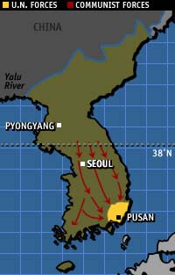
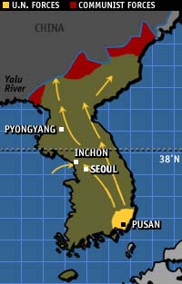
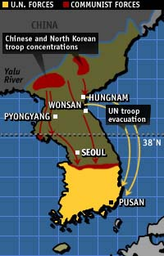
Truman was unable to end the Korean War
United Nations Counter-Attack
September-October 1950
North Korean Invasion
June-September 1950
Chinese Advance
October-January 1951
Eisenhower made the Korean War a campaign issue in 1952

Slide 32
The Korean War
MacArthur hoped to unify Korea but Truman feared a world war
In 1953, the 38° was restored under Eisenhower, but:
Truman achieved his original goal to defend South Korea
The U.S. showed its dedication to fight (not just talk) in the war against the Communists

Slide 33
The Cold War at Home
The Second Red Scare and Truman’s Domestic Policies

Slide 34
The Cold War at Home
The Republican Congress overturned the Wagner Act with the Taft-Hartley Act that weakened unions by forcing members to swear an anti-communist oath
Truman’s domestic policy was not as successful as his foreign policy
Post-war Americans found prices too high & supply too low on new consumer goods
Union members went on strike to demand their share of wartime company profits
In the 1946 mid-terms, Repubs took back the House & Senate

Slide 35
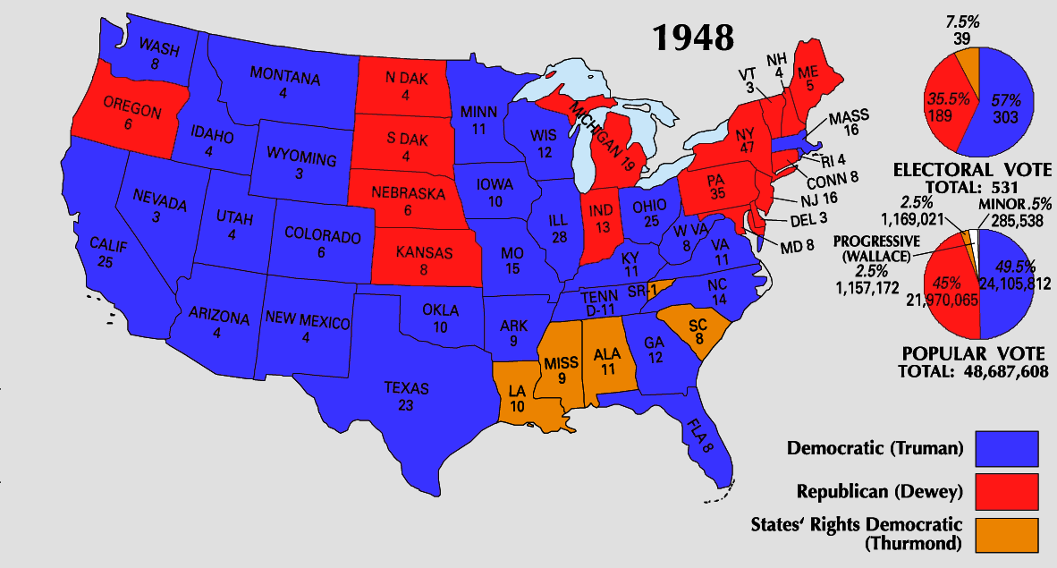
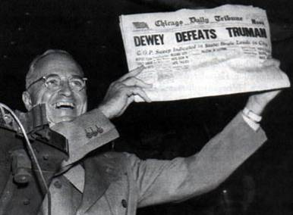
The Cold War at Home
Reelection in 1948 seemed remote
Truman faced strong opposition from Republican Thomas Dewey, Progressive Henry Wallace, & Dixiecrat Strom Thurman
With nothing to lose, Truman campaigned across the country
The “FDR coalition” of farmers, labor, urban, black voters held together to keep Truman in office
He attacked the “do-nothings” Republicans
He reminded voters that the Democrats ended the Depression
The Republicans couldn’t attack Truman’s Cold War successes

Slide 36
Truman’s Fair Deal
A continuation of New Deal-style social welfare programs
21-Point Domestic Program
Expansion of Social Security
Increased minimum wage
Housing Act of 1949
Urban projects and public housing
Prevention by Conservative Coalition
National healthcare insurance
Limited civil rights legislation

Slide 37
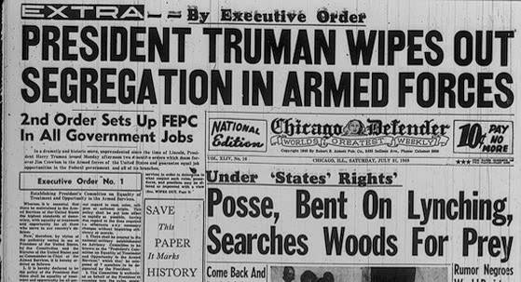
Truman and the Fair Deal
Truman’s Fair Deal tried to extend FDR’s social aid programs:
Called for increasing minimum wage & Social Security benefits
Wanted national heath insurance
Fair Employment Practices Commission to end economic discrimination against blacks
Repubs & southern Democrats blocked all Fair Deal legislation
Notes:
Ex Order 9981-in military
Ex Order 8802-In defense industries

Slide 38
The Loyalty Issue
The Federalists in the 1790s used the Alien & Sedition Acts
Fear of radicalism is a recurrent theme in U.S. history; In the 1940s & 1950s, American fears of Communism grew as a result of:
The fall of China to communism
The successful testing of an atomic bomb by the USSR
The discovery of American spies
Fear of an unseen conspiracy
The Know-Nothings attacked foreigners in the 1850s
The Red Scare after WW1 was aimed at radicals & foreigners

Slide 39
The Loyalty Issue
The fear of Communism abroad led to a 2nd Red Scare in America:
Fears of Soviet espionage led to House Un-American Activities Committee to rid gov’t of spies
Loyalty Review Board fired gov’t workers for “reasonable doubt”
Justice Dept jailed 11 members of the Communist Party for plotting a socialist revolution
Alger Hiss in the State Dept was accused of being a USSR spy
Manhattan Project employee Klaus Fuchs admitted to providing nuclear plans to the USSR
Ethel & Julius Rosenberg were executed for leaking atomic secrets to the USSR despite a lack of hard evidence

Slide 40
COMMUNISTS IN THE US GOVERNMENT!
Textual Analysis

Slide 41
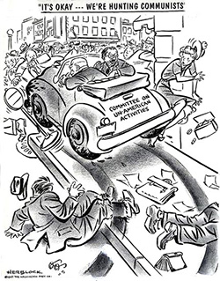

Slide 42
McCarthyism in Action
Used a barrage of treasonable actions against the accused that overwhelmed the defendant’s ability to respond
In 1950 Joseph McCarthy (R-WI) accused 205 State Dept workers of being Communists; Began a 4½ year attack on “Communists”
McCarthyism was popular because it offered an easy solution to the Cold War: defeat the enemy at home & avoid costly, entangling policies abroad
McCarthy failed to find a single confirmed Communist in the U.S. gov’t & never had more than 50% approval rating among voters
He attacked U.S. gov’t agencies, especially the State Dept, of harboring spies

Slide 43
Conclusions
Cold War foreign policy dominated American thoughts throughout the 1940s & early 1950s:
Defense spending increased dramatically
The nuclear arms race made people anxious about the future
With Eisenhower’s election in 1952 American anxieties subsided as the Cold War became more covert

Slide 44
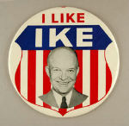
Election of 1952
Dwight D. Eisenhower (R)
I Like Ike
Richard Nixon as VP
Checkers speech
Adlai Steveneson (D)

