Slide 1
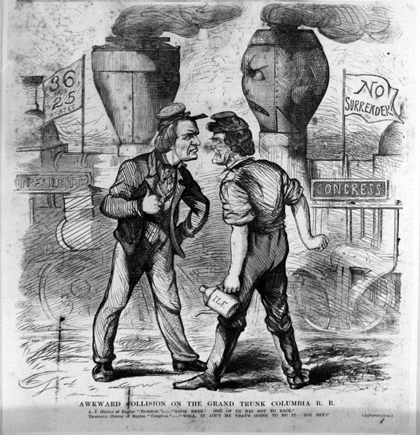
Do Now

Slide 2
Congressional Reconstruction and Reconstruction’s End: 1864-1877
Mr. Winchell
APUSH 2018-2019
Period 5

Slide 3
AP Prompt
Evaluate the extent to which Reconstruction accomplished its political and social goals in the years 1865-1877.

Slide 4
The Problems of Peacemaking
The Aftermath of War and Emancipation
The war is over, now what?
South was destroyed
Physically
Socially (20% of white male pop.)
Economically – hyperinflation, no resources, no trade, no workers, no banks, etc.
The “Lost Cause” = sense of loss for southern whites

Slide 5
4 million slaves freed into far worse conditions?
No family, no $, no land, no donkeys?, no where to go, no food, … you get the picture!
Competing Notions of Freedom
Reconstruction = quest for freedom!!!
Blacks = land “If I cannot live like a white man, than I am not free”
Whites = freedom from “foreign” (federal) “oppression & white supremacy
whites often times tried to keep black workers legally tied to plantations, aka sharecropping
Black Codes

Slide 6
Sharecropping
50% white farmers and 75% black farmers
Crop-lien system
Tenant farming
Exodusters

Slide 7
The Radical Republicans
Radicals
Thaddeus Stevens
Charles Sumner
Midterm Election of 1866
“Not every Democrat was a rebel, but every rebel was a Democrat!”
Won supermajorities in both houses of Congress
Anti-Radical Republican propaganda
Pennsylvania, 1866

Slide 8
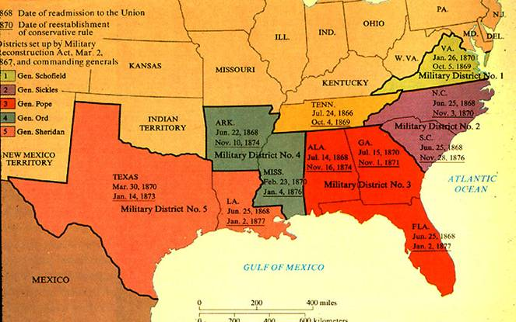
Reconstruction, Phase 3 Radical Republican Plan
Reconstruction Acts of 1867
Military districts
New state constitutions approved by Congress
Black suffrage guarantees
Ratification of the 14th Amendment

Slide 9
Reconstruction, Phase 3 Radical Republican Plan
Fourteenth Amendment (1868)
Civil Rights Act of 1966
Anyone born or naturalized was American citizen (Citizenship Clause)
“nor shall any State deprive any person of life, liberty, or property, without due process of law” (Due Process Clause)
“nor deny to any person within its jurisdiction the equal protection of the laws” (Equal Protection Clause)
Disavowed Confederate leaders; states responsible for own war debt; loss of electoral votes for disenfranchisement
Fifteenth Amendment (1870)
”The right of citizens of the United States to vote shall not be denied or abridged by the United States or by any State on account of race, color, or previous condition of servitude.”

Slide 10
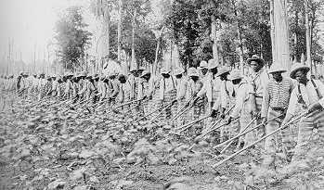
Freedmen in the South
Political Recognition
Voting Rights
Affiliated with Republican Party
Public Office
2 U.S. Senators
14 U.S. Representatives
630 black state legislators
Black governor of Louisiana
Desire for Autonomy and Opportunity
Independent churches
Public schools
Slavery By Another Name
Sharecropping
Convict leasing

Slide 11
Northern Influence on the South
Scalawags
Southern Republicans fostering American System-type programs
Cooperated with Northern politics and economics
Carpetbaggers
Northerners investing in “New South,”
Reformers/provide aid
Squatters and plunderers
The Man with the (Carpet) Bags
Thomas Nast, 1872
Depicts Carl Schurz, a Liberal Republican critical of Grant’s Reconstruction policies

Slide 12
White Southern Resistance
White Supremacy Paramilitary Groups
The South Will Rise Again!
White League
Ku Klux Klan (1867)
Nathaniel Bedford Forrest
“invisible empire”
Enforcement Acts (1870, 1871)
“The Union as it Was”
Thomas Nast, Harper’s Weekly
October 1874

Slide 13
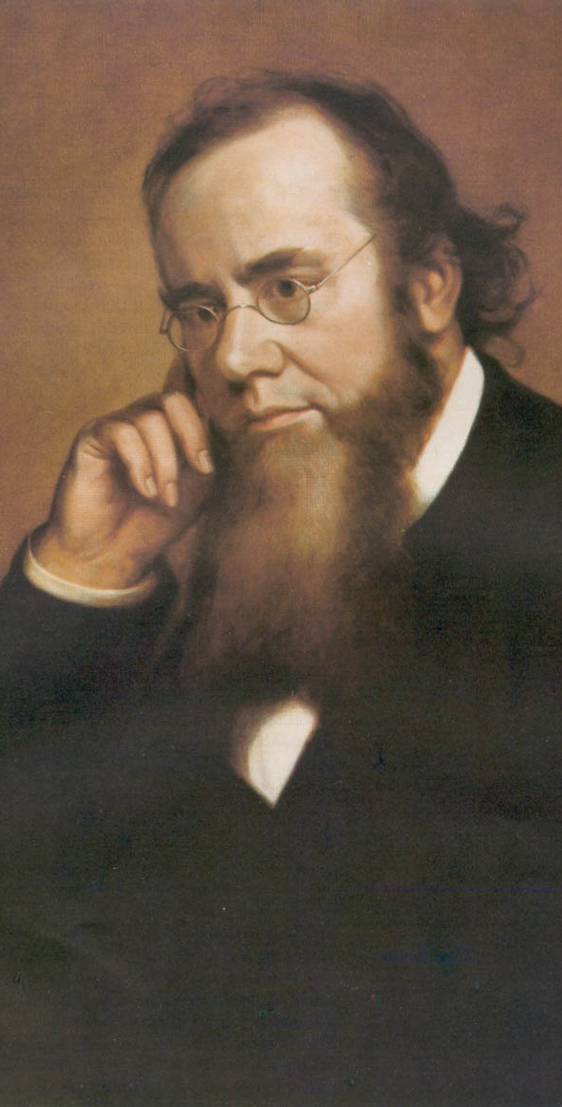
Reconstruction Acts of 1867
Command of the Army Act
The President must issue all Reconstruction orders through the commander of the military.
Tenure of Office Act
The President could not remove any officials [esp. Cabinet members] without the Senate’s consent, if the position originally required Senate approval.
Designed to protect radical members of Lincoln’s government.
A question of the constitutionality of this law.
Edwin Stanton

Slide 14
President Johnson’s Impeachment
Johnson removed Stanton in February, 1868.
Johnson replaced generals in the field who were more sympathetic to Radical Reconstruction.
House impeaches him by massive majority
Senate hears trial, 1 vote short of removing from office.

Slide 15
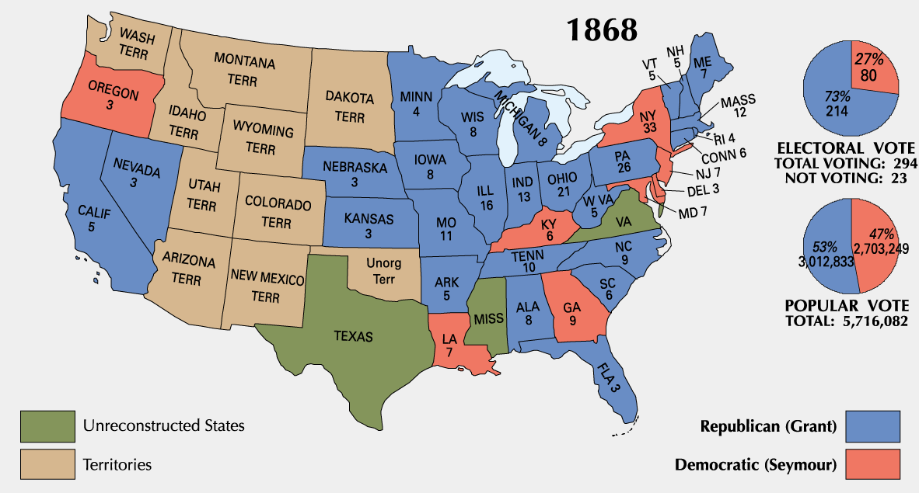
1868 Presidential Election
Notes:
COULD NOT HAVE WON WITHOUT BLACK VOTE

Slide 16
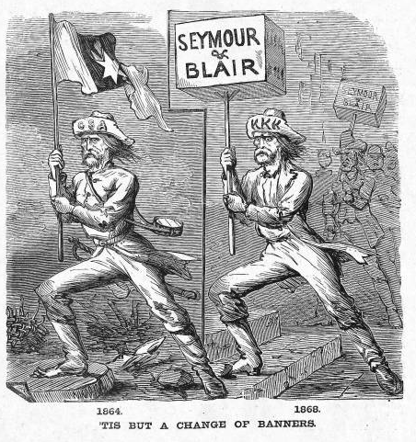
Waving the Bloody Shirt!
Republican “Southern Strategy”

Slide 17
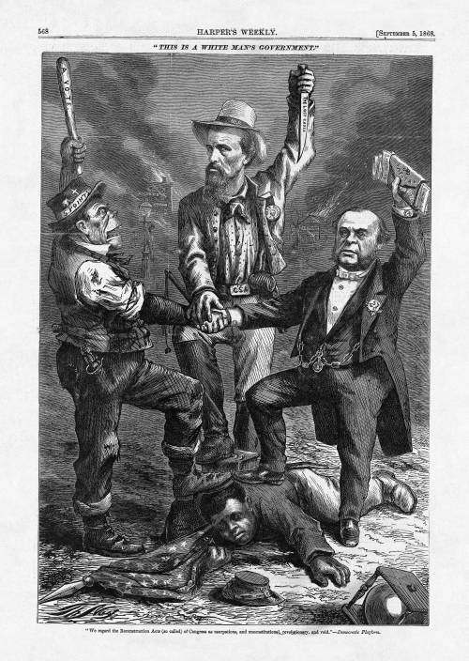
Notes:
"We regard the Reconstruction Acts (so called) of Congress as usurpations, and unconstitutional, revolutionary, and void." - Democratic Platform
The man on the left is a caricature of an Irish American man, whose hat reads "5 Points," referring to the New York City Irish residents, who are often configured as a mob. The man in the middle is identified by the initials on his hat "NBF" - Nathan Bedford Forrest, a former Confederate general and founder of the Ku Klux Klan. The man on the right is a wealthy man from 5th Avenue in New York who holds a stack of money that will be used to purchase votes.

Slide 18
Ulysses S. Grant’s Presidency
President Grant’s (a Republican) cabinet is corrupt and scandals break out
People move away from Republican party as a result
Grant thought of as one of worst Presidents

Slide 19
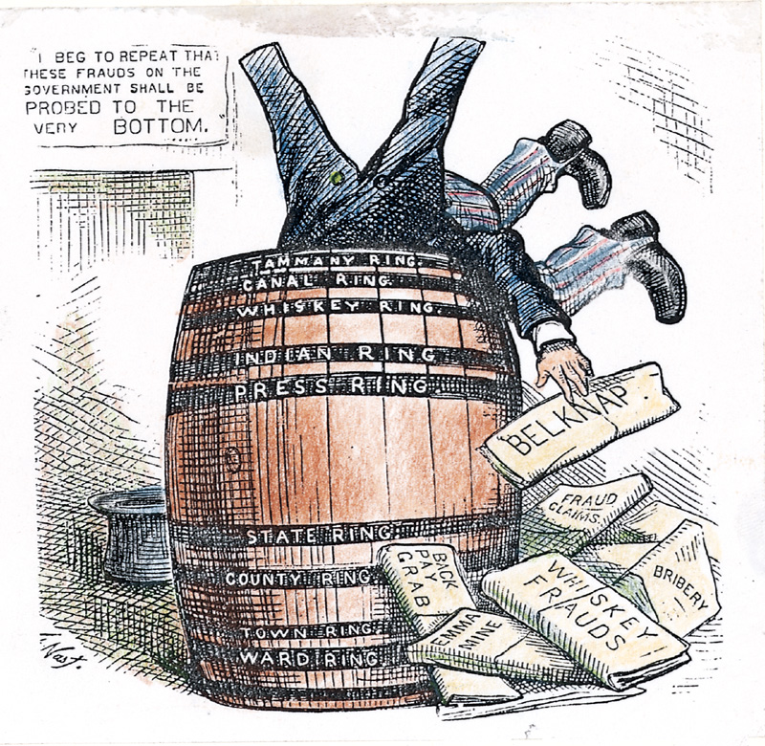
Ulysses S. Grant (R) (1869-1877)
Civil War hero, but no political experience; linked with moderates and Radicals
Grantism
Credit Mobilier
Union Pacific Railroad creates dummy construction company to hire execs at inflated salaries and earn high dividends
Sold stock to Republican congressmen and bribed press to keep quiet
Whiskey Ring
Republicans embezzled liquor tax revenues using bribes and networks
Amnesty Act of 1872
Panic of 1873

Slide 20
Panic of 1873
US economy goes into a severe recession (2 million unemployed of 36 million)
Cause: Civil War currency & overextension of industry
NO DIFFERENT THAN EVERY OTHER PANIC
People increasingly choose Democrats to try to fix the problems

Slide 21
Legal Challenges to Reconstruction
Civil Rights Act of 1875:
Equal access to public places
No enforcement mechanism
Slaughterhouse Cases (1873)
STRICT interpretation of 14th Amendment
States have authority over citizens’ rights
Bradwell v. Illinois (1873)
Female attorney sues for right to practice law
SC rules she’s a woman, shouldn’t be practicing law
US v. Cruickshank (1876)
LA white supremacists accused of attacking meeting of African Americans, convicted under Enforcement Acts.
SC rules 14th Amendment only applies to STATES discriminating, not people/business.
US v. Reese, et. Al (1876)
SC rules STATES confer voting rights on individuals, not fed. gov.
15th Amendment doesn’t guarantee right to vote apparently
Notes:
Uhhh and then Plessy v. Ferguson

Slide 22
Northern Support Wanes
“Grantism” & corruption.
Panic of 1873 [6-year depression].
Concern over westward expansion and Indian wars.
Key monetary issues:
should the government retire $432m worth of “greenbacks” issued during the Civil War.
should war bonds be paid back in specie or greenbacks.

Slide 23
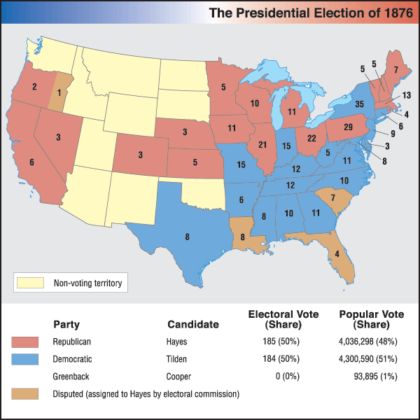
“Election” of 1876
Samuel
Tilden (D)
Rutherford B.
Hayes (R)
Republicans struggle to nominate “boring” Rutherford B. Hayes
Democrats nominate solid and popular Samuel J. Tilden
Tilden won the popular vote solidly and needed only 1 more electoral vote for majority
Contested electoral votes in 3 Reconstruction states (Louisiana, South Carolina, Florida)
Electoral Commission rewarded 3 sets of electoral votes to Hayes
Split ideologically 8-7 in favor of Republicans

Slide 24
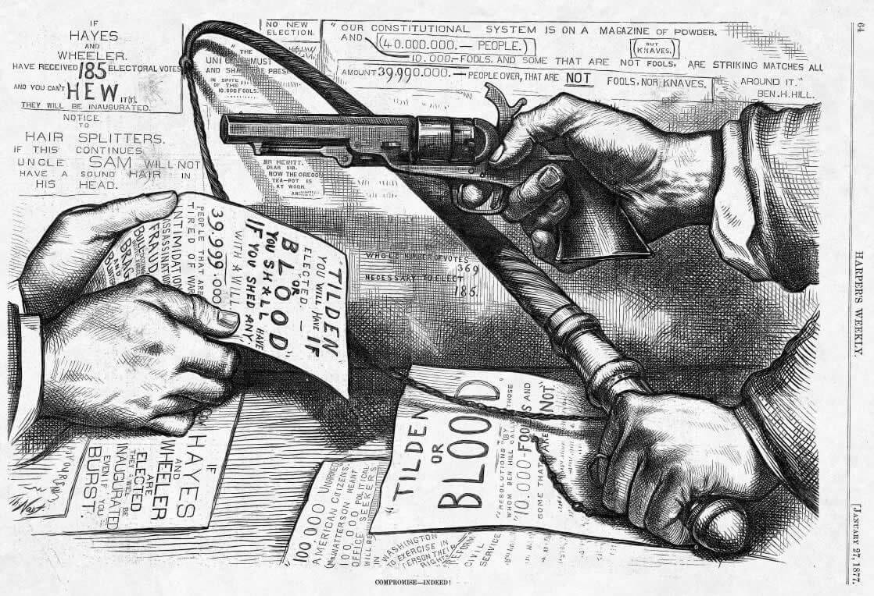

Slide 25
U.S. Troops Recalled
Hayes wins support of the House in exchange for removing federal troops from South
Army that Congress sent to South to supervise Reconstruction were called back in 1877 by President Rutherford B. Hayes
Effectively ends supervision in the South
Southern Democrats (segregationists) are now in control

Slide 26
Four Reasons For End of Reconstruction
Legal challenges to Reconstruction
Grant’s Presidency (he sucks)
Panic of 1873
Recall of troops in 1877/Compromise of 1877

Slide 27
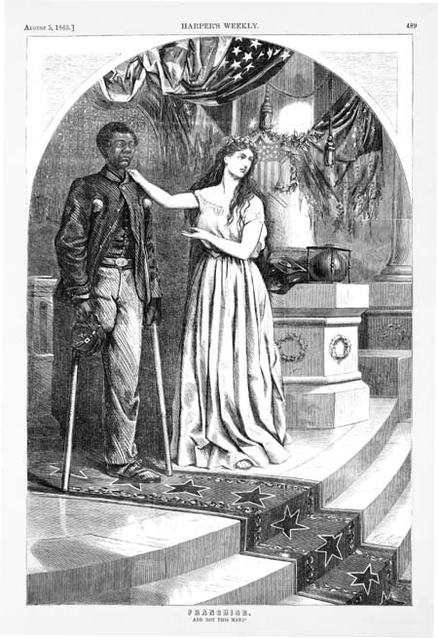
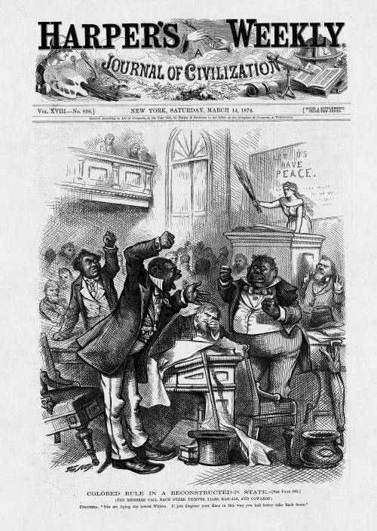
Evolution of Northern Attitude Toward Blacks During Reconstruction
Shown through the political cartoons of Thomas Nast of Harper’s Weekly
“And Not This Man?”
August 1865
“Colored Rule in a Reconstructed State”
March 1874

Slide 28
End of Reconstruction
Why did it end?
Compromise of 1877
The compromise settled the disputed 1876 election
Hayes (Republican) became President
ENDED MILITARY RULE IN THE SOUTH!
Southerner appointed to cabinet
Impact of end of Reconstruction?
Jim Crow Laws
Upheld by Plessy v. Ferguson
Disenfranchisement for blacks

Slide 29
The Southern States “Redeemed”
States of the upper south had a majority of white citizens, thus had an easy time putting their candidates into power once they regained suffrage
In states where blacks had the majority, whites used intimidation and violence to undermine the Reconstruction regimes
KKK – secret society, midnight raids, military force; thought of as a patriotic society by southern whites
Knights of the White Camellia
Red Shirts and White Leagues worked to force all whites to join Democratic party and exclude blacks from political activities
economic intimidation = land owners did not rent to blacks who voted

Slide 30
The Birth of Jim Crow
Evading the 15th Amendment
poll tax
“literacy” or “understanding” tests (often unfair)
grandfather laws
Williams v. Mississippi (1890) validated southern literacy tests
Jim Crow = an elaborate system of segregation reaching into almost every area of southern life. Served as a means for whites to retain control of social relations between the races in the newly growing cities and towns of the South.

Slide 31
The Birth of Jim Crow
1890s dramatic increase in white violence towards blacks: 187 lynchings each year, more than 80% of them in the South, the vast majority of victims black
prisoners seized from within prisons and hanged in front of large audiences
Southern whites controlled black population through terror

Slide 32
The New South
The “Redeemers”
by 1877 every southern state “redeemed” = white Democrats in charge at nearly every level of Southern government
South falls into control of a powerful, conservative oligarchy known as “Redeemers” or “Bourbons”
Committed to home rule, social conservatism and economic development
Democrats cut taxes, reduced government spending, drastically diminished state services
Dissenting movements (“Readjusters”, etc.) crushed

Slide 33
The Industrialization of the “New South”
Many Southerners believed they had lost the war because they had a weak industrial economy... now the goal of the “New South was to Out Yankee the Yankees”
Southern literature and print depicted antebellum South with nostalgia and embraced the “Lost Cause”... portrayed slaves society as a harmonious world
Textile factories appearing in greater numbers in the South
Iron and the Railroad
Women working in them, African Americans barred
Efforts to unionize crushed
Prisoners, “chain gangs”, often doing hard labor and being paid nothing

Slide 34
The “New South”
Henry W. Grady
"There was a South of slavery and secession - that South is dead. There is now a South of union and freedom- that South, thank God, is living, breathing, and growing every hour,” (1886)
"the supremacy of the white race of the South must be maintained forever, and the domination of the negro race resisted at all points and at all hazards, because the white race is the superior race... [This declaration] shall run forever with the blood that feeds Anglo-Saxon hearts.” (1888)
Public School Systems
Agriculture
Cotton, tobacco, rice
Industry and Urbanization
Dependent on Northern investment
Increased network of standardized rail lines
Coal mining

