Slide 1
Do Now
Evaluate the goals and realities of Presidential Reconstruction (1865-1867)

Slide 2
10. Reconstruction: Successes, Failures and Legacies
Mr. Winchell
APUSH
Period 5

Slide 3
AP Prompt
Evaluate the extent to which racial division led to the end of Reconstruction.

Slide 4
Sharecropping
50% white farmers and 75% black farmers
Crop-lien system
Tenant farming
Exodusters

Slide 5
The Radical Republicans
Radicals
Thaddeus Stevens
Charles Sumner
Midterm Election of 1866
“Not every Democrat was a rebel, but every rebel was a Democrat!”
Won supermajorities in both houses of Congress
Anti-Radical Republican propaganda
Pennsylvania, 1866

Slide 6
Congressional/Radical Reconstruction – Phase 3 Reconstruction Acts of 1867-1868
Former confederate state refused to ratify the Fourteenth Amendment (except Tennessee)
Previously admitted former Confederate states placed under U.S. Army control in military districts
Military enforced martial law to protect blacks, supervise elections, and protect office holders
Register all eligible voters, including whites and free/freed blacks
Excluded former Confederates until approved by Congress
Call new state constitutional conventions
Congress must approve new state constitutions
State constitutions must include black suffrage
Must ratify Fourteenth Amendment

Slide 7
Reconstruction, Phase 3 Radical Republican Plan
Fourteenth Amendment (1868)
Civil Rights Act of 1966
Anyone born or naturalized was American citizen (Citizenship Clause)
“nor shall any State deprive any person of life, liberty, or property, without due process of law” (Due Process Clause)
“nor deny to any person within its jurisdiction the equal protection of the laws” (Equal Protection Clause)
Disavowed Confederate leaders; states responsible for own war debt; loss of electoral votes for disenfranchisement
Fifteenth Amendment (1870)
”The right of citizens of the United States to vote shall not be denied or abridged by the United States or by any State on account of race, color, or previous condition of servitude.”

Slide 8
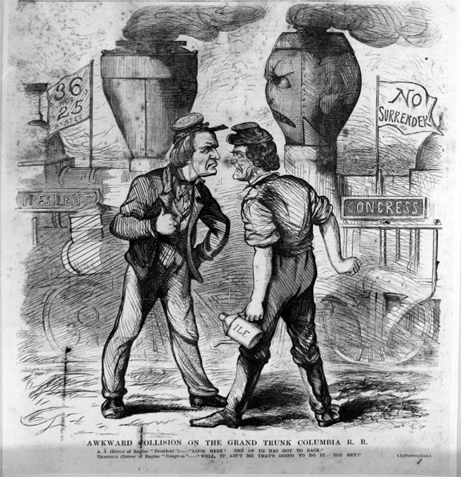
Do Now

Slide 9
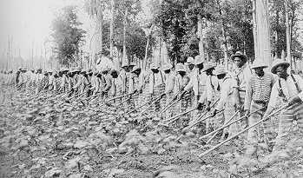
Freedmen in the South
Political Recognition
Voting Rights
Affiliated with Republican Party
Public Office
2 U.S. Senators
14 U.S. Representatives
630 black state legislators
Black governor of Louisiana
Desire for Autonomy and Opportunity
Independent churches
Public schools
Slavery By Another Name
Sharecropping
Convict leasing

Slide 10
Northern Influence on the South
Scalawags
Southern Republicans fostering American System-type programs
Cooperated with Northern politics and economics
Carpetbaggers
Northerners investing in “New South,”
Reformers/provide aid
Squatters and plunderers
The Man with the (Carpet) Bags
Thomas Nast, 1872
Depicts Carl Schurz, a Liberal Republican critical of Grant’s Reconstruction policies

Slide 11
White Southern Resistance
White Supremacy Paramilitary Groups
The South Will Rise Again!
White League
Ku Klux Klan (1867)
Nathaniel Bedford Forrest
“invisible empire”
Enforcement Acts (1870, 1871)
“You cannot make the negro work, without physical compulsion.” – Southern sentiment noted by Carl Schurz (1865)
Racial Riots
Memphis and New Orleans (1866)
“The murder of negroes is so common as to render it impossible to keep an accurate account of them. They cannot be punished by the civil courts until some examples by military commissions show that men can be punished in Texas for murder and kindred crimes. Perpetrators of such crimes have not heretofore, except in very rare instances, been punished in this state at all.” – Report from Major General J.J. Reynolds of the Fifth District
Colfax Massacre (April 13, 1873)
Over 150 blacks massacred, many after surrendered to white mob
“We were unable to find the body of a single white man…[Many blacks] were shot in the back at the head and neck… almost all had from three to a dozen wounds. Many of them had their brains literally blown out.” – Colonel T.W. DeKlyne
United States v. Cruikshank (1876)

Slide 12
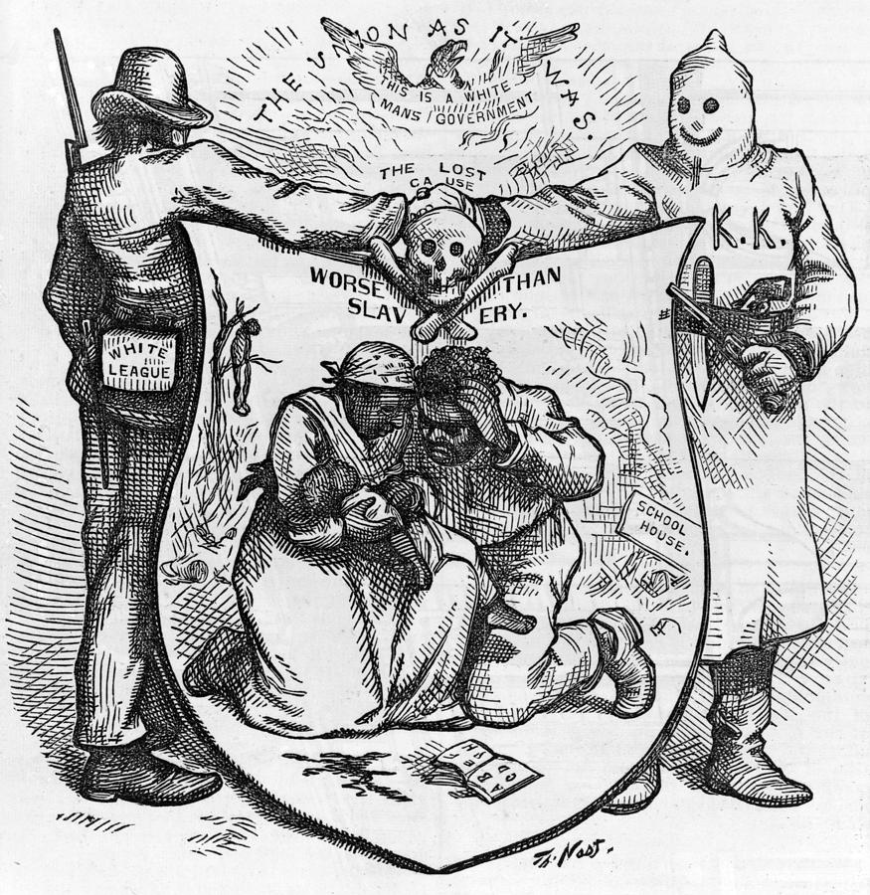

Slide 13
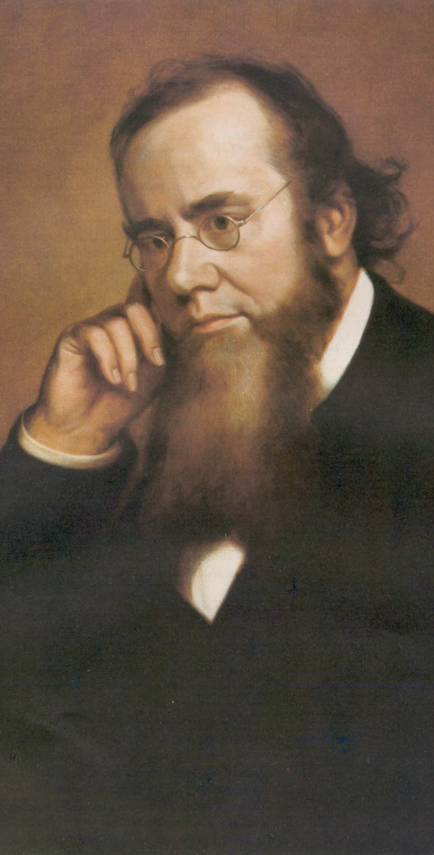
Reconstruction Acts of 1867
Command of the Army Act
The President must issue all Reconstruction orders through the commander of the military.
Tenure of Office Act
The President could not remove any officials [esp. Cabinet members] without the Senate’s consent, if the position originally required Senate approval.
Designed to protect Republican members of Lincoln’s government.
A question of the constitutionality of this law.
Edwin Stanton

Slide 14
President Johnson’s Impeachment
Johnson removed Stanton in February, 1868.
Johnson replaced generals in the field who were more sympathetic to Radical Reconstruction.
House impeaches him by massive majority
Senate hears trial, 1 vote short of removing from office.

Slide 15
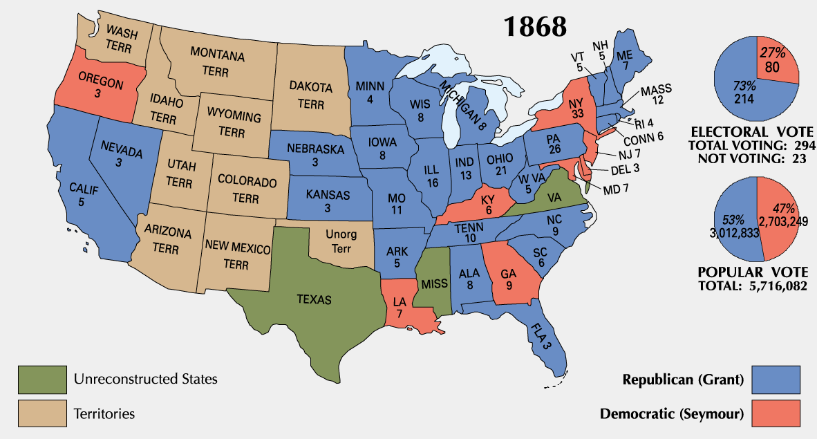
1868 Presidential Election
Notes:
COULD NOT HAVE WON WITHOUT BLACK VOTE

Slide 16
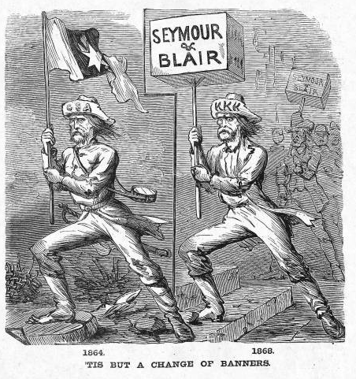
Waving the Bloody Shirt!
Republican “Southern Strategy”

Slide 17
Ulysses S. Grant’s Presidency
President Grant’s (a Republican) cabinet is corrupt and scandals break out
People move away from Republican party as a result
Grant thought of as one of worst Presidents

Slide 18
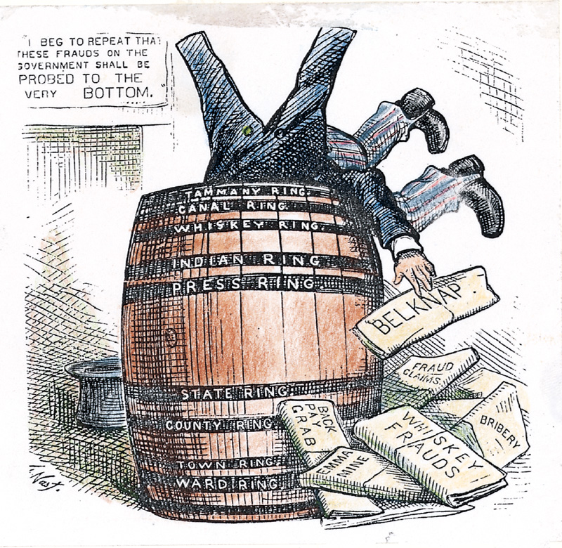
Ulysses S. Grant (R) (1869-1877)
Civil War hero, but no political experience; linked with moderates and Radicals
Grantism
Credit Mobilier
Union Pacific Railroad creates dummy construction company to hire execs at inflated salaries and earn high dividends
Sold stock to Republican congressmen and bribed press to keep quiet
Whiskey Ring
Republicans embezzled liquor tax revenues using bribes and networks
Amnesty Act of 1872
Panic of 1873

Slide 19
Panic of 1873
US economy goes into a severe recession (2 million unemployed of 36 million)
Cause: Civil War currency & overextension of industry
NO DIFFERENT THAN EVERY OTHER PANIC
People increasingly choose Democrats to try to fix the problems

Slide 20
Legal Challenges to Reconstruction
Civil Rights Act of 1875:
Equal access to public places
No enforcement mechanism
Slaughterhouse Cases (1873)
STRICT interpretation of 14th Amendment
States have authority over citizens’ rights
Bradwell v. Illinois (1873)
Female attorney sues for right to practice law
SC rules she’s a woman, shouldn’t be practicing law
US v. Cruickshank (1876)
LA white supremacists accused of attacking meeting of African Americans, convicted under Enforcement Acts.
SC rules 14th Amendment only applies to STATES discriminating, not people/business.
US v. Reese, et. Al (1876)
SC rules STATES confer voting rights on individuals, not fed. gov.
15th Amendment doesn’t guarantee right to vote apparently
Notes:
Uhhh and then Plessy v. Ferguson

Slide 21
Northern Support Wanes
“Grantism” & corruption.
Panic of 1873 [6-year depression].
Concern over westward expansion and Indian wars.
Key monetary issues:
should the government retire $432m worth of “greenbacks” issued during the Civil War.
should war bonds be paid back in specie or greenbacks.

Slide 22
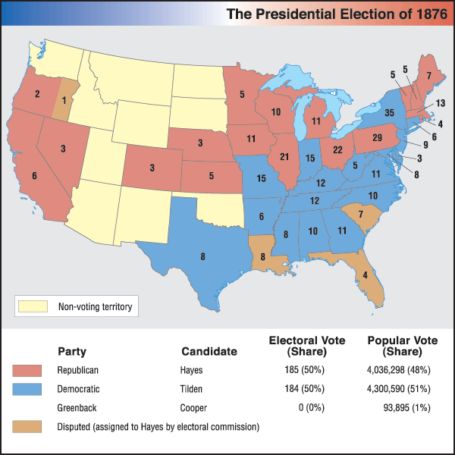
“Election” of 1876
Samuel
Tilden (D)
Rutherford B.
Hayes (R)
Republicans struggle to nominate “boring” Rutherford B. Hayes
Democrats nominate solid and popular Samuel J. Tilden
Tilden won the popular vote solidly and needed only 1 more electoral vote for majority
Contested electoral votes in 3 Reconstruction states (Louisiana, South Carolina, Florida)
Electoral Commission rewarded 3 sets of electoral votes to Hayes
Split ideologically 8-7 in favor of Republicans

Slide 23
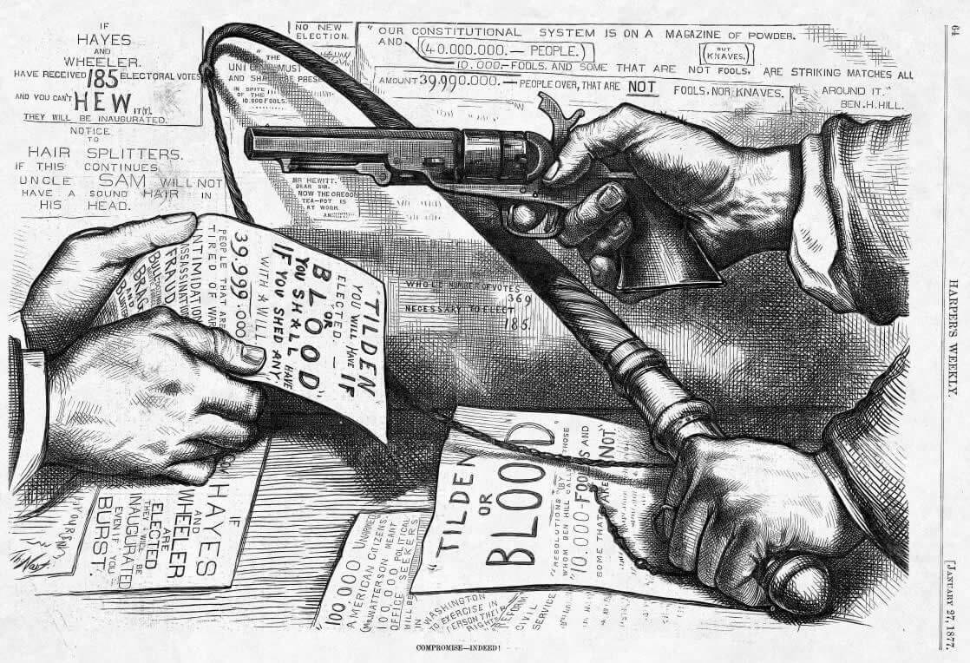

Slide 24
U.S. Troops Recalled
Hayes wins support of the House in exchange for removing federal troops from South
Army that Congress sent to South to supervise Reconstruction were called back in 1877 by President Rutherford B. Hayes
Effectively ends supervision in the South
Southern Democrats (segregationists) are now in control

Slide 25
Four Reasons For End of Reconstruction
Legal challenges to Reconstruction
Grant’s Presidency (he sucks)
Panic of 1873
Recall of troops in 1877/Compromise of 1877

Slide 26
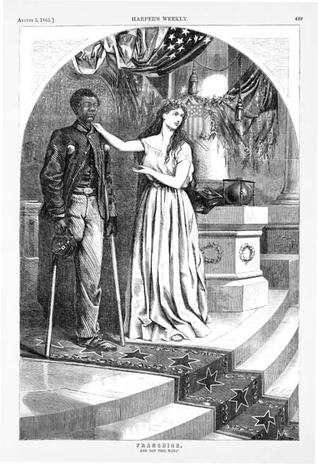
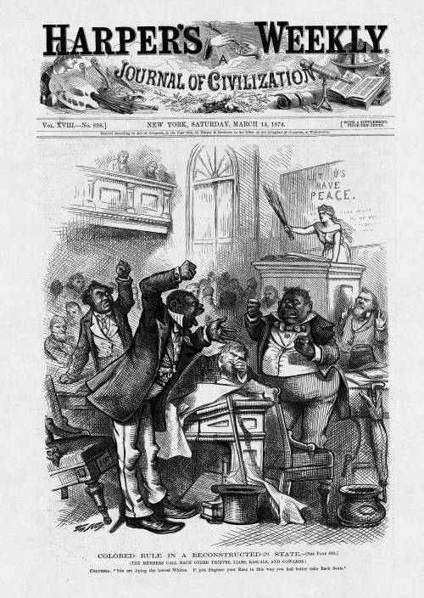
Evolution of Northern Attitude Toward Blacks During Reconstruction
Shown through the political cartoons of Thomas Nast of Harper’s Weekly
“And Not This Man?”
August 1865
“Colored Rule in a Reconstructed State”
March 1874

Slide 27
End of Reconstruction
Why did it end?
Compromise of 1877
The compromise settled the disputed 1876 election
Hayes (Republican) became President
ENDED MILITARY RULE IN THE SOUTH!
Southerner appointed to cabinet
Impact of end of Reconstruction?
Jim Crow Laws
Upheld by Plessy v. Ferguson
Disenfranchisement for blacks

Slide 28
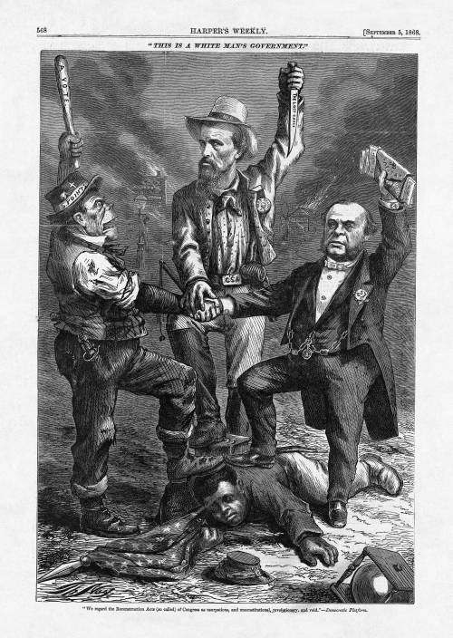
Notes:
"We regard the Reconstruction Acts (so called) of Congress as usurpations, and unconstitutional, revolutionary, and void." - Democratic Platform
The man on the left is a caricature of an Irish American man, whose hat reads "5 Points," referring to the New York City Irish residents, who are often configured as a mob. The man in the middle is identified by the initials on his hat "NBF" - Nathan Bedford Forrest, a former Confederate general and founder of the Ku Klux Klan. The man on the right is a wealthy man from 5th Avenue in New York who holds a stack of money that will be used to purchase votes.

