Slide 1
Do Now
Identify the successes of Reconstruction:
Economically
Politically
Socially

Slide 2
The Fall of Reconstruction-The Compromise of 1877 and Waning Northern Support
Mr. Winchell
APUSH
Period 5

Slide 3
Key Concepts
5.3: The Union victory in the Civil War & the contested reconstruction of the South settled the issues of slavery & secession, but left unresolved many questions about the power of the federal govt. and citizenship rights.
II: Reconstruction and the Civil War ended slavery, altered relationships between the states and the federal government, and led to debates over new definitions of citizenship, particularly regarding the rights of African Americans, women, and other minorities.

Slide 4
AP Prompt
Evaluate the extent to which economic factors led to the downfall of Reconstruction.

Slide 5
The Problems of Peacemaking
The Aftermath of War and Emancipation
The war is over, now what?
South was destroyed
Physically
Socially (20% of white male pop.)
Economically – hyperinflation, no resources, no trade, no workers, no banks, etc.
The “Lost Cause” = sense of loss for southern whites

Slide 6
4 million slaves freed into far worse conditions?
No family, no $, no land, no donkeys?, no where to go, no food, … you get the picture!
Competing Notions of Freedom
Reconstruction = quest for freedom!!!
Blacks = land “If I cannot live like a white man, than I am not free”
Whites = freedom from “foreign” (federal) “oppression & white supremacy
whites often times tried to keep black workers legally tied to plantations, aka sharecropping

Slide 7
An Unreconstructed Southerner

Slide 8
Outline
Johnson’s Impeachment
Grant’s Presidency
Successes and Failures of Reconstruction
Election of 1876/Compromise of 1877
Plessy v. Ferguson

Slide 9
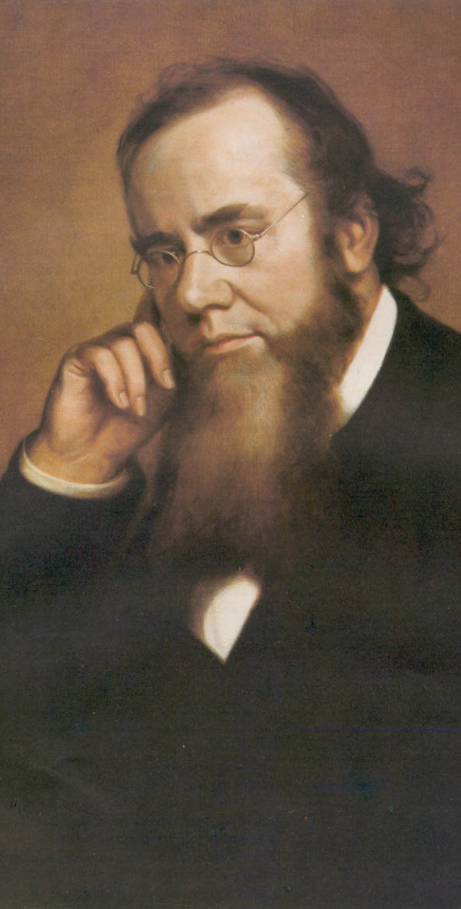
Reconstruction Acts of 1867
Command of the Army Act
The President must issue all Reconstruction orders through the commander of the military.
Tenure of Office Act
The President could not remove any officials [esp. Cabinet members] without the Senate’s consent, if the position originally required Senate approval.
Designed to protect radical members of Lincoln’s government.
A question of the constitutionality of this law.
Edwin Stanton

Slide 10
President Johnson’s Impeachment
Johnson removed Stanton in February, 1868.
Johnson replaced generals in the field who were more sympathetic to Radical Reconstruction.
House impeaches him by massive majority
Senate hears trial, 1 vote short of removing from office.

Slide 11
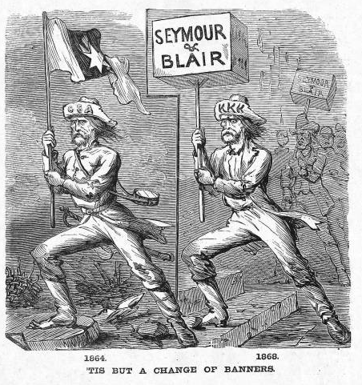
Waving the Bloody Shirt!
Republican “Southern Strategy”

Slide 12
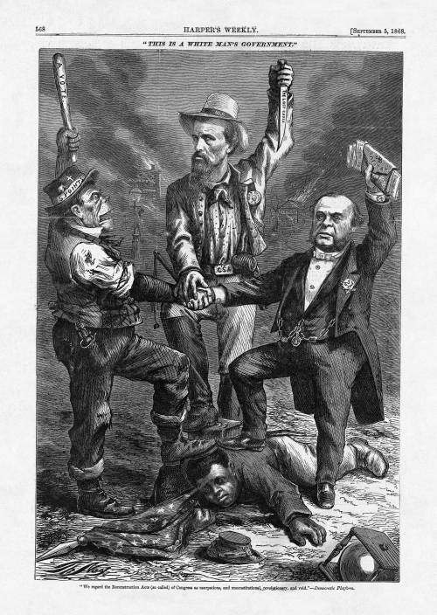
Notes:
"We regard the Reconstruction Acts (so called) of Congress as usurpations, and unconstitutional, revolutionary, and void." - Democratic Platform

Slide 13
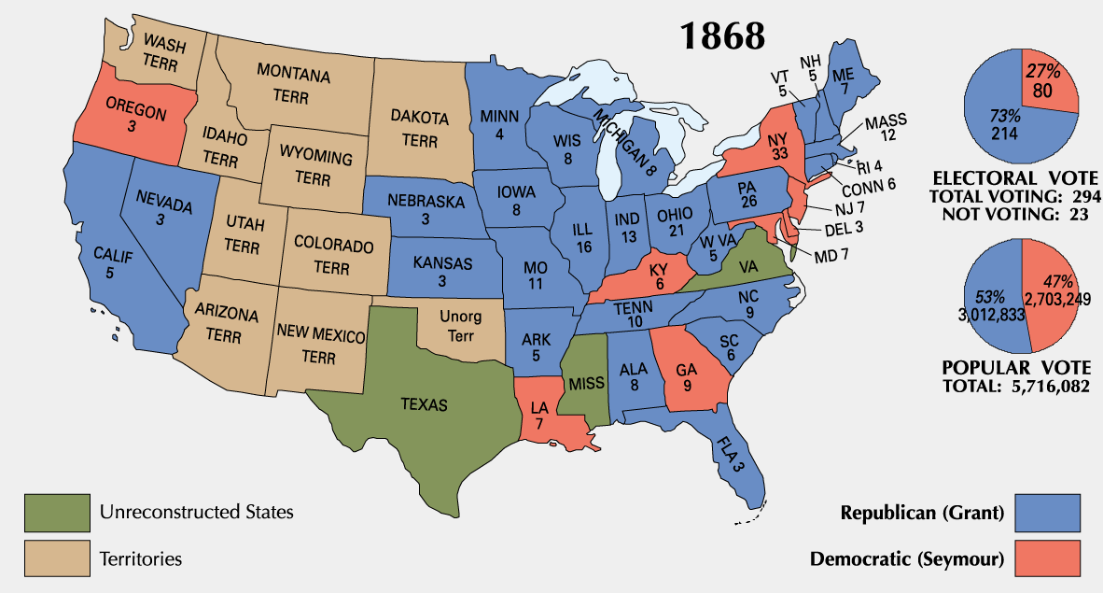
1868 Presidential Election
Notes:
COULD NOT HAVE WON WITHOUT BLACK VOTE

Slide 14
Ulysses S. Grant’s Presidency
President Grant’s (a Republican) cabinet is corrupt and scandals break out
People move away from Republican party as a result
Grant thought of as one of worst Presidents

Slide 15
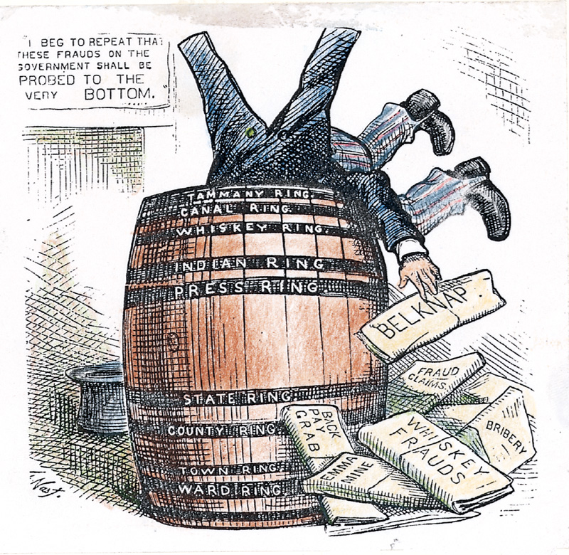
Grant Administration Scandals
Grant presided over an era of unprecedented growth and corruption.
Credit Mobilier Scandal.
Whiskey Ring.
The “Indian Ring.”

Slide 16
Panic of 1873
US economy goes into a severe recession (2 million unemployed of 36 million)
Cause: Civil War currency & overextension of industry
NO DIFFERENT THAN EVERY OTHER PANIC
People increasingly choose Democrats to try to fix the problems

Slide 17
Legal Challenges to Reconstruction
Civil Rights Act of 1875:
Equal access to public places
No enforcement mechanism
Slaughterhouse Cases (1873)
STRICT interpretation of 14th Amendment
States have authority over citizens’ rights
Bradwell v. Illinois (1873)
Female attorney sues for right to practice law
SC rules she’s a woman, shouldn’t be practicing law
US v. Cruickshank (1876)
LA white supremacists accused of attacking meeting of African Americans, convicted under Enforcement Acts.
SC rules 14th Amendment only applies to STATES discriminating, not people/business.
US v. Reese, et. Al (1876)
SC rules STATES confer voting rights on individuals, not fed. gov.
15th Amendment doesn’t guarantee right to vote apparently
Notes:
Uhhh and then Plessy v. Ferguson

Slide 18
Northern Support Wanes
“Grantism” & corruption.
Panic of 1873 [6-year depression].
Concern over westward expansion and Indian wars.
Key monetary issues:
should the government retire $432m worth of “greenbacks” issued during the Civil War.
should war bonds be paid back in specie or greenbacks.

Slide 19
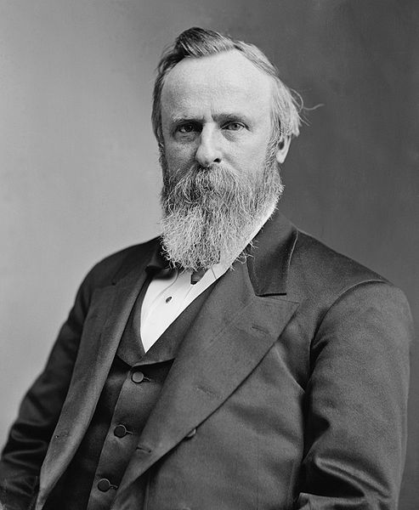
The Election of 1876
Republicans nominate Rutherford B. Hayes
Democrats nominate Samuel J. Tilden
Votes contested in LA, FL, SC
Special electoral commission created to decide who gets disputed votes
Votes 8-7 to give all electoral votes to Hayes
Democrats threaten to filibuster the results, send election to the House

Slide 20
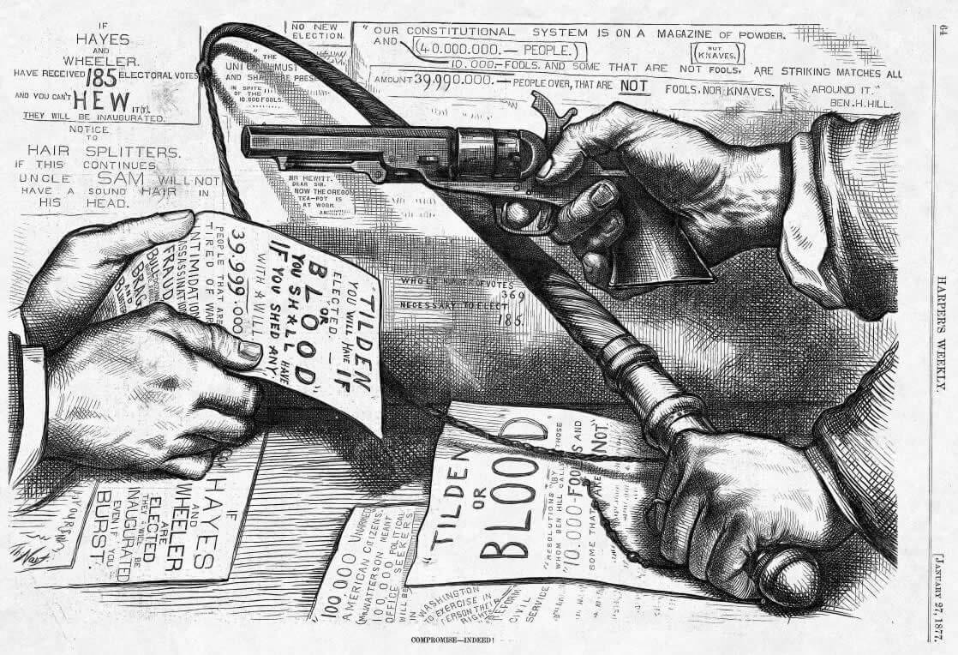

Slide 21
U.S. Troops Recalled
Hayes wins support of the House in exchange for removing federal troops from South
Army that Congress sent to South to supervise Reconstruction were called back in 1877 by President Rutherford B. Hayes
Effectively ends supervision in the South
Southern Democrats (segregationists) are now in control

Slide 22
End of Reconstruction
Why did it end?
Compromise of 1877
The compromise settled the disputed 1876 election
Hayes (Republican) became President
ENDED MILITARY RULE IN THE SOUTH!
Southerner appointed to cabinet
Impact of end of Reconstruction?
Jim Crow Laws
Upheld by Plessy v. Ferguson
Disenfranchisement for blacks

Slide 23
The Southern States “Redeemed”
States of the upper south had a majority of white citizens, thus had an easy time putting their candidates into power once they regained suffrage
In states where blacks had the majority, whites used intimidation and violence to undermine the Reconstruction regimes
KKK – secret society, midnight raids, military force; thought of as a patriotic society by southern whites
Knights of the White Camellia
Red Shirts and White Leagues worked to force all whites to join Democratic party and exclude blacks from political activities
economic intimidation = land owners did not rent to blacks who voted

Slide 24
The Birth of Jim Crow
Evading the 15th Amendment
poll tax
“literacy” or “understanding” tests (often unfair)
grandfather laws
Williams v. Mississippi (1890) validated southern literacy tests
Jim Crow = an elaborate system of segregation reaching into almost every area of southern life. Served as a means for whites to retain control of social relations between the races in the newly growing cities and towns of the South.

Slide 25
The Birth of Jim Crow
1890s dramatic increase in white violence towards blacks: 187 lynchings each year, more than 80% of them in the South, the vast majority of victims black
prisoners seized from within prisons and hanged in front of large audiences
Southern whites controlled black population through terror

Slide 26
The New South
The “Redeemers”
by 1877 every southern state “redeemed” = white Democrats in charge at nearly every level of Southern government
South falls into control of a powerful, conservative oligarchy known as “Redeemers” or “Bourbons”
Committed to home rule, social conservatism and economic development
Democrats cut taxes, reduced government spending, drastically diminished state services
Dissenting movements (“Readjusters”, etc.) crushed

Slide 27
The Industrialization of the “New South”
Many Southerners believed they had lost the war because they had a weak industrial economy... now the goal of the “New South was to Out Yankee the Yankees”
Southern literature and print depicted antebellum South with nostalgia and embraced the “Lost Cause”... portrayed slaves society as a harmonious world
Textile factories appearing in greater numbers in the South
Iron and the Railroad
Women working in them, African Americans barred
Efforts to unionize crushed
Prisoners, “chain gangs”, often doing hard labor and being paid nothing

Slide 28
The “New South”
Henry W. Grady
"There was a South of slavery and secession - that South is dead. There is now a South of union and freedom- that South, thank God, is living, breathing, and growing every hour,” (1886)
"the supremacy of the white race of the South must be maintained forever, and the domination of the negro race resisted at all points and at all hazards, because the white race is the superior race... [This declaration] shall run forever with the blood that feeds Anglo-Saxon hearts.” (1888)
Public School Systems
Agriculture
Cotton, tobacco, rice
Industry and Urbanization
Dependent on Northern investment
Increased network of standardized rail lines
Coal mining

Slide 29
Four Reasons For End of Reconstruction
Legal challenges to Reconstruction
Grant’s Presidency (he sucks)
Panic of 1873
Recall of troops in 1877/Compromise of 1877

Slide 30
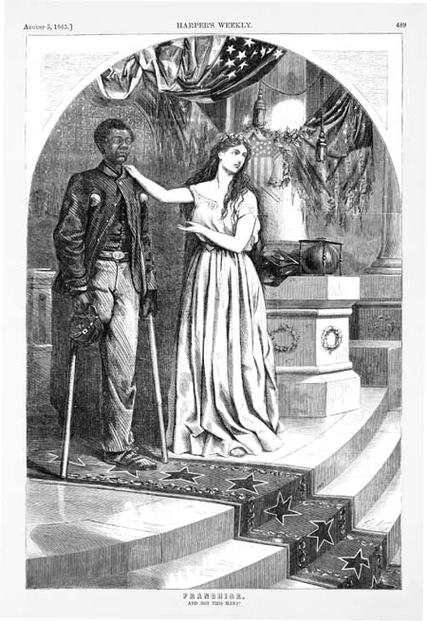
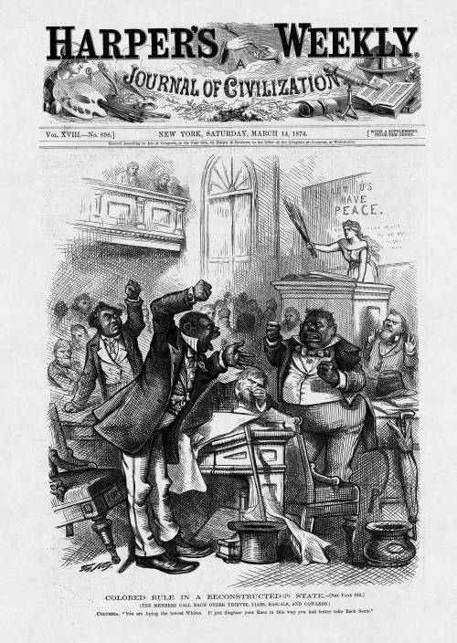
Evolution of Northern Attitude Toward Blacks During Reconstruction
Shown through the political cartoons of Thomas Nast of Harper’s Weekly
“And Not This Man?”
August 1865
“Colored Rule in a Reconstructed State”
March 1874

