Slide 1
Do Now
Big Day. Sit Dow and Shut Up

Slide 2
10. The Homefront in World War II-Mobilization of a War Economy
Mr. Winchell
APUSH 2018-2019
Period 7

Slide 3
Key Concepts
7.3.III.
B: The mass mobilization of American society helped end the Great Depression, and the country’s strong industrial base played a pivotal role in winning the war by equipping and provisioning allies and millions of U.S. troops.
C: Mobilization and military service provided opportunities for women and minorities to improve their socioeconomic positions for the war’s duration, while also leading to debates over racial segregation. Wartime experiences also generated challenges to civil liberties.

Slide 4
AP Prompt
Evaluate the extent to which the Homefront experience during WWII expanded the freedom and opportunities available to Americans.

Slide 5
American Foreign Policy of the 1920s Disarmament Initiatives
Washington Naval Conference (1921)
Five-Power Treaty
U.S.:GB:Japan:France:Italy
5:5:3:1.75:1.75
Kellogg-Briand Pact (1928)
Notes:
The USA never joined the League of Nations, but did play a role in attempts to avoid future wars:
At the Washington Disarmament Conference in 1921, world leaders agreed to disarmament, free trade, & collective security
In 1928, almost every nation, including the USA, signed the Kellogg-Briand Pact, renouncing war as a tool of foreign policy

Slide 6
American Foreign Policy of the 1920s Economic Policies
Fordney-McCumber Tariff (1922)
Dawes Plan (1924)

Slide 7
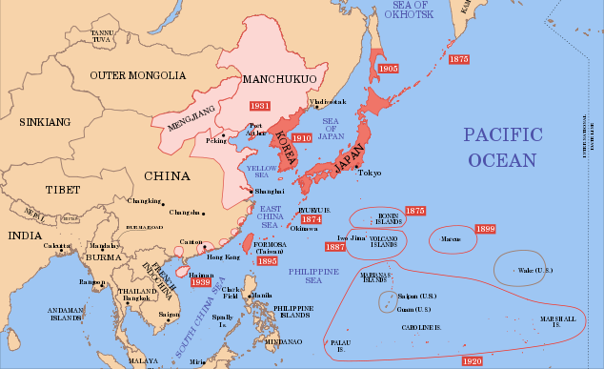
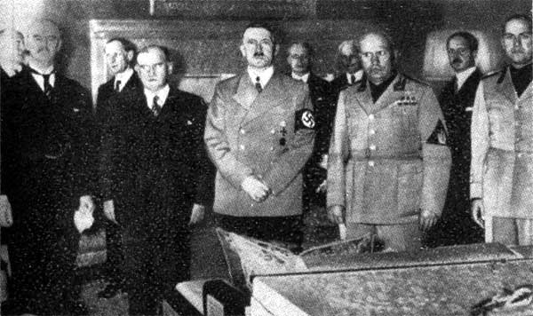
The Axis Powers and Appeasement
Japan
Invasion of Manchuria (1931)
Invasion of China (1937)
Italy
Invasion of Ethiopia (1935)
Germany
Remilitarization of the Rhineland (1936)
Anschluss and the Sudetenland (1938)
Global Response
Munich Conference (1938)
Molotov-Ribbentrop Non-Aggression Pact (1939)
German invasion of Poland begins World War II in Europe (1939)

Slide 8
Franklin Delano Roosevelt (D) (1933-1945) Depression and Foreign Policy
Good Neighbor Policy
Pan-American Conferences (1933, 1936)
London Economic Conference (1933)
Reciprocal Trade Agreements
Notes:
The London Economic Conference was a meeting of representatives of 66 nations from June 12 to July 27, 1933 at the Geological Museum in London. Its purpose was to win agreement on measures to fight the Great Depression, revive international trade, and stabilize currency exchange rates.
Reciprocal Tariff Act of 1934. President Franklin D. Roosevelt signed the Reciprocal Trade Agreements Act (RTAA) into law in 1934. RTAA gave the president power to negotiate bilateral, reciprocal trade agreements with other countries. ... At the same time, countries in Europe enacted protectionist policies.

Slide 9
Foreign Policy: International Peace
In the 1930s, FDR & Congress were preoccupied with the Great Depression to adequately plan for new world conflicts involving totalitarian dictators
The rising threat of war in Europe & Asia strengthened Americans’ desire to avoid involvement in another world war

Slide 10
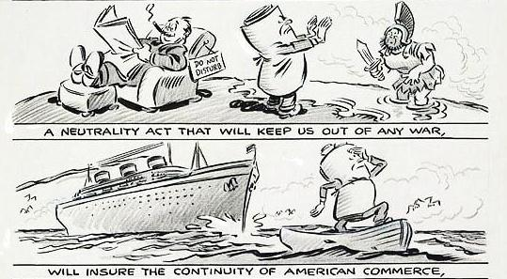
The Neutrality Acts
The Neutrality Act of 1935 banned arms sales to nations at war & warned citizens not to sail on belligerent ships
The Neutrality Act of 1936 banned loans to any warring nation
The “merchants of death” charges were led by North Dakota Senator Gerald Nye from 1934 to 1936:
Reaction to the Nye Committee report led to popular support to avoid making the same mistakes that led America to enter WW1
Congress passed 3 neutrality acts to avoid future wars
The Neutrality Act of 1937 made the 1935 & 1936 acts permanent & required all trade to be on a cash & carry basis

Slide 11
American Isolationists
Characteristics
Midwest region
Rural sectors
Republicans and conservatives
Nye Committee
“Merchants of Death”
America First Committee
Avoid possible entanglements with European affairs in WWII
Promote isolationism across the nation

Slide 12
From Neutrality to Undeclared War
But…FDR was able to get $1 billion from Congress to expand the U.S. navy
As Europe headed toward war, FDR openly expressed his favor for intervention & took steps to ready the U.S. for war
In 1937, FDR unsuccessfully tried to convince world leaders to “quarantine the aggressors”
Everything changed in 1939 with the Nazi-Soviet Pact & the German invasion of Poland

Slide 13
Quarantine Speech
Text Analysis

Slide 14
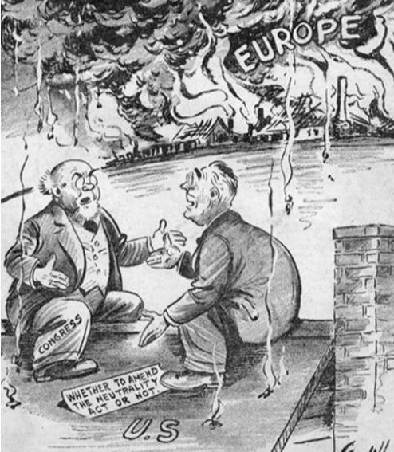
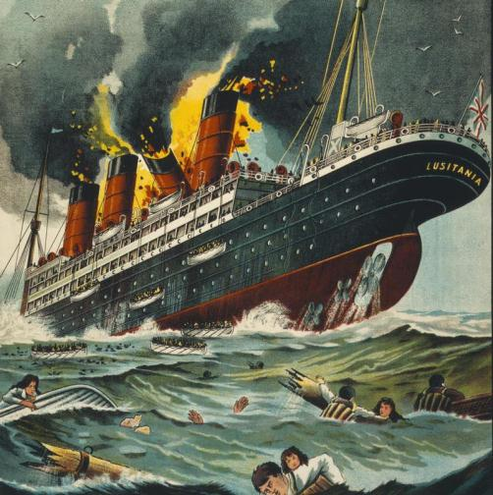
When the war started, Congress amended the Neutrality Acts and allowed U.S. companies to sell weapons to the Allies on a “cash and carry” basis
Allied nations could buy U.S.-made war goods but had to pay in cash and had to transport goods on their own ships
Remember Germany’s unrestricted submarine warfare?
The cash-and-carry policy allowed the USA to aid the Allies while remaining neutral and avoid the causes of American entry into the first world war

Slide 15
FDR and Preparedness
Neutrality Acts (1935-1937)
Cash and Carry (1939)
Selective Service Act of 1940
Destroyers-for-Bases (1940)

Slide 16
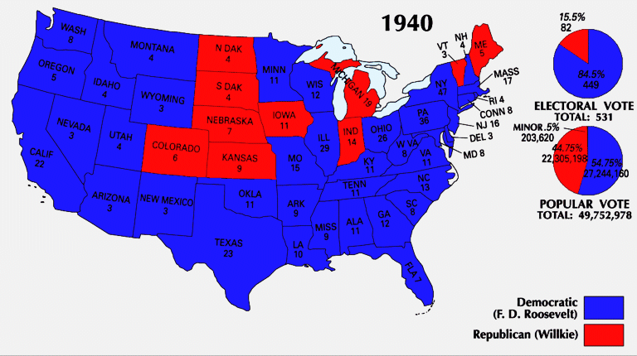
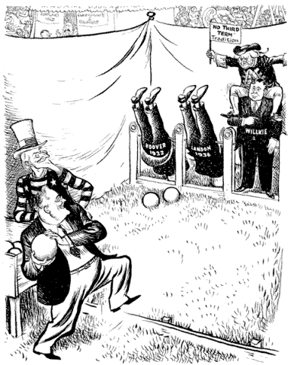
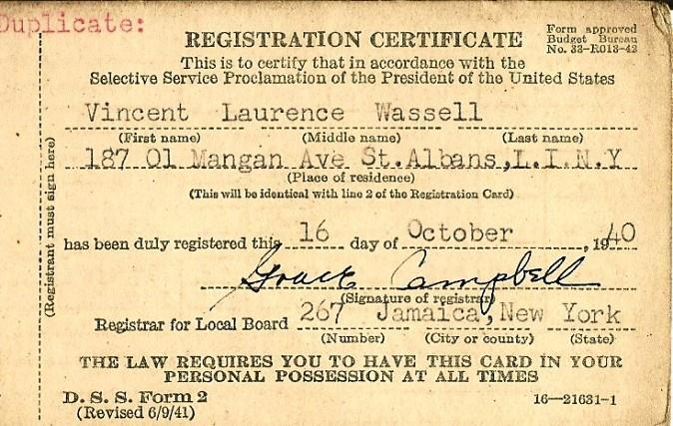
In 1940, Franklin Roosevelt was elected to an unprecedented third term as president
He campaigned on a platform of neutrality but with “preparedness”
FDR prepared for possible entry into the war by calling for the first peacetime draft

Slide 17
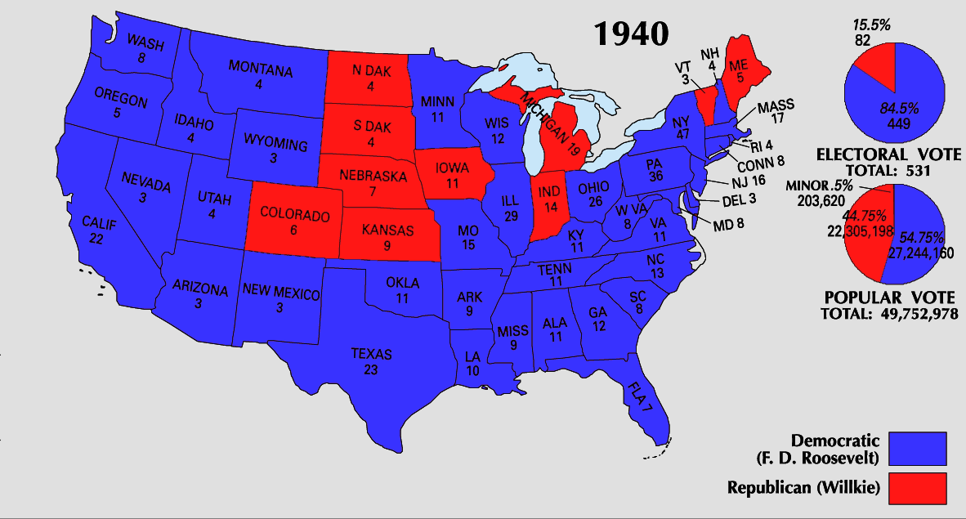
From Neutrality to Undeclared War
By 1940, “interventionists” had the majority of American public sentiment on their side:
in 1940, Congress appropriated $10 billion for preparedness
FDR called for America’s first ever peacetime draft
In the election of 1940, FDR was overwhelmingly elected for an unprecedented 3rd term

Slide 18
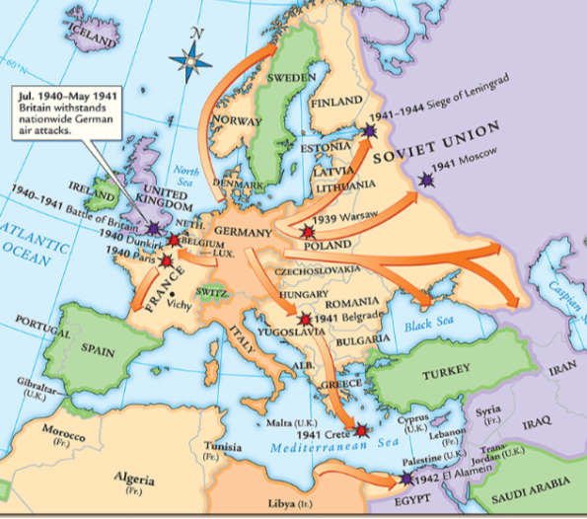
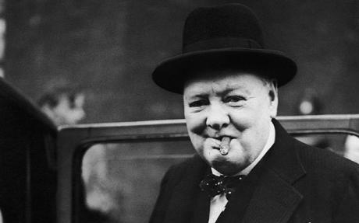
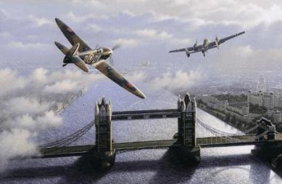
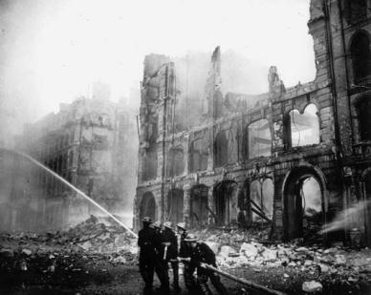
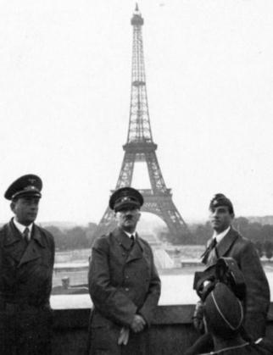
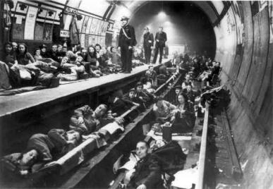
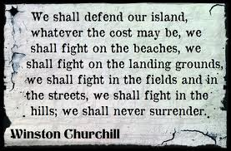
The fall of France in 1940 worried Americans that the Axis Powers might win World War II
German Luftwaffe attacks on Britain meant that England needed U.S. aid more than ever

Slide 19
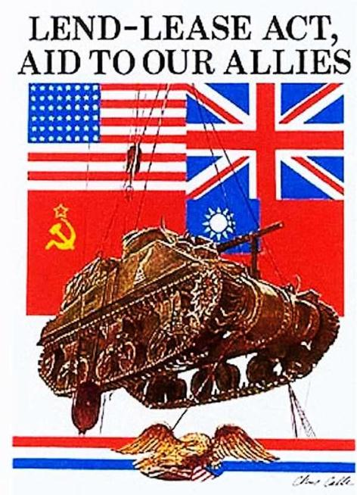
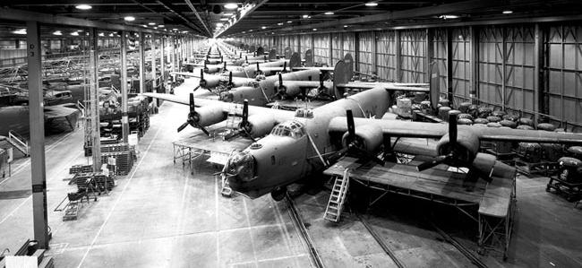
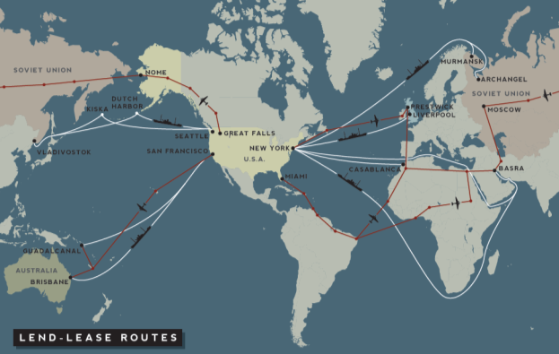
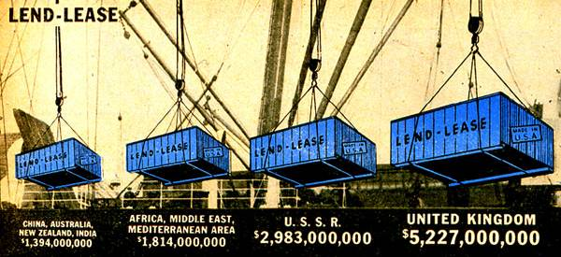
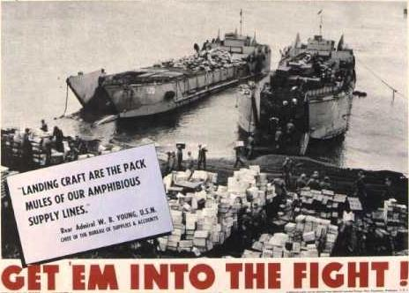
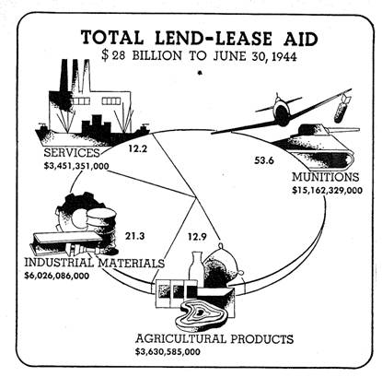
The USA responded with the Lend-Lease Act in 1941
The Lend-Lease Act allowed the USA to send war supplies to Allied nations and transport war-related goods to Europe on armed ships
The Lend-Lease Act was used throughout WWII, transformed the USA into an “arsenal of democracy,” and helped end the depression in America

Slide 20
Arsenal of Democracy
Fireside Chat

Slide 21
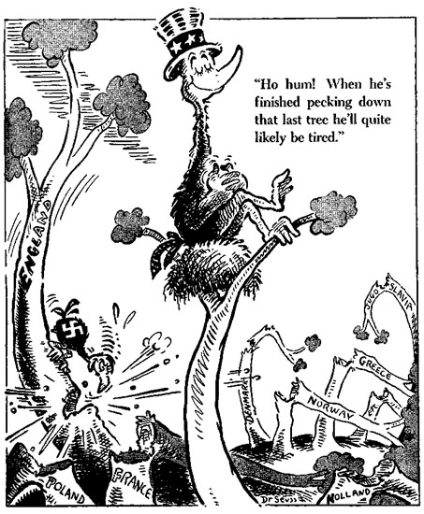

Slide 22
From Neutrality to Undeclared War
In 1941, FDR & Churchill met to secretly draft the Atlantic Charter:
The U.S. & Britain discussed a military strategy if the USA were to enter the war
They discussed post-war goals of free trade & disarmament
In 1941, Germany broke the Nazi-Soviet Pact & invaded Russia

Slide 23
From Neutrality to Undeclared War
FDR brought U.S. to the brink of war & opened himself to criticism:
In Sept 1941, polls showed 80% of Americans supported remaining neutral in WW2
FDR had to wait for the Axis to make a decisive move…which Japan delivered on Dec 7, 1941

Slide 24
Showdown in the Pacific
The U.S. now faced a possible 2-ocean war…
Japan took full advantage of the European war to expand in Asia:
Attacked coastal China
Seized French & Dutch colonies in East Indies & Indochina
Signed the Tripartite Pact with Germany & Italy in 1940
FDR retaliated against Japan with fuel, iron, & oil sanctions
…but Germany was still seen as the primary danger

Slide 25
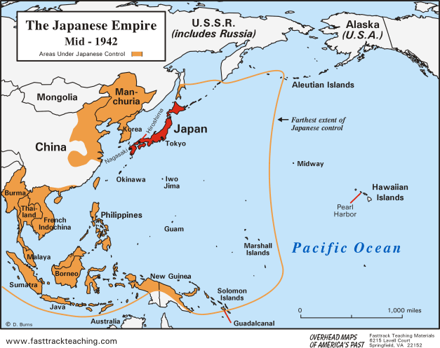
Pearl Harbor
U.S. Embargoes on Japan
Prohibited trade of steel and oil
Required Japan’s halt on expansion and removal from China
December 7, 1941
Japanese surprise attack on U.S. naval base at Pearl Harbor in Hawaii
2,400 Americans killed
“a date that will live in infamy”
United States enters WWII
U.S. declares war on Japan (12/8/41)
Germany and Italy declare on U.S.
German invasion of Soviet Union (1942)
Allies
U.S., Great Britain, Soviet Union
Axis
Germany, Italy, Japan

Slide 26
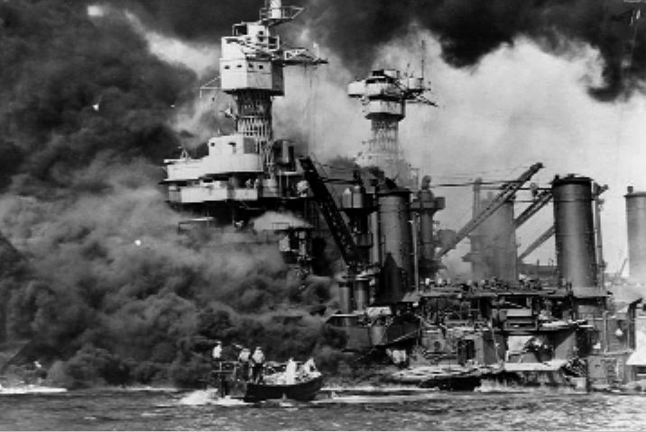
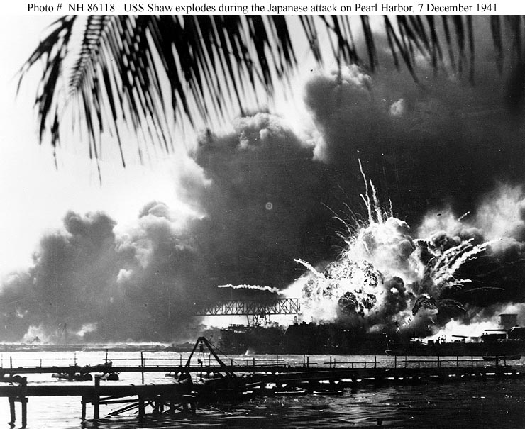
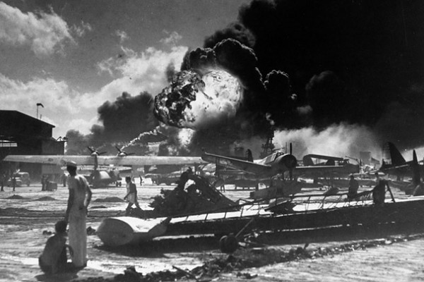
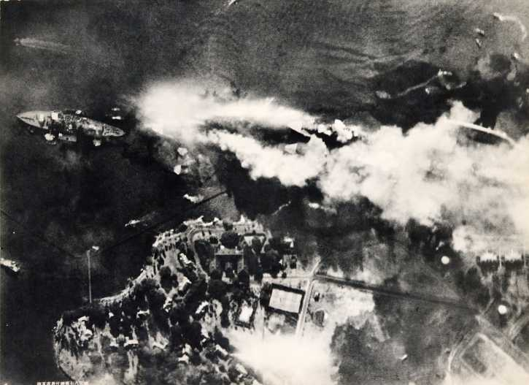
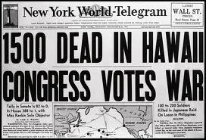
On Dec 7, 1941, the U.S. naval fleet in the Pacific was crippled by the attack; 8 battleships were sunk & 2,400 Americans were killed
Notes:
On Dec 7, 1941, the U.S. naval fleet in the Pacific was crippled by the surprise attack; 8 battleships were sunk & 2,400 Americans were killed

Slide 27
Showdown in the Pacific
After Pearl Harbor:
Congress declared war against Japan on Dec 8, 1941
Italy & Germany declared war on the U.S. on Dec 11, 1941
American public opinion was now fully behind the war effort to defeat the fascist threat in Europe & to seek revenge against Japan

Slide 28
The Home Front
WW2 impacted all aspects of American life:
FDR hoped the U.S. would be the great “arsenal of democracy”
The boost of wartime industry ended the Great Depression
The war altered the lives of women, African-Americans, Japanese-Americans, & Mexican-Americans

Slide 29
Mobilization
The Office of War Information directed press, print, radio, & film propaganda
The power to create new gov’t agencies
to censor the press
The Office of War Mobilization coordinated the draft, consumer prices, & the labor force
to limit civil liberties & seize personal property
To win wars in Asia & Europe & meet civilian demands, the U.S. gov’t grew to its largest size ever:
The War Powers Act gave the president unprecedented power
New bureaucracies were formed to direct the economy, create propaganda, sell war bonds, & prevent enemy subversion
The Office of Strategic Services gathered enemy intelligence & conducted espionage
The U.S. gov’t spent $250 million per day from 1941 to 1945

Slide 30
Economic Impact of World War II

Slide 31
The Economy and World War II
Economic Recovery and Growth
GDP
$103.6B - 1929
$56.4B - 1933
$101.4B - 1940
$223.1B - 1945
Unemployment
17 million new jobs
3.2% - 1929
24.9% - 1933
14.6% - 1940
1.2% - 1944
Fiscal Policy
War cost $304B
$136B from tax revenue
Revenue Act of 1942
$168B from war bonds
National Debt
$25B in 1918
$20B in 1933
$39.65B in 1939
$251B in 1945
Industry
Factories converted for war production
Doubled industrial production
Real wages increased by 50%
Agriculture
Net farm income doubled
$20B increase in land value
$11B savings accumulated
17% decline in farm population
Labor Unions
National War Labor Board
Smith-Connally War Act (1943)
Union membership
9 million – 1940
14.8 million - 1945

Slide 32
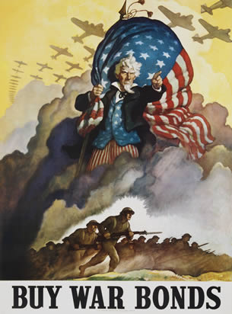
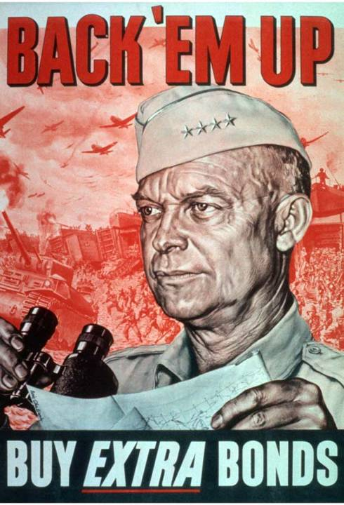
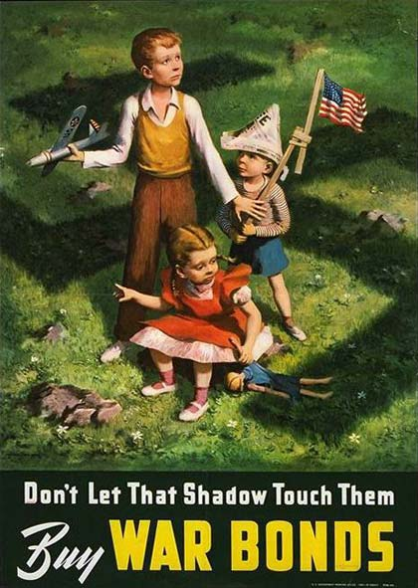
War bonds helped raise $187 billion to support the war effort

Slide 33
Victory Gardens: Grow Your Own

Slide 34
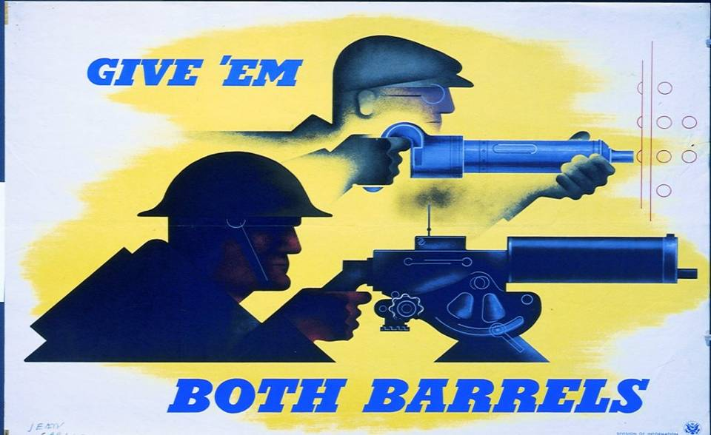
Propaganda: Fighting the Enemy on the Battlefield & on the Home Front

Slide 35
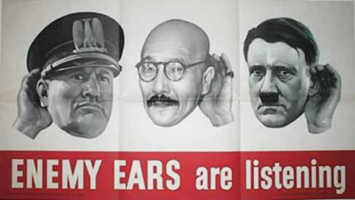
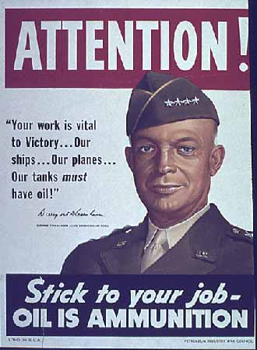
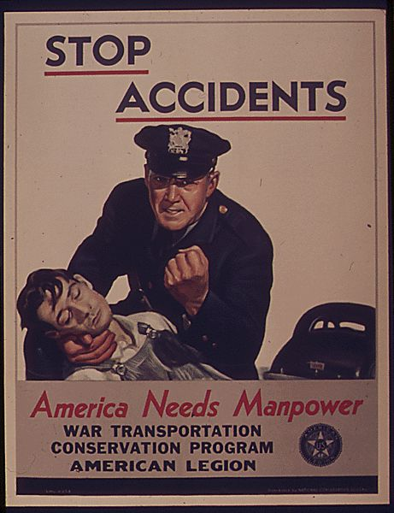
Office of War Information

Slide 36
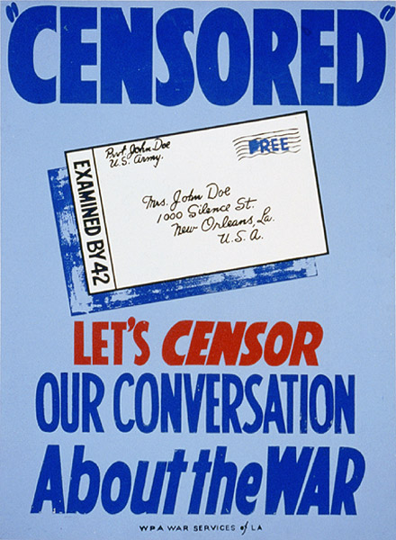
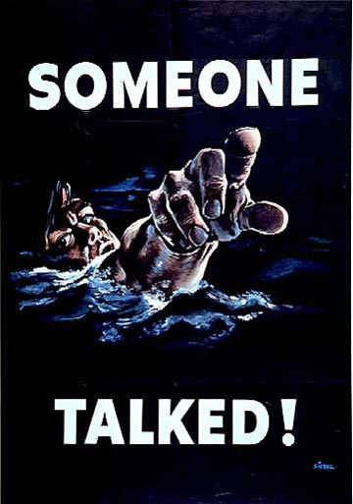
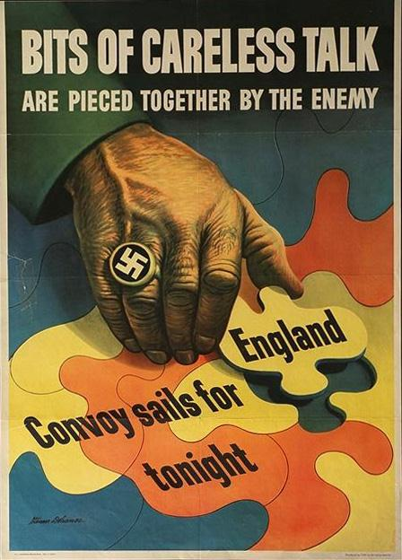
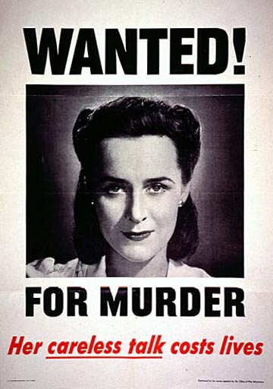
Office of Censorship

Slide 37
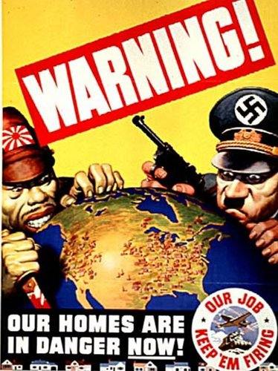
Fear Propaganda

Slide 38
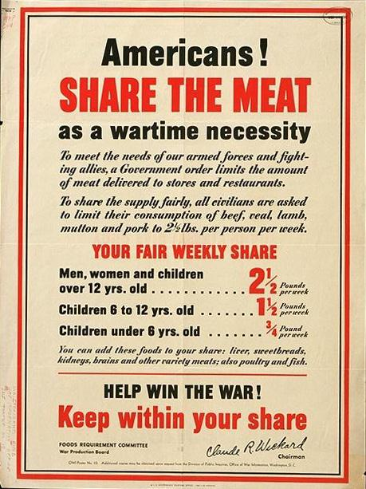
Office of Price Administration (OPA) and Ration Books

Slide 39
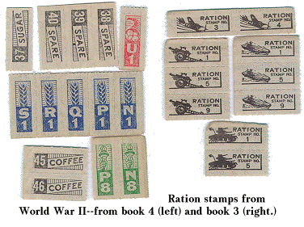
War Rations

Slide 40
The Wartime Economy
The most decisive factor for Allied victory was America’s ability to out-produce both Germany & Japan
Heavy industry was converted to war & was directed by the War Production Board (WPB)
15 million U.S. soldiers fought but 60 million workers & farmers supplied them with supplies
U.S. made 2x more goods than Germany & 5x more than Japan

Slide 41
War Productions Board

Slide 42
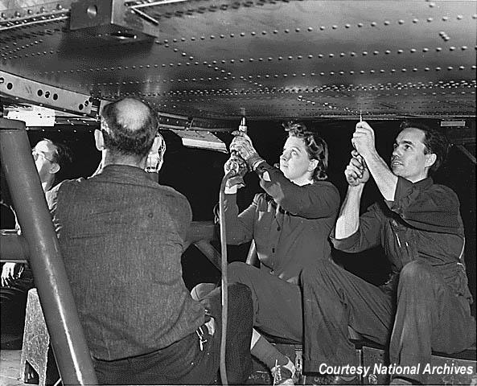
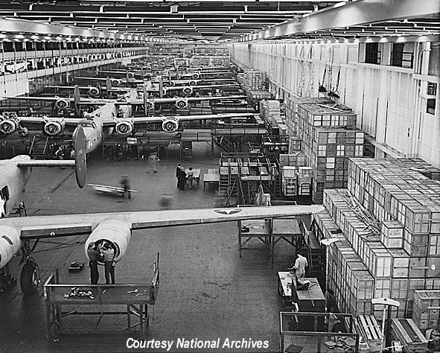
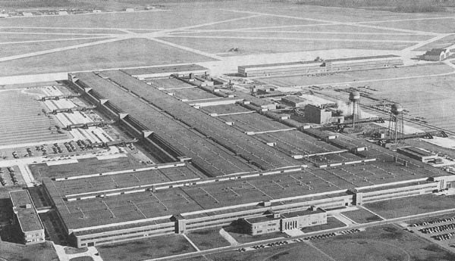
Ford’s Willow Run Factory
Ford made one B-24 bomber every hour

Slide 43
Women
The war presented new economic opportunities for women:
Dramatic rise in employment (14 million to 19 million by 1945)
Most new female workers were married, many middle-aged
Entered “exclusively male” fields
Temporarily redefined “woman’s sphere” from “just at home”
Earned 65% of what men earned

Slide 44
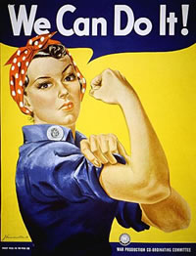
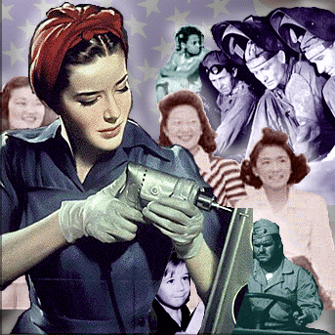
“Rosie, the Riveter”

Slide 45
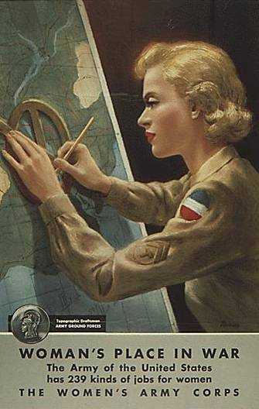
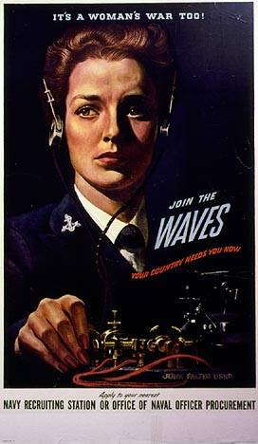
Women Accepted for Volunteer Emergency Service (WAVES)
Join the Women’s Army Corps (WACs)
Women’s Army Air Corps Pilots

Slide 46
Double V: Victory at Home & Abroad
A. Philip Randolph threatened a “March on Washington” to protest war time discrimination
Other groups, like the Congress of Racial Equality (CORE), staged sit-ins in restaurants in major cities to protest discrimination

Slide 47
Segregated units…again
Tuskegee Airmen

Slide 48
Blacks and World War II
1.2 million served during the war
Tuskegee Airmen
Double V Campaign
Great Migration
Detroit Race Riot (1943)
March on Washington (1941)
A. Phillip Randolph
Executive Order 8802
Desegregation of national defense industry
Committee on Fair Employment Practice to enforce
Congress of Racial Equality (CORE)

Slide 50
Japanese in World War II
442nd Infantry
Japanese internment camps
Executive Order 9066
Over 100,000 Japanese immigrants (isei) and Americans (nisei)
Korematsu v. United States (1944)
Supreme Court ruled internment camps constitutional in wartime

Slide 52
Other Minorities in World War II
Mexicans
Braceros program
Zoot Suit Riots (June 1943)
Natives
Navajo Code Talkers
25,000 enlisted

Slide 53
Win-the-War Politics
In 1944, FDR used the war to strengthen his leadership:
“Mr. New Deal” had shifted to “Mr. Win the War”
Opponent Thomas Dewey made communism & FDR’s health the focus of the election
FDR switched VPs from liberal Henry Wallace to moderate Harry Truman to gain appeal

