Slide 1
Do Now
BEFORE WWII… How were former wars catalysts for social progress? How were they NOT catalysts for social progress?

Slide 2
10. The Homefront in World War II-Mobilization of the War Economy
Mr. Winchell
APUSH 19-20
Period 7

Slide 3
AP PROMPT
Evaluate the extent to which the Homefront experience during WWII expanded the freedom and opportunities available to Americans.

Slide 4
American Foreign Policy of the 1920s Disarmament Initiatives
Washington Naval Conference (1921)
Five-Power Treaty
U.S.:GB:Japan:France:Italy
5:5:3:1.75:1.75
Kellogg-Briand Pact (1928)
Notes:
The USA never joined the League of Nations, but did play a role in attempts to avoid future wars:
At the Washington Disarmament Conference in 1921, world leaders agreed to disarmament, free trade, & collective security
In 1928, almost every nation, including the USA, signed the Kellogg-Briand Pact, renouncing war as a tool of foreign policy

Slide 5
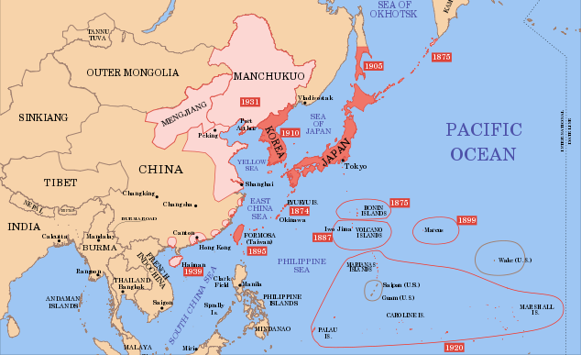
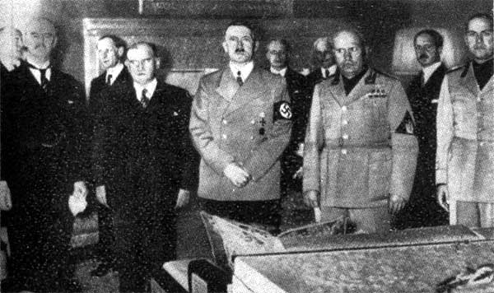
The Axis Powers and Appeasement
Japan
Invasion of Manchuria (1931)
Invasion of China (1937)
Italy
Invasion of Ethiopia (1935)
Germany
Remilitarization of the Rhineland (1936)
Anschluss and the Sudetenland (1938)
Global Response
Munich Conference (1938)
Molotov-Ribbentrop Non-Aggression Pact (1939)
German invasion of Poland begins World War II in Europe (1939)

Slide 6
American Isolationists
Characteristics
Midwest region
Rural sectors
Republicans and conservatives
Nye Committee
“Merchants of Death”
America First Committee
Avoid possible entanglements with European affairs in WWII
Promote isolationism across the nation

Slide 7
FDR and Preparedness
Neutrality Acts (1935-1937)
Cash and Carry (1939)
Selective Service Act of 1940
Destroyers-for-Bases (1940)

Slide 8
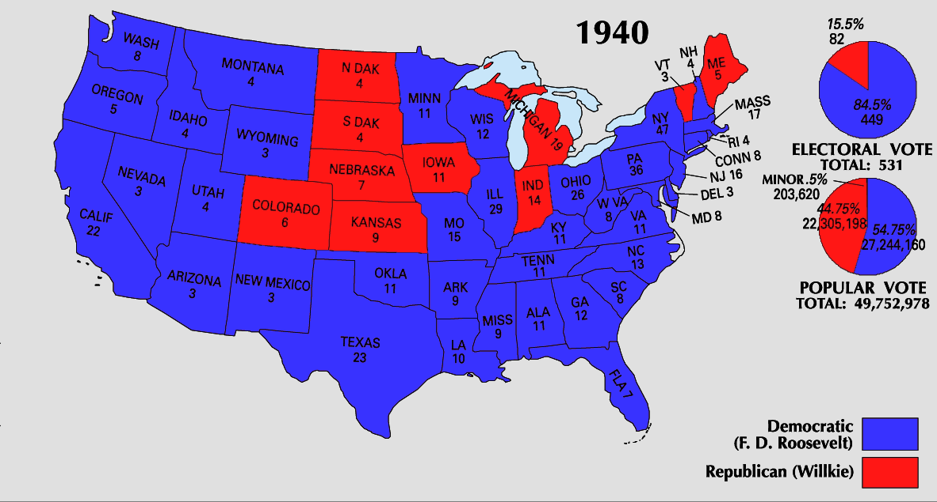
From Neutrality to Undeclared War
By 1940, “interventionists” had the majority of American public sentiment on their side:
in 1940, Congress appropriated $10 billion for preparedness
FDR called for America’s first ever peacetime draft
In the election of 1940, FDR was overwhelmingly elected for an unprecedented 3rd term
Arsenal of Democracy Fireside Chat

Slide 9
From Neutrality to Undeclared War
In 1941, FDR & Churchill met to secretly draft the Atlantic Charter:
The U.S. & Britain discussed a military strategy if the USA were to enter the war
They discussed post-war goals of free trade & disarmament
In 1941, Germany broke the Nazi-Soviet Pact & invaded Russia
In Sept 1941, polls showed 80% of Americans supported remaining “neutral” in WW2

Slide 10
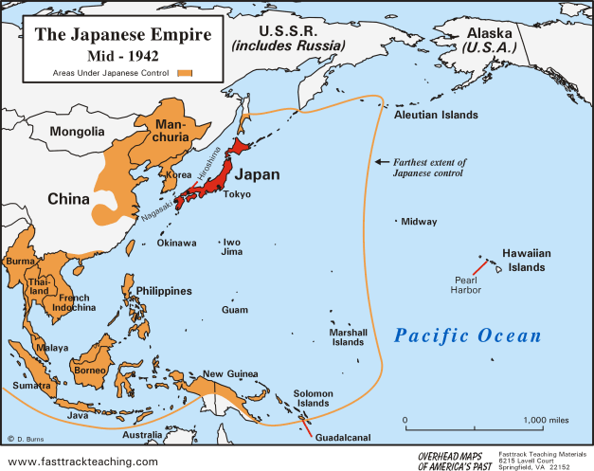
Pearl Harbor
U.S. Embargoes on Japan
Prohibited trade of steel and oil
Required Japan’s halt on expansion and removal from China
December 7, 1941
Japanese surprise attack on U.S. naval base at Pearl Harbor in Hawaii
2,400 Americans killed
“a date that will live in infamy”
United States enters WWII
U.S. declares war on Japan (12/8/41)
Germany and Italy declare on U.S.
German invasion of Soviet Union (1942)
Allies
U.S., Great Britain, Soviet Union
Axis
Germany, Italy, Japan

Slide 11
The Home Front
WW2 impacted all aspects of American life:
FDR hoped the U.S. would be the great “arsenal of democracy”
The boost of wartime industry ended the Great Depression
The war altered the lives of women, African-Americans, Japanese-Americans, & Mexican-Americans

Slide 12
Mobilization
The Office of War Information directed press, print, radio, & film propaganda
The power to create new gov’t agencies
to censor the press
The Office of War Mobilization coordinated the draft, consumer prices, & the labor force
to limit civil liberties & seize personal property
To win wars in Asia & Europe & meet civilian demands, the U.S. gov’t grew to its largest size ever:
The War Powers Act gave the president unprecedented power
New bureaucracies were formed to direct the economy, create propaganda, sell war bonds, & prevent enemy subversion
The Office of Strategic Services gathered enemy intelligence & conducted espionage
The U.S. gov’t spent $250 million per day from 1941 to 1945

Slide 13
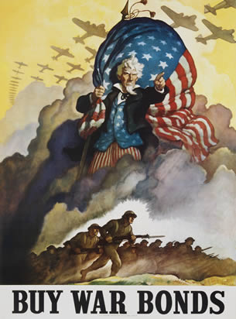
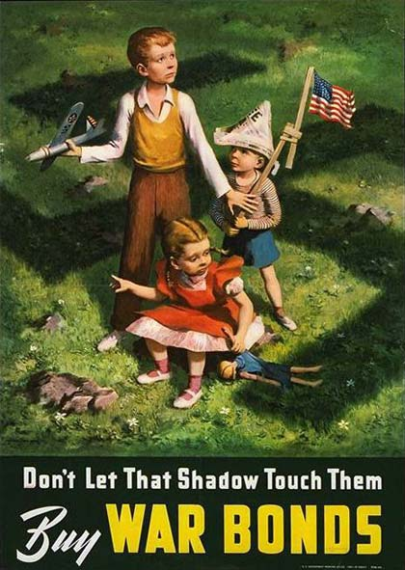
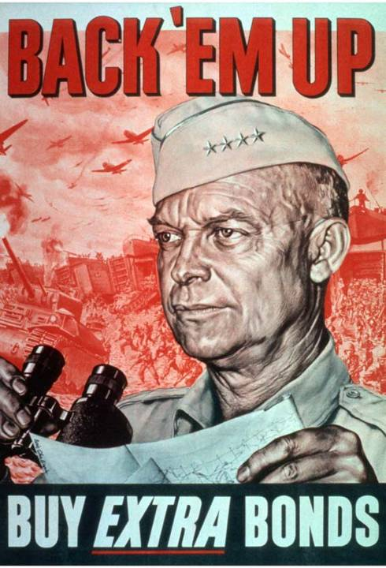
War bonds helped raise $187 billion to support the war effort

Slide 14
Victory Gardens: Grow Your Own

Slide 15
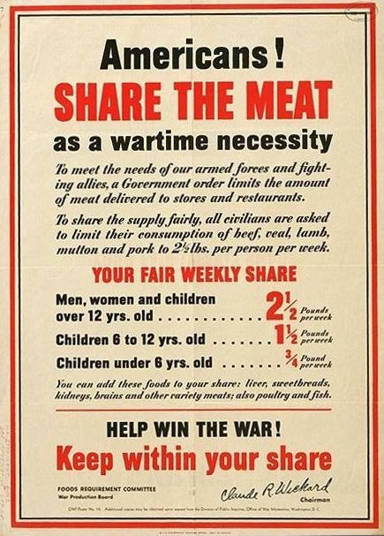

Slide 16
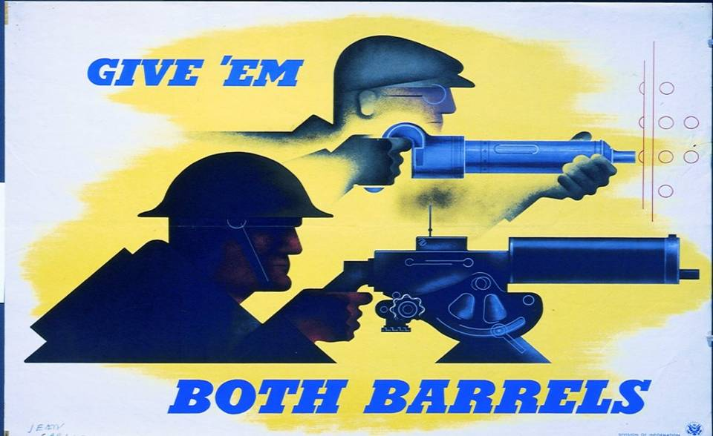
Propaganda: Fighting the Enemy on the Battlefield & on the Home Front

Slide 17
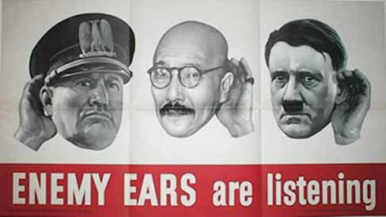
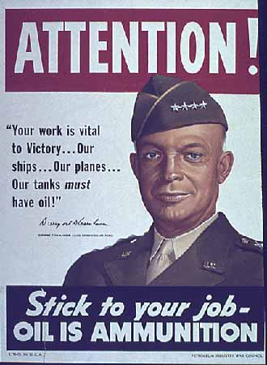
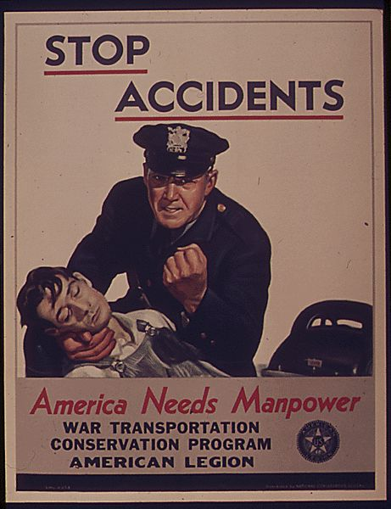
Office of War Information

Slide 18
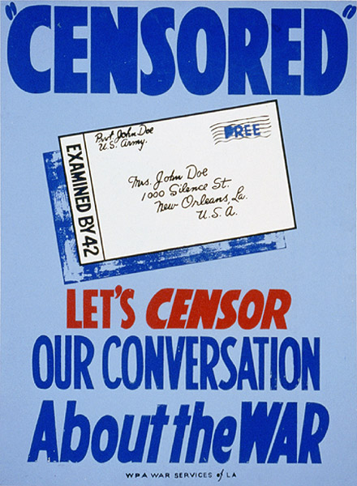
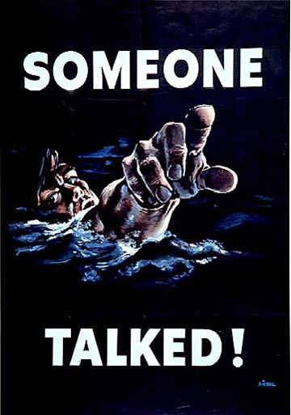
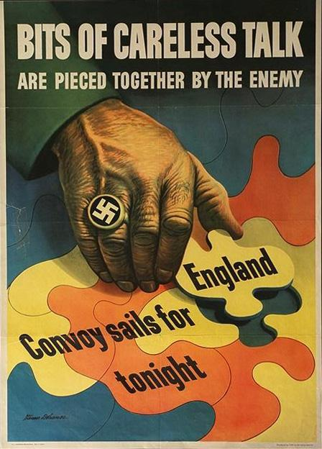
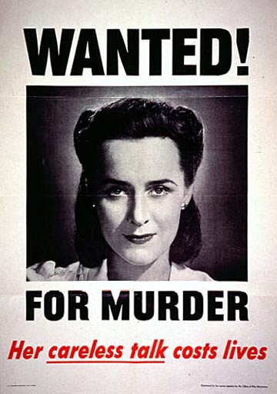
Office of Censorship

Slide 19
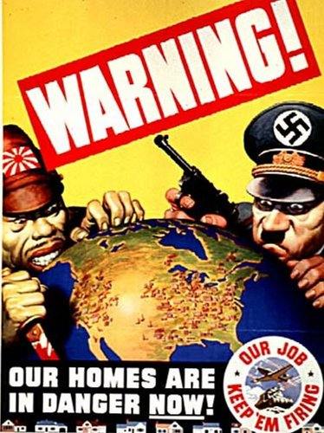
Fear Propaganda

Slide 20
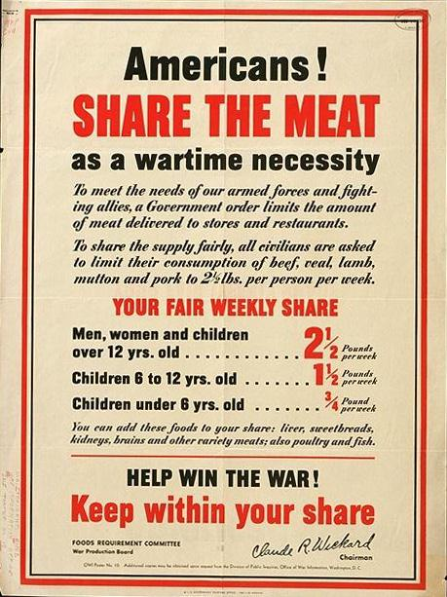
Office of Price Administration (OPA) and Ration Books

Slide 21
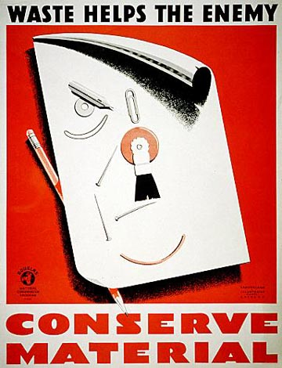
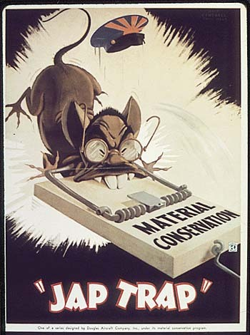

Slide 22
War Productions Board

Slide 23
Labor
Taft-Hartley Act
Anti-Union Law (overturns much of the Wagner Act)
Fear of communism (seeds of Cold War/2nd Red Scare
National War Labor Board
AFL-CIO Split (1938)
Refrained from strikes during wa
Reunited in 1955

Slide 24
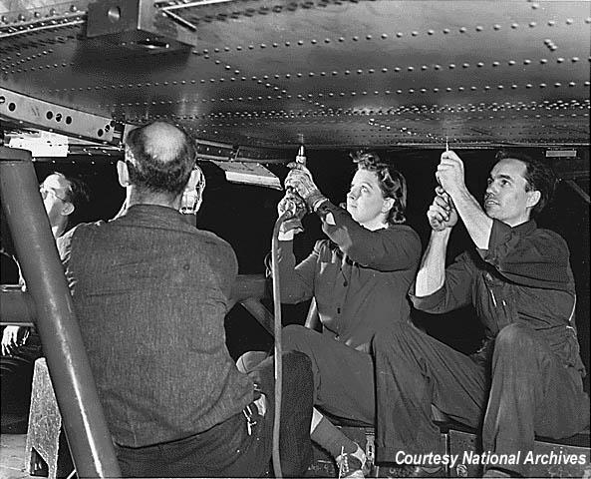
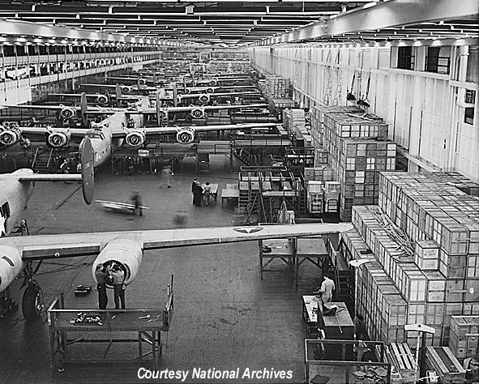
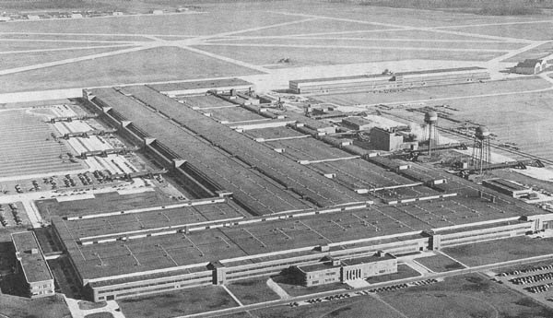
Ford’s Willow Run Factory
Ford made one B-24 bomber every hour

Slide 25
Economic Impact of World War II

Slide 26
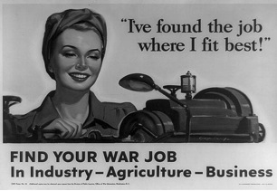
Women and World War II
Women in Armed Forces
350,000 served in military
Women’s Army Corps (WAC)
Women Appointed for Voluntary Emergency Service (WAVES)
“Rosie the Riveter”
“A woman is a substitute, like plastic instead of metal.” – War Department brochure
Women in the Workforce
1940 – 27%
1945 – 37%
Earned 65% of what men earned
Domestic sphere included the home front
American Family
Marriage and birth rates increased
Divorce rates increased
High school enrollment decreased
“At Boeing I found a freedom and an independence I had never known. After the war I could never go back to playing bridge again, being a clubwoman and listening to a lot of inanities when I knew there were things you could use for your mind. The war changed my life completely.” – Inez Sauer

Slide 27
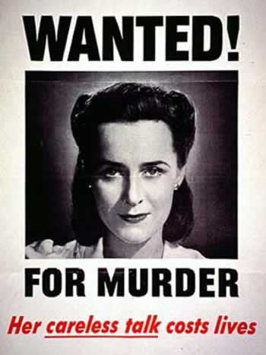
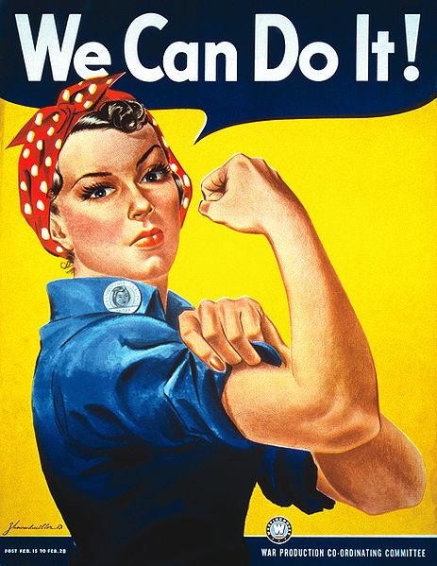
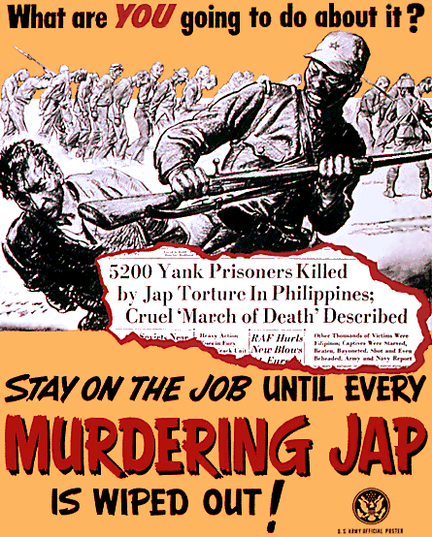
In a Nutshell…
SHUT UP
PRODUCE
SACRIFICE
HATE

Slide 28
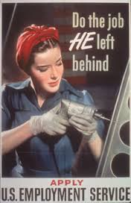
“Rosie, the Riveter”

Slide 29
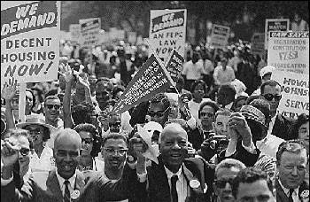
Double V: Victory at Home & Abroad
A. Philip Randolph threatened a “March on Washington” to protest war time discrimination
Other groups, like the Congress of Racial Equality (CORE), staged sit-ins in restaurants in major cities to protest discrimination

Slide 30
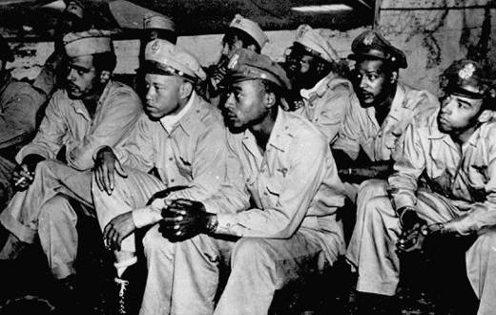
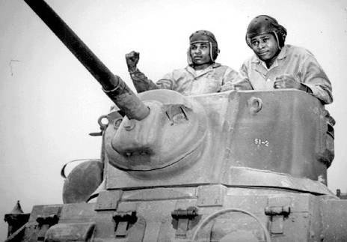
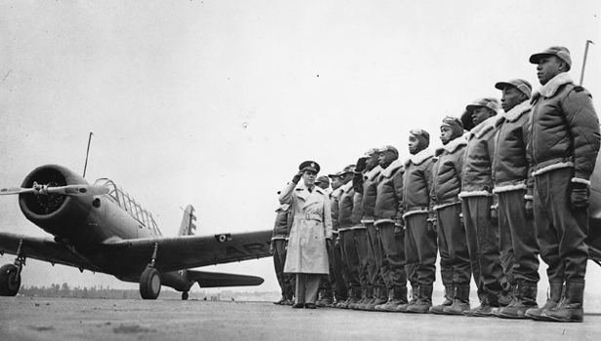
Segregated units…again
Tuskegee Airmen

Slide 31
Blacks and World War II
1.2 million served during the war
Tuskegee Airmen
Double V Campaign
Great Migration
Detroit Race Riot (1943)
March on Washington (1941)
A. Phillip Randolph
Executive Order 8802
Desegregation of national defense industry
Committee on Fair Employment Practice to enforce
Congress of Racial Equality (CORE)

Slide 32
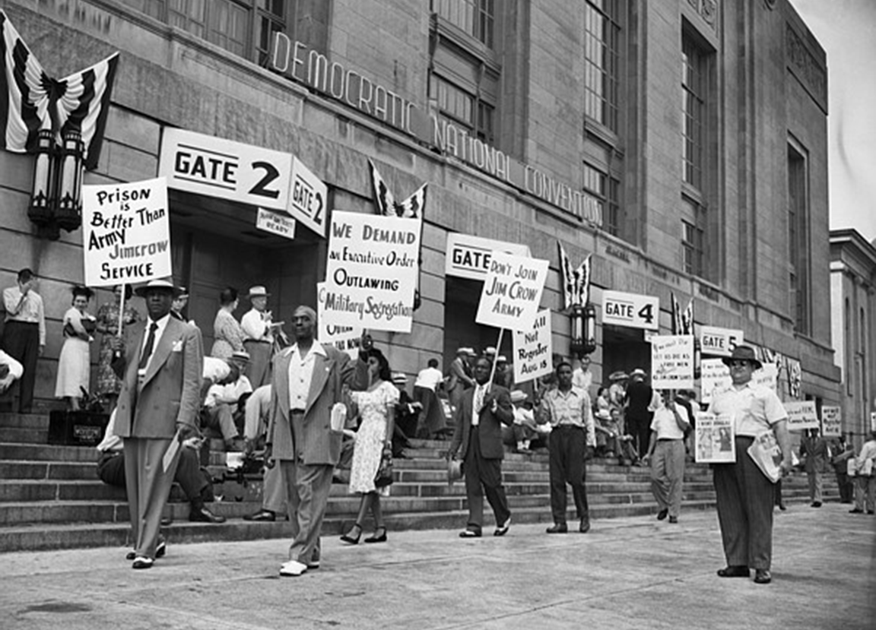

Slide 33
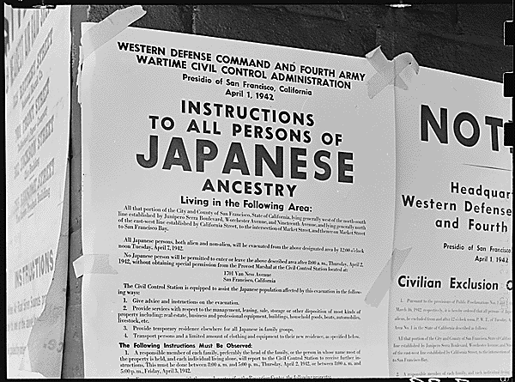
Japanese in World War II
442nd Infantry
Japanese internment camps
Executive Order 9066
Over 100,000 Japanese immigrants (isei) and Americans (nisei)
Korematsu v. United States (1944)
Supreme Court ruled internment camps constitutional in wartime

Slide 34
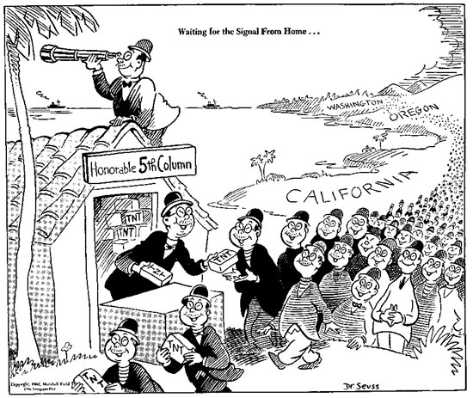

Slide 35
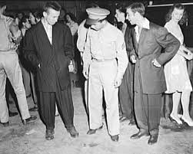
Other Minorities in World War II
Mexicans
Braceros program
Zoot Suit Riots (June 1943)
Natives
Navajo Code Talkers
25,000 enlisted

Slide 36
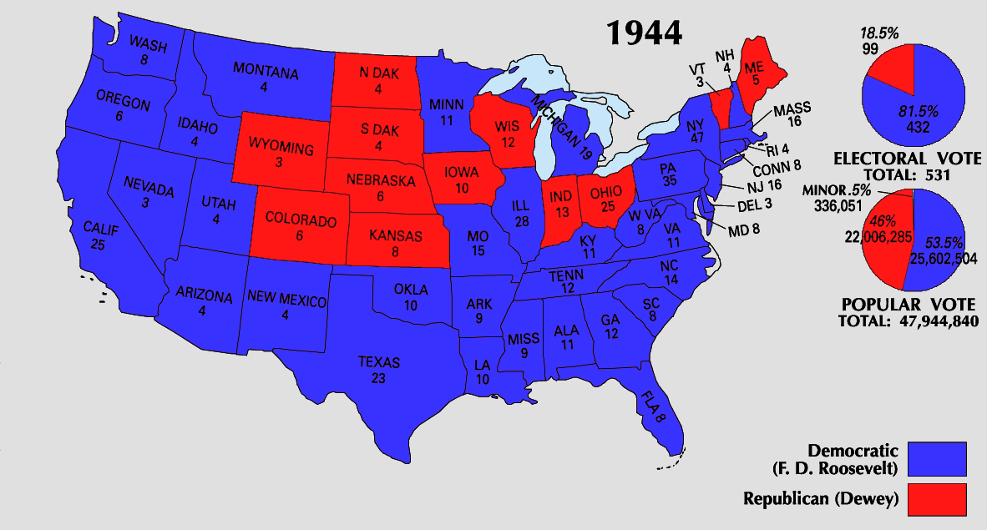
Win-the-War Politics
In 1944, FDR used the war to strengthen his leadership:
“Mr. New Deal” had shifted to “Mr. Win the War”
Opponent Thomas Dewey made communism & FDR’s health the focus of the election
FDR switched VPs from liberal Henry Wallace to moderate Harry Truman to gain appeal

Slide 37
Restoration of U.S. Prosperity
World War II ended the Great Depression.
Factories run at full capacity
Ford Motor Company – one bomber plane per hour
People save money (rationing)
Army bases in South provide economic boom (most bases in South b/c of climate)
The national debt grew to $260 billion (6 times its size on Dec. 7, 1941)

Slide 38
G.I. Bill
Passed in 1944
Federal aid to veterans
Education
Housing
Unemployment
“Servicemen’s Readjustment Act”

