Slide 1
10. The Supreme Court and Checks on the Judiciary
Mr. Winchell
AP GoPo
Unit 2: Interactions Among Branches of Government

Slide 2
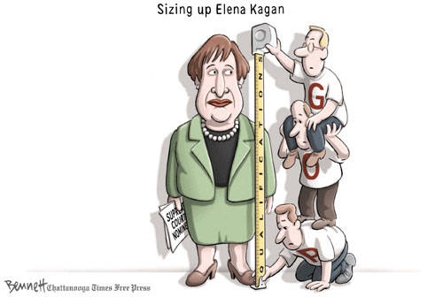
Nominating a Supreme Court Justice
Presidential appointments politicized
Party Affiliation
Political Ideology
Litmus Test
Asking questions about stance on major issues, i.e. abortion
Race, Gender, Religion, Region
Judicial and Legal Experience and Record
Political Acceptability
Legal organizations
American Bar Association
Interest groups
U.S. Senate
Simple majority required
Other justices

Slide 3
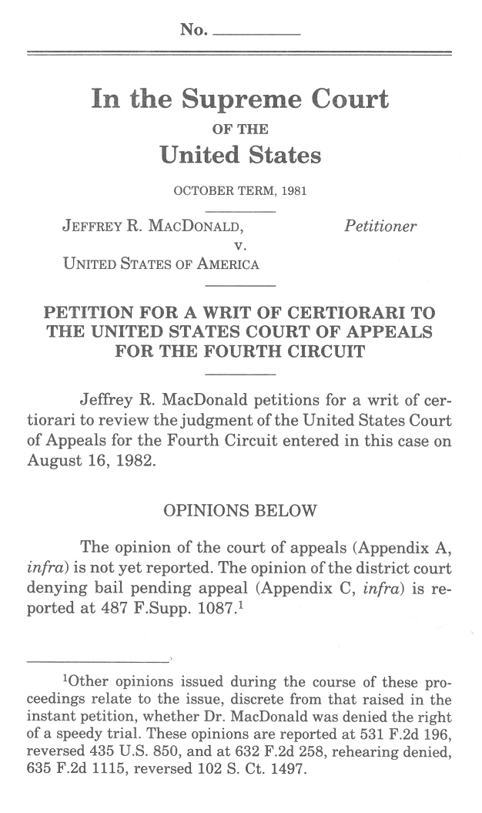
The Supreme Court Accepting Cases
Supreme Court Sessions
Term begins on first Monday in October
Usually ends in June or July
Original Jurisdiction and Appellate Jurisdiction
Cases involving ambassadors, foreign ministers, consuls, or state a party
Most cases based on appellate jurisdiction
Very few cases are reviewed by the SC
Only a 100 out of 10,000 cases a year
Lower court decision stands if SC refuses to hear case
Justices may recuse themselves if conflict of interest
Writ of Certiorari
Petition the Supreme Court to review a lower court decision
SC directs lower court to provide all records regarding a case when petitioned for review
Rule of Four
Four of the nine justices must agree to hear/review a case

Slide 4
Supreme Court—Certiorari Process
Process
Petition
S.C. Original Jurisdiction: state v. state; U.S. v. state; Ambassadors/Consuls
Conference/Discussion List
Writ of Certiorari (Discretionary Jurisdiction)
Rule of 4
If 4 justices want to hear a case; it’s called up to SCOTUS
Solicitor General influence
Briefs
Detailed arguments arguing each side of case
Cite facts, legal principles, precedents
Amicus Curiae: Briefs submitted by interested parties (i.e. interest groups…trying to influence the court’s decision
Oral Argument (2 week cycles)
Abortion Case: Amicus Curiae Briefs
Notes:
9000 cases a year petitioned…reviewed by supreme court clerks…refined and then brought to justices
Writ of Certiorari
a. requirements: case must come from a U.S. Ct of Appeals, a special 3 judge district, or a state supreme court; the case must involve a federal question (interpretation of a federal law or the U.S. Constitution or conflicting interpretations of those laws)

Slide 5
Process Cont…
Conference
Tentative vote & assign writing of the Opinion
Opinion: Est. Precedent for entire nation/lower courts
Majority Opinion “law of the land”
Concurring Opinion
Dissenting Opinion
Per Curiam
An opinion from an appellate/Supreme court that does not identify any specific judge who may have written the opinion
Most Cases Decided on Prior Precedent
Stare Decisis: “Let the decision stand”
Vast majority of cases decided on prev. precedents
Announce Decision
Notes:
Discuss Per Curiam decisions; Obergefell v Hodges,

Slide 6
Texas Abortion Law: Whole Woman’s Health v. Hellerstedt
Texas Abortion Restriction Provisions
Requires abortion clinics to meet the same standards as hospital-like ambulatory surgical centers, which range from minimum sizes for rooms and doorways to the number of nurses required to be on duty.
Separate provision requires doctors performing abortions to have admitting privileges at a hospital within 30 miles of an abortion clinic.
Effects of the Texas Law (HB 2)
Only 19 Texas clinics remain of the more than 40 that were open before HB 2 passed, The court’s decision in, expected sometime this summer, could leave the state with as few as 10 clinics.
Whole Woman’s Health v. Hellerstedt (2016)
Case filed in 2014 by a coalition of Texas abortion providers who argue the restrictions create substantial obstacles for Texas women seeking abortions — an "undue burden" that renders the rules unconstitutional — and do not advance the state’s interest in promoting health. (Planned Parenthood v. Casey)
Notes:
UNDUE BURDEN

Slide 7
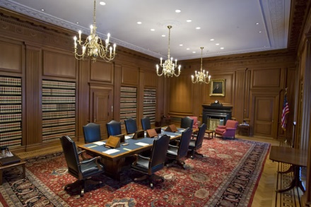
The Supreme Court Deciding a Case
Conferences
Justices discuss the case on Wednesday afternoons and Fridays
Writing Opinions
Most opinions written by justice’s law clerks
Majority opinion
The official opinion of the court, the supreme ruling
Outlined by legal reasons
Dissenting opinion
Justices who disagree with the majority opinion write a dissent outlined by legal reasons
Concurring opinion
If a justice concurs with the majority but disagrees with the legal reasons

Slide 8
Court Docket
Cases more likely to be heard if…
Court decision conflicts with precedent
Ct. of appeals decision that conflicts with another court of appeals decision
Inconsistency between the courts of different states
Split decision in court of appeals
More likely to void state and local laws than federal laws

Slide 9
Court Docket
“Political Questions”: Doctrine developed and used as means to avoid deciding some cases (principally those involving conflicts between Pres. and Congress
Been construed narrowly; doesn’t stop from hearing cases like Abortion, Campaign Finance…
Supreme Court has held that federal courts should not hear cases which deal directly with issues that Constitution makes the sole responsibility of the other branches of government
Court has held that the conduct of foreign relations is the sole responsibility of the executive branch, and cases challenging the way the executive is using that power present political ?s

Slide 10
Impact of Decisions: Judicial Activism v. Restraint
Judicial Activism v. Restraint:
Refers to the process or method a judge uses to reach a particular decision, not to the political ramifications of the decision
Activist (Judicial Activism)
Strike down/alter acts & overturn previous rulings
Influence policy
Correct injustices; Loose interpretation of Const.
Defense: merely fulfilling courts job in system of checks/balance
More likely support affirmative action; reproductive rights; equal protection
Restrained (Judicial Restraint)
“The Constitution is not an empty bottle……it is like a statute, and the meaning doesn’t change.” –Antonin Scalia
Strict Constructionist
Use precedent & “framers intent” to decide case
Isn’t court’s job to make policy; defer to other 2 branches

Slide 11
The Supreme Court Jurisprudence/Judicial Philosophy
Originalism
Based on TEXT, HISTORY, TRADITION, PRECEDENT
Limit the initiative on social and political questions
Passive on policymaking
Strict interpretation of the Constitution
“The Constitution is not an empty bottle…it is like a statue, and the meaning doesn’t change.” – Antonin Scalia
Living Constitution
Based on TEXT, HISTORY, TRADITION, PRECEDENT, PURPOSE & VALUES, CONSEQUENCES
Active role in society and politics
Judicial intervention
Loose interpretation of the Constitution
“Provisions of the Constitution of the United States are not mathematical formulas having their essence in their form, but are organic living institutions transplanted from English soil. Their significance is not to be gathered simply from the words and a dictionary, but by considering their origin and the line of their growth” – Oliver Wendell Holmes
Judicial Restraint
Justices hold to legal precedent and defer to the elected legislatures
Stare decisis
Apply the law, not determine the law
Judicial Activism
Development of new legal principles to preserve fundamental principles
Conflicts with legal precedent and public policy
Justices consider personal opinions on public policy in legal decisions

Slide 12
Judicial Activism or Restraint
Plessy v. Ferguson
Brown v. Board of Educ.
Roe v. Wade
Bush v. Gore
Texas v. Johnson

Slide 13
Key Figures in the Justice Department
Chief Justice
Presides over Supreme Court cases
Determines which decisions will be discussed in conference
If C.J. in the majority, they get to choose who writes the majority opinion…very important…why?
Ex. Earl Warren
Attorney General
Head of the Department of Justice
Solicitor General
Person appointed to represent the federal government of U.S. before the Supreme Court.
Large role influencing which cases heard by supreme court
Notes:
The chief justice determines which decisions the Court will discuss in conferences where the justices choose the cases they will accept for review. The chief justice also leads the private discussions on cases recently argued. After presenting the facts and issues in such a case and the relevant law, the chief justice states her or his conclusions and casts a vote. The discussion continues in order of seniority, with each associate justice presenting her or his views and vote.
If the chief justice is in the majority after voting has concluded, he or she assigns the writing of the opinion in the case. This critical responsibility provides the chief justice with an important opportunity to influence the out-come of the case, since he or she can assign the case to a justice who he or she believes has similar views. The chief justice may also assign the authorship of the opinion to himself or herself, as many chief justices have done in cases involving far-reaching constitutional issues. If the chief justice is not in the majority, the senior justice in the majority has the power of assignment.

Slide 14
Supreme Court History
Marshall Court (early 19th century)
Marbury v. Madison (1803) – judicial review; constitutionality of laws and policies
Pro-Federalist decisions – expansion of national government power and influence
Taney Court (mid 19th century)
Scott v. Sanford (Dred Scott decision) (1857)
Pro-Democratic decisions – states’ rights and limited government
Late 19th Century-Early 20th Century (“Lochner Era”)
Wake of 14th Amendment – incorporation
Plessy v. Ferguson (1896) – “separate but equal”
Pro-business, pro-laissez-faire decisions during Gilded Age/Progressive Era/1920s
New Deal (1930s)
FDR’s court-packing to save New Deal policies from conservative rulings
“the switch in time to save nine”
Warren Court (1950s-1960s)
Active in civil rights and civil liberties decisions; “most liberal court ever”
Brown v. Board of Education, Miranda v. Arizona
Burger Court (late 1960s- early 1980s)
More conservative regarding rights of defendants
Roe v. Wade, Regents of UC v. Bakke
Rehnquist and Roberts Courts (late 1980s-2010s)
Continues the conservative ideology
Planned Parenthood v. Casey, McDonald v. Chicago, Citizens United v. FEC

Slide 15
Current Chief Justice
Current Chief Justice: John Roberts
Key Cases Under his Tenure:
Voting Rights
Florida v. Holder
Campaign Finance:
Citizens United v. FEC; McCutcheon v. FEC
Healthcare:
National Federation of Indep. Business v. Sebelius
Burwell v. Hobby Lobby
King v. Burwell
Marriage Equality:
Obergefelle v. Hodges

Slide 16
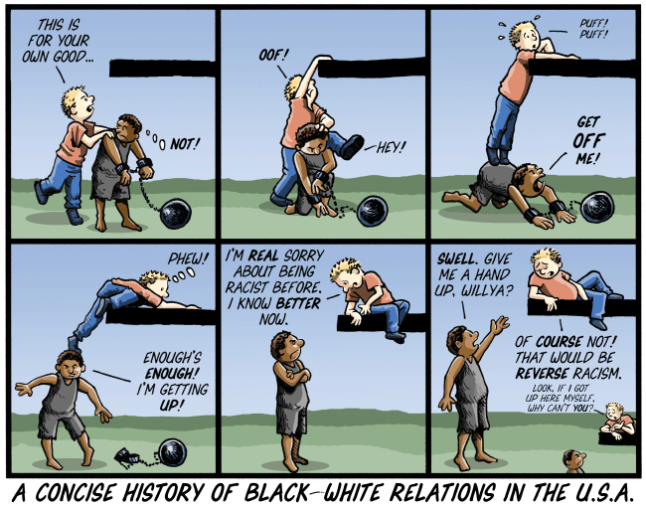
Notes:
There have been 312 innocent people exonerated in U.S. due to DNA evidence since death penalty been in effect.

Slide 17
Checking and Balancing Judges
Adversarial System
Issue between two parties settled by an impartial judge or jury
Justiciable Dispute
Based on an actual situation and not a hypothetical test
Political Questions
Disputes between Congress and the President or a matter left to a branch of government
Appointments
President appoints with Senate approval
Impeachment
House of Representatives may impeach a federal judge and the Senate tries
Structure of the Courts
Congress may alter the number of district or appellate courts, number of SC justices
Amendments
Overrule a federal court decision by amending the Constitution or bounding the courts to the supreme law of the land

