Slide 1
2.2: The Legislative Branch: Structure and Organization
Mr. Winchell
AP GoPo
Unit 2: Interactions Among Branches of Government

Slide 2
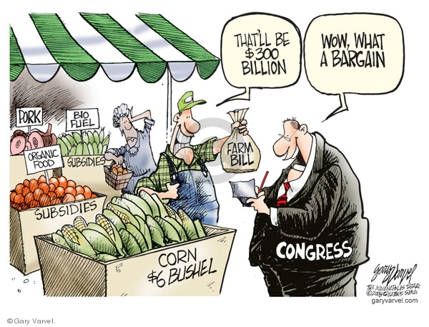

Slide 3
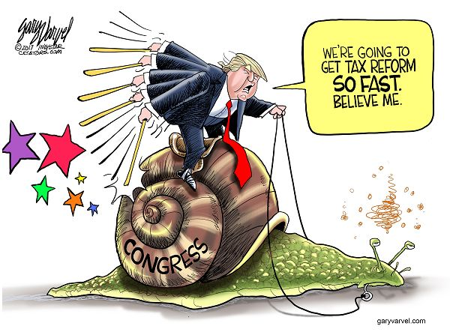

Slide 4
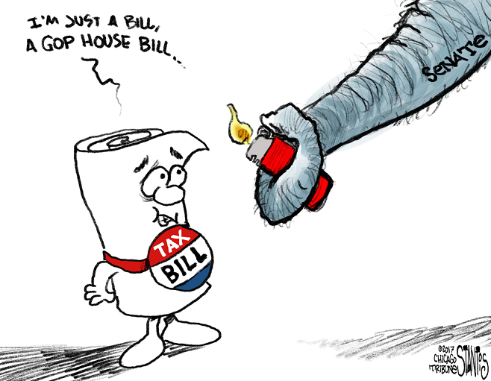

Slide 5
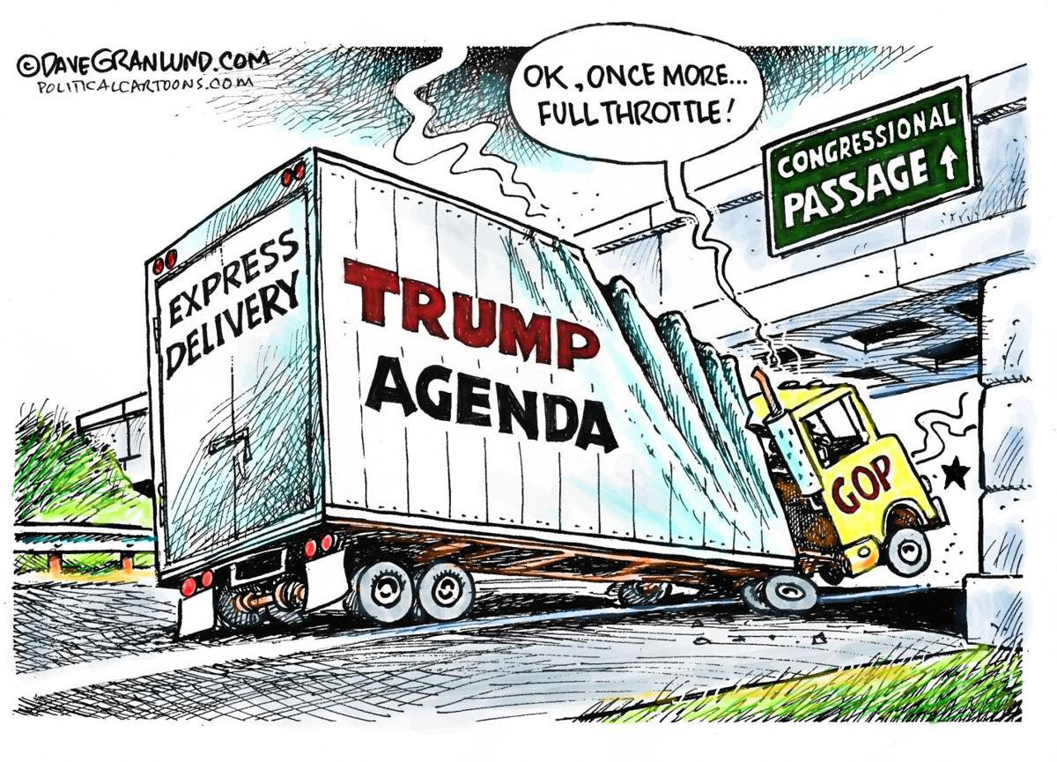

Slide 6
Essential Question
How do the structure and operation of the legislative branch reflect the United States’ republican ideals?

Slide 7
Structure of Congress

Slide 8
Powers of Congress Article I, Section 8*
Lay and collect taxes*
Power of the Purse
Borrow money*
Commerce Clause*
Regulate interstate and foreign commerce*
Immigration and naturalization rules*
Coin money and set its value*
Create lower federal courts*
Declare war*
Necessary and Proper Clause*
aka Elastic Clause
Bankruptcy rules*
Punish counterfeiters*
Fix weights and measures*
Post office and postal roads*
Issue patents and copyrights*
Piracy laws*
Raise army and navy*
Provide for militia*
Run D.C.*
Propose amendments
Congressional oversight

Slide 9
Meeting of Congress
Both houses meet for a term of two years
Makeup of congressional terms determined by congressional elections every two years
Terms begin on January 3rd of odd-numbered years
2016 Elections in November 2016
115th Congress begins term on January 3, 2017
Special sessions
President may call Congress in times of emergency situations or significant political developments
Pearl Harbor in December 1941

Slide 10
Exclusive Powers of House and Senate
House of Representatives
Senate
Initiate revenue bills
Impeach executive and judicial officials
Choose president if neither candidate receives majority in Electoral College
Trial of impeached officials
Advice and Consent
Approve presidential appointments
Executive department heads, federal justices
Simple majority
Ratify treaties negotiated by president
2/3 majority
Choose vice president if neither candidate received majority in Electoral College

Slide 11
General Description of Congressional Chambers
House of Representatives
Senate
More formal and descriptive rules
Highly influenced by party politics
More specialized in particular policy areas
Very committee based
Majoritarian decisions
More bipartisanship
Members more generalist than specialist
Less committee based
Decisions based more on consensus and consent

Slide 12
Congressional Oversight
Senate Committee on Energy and Natural Resources and Secretary of Energy
Senate Judiciary Subcommittee on Crime and Terrorism

Slide 13
Evolution of Congress
From 1789 to 1932, Congress virtually dominated the federal government
Exceptions under Jackson, Lincoln, T. Roosevelt, and Wilson
From 1932 to the present the President has become the focus of federal government power and authority
In conjunction with expansion of government with FDR’s New Deal programs
Media coverage

Slide 14
Electing the House
Directly elected by the people
Two-year terms
Frequency of elections
Mid-Term Elections
Non-presidential election
Low voter turnout

Slide 15
Congressional Apportionment and Districts
Congress established number of representatives for House at 435 (1911)
Each state with at least one representative
Currently, one representative per 709,760
Reapportionment every 10 years based on national census
Redistricting
States draw congressional districts
Districts must be relatively equal

Slide 16
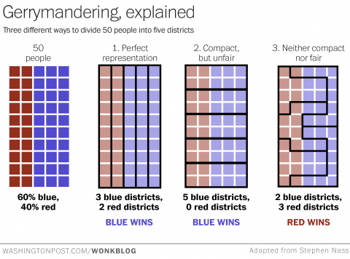
Congressional Apportionment and Districts
Consequences
Gerrymandering
Drawing districts to favor a political party or group
Independent commissions
Baker v. Carr (1962)
Wesberry v. Sanders (1964)
Reynolds v. Sims (1964)
Shaw v. Reno (1993)

Slide 17
Electing the Senate
Staggered terms
1/3 of senators every two years
How Elected
State legislatures originally elected senators
“Millionaires’ Club”
Seventeenth Amendment
Popular election of senators

Slide 18
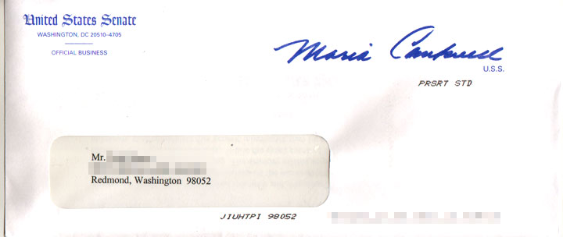
Incumbency Effect
Current office holders winning reelection
Advantages
Name recognition
Credit claiming
Casework
Visibility
Media exposure
Fund-raising
Campaign experience
Voting record
Franking privilege
Disadvantages
Mistrust of government
Unpopular political party
Redistricting effect
“Held responsible”

Slide 19
Congressional Incumbency Rates

Slide 20
Congressional Term Limits
Congressional members have NO term limits
May be reelected as many times as possible
U.S. Term Limits, Inc. v. Thornton (1995)
Supreme Court overruled Arkansas law imposing term limits on U.S. congressional representatives

Slide 21
Congressional Agencies
Congressional Budget Office (CBO)
Analyze budget and economic proposals
Government Accountability Office (GAO)
Audits
Investigations
Congressional Research Service (CRS)
Information, history

Slide 22
House Congressional Leadership
SPEAKER OF THE HOUSE
Elected by House members; need 218 votes to be elected
Presides over the House
Most powerful person in Congress
Most powerful member from majority party
Assigns bills to committee, controls floor debate, appoints party member to committees and chairs
House Majority Leader
Assists Speaker of the House; second in command
Plans party’s legislative program
Directs floor debate
House Minority Leader
Represents House leader of opposition party
House Majority Whip and House Minority Whip
Assist in party voting, inform on voting, vote
counts, voting pressure

Slide 23
Senate Congressional Leadership
President of the Senate
Vice-President presides
Votes only to break a tie
President Pro Tempore
Majority party senior member to preside in absence of VP
Senate Majority Leader
Most powerful Senate member and party spokesperson
Senate Minority Leader
Represents Senate leader of opposition party
Senate Majority Whip and Senate Minority Whip
Rallies respective Senate party member to votes, vote counts

Slide 24
I’m Just a Bill
School House Rock

Slide 25
Lawmaking Process
Essential Question

Slide 26
Essential Question
How do the structure and operation of the legislative branch reflect the United States’ republican ideals?

