Slide 2
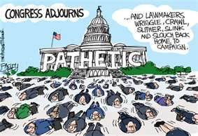

Slide 3
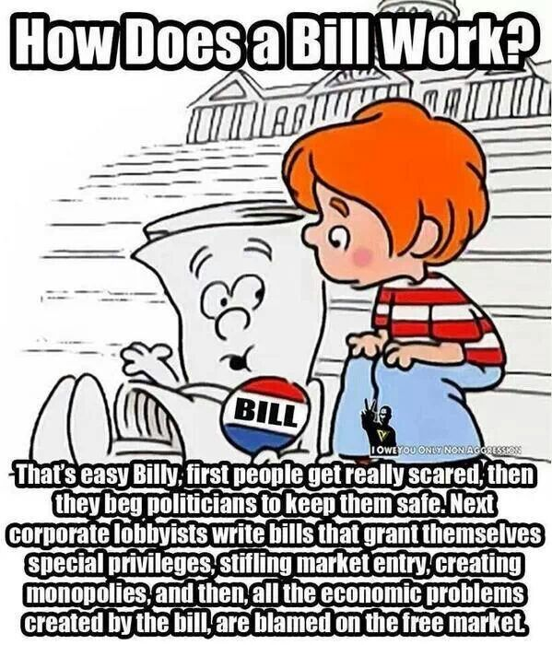

Slide 4
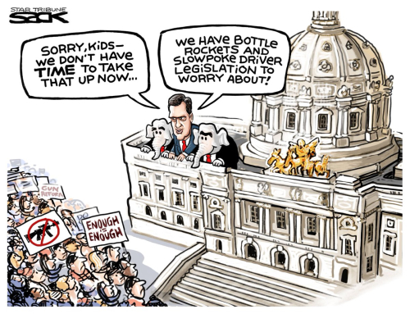

Slide 5
2.3: Congressional Roles and the Legislative Process
Mr. Winchell
AP GoPo
Unit 2: Interactions Among Branches of Government

Slide 6
Twenty Seventh Amendment
Members of Congress set their own salaries.
Pay raises typically become campaign issues, as the election chall enger can easily point to the incumbent member's "salary grab."
The 27th amendment passed in 1992, prevents any pay raises from taking effect until the following Congress.
In 2015, members of Congress earned $174,000 per year.

Slide 7
Leadership in Congress
The only official congressional leaders mentioned in the Constitution are the Speaker of the House, the President of the Senate, and the President Pro Tempore of the Senate.
Notes:
Congress' formalized group include both lawmaking committees and partisan or ideological private groups. Some of the powerful committees are institutions unto themselves, as committees are where the real work of Congress is done.

Slide 8
Duties
Legislators
Lawmakers
Committee Members
Most of work done here
Standing Committees: 20 in House, 16 in Senate
Rules Committee – “Traffic cop” decides what measures to consider
Select Committee – for specific purpose, limited Time
Joint Committee – members of both houses
Conference Committee – both houses to pass identical bill
Legislative Oversight – monitoring bureaucracy and execution of laws
Representatives of Constituents (people)
Servants of Constituents
Politicians
Oversight
Notes:
“Committee Members” link connects to house.gov list of all committees in the House of Representatives. The list is also available at senate.gov. Another option is to find your congressman and see what committees they are a part of. Ask students why your congressmen might be assigned to these committees.

Slide 9
Checks on Lawmaking within Congress
Congress has two chambers that must approve legislation helps prevent that passage of rash laws.
It doubles the people's scrutiny by requiring the concurrence of two distinct bodies.

Slide 10
Majority in Congress
The majority party in Congress holds certain advantages:
assigns Speaker of House/Senate Majority Leader
holds committee chairs
controls rules committees
set the agenda
assign bills to committees

Slide 11
Committees
Standing Committees
Permanent, Subject Specific
House Energy, House Commerce, Senate Judiciary, Majority Ruled
Joint Committees
Public Communication, Investigation
Joint Committee on Taxation
Select Committees
Temporary, Special Purpose
Watergate
Conference Committees
Temporary, Compromise on Specific Legislation

Slide 12
Congressional Standing Committees
House
Senate
Rules
Ways and Means
Appropriations
Judiciary
Agriculture
Armed Services
Budget
Education and the Workforce
Ethics
Financial Services
Foreign Services
Homeland Security
House Administration
Energy and Commerce
Natural Resources
Oversight and Government Reform
Science, Space, and Technology
Small Business
Transportation and Infrastructure
Veterans’ Affairs
Appropriations
Finance
Judiciary
Foreign Relations
Agriculture, Nutrition, Forestry
Armed Services
Banking, Housing, Urban Affairs
Budget
Commerce, Science, Transportation
Energy and Natural Resources
Environment and Public Works
Health, Education, Labor, and Pensions
Homeland Security and Government Affairs
Rules and Administration
Small Business and Entrepreneurship
Veterans’ Affairs

Slide 13
DISCHARGE PETITION
The discharge petition can bring a bill out of a reluctant committee.
The petition's required number of signatures has altered over the years.
Not it stands at a simple majority (218) to discharge a bill out of committee and onto the House floor.
This measure may or may not lead to the bill's passage, but it prevents a minority from stopping a majority on advancing the bills.

Slide 14
Legislative Process in the Senate
Filibuster- a lengthy speech to delay action on a bill
Rule 22- Wilson called the Senate into special session. And demanded the rules change.
The Senate created Rule 22, or the cloture rule, which enabled and required a two-thirds supermajority to close up or stop debate on a bill and call for a vote.
In 1975, the Senate lowered the standard to three fifths (60 out 100)

Slide 15
Caucuses
The formal, nongovernmental groups of like-minded people organized in Congress.
Small caucuses are organized around specific interests, even some cross party lines, such as agriculture, business, or women's issues.
Caucuses cannot create law, but can work to enhance the chances of passing their desired policies.

Slide 16
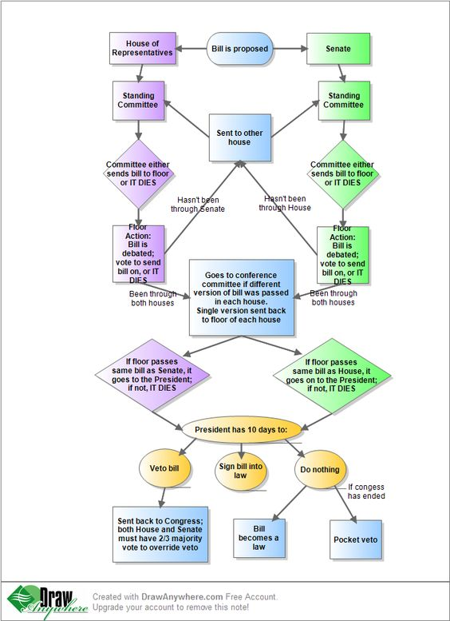

Slide 17
Voting Options as Congressmen
Attitudinal/Trustee
Use their ideology and conscience
Representational/Delegate
Agents for those who elected them
Vote based on their district constituency only
Organizational/Partisan
Allegiance to their party/caucus/PATRONAGE
Politicos
Combination of all of the above
TRUE politician: Make everyone happy

Slide 18
Types of Legislative Actions
Distributive
Distribution of goods/services for general public
i.e. highway construction project
Redistributive
Using taxes on one segment of population for entitlements on another segment
i.e. Social Security
Regulatory
Mandates and limits on groups and individuals
i.e. Clean Air and Water Act
Constituent
Establish executive agencies
i.e. Department of Homeland Security after 9/11

Slide 19
Pork Barrel Legislation
One product of these add- ons is pork barrel spending
Members of Congress try to send federal dollars, also known as pork, back to their district.
Funds directed for a specific purpose, known as earmarks, have generated national debate.
LOGROLLING: Reciprocal support on bills

Slide 20
Dysfunction in Congress
https://www.c-span.org/classroom/document/?8769

