Slide 1
2.5: The Modern American Presidency: The Powers of the Executive Branch
Mr. Winchell
AP GoPo
Unit 2: Interactions Among the Branches of Government

Slide 2
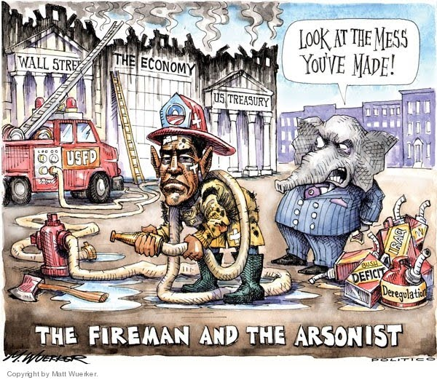

Slide 3
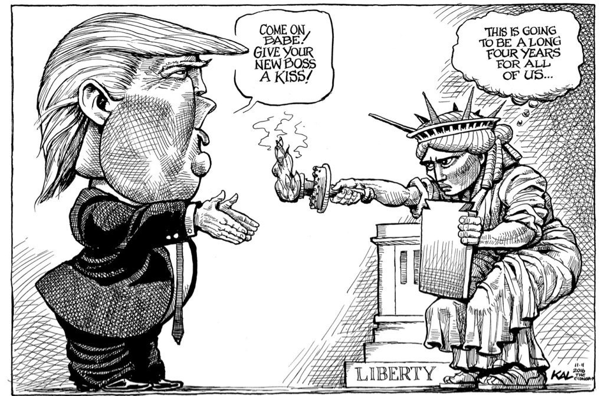

Slide 4
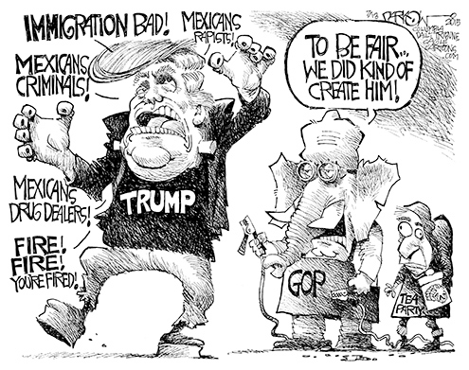

Slide 5
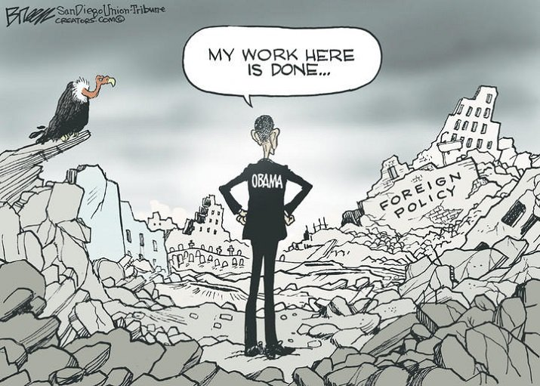

Slide 6
Text Analysis
Article II
Expressed Powers?
Implied Powers?
Checks on other branches?

Slide 7
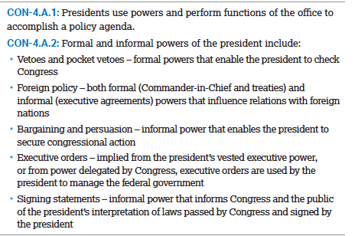

Slide 8
Constitutional Qualifications
Be at least 35 years old
A natural-born citizen of the United States
Lived in the U.S. for 14 years
Twelfth Amendment requires Vice President to fulfill qualifications

Slide 9
“Typical” Qualifications
Political experience
Vice presidents, state governors, U.S. senators, U.S. representatives
Presidents with no prior elected office:
Zachary Taylor (W), Ulysses S. Grant (R), William H. Taft (R), Herbert Hoover (R), Dwight Eisenhower (R). Donald Trump (R)
Military service
13 Presidents with no prior military service:
John Adams (F), John Quincy Adams (D-R, NR), Martin van Buren (D), Grover Cleveland (D), William Howard Taft (R), Woodrow Wilson (D), Warren Harding (R), Calvin Coolidge (R), Herbert Hoover (R), Franklin Roosevelt (D), Bill Clinton (D), Barack Obama (D), Donald Trump (R)
White Anglo-Saxon Protestant (WASP)
John F. Kennedy (D) was first Catholic president (1961-1963)
Barack Obama (D) was first black president (2009-Present)
Charismatic
Outsider
Not involved in the “mess in Washington”
Only two female vice-presidential major party candidates
Geraldine Ferraro (D) (1984), Sarah Palin (R) (2008)
James Buchanan (R) was only president not married (1857-1861)

Slide 10
Electoral College
Article II establishes Electoral College
12th Amendment requires vote for president AND vice president
In response to Election of 1800; Jefferson and Burr
Each state receives number of electors equal to number of representatives and senators
23rd Amendment provides 3 electoral votes for District of Columbia
Usually, state political parties nominate their electors
Winner-take-all for 48 states based on popular vote in state
Maine and Nebraska split electoral votes
Electoral majority required
Currently, 270 out of 538
House of Representatives chooses if no majority
20th Amendment requires newly elected incoming House to choose

Slide 11
Presidential Candidates and State Campaigns
Number of Hand Waves depicts number of presidential and vice-presidential candidate visits in last five weeks of election of 2004
Number of Dollar Signs depicts number of presidential campaign spending in last five weeks of election of 2004

Slide 12
Electoral College?
Against the Electoral College
May lose popular vote
Swing-state campaigning
For the Electoral College
Preserve states’ perspectives
Proposals
Nebraska/Maine model
National popular vote

Slide 13
Electoral History
Election of 1800
Thomas Jefferson and Aaron Burr tied in Electoral College
House of Rep elected Thomas Jefferson
Led to Twelfth Amendment
Election of 1824
Andrew Jackson earned plurality of the popular vote and plurality of electoral votes
House of Rep elected John Q. Adams
Election of 1844
James K. Polk won Electoral College, but only 49.5% of popular vote
Election of 1848
Zachary Taylor won Electoral College, but only 47.3% of the popular vote
Election of 1856
James Buchanan won Electoral College, but only 45.3% of the popular vote
Election of 1860
Abraham Lincoln won Electoral College, but only 39.7% of the popular vote
Election of 1876
Samuel Tilden (D) won 50.9% of popular vote
3 contested states awarded to Rutherford B. Hayes (R)
Election of 1880
James Garfield won Electoral College, but only 48.27% of the popular vote
Election of 1884
Grover Cleveland won Electoral College, but only 48.9% of the popular vote
Election of 1888
Grover Cleveland (D) won a plurality of the popular vote (48.9%), but lost to Benjamin Harrison (R) in Electoral College
Election of 1892
Grover Cleveland won Electoral College, but only 46% of the popular vote
Populist Party ran James Weaver
Election of 1912
Woodrow Wilson won Electoral College, but only 41.8% of the popular vote
Bull Moose Party ran Theodore Roosevelt
Election of 1916
Woodrow Wilson won Electoral College, but only 49.2% of the popular vote
Election of 1948
Harry Truman won Electoral College, but only 49.6% of the popular vote
States Rights Party ran Strom Thurmond
Election of 1960
John F. Kennedy won Electoral College, but only 49.72% of the popular vote
Election of 1968
Richard Nixon won Electoral College, but only 43.4% of the popular vote
American Independence Party ran George Wallace
Election of 1992
Bill Clinton won Electoral College, but only 43% of the popular vote
Election of 1996
Bill Clinton won Electoral College, but only 49.2% of the popular vote
Election of 2000
Al Gore (D) won popular vote, but lost to George W. Bush (R)
U.S. Supreme Court decided on recount of Florida’s votes

Slide 14
Inauguration
“I do solemnly swear (or affirm) that I will faithfully execute the Office of President of the United States, and will to the best of my Ability, preserve, protect and defend the Constitution of the United States.” – Oath of Office
Twentieth Amendment (1933) established January 20th as inauguration date
Used to be on March 4th
Since John Adams, the Chief Justice of the Supreme Court has administered the oath

Slide 15
Presidential Terms of Office
Four-year terms
Originally, no limit to number of terms served
George Washington set precedent/tradition of two terms
Franklin D. Roosevelt
Elected to 4 terms (1932, 1936, 1940, 1944)
22nd Amendment (1951)
Limited president to two terms

Slide 16
Presidential Benefits
$400,000 annual salary
$50,000 annual tax-free expense account
$100,000 annual tax-free travel allowance
Taxable pension plan
Secret Service protection
Support staff
White House staff of 400-500 people
Camp David, a countryside getaway
Air Force One (plane) and Marine One (helicopter)
Considered the most powerful person in the world
Leader of the Free World

Slide 17
The Many Hats of the President
Chief Executive
Execute laws, appoint executive officials
Chief Legislator
Propose legislation, veto power, State of the Union
Commander-in-Chief
In charge of armed forces
Head of State
Ceremonies, receive foreign leaders, official dinners
Chief Diplomat
Negotiate treaties/alliances, develop foreign policies, appoint ambassadors
Head of Political Party
Agenda setting, coattails, patronage

Slide 18
Commander-in-Chief
Commander-in-Chief (FORMAL POWER)
Over all armed forces
Appoints Joint Chiefs of Staff (military advisors)
Wages war
Troop deployment
Provides for domestic order
Call up the National Guard in affected state/locality
Crisis Manager (INFORMAL POWER)
Youngstown Sheet Co. v. Sawyer (1951)
War Powers Resolution (1973)
Gulf of Tonkin Resolution (1964) and Vietnam
President notifies Congress 48 hours in advance of combat
Armed forces for 60 days and 30-day withdrawal period
Congress may extend military use, declare war, or authorize use of military

Slide 19
A View on the President’s War Powers
Elizabeth Holtzman – “The Impeachment of George W. Bush” (2006)
John Yoo – “Wartime, Constitution, Empower Presidents” (2006)
Ours is a government of limited power. We learn in elementary school the concept of checks and balances. Those checks do not vanish in wartime; the President’s role as Commander in Chief does not swallow up Congress’s powers or the Bill of Rights…it is impossible to find in the Constitution unilateral presidential authority to act against US citizens in a way that violates US laws, even in wartime. As Justice Sandra Day O’Connor recently wrote, “A state of war is not a blank check for the President when it comes to the rights of the nation’s citizens.”… Indeed, the claim to protect Americans the President needs to be able to avoid court review of his wiretap applications rings hollow. It is unclear why or in what way the existing law, requiring court approval, is not satisfactory. And, if the law is too cumbersome or inapplicable to modern technology, then it is unclear why the President did not seek to revise it instead of disregarding it and thus jeopardizing many otherwise legitimate anti-terrorism prosecutions. His defenders’ claim that changing the law would have given away secrets is unacceptable. There are procedures for considering classified information in Congress.
Similarly, the least dangerous way to prevent rogue nations from acquiring WMDs may depend on secret intelligence gathering and covert action, rather than open military intervention. Delay for a congressional debate could render useless any time-critical intelligence or windows of opportunity. If Congress wants to prevent military adventurism, it can simply do nothing – presidents can wage no war without the troops and weapons funded by Congress. The Constitution creates a presidency that can respond forcefully and independently to pre-empt serious threats to our national security. Instead of demanding a legalistic process to begin war, the framers left war to politics. Presidents can take the initiative and Congress would use their funding power to check him. As we confront terrorism, rogue nations, and WMD proliferation, now is not the time to engage in a radical change in the way our government has waged war for decades.
Notes:
President George W. Bush Is Abusing the War Powers; The President Needs Broad Wartime Powers to Protect the Nation

Slide 20
Chief Executive
Presidential Appointments (FORMAL POWER)
* - The president cannot remove from office
Executive department heads
(i.e. Secretary of State)
Heads of independent regulatory agencies
(i.e. Federal Reserve Chairperson)*
Federal judiciary
(including U.S. Supreme Court)*
U.S. marshals and attorneys
Ambassadors
Requires U.S. Senate approval (simple majority)
Recess appointments (FORMAL POWER)
Executive Appointments
* Informal powers
White House Staff
Executive Office of President (EOP)
Some positions need U.S. Senate approval
“…take care that the laws be faithfully executed”
EXECUTIVE ORDERS (INFORMAL POWER)
A presidential directive to an executive agency to implement or interpret a federal statute or constitutional provision
Specie Circular
Ex parte Merryman
Emancipation Proclamation
Korematsu v. United States (E.O. 9066)
Desegregation of U.S. military (E.O. 9981)
Little Rock Nine (E.O. 10730)
EXECUTIVE PRIVILEGE (INFORMAL POWER)
Power to refuse appearing before or refusing to provide information to Congress or the Supreme Court
Presidents argue for it based on separation of powers
Washington and the House on treaties
United States v. Nixon (1974)
Evidence may not be withheld in criminal proceedings
Clinton v. Jones (1997)
Presidency cannot protect from civil litigation on actions before becoming president

Slide 21
Chief Legislator
Veto Power
Sign bills into law (FORMAL POWER)
Signing Statements (INFORMAL POWER)
Veto bills (FORMAL POWER)
Congressional override (2/3 majority of both houses)
Less than 10% of vetoes ever overridden
POCKET VETO (FORMAL POWER)
LINE-ITEM VETO
Clinton v. City of New York
State of the Union Address (FORMAL POWER)
Special Sessions of Congress (FORMAL POWER)
Prepare and propose federal budget to Congress (INFORMAL POWER)
Per the Budget and Accounting Act of 1921
Congressional Budget and Impoundment Control Act (1974)
Denied president right to refuse spending appropriated funds
Office of Management and Budget (OMB)
Agenda Setting and Power of Persuasion
National leader and representative (INFORMAL POWER)
Head of the party (INFORMAL POWER)
Bully pulpit (INFORMAL POWER)
Presidential approval ratings (INFORMAL POWER)
Veto threat (FORMAL POWER)

Slide 22
Formal Judicial Powers of the President
Appoint justices to the U.S. Supreme Court and lower federal courts
Litmus test
Requires U.S. Senate approval (simple majority)
Senatorial courtesy*
Grants reprieves, pardons, amnesty
Pardons forgive a crime and cancel the punishment
Gerald Ford’s blanket pardon of Nixon for Watergate
Reprieves postpone a sentence allowing for appeals
Amnesty is to forget the crime in lieu of testimony or support

Slide 23
Chief Diplomat
Congress delegates diplomatic powers to President
Appoints ambassadors (FORMAL POWER)
U.S. Senate approval (simple majority)
Receives foreign dignitaries (FORMAL POWER)
Recognize nations (FORMAL POWER)
Treaties and Pacts
Negotiates Treaties (FORMAL POWER)
Legally binding
Requires advice and consent of 2/3 majority of U.S. Senate
Woodrow Wilson and Treaty of Versailles/League of Nations Denial
EXECUTIVE AGREEMENTS (INFORMAL POWER)
An agreement between heads of government
Politically binding
Does not require Senate approval
Must be re-consented by each new president
North American Free Trade Agreement (NAFTA)

Slide 24
How does the structure and operation of the executive branch reflect the United States’ republican ideals?

