Slide 1
7. The Purpose and Structure of the Bureaucracy
Mr. Winchell
AP GoPo
Unit 2-Interactions Among Branches of Government

Slide 2
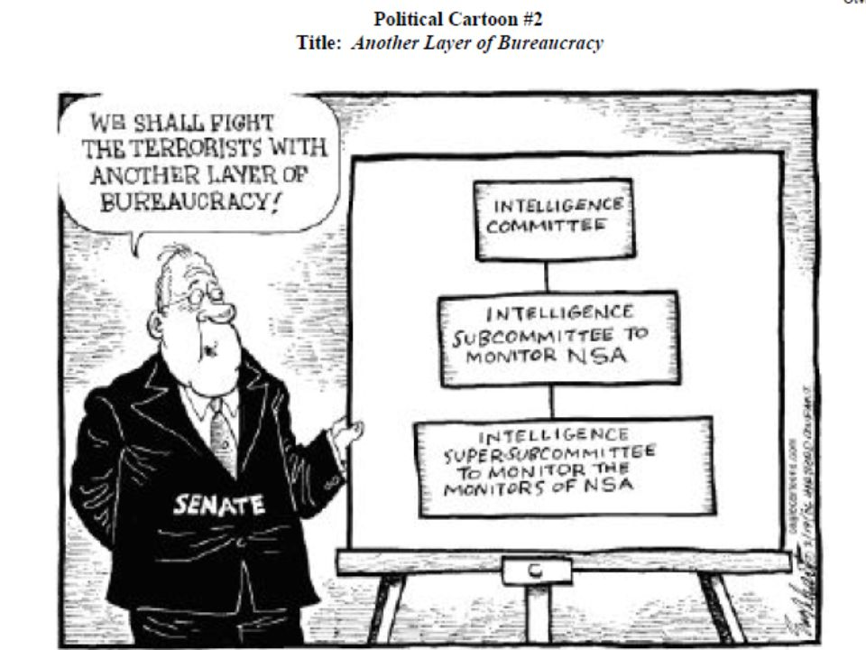

Slide 3
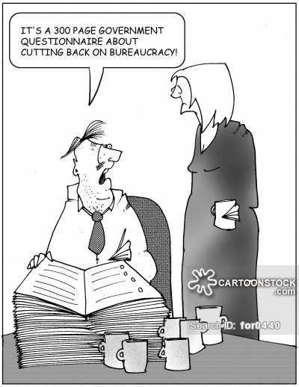

Slide 4
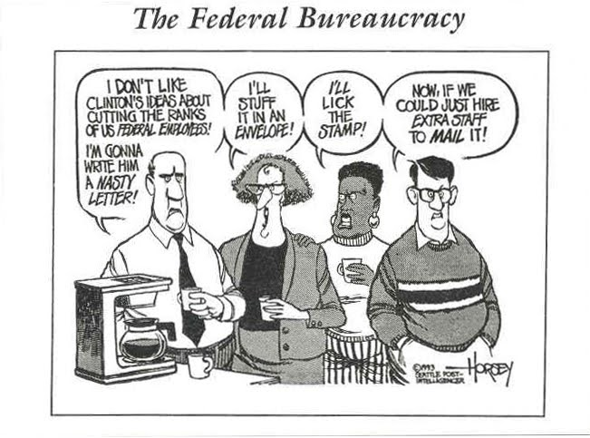

Slide 5
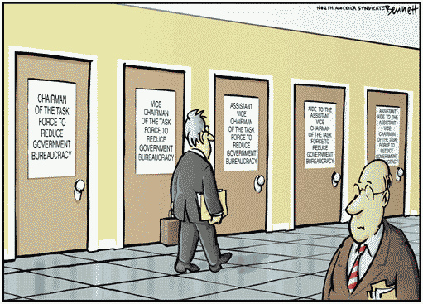
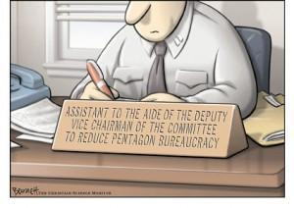

Slide 6
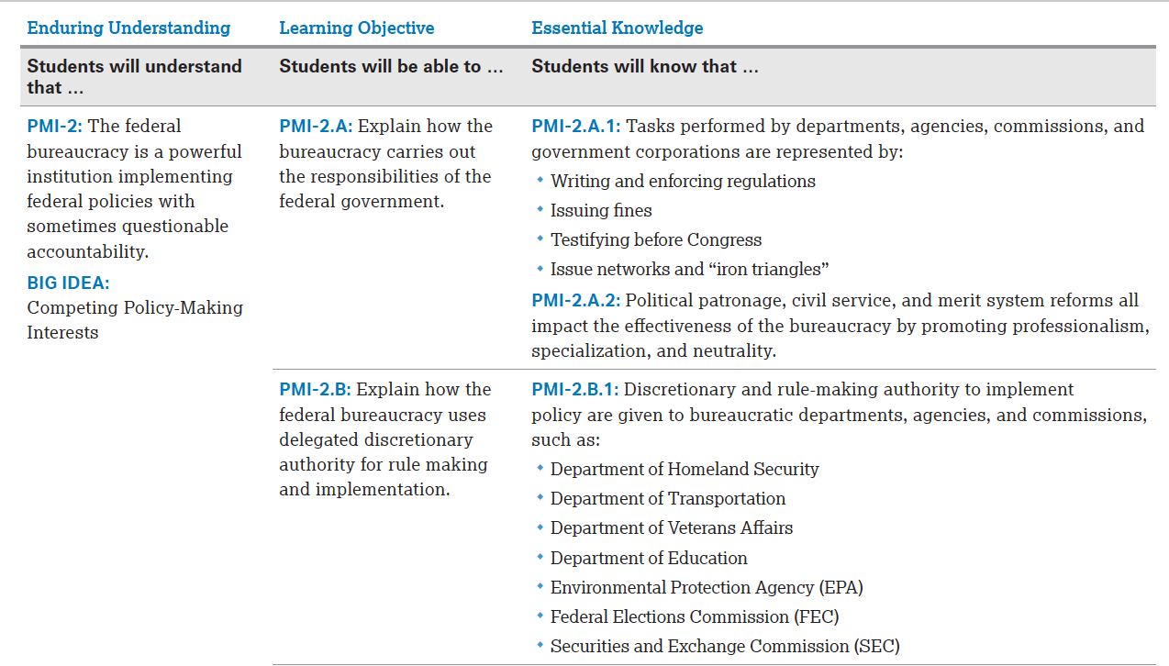

Slide 7
Introduction to the Bureaucracy
CSPAN and the Bureaucracy

Slide 8
Reading
James Q. Wilson-Bureaucracy
What does the text demonstrate about the limitations of the bureaucracy?
Identify the freedoms that ‘private sector’ businesses hold that government agencies in the bureaucracy do not. How does that impact the efficiency of work?

Slide 9
Development of the Federal Bureaucracy
Early Constitutional Period
Small number of agencies and positions
Selection based on qualifications and political affiliation
Antebellum Period
Jackson and the spoils system
Late 19th Century
Civil Service Reform
Pendleton Act/Civil Service Act of 1883
Merit system, competitive exams; limited partisan politics
Established Civil Service Commission to enforce
Modern Bureaucracy
Agencies grew substantially due to New Deal programs, Great Society, Cold War, wars/conflicts
Hatch Act (1939)
Limited political activities on duty, use of position for campaigns
Civil Service Reform Act of 1978
Established Office of Personnel Management (OPM)
Established government employee classifications and salaries, training and recruitment programs
Protection of whistleblowers

Slide 10
Growth of Modern Bureaucracy
Power and Justification
Regulation and de-regulation
Agency capture
Political appointments
Evolving Government for Evolving World
Technological development (communication, transportation)
Globalization and world affairs
Difficulty of Termination
Numerous steps to ultimately fire a government employee
Official record of chronic behavior, substantial evidence, public hearings, viable witnesses, right of due process, appeals
Fewer than 1/10th of 1% of federal employees have been fired for incompetence
The Plum Book

Slide 11
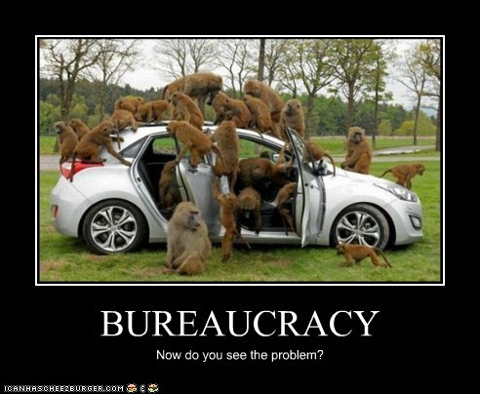

Slide 13
Federal Bureaucracy Organization
Executive Departments
Cabinet-level executive agencies established for specific policy areas
Agency heads work at the pleasure of the President
May be impeached/removed by Congress
Independent Executive Agencies
Administration, policy analysis, intelligence
Agency heads work at the pleasure of the President
May report to Congress and other agencies
May be impeached/removed by Congress
Independent Regulatory Agencies
Agencies that regulate and police; enforcers of legislation
Function outside influence of the President
Agency heads serve fixed terms and only removed for just cause
Government Corporations
Business-like agencies usually providing goods and services

Slide 14
Independent Executive Agencies
Small Business Administration (SBA)
Promote small businesses and economic recovery
Social Security Administration (SSA)
Social security checks and applications
National Aeronautic and Space Administration (NASA)
Central Intelligence Agency (CIA)
Foreign policy information; espionage
Office of Personnel Management (OPM)
Selective Service System (SSS)
National Endowment for the Arts and Humanities
National Archives and Records Administration (NARA)
Peace Corps
The Smithsonian Institution

Slide 15
Independent Regulatory Agencies
Federal Trade Commission (FTC)
Prevent monopolies; consumer protection
Securities and Exchange Commission (SEC)
Securities, stocks, bonds, commodity trading
Federal Reserve
Monetary policy
National Labor Relations Board (NLRB)
Federal Communications Commission (FCC)
Federal Elections Commission (FEC)
Environmental Protection Agency (EPA)
Equal Employment Opportunity Commission (EEOC)
Nuclear Regulatory Commission (NRC)
Consumer Product Safety Commission (CPSC)
Commodity Futures Trading Commission (CFTC)
Federal Energy Regulatory Commission (FERC)
Federal Maritime Commission (FMC)

Slide 16
Government Corporations
Tennessee Valley Authority (TVA)
National Railroad Passenger Corporation (AMTRAK)
United States Postal Service (USPS)
Federal Deposit Insurance Corporation (FDIC)
Corporation for Public Broadcasting
Public Broadcasting Service (PBS)
National Public Radio (NPR)
Government Enterprises
Federal National Mortgage Association (Fannie Mae)
Federal Home Loan Mortgage Corporation (Freddie Mac)

