Slide 1
Do Now
Bureaucratic Regulation

Slide 2
Holding the Bureaucracy Accountable
Mr. Winchell
AP GoPo
Unit 2: Interactions Among Branches of Government

Slide 3
Organization of the Bureaucracy
Cabinet Departments
Independent Regulatory Agencies
Government Corporations
Independent Executive Agencies

Slide 4
Bureaucratic Roles
Implementation
Policies don’t implement/enforce themselves
Policy can be ambiguous/general
Bureaucratic latitude in translating general guidelines -> specific directives
Regulation
Munn v. Illinois
New Deal legacies
Regulatory Guidelines
Permits/Licenses/Applications

Slide 5
Controlling the Bureaucrats
Congress
Authorization
Permitting funds by related committees
Appropriations
Reallocation of federal funding
Oversight
Supervision and investigations by committees
Subpoena agencies for public committee hearings and testify under oath
Legislative Authority
Pass laws to limit or terminate an agency
Sunset laws
The President
Appointments
Change department/agency heads for a supportive or efficient leader
Executive Orders
President invokes preferences through legal means
Office of Management and Budget
Change agency budget; require increased supervision
Reorganization
Supreme Court
Rule a policy/law/executive action unconstitutional
The Media
Watchdog
Investigative journalism
Freedom of Information Act
The People
Freedom of Information Act
Sunshine Laws
Interest groups

Slide 6
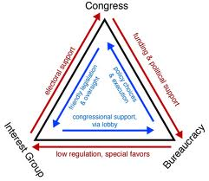
Bureaucrats as Policymakers
Iron Triangles
Bureaucratic Agency
Receive increased power and appropriations
Congressional Committee
Receive electoral support and campaign contributions
Interest Groups
Interests satisfied
Designed for mutual benefit
Issue Networks
Congressional Staff
Experts/Professors
Interest Groups
Mass Media
Designed for the benefit of
public interest

Slide 7
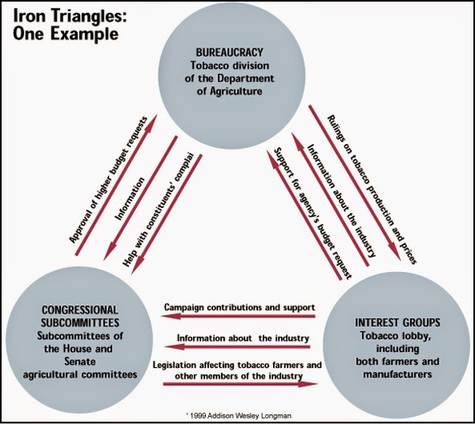

Slide 9
Bureaucratic Issues/Problems
Red Tape
Complex rules and procedures to accomplish tasks
“Make sure the government is being equal and just.”
‘Too much paperwork. Slows down process. Frustrating for constituents.’
Conflict
Rivalries between agencies on similar policies
‘Sometimes the goal/objective is overlooked by competition.’
Duplication
Agencies performing same or similar tasks
“Congress doesn’t know what it’s doing, but they made the laws so we follow them.”
Imperialism
Increase of agency’s power and influence no matter the cost
“We interpreted the vague law as best we could and developed our policies in accordance. Tell Congress to write clearer laws.”
Waste
Inefficient use of funding and manpower; spending too much
“Why lower costs? We’re the government. There’s plenty.”
‘Lining the pockets of bureaucrats and lobbyists.’

