Slide 1
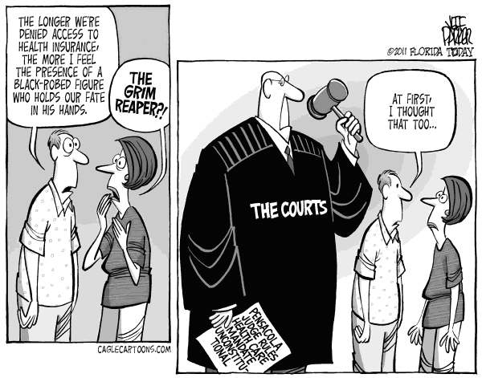

Slide 2
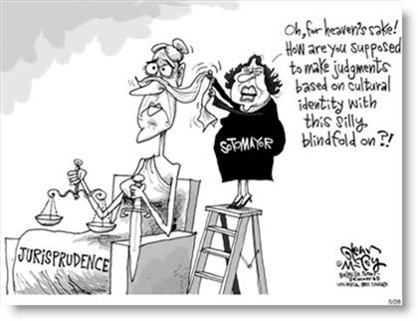

Slide 3
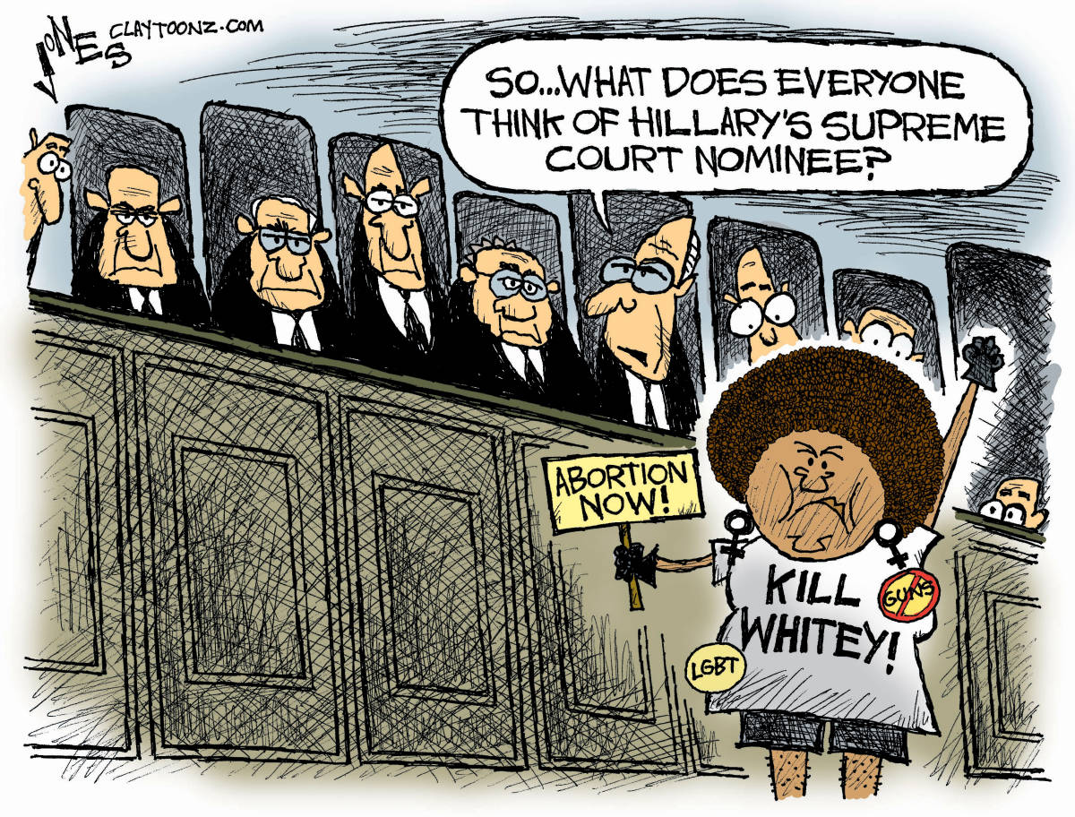

Slide 4
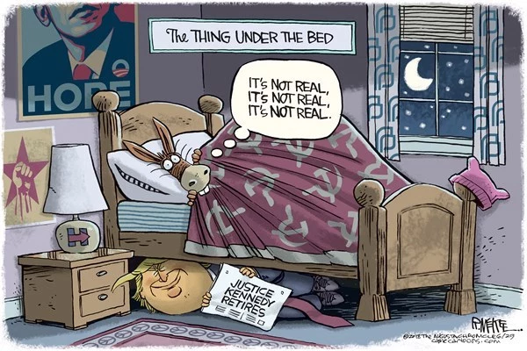

Slide 5
9. The Structure of the Federal Judiciary
Mr. Winchell
AP GoPo
Unit 2: Interactions Among Branches of Government

Slide 6
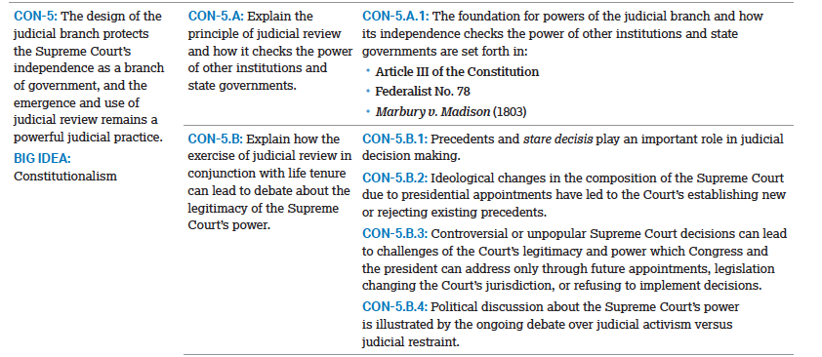

Slide 7
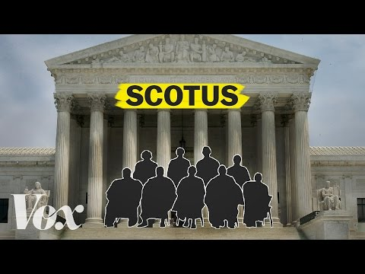
The Federal Court System
The judicial branch is a term that refers to the court system within the United States. Much like federalism, it is comprised of different levels each with specific jurisdiction (official power to make legal decisions). There are local courts, state courts, federal courts, and of course, the Supreme Court--the most powerful court in America. The federal courts are comprised of 3 levels: district courts, circuit courts, and the Supreme Court.
Document facts regarding the federal court system, be sure to find facts related to the following terms:
district court
circuit court
Supreme Court
Notes:
The Supreme Court hears less than 1% of the cases brought before the court.
Categories for case selection:
cases of national importance
lower courts invalidating federal law
resolve split decisions

Slide 8
American Legal System
Criminal Law Cases
An individual violating a specific law based on regulating morality
Varying degrees of crimes based on intent
Misdemeanor
Less serious crime; less than 1 year incarceration; fines
Felony
More serious crime; more than 1 year incarceration
Beyond a reasonable doubt
Civil Law Cases
Involving a perceived violation of civil rights or legal relationships
i.e. contracts
Lawsuits
Class action involves a one or a few representing many affected
Preponderance of evidence
Basic Structure of a Court
Litigants
Plaintiff – brings up charges, sues
Burden of proof
Defendant/respondent – answering charges
Lawyers
Prosecution – government lawyers accusing of criminal charges
Public defenders – government-paid lawyers for criminally-charged individuals
Jury
Trial by jury; one may request a bench trial or trial by jury
Judge
Presides over the case; rules on objections; final ruling; passes sentence
Public
Audience members, interest groups, relations to litigants

Slide 9
Constitutional Structure
Article III establishes the judicial branch
United States Supreme Court
Congress establishes lower federal courts
Judiciary Act of 1789
Also set number of SC justices, position of Chief justice
Constitutional Courts
District Courts (original jurisdiction) – 1789
Each state has at least one district court
94 district courts
Courts of Appeals (appellate jurisdiction) – 1891
13 Courts of Appeals separated by geographic circuits
Legislative Courts
Agency reviews (taxes, trade, bankruptcy)
Not subject to Article III parameters

Slide 10
Court of Appeals

Slide 11
Jurisdiction
Original Jurisdiction
Court is the first to hear the case
Appellate Jurisdiction
Reviewed by a higher/alternate court
Supreme Court’s Jurisdiction
Original jurisdiction involving cases with ambassadors, foreign ministers, consuls, state is a party
Appellate jurisdiction in all other cases
From federal district or appeals courts, or state supreme courts involving federal law or Constitution
Discretionary Jurisdiction
Judiciary Act of 1925
Supreme Court gets to choose it’s own docket (Rule of 4)
Reserved for Sup. Ct. (Must petition for writ of certiorari)
Concurrent Jurisdiction
Cases may be tried in state or federal courts

Slide 12
Jurisdiction
Depends on issue/nature of case
Different Kinds
Original Jurisdiction
Appellate Jurisdiction
Exclusive Jurisdiction
Concurrent Jurisdiction
Discretionary Jurisdiction
Judiciary Act of 1925
Supreme Court gets to choose it’s own docket (Rule of 4)
Reserved for Sup. Ct. (Must petition for writ of certiorari)
Types of Law
Common: Precedent (Policy)
Criminal
Civil
Notes:
Original jurisdiction: Cases involving ambassadors, consuls, and public ministers, admiralty/maritime jurisdiction; cases where U.S. is a party; controversies between two states or citizens of two states
Federal law must be in question to be heard in federal court

Slide 13
Dual Court System
Federal Court System
Federal-Question cases
Arising under the Constitution, the law of the U.S., and treaties
Diversity cases
Involving different states or citizens of different states
Dual Sovereignty
Either state or federal court can review case if both state and federal laws broken
State Court Systems
Circuit court system with original and appellate jurisdiction courts
State supreme court decisions final law in respective state
May be appealed to U.S. Court of Appeals and Supreme Court if a constitutional question

Slide 14
Federal Judges
Serve “during good behavior” – Article III
Life terms
Appointment
Not elected hence not directly subject to political pressures
President appoints with advice and consent from the Senate
Senatorial courtesy
Blue slips

Slide 15
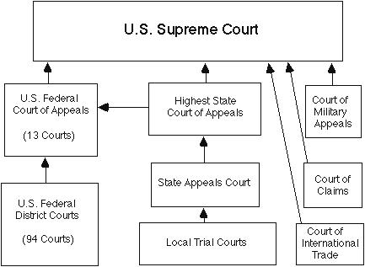
Federal Courts-3 Tiers
Supreme Court
9 Justices
Court of last resort; highest court in the land
Hears cases from State Supreme Ct.; U.S. Courts of Appeals; etc.
Orig. Jurisdiction Cases:
2+ states; U.S. & state; US/For. Ambassadors & diplomats
Judicial Review: Rulings set precedent for entire nation
Notes:
Transparency; Appellate courts authorized to review all district court decisions; don’t hold trials or hear testimony; appellate courts also empowered to rule on decisions of federal regulatory agencies

Slide 17
Terms?
Life Terms…good for democracy?
Designed to be free from public opinion…How?
Life term, appointed, choose own docket, limited access to ct. proceedings, salaries can’t be reduced
Yet, court rarely deviates too far from public opinion? Why?
Appointment/Confirmation, judicial implementation, impeachment, judicial legitimacy, overruled with laws, or Amendments
Congress can change jurisdiction/# of justices

Slide 18
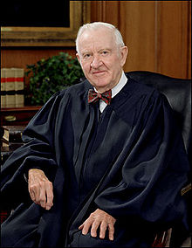
Interview with John Paul Stevens
Supreme Court Justice (1975-2010)
Colbert Nation: John Paul Stevens Interview

Slide 19
The U.S. Supreme Court
Currently made of 9 justices, including a Chief Justice and 8 associate justices
Congress determines the number of justices
$217,400 salary for Chief Justice
$208,100 salary for Associate Justices

Slide 20
Fed. 78 Analysis

