Slide 1
Do Now
Compare the British view of the new colonial policy with the colonists’ view of the same policy.

Slide 2
Declaring Independence
Mr. Winchell
APUSH
Period 3

Slide 3
AP Prompt
Evaluate the extent to which taxation played a role in the American Colonists declaring their independence.

Slide 4
Key Concepts

Slide 5
Timeline of Parliamentary Acts
Sugar Act of 1764
Revenue tax
Quartering Act of 1765
Stamp Act of 1765
First direct tax
Declaratory Act of 1766
Parliament’s right to tax whatsoever
Townshend Acts of 1767
Pay royal colonial officials
Writs of assistance
Tea Act of 1773
Support British East India Company
“Intolerable Acts”
Coercive Acts of 1774
Massachusetts Government Act (royal appointments)
Port Act (Boston closed)
Administration of Justice Act (trial of royal officials moved)
Quebec Act of 1774
Appointed government; Catholicism recognized
Prohibitory Act of 1775
Colonies in open rebellion

Slide 6
Which Side Are You On?
Colonies
British Empire/Parliament
Fought and died in wars with Natives and European enemies
Risk life and health in a new environment
Proud and loyal English subjects entitled to rights
Developed economies which benefit the Empire
Familiar with life in colonies more so than in England
God-given liberty
Provide protection from Natives and Europeans
Benefit exceptionally well from success of British Empire with little contribution
Abide by the rule of law
Colonists as second-class citizens
“virtual representation”
Britons pay 2-3 times taxes than colonists

Slide 7
The Enlightenment
Colonists used the ideas of the Enlightenment to justify their protest
John Locke wrote that people have natural rights (life, liberty, & property) & should oppose tyranny
Rousseau believed that citizens have a social contract with their gov’t
Montesquieu argued that power should not be in the hands of a king, but separated among gov’t branches

Slide 8
Lexington and Concord (April 19, 1775)
Organization of militia (Minutemen) compels Governor Gage to send 700 British soldiers to arrest rebel leaders and confiscate arms
William Dawes and Paul Revere
8 Minutemen die and 1 Redcoat wounded at Lexington
“Shot heard ‘round the world” at Concord

Slide 9
Second Continental Congress
Delegates from 13 colonies begin meeting in May of 1775
Battles of Breed’s Hill and Bunker Hill (June 1775)
Olive Branch Petition (July 1775)
Proclamation of Rebellion (August 1775)
Prohibitory Act (December 1775)
Continental Army and George Washington
State Constitutions
Virginia Declaration of Rights (May 1776)
Independence Hall Debate
John Dickinson
John Adams
Declaration of Independence (July 1776)
Notes:
INSERT VIRGINIA DECLARATION OF RIGHTS

Slide 10
Thomas Paine
Wrote Common Sense which was published in January of 1776
Written in language that an average person could understand
Paine explained the reasons why the 13 colonies should declare their independence
Sold 150,000 copies in six months—the population of the 13 colonies was about 2 million

Slide 11
Thomas Paine’s Common Sense (January 1776)
“But Britain is the parent country, say some. Then the more shame upon her conduct. Even brutes do not devour their young, nor savages make war upon their families; wherefore the assertion, if true, turns to her reproach; but it happens not to be true, or only partly so and the phrase PARENT or MOTHER COUNTRY hath been jesuitically adopted by the king and his parasites, with a low papistical design of gaining an unfair bias on the credulous weakness of our minds. Europe, and not England, is the parent country of America. This new world hath been the asylum for the persecuted lovers of civil and religious liberty from EVERY PART of Europe. Hither have they fled, not from the tender embraces of the mother, but from the cruelty of the monster; and it is so far true of England, that the same tyranny which drove the first emigrants from home, pursues their descendants still.”
“As to government matters, it is not in the power of Britain to do this continent justice: The business of it will soon be too weighty, and intricate, to be managed with any tolerable degree of convenience, by a power so distant from us, and so very ignorant of us; for if they cannot conquer us, they cannot govern us. To be always running three or four thousand miles with a tale or a petition, waiting four or five months for an answer, which when obtained requires five or six more to explain it in, will in a few years be looked upon as folly and childishness--There was a time when it was proper, and there is a proper time for it to cease. Small islands not capable of protecting themselves, are the proper objects for kingdoms to take under their care; but there is something very absurd, in supposing a continent to be perpetually governed by an island. In no instance hath nature made the satellite larger than its primary planet, and as England and America, with respect to each other, reverses the common order of nature, it is evident they belong to different systems; England to Europe, America to itself. “
“Europe is too thickly planted with kingdoms to be long at peace, and whenever a war breaks out between England and any foreign power, the trade of America goes to ruin, BECAUSE OF HER CONNECTION WITH ENGLAND. The next war may not turn out like the last, and should it not, the advocates for reconciliation now, will be wishing for separation then, because, neutrality in that case, would be a safer convoy than a man of war. Every thing that is right or natural pleads for separation. The blood of the slain, the weeping voice of nature cries, 'TIS TIME TO PART. Even the distance at which the Almighty hath placed England and America, is a strong and natural proof, that the authority of the one, over the other, was never the design of Heaven. The time likewise at which the continent was discovered, adds weight to the argument, and the manner in which it was peopled increases the force of it. The reformation was preceded by the discovery of America, as if the Almighty graciously meant to open a sanctuary to the Persecuted in future years, when home should afford neither friendship nor safety. “
Notes:
INSERT TEXT EXCERPTS IN DQs

Slide 12
The Second Continental Congress moves toward Independence
Congress established a committee to write a declaration of independence
The committee did its work and then Thomas Jefferson wrote the Declaration of Independence
Richard Henry Lee introduced a resolution of independence on July 2, 1776
The Declaration was accepted and signed by John Hancock on July 4, 1776

Slide 13
Declaration of Independence (1776)
Applies laws of Nature
People’s right to revolution
“self-evident”
“all men are created equal”
Endowed…with certain unalienable rights…life, liberty, pursuit of happiness”
List of grievances against the British Empire, specifically toward George III
WHAT’S WRONG WITH THIS PICTURE IN REGARDS TO AMERICAN SOCIETY?
Notes:
INSERT TEXT EXCERPT IN DQs

Slide 14
America vs. Great Britain
American Advantages/Tactics
Militia’s guerilla tactics
Familiar with the territory and environment
Prolong the war
Hope for support from Britain’s enemies (France, Spain)
American Disadvantages
No well-trained regular army or officers
Insufficient funds and supplies
Small support among population (1/3 loyalists, 1/3 neutral, slaves)
British Advantages/Tactics
11 million Britons to America’s 2.5 million (1/3 slaves or loyalists)
World’s largest navy
Disciplined and experienced army
Support from Loyalists, Natives, and slaves
Entrenched forts and garrisons in America
British Disadvantages
War debt and war fatigue
American privateers (pirates) hounded British ships
Unpopular home support
Spread thin around the world

Slide 15
Patriots, Loyalists, Neutrals
Patriots (aka Whigs)
Supported independence, but may disagree on course of action (war, petition, boycott, etc.)
Advocated independence based on rhetoric and education on rights and liberties
Loyalists (aka Tories)
Loyalty to the Crown
Agreed about excess taxes, but against separation
Fear of a possible American victory
Recent British immigrants
Some neutral due to ignorance, apathy, or economic reasons

Slide 16
Foreign Assistance
Marquis de Lafayette
Baron Friedrich Wilhelm von Steuben

Slide 17
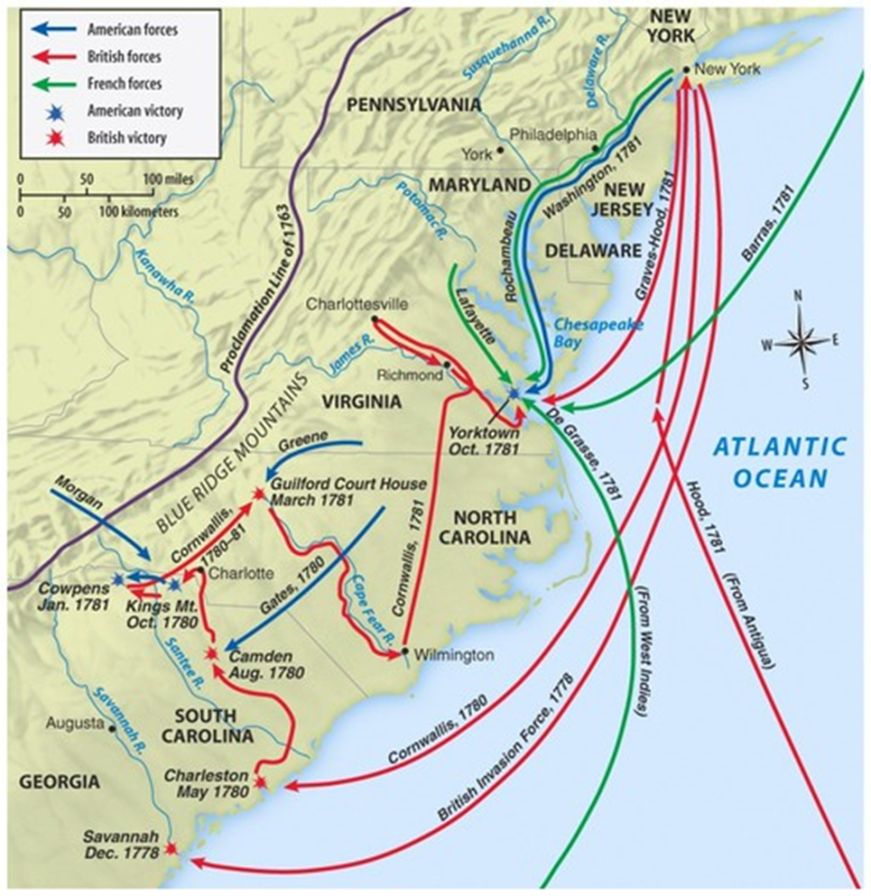
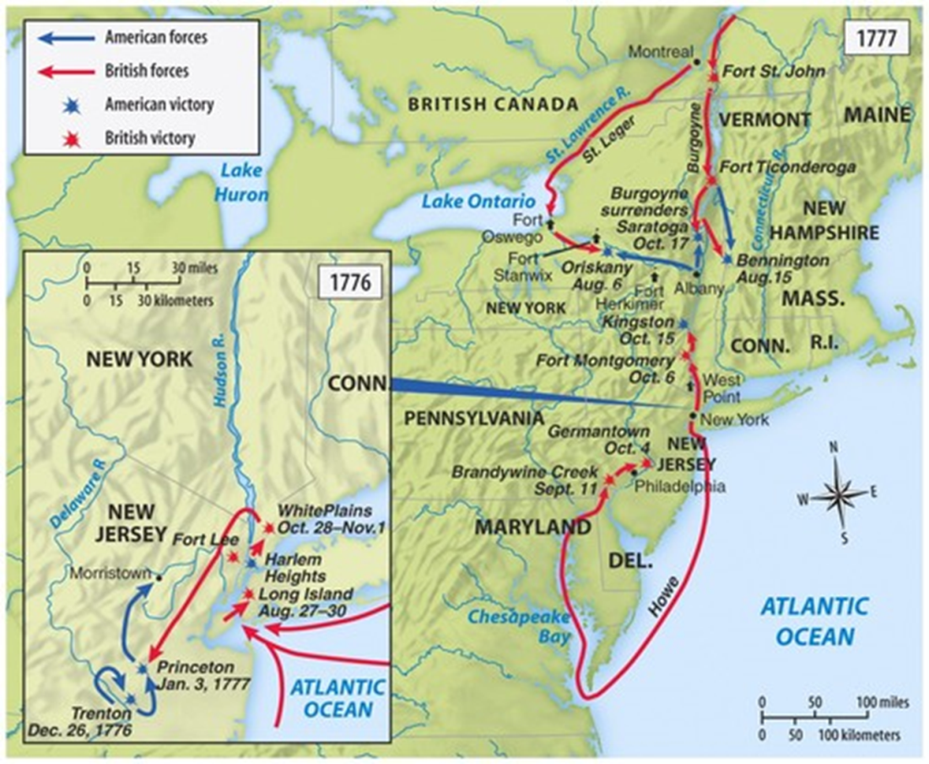
The War
In the North
Boston and New York under British control and conquest
Battles of Trenton (1776) and Princeton (1777)
Battle of Saratoga (Oct 1777)
Valley Forge (Winter 1777-78)
In the South
Lord Cornwalis’s strategy
Battle of Camden (1780)
Battle of Cowpens (1781)
Battle of Yorktown (1781)

Slide 18
Why Saratoga?
…was a great turning point of the war, because it won for Americans the foreign assistance which was the last element needed for victory.
France wanted to help the Patriots.
Worried Patriots had no shot to win.
Saratoga convinced France there was a chance.
King Louis XVI wanted revenge on Britain, saw this as a change, sent aid, military support, supplies, etc. and forced Britain to divert resources.
Franklin and other diplomats pledged that neither would sign a separate peace.
Notes:
War also becomes much less popular in England.

Slide 19
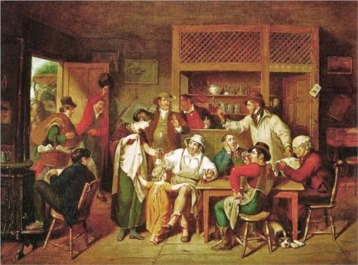
A “Revolutionary” Society
Liberalism and egalitarianism
Civil rights and private property
Republicanism and the common good
Representative government
Merits over Inheritance/Heredity
More and more self-made men participate in political leadership
Despite a new perception, the small upper class retained its status as owners of most of America’s wealth

Slide 20
The Treaty of Paris (1783)
The Treaty of Paris in 1783 was negotiated with England by Franklin, John Adams, John Jay
The terms included:
Full American independence
All territory east of Mississippi River, between Canada & FL
The removal of the British army from U.S. claims in America
Fishing rights in the Atlantic
Florida back to Spain (T. of Versailles)
Notes:
28

Slide 21
North America after the Treaty of Paris, 1763

Slide 22
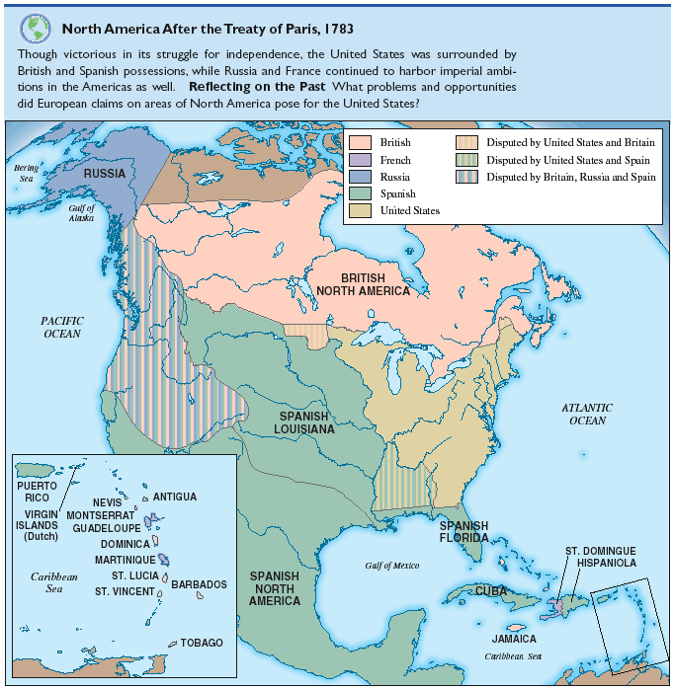
After the Treaty of Paris, 1783

Slide 23
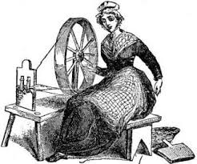
Women of the Revolution
Upper-class women promoted cause through correspondence
Participated against Stamp Act and Townshend Acts
Spinning bees
Ran households and estates during husband’s absence
Formed campaigns to promote war and funds
Abigail Adams
“…Remember the Ladies.”

Slide 24
Blacks and Slaves During the Revolution
Lord Dunmore’s Proclamation (1775)
Limited participation in Continental Army
Slavery as “necessary evil”
Northern states and abolition
Limited civil rights

Slide 25
Natives of the Revolution
Half of the population from 1754 to 1783 wiped out
New land acquisitions led to increased hostilities
Adapted lifestyle by incorporating European goods
Appealed to Congress on recognizing territories; little to no support
Thayendanega (Joseph Brant)

