Slide 1
DO NOW
What struggles did colonists in Jamestown face and how did they overcome those challenges?

Slide 2
Development of the Chesapeake and Southern Colonies
Mr. Winchell
APUSH
Period 2

Slide 3
AP Prompt
Evaluate the extent to which Bacon’s Rebellion marked a turning point in Virginia’s economic, political, and social development, accounting for what changed and what stayed the same.

Slide 4
Key Concepts
2.1.II: In the 17th century, early British colonies developed along the Atlantic coast, with regional differences that reflected various environmental, economic, cultural, and demographic factors.
2.1.II.A: The Chesapeake and North Carolina colonies grew prosperous exporting tobacco—a labor intensive product initially cultivated by white, mostly male indentured servants and later by enslaved Africans.

Slide 6
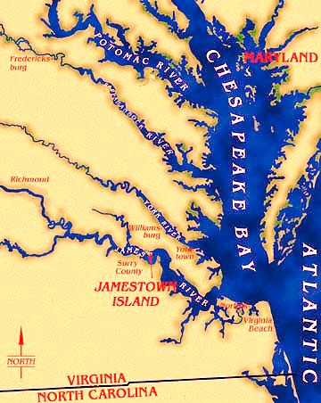
Chesapeake Colonies

Slide 7
The Chesapeake: Dreams of Wealth
After Walter Raleigh's failed Roanoke settlement, there was little interest in colonizing America; but Richard Hakluyt (& others) kept promoting colonies:
Possibilities for wealth
Rivaling Spain, Holland, France
Nationalism, anti-Catholicism, & anti-Spanish zeal

Slide 8
Entrepreneurs in Virginia
The major obstacle to colonizing in America was funding; Queen Elizabeth would not spend tax revenue:
Joint-stock companies provided financing for colonies
In 1606, King James gave the London Company the 1st charter to establish colonies in America

Slide 9
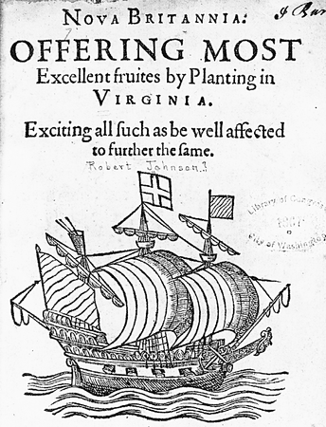
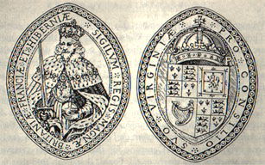
The London Company, 1606
The London Co was later renamed the Virginia Company; English stockholders in Virginia Company expected instant profits

Slide 10
Entrepreneurs in Virginia
Jamestown was settled in 1607 along the Chesapeake Bay:
the location was unhealthy but easy to defend from Spanish ships (but not from inland Indians)
Settlers had no experience in founding a settlement
Colonists expected to become immediately wealthy & failed to plant crops or prepare for long-term habitation in America
Chesapeake colonists did not work for the common good & many starved to death
Notes:
Clash of cultures; settlers had no experience in founding a settlement-they simply did that they knew. This did not work

Slide 11
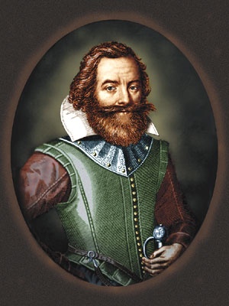
Spinning Out of Control
In 1608, John Smith imposed order in Jamestown & traded for food with natives
But, Jamestown faced difficulties:
Poor leadership & harsh winters led to ‘starving time’ (1609-1610)
In 1622 & 1644, Jamestown was attacked by Powhatan Indians
Captain John Smith
The most powerful Native Americans east of Mississippi River
Notes:
In 1609, London Co. reorganized the colonial gov’t; but the new governor would not arrive until 1610; meanwhile the colony lacked leadership; In 1616, the investors of the Virginia Co. had worthless stock; could claim un-surveyed land 3,000 miles from England

Slide 12
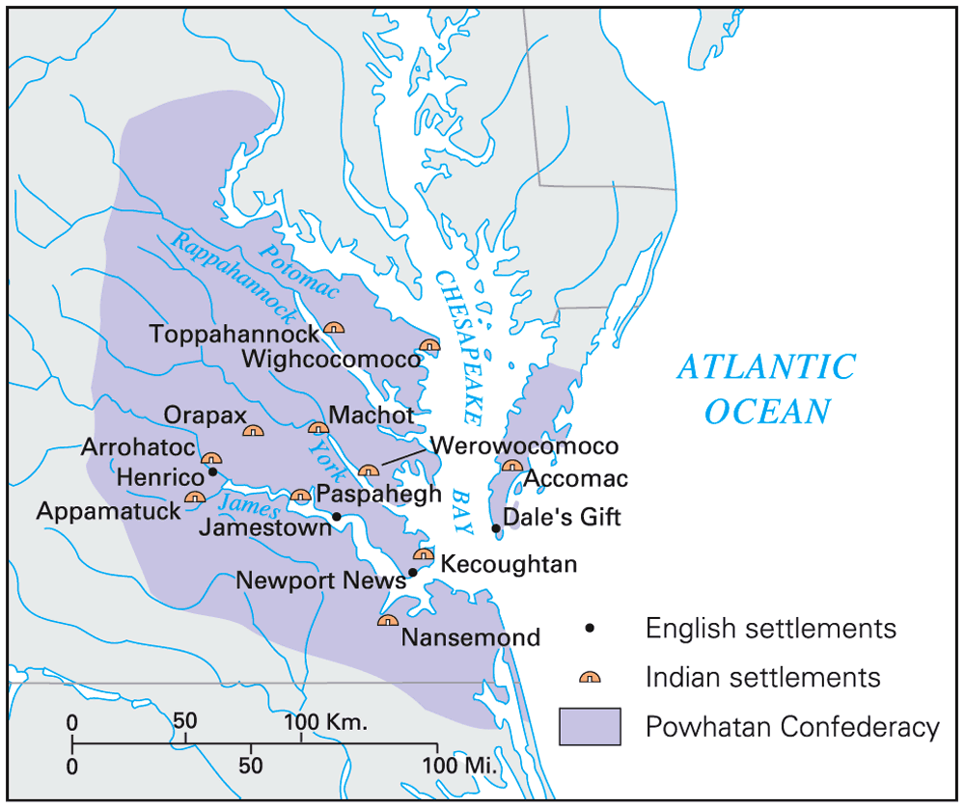
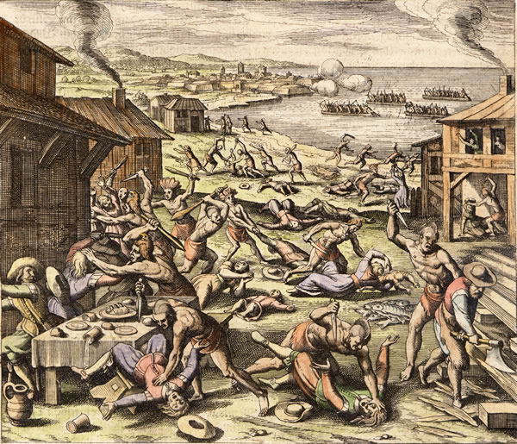
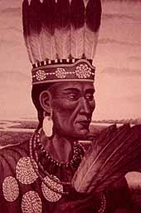
Powhatan Confederacy
The 1622 Powhatan uprising killed 347

Slide 13
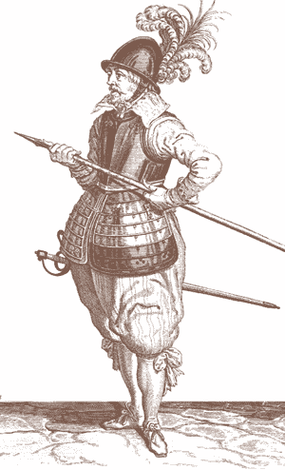
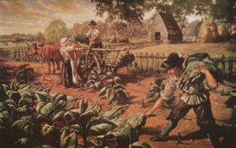
Saved by a “Stinking Weed”
John Rolfe introduced a tobacco hybrid that gave Jamestown a cash crop economy

Slide 14
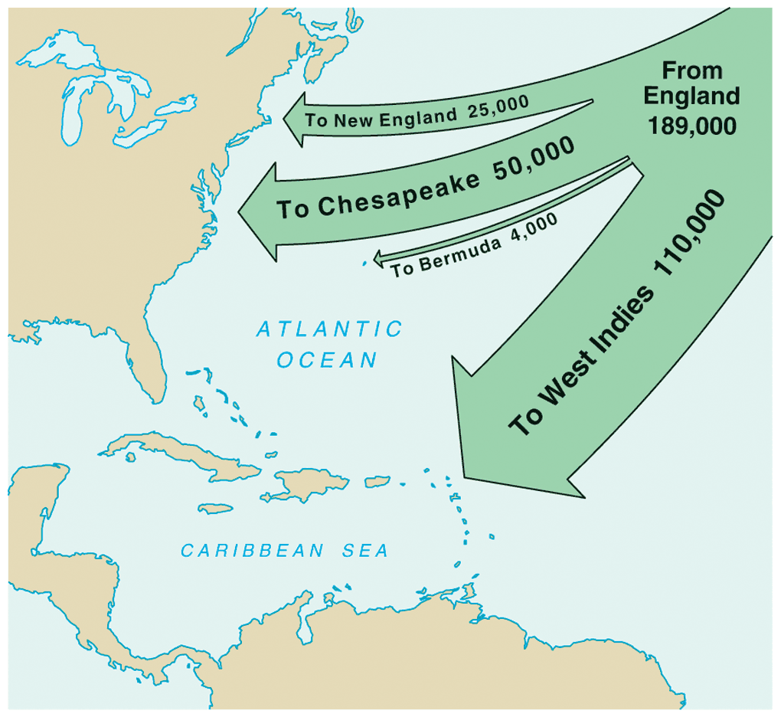
Saved by a“Stinking Weed”
In 1618, headrights were used to encourage cultivation of tobacco & the settlement of Jamestown:
A 50-acre lot was granted to each colonist who paid for his own transportation, or for each servant brought into the colony
Led to huge tobacco plantations & thousands of new settlers who hoped to
make their fortunes
Virginia’s growth was due largely to headrights
English Migration, 1610-1660

Slide 15
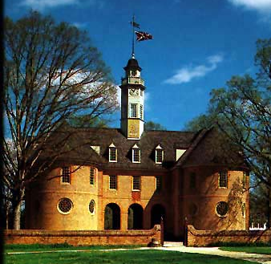
Virginia House of Burgesses
In 1619, Virginia colonists created a legislative assembly to create local taxes & oversee finances
The Virginia House of Burgesses became the 1st legislative assembly in America

Slide 16
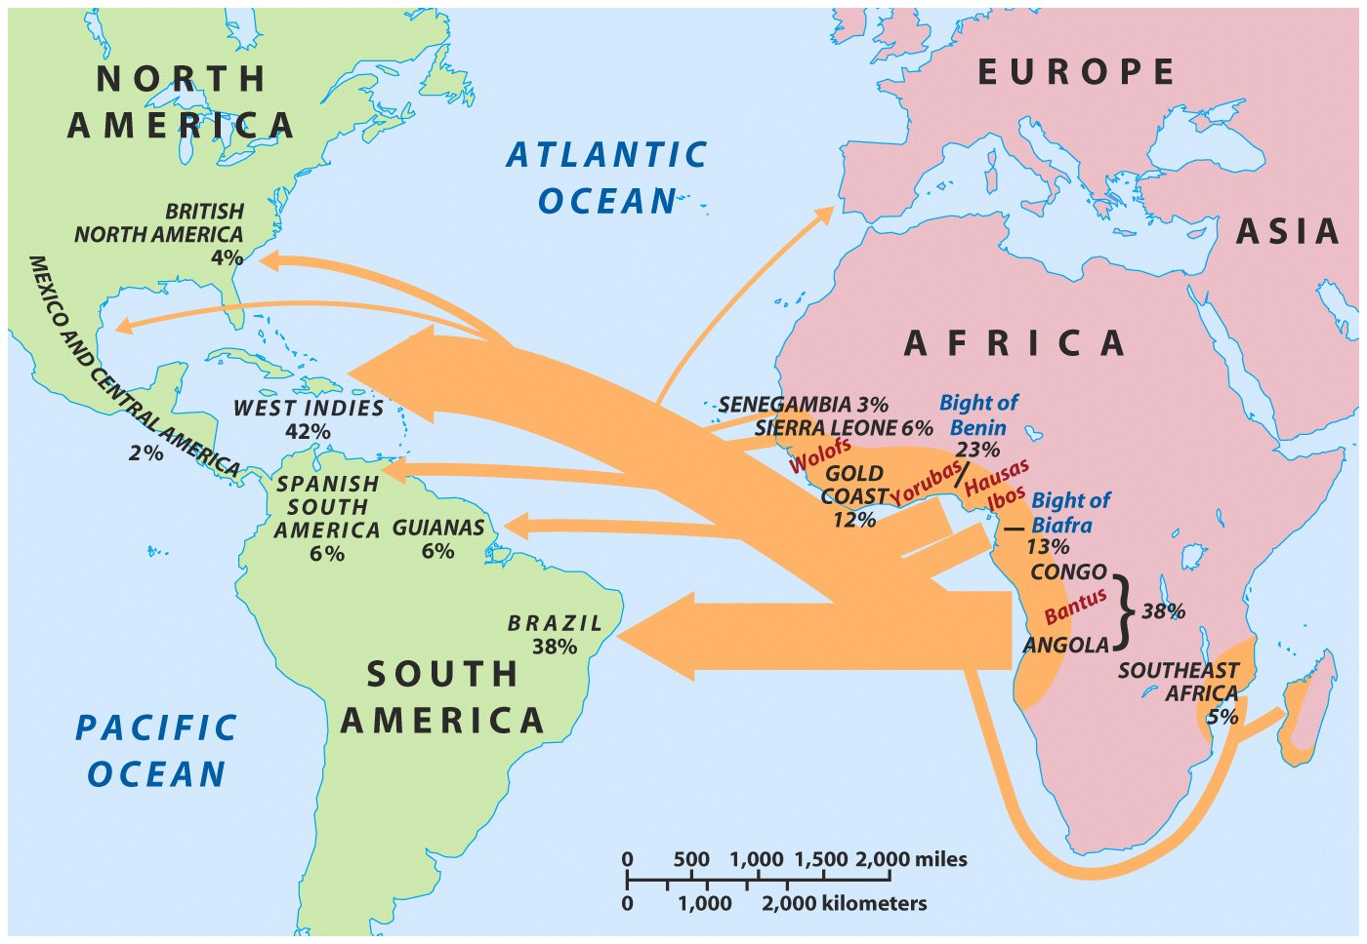
How Many Slaves?
In 1619, the 1st African slaves arrived in Jamestown
In the 17th century, 1,000 slaves arrived in the New World per year
Through the 18th century, 5.5 million arrived in America
By 1860, 11 million slaves were brought to the New World
Before 1831, more African slaves came to America than Europeans
Notes:
12
12
12
04/06/98
1

Slide 17
Time of Reckoning
Despite the profits from tobacco, VA was a deadly place to live
Many died from disease
Numerous Powhatan attacks
Indentured servants were treated badly & cheated out of land when servitude ended
Few females (6:1 ratio) made families or reproduction difficult
In 1624, James I dissolved the Virginia Company & made Virginia a royal colony
But colonists continued to meet in the House of Burgesses
VA was divided into 8 counties each with a county court
Very little changed; Jamestown colonists still focused on tobacco & continued to lack unity

Slide 18
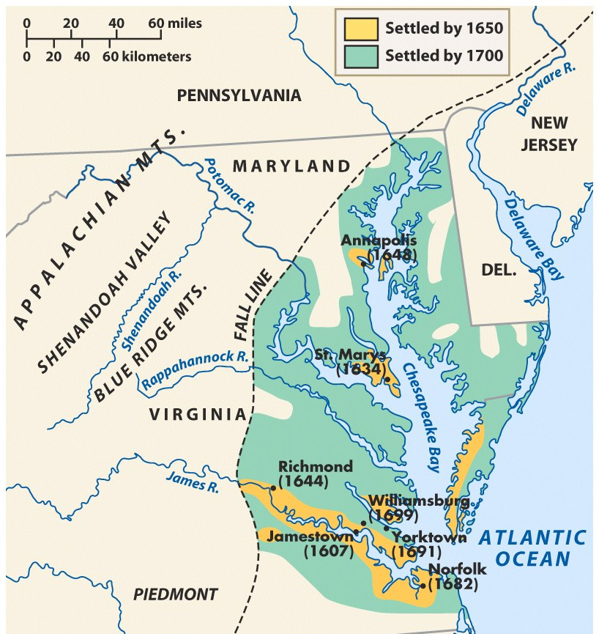
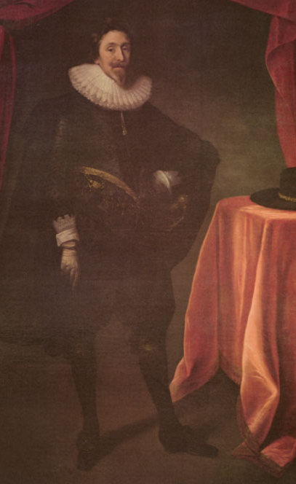
Maryland: A Refuge for Catholics
Initiated by Sir George Calvert (Lord Baltimore) as a refuge for English Catholics
In 1632, Charles I granted a charter for Maryland
To recruit laborers, Lord Baltimore required toleration among Catholics & Protestants

Slide 19
Maryland: A Refuge for Catholics
Wealthy Catholics proved unwilling to relocate to America so Maryland became populated largely by poor Protestant farmers & indentured servants:
Maryland had few large tobacco plantations
Farmers (mostly poor tobacco planters) lived in scattered riverfront settlements

Slide 20
STOP
And read some documents!

Slide 21
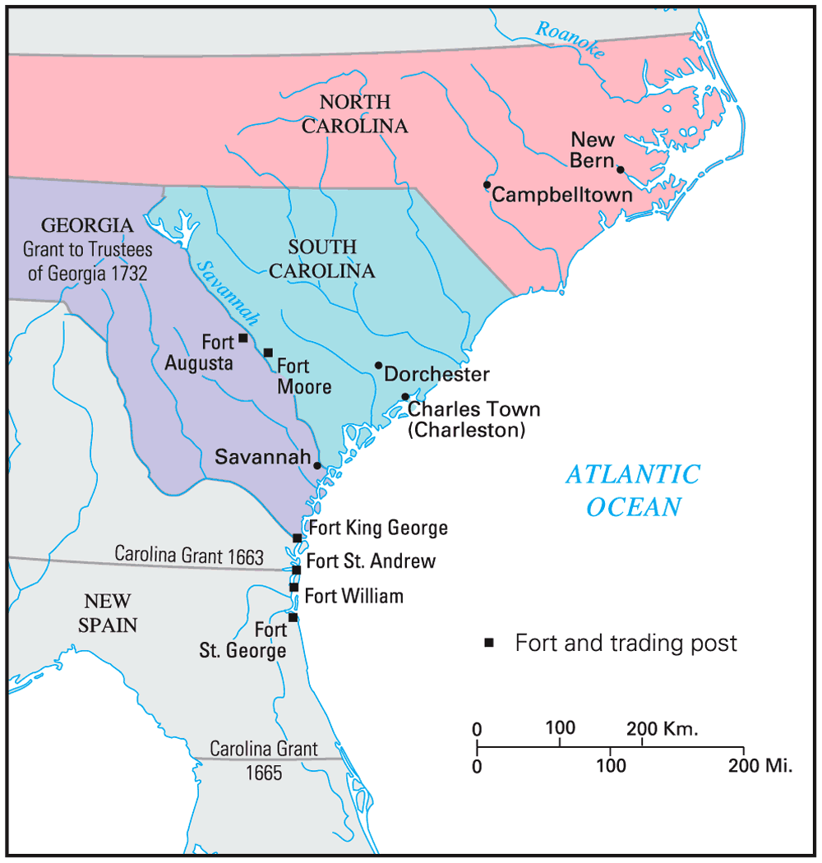
Settling the Lower South

Slide 22
Carolina
Although Carolina relied on slave labor & agriculture (& therefore looked like Chesapeake colonies) it was very different due to:
Diversity of settlers
Environment very different from the Chesapeake
No“Solid South” yet

Slide 23
Proprietors of the Carolinas
Carolina was granted a charter in 1663 to eight“proprietors” to reward their loyalty:
Proprietors were inspired by John Locke & created a government led by wealthy lawmakers but with veto power for average citizens
But Carolina had difficulty recruiting settlers in its first years
Carolina was established as a“political utopia & experimented with early forms of democracy

Slide 24
The Barbadian Connection
English planters from the Caribbean island of Barbados were recruited to Charlestown:
Barbadians brought a strict, cruel slave code with them
Demanded greater self-government within Carolina; led to 1729 strife that led to division of colony into North & South Carolinas

Slide 25
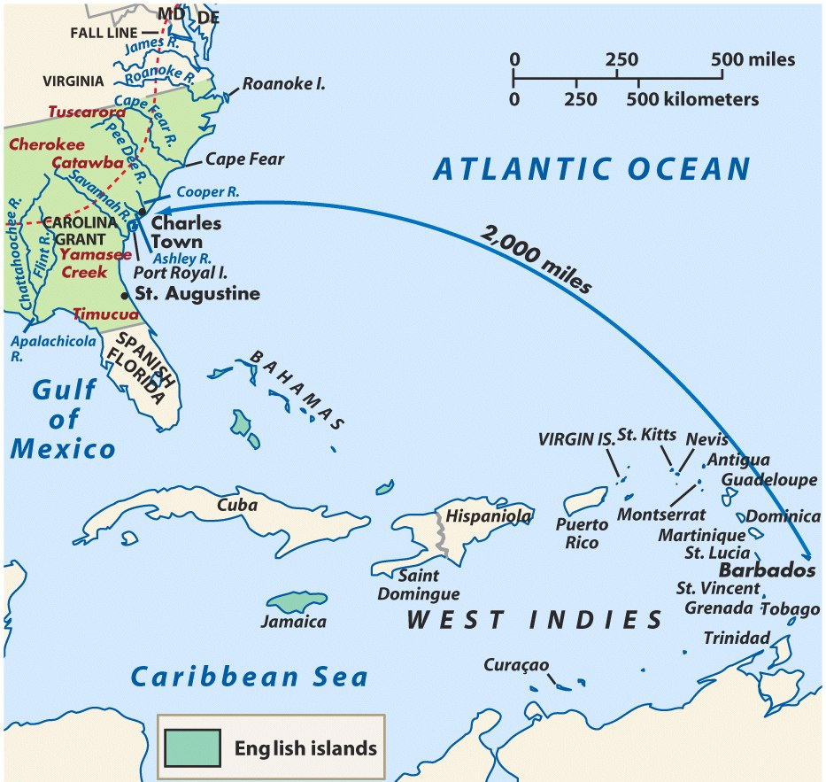
Charles Town, South Carolina, the only southern port

Slide 26
Founding of Georgia
Georgia was founded in 1732 by James Oglethorpe as a strategic buffer between the Carolinas & Spanish Florida
Oglethorpe offered Georgia as a refuge for imprisoned debtors from England
By 1751, Georgia was a small colony with a slave-owning plantation society
Georgia was in many ways a “social utopia” because it offered a fresh start for many of the lowest English citizens

Slide 27
Southern Colonies
The Carolinas
Est. 1663 for Charles II’s favorite nobles
Split 1729
South Carolina
recruits wealthy, elite planters from Barbados; slaves brought
Rice, Indigo
North Carolina
recruits pop. from VA
Tobacco & timber
GEORGIA
Est. 1732- James Ogelthorpe
For debtors & “deserving poor”
Buffer zone with Spain
Pop. of planters & slaves moved from Carolinas

Slide 28
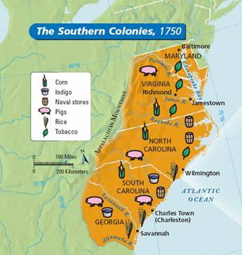
Chesapeake/Southern Society & Economy
Less urban; headright system
Southern coastal regions plantation economies; cash crops (Tobacco, rice, indigo)
Inland (Appalachian foothills) small-scale subsistence farming, hunting, and trading.
Note: A strong belief in private ownership of property and free enterprise characterized colonial life everywhere.

Slide 29
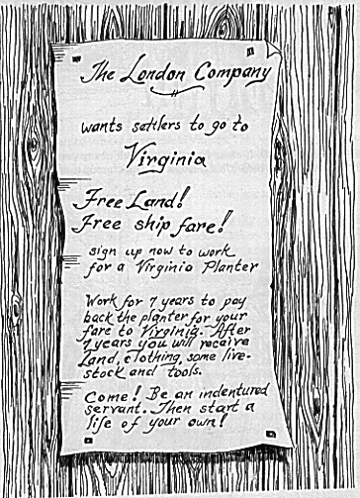
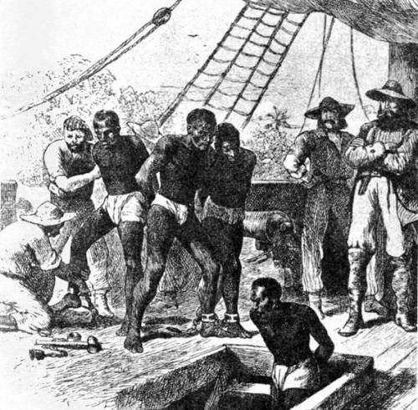
From Indentured Servitude to Slavery
Indentured Servants: very common 17th century
Contracts of passage for labor→ 7 years service→ “freedom dues”
Slavery: gradually replaced I.S. by 18th century
Source West Africa & West Indies
Racial Prejudice & inability to use Indians effectively
Perpetual & Hereditary; Slave Codes
“Peculiar Institution” sharpened distinction between N & S.
Stono Rebellion – S.C. - 1739

Slide 30
The Roots of Slavery
The importation of African slaves was based on a “need” for labor:
Native Americans made poor slaves because they were decimated by European disease
Indentured servant-pool waned after 1660
An estimated 11 million slaves (mostly males) were brought to the English American colonies
Notes:
13

Slide 31
The Roots of Slavery
Slaves were originally treated as indentured servants but the growing black population in Virginia by 1672 prompted stricter slave laws:
Africans were defined as slaves for life; permanent slave status was passed on to slave children
By 1700, slavery was based exclusively on skin color.
Notes:
13
Some slaves upon their “indentured” release went on to become successful plantation owners—although this was extremely rare; Slavery was justified because colonists were Christianizing Africans

Slide 32
The Slave Population
40% in VA
60% in SC
In the Chesapeake & Southern colonies with large black populations, slaves found it easier to maintain their African culture
By 1720, the African population became self-sustaining:
Fertility rates exceeded immigration rates for the 1st time
Did not occur in the Caribbean or in South America
Free & enslaved blacks were much less numerous in NE & Middle colonies
Notes:
14

Slide 33
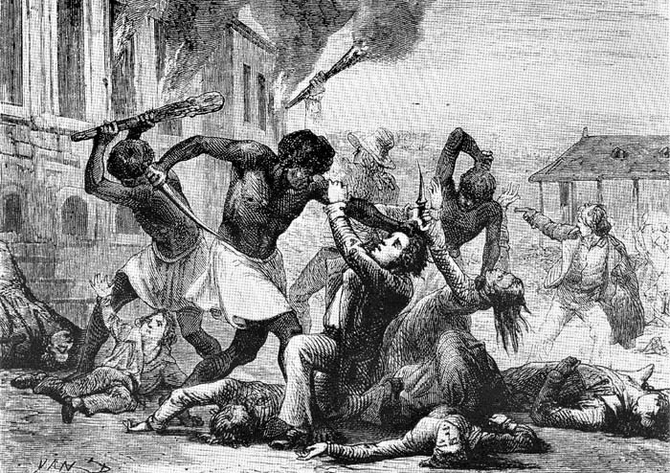
The Slave Population
150 blacks rose up & seized a munitions hold & killed several white planters
Widespread resentment of their slave status led to resistance in the 18th Century:
Armed resistance such as the Stono Rebellion of 1739 (SC)
In 1741, 106 slaves were hung or deported due to a rumor that slaves planned to burn NYC
Runaway slaves were common
Notes:
16

Slide 34
Bacon's Rebellion in Virginia
Former indentured servants living in the VA frontier suffered due to:
Poor tobacco prices in 1660s
Indian attacks in 1675
These farmers blamed VA’s royal governor Berkeley who did little to help; Nathaniel Bacon led a rebellion in 1676 against Berkeley & was joined by small farmers, blacks, & women
Notes:
22

Slide 35
Results
The rebellion failed and several rebels were killed.
Significance: Plantation owners sought large numbers of black slaves instead of indentured servants
White indentured servants were now seen as too troublesome
Socio-economic class differences/clashes between rural and urban communities would continue throughout American history
Planters used racism to manipulate poor whites

