Slide 1
Industrializing America
Mr. Winchell
APUSH
Period 6

Slide 2
Question to Consider…
What were the effects of industrialization on US society in the years 1865-1900?

Slide 3
The Industrial Boom
The Civil War and the growth of railroads in the 1860s contributed to the start of America’s Second Industrial Revolution (c. 1865-1900)
Whereas America’s First Industrial Revolution of the early 1800s had been characterized by steam powered textile factories in New England, the Second Industrial Revolution spread nationwide and was characterized by:
1. Exploitation of vast coal reserves (especially in Appalachia)
2. Technological innovations (transportation, communication)
3. Huge demand for labor (both skilled and unskilled)
4. Intense competition that led to the rise of monopolies
5. Rapid decline of prices (both agricultural and industrial)
6. Failure of the money supply to keep pace with expansion

Slide 4
Corporation Charters
1819 (Dartmouth College v. Woodward): This decision declared private corporation charters to be contracts and immune from state legislation impairing its progress.
This allowed companies to grow exponentially without regulation by the states they resided in.

Slide 5
High Tariffs
Throughout American history, especially Jacksonian America in the early 1800’s and then during the rise of industrial America (1865-1900), high taxes on imported goods protected American businesses. The government was motivated to protect American interests to help the economy grow, both in strength and stability.

Slide 6
Free Enterprise: Capitalism
Adam Smith: The Wealth of Nations (1776)
Laissez-faire Capitalism: “Let it Be”
The Market System:
Laws of supply and demand determine prices (The Invisible Hand)
According to Smith’s ideas:
Business should be free of government interference.
Smith understood that:
Business owners or Entrepreneurs, as a rule, want to make as much money or profit as possible.
They don’t want to pay taxes.
They want to provide goods or services at the lowest possible price and creating the most profit.
According to Smith a Pure Market Economic System would achieve the maximum good for society:
Characteristics
No government control
Freedom of choice
Private Property
Profit
Competition

Slide 7
New Innovations and Inventions
Factors
1. natural resources (coal and iron)
2. government support of business (Laissez-faire economics)
3. growing urban population (Cheap labor)
Natural Resources
Edwin Drake Titusville, PA in 1859 – drilled for oil – brought about refineries everywhere - created Kerosene and gasoline.
Coal – used in steam engines and the only way to move machines at first.
Iron – remove carbon through the Bessemer Process invented by Henry Bessemer and William Kelly – produced steel (looked like a river of fire).
Uses: Railroad tracks, Barbwire, steel plow, bridges (Brooklyn bridge – wonder of the world), skyscrapers (created by William Le Baron Jenney)

Slide 8
New Innovations and Inventions
Other Inventions
Thomas Edison (nicknamed the wizard) - incandescent light bulb and electricity (promoted outward growth with electric trolleys and factories were now free from water sources for power).
Christopher Sholes – typewriter in 1867
Alexander Graham Bell – telephone
Both created jobs for women.
Inventions also limited backbreaking labor for workers, but reduced human worth.
Also led to increased industrialization and expanded work hours! – bad and good for the worker, good for owners.

Slide 9
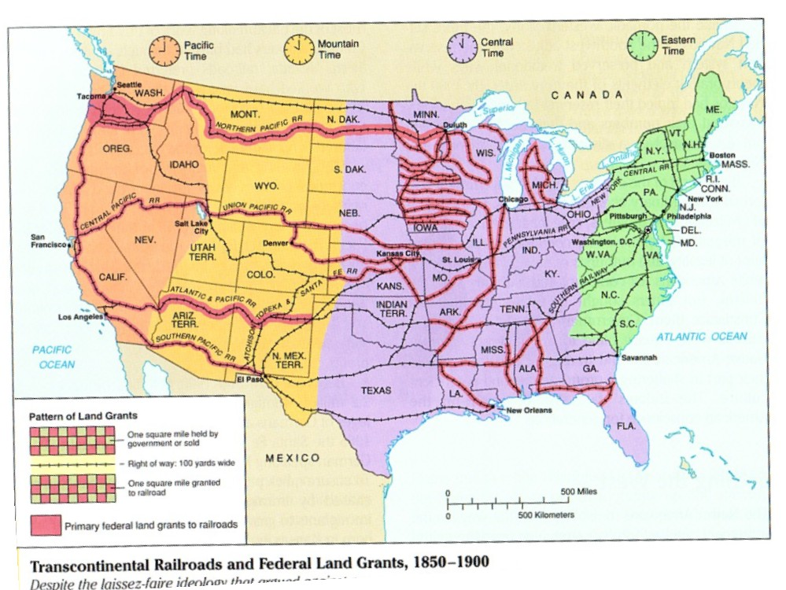
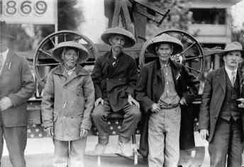
The Power of the Iron Horse
Pacific Railway Acts (1862+) - railroad companies get generous federal loans.
Land grants in exchange for railroad construction.
Get beneficial postal and transportation rates.
Four additional railroads were built - eastern network was also expanded.
Expanded south and west – created the transcontinental railroad (met at Promontory Point, UT).
US became a connected, unified nation (30k to 180K).
Called for the standardization of time – Prof. CF Dowd – 24 time zones – known as railroad time.
Cornelius Vanderbilt – bought all RR’s up and consolidated ownership.
Workers – many died from accidents and disease – generally Chinese, Irish and CW vets.

Slide 10
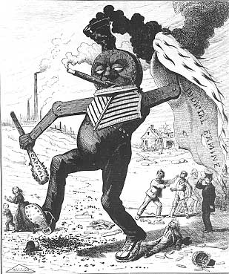
The Power of the Iron Horse Cont.
Overall impact
Made transportation SUPER quick –Helped other industries (iron, coal, lumber, etc.).
Connected various parts of the country and helped industrialization.
Towns would specialize in a product and grow around railroads (ex: Pullman towns).
Everyone needed it…which drives its cost UP!!!!
Also brought about corruption. (ex: Credit Mobilier during Grant’s admin).
Often bribed public officials.
Charged variable prices - reward or punish certain areas or people (called rebates).
Used business “pools” to control the market.
Hurt the western farmer and American Indians A LOT…

Slide 11
The Railroad Industry
Expansion from 10,000 miles of track in 1850 to nearly 200,000 miles by 1900 – opened up a huge internal market that promoted farming, commerce, and closure of the frontier
Railroad companies were the first “modern” corporations – sought capital through stock issuances, separated ownership from management, created national distribution and marketing systems, established complex accounting methods, and formed new organizational structures
Railroads often went deeply into debt, relied on government subsidies (often in the form of real estate) and used questionable business practices to compete for business and profits; owners (such as Jay Gould of the Union Pacific) were depicted as “robber barons” who violated the public trust

Slide 12
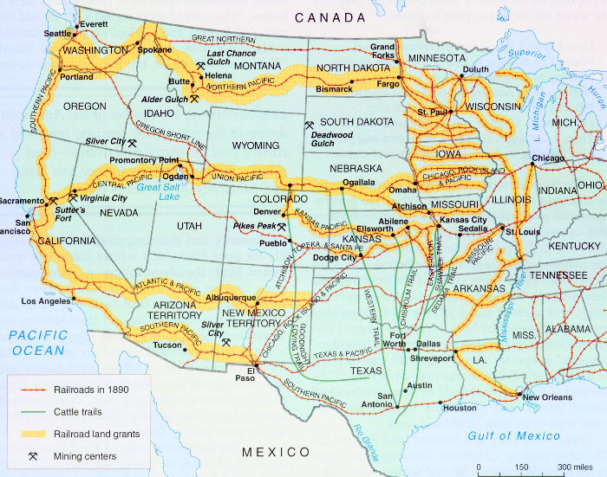
Governmental Control of the Railroad
Keeping railroads ‘honest’
Munn V. Illinois – railroads were abusing their control by charging too much - decision said states could regulate RR for public interest.
Then - Wabash V. Illinois said only federal government could regulate railroads.
weakening many farmers and any western state efforts to stop RR corruption.
Supreme court – states cannot regulate interstate commerce – Federal gov. created the Interstate Commerce Commission (ICC) to watch the RR’s (regulate railroad fares and practices. ).
First attempt by DC to regulate business.

Slide 13
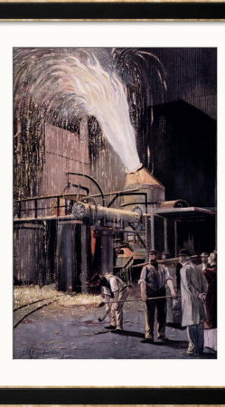
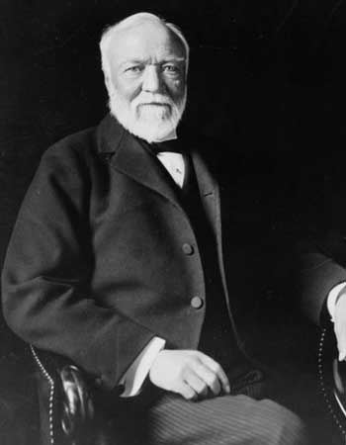
Big Steel
Andrew Carnegie led the industry in the late 1800s thanks to the introduction of:
1. the Bessemer steel process → high-quality steel
2. cost-analysis → cut back costs, higher profits
3. vertical integration → control of every stage of steel production from mining iron ore and coal to selling the finished product → reduced costs and allowed Carnegie to under-price the competition through economy of scale→ monopoly control of the industry
Overall result: More steel produced and at lower cost ($65/ton in 1875 vs. $11.50/ton in 1900)
Carnegie sold Carnegie Steel to J.P. Morgan and other investors in 1900 for $500 million and became a major philanthropist, advocated the “Gospel of Wealth”

Slide 14
Big Oil
John D. Rockefeller sought control of the expanding industry through horizontal integration → control of one stage of production (transportation and then refineries)
Rockefeller established the Standard Oil Trust (1882) to control companies that had previously participated in price fixing arrangements (controlled 90% of the industry through horizontal and vertical integration) – emulated by other industries

Slide 15
Vertical Integration: Controlling all aspects of a company, from raw material to production to distribution, in order to maximize profits.
Horizontal Integration: Controlling all aspects of a business or good by buying out competing interests to control the market.

Slide 16
Horizontal vs. Vertical Integration

Slide 18
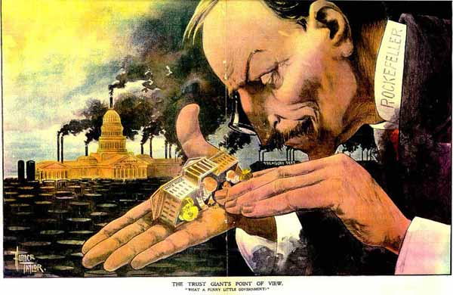

Slide 19
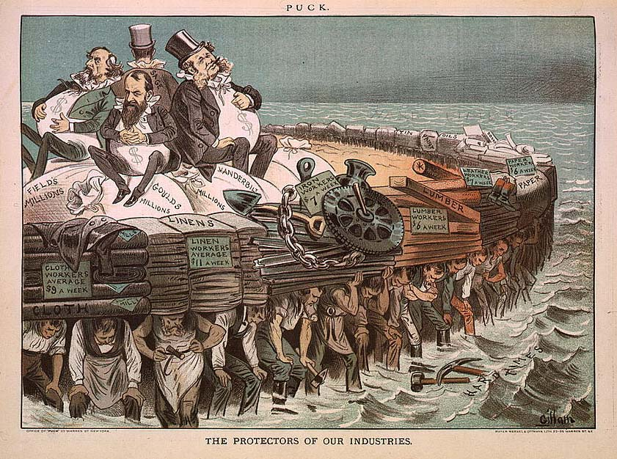

Slide 20
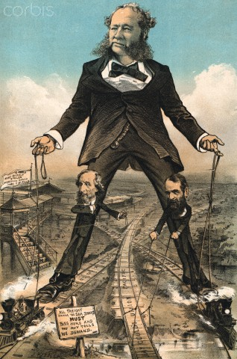

Slide 21
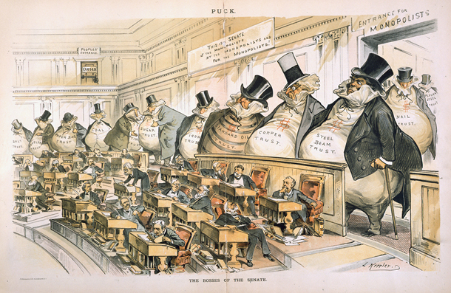

Slide 22
Monopolies Continued
Other ways to create a monopoly
mergers - buy out all companies in an industry and intergrade them into your company.
holding companies - a company that buys out other companies.
rebates - giving special people discounts (RR practice).
Interlocking directorates - one man on board of two companies.
Trusts - stock control given to one committee and multiple companies ran as one.
Hardest to regulate and most “sneaky of the monopolist categories.

Slide 23
Labor changes…

Slide 24
Labor changes…

Slide 25
Working Conditions

Slide 26
Regulating Monopolies and Trusts
1890 – Congress passed the Sherman Anti-Trust Act in an attempt to break up trusts and monopolies that were found to be operating “in restraint of trade”
To avoid being targeted by this legislation, Standard Oil reorganized into a holding company, whereby control was no longer exercised through direct ownership of companies but instead through majority share ownership
1895 - the Supreme Court ruled in U.S. vs. E.C. Knight Company (a sugar trust) that manufacturing did not constitute interstate commerce and therefore could not be regulated → encouraged further consolidation of industry into larger trusts

Slide 27
The development of factory production has consequences for virtually every portion of society.
Industrialization brings positives effects:
Inventions are created-→More products--→produced faster--→ produced cheaper
Jobs are created---→ people have money to buy more goods-→economy gets better for everyone
Rich people get richer--→ create more factories or businesses --→ create more jobs--→economy gets better for everyone
Immigration-→when jobs are available-------→people move to the location of jobs-→industrialization causes immigration--→
Factories are built where people live-------→cities grow

Slide 28
The development of factory production has consequences for virtually every portion of society.
Industrialization brings negative effects:
Industrialization causes--→pollution-→air, water
Industrialization causes---→poverty-→ government doesn’t protect workers at first-→ workers compete with other workers for low skill jobs-→ workers work long hours-→ get low pay-→ unsafe working conditions
Poverty is so bad-→children need to work
Massive wealth is created by factory owners-→ causes corruption-→ business owners use money to influence government officials

Slide 29
Taylorism= Scientific Management
Production process should be divided into specialized tasks
Each task speeds up production
Train all workers to do unskilled jobs
“Makes workers interchangeable”

