Slide 1
Do Now
How did British colonization differ from that of the Spanish, French and Dutch? How might that impact their relations with Native Americans and colonial development?

Slide 2
Jamestown and the Growth of the Chesapeake/Southern Colonies: An Identity Rooted in Cash Crops
Mr. Winchell
APUSH 2018-2019
Period 1-2

Slide 3
AP Prompt
Evaluate the extent to which motivations for colonization shaped regional identity in the Chesapeake & Southern Colonies.

Slide 4
English Colonies
Charters
Corporate Colony
Granted a charter to stockholders
Ex. Virginia
Proprietary Colony
Granted a charter to individual or group
Ex. Maryland, Pennsylvania
Royal Colony
Under direct control of the monarch
Ex. New Hampshire
Eventually, 8 of the 13 colonies became royal colonies, including Virginia and Massachusetts
First page of the Carolina charter, authorized by Charles II, 1663

Slide 5
Thirteen Colonies

Slide 6
Colonial Geography

Slide 7
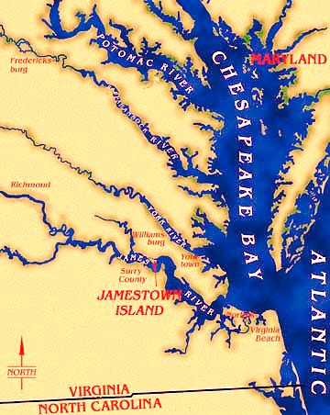
Chesapeake Colonies

Slide 8
The Chesapeake: Dreams of Wealth
After Walter Raleigh's failed Roanoke settlement, there was little interest in colonizing America; but Richard Hakluyt (& others) kept promoting colonies:
Possibilities for wealth
Rivaling Spain, Holland, France
Nationalism, anti-Catholicism, & anti-Spanish zeal

Slide 9
Entrepreneurs in Virginia
The major obstacle to colonizing in America was funding; Queen Elizabeth would not spend tax revenue:
Joint-stock companies provided financing for colonies
In 1606, King James gave the London Company the 1st charter to establish colonies in America

Slide 10
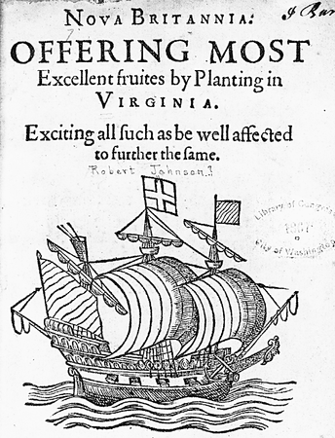
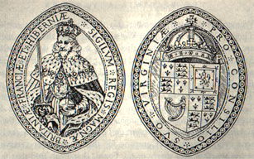
The London Company, 1606
The London Co was later renamed the Virginia Company; English stockholders in Virginia Company expected instant profits

Slide 11
Entrepreneurs in Virginia
Jamestown was settled in 1607 along the Chesapeake Bay:
the location was unhealthy but easy to defend from Spanish ships (but not from inland Indians)
Settlers had no experience in founding a settlement
Colonists expected to become immediately wealthy & failed to plant crops or prepare for long-term habitation in America
Chesapeake colonists did not work for the common good & many starved to death
Notes:
Clash of cultures; settlers had no experience in founding a settlement-they simply did that they knew. This did not work

Slide 12
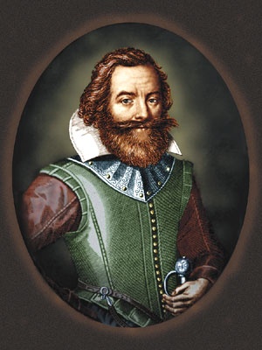
Spinning Out of Control
In 1608, John Smith imposed order in Jamestown & traded for food with natives
But, Jamestown faced difficulties:
Poor leadership & harsh winters led to ‘starving time’ (1609-1610)
In 1622 & 1644, Jamestown was attacked by Powhatan Indians
Captain John Smith
The most powerful Native Americans east of Mississippi River
Notes:
In 1609, London Co. reorganized the colonial gov’t; but the new governor would not arrive until 1610; meanwhile the colony lacked leadership; In 1616, the investors of the Virginia Co. had worthless stock; could claim un-surveyed land 3,000 miles from England

Slide 13
George Percy
Life in Jamestown Text Analysis

Slide 14
Powhatan Uprising

Slide 15
Powhatan Uprising
Textual Analysis
Given these documents, evaluate the challenges of colonization in the Chesapeake region. What solutions might the colonists utilize to create success?

Slide 16
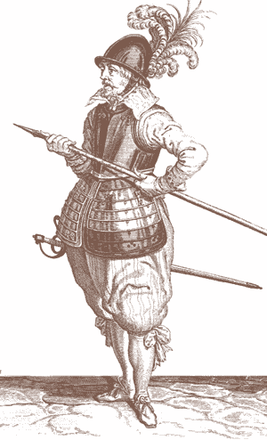
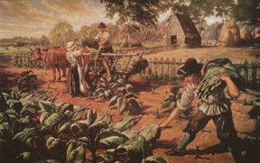
Saved by a “Stinking Weed”
John Rolfe introduced a tobacco hybrid that gave Jamestown a cash crop economy

Slide 17
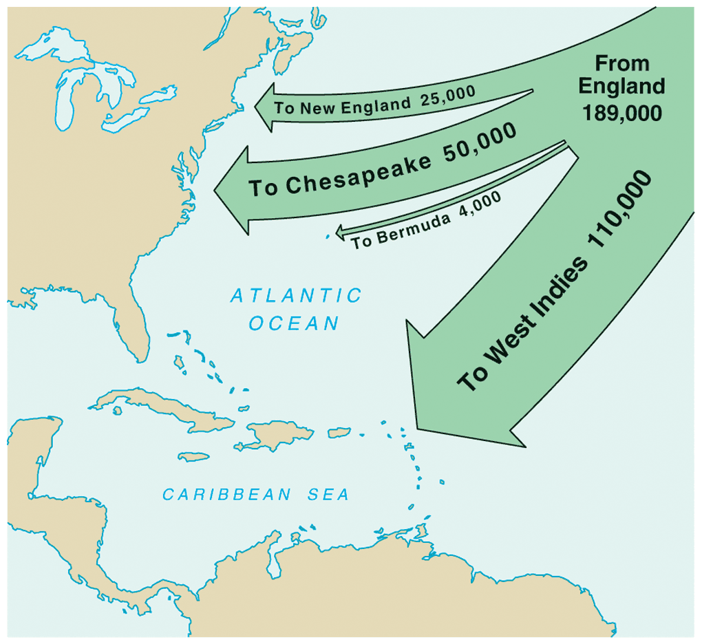
Saved by a“Stinking Weed”
In 1618, headrights were used to encourage cultivation of tobacco & the settlement of Jamestown:
A 50-acre lot was granted to each colonist who paid for his own transportation, or for each servant brought into the colony
Led to huge tobacco plantations & thousands of new settlers who hoped to
make their fortunes
Virginia’s growth was due largely to headrights
English Migration, 1610-1660

Slide 18
Notes:
https://www.encyclopediavirginia.org/media_player?mets_filename=evr8029mets.xml

Slide 19
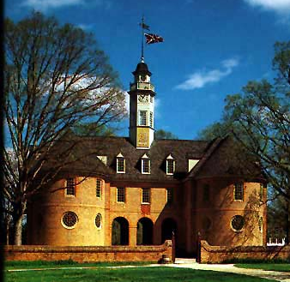
1619: A Turning Point
In 1619, Virginia colonists created a legislative assembly to create local taxes & oversee finances
The Virginia House of Burgesses became the 1st legislative assembly in America
Also in 1619, the first African slaves were sold in Virginia
In the 17th century, 1,000 slaves arrived in the New World/year
18th century: 5.5 million in America
By 1860: 11 million slaves were brought to the New World

Slide 20
Time of Reckoning
Despite the profits from tobacco, VA was a deadly place to live
Many died from disease
Numerous Powhatan attacks
Indentured servants were treated badly & cheated out of land when servitude ended
Few females (6:1 ratio) made families or reproduction difficult
In 1624, James I dissolved the Virginia Company & made Virginia a royal colony
But colonists continued to meet in the House of Burgesses
VA was divided into 8 counties each with a county court
Very little changed; Jamestown colonists still focused on tobacco & continued to lack unity

Slide 21
Maryland
Initiated by Lord Baltimore as a refuge for English Catholics
1632: Charter granted-toleration required to attract a labor force.
Wealthy Catholics: unwilling to relocate
Maryland populated with Poor Protestant farmers, few Catholics & indentured servants
Fewer large tobacco plantations
Scattered riverfront settlements

Slide 22
Maryland Act of Toleration
TAS 39

Slide 23
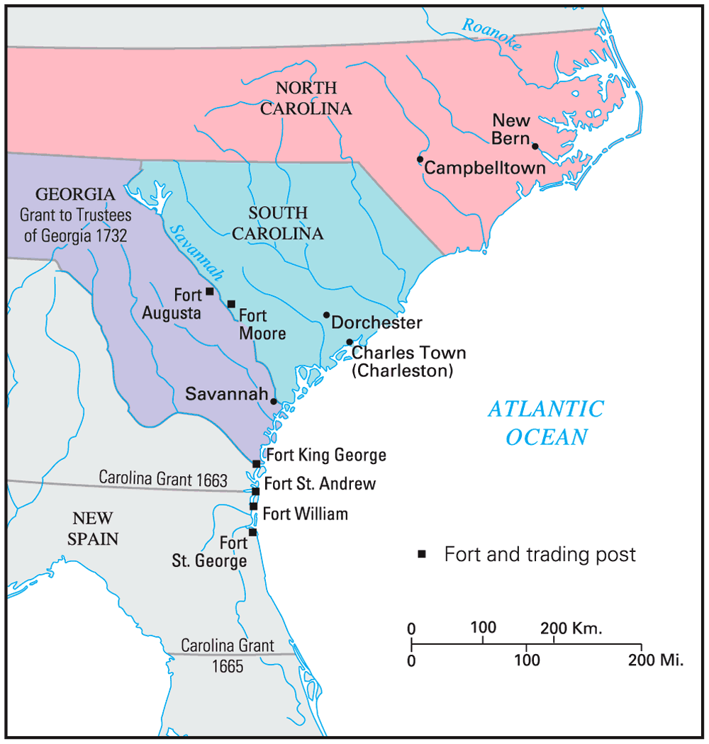
Settling the Lower South

Slide 24
Proprietors of the Carolinas
Carolina was granted a charter in 1663 to eight“proprietors” to reward their loyalty:
Proprietors were inspired by John Locke & created a government led by wealthy lawmakers but with veto power for average citizens
But Carolina had difficulty recruiting settlers in its first years
Carolina was established as a“political utopia & experimented with early forms of democracy

Slide 25
The Barbadian Connection
English planters from the Caribbean island of Barbados were recruited to Charlestown:
Barbadians brought a strict, cruel slave code with them
Demanded greater self-government within Carolina; led to 1729 strife that led to division of colony into North & South Carolinas

Slide 26
Carolina
Although Carolina relied on slave labor & agriculture (& therefore looked like Chesapeake colonies) it was very different due to:
Diversity of settlers
Environment very different from the Chesapeake

Slide 27
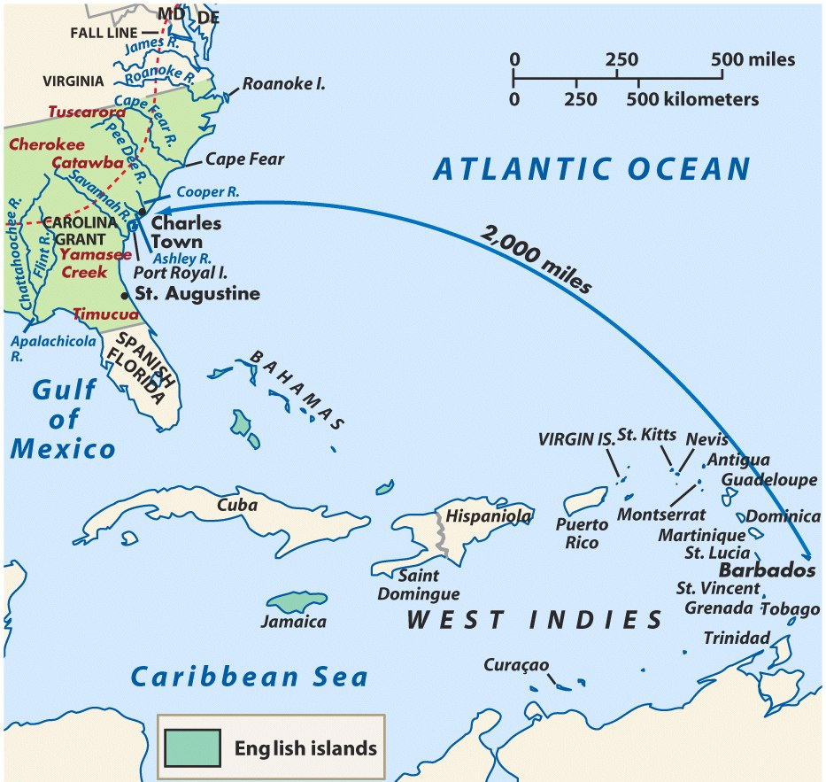
Charles Town, South Carolina, the only southern port

Slide 28
Founding of Georgia
Georgia was founded in 1732 by James Oglethorpe as a strategic buffer between the Carolinas & Spanish Florida
Oglethorpe offered Georgia as a refuge for imprisoned debtors from England
By 1751, Georgia was a small colony with a slave-owning plantation society
Georgia was in many ways a “social utopia” because it offered a fresh start for many of the lowest English citizens

Slide 29
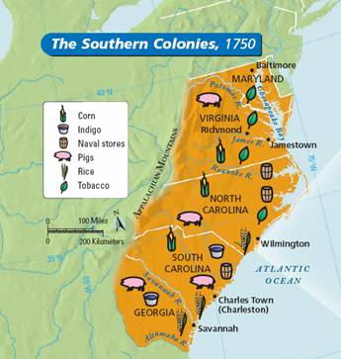
Chesapeake/Southern Society & Economy
Less urban; headright system
Southern coastal regions plantation economies; cash crops (Tobacco, rice, indigo)
Inland (Appalachian foothills) small-scale subsistence farming, hunting, and trading.
Note: A strong belief in private ownership of property and free enterprise characterized colonial life everywhere.

Slide 30
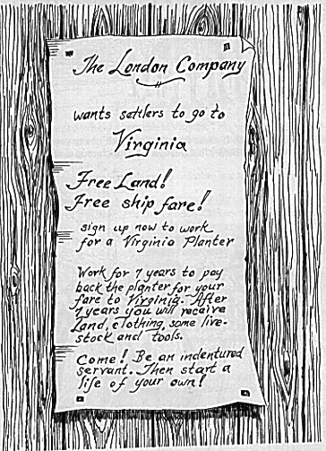
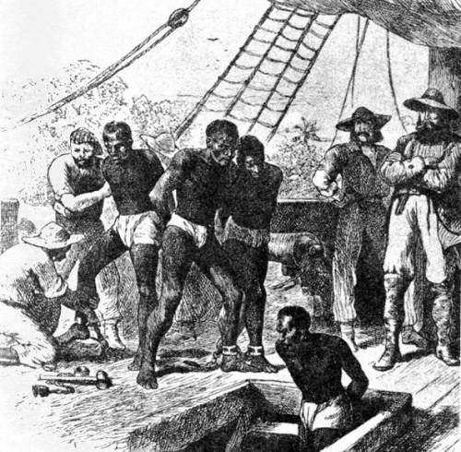
From Indentured Servitude to Slavery
Indentured Servants: very common 17th century
Contracts of passage for labor→ 7 years service→ “freedom dues”
Slavery: gradually replaced I.S. by 18th century
Source West Africa & West Indies
Racial Prejudice & inability to use Indians effectively
Perpetual & Hereditary; Slave Codes
“Peculiar Institution” sharpened distinction between N & S.
Stono Rebellion – S.C. - 1739

Slide 33
Southern Colonies
Maryland (1634)
Lord Baltimore
Act of Toleration (1649)
Virginia (1607)
Carolinas (1663)
North Carolina (1729)
Tobacco
South Carolina (1729)
Rice and indigo
Georgia (1732)
James Oglethorpe

