Slide 1
Do Now
Compare the Democrats and Republicans in the Gilded Age. How were they similar? How were they different?

Slide 2
2. Politics of the Gilded Age-National Politics in a Time of Change
Mr. Winchell
APUSH 19-20
Period 6

Slide 3
AP PROMPT
Evaluate the impact of economic issues like tariffs on political parties during the Gilded Age

Slide 4
Gilded Age Political Issues
Civil Service Reform
Role of Government in Business
Social Darwinism
Machine Politics
Money (Standard and in Politics)
Tariffs!

Slide 5
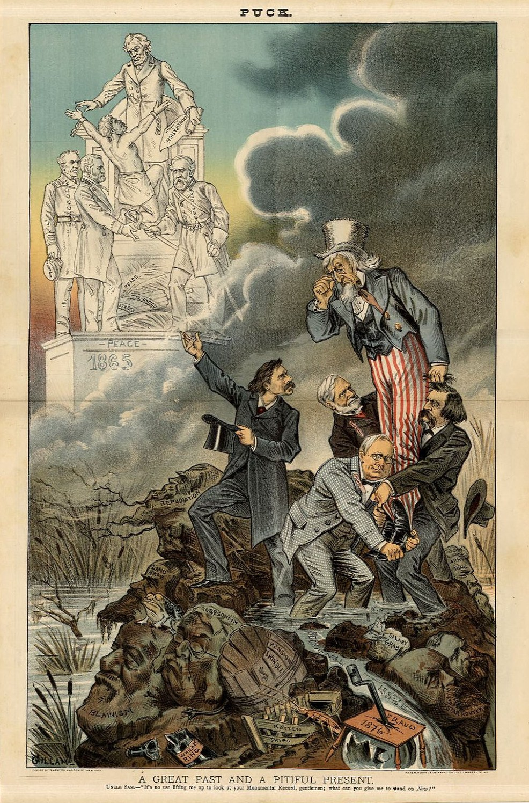
What argument does this cartoon make regarding Gilded Age politics? To what extent is that argument accurate?

Slide 6
Gilded Age Politics
The American Presidents who resided in the White House from the end of the Civil War until the 1890s are sometimes called "the forgettable Presidents.”
Congress strong, but tied to corporate interests.
Local politics (state, city, county) stronger, but controlled by political machines.

Slide 7
Very Laissez Faire Federal Govt.
From 1870-1900 → Govt. did very little domestically.
Main duties of the federal govt.:
Deliver the mail.
Maintain a national military.
Collect taxes & tariffs.
Conduct a foreign policy.
Exception → administer the annual Civil War veterans’ pension.

Slide 8
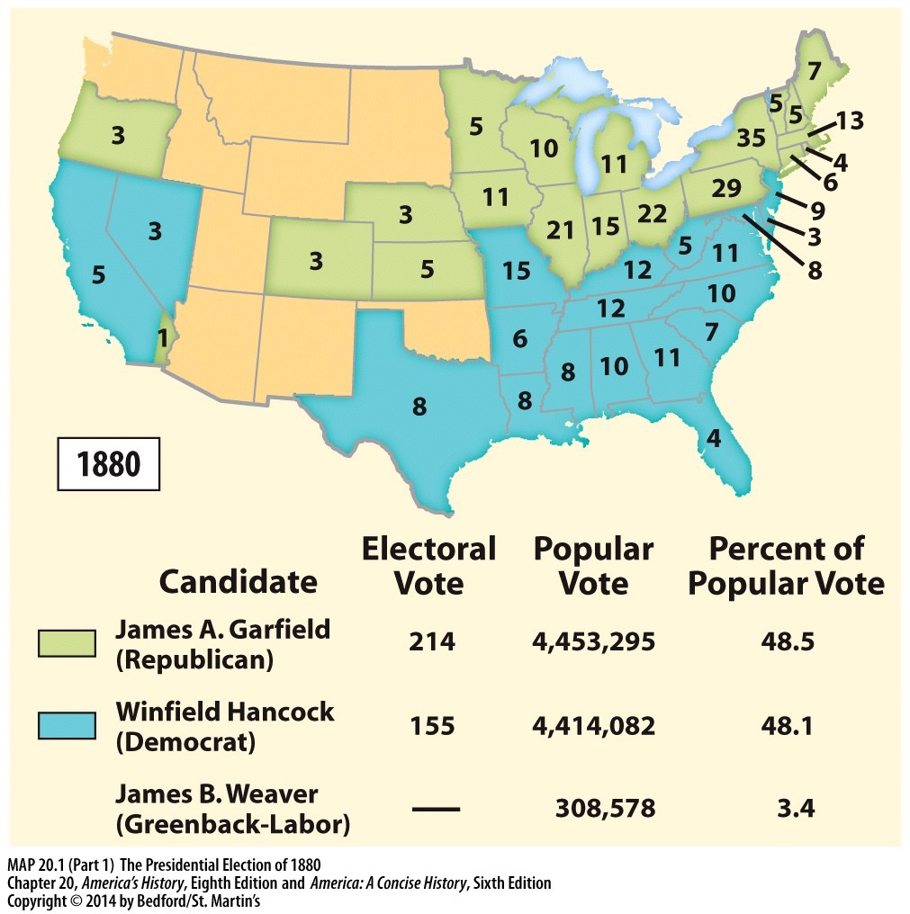
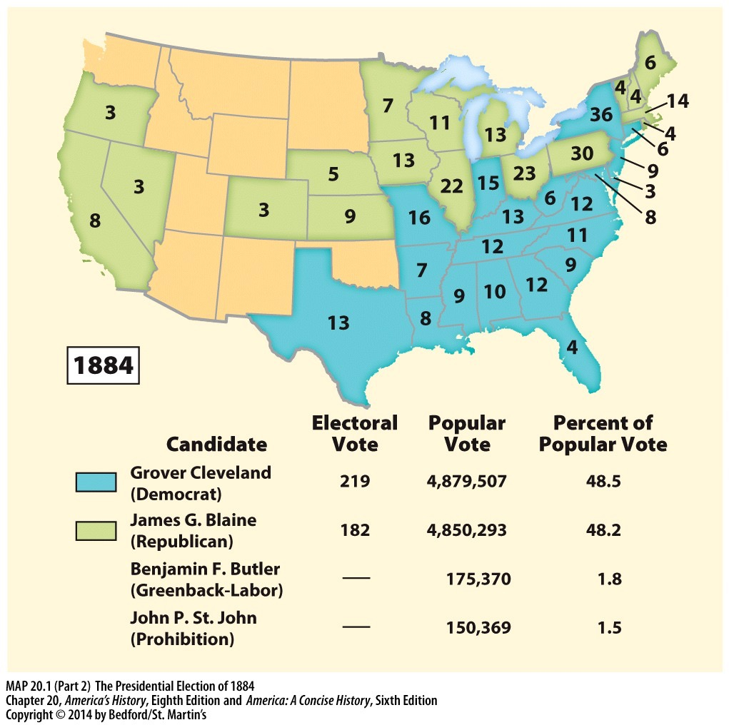
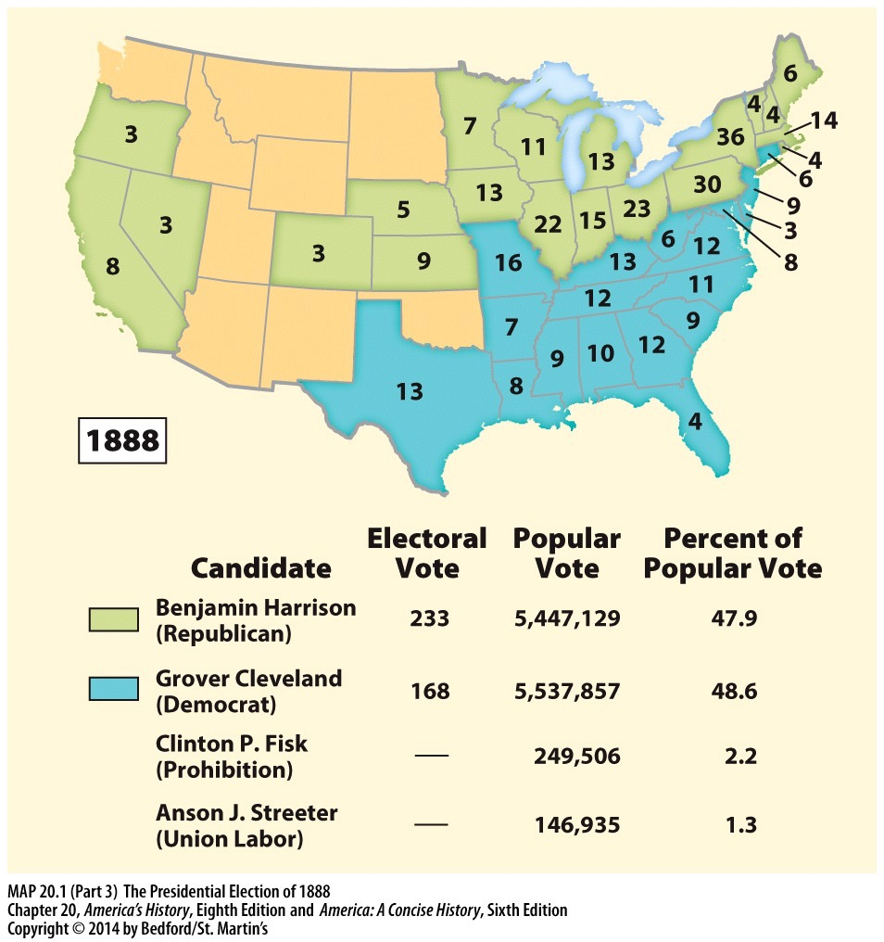
THE ELECTIONS OF THE GILDED AGE
2. What does the popular vote in these elections say about the nature of US politics in the Gilded Age?
1. What does the pattern of electoral votes say about the nation’s unity after the Civil War?
3. In these elections, Republicans promoted tariffs and Democrats opposed them? What groups would support each party? Why would they support them?

Slide 10
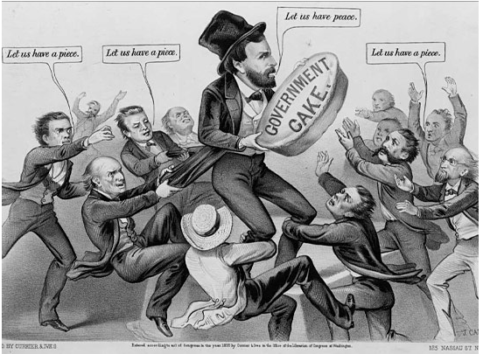
Ulysses S. Grant (R) (1869-1877)
Civil War hero, but no political experience; linked with moderates and Radicals
Grantism
Credit Mobilier
Union Pacific Railroad creates dummy construction company to hire execs at inflated salaries and earn high dividends
Sold stock to Republican congressmen and bribed press to keep quiet
Whiskey Ring
Republicans embezzled liquor tax revenues using bribes and networks
Amnesty Act of 1872
Panic of 1873

Slide 11
Panic of 1873: The Long Depression
Causes
Expansion of railroads, enterprises in industries and mines outpaces market demand
Coinage Act of 1873
Demonetizes silver contracting the money supply
“Crime of 73”
Jay Cooke & Company bankrupt
Major financing investment firm leads to chain reaction of banks
Effects
Over 100 railroads fail; 16,000 businesses fail
Unemployment at 14%

Slide 12
Rutherford B. Hayes (R) (1877-1881)
Compromise of 1877
Delegitimizes presidency
Great Railroad Strike of 1877
Uses federal/state militia troops to put down
Civil service reform
Bland-Allison Act
Government to purchase silver for circulation
Vetoed and Passed Over Veto
Generally speaking, a pro-business Republican

Slide 13
Political Quarrels of the Hayes Administration
Political infighting within Rep. party between Stalwarts and Half-Breeds
Stalwarts = strong supporters of Grant & party loyalty
Stalwarts led by Roscoe Conkling (NY)
Half-Breeds = more liberal & reform-minded Republicans
Half-Breeds led by James Blaine (ME)
Notes:
Within the Republican ranks there were bitter quarrels between the Stalwarts and the Half-Breeds.
Stalwarts were staunch supporters of the recent Grant administration and eventually will support the idea of a 3rd Grant term
They were led by the powerful New York Senator Roscoe Conkling
Another prominent Stalwart was Chester A. Arthur
Half-Breeds were more liberal and favored Hayes’s southern policy and civil service reform.
The Half-Breeds were against corruption in govt.
They were led by Senator James Blaine of Maine.
A prominent Half-Breed was James A. Garfield (R-OH)

Slide 14
Honest Republican Voter 1884

Slide 15
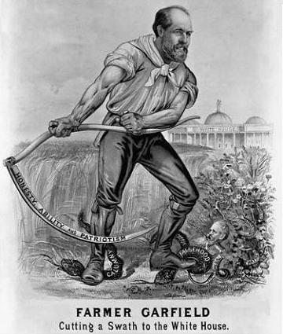

Slide 16
James A. Garfield (R) (1881)
Challenged political machines, spoils system, and senatorial courtesy
Assassination
July 2, 1881
Charles J. Guiteau
“a disgruntled office-seeker”
Death
September 19, 1881
Chester A. Arthur assumes presidency

Slide 17
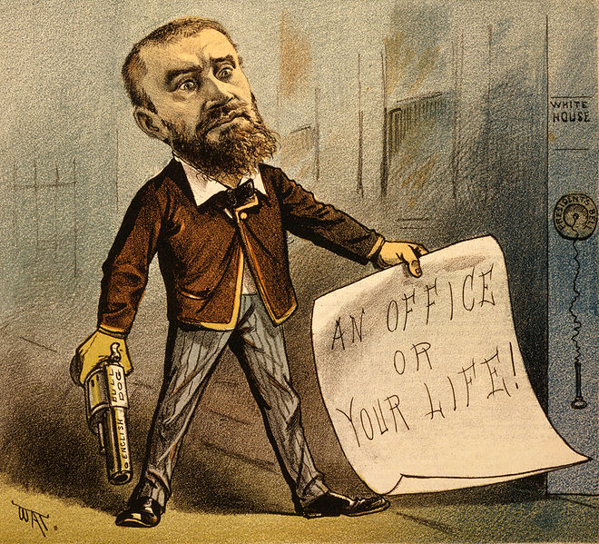

Slide 18
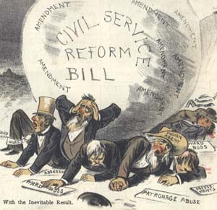
Civil Service Reform
Corruption during Grant administration called for reform
Stalwarts
Supported machine politics and spoils system
Roscoe Conkling
Half-breeds
Pursued civil service reform
James G. Blaine
Garfield’s assassination
Pendleton Civil Service Reform Act (1883)
United States Civil Service Commission
Federal employees based on expertise, civil service exams
Prohibited federal employees and campaign contributions
The “Magna Carta” of civil service reform.
Spoils system…. To MERIT system

Slide 19
Chester A. Arthur (R) (1881-1885)
Assumed office after Garfield’s assassination
Pendleton Act (1883)
Despite being a Stalwart
Chinese Exclusion Act of 1882

Slide 20
Election of 1884
Dems win White House for 1st time in 28 years with Grover Cleveland (D-NY)
Reps. rejected Arthur & nominated James Blaine
Blaine favored patronage - Cleveland had a record of fighting it
Republican reformers (Mugwumps) backed Cleveland instead of Blaine
Notes:
The Republican party rejected Chester A. Arthur for the 1884 nomination and instead gave it to James Blaine, their best-known party leader.
Blaine was a believer in patronage while his Democratic opponent, Grover Cleveland (D-NY) had a record establishing him as an opponent of political bosses and patronage.
Reform-minded Republicans jumped ship from the party and voted instead for Cleveland, tipping the scales in his favor.
Mugwump - Algonquian word meaning renegade chief

Slide 21
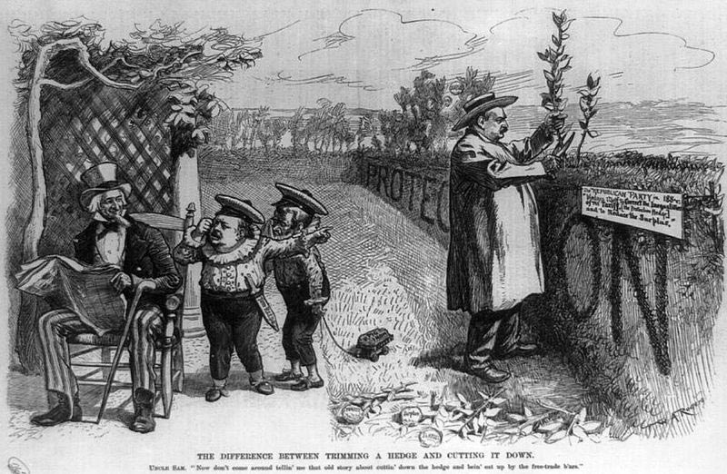
Grover Cleveland
Fought fraud in Civil War veterans pension claims
Thought of pensions as honor roll and reserved for those who deserved them
Earned anger of biz and vets groups
Considered an able president
honest and independent
Focused on lowering tariff rates
Tariffs a source of federal revenue and business protection
Notes:
Tariff duties were a major source of public revenue (there was no fed. income tax)
U.S. producers wanted protection from foreign competition. Some manufacturers sought protection of finished product (e.g. shoes) while favoring access to foreign raw materials (hides)
As usual - South and West disliked tariffs because they increased prices of goods they needed to buy and scared off foreign buyers of U.S. agricultural commodities.
Republicans supported tariffs - Dems favored lower rates
Cleveland wanted to lower tariff rates because they were actually bringing in surplus money that was being distributed into veterans pensions and pork barrel projects.
Cleveland viewed the budget surplus as a corrupting influence.
He saw protection as aiding the growth of massive trusts and other biz combinations that eliminated competition and ultimately raised prices
In an address to Congress in 1877, Cleveland called for lower tariff rates, angering business
Cleveland also sought to minimize fraudulent pension claims.
Military pensions cost millions annually - fraud inflated the cost
Cleveland rejected many spending bills that would have sent more $ into pension funds
This angered veterans groups

Slide 22
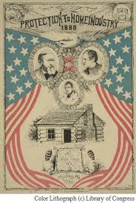
Election of 1888
Republicans win back the White House with Benjamin Harrison (R-IN)
Reps. wrongly portrayed Cleveland as anti-biz and favoring free-trade (no tariffs)
Big biz contributed $$$ to defeat him
Harrison lost pop vote but won electoral
Reps. also gained control of Congress
Notes:
The major campaign issue of the 1888 election was Cleveland’s call for lower tariff rates.
The Dems enthusiastically re-nominated Cleveland while the Reps nominated Benjamin Harrison, grandson of William Henry Harrison.
The Republicans were aggressive and well financed by corporate money. Since the Pendleton Act forbid campaign contributions from govt. workers, parties relied heavily on corporate contributions to fund campaigns.
The Reps accused Cleveland of supporting a policy of removing all restrictions on trade, including tariffs, which benefited foreign manufacturers at the expense of American ones.
The Reps also appealed to Union vets who were angry about the pension issue.
Harrison lost the popular vote by over 100K votes but won important electoral states.
Electoral vote - 233 to 168

Slide 23
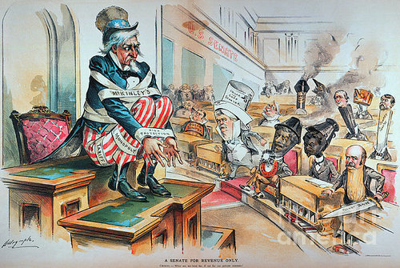
Benjamin Harrison
Instead of cabinet, Harrison followed advice of 3 prominent Republicans
Blaine (NY), Thomas Reed (ME), William McKinley (OH)
Rep. controlled Congress passed McKinley Tariff of 1890
Highest rates ever - as high as 50%
Domestic prices increase, Reps. pay in 1890
Notes:
Harrison preferred to listen to the advice of 3 prominent Republicans rather than the members of his cabinet.
James Blaine (who was his Sec. of State)
Thomas Reed (R-ME) - Speaker of the House
William McKinley (R-OH) - Chairman of the House Ways & Means Committee (in charge of raising revenue for national expenses)
With control of both the Senate and the House, the Republicans moved to pass a new protective tariff.
The McKinley Tariff of 1890 raised tariff rates on woolen and cotton goods, steel products and even some farm products, including wheat, potatoes, butter, and eggs.
The tariff raised rates to their highest level ever - up to 50%!
As a result of such a high rate, domestic producers increased their prices to raise their profits.
The Democrats railed against the Republicans for “raising the cost of living.”
The people listened because Democrats won big in the 1890 midterm election

Slide 24
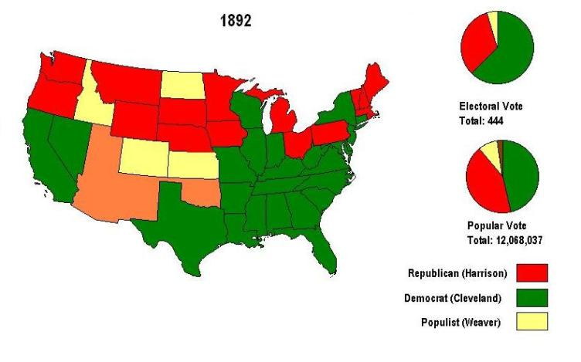
Election of 1892
Grover Cleveland (D-NY)
Benjamin Harrison (R-IN)
James Weaver (Populist -IA)
Party of farmers and laborers
Platform geared toward pro-farmer & Labor reforms
Cleveland wins - due in part to Populist draw and public resentment of Republicans
Notes:
Former president Cleveland was again nominated by the Democrats.
Harrison won the Republican nod, though Blain put his name in the hat.
A 3rd party, the Populists, entered the fray with agrarian-oriented politician James Weaver.
The Populist were a party that grew out of the Farmers Alliances of the West.
The party platform advocated reforms that would benefit farmers and eastern laborers.
The Republicans suffered from public resentment over a number of issues.
Harrison’s failure to use the Merit system
McKinley Tariff price increases
An attempt to force federal control of elections on Southern states (unsuccessful)
Disgust with the Billion Dollar Congress
Cleveland won the election and his party won control of Congress as well.
Won by 360K votes and 277-145 in the electoral vote

Slide 25
Gilded Age Presidents
Grant: covered him Period 5-Corruption
Rutherford B. Hayes: Ineffective. Wanted patronage reform but his own election was corrupt
James Garfield: Wanted reform for the Civil Service-so he got shot.
Chester Arthur: Supported the Pendleton Civil Service Act of 1883 (merit system for all gov. civil service jobs)
SUPER UNINTENDED CONSEQUENCE: drove politicians and businesses together (money/influence)
Leads to a new era where politics are controlled by business

Slide 26
Gilded Age Presidents Cont’d
Grover Cleveland round 1: First Democrat to be president since James Buchanan.
Laissez-faire capitalism: no government involvement in the economy.
Against public bills and army pensions due to abuse post-Civil War
Supported lower tariffs
Benjamin Harrison: Billion dollar Congress
Sherman Silver Purchase Act
McKinley Tariff Bill of 1890: Highest tariff since the war. Hurts Western Farmers and Southerners
Leads to hostility
Grover Cleveland round 2: Panic of 1893. Thanks to loss of value of dollar. JP Morgan bails out the government. Angers Westerners who view as government ‘selling out’ to Wall Street.

Slide 27
Panic of 1893
Causes
Overexpansion
Railroad speculation
Pennsylvania and Reading Railroad bankruptcy
Silver Purchase Act repealed
Impact
Unemployment to 18.4%
16,000 businesses and 500 banks bankrupt/failed
Pullman Strike (July 1894)
Coxey’s Army (1894)
March on Washington by unemployed workers and farmers $500 million for jobs
Dispersed by federal troops
J.P. Morgan and the Treasury
Cleveland and U.S. borrowed $65 million in gold

Slide 28
Cleveland Loses Support Fast!
The only President to serve two non- consecutive terms.
Blamed for the 1893 Panic.
Defended the gold standard.
Used federal troops in the 1894 Pullman strike.
Refused to sign the Wilson-Gorman Tariff of 1894.
Repealed the Sherman Silver Purchase Act.

Slide 29
Disenfranchisement of the African Americans
Voting:
Poll taxes – annual voting tax (if you were poor, you couldn’t pay to vote)
literacy tests – reading test in order to vote (more difficult for Afams as they are not provided good education)
Grandfather clause – if your grandfather can vote=you vote (made sure former slaves ancestors couldn’t vote)
Separation:
Plessy v. Ferguson – ruled that Black and White populations could be “separate but equal” – legalized racial segregation for almost 60 years.
Violence:
Lynching's (with no punishment) were very common!

Slide 30
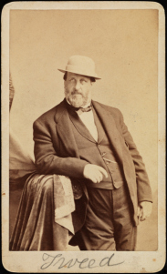
Political Machines and Boss Politics
Definition
“in U.S. politics, a party organization, headed by a single boss or small autocratic group, that commands enough votes to maintain political and administrative control of a city, county, or state”
Patronage and spoils system
Tammany Hall (New York City)
William “Boss” Tweed

Slide 31
Immigrants
Politicians
Bribes
Citizenship
Votes
Political Support
Poor People
Tax Revenue
Living Expenses
City Funds
Boss
Votes
Bribes
Bribes
City Contracts
Votes
Businessmen
Poll Workers
Bribes
Votes
Key
Hired Voters

Slide 32
