Slide 1
2. Polling and Ideology: Measuring & Evaluating Public Opinion
Mr. Winchell
AP GoPo
Unit 4: American Political Ideologies and Beliefs

Slide 2
Do Now
Current Event Cartoon of the Day

Slide 3
Content Correlation

Slide 4
Public Opinion
The attitudes, perceptions, and viewpoints individuals hold about government and politics
Influenced by political culture and political socialization
Skewed by limited political education and efficacy
Shaped by government, interest groups, and mass media

Slide 5
Types of Public Opinion Polls
Straw Polls
A non-binding, and usually impromptu, poll among a large group of people to initiate discussion
Unreliable due to no cross-section of general population
Telephone Polls
Internet Polls
Focus Groups
A demographically diverse group of people gathered to be surveyed on particular issue or to be surveyed throughout a campaign
Benchmark Polls
The first public opinion survey done before or immediately after a candidate announces their campaign
Entrance Polls
Public opinion surveys taken before voters cast their ballots
Tracking Polls
The same samples are periodically surveyed to measure shifts in opinion
Exit Polls
Public opinion surveys taken after voters cast their ballots
Push Polls
Misleading poll questions to push a certain choice/candidate/issue

Slide 6
Measurement of Public Opinion Development of Polls
George Gallup’s Ideas
Sampling
Represent general population and randomized
Valid questions
Clear, fair, unbiased, not misleading
Control of poll
Tone of question, basic knowledge of issues
Analysis
Provide sampling errors, show time and place of poll

Slide 7
Sample Poll Examples
Do you favor or oppose taxes?
Do you favor or oppose taxes as a means to national security?
Do you favor or oppose Senator Smith, who voted to raise taxes last session?
Do you favor or oppose a state income tax of 7%?
GOP Listening to America
Dem CCC 2018 Campaign Survey
Notes:
https://action.dccc.org/survey/2018-survey

Slide 8
Why Polling Matters
Elections
Issue Polling
Personal Polling
Opposition Polling
Interest Groups
Public Feeling on Issues
Media
What do the people want to see/hear?

Slide 9
Poll Credibility
STATS (WANG)
Random Sampling vs. Non Random Sampling
Likely Voters
Demographically Similar
Large Population Size (at least 500)
500-1,000 standard
Higher size -> lower margin of error -> closer to TRUE public opinion
Neutral Language
Unbiased/non-leading
Transparent to the ‘how’
Margin of Error (+/-)
Notes:
Start Video at 3:18

Slide 10
Evaluating Public Opinion Data
“Likely Voters” Designation
What if they vote/don’t vote?
Skewed Data
Just ‘samples’ from population

Slide 11
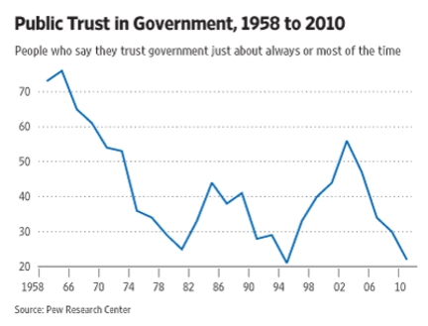
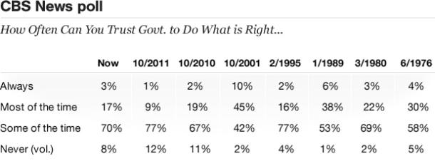
Political Trust
Government is a “necessary evil”
Major shifts in public opinion with major events
Pearl Harbor
Vietnam
9/11
Hurricane Katrina
Great Recession

Slide 12
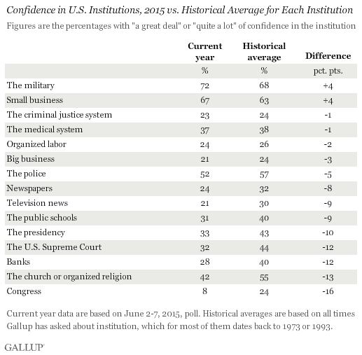
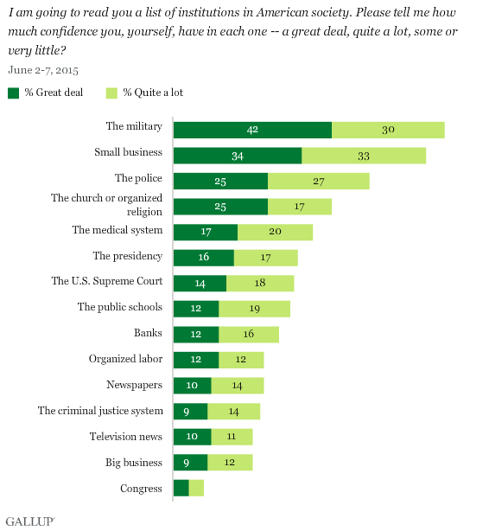
Confidence in Institutions

Slide 13
Politicians and Public Opinion
Shape public stances
Push for legislation
Fundraise
Re-election

Slide 14
Polling Today
Presidential Job Approval
How to question a poll...
Notes:
https://www.realclearpolitics.com/epolls/other/president_trump_job_approval-6179.html

