Slide 1
Postwar Affluence-1950s Domestic Policy
Mr. Winchell
APUSH
Period 8

Slide 2
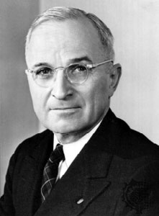
Harry Truman (D) (1945-1953)
Fair Deal
  "Every segment of our population, and every individual, has a right to expect from his government a fair deal.“ – State of the Union (1949)
Labor Relations
  Taft-Hartley Act (1947)
    Prohibited closed shops, political contributions, sympathy strikes
    Permitted “right to work” states
  Youngstown Sheet & Tube Co. v. Sawyer (1952)
    President order to seize national steel mills unconstitutional
Presidential Succession Act of 1947
Social and Cultural Developments
  Civil Rights
    Executive Orders 9980 and 9981 (1948)
      Desegregated the federal government and military
Foreign Developments
  Containment
  Marshall Plan
  Berlin Airlift
  Korean Conflict

Slide 3
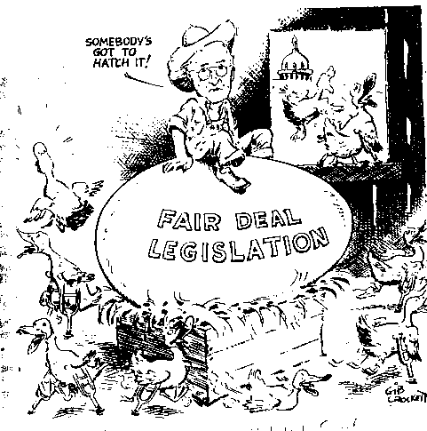
Truman’s Fair Deal
A continuation of New Deal-style social welfare programs
21-Point Domestic Program
  Expansion of Social Security
  Increased minimum wage
  Housing Act of 1949
    Urban projects and public housing
Prevention by Conservative Coalition
  National healthcare insurance
  Limited civil rights legislation

Slide 4
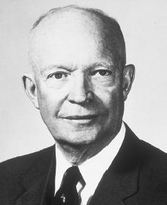
Dwight D. Eisenhower (R) (1953-1961)
Modern Republicanism/Dynamic Conservatism
  Reduce federal scope of power
  Balanced budgets
  Pro-business policies
  Progressive republicans
Interstate Highway System (1956)
National Defense Education Act (1958)
Social and Cultural Developments
  Second Red Scare
  Affluent Society
  Conformity and Consensus of Values
  Civil Rights Movement
    Brown v. Board of Education (1954)
    Rosa Parks and Montgomery Bus Boycott (1955-1956)
    Little Rock Nine (1957)
    Student Nonviolent Coordinating Committee (SNCC)
      Sit-ins
Foreign Developments
  Brinkmanship
  Sputnik
  U-2 Incident

Slide 5
Eisenhower’s Modern Republicanism
“I’m conservative when it comes to money and liberal when it comes to human beings”
Eisenhower labeled his politics “Modern Republicanism”:
  “Ike” believed in conservative gov’t spending & a balanced budget but he had no desire to end New Deal programs
  The affluent, postwar “good life” at home was dependent upon a strong Cold War foreign policy

Slide 6
Eisenhower’s Modern Republicanism
During the Eisenhower era, the U.S. economy avoided spiraling inflation & brought middle-class prosperity to more Americans
In his 8 years as president, Ike had a modest domestic record:
  Instead of ending New Deal programs, Eisenhower added to social security & minimum wage
  Helped finance building & purchasing of suburban homes
  Created the Depts of Health, Education, & Welfare
  Interstate Highway Act of 1956 added 41,000 miles of road

Slide 7
If one word sums up the fifties (Eisenhower era), it’s “restless”
We tend to imagine the Fifties as a calm, peaceful decade, but in fact Americans spent the years moving and searching.
They moved physically, from the Northeast (Frostbelt) to the South and West (Sunbelt)—California's population grew by 49% during the Fifties, Florida's by 79%.
They moved from rural areas to cities and from cities to suburbs. By 1960, a third of the country's population lived in the 'burbs.
Many people were content, but many others felt ill at ease because of the speed at which the world was changing.
Searching for new ways of coping, they embraced religion and visited psychiatrists in unprecedented numbers.

Slide 8
The 1950s: The Affluent Society
The end of WWII led to an era of wealth & spending in the 1950s:
  The war stimulated the economy & ended the Great Depression
  High wages, service pay for soldiers, & war bond investments gave Americans money to spend
  The economic boom allowed Americans to enjoy the highest standard of living in the world
Notes:
Most economists who had forecast a postwar depression were proved wrong because they had failed to consider consumers’ pent-up accumulation of needs and wants. People had gone without many goods for so long that by the late 1940s, with more than $135 billion in savings from defense work, service pay, and investments in war bonds, Americans suddenly had money to spend. They snatched up everything from automobiles to houses. After a brief period of postwar economic readjustment, the American economy boomed. The demand for goods and services outstripped the supply and increased production, which created new jobs. Judging from the graphs (shown left), many Americans prospered in the 1950s in what the economist John Kenneth Galbraith called “the affluent society.” The Cold War also contributed to economic growth. Concern over Soviet expansion kept American defense spending high and people employed. Foreign-aid programs, such as the Marshall Plan, provided another boost to the American economy. By helping nations in Western Europe recover from the war, the United States helped itself by creating strong foreign markets for its exports
After World War II ended, Americans turned their attention to their families and jobs. The economy prospered. New technologies and business ideas created fresh opportunities for many, and by the end of the decade Americans were enjoying the highest standard of living in the world. The American dream of a happy and successful life seemed within the reach of many people.

Slide 9
The 1950s: Consumerism
Consumerism returned in the 1950s
  People rushed to buy new goods like TVs & hi-fi record players
  Credit became available (The 1st credit card was created in 1950)
  Advertisers used newspaper ads, radio, & new TV commercials to market goods to Americans
  Franchises offered people across the country the same products
For the 1st time since the 1920s, Americans had access to cheap electrical appliances & cars
Notes:
Expansion of business in the 1950s:
Corporations, Franchises (848)
Consumerism (854-855)

Slide 10
The 1950s: The Baby Boom
Americans produced a “baby boom” in the 1950s, leading to the largest generation in U.S. history
  The return of soldiers from war led to an increase in marriages
  & a rise in the birthrate
  The baby boom led to a demand for new baby products, schools, & homes for growing families
Notes:
Returning soldiers, housing shortage, baby boom
Levittville
Suburban shopping centers
GI Bill of Rights (?)

Slide 11
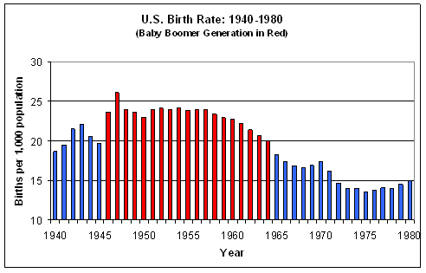
Baby Boom (1946-1964)

Slide 12
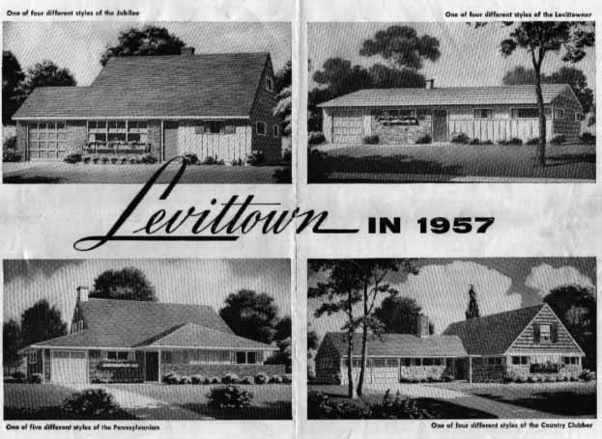
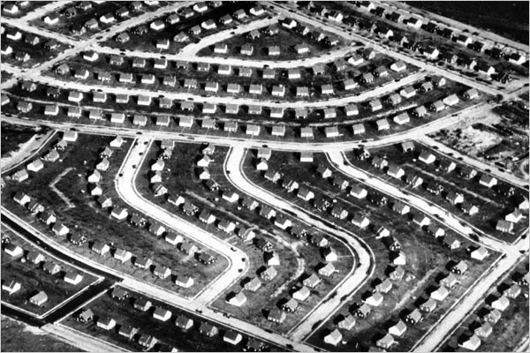
American Suburbia
Causes
  Postwar economic expansion
  G.I. Bill and FHA
  Great Migration
  Interstate highways
Details
  Single-family homes
  Subdivisions and zoning
  Shopping malls
Effects
  “White flight”
  Urban decay

Slide 13
The 1950s: Automania
In the 1950s, Americans bought cars in record numbers:
  The growth of suburbs, creative advertising, easy credit, & cheap gasoline led to a car boom
  Congress added 41,000 miles of expressway when the Interstate Highway Act was passed in 1956
  Automobile companies made big, powerful, flashy cars

Slide 14
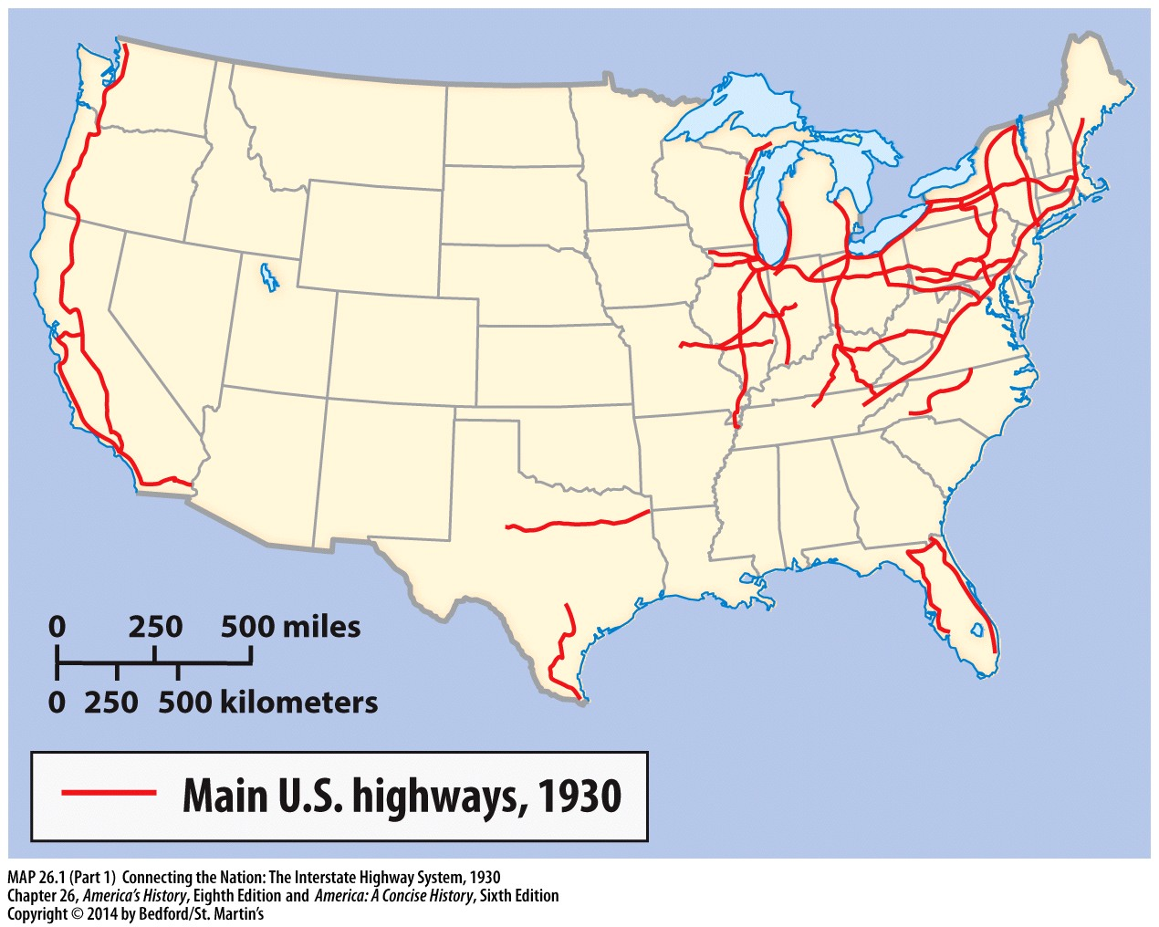

Slide 15
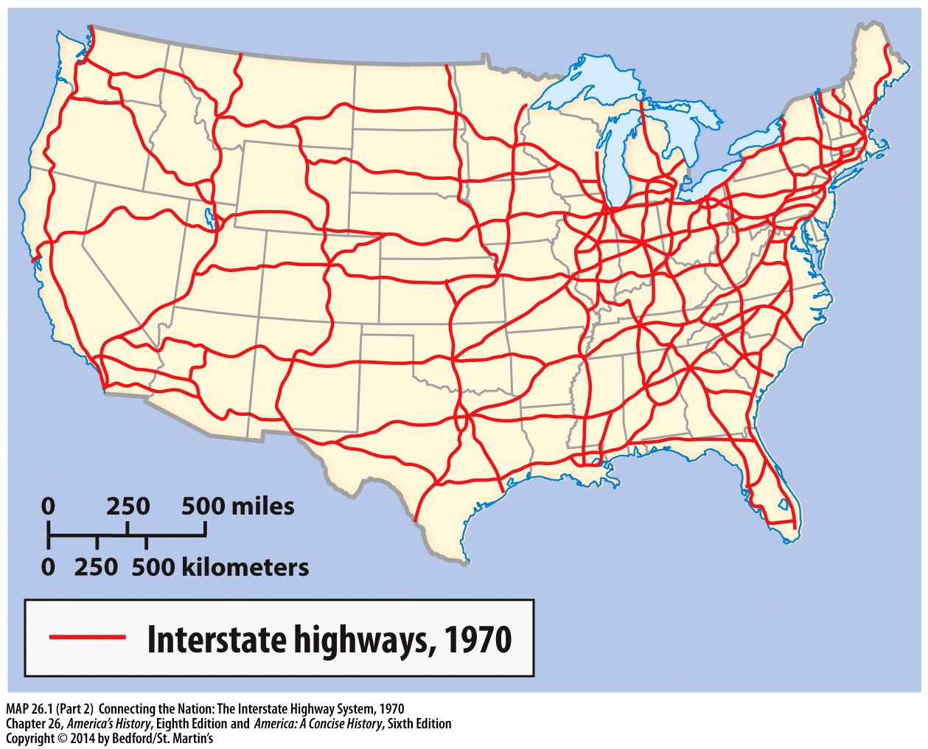

Slide 16
The 1950s: Popular Culture
Americans in the 1950s enjoyed new forms of entertainment:
  Television boomed as Americans watched comedies, news reports, westerns, & variety shows
  TV ownership jumped from 9% in 1950 to 90% by 1960 (45 million)
  Businesses took advantage of TV to advertise goods to buyers

Slide 17
The 1950s: Popular Culture
Music changed in the 1950s:
  “Doo-wop” music dominated the early 1950s, but, was challenged in popularity by rock n’ roll
  Rock ‘n’ roll music was inspired by black artists, but Elvis Presley made it popular among the youth
  Rock scared parents who thought the fast beats were immoral

Slide 18


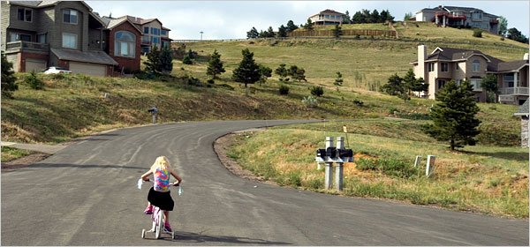
AN AFFLUENT SOCIETY: Economic Prosperity
Reasons for Prosperity:
Pent-up [stored] savings
Lack of foreign competition
Government spending
  military (Korean War, Cold War)
  G.I. Bill
Expansion of suburbs – grew 47% during decade
  stimulated demand for cars and homes

Slide 19
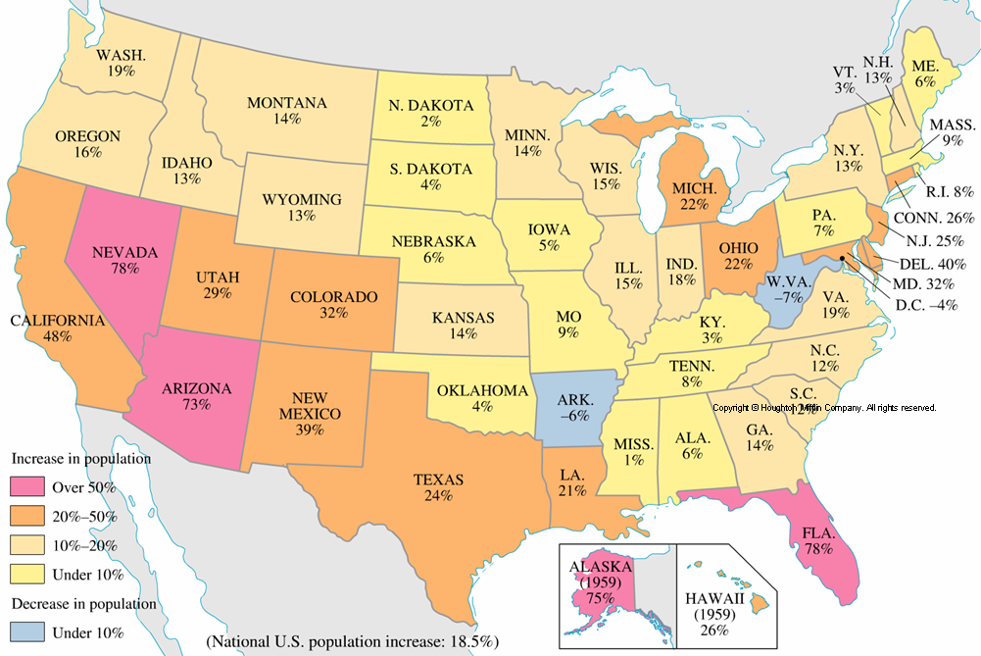
AN AFFLUENT SOCIETY: Economic Prosperity
Regional Growth: The Sunbelt
  Warmer climate, lower taxes, lower labor costs
  Military spending
Population Change, 1950-1960
Notes:
Kennedy, American Pageant 13e [History Companion CD]

Slide 20
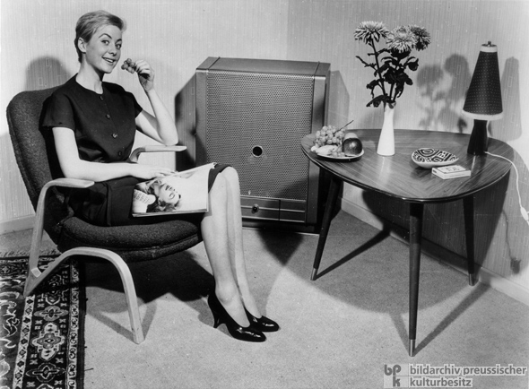

Fifties
The American Dream
Corporate America
  White-collar jobs
  Business dress codes
Consumerism
  Credit cards
  Shopping malls and strip malls
Advertising/Brand Names/Franchising
  Ford
  Cheerios
  Chef Boyardee
  Carnation Milk

Slide 21
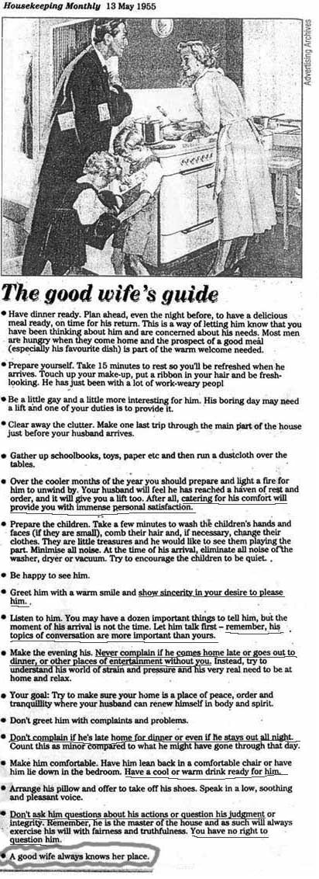
Fifties
Women
Suburban and middle-class growth and mainstream media culture reinforced cult of domesticity
  “Know your role”
Increased employment opportunities
  40% of women held jobs

Slide 22
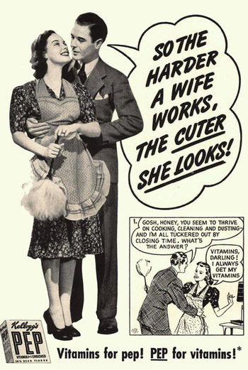
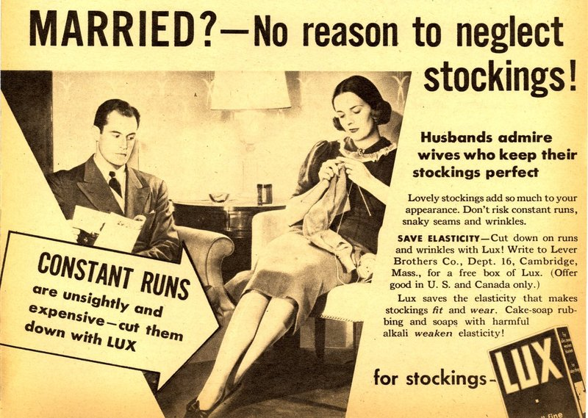
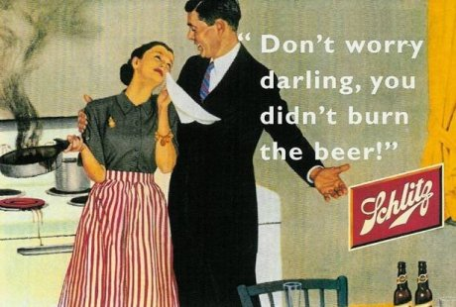
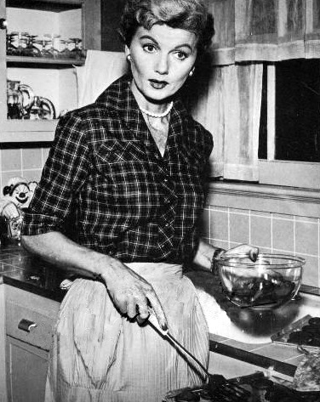
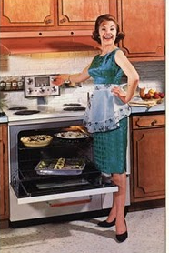
The 1950s: Conformity
TV, movies, & advertising in the 1950s promoted conformity & stereotypes
The “ideal woman” was a housewife & mother
Notes:
Ideal man? Ideal woman? Family expectations? Social expectations? Keeping up with the Joneses? White America?

Slide 23
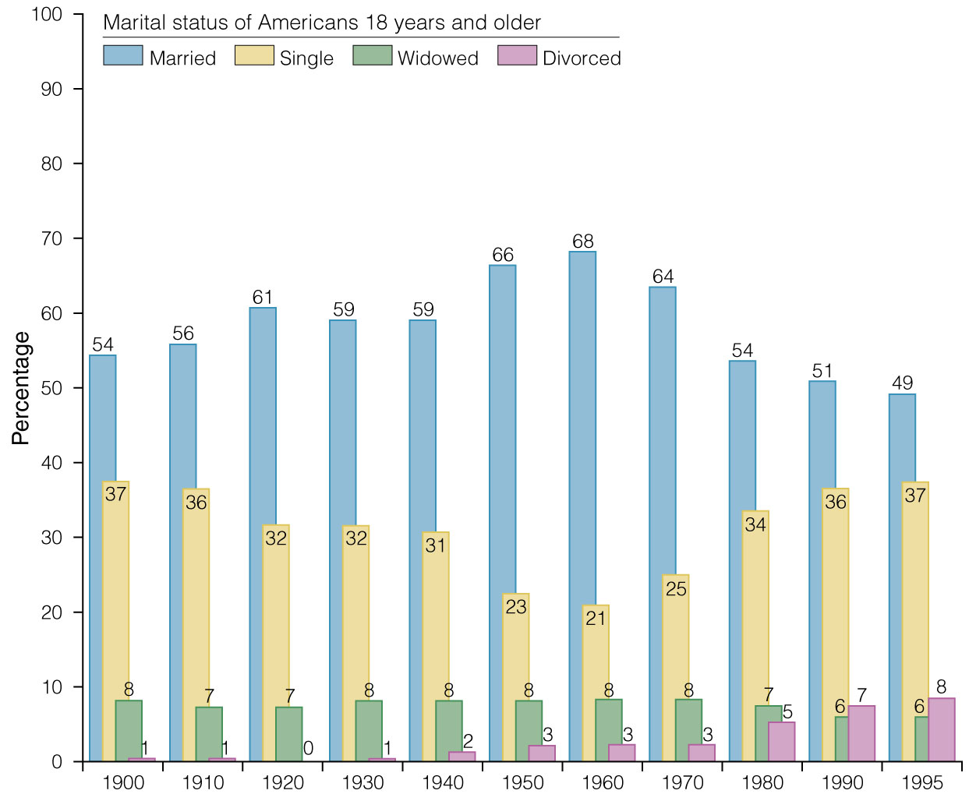
CONSENSUS AND CONFORMITY: Gender Roles & Women
Traditional gender roles reaffirmed
  baby boom
  home in suburbs
  mass media
  Dr. Benjamin Spock’s best-selling book Baby and Child Care (1946)
Notes:
J. Jones, P. Wood, et al, CREATED EQUAL: A Social and Political History of the US, http://wps.ablongman.com/long_jones_ce_1/0,7283,494555-,00.html

Slide 24
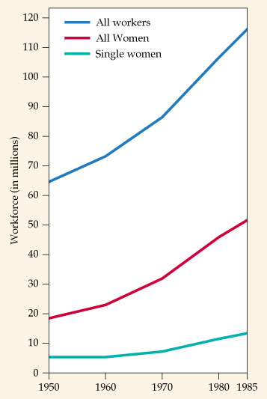
CONSENSUS AND CONFORMITY: Gender Roles & Women
At end of WWII, many women left the “man’s” work force
  “pink collar” jobs [clerical, wait staff, hostess, cashiers]
  Paid less - seen primarily as wives and mothers
Yet by end of decade 33% of women held jobs
  More married women joined workforce, especially as they reached middle age

Slide 25

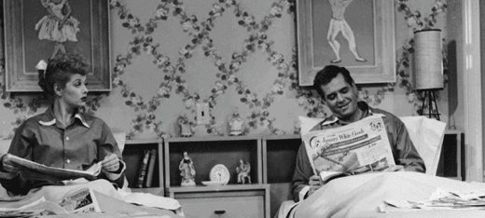
Fifties
Conformist and Conservative Society
Causes
  New Deal politics, Cold War/Communism, Materialism, Baby Boom, Suburbia
Social Mores
  Traditional gender roles
  Respect for authority
  Against perversion, drugs
Church Membership
  49% in 1950
  69% in 1960
Impact on Politics
  “under God” added to the Pledge of Allegiance (1954)
  “In God We Trust” as national motto and on paper currency (1956)
Billy Graham
  Evangelism to be pure, not improved

Slide 26
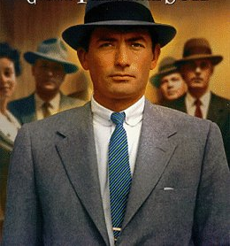
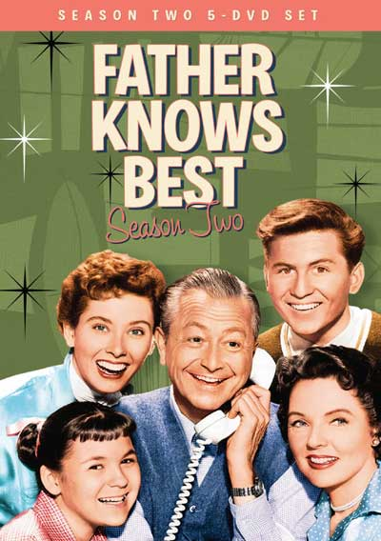
The 1950s: Conformity
TV, movies, & advertising in the 1950s promoted conformity & stereotypes
The “ideal man” was provider & boss of the house
Notes:
Ideal man? Ideal woman? Family expectations? Social expectations? Keeping up with the Joneses? White America?

Slide 27
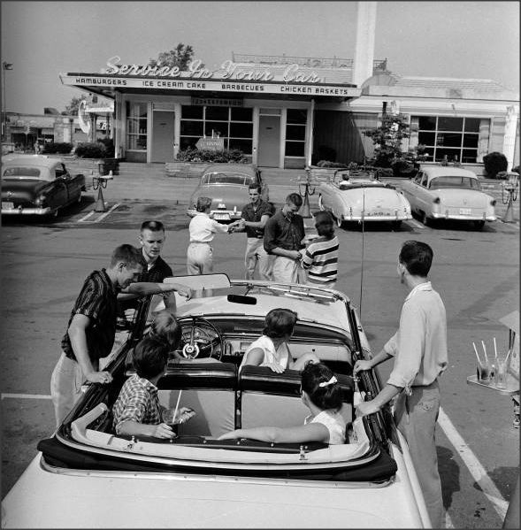
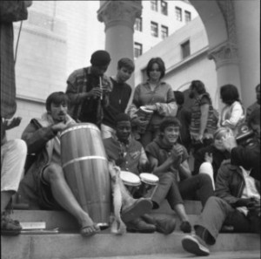
Fifties
Teenagers and Rebellion
Teenagers
  “Quiet Generation”
  Attracted to lifestyle of rock and roll, television, and movie stars
  Rise in juvenile delinquency
Beat Generation/Beatniks
  Rejection of contemporary conformist and materialist lifestyle
  Spiritual liberation
  Free lifestyle and experimentation

Slide 28
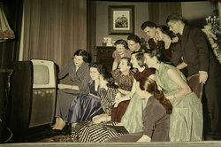
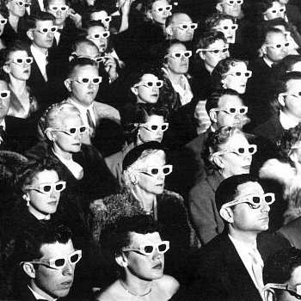
Fifties
Television and Movies
Television
  Ownership
    9% in 1950
    65% in 1955
    87% in 1960
  Impact
    Corporate sponsorships
    Sitcoms of the American middle class family
    Ozzie and Harriet
    Leave it to Beaver
    Father Knows Best
Movies
  Epic, science fiction, and Cold War themes
  The Day the Earth Stood Still
  Rebel Without a Cause

Slide 29


Fifties
Literature
Post-Modernism
  Post-WWII reactionary movement
  The Catcher in the Rye by J.D. Salinger
  The Death of a Salesman and The Crucible by Arthur Miller
  To Kill a Mockingbird by Harper Lee
Beat Generation
  Rejection of materialism, sexual liberation, drug experimentation, Eastern religions and philosophies
  On the Road by Jack Kerouac

Slide 30
OTHER “AMERICAS”: SOCIAL CRITICS
William H. Whyte, Jr., The Organization Man (1956)
  conformity
David Riesman, The Lonely Crowd (1958)
  “inner-directed” individuals → “other-directed” conformists.
John Kenneth Galbraith, The Affluent Society (1958)
  failure to address significant social issues and common good (would influence JFK and LBJ)
Michael Harrington, The Other America
  rural poverty, inner cities

Slide 31
Other Americas
“The entire invisible land of the other Americans became a ghetto, a modern poor farm for the rejects of society and the economy.”
--Michael Harrington

Slide 32
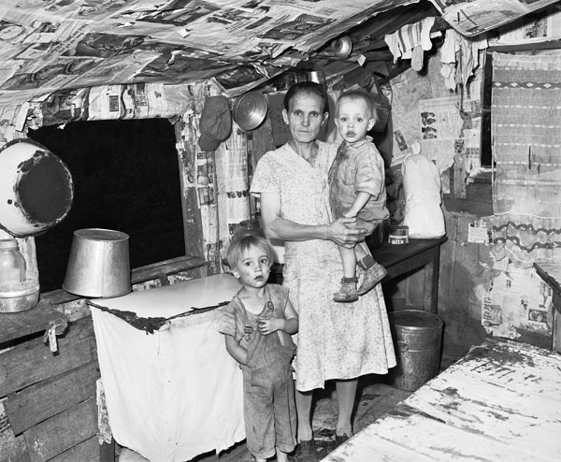
Bell County, Kentucky, August 31, 1946
Notes:
"Mrs. John Whitehead, wife of miner, and two of her children (or grandchildren) in the kitchen of her three room house. Mr. and Mrs. John Whitehead and their six children and six grandchildren live here. This house, built on company owned land, was built by Mrs. Whitehead's half brother at no expense for materials or labor to the company; the builder (half brother) was to receive the use of the house rent-free for three years and at the end of this period the ownership of the house would revert to the company. The brother moved away at the end of one year, receiving no cash settlement from the company. The house now rents for $6 monthly. It has no running water, no electricity, access is over a mountain trail; there are three rooms."
By Russell Lee, Field, Bell County, Kentucky, August 31, 1946

Slide 33
The 1950s: Social Groups
African American civil rights leaders began to challenge segregation laws
  In 1947, Jackie Robinson integrated professional baseball
  In 1954, in Brown v Board of Education, the Supreme Court integrated public schools
  In 1955, Martin Luther King, Jr. emerged as the leader of the civil rights movement

Slide 34
