Slide 1
Do Now-Discuss
How did the chaotic conditions of urban America in the Gilded Age contribute to ‘progressive’ reforms in the early 20th century?

Slide 2
Progressive Era Politics, Presidents and Policies
Mr. Winchell
Period 7
Day 2

Slide 3
Big Idea
The unrestrained capitalism and laissez-faire attitude of politicians during the Gilded Age resulted in a variety of problems and exposed a need for reform. The Progressives, led by investigative journalists and urban reformers, attempted to clean up America’s problems. While neither a unified nor wholly successful movement, progressives gained success in protecting the urban poor, improving urban infrastructure, restraining monopolies, regulating commerce, monitoring political corruption, expanding democratic opportunities, reforming the American tax and monetary system, conserving the environment.

Slide 4
What is Progressivism?
From 1890s to 1920, progressives addressed the rapid economic & social changes of the Gilded Age
Progressive reform had wide appeal but was not a unified movement with a common agenda
Progressive reforms included prostitution, poverty, child labor, factory safety, women’s rights, temperance, & political corruption
Democrats, Republicans, & Socialists all found reasons to support progressivism
Progressive reform began in the late Gilded Age, especially during the Panic of 1893 which exposed serious flaws in the American political, economic, & social fabric
Some histories mark the end of Progressivism in 1917 when the USA entered WWI; others mark the end at 1920 with the 19th amendment
Some reformers targeted local community problems, others aimed for state changes, & others wanted national reforms

Slide 5
What is Progressivism?
Optimism & belief in progress (“investigate, educate, & legislate”)
Social Gospel taught Christians that it was their duty to end poverty & inequality
But, Progressive reform had distinguishing characteristics:
Progressive Themes
Looked to the government to help achieve goals
Desire to “humanize” industry & urbanization
Their actions impacted the entire nation; not regions like the Populists
Led by educated middle-class “experts” who developed “rational” solutions
Change the environment in order to change people (no Social Darwinism)

Slide 6
Progressives Were a Diverse Group
Different reform movements (not united)
Moral and Social | Political | Economic
Women’s Rights Temperance Immigrant/Poor Conditions | Curtail Power of Big Business End Corruption Increase Direct Democracy | Labor Recognition Stabilize the Banking and Economy

Slide 7
Reforming America’s Cities
Progressive reform 1st began in cities in the 1890s to address factory, tenement, labor problems:
Early reformers realized that private charity was not enough to cure all social ills
The Social Gospel movement was a new religious philosophy that focused on improving society & saving individual souls

Slide 8
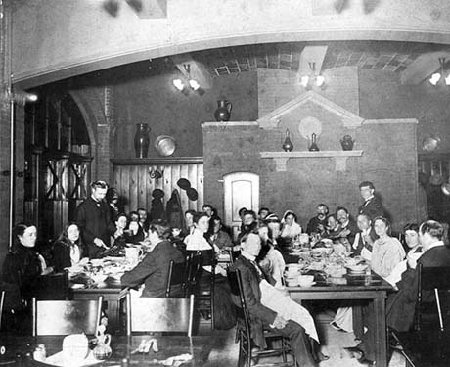
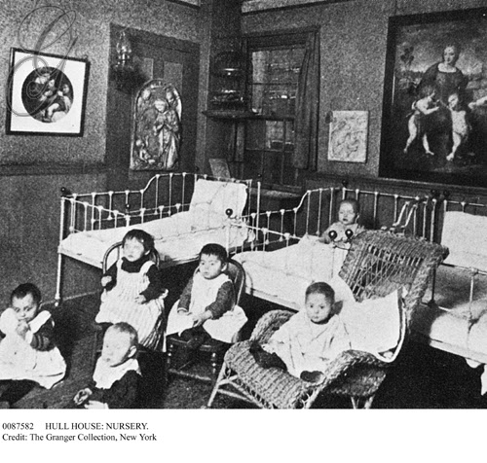
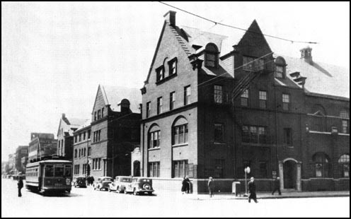
Hull House in Chicago

Slide 9
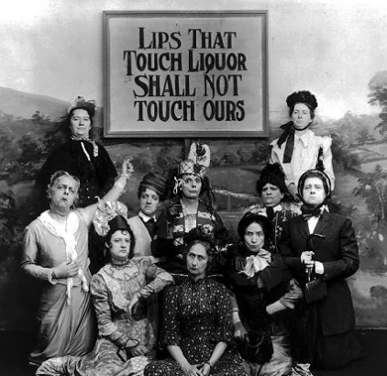
The Female Dominion
Membership grew in the WCTU
Women’s groups, like the WCTU, helped gain key reforms:
Prohibition—Shocking reports of alcohol abuse led 19 states to outlaw booze & the passage of the 18th Amendment (1920)
Prostitution—By 1915, almost all states banned brothels & the Mann Act banned the interstate transport of “immoral” women

Slide 10
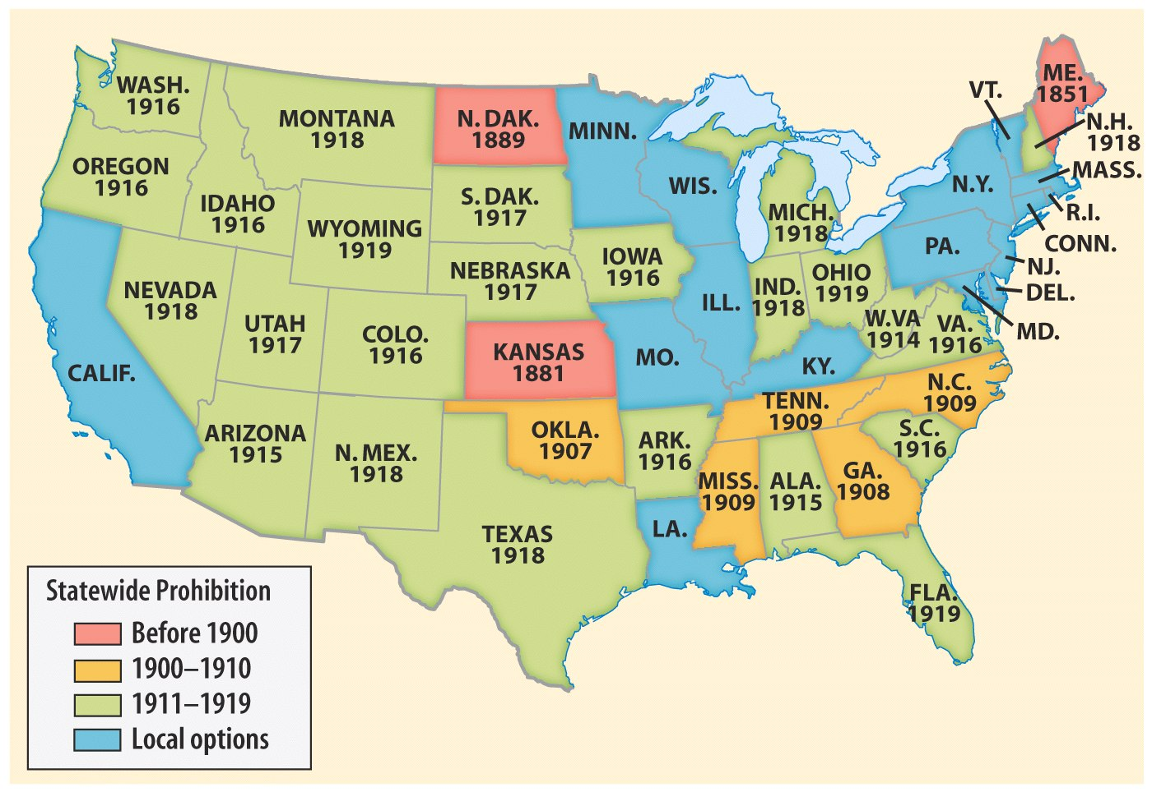
Prohibition of alcohol in the states prior to 1920

Slide 11
Muckraking Journalism
New “muckraking” journalism drew attention to social problems, such as urban poverty, corruption, & big business practices:
Popular monthly magazines, like McClure’s & Collier’s, used investigative journalism & photos
Jacob Riis’ How the Other Half Lives (1890) was the 1st exposé of urban poverty & slums

Slide 12
Muckraking Journalism
Other groundbreaking exposés:
Henry George’s Progress & Poverty (1879) showed the growing gap between rich & poor
Lincoln Steffen’s Shame of the Cities (1902) exposed corrupt political machine bosses
Ida Tarbell’s History of Standard Oil (1904) revealed Rockefeller’s ruthless business practices

Slide 13
Muckraking Journalism
Upton Sinclair’s The Jungle (1906) led to federal investigation of the meatpacking industry, gov’t inspections, & improved sanitation
Sam H. Adams exposed the dangers of patent medicines which led to the Pure Food & Drug Act requiring listing of ingredients & banned “adulterated” drugs
“I aimed at the public’s heart & by accident I hit it in the stomach”
Notes:
Samuel Hopkins Adams

Slide 14
Standardizing Education
Psychologist William James promoted the idea that one’s environment dictates behavior
School leaders applied these ideas to reform public education:
Schools became a primary vehicle to assimilate immigrants
John Dewey promoted “creative intelligence,” not memorization or strict teaching

Slide 15
Progressive Era Presidents
Roosevelt
Taft
Wilson

Slide 16
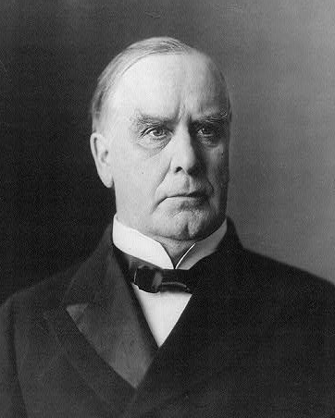
Theodore Roosevelt/Assumes Presidency After the McKinley Assassination 1901
Used Presidency as “Bully Pulpit” a means to bring attention and demand corruption
Supported the growth of industry but believed there were GOOD trusts and BAD trusts
Nicknamed the “Trustbuster” in 1902 he ordered his Attorney General to bring a lawsuit against the Northern Securities Company (J.P. Morgan)
1904 US v. Northern Securities went to the Supreme Court which ordered the trust to be broken up (it was in violation of the Sherman Anti Trust Act
Roosevelt later broke up Standard Oil and American Tobacco Company

Slide 17
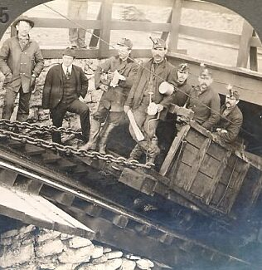
The Anthracite Coal Strike, 1902
In 1902, the United Mine Workers went on strike to demand higher pay & an eight-hour work day
The anthracite coal strike lasted 11 months & threatened the nation as winter approached

Slide 18
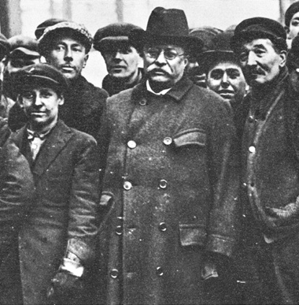
Teddy Roosevelt’s “Square Deal”
In an unprecedented move for a Gilded Age president, TR did not immediately side with the owners
TR forced both sides to arbitrate & threatened gov’t seizure of the coal mine
The result was a “square deal” for both sides
TR’s “Square Deal” is the inspiration for future presidents: FDR’s New Deal, Wilson’s New Freedom & Truman’s Fair Deal
Notes:
The result was a “square deal” for labor (higher wages) & owners (no formal recognition of the union)

Slide 19
3 C’S OF SQUARE DEAL
Control Corporations
Attacked ‘irresponsible’ trusts
Consumer Protection
Unchecked business created dangers for consumers
FDA, Meat Inspection…
Conservation of Natural Resources
Expanded national parks and forests

Slide 20
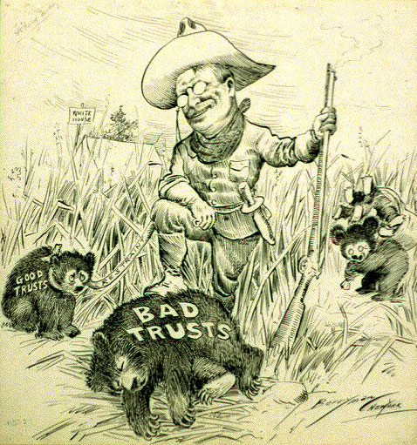
TR accepted monopolies as a fact of life for 20th century business but viewed regulation as the best way to tame trusts who use corrupt business practices

Slide 22
TR the Trustbuster?
TR was not always consistent:
Initiated suits against beef trust, American Tobacco, DuPont, Standard Oil, & New Haven RR
But he relied on business to gain re-election in 1904; sought the advice of JP Morgan; allowed some monopolistic mergers
The Roosevelt administration only “busted” 25 trusts in 7 years
Taft busted 43 monopolies in 4 years

Slide 23
Other Roosevelt Accomplishments
Elkins Act (1903) Ended Rebates
Hepburn Act (1906) Gave the ICC greater power including the authority to set railroad rates
Meat Inspection Act (Passed After TR read the Jungle) Forced Meat packing Plants to open their doors to government inspectors
Pure Food and Drug Act required food and drug companies to list all ingredients on their package and monitored untrue claims
First CONSERVATIONIST President
Created 5 Natural Wilderness areas and Convinced Congress to ban lumbering in 150 million acres of Govt. land

Slide 24
Teddy’s Foreign Policy
Big Stick Diplomacy
“Speak softly and carry a big stick.” (A strong Navy and military)
The goal was to make nations think twice about fighting, thus promoting global peace.
Roosevelt Actions:
Supported a stronger military
Built the Panama Canal
Issued the Roosevelt Corollary to the Monroe Doctrine

Slide 25
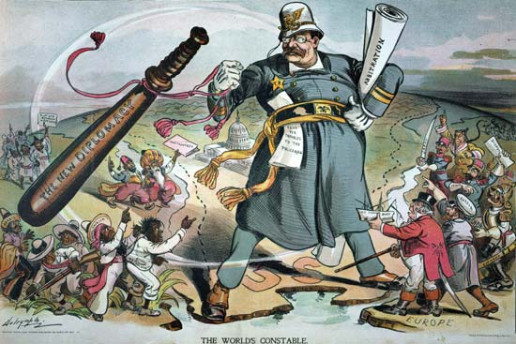

Slide 26
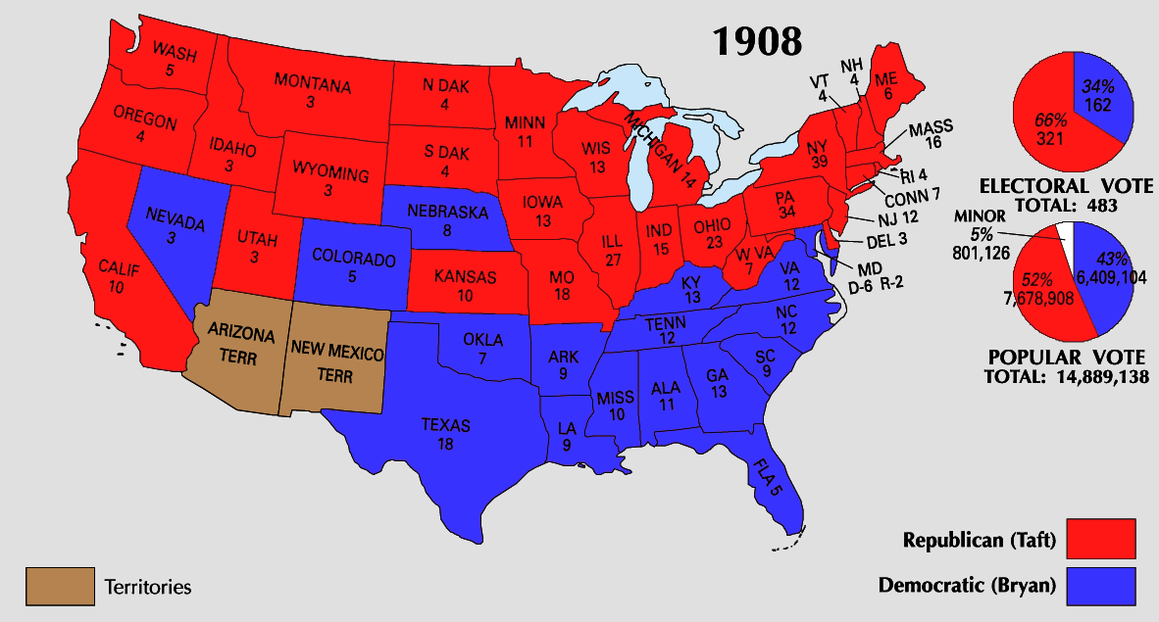
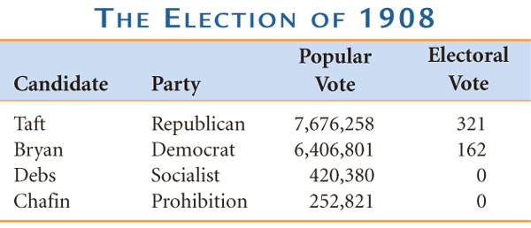
The Taft Presidency
TR remained true to his promise not to run for a 3rd term & helped pick William Howard Taft as the Republican nominee for president
Taft seemed ready to carry out TR’s political agenda
“I feel a bit like a fish out of water…I hate the limelight.”

Slide 27
The Taft Presidency
Taft backed the Payne-Aldrich Tariff (1909) which angered progressive Republicans who wanted more foreign competition to force monopolies to reduce their prices
But, Taft was poorly equipped to continue Roosevelt’s agenda:
Taft did not trust the gov’t to regulate business behavior
He didn’t have the flair of TR; Taft was “too honest & sincere”
Taft tended to side with conservative Republicans rather than progressive Republicans
Taft fired Pinchot, TR’s chief conservationist after the Ballinger-Pinchot Affair
These issues divided the Republican Party into progressive & “Old Guard” factions opening the door for a Democrat in the 1912 presidential election
Notes:
In 1909, Sec of Interior Ballinger offered for sale 1 million acres of land Pinchot refused to sell; After investigation, Taft backed Ballinger; Pinchot covertly leaked ties to JP Morgan & issue became a scandal; Taft fired Pinchot & muckrakers assailed Taft in newspapers
Progressive break with Taft began talk of a TR return to the White House

Slide 28
The Taft Presidency
All the work to create the 16th & 17th amendments was done under Taft, but neither was ratified while Taft was president
Despite these set backs, Taft helped push through significant progressive legislation:
16th Amendment was written; created a national income tax
17th Amendment was written; direct election of U.S. Senators
Safety codes for miners & RRs
Created the Children’s Bureau
Vindication for the Populists!!
Vindication for the Populists!!

Slide 29
Taft’s Foreign Policy
Dollar Diplomacy:
Improve financial opportunities for American businesses.
Use private capital to further U. S. interests overseas.
Therefore, the U.S. should create stability and order abroad that would best promote America’s commercial interests.

Slide 30
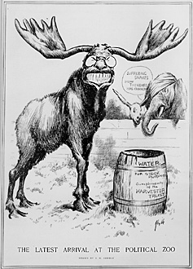
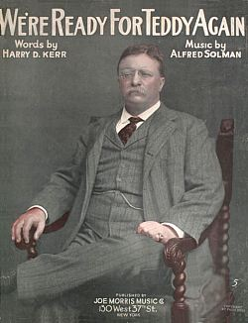
The Election of 1912
“I’m feeling like a Bull Moose!”
TR decided to run against Taft for the Republican nomination in 1912 but conservative Republicans refused to nominate him over Taft
TR was nominated to the new Progressive (Bull Moose) Party
Democrats nominated former Princeton president & NJ governor Woodrow Wilson who ran as a progressive reformer
This further divided the already fragmented Republican Party
Notes:
After being shot by anti-third term fanatic: “I have a message to deliver and I will deliver it as long as there is life in my body.”

Slide 31
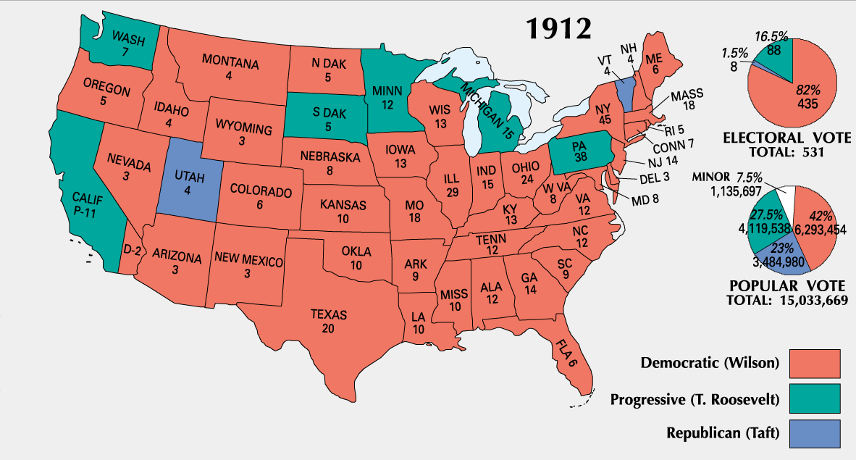

Slide 32
Woodrow Wilson/New Freedom
Lowers Tariffs
Wilson does not believe that any trusts were “good” trusts:
found it impossible to break them all up and so worked to control big corporations
Federal Trade Commission: Could investigate companies and order them to stop using unfair business practices
Clayton Anti Trust Act: Prohibited business practices that tried to destroy competition. It also protected Unions and Workers right to organize. (reinforced/clarified Sherman Anti-Trust Act)
Federal Reserve Act – regulated and centralized banking
Began Graduated Federal Income Tax

Slide 33
Woodrow Wilson's New Freedom
Wilson believed in strong, activist leadership & helped push through many “New Freedom” ideas:
Underwood Tariff Act (1913) reduced tariffs & created the 1st graduated income tax
Federal Reserve Act (1913): the Federal Reserve regulates the economy by adjusting the money supply & interest rates
1% tax for all, but 2% for the rich
The 1st efficient national banking system since Jackson destroyed the BUS in 1832
Notes:
(1913) was;

Slide 34
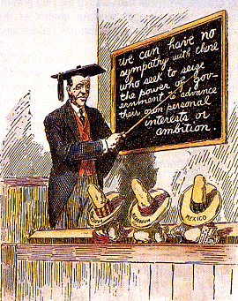
Wilson’s Foreign Policy
Moral Diplomacy:
The U. S. should be the conscience of the world.
Spread democracy.
Promote peace.
Condemn colonialism.

Slide 35
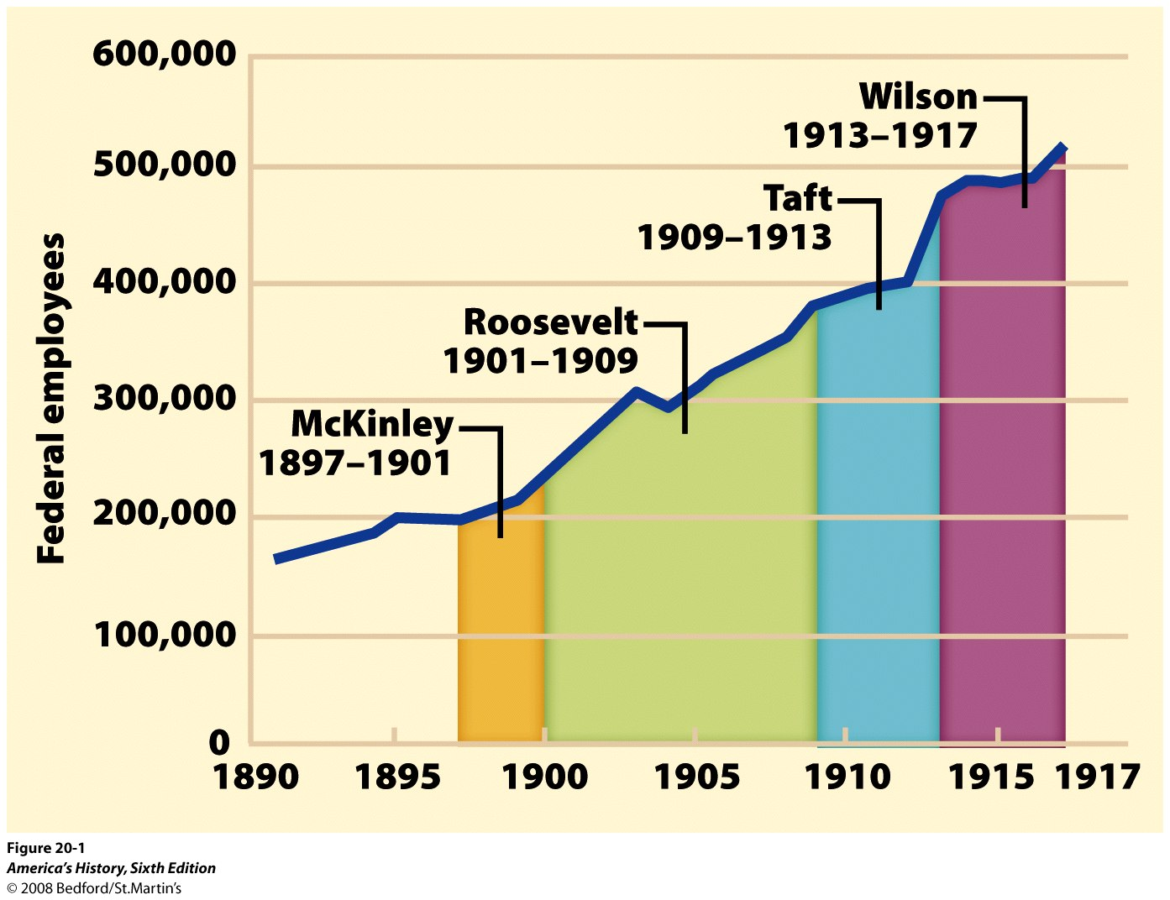
Look over the chart. How are these Presidents’ progressive reforms changing the federal government?

Slide 36
CONCLUSIONS:
How did the “PROGRESSIVE PRESIDENTS” influence Government?
Used the government as a means to reform & regulate big business/broke up unfair trusts
Government regulation/protection for consumers (pure food & drug act)
Regulated the money supply/attempted to add fairness to the tax system
Protected the environment/created the national parks system

Slide 37
Gov Steps in to Attack business: Laws Passed
Interstate Commerce Commission: Gov Agency to oversee = regulate on RR. (TR)
Elkins Act- regulate RR – no specials to friends (TR)
Hepburn Act- regulate RR- no free passes- Bribery (TR)
Meat Inspection Act-
Pure Food and Drug Act- Gov regulate food industry, and drugs- The Jungle- Upton Sinclair-
Clayton Anti-Trust Act- attacks Big Business (Wilson)
Federal Trade Commission-
Federal Reserve System- Organizes the Banking system, regulate the money supply
Federal Income Tax

Slide 38
Progressive Era What to know
Origins of Progressivism
Progressive attitudes and motives
Muckrakers
Social Gospel
Municipal, state, and national reforms
Political: suffrage
Social and economic: regulation
Socialism: alternatives
Black America
Washington, Du Bois, and Garvey
Urban migration
Civil rights organizations
Women's role: family, work, education, unionization, and suffrage
Roosevelt's Square Deal
Managing the trusts
Conservation
Taft
Pinchot-Ballinger controversy
Payne-Aldrich Tariff
Wilson's New Freedom
Tariffs
Banking reform
Antitrust Act of 1914

Slide 39
Progressive Constitutional Amendments
16th Amendment= Income Taxes
17th Amendment= Direct Election of Senators
18th Amendment= Prohibition of Alcohol
19th Amendment= Women’s Right to Vote

Slide 40
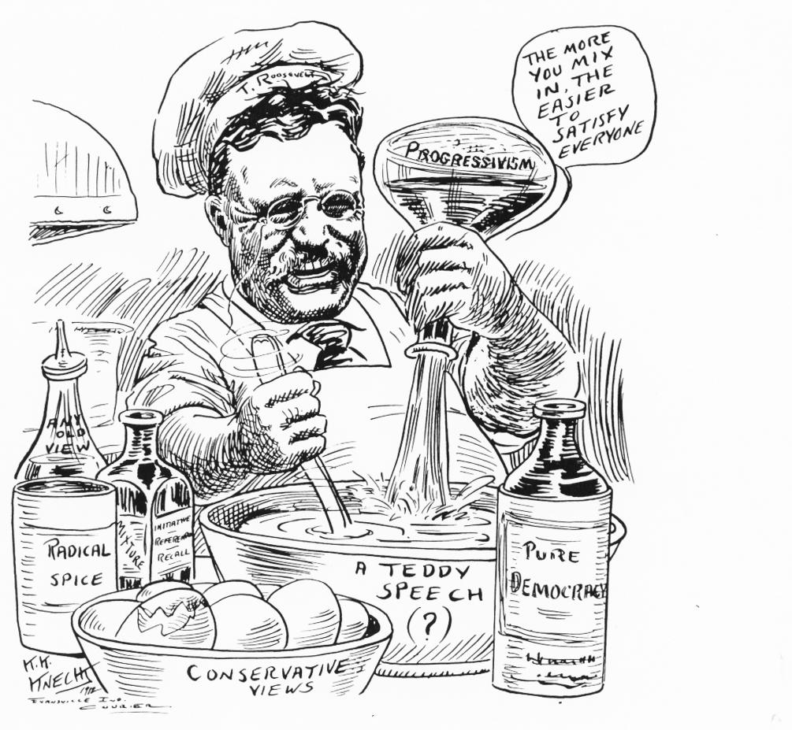
1005 × 927 - boundless.com

