Slide 1
“The United States will conquer Mexico, but it will be as the man swallows arsenic…Mexico will poison us.”
Ralph Waldo Emerson

Slide 2
The Compromise of 1850 and Kansas-Nebraska Act
Mr. Winchell
APUSH Period 5

Slide 3
Election of 1848
Zachary Taylor (W)
Slave owner
War hero
Lewis Cass (D)
Martin van Buren (FSP)

Slide 4
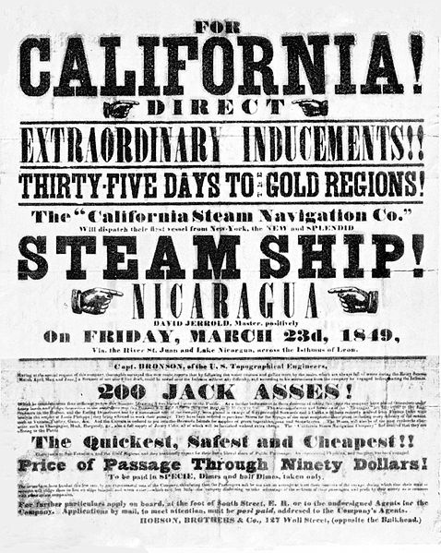
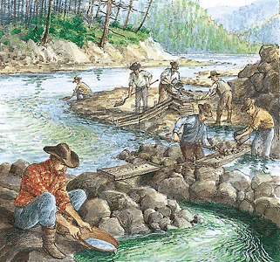
California Gold Rush
Sutter’s Mill
January 24, 1848
Massive migration to California
Forty-Niners
San Francisco
5,000 in 1848
25,000 in 1850

Slide 5
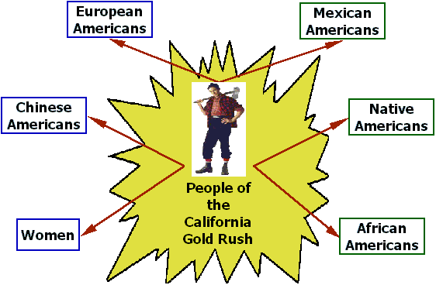
Sectionalism over Slavery Intensified
California’s population - increased exponentially due to the California Gold Rush (ironically, not a large amount of gold).
1849-1850 - apply for statehood as a free state.
The South - fearing the loss of power in the Senate, objected!
Northerners drafted petitions demanding the prohibition of slavery in the territories.
Southerners talked openly of secession!
Things are getting tense!

Slide 6
A Solution is Needed!
Sectional crisis – Senate tried to find compromise – it is a mess at this point!
Issues to Fix:
CA wants to be a state – most thought it would be slave due to most of the territory being under the 36-30 line, but people of CA and Pres. Taylor
Texas (slave state) is claiming NM lands for themselves.
Abolitionists want slavery out of DC.
South is mad at North for not enforcing the Fugitive Slave Act of 1793.
Henry Clay - presented a bill that contained:
Admission of California as a free state.
Forming territorial governments without restrictions on slavery.
Eliminate the slave trade in DC, but not slavery itself.
A more effective fugitive slave law.

Slide 7
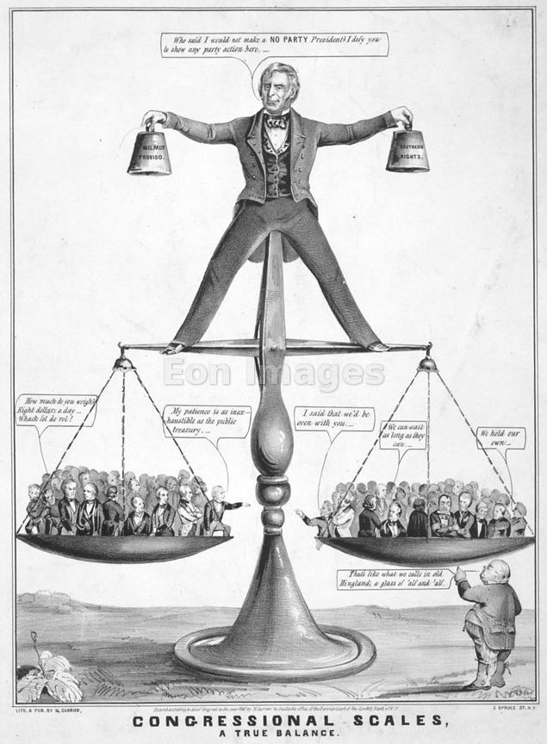
Solution: The Compromise of 1850
Debate raged for months (Congress/nationwide).
Congress - two phases (reveals the changing politics in the 1850’s).
Phase 1: dominated by older leaders (Henry Clay, John C Calhoun, and Daniel Webster).
Phase 2: dominated by younger leaders (William Seward, Jefferson Davis, and Stephen Douglas).
July 1850 - President Taylor died suddenly - Millard Fillmore became president.
Notes:
Resembled founders like Jefferson, Adams….they were searching for compromise based upon ideals and ultimate unification.
Union was less important to them than practicality, their personal objectives, and economic self interest.
Helped the Compromise of 1850 pass Congress.

Slide 8
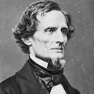
The Death of Compromising?
The Great Triumvirate was no more by 1852
A new generation of sectional and ambitious politicians assume leadership roles
William Seward (W, R)
Stephen Douglas (D)
Jefferson Davis (D)

Slide 9
Compromise of 1850
Parameters
Admit California as free state
Mexican Cession
Popular sovereignty
Reinforced Fugitive Slave Law
Texas boundary and debt disputes
Slave trade abolished in D.C.
“I trust we shall persist in our resistance [to the admission of California] until the restoration of all our rights, or disunion, one or the other is the consequence. We have borne the wrongs and insults of the North long enough.” - John C. Calhoun

Slide 10
Compromise of 1850

Slide 11
Fugitive Slave Law
Enforcement of capturing and returning escaped slaves
Slaves flee to Canada
Right to trial by jury denied
Special Commission
$10 for those finding for slaveholder
$5 for those finding for fugitive

Slide 12
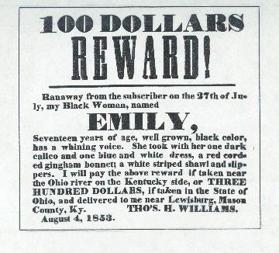
Fugitive Slave Act

Slide 13
Underground Railroad
Mostly run by free blacks and fugitive slaves
Harriet Tubman
Abolitionists and white supporters
Few white families in South assisted
Slave catchers knowledge

Slide 14
Uncle Tom’s Cabin (1852)
Harriet Beacher Stowe
“I would write something that would make this whole nation feel what an accursed thing slavery is.”
Bestselling novel
Adapted as a play
Fuels abolitionist guilt and rhetoric in Northern free states

Slide 15
Sectionalist Presidents Zachary Taylor (W) (1849-1850)
War hero of Mexican-American War
States’ rights, but no secession
Views on Slavery
Slave owner
No expansion of slavery
Refused to sign Compromise of 1850
Died after a year in office

Slide 16
Sectionalist Presidents Millard Fillmore (W) (1850-1853)
Assumes the presidency after Taylor’s death
Anti-slave moderate
Signs Compromise of 1850
Perry Expedition to Japan (1853-1854)

Slide 17
The Kansas-Nebraska Act
Stephen Douglas (Illinois senator) - wanted the railroad to go thru Chicago.
1854 - introduced a bill to organize a territory (Split a large chuck into two pieces – Kansas and Nebraska).
Nebraska territory - railroad could run through.
South would oppose the bill – so…included a provision to let the new territory decide for itself the status of slavery (popular sovereignty).
Ended the Missouri Compromise (Nebraska above the 36-30 split).
South was happy and the northern abolitionists were upset – slavery is now allowed to grow!
Violence and conflict to come!

Slide 18
“A living, creeping, lie.”
"If Kansas should sink to-day, and leave a great vacant space in the earth's surface, this vexed question [of slavery] would still be among us.“
A. Lincoln

Slide 19
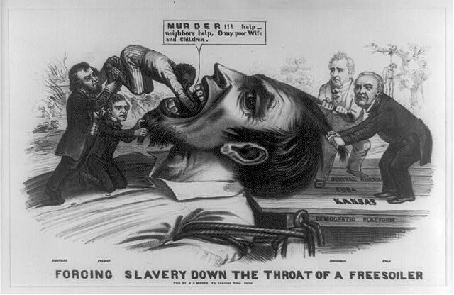

Slide 20
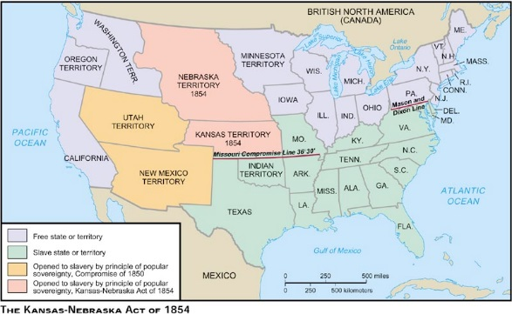

Slide 21
Kansas-Nebraska Act (1854)
Stephen Douglas and Chicago
Parameters
Separate Nebraska Territory into Nebraska and Kansas
Each territory voted for slavery based on popular sovereignty
Impact
Douglas won his railroad and Southern support
Virtually repealed the Missouri Compromise
Ended the Whig Party and Second Party System

