Slide 1
Do Now
What social, economic, and political problems existed at the beginning of 20th century America?

Slide 2
2. The Era of Roosevelt-The Progressives and the Republican Split
Mr. Winchell
APUSH 2018-2019
Period 7

Slide 3
AP Prompt
Evaluate the extent to which Progressive efforts impacted the role of government by 1920.

Slide 4
Outline
Grassroots Progressivism
Teddy’s Presidency and Approach
Taft’s Presidency and Approach
The Election of 1912 and the Rep. Split
Wilson’s Presidency and Approach
The Legacy of the Progressives

Slide 5
What is Progressivism?
From 1890s to 1920, progressives addressed the rapid economic & social changes of the Gilded Age
Progressive reform had wide appeal but was not a unified movement with a common agenda
Progressive reforms included prostitution, poverty, child labor, factory safety, women’s rights, temperance, & political corruption
Democrats, Republicans, & Socialists all found reasons to support progressivism
Progressive reform began in the late Gilded Age, especially during the Panic of 1893 which exposed serious flaws in the American political, economic, & social fabric
Some histories mark the end of Progressivism in 1917 when the USA entered WWI; others mark the end at 1920 with the 19th amendment
Some reformers targeted local community problems, others aimed for state changes, & others wanted national reforms

Slide 6
Optimism & belief in progress (“investigate, educate, & legislate”)
Social Gospel taught Christians that it was their duty to end poverty & inequality
PROGRESSIVE THEMES
Looked to the government to help achieve goals
Desire to “humanize” industry & urbanization
Their actions impacted the entire nation; not regions like the Populists
Led by educated middle-class “experts” who developed “rational” solutions
Change the environment in order to change people (no Social Darwinism)

Slide 7
Progressive Reform
Social Problems
Social Solutions
Urban Poverty
Unsafe Housing
Alcohol Abuse
Child Labor
Unsafe Work Conditions
Settlement Houses/Social Gospel
Exposure (How the Other Half Lives)
Prohibition
Child Labor Laws
Ten Hour Work Days

Slide 8
Progressive Reform
Economic Problems
Economic Solutions
Monopolies
Income Inequality
  HUGE gap between rich/poor
More riches=More political power
Government control
Pro-Labor Union legislation
  Sherman Anti-Trust Act
  Clayton Anti-Trust Act

Slide 9
Progressive Reform
Political Problems
Political Solution
Political Machines
Corrupt Legislatures
Democracy not ‘democratic’ enough
Goal: Put government back in the hands of the people!
Referendum - Process that allows citizens to approve or reject a law passed by their legislature
Initiative – citizens use a petition to force the legislature to consider a law
Recall - A way for voters to remove public officials from office before the next election
Direct election of Senators (17th Amend) – the people elect Senators, instead of the legislature choosing Senators
Secret ballot – Nobody has to know your vote!
Women’s Suffrage (19th Amendment) Women Can Vote!

Slide 10
Muckraking Journalism
New “muckraking” journalism drew attention to social problems, such as urban poverty, corruption, & big business practices:
  Popular monthly magazines, like McClure’s & Collier’s, used investigative journalism & photos
  Jacob Riis’ How the Other Half Lives (1890) was the 1st exposé of urban poverty & slums

Slide 11
Muckraking Journalism
Other groundbreaking exposés:
  Henry George’s Progress & Poverty (1879) showed the growing gap between rich & poor
  Lincoln Steffen’s Shame of the Cities (1902) exposed corrupt political machine bosses
  Ida Tarbell’s History of Standard Oil (1904) revealed Rockefeller’s ruthless business practices

Slide 12
The Jungle-Upton Sinclair
It was only when the whole ham was spoiled that it came into the department of Elzbieta. There was never the least attention paid to what was cut up for sausage; there would come all the way back from Europe old sausage that had been rejected, and that was moldy and white - it would be dosed with borax and glycerine, and dumped into the hoppers, and made over again for home consumption. There would be meat that had tumbled out on the floor, in the dirt and sawdust, where the workers had tramped and spit uncounted billions of consumption germs. There would be meat stored in great piles in rooms; and the water from leaky roofs would drip over it, and thousands of rats would race about on it. It was too dark in these storage places to see well, but a man could run his hand over these piles of meat and sweep off handfuls of the dried dung of rats. These rats were nuisances, and the packers would put poisoned bread out for them; they would die, and then rats, bread, and meat would go into the hoppers together. This is no fairy story and no joke; the meat would be shoveled into carts, and the man who did the shoveling would not trouble to lift out a rat even when he saw one - there were things that went into the sausage in comparison with which a poisoned rat was a tidbit.

Slide 13
Muckraking Journalism
Upton Sinclair’s The Jungle (1906) led to federal investigation of the meatpacking industry, gov’t inspections, & improved sanitation
  Meat Inspection Act (1906)
Sam H. Adams exposed the dangers of patent medicines which led to the Pure Food & Drug Act requiring listing of ingredients & banned “adulterated” drugs
“I aimed at the public’s heart & by accident I hit it in the stomach”
Notes:
Samuel Hopkins Adams

Slide 14
Varieties of Reform
African American Civil Rights
  Anti-lynching: Ida B. Wells, journalism, political pressure
  W.E.B. DuBois: talented tenth will lead way, prove equality
  NAACP founded in 1909 – political equality
  Booker T. Washington: start with lower-skilled trades and jobs to earn a living, gain respect, before fighting for political rights or equality

Slide 15
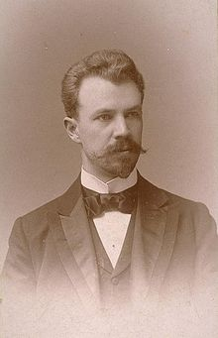
Progressive Political Reform
Local/Municipalities
Assert more control and regulation of public utilities and services
  Built public parks and playgrounds, sanitation services, municipal services, public schools
  Zoning laws (industrial, commercial, residential)
Local Governments
  Galveston Plan
    Commissioners and councils directly elected
  Dayton Plan
    City managers hired as non-partisan administrators
Lincoln Steffens
The Shame of the Cities
Inspired social and municipal reform

Slide 16
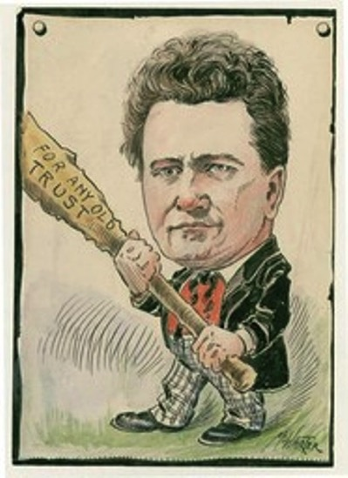
Progressive Political Reform
States
“Wisconsin Idea”
  Robert LaFollette
  Influence and Application of Education on Politics
    Direct primaries
    Progressive taxes
    Workers’ compensation and minimum wages
    Insurance plans
    Business regulations
    Child labor laws
    Limit or eliminate monopolies and trusts
    Supported direct election of senators

Slide 17
McKinley Arrives
William McKinley won 1896 election
  Versus William Jennings Bryan (D-NE)
  Main election issue - Silver vs. Gold
Highlights of 1st term
  Dingley Tariff Act (1897) - avg. 57%
  Gold Standard Act (1900)
  Increase in American Imperialism

Slide 18
McKinley Departs
Imperialism the major campaign issue of 1900
  Dems - Bryan & Adlai Stevenson
  Reps - McKinley and T. Roosevelt
Renewed prosperity at home - prestige abroad brought easy victory for McKinley
Sept. 6, 1901 - McKinley assassinated by crazed anarchist

Slide 19
Look out! Here comes Teddy!
Theodore Roosevelt (R-NY)
  Elected Gov. of New York (1898)
  Reform minded – angers Rep. leaders
  TR “kicked upstairs” - party leaders got him nominated for Vice Prez.
    “Powerless” position – safe to have him there
  Oops! McKinley dies - the job is TR’s!
Notes:
Career civil servant & part-time soldier
Capitalizes on fame from Spanish American War - elected Gov. of NY in 1898
TR was a reform-minded man in a party that did not care for strident reformers.
His progressive stands quickly got him in trouble with the Republican party leadership.
The Republican power brokers decided to move TR out of an office where he could do a lot of damage (Gov. of NY) and ran him for the supposedly powerless job of Vice President on the McKinley ticket of 1900.
The idea was a good one until McKinley was assassinated in 1901. TR succeeded to the Presidency to the horror of the party elite.
Roosevelt a high energy man – very active
Rancher, outdoorsman, historian, politician – popular!

Slide 20
Roosevelt’s Message to Congress-1901
Text Analysis Questions

Slide 21
TR’s Goals
Greater control of corporations by fed. govt.
Increased power for ICC
Conservation of natural resources
Extension of merit system in civil service
Strong foreign policy

Slide 22
TR’s “Square Deal”
TR’s “Square Deal” is the inspiration for future presidents: FDR’s New Deal, Wilson’s New Freedom & Truman’s Fair Deal
Said his admin. would afford all groups (biz, labor, farmers, consumers, etc.) a “square deal”
Believed govt. should assure:
  honesty & fairness in govt. & biz
  more econ. opportunity for individuals
Opposed radicals from left and right
  Represented middle-class moderate progressive reformers

Slide 23
3 C’S OF SQUARE DEAL
Control Corporations
  Attacked ‘irresponsible’ trusts
Consumer Protection
  Unchecked business created dangers for consumers
    FDA, Meat Inspection…
Conservation of Natural Resources
  Expanded national parks and forests

Slide 24
Govt. Regulation of Big Biz
Believed in regulating “bad” trusts
  Benefiting public welfare = “good”
Remembered as a “trust buster”
  Filed over 40 anti-trust suits
  Northern Securities v. U.S. (1902)
Notes:
Roosevelt believed that there were good and bad trusts. A trust that did not harm the public welfare was permissible.
Though Taft will bring about more prosecutions of trusts, TR gains the title of “trust buster” for filing over 40 antitrust suits.
One highly publicized case was Northern Securities v. United States in 1902.
TR ordered the Justice Dept. to use the Sherman Antitrust Act against a railroad holding company known as the Northern Securities Company.
In 1904, the Supreme Court ruled 5-4 that Northern Securities should be dissolved.

Slide 25
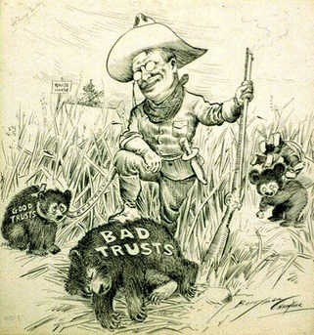

Slide 26
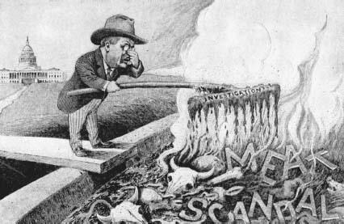

Slide 27
1902 Coal Miner’s Strike
TR stepped in to settle a strike by the United Mine Workers in PA
TR found mine owners to be unyielding and difficult
TR threatened to take over the mines - convinced owners to come to the table
Workers given raise & shorter hours but were denied recognition of the union
  TR viewed as a friend of labor

Slide 28
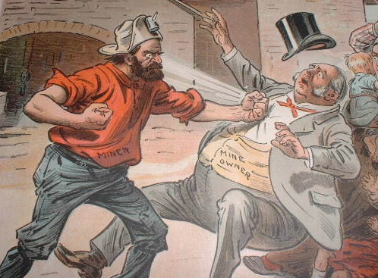
Anthracite Coal Strike of 1902

Slide 29
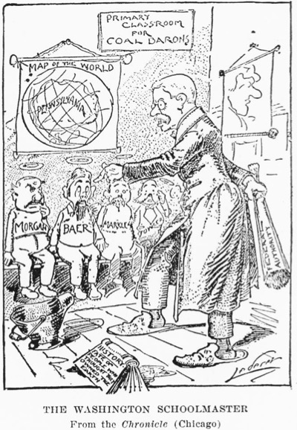
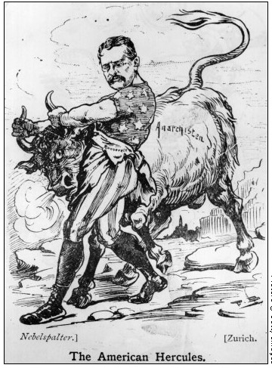
T.R. Arbitrates

Slide 30
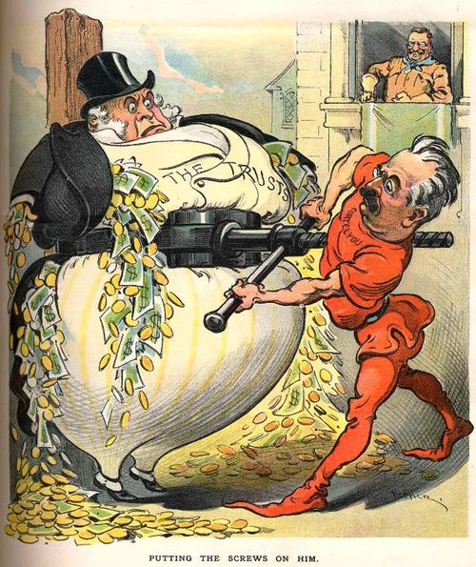
Trust-busting Under Roosevelt

Slide 31
Other Roosevelt Accomplishments
Elkins Act (1903) Ended Rebates
Hepburn Act (1906) Gave the ICC greater power including the authority to set railroad rates
Meat Inspection Act (Passed After TR read the Jungle) Forced Meat packing Plants to open their doors to government inspectors
Pure Food and Drug Act required food and drug companies to list all ingredients on their package and monitored untrue claims
First CONSERVATIONIST President
  Created 5 Natural Wilderness areas and Convinced Congress to ban lumbering in 150 million acres of Govt. land

Slide 32
Conservation Movement: against waste of natural resources; national parks; preservation of wild areas for production of masculine males
  Gifford Pinchot, conservationist: management of federal lands for “the greatest good of the greatest number in the long run” – managed use
  John Muir, preservationist: preserve wild areas
  T. Roosevelt, tended towards conservation, but also added National Parks and wild areas to fed. lands
    All of them were opposed by those who believed that unused lands were wasted and that fed. govt. shouldn’t control lands

Slide 33
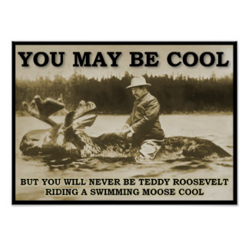

Slide 34
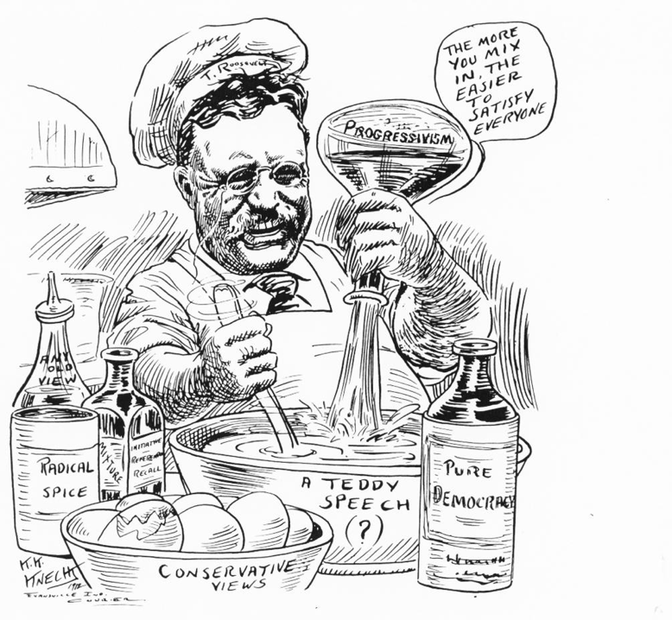
1005 × 927 - boundless.com

Slide 35
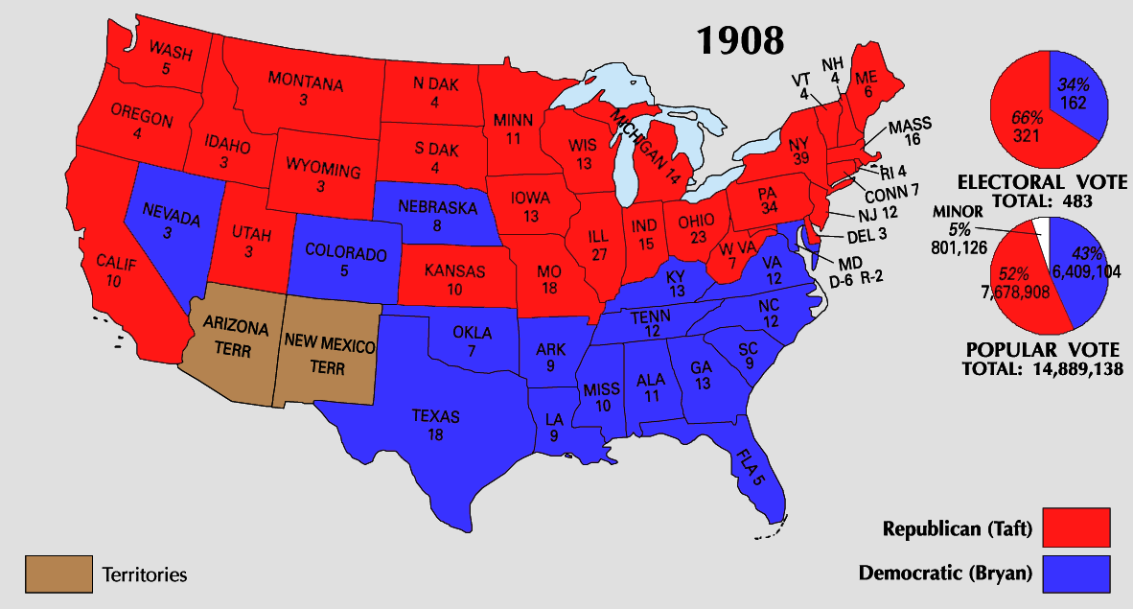
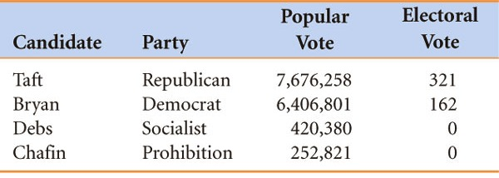
The Taft Presidency
TR remained true to his promise not to run for a 3rd term & helped pick William Howard Taft as the Republican nominee for president
Taft seemed ready to carry out TR’s political agenda
“I feel a bit like a fish out of water…I hate the limelight.”

Slide 36
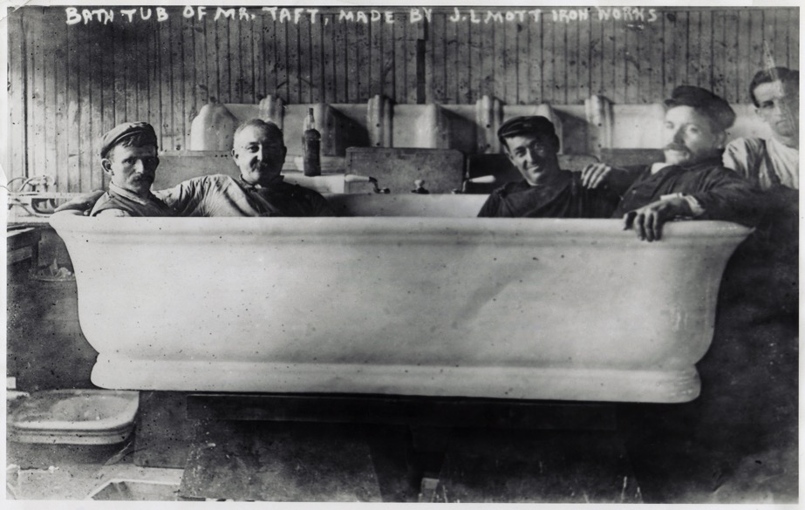
Taft’s Bath Tub

Slide 37
The Taft Presidency
Taft backed the Payne-Aldrich Tariff (1909) which angered progressive Republicans who wanted more foreign competition to force monopolies to reduce their prices
But, Taft was poorly equipped to continue Roosevelt’s agenda:
  Taft did not trust the gov’t to regulate business behavior
  He didn’t have the flair of TR; Taft was“too honest & sincere”
  Taft tended to side with conservative Republicans rather than progressive Republicans
Taft fired Pinchot, TR’s chief conservationist after the Ballinger-Pinchot Affair
These issues divided the Republican Party into progressive & “Old Guard” factions opening the door for a Democrat in the 1912 presidential election
Notes:
In 1909, Sec of Interior Ballinger offered for sale 1 million acres of land Pinchot refused to sell; After investigation, Taft backed Ballinger; Pinchot covertly leaked ties to JP Morgan & issue became a scandal; Taft fired Pinchot & muckrakers assailed Taft in newspapers
Progressive break with Taft began talk of a TR return to the White House

Slide 38
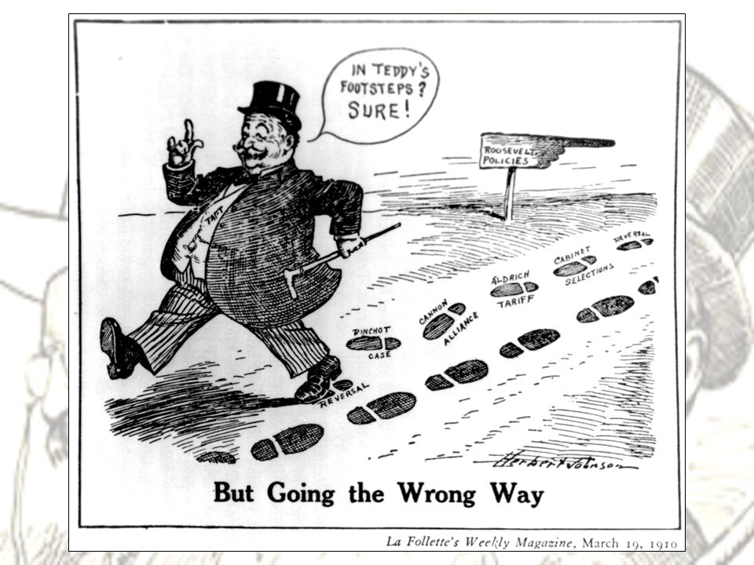

Slide 39
The Taft Presidency
All the work to create the 16th & 17th amendments was done under Taft, but neither was ratified while Taft was president
Despite these set backs, Taft helped push through significant progressive legislation:
  16th Amendment was written; created a national income tax
  17th Amendment was written; direct election of U.S. Senators
  Safety codes for miners & RRs
  Created the Children’s Bureau
Vindication for the Populists!!
Vindication for the Populists!!

Slide 40
The Election of 1912
TR decided to run against Taft for the Republican nomination in 1912 (mad about losing Conservationist policies) but conservative Republicans refused to nominate him over Taft
TR was nominated to the new Progressive (Bull Moose) Party
Democrats nominated former Princeton president & NJ governor Woodrow Wilson who ran as a progressive reformer
Notes:
After being shot by anti-third term fanatic: “I have a message to deliver and I will deliver it as long as there is life in my body.”

Slide 41

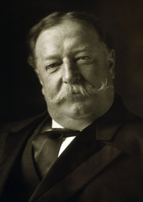

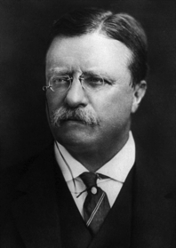

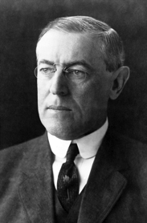

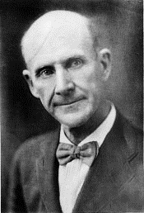


The Candidates of 1912
Taft
(Republican)
Roosevelt
(Progressive)
Wilson
(Democratic)
Debs
(Socialist)
Chafin
(Prohibition)

Slide 42
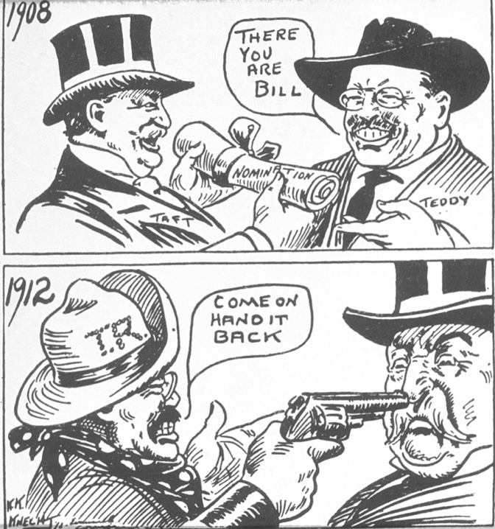

Slide 43
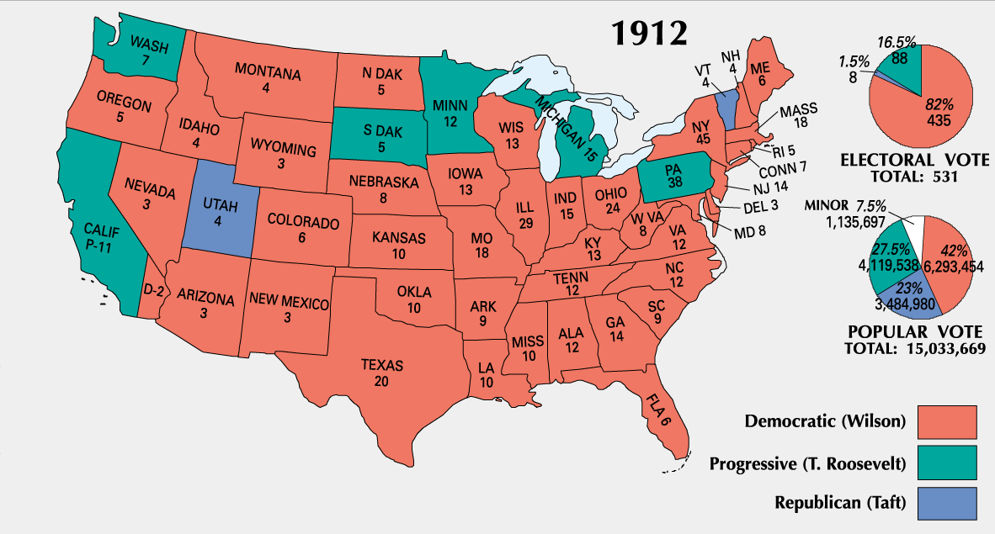

Slide 44
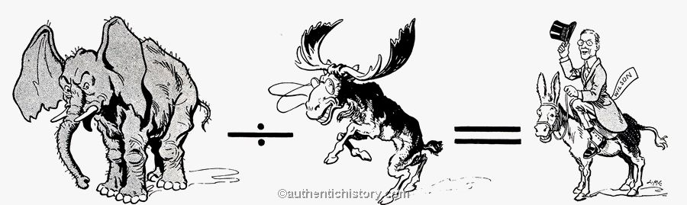


Wilson’s Landslide Victory
Republican Party divided by Bull Moose equals Democratic victory

Slide 45
Progressive Amendments:
    Political Reforms
16th Amendment
17th Amendment
18th Amendment
19th Amendment
This gave Congress the power to levy (impose) an income tax.
This called for direct election of Senators.
Prohibited the manufacture and sale of alcoholic beverages.
This gave women the right to vote.

Slide 46
The Waning of the Progressive Movement
Progressive movement peaks by 1917
Success of the movement led to its decline
Advent of World War I also hurt progressive activism
Progressives themselves began to weary of their reform zeal—as did the nation as a whole
Ironically, voter participation has steadily declined since the election of 1912

Slide 47
Progressive Era: An Analysis
How could it be seen as effective?
  Reforms: child labor, women’s labor
  Increased participation in politics
    17th amendment, 19th amendment, initiative, referendum, reform
  Trusts were broken up
Ineffective?
  African American Civil Rights Lacking

