Slide 1
Do Now
What ideological perspectives did Chief Justice John Marshall bring to the federal judiciary? Why is that historically significant?

Slide 2
2. The Marshall Court
Mr. Winchell
APUSH 2019-2020
Period 4

Slide 3
Who Interprets the Constitution?
John Marshall
Judicial review
Thomas Jefferson
Nullification by states

Slide 4
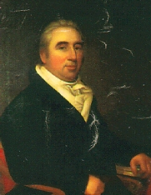
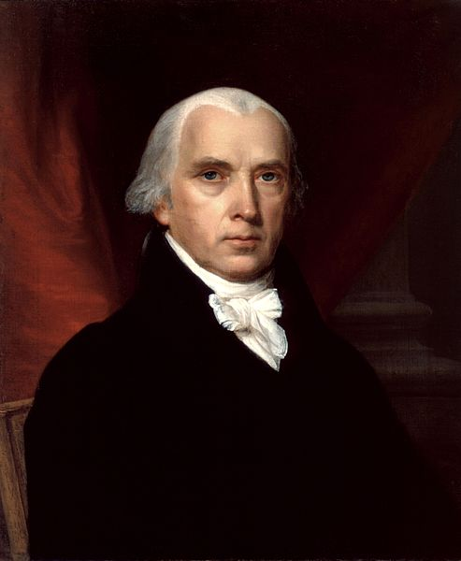
Marbury v. Madison, 1803
“Midnight Judges”
Outgoing Federalists vs. incoming Democratic-Republicans
Supreme Court’s power of judicial review

Slide 5
The Yazoo Controversy
Jefferson endured heavy criticism due to the Yazoo Land Fraud:
Corrupt GA politicians sold 35 million acres of land to insiders at ridiculously low prices
Quids attacked Jefferson for allowing defrauded individuals to keep lands they bought
In Fletcher v. Peck (1810), the Supreme Court allowed purchasers to keep these lands
Together with Marbury v Madison, the Supreme Court defined itself as a legitimate 3rd branch of gov’t
The case established an important precedent:
Supreme Court can nullify any unconstitutional state laws
Again, it’s the Marshall Court
Notes:
massive fraud perpetrated by several Georgia governors and the state legislature from 1795 to 1803 by selling large tracts of land to insiders at ridiculously low prices.

Slide 6
Dartmouth College v. Woodward, 1819
Royal charter from King George III
New Hampshire tried to place college under state control
Decision
Charter stands
Sanctity of contracts
Laissez-faire

Slide 7
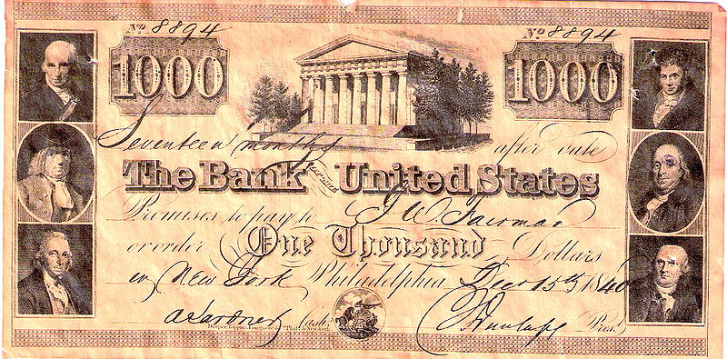
McCulloch v. Maryland, 1819
National bank vs. Maryland state tax
Decision
Bank is constitutional under the necessary & proper (“elastic”) clause
“The power to tax is the power to destroy”
National supremacy

Slide 8
Gibbons v. Ogden, 1824
Steamboats
State monopoly license vs. federal license
Decision
Only the federal government may regulate interstate commerce
National supremacy

