Slide 1
Do Now
What elements of mass industrialization is this perspective identifying?
"We are born in a Pullman house. We are fed from a Pullman shop, taught in a Pullman school, catechized in the Pullman church and when we die we shall be buried in a Pullman cemetery and go to a Pullman hell."
- Pullman employee on life in Pullman town, 1883

Slide 2
The Rise of Industry: Big Business in the Gilded Age
Mr. Winchell
APUSH 2018-2019
Period 6

Slide 3
Key Concepts
6.1: Technological advances, large-scale production methods, and the opening of new markets encouraged the rise of industrial capitalism in the United States.

Slide 4
AP Prompt
In the post-Civil War US, corporations grew significantly in number, size, and influence. Evaluate the impact of big business on the economy and politics.

Slide 5
Free Enterprise: Capitalism
Adam Smith: The Wealth of Nations (1776)
Laissez-faire Capitalism: “Let it Be”
The Market System:
Laws of supply and demand determine prices (The Invisible Hand)
According to Smith’s ideas:
  Business should be free of government interference.
Smith understood that:
  Business owners or Entrepreneurs, as a rule, want to make as much money or profit as possible.
  They don’t want to pay taxes.
  They want to provide goods or services at the lowest possible price and creating the most profit.
According to Smith a Pure Market Economic System would achieve the maximum good for society:
Characteristics
  No government control
  Freedom of choice
  Private Property
  Profit
  Competition

Slide 6
WHAT DOES IT TAKE TO BUILD AN ECONOMY?
A national market
A national financial system
Infrastructure
Three additional influences:
  Geography
  Demography
  Laws

Slide 7
THE RISE OF BIG BUSINESS
The Old Business Format
Proprietorship:
A single owner business OR
Partnership:
Small group
ownership
of a business
Notes:
The Rise of Big Business
[This slide if for background only—not for notes]

Slide 8
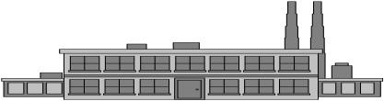




THE RISE OF BIG BUSINESS
The New Format—
The Corporation
Capital
Shares &
Dividends
Limited Liability
Shareholders
Notes:
The Corporation
Shareholders invest in a company by buying shares (stock)
Financial capital to build and grow a company comes—in part—from the sale of shares
The new kind of business is a corporation—a legal entity rather than a person or partnership—that runs the company
In return for financial capital, the corporation issues shares of ownership, and many also share a portion of profits by paying dividends per share at regular intervals
Limited liability protects shareholders from legal action if the company does something wrong

Slide 9
Principles of Scientific Management

Slide 10
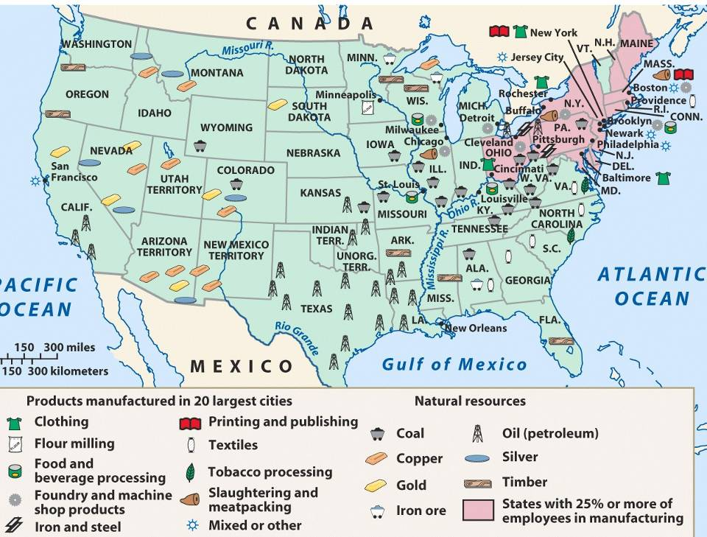
America’s industrial revolution was
fueled by 4 major industries (R.O.S.E.)
Railroads, Oil, Steel, Electricity

Slide 11
Gilded Age Industrialization
During the Gilded Age, American businesses were transformed:
  Massive corporations replaced small, family businesses
  New technology, transportation, marketing, labor relations, & efficient mass-production
  By 1900, the U.S. was the most industrialized country in the world

Slide 12
Factors Encouraging Industrial Growth
Natural Resources
Favorable Government Policies (Pro Corp-Dartmouth v. Woodward & Tariffs)
Growing Population
New Sources of Power
Introduction of Machinery
Improved Transportation & Communication
Effect of Wars
Notes:
Natural resources available in the U.S. included coal, iron, lumber.
Also fertile soil for growing food and cash crops as well as swift running water for waterpower.
The Constitution was written in a way that helped industry.
Coining of money provided a stable currency for trade.
Regulation of interstate commerce made possible nationwide laws to regulate industry and transportation.
Levying tariffs on imports protected domestic industry against foreign competition.
A system of patents protected inventors.
The 5th and 14th Amendments also provided that no person could be deprived of property without due process of law. This encouraged domestic and foreign investors to provide capital for American Industry.
The govt. also spurred growth by providing land grants and cash subsidies to railroads, levying high protective tariffs, and maintaining a laissez-faire approach to business.
A high birthrate and considerable migration led to a steady increase in the U.S. population (about 76 million in 1900) which provided sufficient workers for industry and expanding markets for goods.
New sources of power included electricity and petroleum.
Electricity first used for communication and later for lighting and driving motors.
Petroleum first used for lubrication and lighting and later for transportation.

Slide 13
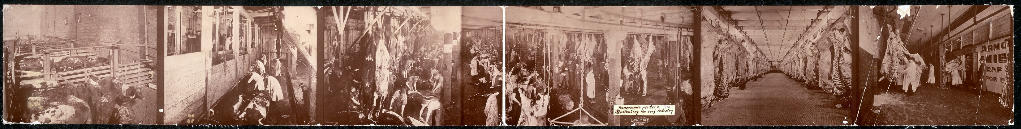
Chicago Meatpackers:
The 1st “Disassembly Line”

Slide 14
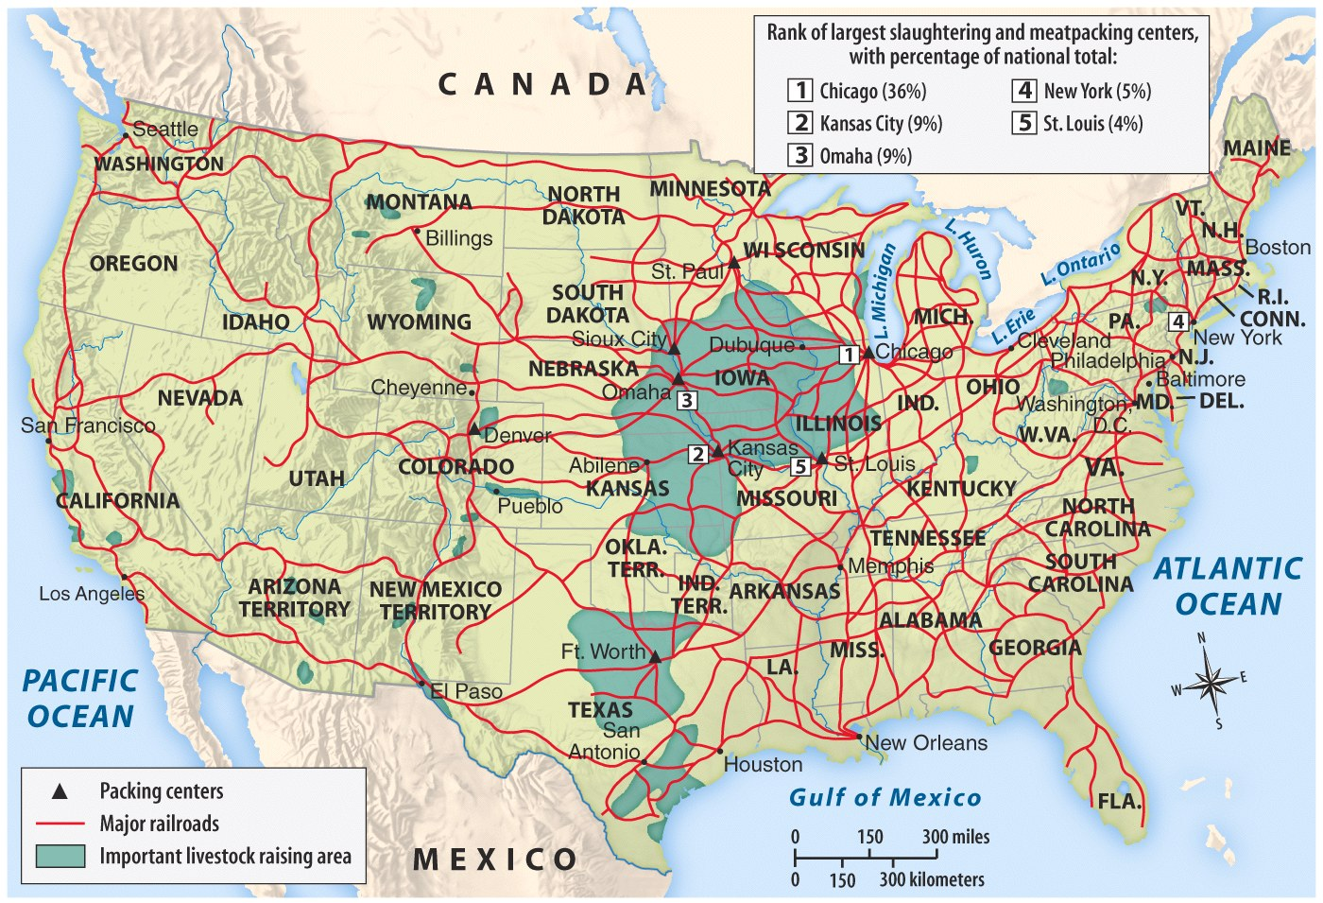
The Midwest Made Meat for America
A new-and-improved “market revolution”: More regional specialization made mass production & mass consumption possible
Notes:
(Chicago→meat, St Louis→beer, & Minneapolis→grain)

Slide 15
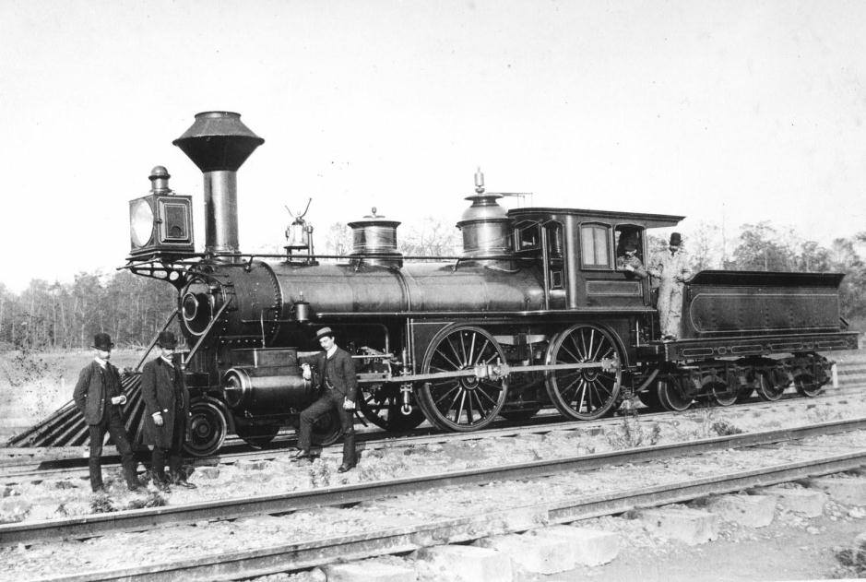
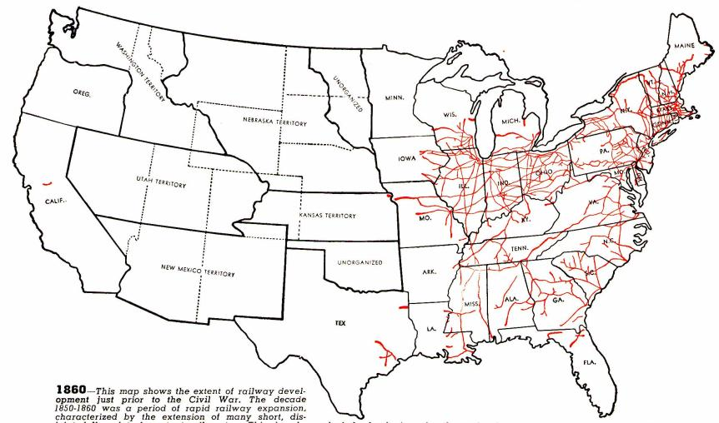
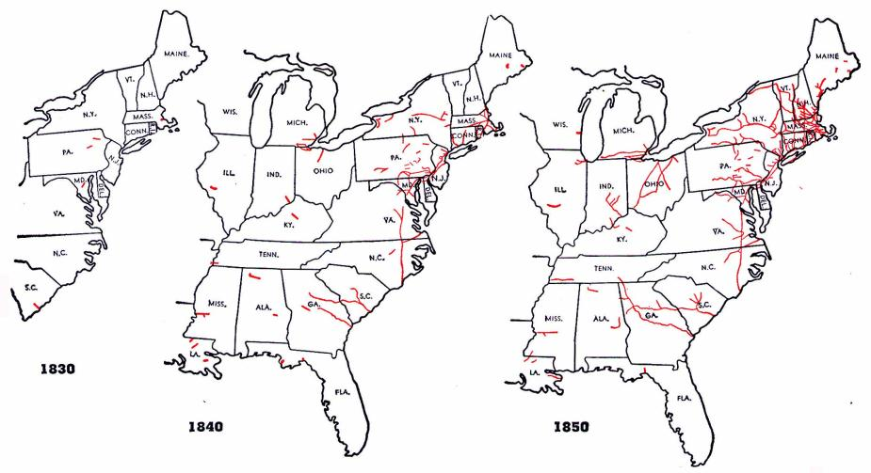
The railroad was America’s first “big business”
Railroad construction grew in the years before the Civil War…
…But, tracks were owned
by different companies
and were not standardized

Slide 16
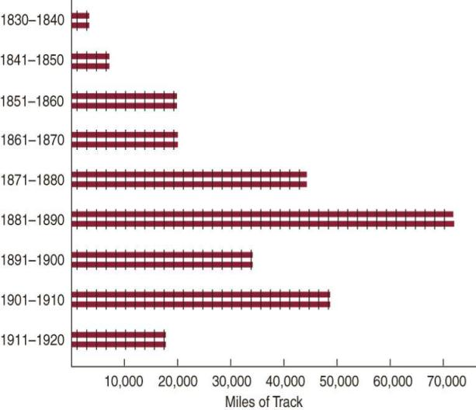
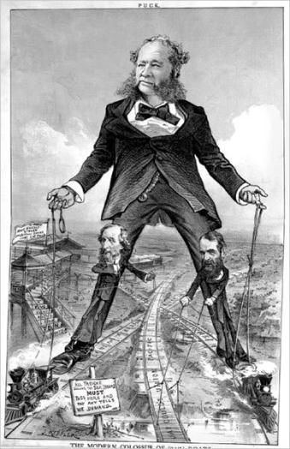

During the Gilded Age, railroad construction boomed, led by tycoons like Cornelius Vanderbilt
Large companies
bought small railroads, standardized gauges and schedules, and pooled cars

Slide 17
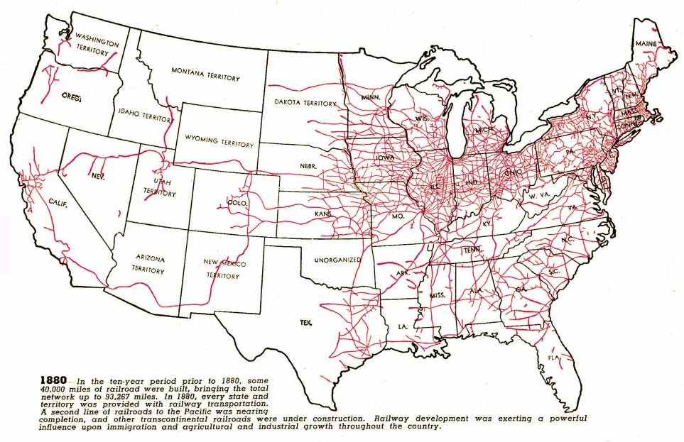
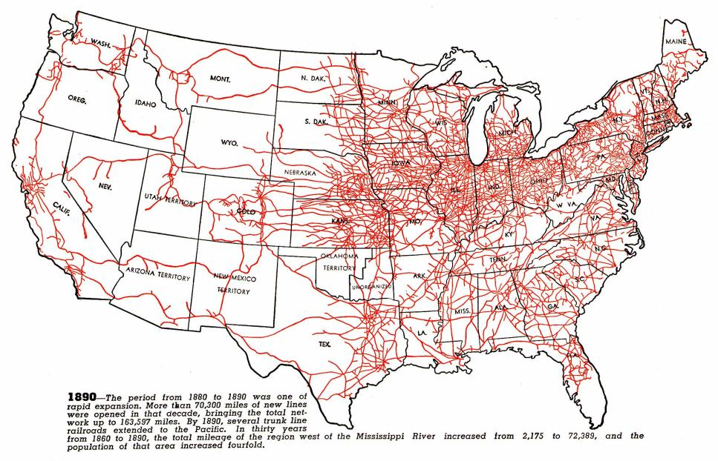
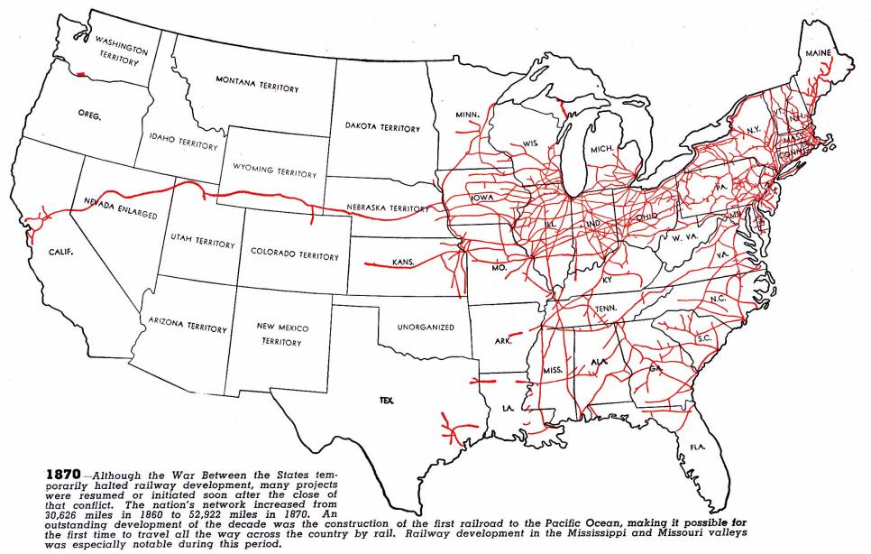
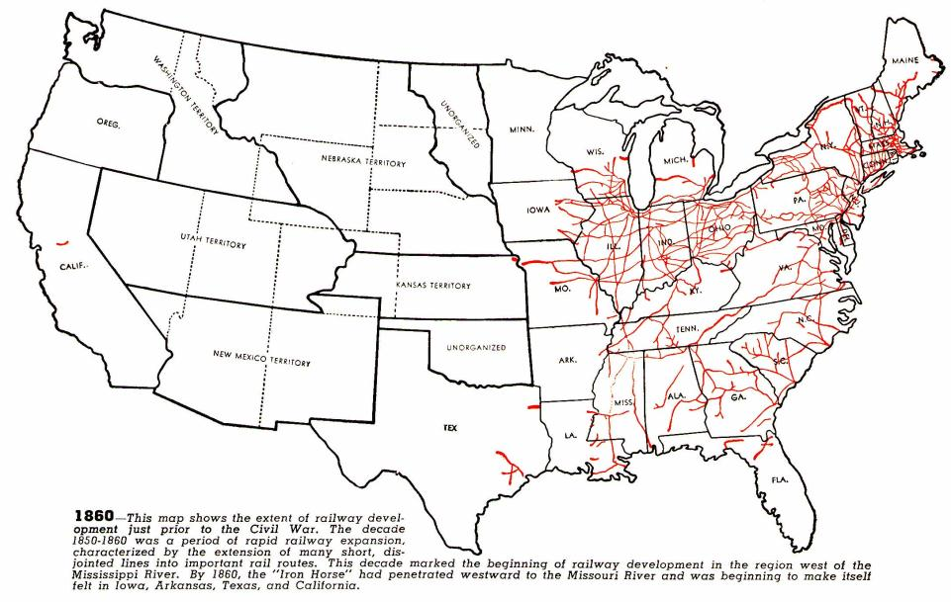
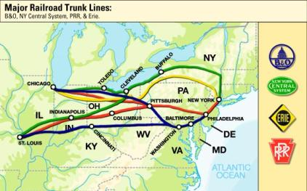
Railroad expansion led to a boom in the economy
Railroads connected the East, South, and West and allowed for national trade and regional specialization
The 1st transcontinental railroad was finished in 1869
Eastern railroads were connected to the West by 4 great trunk lines
Railroads stimulated demand for coal, oil, iron, and steel

Slide 18
Problems of Growth
Speculators like Jay Gould built & bought rail lines to profit with little concern for efficient use
But, the railroad industry faced problems due to overbuilding in the 1870s & 1880s:
  Mass competition among RRs
  RR lines offered special rates & rebates (secret discounts) to lure passengers & freight on their lines
  Pooling & consolidation failed to help over-speculation
Notes:
8

Slide 19
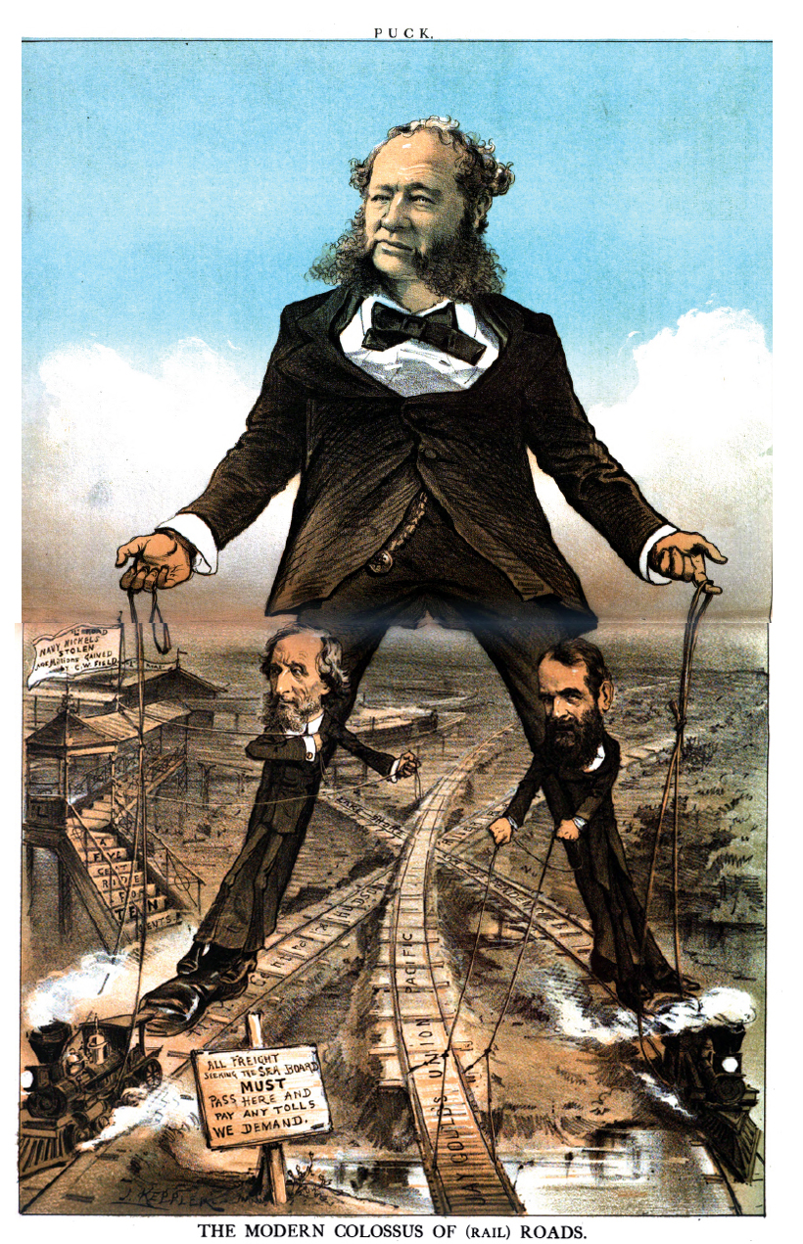

Slide 20
Regulating the Railroads
Munn v. Illinois (1879)
Wabash v. Illinois (1886)
Interstate Commerce Act

Slide 21
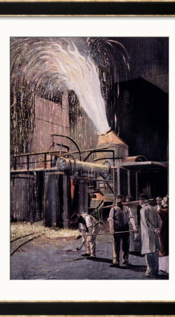
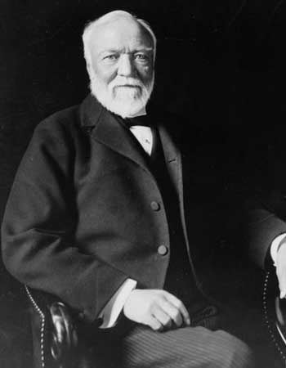
Big Steel
Andrew Carnegie led the industry in the late 1800s thanks to the introduction of:
1. the Bessemer steel process → high-quality steel
2. cost-analysis → cut back costs, higher profits
3. vertical integration → control of every stage of steel production from mining iron ore and coal to selling the finished product → reduced costs and allowed Carnegie to under-price the competition through economy of scale→ monopoly control of the industry
Overall result: More steel produced and at lower cost ($65/ton in 1875 vs. $11.50/ton in 1900)
Carnegie sold Carnegie Steel to J.P. Morgan and other investors in 1900 for $500 million and became a major philanthropist, advocated the “Gospel of Wealth”

Slide 22
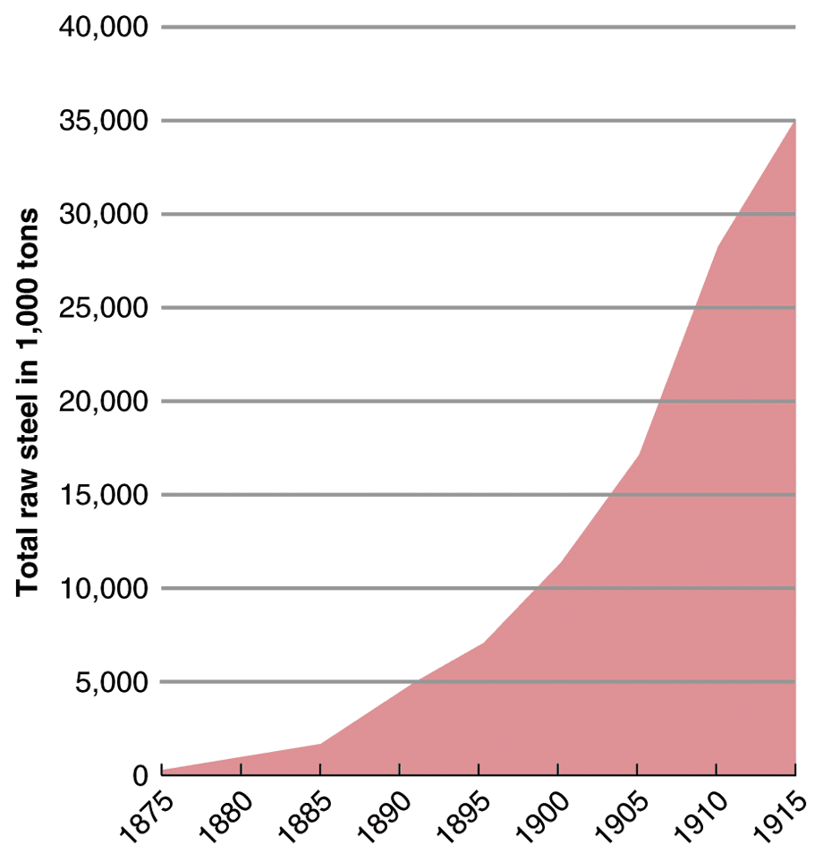
Steel Production

Slide 23
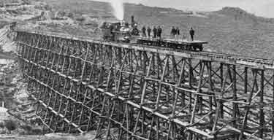
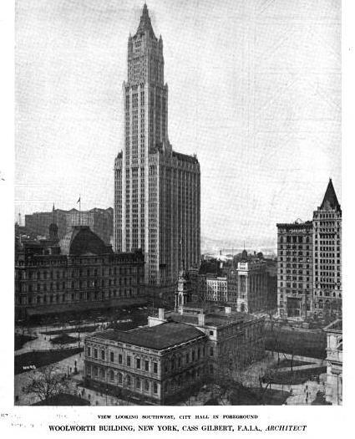
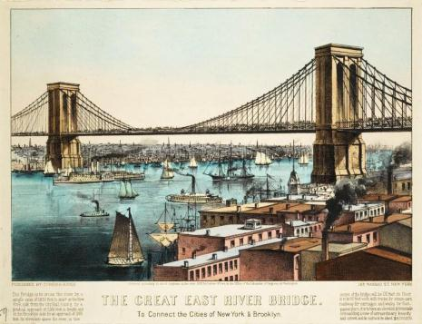
Steel led to skyscrapers, longer bridges,
stronger railroads, and heavier machinery

Slide 24
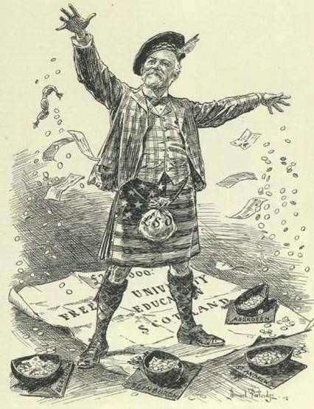
Carnegie did not pay his employees very much and did not allow unions in his factories…
…but he was a philanthropist who gave money to New York City libraries, colleges,
and performing arts institutions
Andrew Carnegie (2.11)
Notes:
9
Henry Bessemer (& William Kelly) turned iron into steel in 1850s—process allowed for mass production of steel

Slide 25
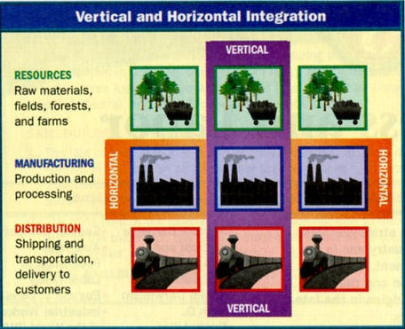

Slide 26
Big Oil
John D. Rockefeller sought control of the expanding industry through horizontal integration → control of one stage of production (transportation and then refineries)
Rockefeller established the Standard Oil Trust (1882) to control companies that had previously participated in price fixing arrangements (controlled 90% of the industry through horizontal and vertical integration) – emulated by other industries

Slide 27
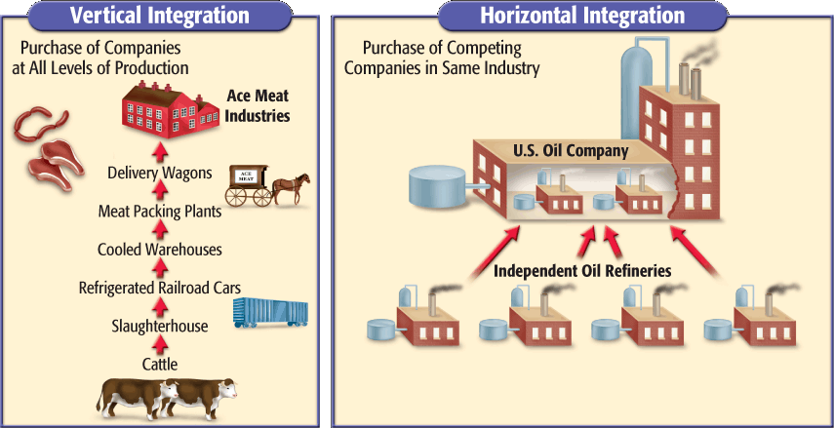
Horizontal Integration

Slide 28
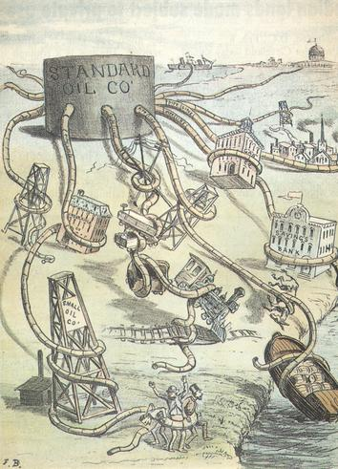
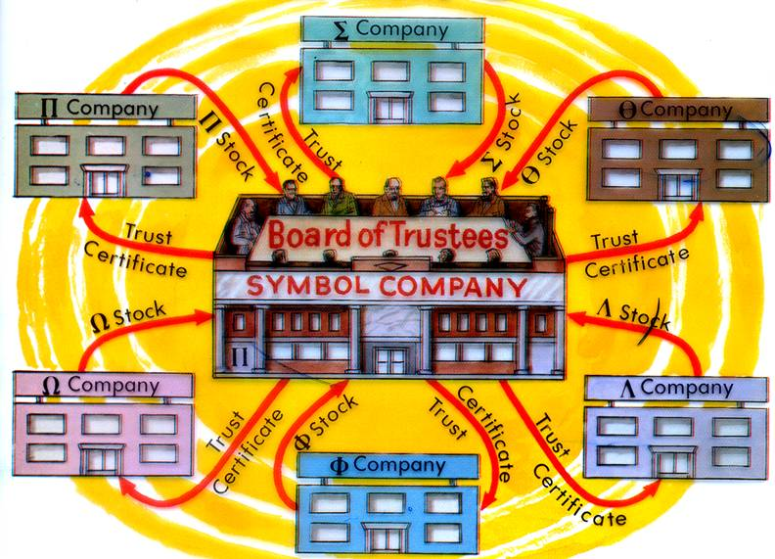
Standard Oil Trust
Tactics
  Lowered prices to drive out competitors (rate wars)
  Threatened companies to sell to Standard Oil (buyouts)
  Bribed railroads to buy Standard Oil fuel (rebates, kickbacks)
  Bribed Congress members
Trusts and Monopolies
  Controls prices
  Limits competition

Slide 29
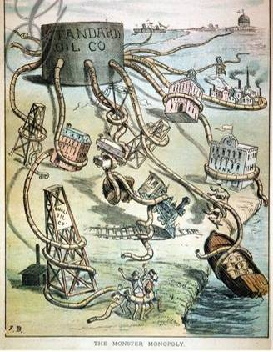

Rockefeller took advantage of his workers and used his fortune to influence
the national gov’t…
…but Rockefeller gave away $500 million
to charities, created the Rockefeller Foundation, and founded the University of Chicago

Slide 30
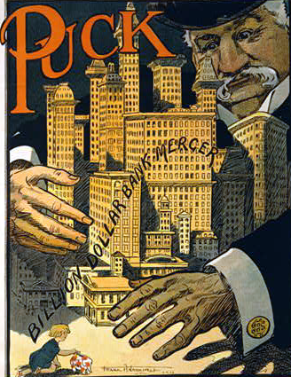
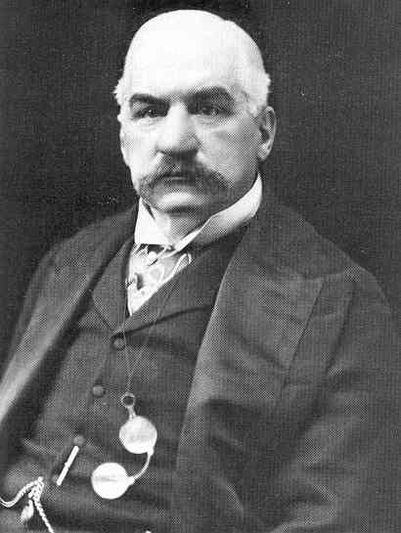
Industrialization led to a demand for financing so banking became a significant part of the Gilded Age
American finance was dominated by JP Morgan
He was so influential that he bailed out the railroad industry when companies were in trouble
He helped ease an economic depression during the Panic of 1907

Slide 31
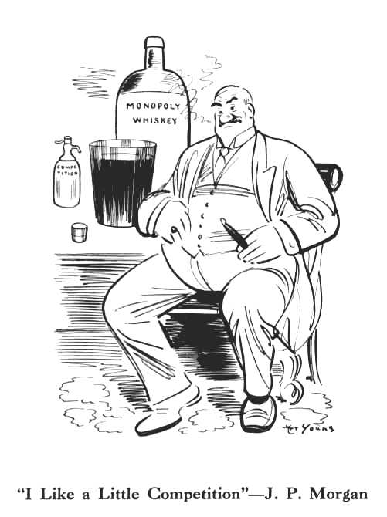
Corporations
American Telephone and Telegraph Co. (1885)
  J.P. Morgan Co. financed merger of Bell and communication companies
General Electric (1892)
  J.P. Morgan merged Edison General Electric and Thomas-Houston Electric Company
U.S. Steel (1901)
  J.P. Morgan bought Carnegie Steel and merged with other steel companies
  Becomes first billion dollar company in world

Slide 32
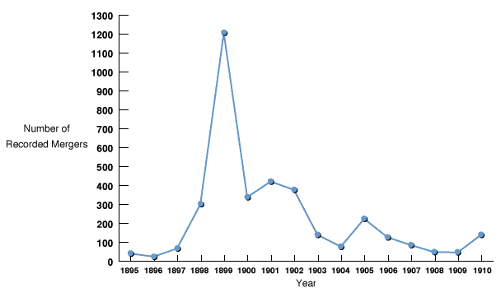
Corporate Mergers - 1895-1910

Slide 33
Monopolies Continued
Other ways to create a monopoly
mergers - buy out all companies in an industry and intergrade them into your company.
holding companies - a company that buys out other companies.
rebates - giving special people discounts (RR practice).
Interlocking directorates - one man on board of two companies.
Trusts - stock control given to one committee and multiple companies ran as one.
  Hardest to regulate and most “sneaky of the monopolist categories.

Slide 34
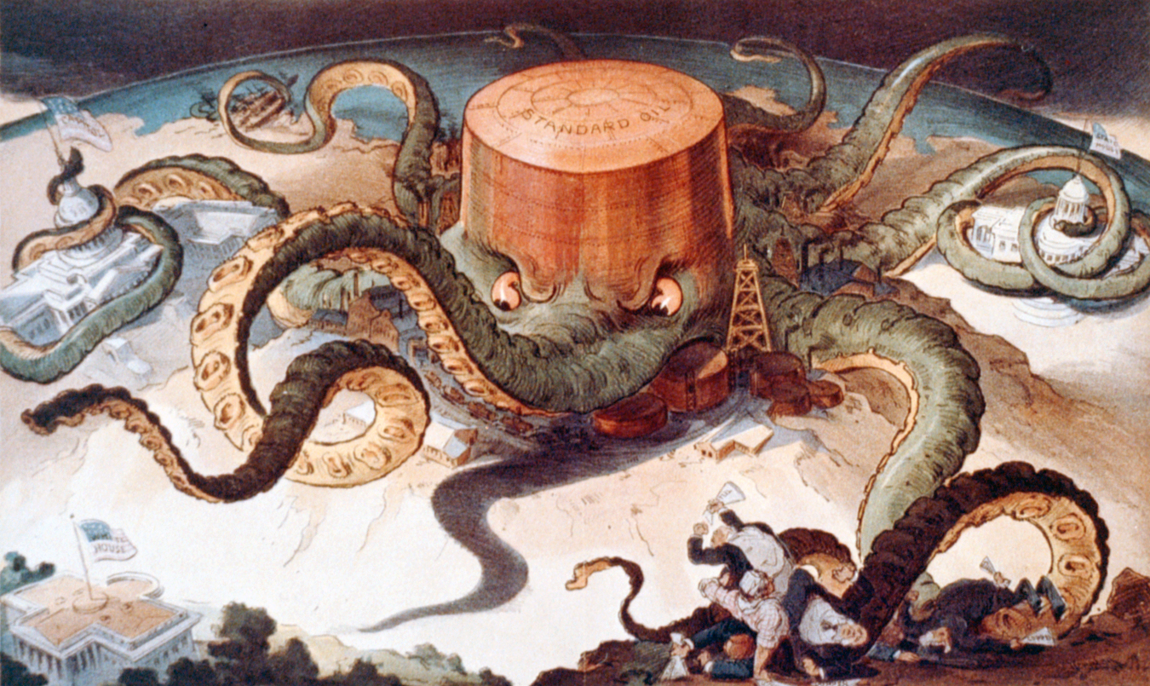

Slide 35
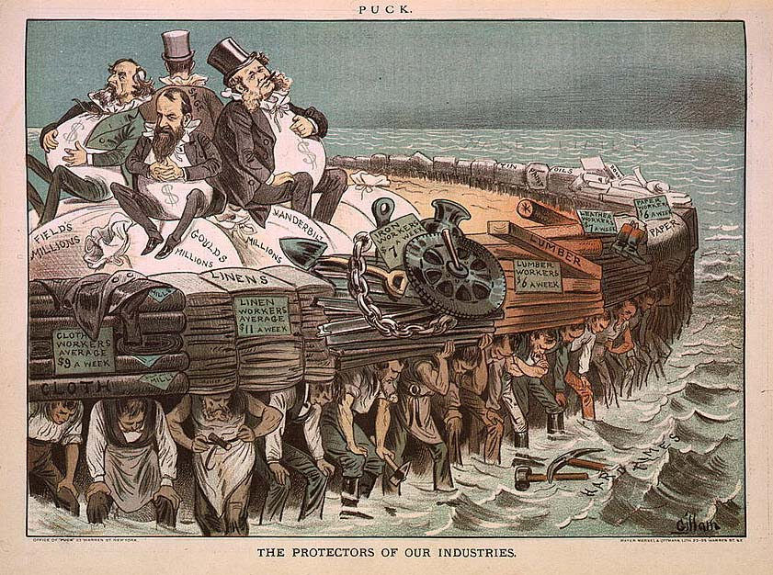

Slide 36
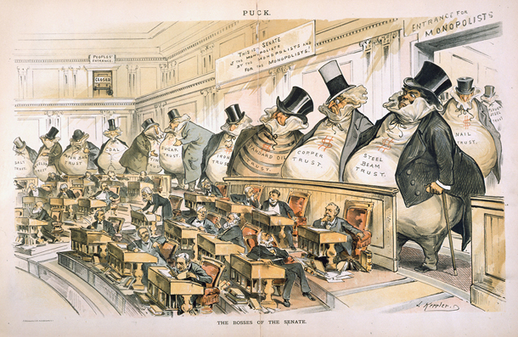
Bosses of the Senate

Slide 37
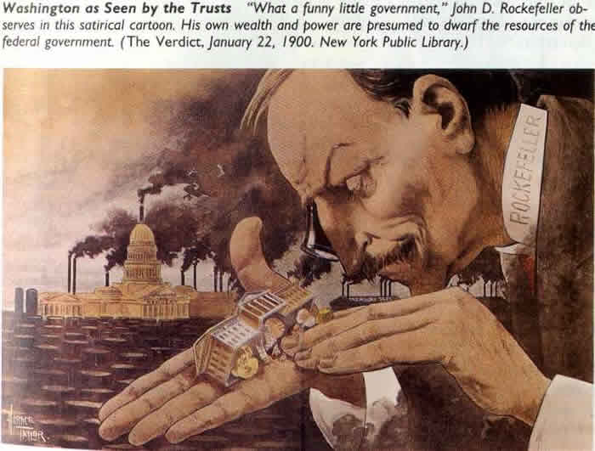
“What a funny little government”

Slide 38
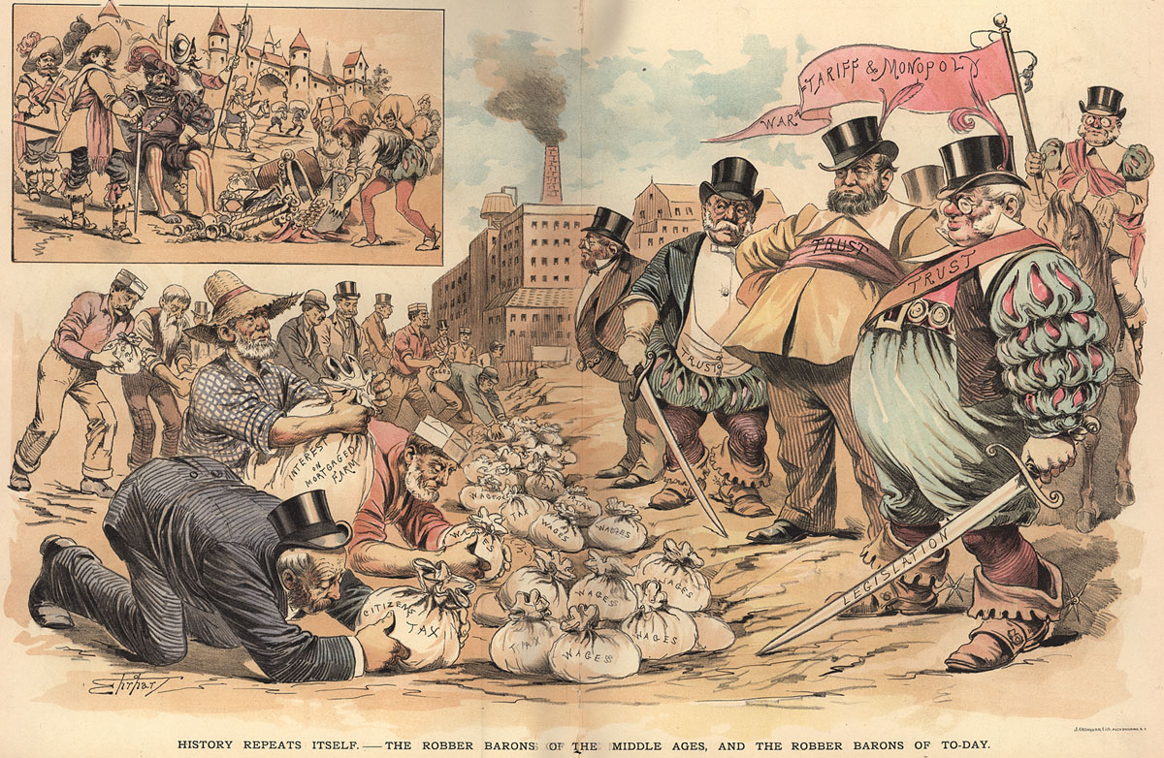

Slide 39
The development of factory production has consequences for virtually every portion of society.
Industrialization brings positives effects:
Inventions are created-→More products--→produced faster--→ produced cheaper
Jobs are created---→ people have money to buy more goods-→economy gets better for everyone
Rich people get richer--→ create more factories or businesses --→ create more jobs--→economy gets better for everyone
Immigration-→when jobs are available-------→people move to the location of jobs-→industrialization causes immigration--→
Factories are built where people live-------→cities grow

Slide 40
The development of factory production has consequences for virtually every portion of society.
Industrialization brings negative effects:
Industrialization causes--→pollution-→air, water
Industrialization causes---→poverty-→ government doesn’t protect workers at first-→ workers compete with other workers for low skill jobs-→ workers work long hours-→ get low pay-→ unsafe working conditions
Poverty is so bad-→children need to work
Massive wealth is created by factory owners-→ causes corruption-→ business owners use money to influence government officials

