Slide 1
Do Now Monday Quiz
Write a thesis to the following prompt:
-With respect to the federal Constitution, the Jeffersonian Republicans are usually characterized as strict constructionists who were opposed to the broad constructionism of the Federalists. To what extent was this characterization of the two parties accurate during the presidency of Jefferson?

Slide 2
The War of 1812 & The End of the Federalists
Mr. Winchell APUSH
Period 4

Slide 3
AP Prompt
What were the social, political, and economic effects of the War of 1812?

Slide 4
Key Concepts
4.3: The US interest in increasing foreign trade and expanding its national borders shaped the nation’s foreign policy and spurred government and private initiatives.

Slide 5
The Embargo of 1807
When England & France resumed war in 1803 & violated U.S. neutrality, Jefferson approved the unpopular Embargo of 1807
To enforce the embargo, Jefferson contradicted his principles of individual liberty & weak gov’t:
He mobilized the military to enforce the blockade
He declared regions of NY (near Canada) in a state of insurrection
Notes:
19

Slide 6
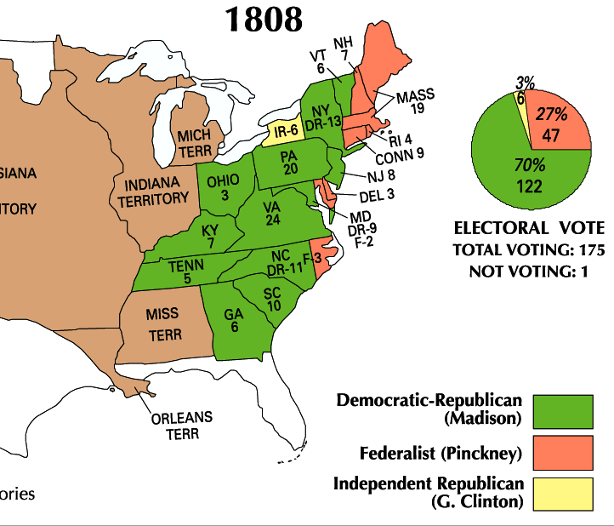
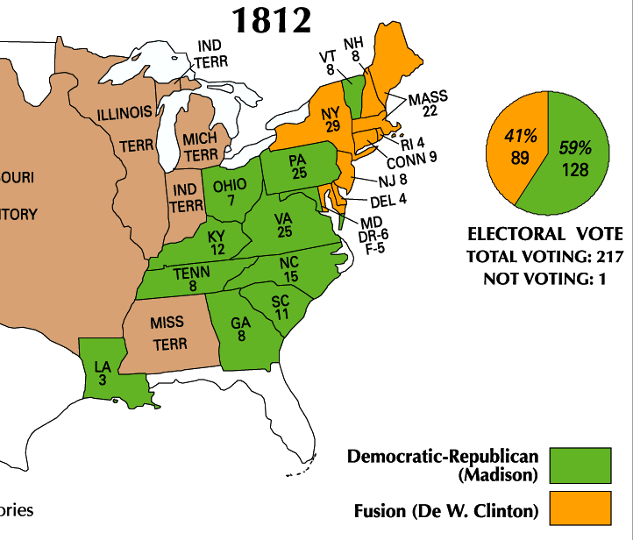
Jefferson’s hand-picked successor, James Madison, won the presidency in 1808 & 1812
Madison was well-qualified: He was the architect of the Constitution, served in Congress, & served as Jefferson’s Secretary of State

Slide 7
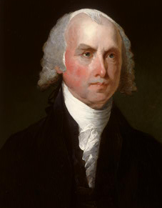
James Madison
1809-1817
“Father of the Constitution”
Federalist Papers
Bill of Rights
Kentucky & Virginia Resolutions
Democratic-Republican
Secretary of State

Slide 8
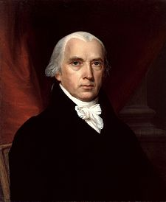
James Madison (D-R) (1809-1817)
Napoleonic Wars
Impressment continues
Non-intercourse Act of 1809
Macon’s Bill No. 2 (1810)
Western Frontier
Alleged British influence on Natives
Native wars
War of 1812

Slide 9
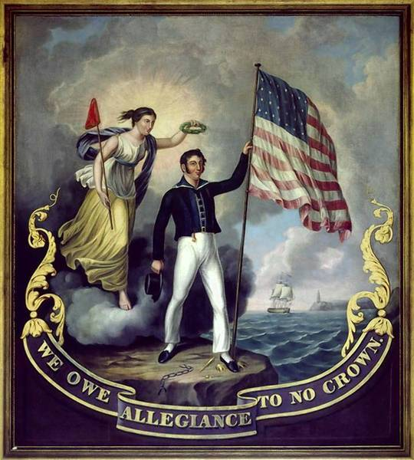
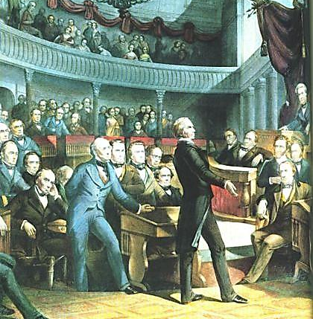
Many Congressmen called “War Hawks” demanded war with Britain to defend U.S. honor
“Free Trade and Sailors' Rights” was a popular battle cry

Slide 10
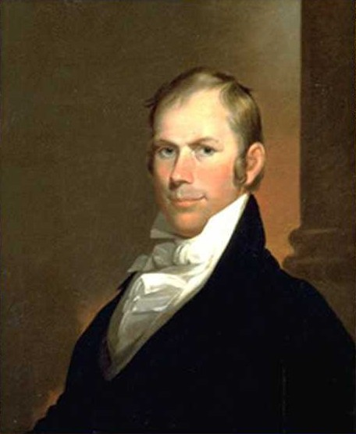
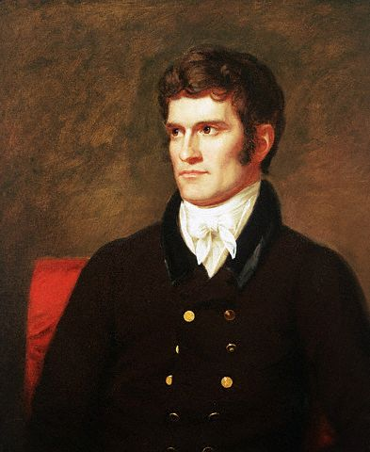
War Hawks
Young Democratic-Republican leaders
Wanted to protect American interests
Webster, Clay, Calhoun

Slide 11
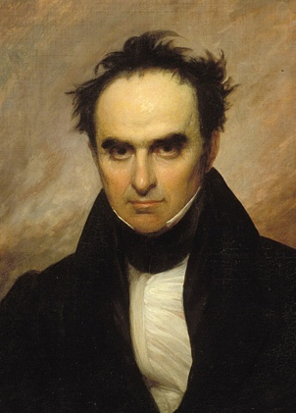
War Hawks’ Goals
Northerners
Seize Canada
Southerners
Seize Florida
All War Hawks
Stop impressment
Protect trade
Expand westward

Slide 12
Problem: Since 1793, Britain and France have been at war, violated free trade, and used impressment against American merchants. Attempts to resolve these issues did not solve these problems
Washington’s Proclamation of Neutrality (1793)
Adams’ XYZ Affair (1798)
Jefferson’s embargo (1807)
Brainstorm three solutions President Madison could use to solve this problem and select the 1 best alternative. Be sure to explain your decision

Slide 13
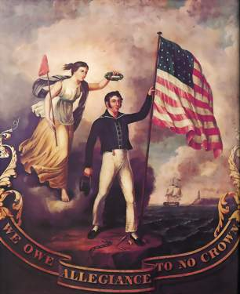
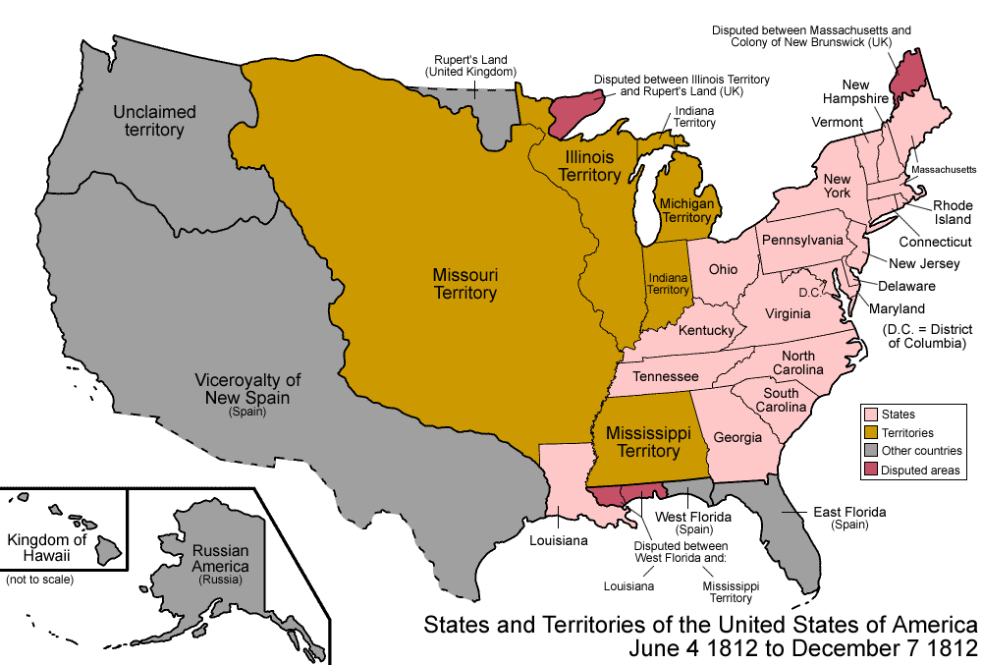
Which region would have supported a declaration of war the most?
Patriotism surged as War Hawks claimed the War of 1812 the “Second American Revolution”
Americans in the West & South wanted war to gain Canada & Spanish Florida
Madison eventually gave in & asked Congress for a declaration of war in June 1812
NE Federalists thought war with Britain as a mistake: they feared the U.S. could not defeat England & a war would bankrupt the country
Most calls for war centered on British interference with U.S. trade rights.
"Free Trade & Sailors' Rights" was a popular battle cry
By 1810, War Hawks in Congress, led by Henry Clay (KY) & John C. Calhoun (SC), demanded war with England
Notes:
23

Slide 14
Declaration of War by Congress
Be it enacted by the Senate and House of Representatives of the United States of America in Congress assembled, That war be and the same is hereby declared to exist between the United Kingdom of Great Britain and Ireland and the dependencies thereof, and the United States of America and their territories; and that the President of the United States is hereby authorized to use the whole land and naval force of the United States to carry the same into effect, and to issue to private armed vessels of the United States commissions or letters of marque and general reprisal, in such form as he shall think proper, and under the seal of the United States, against the vessels, goods, and effects of the government of the said United Kingdom of Great Britain and Ireland, and the subjects thereof
APPROVED, June 18, 1812

Slide 15
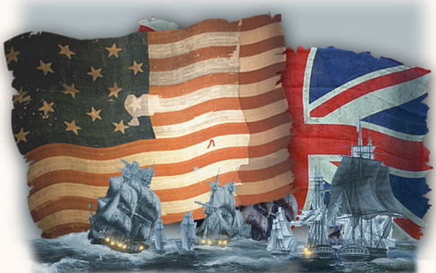
Congress’ Declaration of War
War Hawks in Congress & failure of “Peaceable Coercion” led Madison to call for war against Britain - June 1, 1812
Cited maritime rights, impressment, and agitation of western Indians against settlers
Generally popular but Federalists opposed the war
Notes:
READ MADISON’S WAR MESSAGE

Slide 16
War for U.S. maritime rights or a war for territory?
Northeasterners most directly concerned with maritime rights were largely opposed to the war
South & West, most strongly for territorial expansion, favored the war

Slide 17
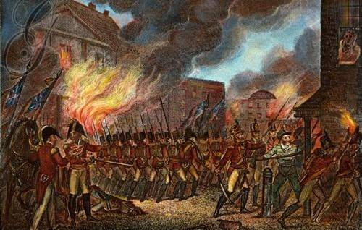
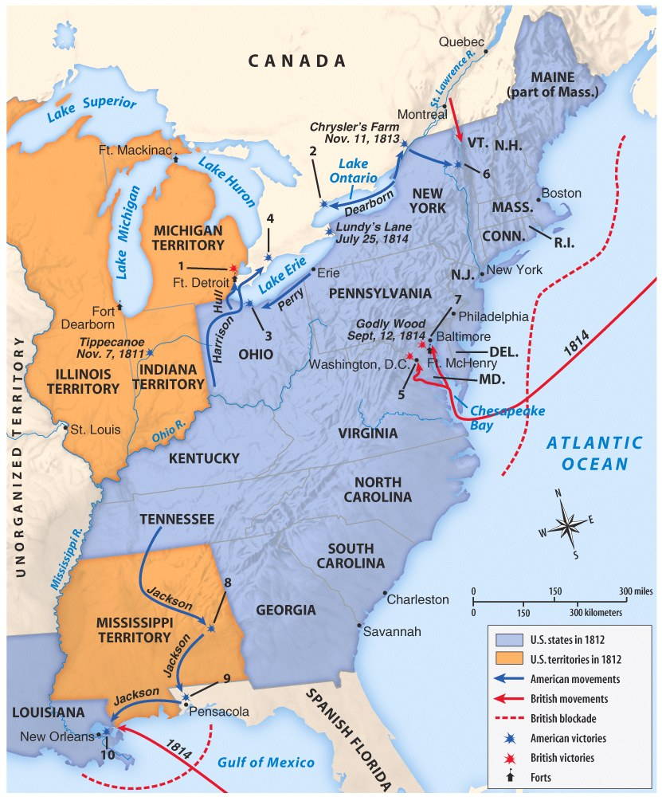
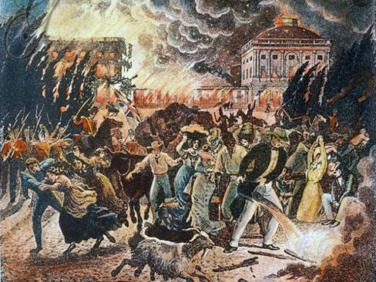
The War of 1812 (1812—1815)
The U.S. had a small navy and poorly trained army when the war began
Meanwhile, Britain’s well-trained army had been fighting France for a decade
The war went badly in the early years
The British attacked and burned the national capital Washington, D.C.
Notes:
12 ships vs. 800 ships!

Slide 18
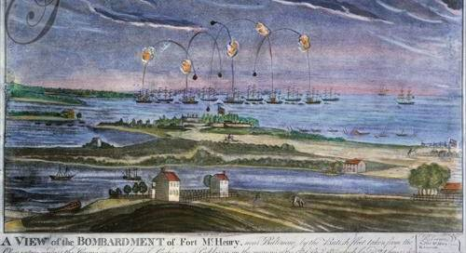
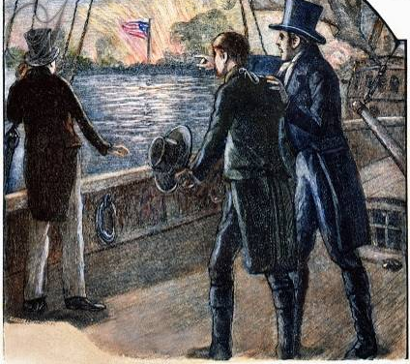
When the British laid siege to Fort McHenry, American Francis Scott Key wrote the poem “The Star Spangled Banner”

Slide 19
Though Britain was winning, they were also fighting France and wanted to quickly end the War of 1812
In 1814, Britain and the United States signed the Treaty of Ghent ending the war

Slide 20
War of 1812 Battles with Frontier Natives
Tecumseh’s War
Battle of Tippecanoe (1811)
Battle of the Thames (1813)
Creek War
Battle of Horseshoe Bend (1814)

Slide 21
Treaty of Ghent
Treaty of Ghent did not address U.S. neutrality but was ratified unanimously by the Senate
Effects of the war:
Ended all Indian-British alliances in western lands
Scared Spain into signing the Adams-Onis Treaty in 1819
The lack of Federalist loyalty was the fatal blow to the party
‘Status Quo Antebelllum’
Spain ceded Florida to the USA
Notes:
27

Slide 22
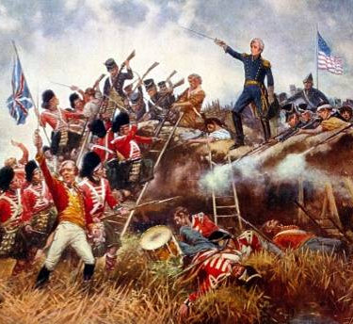
The War of 1812 (1812—1815)
Before news arrived, the Americans beat the British at the Battle of New Orleans
General Andrew Jackson emerged as a war hero
The victory at New Orleans led many Americans to feel as though they won the war

Slide 23
Death of Federalist Party
New England states opposed war
Dec. 15, 1814 - leading Federalists held Hartford Convention
Proposed 7 amendments to Const. to strengthen states rights (ironic!) & protect northern interests
Some hinted at secession though did not have support
Convention ill-timed – Americans thought we won and Federalists came off as weak

Slide 24
Hartford Convention (1814)
In order to reduce southern control of Congress
The War of 1812 is still going on!!
Platform
Federal economic assistance for New England
2/3 congressional majority for embargoes, state admission, and declaration of war
Rescind the Three-Fifths Compromise
One-term president and no same-state successor
Talk of secession by radicals
After War of 1812
Perceived as traitors
Effectively weakened as a national party
In order to break the Virginia presidential dynasty

Slide 25
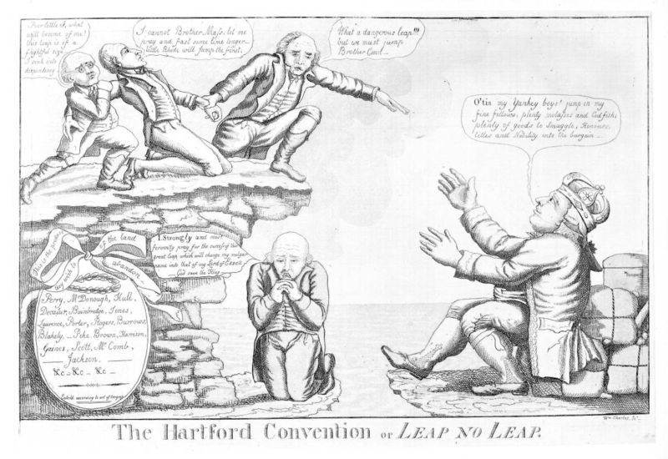

Slide 26
War of 1812’s Impact
Growth of nationalism
Ushered in an “Era of Good Feelings”
Domestic industrial and manufacturing development
Emphasis on national infrastructure
Promotion of professional military
International respect
Natives significantly weakened
Increased drive to expand west

Slide 27
The War of 1812 had important effects on America
Americans were united in a sense of nationalism, believing that they had beaten the British
America entered an “Era of Good Feelings” with a popular president and booming national economy

