Slide 1
2nd Great Awakening and the Reforming of American Culture
Mr. Winchell
APUSH Period 4

Slide 2
Importance of Popular Religion in America
In France, I had almost always seen the spirit of religion and the spirit of freedom pursuing courses diametrically opposed to each other; but in America, I found that they were intimately united, and that they reigned in common over the same country… Religion was the foremost of the political institutions of the United States. -- Alexis de Tocqueville, 1832

Slide 3
Big Picture
1st Great Awakening-reaction to Enlightenment
2nd Great Awakening-reaction to Deism
2nd Great Awakening leads to REFORM MOVEMENTS
Prison
Temperance
Women’s Rights
Slavery
Abolition

Slide 4
Reviving Religion
Religion in the 1790-1860:
Church attendance was still a regular ritual with ¾ of the 23 million Americans in 1850
Alexis de Tocqueville declared there was “no country in the world where the Christian religion retains a greater influence over the souls of men than in America.”
“Religion is the most important political institution in America”
Yet religion of these years was not the old-time religion of colonial days:
Austere Calvinism was seeping out of the American churches

Slide 5
Reviving Religion
2nd Great Awakening inspired Americans to ‘battle evils.’
Puritan vision of a perfected society: no cruelty, war, ‘intoxicating drink,’ discrimination, and slavery
Women played a key role in reform movements: could escape the confines of the home
Other changes in society:
Prison reform, imprisonment for debt, mental health reform (DOROTHEA DIX!)
Notes:
Lot of similarities. First GA didn’t inspire reform movements, second one did

Slide 6
Reviving Religion
Charles Grandison Finney was the greatest of the revival preachers:
Had a deeply moving conversion experience
Led massive revivals in Rochester and New York City in 1830 and 1831
He preached a version of the old-time religion, but he was also an innovator:
He devised the “anxious bench” where repentant sinners could sit in full view of the congregation
He encouraged women to pray aloud in public
He denounced both alcohol and slavery
He served as president of Oberlin College in Ohio, where he helped to make a hotbed of revivalist activity and abolitionism.

Slide 7
Reviving Religion
A key feature of the Second Great Awakening was the feminization of religion, both in church membership and theology:
Middle-class women were the first and most fervent enthusiasts of religious revivalism

Slide 8
Denominational Diversity
Religious diversity reflected social cleavages facing the slavery issue:
By 1844-45 the southern Baptists and southern Methodists split with their northern brethren
In 1857 the Presbyterians, North and South parted company
The secession of the southern churches foreshadowed the secession of southern states
First the churches split, then the political parties split, and then the Union split.

Slide 9
Reviving Religion
The Second Great Awakening was spread to the masses on the frontier by huge “camp meetings”:
25,000 people would gather for encampment of several days
Served by itinerant preacher
Thousands of spiritually starved souls “got religion”
Many of the “saved” soon backslid into their former sinful ways
But the revivals boosted church attendance

Slide 10
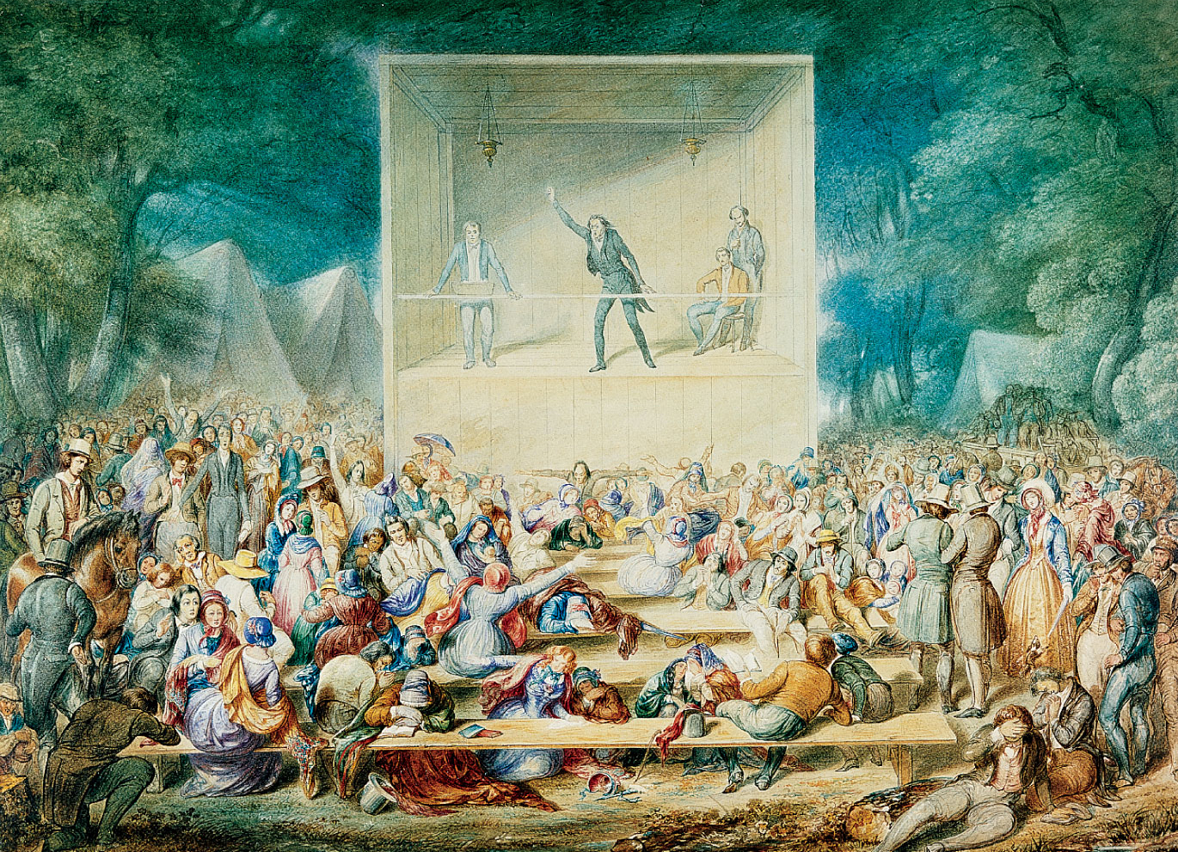
p308
Notes:
Religious Camp Meeting, by
J. Maze Burbank, 1839 At
huge, daylong encampments,
repentant sinners dedicated
themselves to lives of personal
rectitude and social reform.
Fire-and-brimstone preachers
like the one depicted here
inspired convulsions, speaking
in tongues, and ecstatic singing
and dancing among the
converted. Out of this religious
upheaval grew many of the
movements for social
improvement in the pre–Civil
War decades, including the
abolitionist crusade.

Slide 11
Mormons!
Joseph Smith:
Church of Jesus Christ of Latter-Day Saints
Powerful collective unit in terms of voting
1844, Smith is murdered
Brigham Young:
1846-47: led the Mormons to Utah
Becomes a prosperous frontier society
Due to polygamy issues, Utah is not admitted as a state until 1896

Slide 12
Free Schools for a Free People!
Education was seen as a way to instill republican values.
Focus in school was more on discipline than learning.
Most people in the mid-1800s didn’t go past 6th grade.
Horace Mann:
Key reformer of education, promoted more schools, longer days, and expanded curriculum
Noah Webster:
Dictionary helped standardize the American language
Textbooks and readers used by millions of Americans
Black slaves in the South were legally forbidden from learning to read and write

Slide 13
Temperance and Prohibition
Heavy drinking decreased labor efficiency and fouled the sanctity of the family
American Temperance Society (Boston, 1826)
Urged drinkers to quit alcohol, organized children’s clubs.
Temperance crusaders used pictures, pamphlets, and lurid lectures to convey their messages.
Neal S .Dow
‘Father of Prohibition’
Maine Law of 1851 prohibited the manufacture and sale of intoxicating liquor, encouraged other states to pass laws
Openly flouted, later declared unconstitutional or repealed

Slide 14
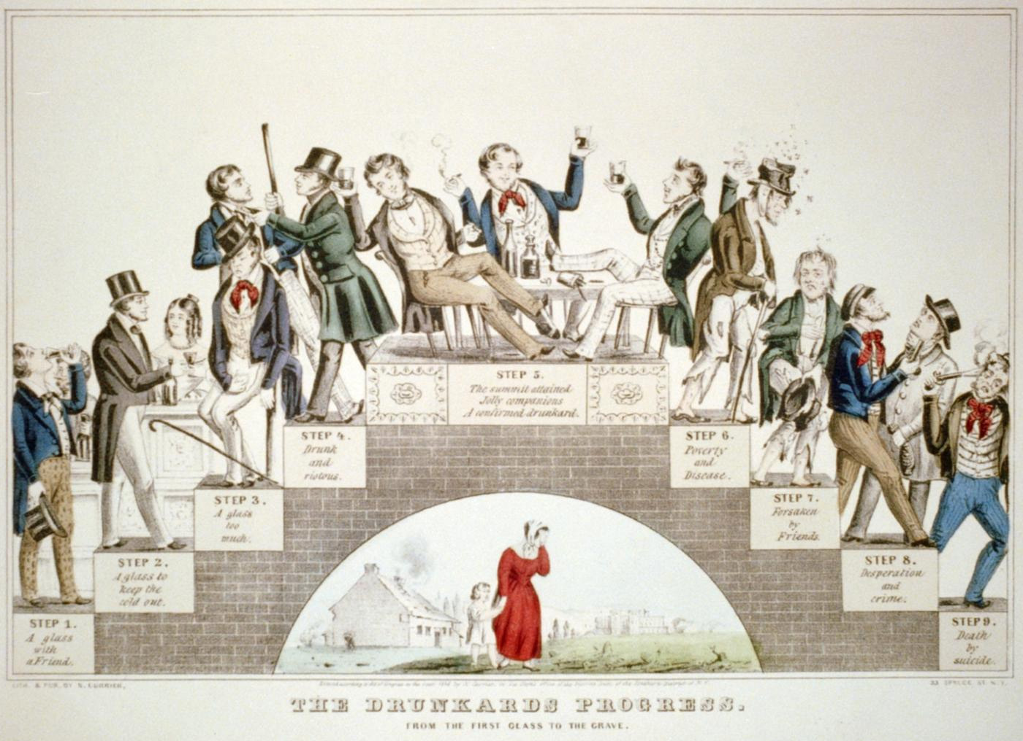
“The Drunkard’s Progress”
From the first glass to the grave, 1846

Slide 15
Women in Revolt
Women in America:
Nineteenth century was still a man’s world
Women in American had it better than in Europe
Women were still “the submerged sex” in America
Women now avoided marriage—10 % of adult women remained “spinsters” at the time of the Civil War
Gender differences were strongly emphasized in 1800s America:
Because the burgeoning market economy separated women and men into distinct economic roles.
The home was a woman’s special sphere, the centerpiece of the “cult of domesticity.”

Slide 16
Women in Revolt
Industrial Revolution separated women and men into sharply distinct roles.
Elizabeth Cady Stanton: advocated suffrage for women
Susan B. Anthony: lecturer on women’s rights.
Seneca Falls Convention (1848)
Stanton read a ‘Declaration of Sentiments’ which declared that ‘all men AND women are created equal’
Launched the modern women’s rights movement
Generally ignored at the time by males and the press, but sets precedent…turning point

Slide 17
Transcendentalism
Beliefs of transcendentalism:
A stiff-backed individualism in matters of religion as well as social
A commitment to self-reliance, self-culture, and self-discipline
Breed hostility to authority and formal institutions of any kind as well to all conventional wisdom
A romantic exaltation of the dignity of the individual, whether black or white—the mainspring of a whole array of humanitarian reforms

Slide 18
Transcendentalism
They rejected the prevailing empiricist theory of John Locke—that all knowledge comes to the mind through the senses
Truth ‘transcends’ the senses
Every person possesses an inner light that can illuminate the highest truth and put him/her in direct touch with God, or the ‘Oversoul.’
People can become one with nature: Thoreau lived in the woods for two years.
Walden: Or Life in the Woods *1854)
Ralph Waldo Emerson:
Advocated self-reliance and self-improvement, self-confidence, optimism, and freedom
Henry David Thoreau:
On the Duty of Civil Disobedience-protest of the Mexican American War and slavery
Influenced MLK and Gandhi

Slide 19
Transcendentalism
Margaret Fuller:
Woman in the Nineteenth Century (1845) a powerful critique of gender roles and an iconic statement of he budding feminist movement.
Walt Whitman (1819-1892):
His famous collection of poems Leaves of Grass (1855) highly emotional and unconventional, he dispensed with titles, stanzas, rhymes, and at times regular meter.
He located divinity in commonplace natural objects as well as the human body.

Slide 20
Wilderness Utopias
Utopias:
40 communities of a cooperative, communistic, or “communitarian” nature were set up:
Robert Owen founded in 1825 a communal society of a thousand people at New Harmony, Indiana
Brook Farm, Mass. 200 acres was started in 1841 with the brotherly and sisterly cooperation of about 20 intellectuals committed to the philosophy of transcendentalism
Destroyed by fire, the whole adventure in “plain living and high thinking” collapsed in debt.

Slide 21
Wilderness Utopias (cont.)
Oneida Community (1848), founded in New York:
It practiced free love (“complex marriage”), birth control through “male continence” and the eugenic selection of parents to produce superior offspring
Flourished for 30 years, largely because its artisans made superior steel traps and Oneida Community (silver).
Shakers:
Longest-lived sect, founded in England (1774) by Mother Ann Lee
Attained a membership of 6000 in 1840
But since their monastic customs prohibited both marriage and sexual relations, they were virtually extinct by 1940.

Slide 22
Artistic Achievements
After the War of 1812, American painters turned from human portraits and history paintings to pastoral mirrorings of local landscapes.
The Hudson River school: 1820s and 1830s
Thomas Cole and Asher Durand celebrated the raw sublimity and grand divinity of nature
Cole’s The Oxbow (1836) portrayed the ecological threat of human encroachment on once pristine environments
His masterpiece five-part series The Course of Empire (1833-1836) depicted the cyclical rise and fall of human civilization—an analogy of industrialization and expansion.

Slide 23
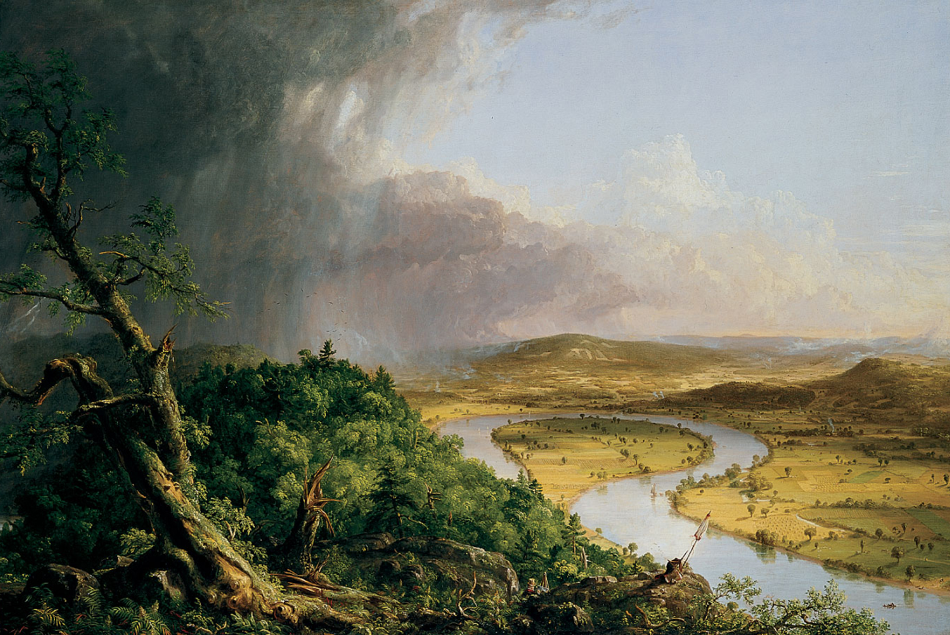
p326
Notes:
The Oxbow, by Thomas Cole, 1836 T his rendering of the oxbow of the Connecticut
River near Northampton, Massachusetts, after a thunderstorm is considered one of
Cole’s (1801–1848) masterpieces. A leader of the so-called Hudson River school, Cole
wandered on foot over the mountains and rivers of New York State and New England,
making pencil studies from which he painted in his studio during the winter. He and
other members of this group transformed their realistic sketches into lyrical, romantic
celebrations of the beauty of the American wilderness.

Slide 24
Development of American Literature
Henry Wadsworth Longfellow (1807-1882):
One of the most popular poets produced in America
Some of his most admired narrative poems—Evangeline (1847), The Song of Hiawatha (1855), The Courtship of Miles Standish (1858)
He was the first American to be enshrined in the Poet’s Corner of Westminster Abbey.
John Greenleaf Whittier (1807-1892):
Was the uncrowned poet laureate of the antislavery crusade

Slide 25
Development of American Literature
Louisa May Alcott (1832-1888):
Little Women (1868).
Emily Dickinson (1830-1886):
Lived as a recluse—an extreme example of the romantic artist’s desire for social remove
In deceptive spare language and simple rhyme schemes she explored universal theses of nature, love, death, and immortality
She hesitated to publish her poems, but after her death nearly 2000 were found and published.

Slide 26
Development of American Literature
Not all writers believed in human goodness and social progress.
Edgar Allen Poe (1809-1849):
He was a gifted poet, as the mesmerizing rhythms of “The Raven” (1845) attest
He excelled in the short story, especially Gothic horror type
He was fascinated by the ghostly and ghastly, as in “The Fall of the House of Usher.”

Slide 27
Two writers reflected the continuing Calvinist obsession with original sin and with the never-ending struggle between good and evil:
Nathaniel Hawthorne (1804-1864):
His masterpiece was The Scarlet Letter (1850); describes the practice of forcing an adulteress to wear a scarlet “A” on her clothing
In The Marble Faun he explores the concepts of the omnipresence of evil
Herman Melville (1819-1891):
His masterpiece, Moby Dick (1851), a complex allegory of good and evil
It had to wait until the twentieth century for readers and for proper recognition

Slide 28
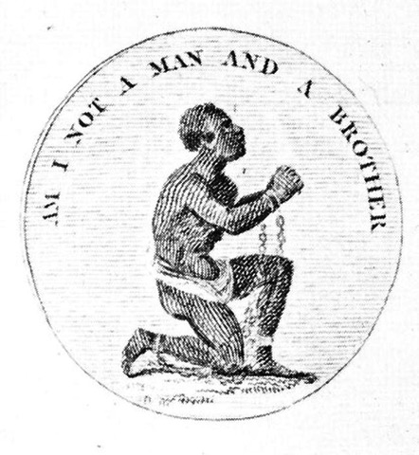
The Abolitionists
Varieties of abolition
Sympathy for slaves – sympathy for whites
Freed slaves should be incorporated as American citizens – transported away
Nonviolent – violent
Religious – rational
Black and white
Men and women

Slide 29
Early Abolitionist Efforts
1816 → American Colonization Society created (gradual, voluntary emancipation)
Freed slaves to be transported back to Africa
Create a free slave state in Liberia, West Africa.
No real anti-slavery sentiment in the North in the 1820s & 1830s

Slide 30
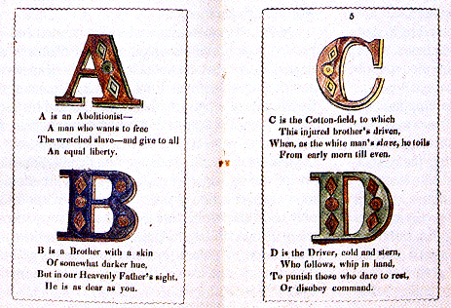
Abolitionist Alphabet

Slide 31
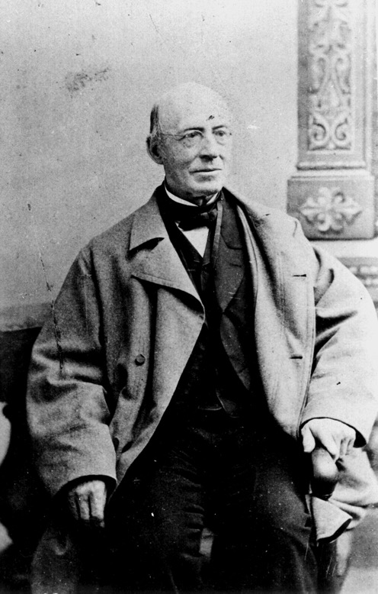
William Lloyd Garrison (1801-1879)
Slavery was a moral evil
It undermined the republic
Constitutionality of slavery was blight on America
Immediate emancipation w/o compensation
Started newspaper, The Liberator

Slide 32
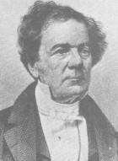
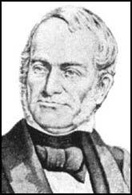
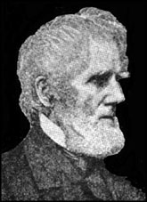
Other White Abolitionists
Lewis Tappan
James Birney
Abolition through political means: Liberty Party
Ran for President in 1840 & 1844
Arthur Tappan

Slide 33
Black Abolitionists
David Walker (1785-1830)
1829 → Appeal to the Coloured Citizens of the World
Fight for freedom rather than wait to be set free by whites
Harriet Jacobs (1813-1897)
North Carolinian slave
Escaped slavery and became writer and abolitionist
Wrote account of her life as a slave, Incidents in the Life of a Slave Girl, 1861

Slide 34
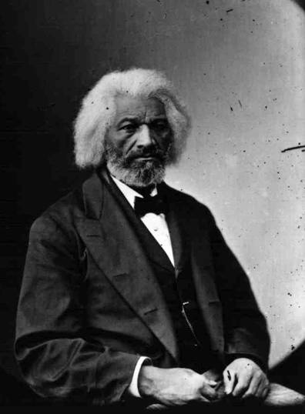
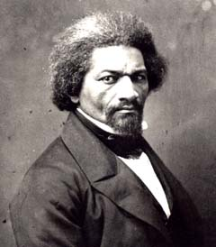
Frederick Douglass
1845 → The Narrative of the Life of Frederick Douglass
1847 → “The North Star”
R2-12

Slide 35
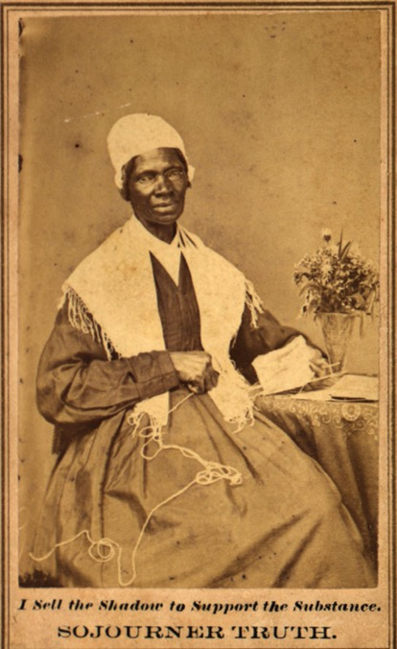
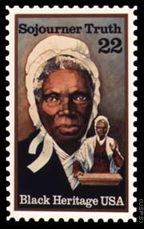
Sojourner Truth (1787-1883)
1850 → The Narrative of Sojourner Truth

Slide 36
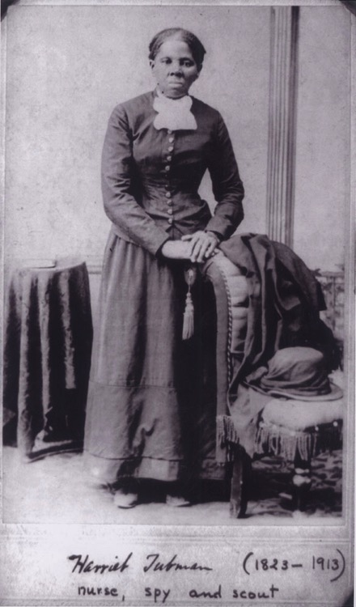
Harriet Tubman (1820-1913)
Helped over 300 slaves to freedom
Called “Moses” for her efforts to lead slaves north to “the promised lands” of northern states and Canada
$40,000 bounty on her head
Served as a Union spy during the Civil War

Slide 37
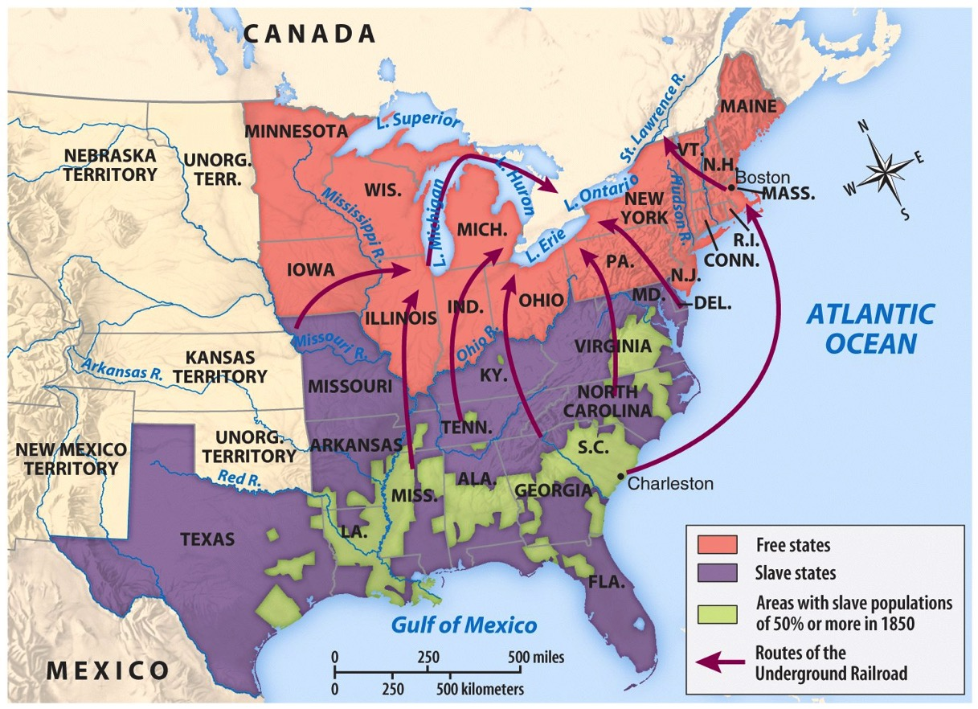
The Underground Railroad

Slide 38
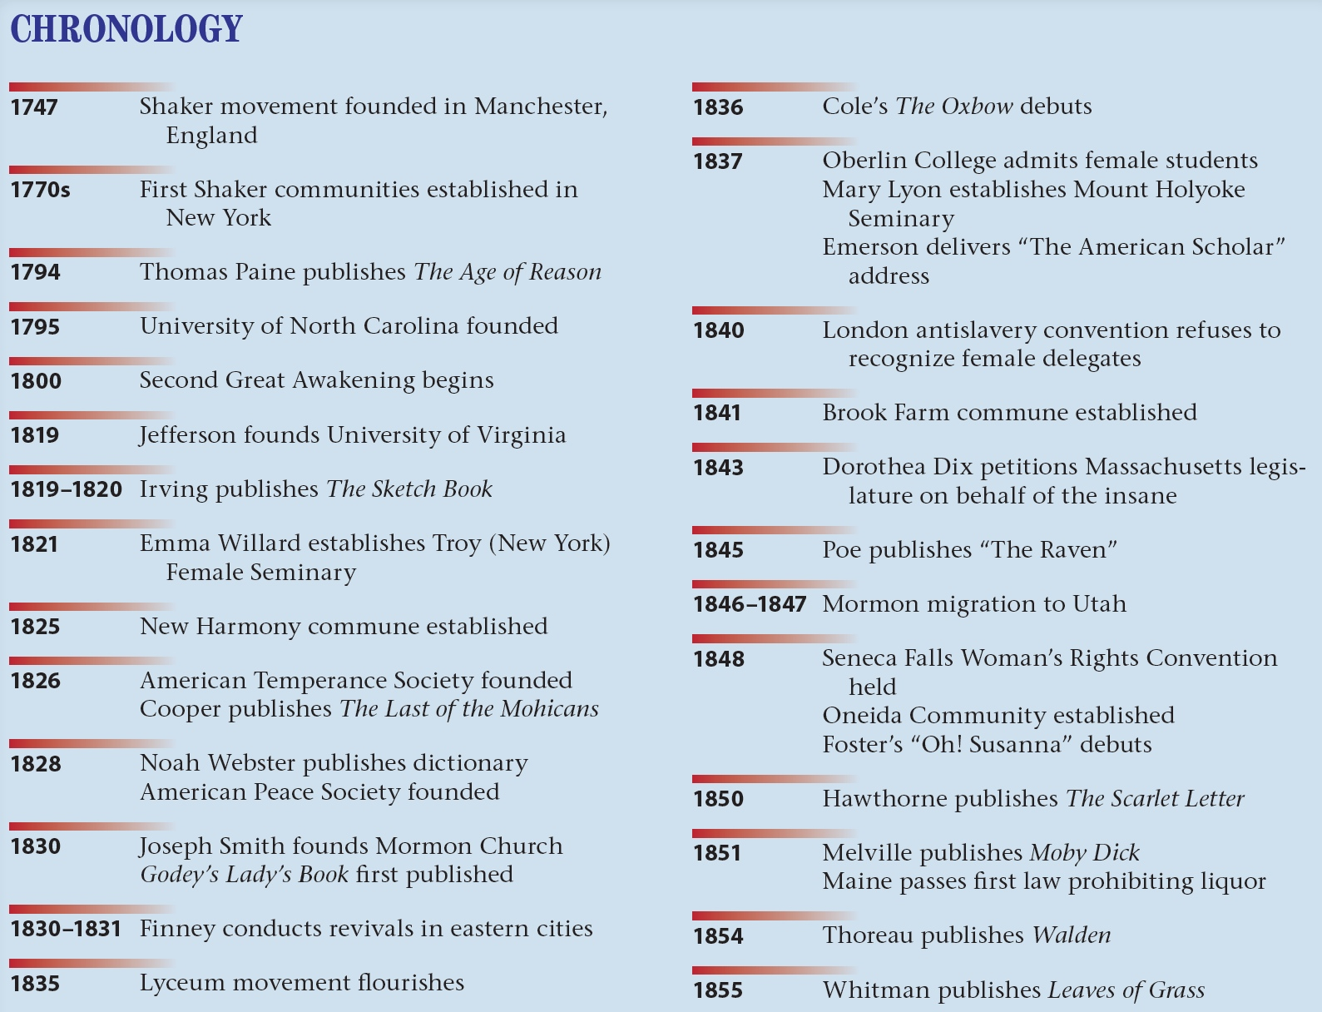
p335

