Slide 1
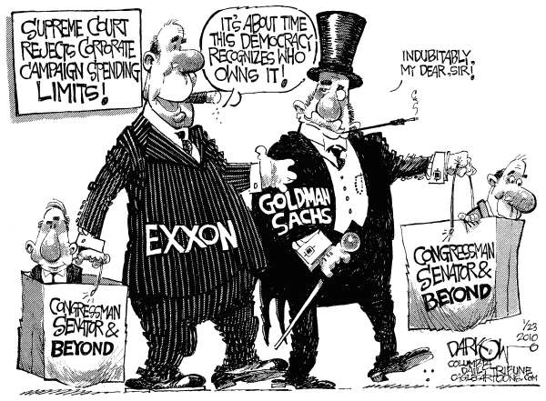

Slide 2
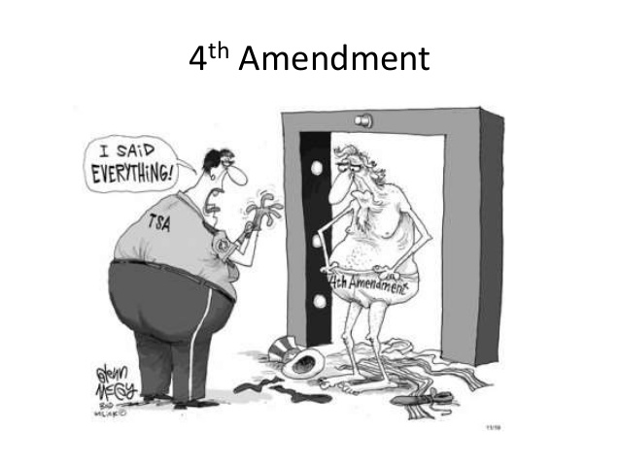

Slide 3
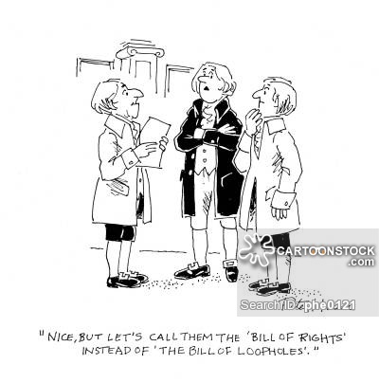

Slide 4
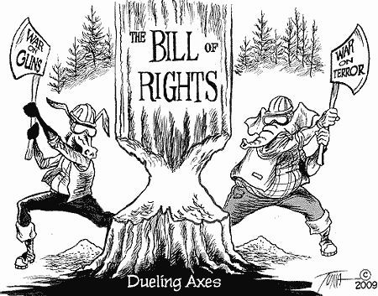

Slide 5
3.1: Civil Liberties
Mr. Winchell
AP GoPo
Unit 3: Civil Liberties and Civil Rights

Slide 6
Differences Between Civil Liberties and Civil Rights
Civil Liberties
Guaranteed freedoms for individuals and protections from government action
Freedom of speech, press, assembly, religion, petition, trial by jury, legal representation
Due process (5th Amendment and 14th Amendment)
Civil Rights
Guaranteed protections of groups from discrimination, prejudice, inequality, injustice
Equal protection (14th Amendment)

Slide 7
Civil Liberties v. Civil Rights
Civil Liberties:
Basic rights and freedoms that are…
Protected either in the Bill of Rights, Constitution, or interpreted in Courts
Free Speech, Free Press, Free from Search & Seizure, etc.
Civil Rights:
Basic right to be free from unequal treatment based on certain protected characteristics (race, gender, disability)
What establishes these protections?
14th Amendment: Equal Protection Clause
What right’s affected? (Civil Lib.) v. Whose rights affected? (Civil Rights)
Notes:
Protection from government
Protect people against arbitrary or discriminatory treatment by government officials.

Slide 8
Original Constitutional Guarantees
Writ of Habeas Corpus (Article I, Section 9)
Informed of charges
No Bills of Attainder (Article I, Section 9)
Due process
No Ex Post Facto (Article I, Section 9)
After the fact
Trial By Jury (Article III, Section 2)
Treason (Article III, Section 3)
Levying war or aiding the enemy; two witnesses to crime
Privileges and Immunities (Article IV, Section 2)
Guaranteed in all states
No Religious Test (Article VI)
No declaration of religion or religious oath to hold public office

Slide 9
Bill of Rights
First Amendment
Establishment and free exercise of religion, speech, press, assembly, petition
Second Amendment
Right to bear arms
Third Amendment
Quartering soldiers
Fourth Amendment
Searches and seizures
Fifth Amendment
Grand jury, double jeopardy, self-incrimination, due process, eminent domain
Sixth Amendment
Speedy and fair public trial by jury, informed of charges, confrontation of witnesses, right to attorney
Seventh Amendment
Trial by jury in civil cases
Eighth Amendment
Cruel and unusual punishment
Ninth Amendment
Un-enumerated rights
Tenth Amendment
Reserved powers

Slide 10
Fourteenth Amendment
Citizenship Clause
Privileges and Immunities Clause
Due Process Clause
Equal Protection Clause
INCORPORATION/Selective Incorporation
Barron v. Baltimore (1833)
Bill of Rights only applied to federal government
Applying the Bill of Rights to the states through the Due Process Clause
Almost all of the Bill of Rights have been incorporated

Slide 11
Civil Liberties First Amendment – Establishment Clause
“Congress shall make no law respecting an establishment of religion…”
Prohibits government from establishing any official religion or sponsoring any religion(s) over others
Everson v. Board of Education (1947)
Incorporated Establishment Clause to states
Engel v. Vitale (1962)
School-sanctioned public prayer unconstitutional
LEMON V. KURTZMAN (1971)
LEMON TEST: a law must…
Primarily secular purpose
Neither aid nor inhibit religion
Not create excessive government/religion entanglements

Slide 12
Civil Liberties First Amendment – Free Exercise Clause
“Congress shall make no law…prohibiting the free exercise thereof.”
Individuals may believe in any religion or in no religion
Religious belief protected; religious practices restricted
Incorporated by Cantwell v. Connecticut (1940)
Religious Freedom Restoration Act (1993)
Reynolds v. United States (1879)
Prohibits polygamy despite Mormon practice
Wisconsin v. Yoder (1972)
Amish may not be required to send children to school beyond 8th grade
Oregon v. Smith (1990)
Prohibits the use of illegal drugs for religious purposes
Church of the Lukumi Babalu Aye v. City of Hialeah (1993)
Animal sacrifice for Santeria is protected

Slide 13
Civil Liberties First Amendment - Speech
Pure speech is verbal
Symbolic speech is actions and symbols
Alien and Sedition Acts (1798)
Espionage Act (1917); Sedition Act (1918)
Time, place, or manner/free speech zones
Slander
Schenck v. United States (1919)
Clear and present danger
Gitlow v. New York (1925)
Incorporated free speech to the states
Upheld law prohibiting advocating for violent overthrow of the government
Tinker v. Des Moines (1969)
Black armbands worn by high school students protesting Vietnam Conflict protected
Brandenburg v. Ohio (1969)
Inflammatory speech protected as long as no imminent danger
Mere advocacy of violent overthrow insufficient
Miller v. California (1973)
OBSCENITY TEST: defined obscenity as
Themes appeal to indecent sexual desires based on contemporary community standards
Clearly offensive sexual behavior prohibited by state law
Lacks serious literary, artistic, political, or scientific value
Texas v. Johnson (1989)
Flag burning protected as symbolic speech
Reno v. ACLU (1997)
Regulating internet speech unconstitutional – Communications Decency Act of 1996

Slide 14
Civil Liberties First Amendment – Press
Print Media
Newspapers, magazines
Broadcast Media
Radio, television, film
Libel
Near v. Minnesota (1931)
PRIOR RESTRAINT
Incorporated free press to the states
New York Times v. Sullivan (1964)
Criticism of public officials protected
New York Times v. United States (1971)
Pentagon Papers
Hazelwood School District v. Kuhlmeier (1988)
Student newspapers may be censored for school safety

Slide 15
Civil Liberties First Amendment – Assembly
“…right of the people peacefully to assemble…”
Dejonge v. Oregon (1937)
Incorporated free assembly to states
Communist Party may be formed
Freedom of association
NAACP v. Alabama (1958)
Requirement of membership lists unconstitutional
Boy Scouts of America v. Dale (2000)
Private organization may limit membership based on expressive guidelines and despite anti-discrimination laws

Slide 16
Civil Liberties First Amendment - Petition
“…petition the Government for a redress of grievances.”
House of Representatives’ gag rule
Edwards v. South Carolina (1963)
incorporated to states

Slide 17
Civil Liberties Second Amendment
“A well regulated militia being necessary to the security of a free state, the right of the people to keep and bear arms shall not be infringed.”
District of Columbia v. Heller (2008)
Firearm possession unrelated to militia protected
Overturned handgun ban
McDonald v. Chicago (2010)
Incorporated to the states

Slide 18
Civil Liberties Third Amendment
“No soldier shall, in time of peace be quartered in any house, without the consent of the owner, nor in time of war, but in a manner to be prescribed by law.”

Slide 19
Civil Liberties Fourth Amendment
“The right of the people to be secure in their persons, houses, papers, and effects, against unreasonable searches and seizures, shall not be violated, and no Warrants shall issue, but upon probable cause, supported by Oath or affirmation, and particularly describing the place to be searched, and the persons or things to be seized.”
“A man’s home is his castle.”
Unreasonable search and seizure
Wolf v. Colorado (1949)
Incorporated to states; exclusionary rule not applied to states
Mapp v. Ohio (1961)
EXCLUSIONARY RULE
Nix v. Williams (1984)
Inevitable Discovery OR Discovery Rule
United States v. Leon (1984)
Good Faith Exception
Horton v. California (1990)
Plain view exception

Slide 20
Civil Liberties Fifth Amendment – Rights of Accused
Grand Juries
“No person shall be held to answer for a capital, or otherwise infamous crime, unless on a presentment or indictment of a grand jury, except in cases arising in the land or naval forces, or in the militia, when in actual service in time of war or public danger…”
Presented evidence to either indict or not
Closed deliberations; no attorney present
Not incorporated
Double Jeopardy
“…nor shall any person be subject for the same offense to be twice put in jeopardy of life or limb…”
May not be tried twice for same offense
Does not protect from other sovereign courts (state courts, federal courts, foreign courts)
Incorporated – Benton v. Maryland
Self-Incrimination
“…nor shall be compelled in any criminal case to be a witness against himself…”
One may not be compelled to testify against oneself
Miranda v. Arizona (1966)
Right to remain silent, right to an attorney, provision of attorney
New York v. Quarles (1984)
Public Safety Exception

Slide 21
Civil Liberties Fifth Amendment – Due Process
“…nor be deprived of life, liberty, or property, without due process of law…”
Procedural due process
Laws enforced according to proper and legal procedures
Substantive due process
Determination of fairness and constitutionality of laws and policies

Slide 22
Civil Liberties Fifth Amendment – Property Rights
Eminent Domain
“…nor shall private property be taken for public use, without just compensation.”
Private property may be confiscated by the government solely for public use and through just compensation
Incorporated through Chicago, Burlington & Quincy Railroad Co. v. City of Chicago (1897)

Slide 23
Civil Liberties Sixth Amendment – Trial and Counsel
“In all criminal prosecutions, the accused shall enjoy the right to a speedy and public trial, by an impartial jury of the state and district wherein the crime shall have been committed, which district shall have been previously ascertained by law, and to be informed of the nature and cause of the accusation; to be confronted with the witnesses against him; to have compulsory process for obtaining witnesses in his favor, and to have the assistance of counsel for his defense.”
Speedy and Public Trial
Trial by Impartial Jury
Notice of Accusations
Confront Witnesses
Attain Witness Testimony
Right to Counsel
GIDEON V. WAINWRIGHT (1963)
Right to attorney if cannot afford one
Incorporated to states
Escobedo v. Illinois (1964)
Right to attorney during police interrogations

Slide 24
Civil Liberties Eighth Amendment – Cruel and Unusual Punishment
“Excessive bail shall not be required, nor excessive fines imposed, nor cruel and unusual punishments inflicted.”
Protection against excessive bail and fines
No cruel and unusual punishment
Incorporated in 1962
Furman v. Georgia (1972)
Death penalty unconstitutional based on arbitrary sentencing
Gregg v. Georgia (1976)
Death penalty constitutional based on circumstances of case

Slide 25
Civil Liberties Ninth Amendment – Un-enumerated Rights
“The enumeration in the Constitution, of certain rights, shall not be construed to deny or disparage others retained by the people.”
Right to Privacy
GRISWOLD V. CONNECTICUT (1965)
Prohibition of contraceptives violated marital privacy
ROE V. WADE (1973)
Webster v. Reproductive Health Services (1989)
Allows states to restrict government funding for abortion services
Planned Parenthood v. Casey (1992)
No undue burden on mothers prior to viablity of fetus
Parental consent for minors

Slide 26
A View on First Red Scare
A. Mitchell Palmer – “The Case Against the Reds” (1920)
National Popular Government League – “Report Upon the Illegal Practices of the United States Department of Justice” (1920)
It has been impossible in short a space to review the entire menace of the internal revolution in this country as I know it, but this may serve to arouse the American citizen to its reality, its danger, and the great need of united effort to stamp it out, under our feet, if needs be. It is being done. The Department of Justice will pursue the attack of these “Reds” upon the Government of the United States with vigilance, and no alien, advocating the overthrow of existing law and order in this country, shall escape arrest and prompt deportation. It is my belief that while they have stirred discontent in our midst, while they have caused irritating strikes, and while they have infected our social ideas with the disease of their own minds and their unclean morals, we can get rid of them! and not until we have done so shall we have removed the menace of Bolshevism for good.
Under the guise of a campaign for the suppression of radical activities, the office of the Attorney General, acting by its local agents throughout the country, and giving express instructions from Washington, has committed continual illegal acts. Wholesale arrests both of aliens and citizens have been made without warrant or any process of law… There is no danger of revolution so great as that created by suppression, by ruthlessness, and by deliberate violation of the simple rules of American law and American decency... It is a fallacy to suppose that, any more than in the past, any servant of the people can safely arrogate to himself unlimited authority. To proceed upon such a supposition is to deny the fundamental American theory of the consent of the governed.
Notes:
The Department of Justice Is Defending America from Communist Subversion; The Department of Justice Is Violating Constitutional Freedoms

Slide 27
USA PATRIOT ACT (2001)
National Security
Individual Liberties
9/11
“…provide for the common defence…”
Information Sharing
Roving Wiretaps
Access to Records
“Sneak & Peek” Warrants
Material Support
Metadata Collection*
Detainment of Immigrants/Non-Citizens
Habeas Corpus
First Amendment
Fourth Amendment
“reasonable expectation of privacy” – Katz v. U.S. (1967)
Fifth Amendment
Sixth Amendment

Slide 28
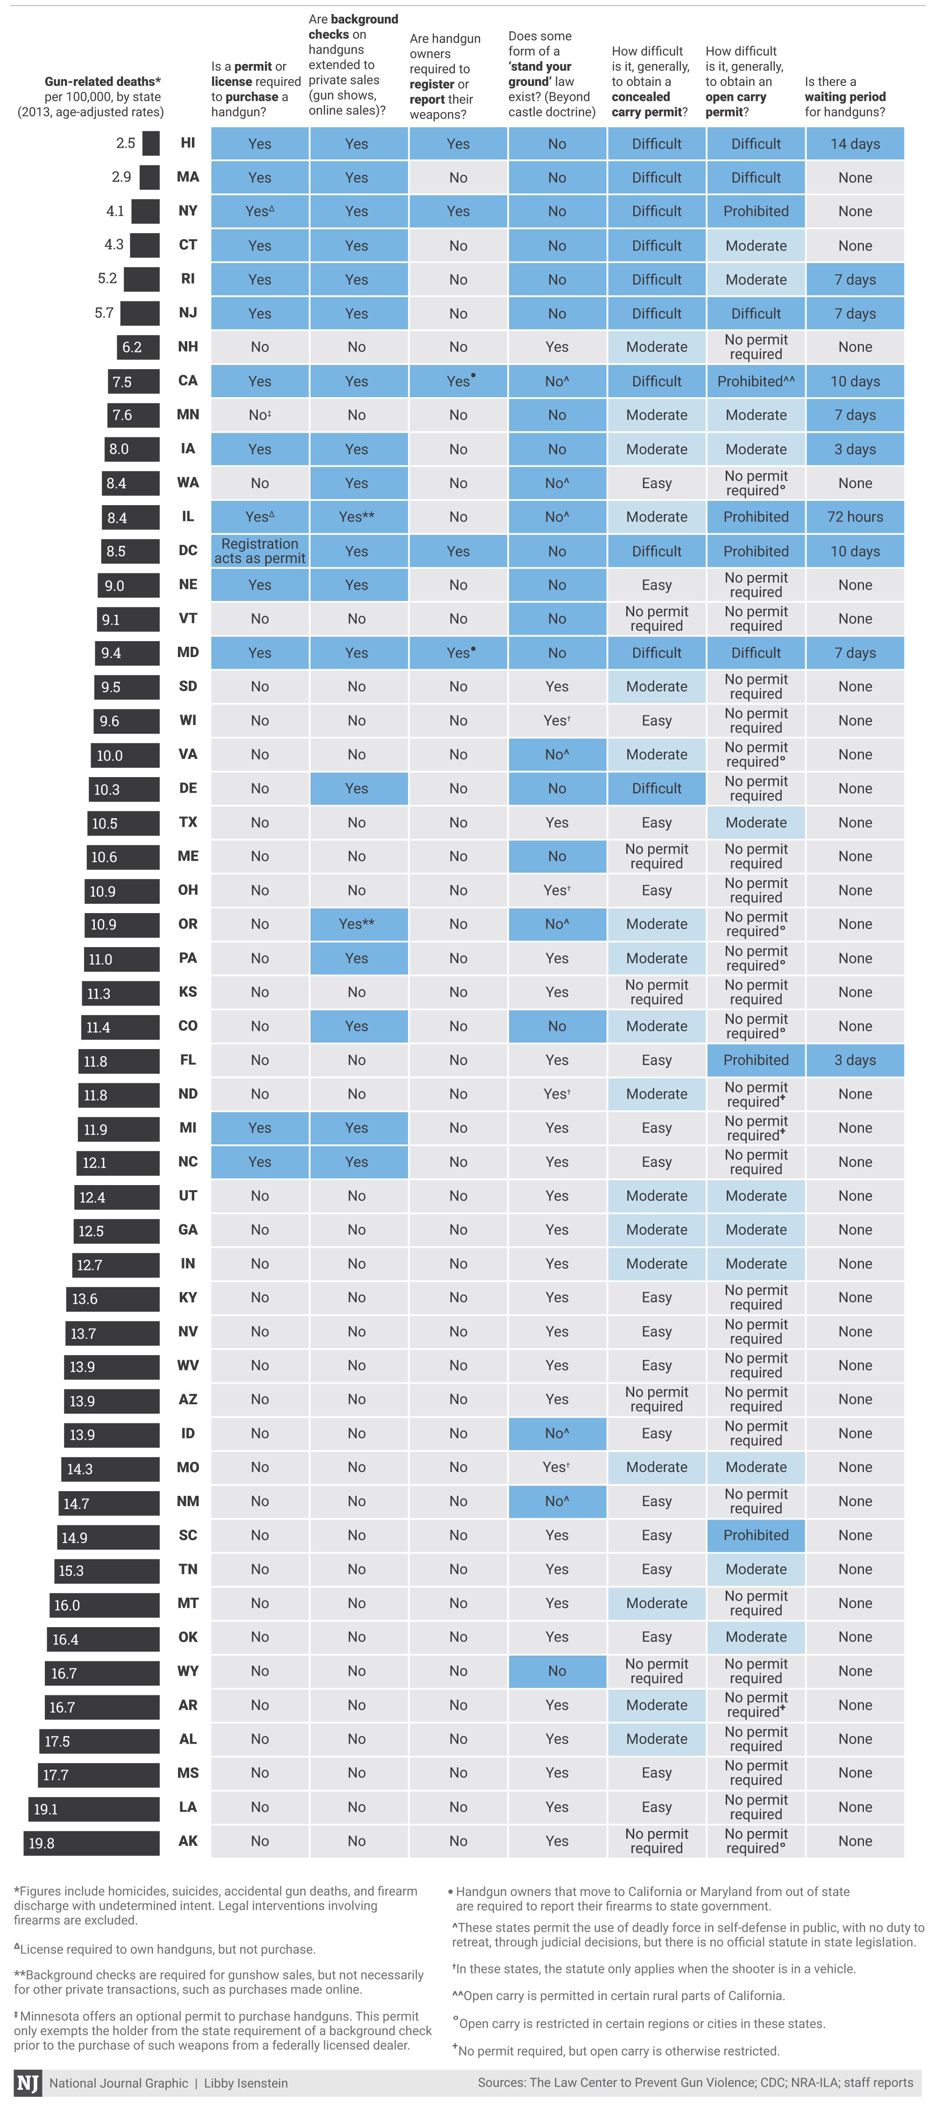
Source: National Journal

