Slide 1
America in WWI
Mr. Winchell
APUSH
Period 7

Slide 2
The “MAIN” Causes of WWI
The underlying causes that created a powder keg in Europe that was ready to explode.
Militarism: The large European powers began an industrial military arms race.
Alliances: an intricate system of national treaties and alliances developed in Europe that would compel most of the world to declare war at the slightest incident.
Imperialism: A growing rivalry over European trade, colonies, and spheres of influence in Africa and Asia
Nationalism: (love of country and willingness to sacrifice and even die for it ) among the countries of the world
The Immediate cause of WWI (the spark that lit the keg’s fuse)
The assassination of Archduke Ferdinand of Austria-Hungary

Slide 3
American Neutrality
When war was declared in Europe in July 1914, Wilson proclaimed American neutrality due to:
Tradition of non-involvement
Progressives & women organized against war
America as a land of immigrants should not take sides in Europe
The majority of the U.S. supported the Allies but wanted to avoid war
Notes:
10

Slide 4
Threats to American Neutrality
Germany blamed the war on Russian expansion & French revenge
England appealed to cultural ties & propaganda of Germans atrocities
U.S. neutrality was threatened from the very beginning:
England & Germany appealed to the U.S. to enter on their side
U.S. trade with England & France provided a strong bond
The most serious threat proved to be Germany’s violation of the right to “freedom of the seas”

Slide 5
Freedom of the Seas
England began a blockade around Germany to cut off war supplies:
Wilson protested that the blockade infringed on America’s right to trade as a neutral nation
But the flood of Allied war orders helped fuel the U.S. economy
Loans & trade drew the U.S. closer to the Allies while trade with Germany all but ended
By 1916, the U.S. was a “neutral” nation in name only
The U.S. gave $2.5 billion in loans to the Allies, but only $27 million to the Central Powers
Trade with the Allies caused U.S. trade to jump from $2 billion to $6 billion from 1913 to 1916
Notes:
11

Slide 6
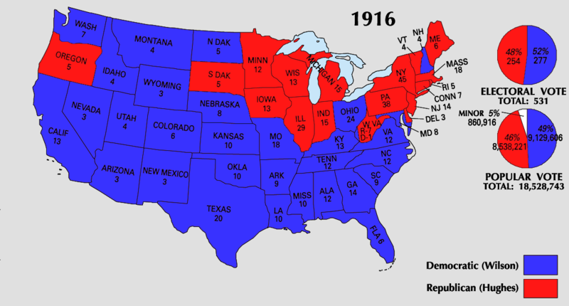
Election of 1916
In the 1916 election, Wilson balanced contrasting stances:
He appealed to progressives & anti-war voters with the slogan “He kept us out of war”
But argued for “preparedness” by building up the military in case the U.S. joins the war
Wilson won by affirming 2 goals: freedom of the seas & neutrality
Notes:
13

Slide 7
America Joins the Allies
German leaders knew this might entice the USA to enter the war…but did it anyway
In December 1916, Germany led a massive European offensive & resumed unrestricted submarine warfare to win the war
In 1917, Wilson hoped for a “peace without victory” but key events made neutrality impossible:
German subs sunk 5 U.S. ships
The interception of Zimmerman Telegram fueled U.S. anger
Notes:
14

Slide 8
Mobilization
The army & navy increased in size but military leaders had not prepared a plan for war (“To plan for war is to violate the terms of neutrality”)
Wilson named John Pershing to head the American Expeditionary Force (AEF), but despite Wilson’s preparedness campaign, the U.S. was not prepared for full scale war
Many wanted a volunteer army, but Wilson pressed Congress to pass a Selective Service Act (24 million registered & 2.8 million were drafted to fight in Europe)
Notes:
15
Bad sign—US military’s most recent battle experience was chasing Pancho Villa in Mexico but did not catch him.
Selective Service Act called for all men aged 21-30 then raised to 18-45

Slide 9
“Over Here”
To win over there, the U.S. had to effectively mobilize over here
Wilson consolidated federal authority to organize U.S. war production & distribution
Wilson began a massive propaganda campaign aimed at winning over the American public to support the war effort

Slide 10
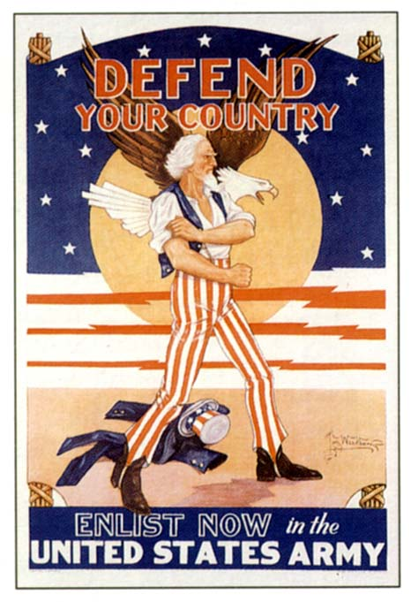
American Propaganda: George Creel’s Committee on Public Information (CPI)

Slide 11
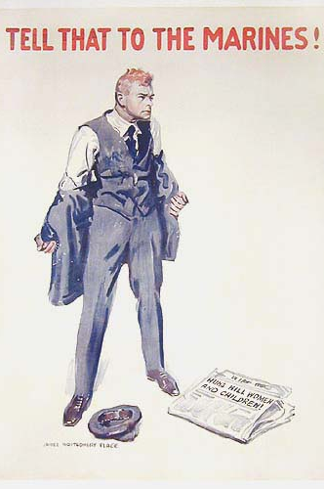

Slide 12
Homefront Propaganda
Wilson formed the Committee on Public Information (CPI) & hired muckraker George Creel to publicize the U.S. war effort:
Voluntary censorship in press
75,000 “4-minute men” gave speeches (facts or emotions?)
Propaganda motion picture films
Led to sweeping anti-German sentiment & some vigilantism
“Why We Are Fighting” & “The Meaning of America”
Sauerkraut was renamed “Liberty Cabbage” & pretzels were no longer served in bars
The Prussian Curse &
The Kaiser, the Beast of Berlin
Bach, Beethoven, & Brahms were not played in symphonies
Notes:
17

Slide 13
Homefront Censorship
Wilson encouraged censorship:
Espionage Act—aiding the enemy, obstructing troop recruitment, or encouraging “disloyalty” were declared illegal
Trading-with-the-Enemy Act—censored the foreign press
Sedition Act—made it illegal to speak “disloyally” towards the U.S. gov’t, the flag, or U.S. troops
Wilson set out to encourage U.S. unity (like Lincoln during the Civil War, Wilson was willing to use force if needed)

Slide 14
Homefront Censorship
Schenk was sentenced for conspiracy to circulate pamphlets encouraging soldiers to mutiny
Eugene V. Debs was jailed when his Socialist newsletter Appeal to Reason encouraged Americans to resist enlisting in the military to fight a “capitalists’ war”
First Amendment restrictions were upheld by the Supreme Court:
3 cases were decided in 1919: Schenk v US, Debs v US, Abrams v US that supported gov’t convictions under the Espionage Act of 1917
The gov’t used the wartime climate to undermine radical labor unions (IWW) & socialism
Socialism in the U.S. never recovered from WWI attacks
Defendants passed out documents that denounced the sending of U.S. troops to Russia (to resist the Bolshevik Revolution) & that called for a general strike & other “revolutionary actions”
1st Amendment rights can be restricted when it presents a “clear & present danger”
(Like “yelling ‘fire’ in a crowded theater”)
Notes:
Schenck v. United States
Citation: 249 U.S. 47 (1919) Concepts: Clear & Present Danger/Free Speech v. Congressional War Powers
Facts
Charles T. Schenck and Elizabeth Baer, charged with conspiring to print and circulate documents intended to cause insubordination within the military, were convicted of violating the Espionage Act of 1917. The act made it a crime to “willfully cause or attempt to cause insubordination, disloyalty, mutiny, or refusal of duty in the military ... or to willfully obstruct the recruiting service of the United States.” Schenck appealed the conviction to the Supreme Court of the United States, claiming all his actions were protected by the First Amendment.
Issue
Whether Schenck’s and Baer’s First Amendment right to freedom of speech were violated when they were convicted of conspiring to obstruct the recruitment and enlistment of service.
Opinion
The Court unanimously upheld the conviction of Schenck, not for violation of the Espionage Act, but rather for conspiracy to violate it. The Court found that the First Amendment did not apply in this case, and that Schenck’s speech was not constitutionally protected because it posed a “clear and present danger” to the country. The nation was involved in World War I, and the Court saw Schenck’s speech and action as counter-productive to the national war effort. The Court reasoned that certain speech could be curtailed, using the example of a situation where one cannot yell “fire” in a crowded theatre.
Debs v. United States
Citation: 249 U.S. 211 (1919) Concepts: Free Speech v. Congressional War Powers
Facts
Eugene V. Debs, a well-known socialist, gave a public speech to an assembly of people in Canton, Ohio. The speech was about the growth of socialism and contained statements which were intended to interfere with recruiting and advocated insubordination, disloyalty, and mutiny in the armed forces. Debs was arrested and charged with violating the Espionage Act of 1917.
Issue
Whether the United States violated the right of freedom of speech given to Debs in the First Amendment of the United States Constitution.
Opinion
The Supreme Court of the United States upheld the lower court’s decision in favor of the United States. The Court said that Debs had actually planned to discourage people from enlisting in the Armed Forces. The Court refused to grant him protection under the First Amendment freedom of speech clause, stating that Debs “used words [in his speech] with the purpose of obstructing the recruiting service.” Debs’ conviction under the Espionage Act would stand, because his speech represented a danger to the safety of the United States.
Abrams v US
Facts of the Case
The defendants were convicted on the basis of two leaflets they printed and threw from windows of a building. One leaflet signed "revolutionists" denounced the sending of American troops to Russia. The second leaflet, written in Yiddish, denounced the war and US efforts to impede the Russian Revolution. The defendants were charged and convicted for inciting resistance to the war effort and for urging curtailment of production of essential war material. They were sentenced to 20 years in prison.
Question
Do the amendments to the Espionage Act or the application of those amendments in this case violate the free speech clause of the First Amendment?
Conclusion
No and no. The act's amendments are constitutional and the defendants' convictions are affirmed. In Clarke's majority opinion, the leaflets are an appeal to violent revolution, a call for a general strike, and an attempt to curtail production of munitions. The leaflets had a tendency to encourage war resistance and to curtail war production. Holmes and Brandeis dissented on narrow ground: the necessary intent had not been shown. These views were to become a classic libertarian pronouncement.

Slide 15
Homefront: The Red Scare
A “red scare” hit America as a result of the Russian Revolution
Americans feared Lenin’s anti-capitalist revolution & were angry over Russia’s pullout on the Eastern Front
Wilson sent troops to the USSR, refused to recognize the new gov’t, & did not allow Russia to attend the post-war conference

Slide 16
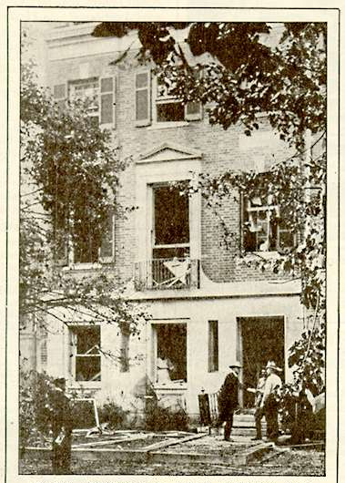
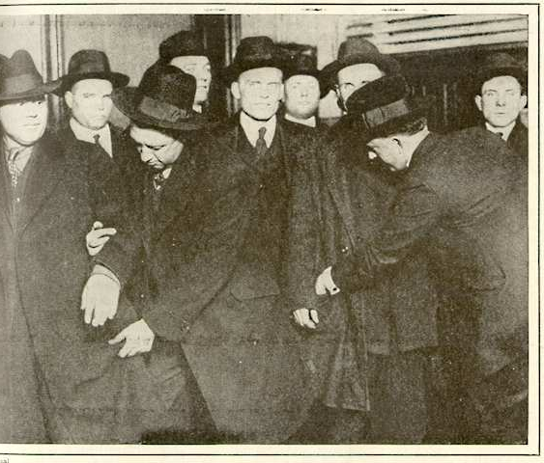
The Red Scare: Palmer Raids
Palmer used this act of violence as an opportunity to invoke the Alien Act of 1918 & arrested or deported ~6,000 suspected radicals (some were innocent U.S. citizens)
U.S. Attorney General Mitchell Palmer’s home was bombed
Police arrested “suspected Reds’ in Chicago, 1920

Slide 17
A Bureaucratic War
To coordinate the war effort, 5,000 new gov’t agencies were created:
War Industries Board (WIB) oversaw all factories, determined priorities, fixed consumer prices
Food Admin supplied food to soldiers by appealing to civilians
Fuel Admin rationed coal & oil
RR Admin, War Shipping Board, & War Trade Board helped move resources to troops
Imposed “gasless” days & shut down factories for days to divert or conserve fuel
WIB director Bernard Baruch became the “dictator of the American economy”
Asked for a spirit of self-sacrifice, imposed “meatless” & “wheat-less” days & encouraged Americans to plant “victory gardens”
Notes:
18

Slide 18
Workers in the War
WWI led to a new alliance between the gov’t & labor unions:
AFL headman Gompers was named to the Council of Nat’l Defense to help enlist union support for the war effort
War Labor Board (WLB) was formed to standardize wages & hours, protect union rights, & give equal pay for women
Notes:
19

Slide 19
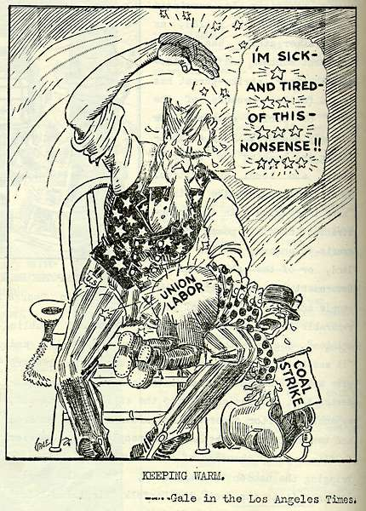
Coal Miner’s Strike 1919
But the WLB seized companies during strikes (national interests come first!)
“Keeping Warm” Los Angeles Times

Slide 20
Workers in the War
The war called for more laborers:
8 million women found new, better-paying jobs in war industry (but few housewives entered the workforce, unlike WW2)
450,000 Southern African Americans moved north for new industrial jobs & better pay (led to race riots)
100,000 Mexican-Americans laborers worked in SW farms & ranches
Notes:
20

Slide 21
Conclusions
9 million soldiers & 5 million civilians died
U.S. had only 320,000 casualties (6.8%)
American soldiers were only engaged in battle for 8 months
The “Great War” was a total war but the U.S. effort paled in comparison to other Allied forces:
The U.S. reluctantly entered WWI after 3 years of neutrality & played a supportive (not a central) military role in the war
But, WWI had a huge impact on the American economic, political, & cultural homefront
Artillery, poison gas, grenades, machine guns led to trench warfare & war of attrition
The Allies had 52% casualties; the Central Powers had 57%

Slide 22
Wilson’s Fourteen Points
Wilson believed WW1 presented an opportunity for the USA to take the lead towards world peace:
Wilson saw moral diplomacy as the antidote to imperialism & military aggression
Wilson’s plan for peace was the Fourteen Points based on progressive liberalism & improved international relations
A faith in government to solve international problems

Slide 23
The Treaty of Versailles
Austria
Hungary
Yugoslavia
Wilson’s Fourteen Points contained 3 main themes:
To create new nations out of weakened empires based on “national self-determination”
To create new internat’l rules: freedom of the seas, no more secret treaties, reduce militarism
To create a League of Nations to solve future problems
Poland
Czechoslovakia
Turkey
Notes:
21

Slide 24
Paris Peace Conference, 1919
The treaty was a compromise:
Poland, Czech, Yugoslavia were formed but Germany’s colonies were split up by the victors
Germany had to accept the “war guilt clause” & pay $33 billion
The treaty did not mention free trade or freedom of seas
Despite calls for open covenants, the treaty was drafted in secret
Wilson originally hoped for a “peace without victory”

Slide 26
Paris Peace Conference, 1919
On June 28, 1919, the Treaty of Versailles was signed by Germany & officially ended WWI
But, Wilson could not sign the treaty & formally end America’s involvement in WWI; According to Article I of the Constitution, the U.S. Senate has the power to ratify all treaties
Unfortunately for Wilson, many Senators did not like the treaty because of the League of Nations

Slide 27
Why did the US Reject the Treaty of Versailles?
Critics of the Treaty believed that the League would drag the US into future European wars (Senator Henry Cabot Lodge)
Americans were “war weary” and wanted to return to isolationism
Wilson suffered a stroke and was unable to sell the treaty to the people
The US refused to join the League of Nations, making the League a “paper tiger” or weak on the world stage.

Slide 28
The True Sons of Freedom
Du Bois’ New Negro:
“We return. We return from fighting. We return fighting.”
Returning black soldiers: “I’m glad I went. I done my part & I’m going to fight right here until Uncle Sam does his.”

Slide 29
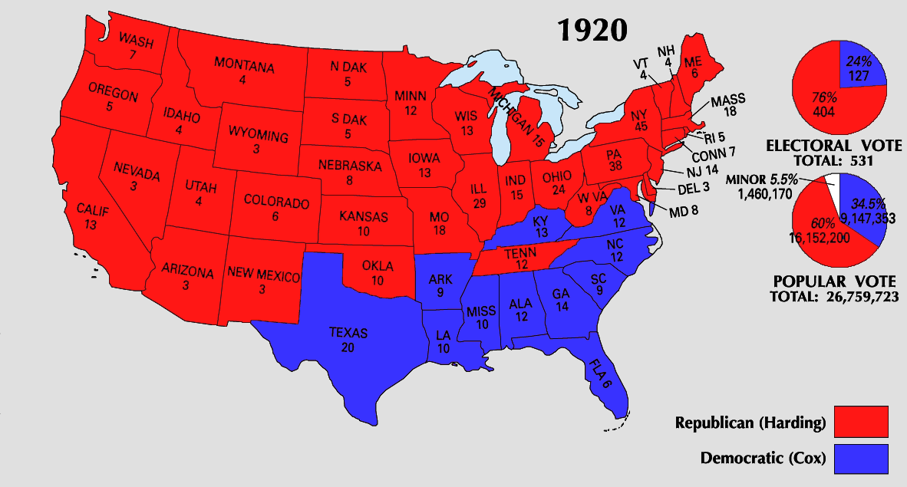
Rejection in the Senate
Wilson’s failure to compromise led the “irreconcilables” & “strong reservations” to defeat the treaty
The United States never signed the Treaty of Versailles nor joined the League of Nations
In 1920, the Republican Warren Harding won in a landslide signaling a “return to normalcy”
“Compromise? Let Lodge compromise… Better a thousand times to go down fighting than to dip your colors to a dishonorable compromise.”
—Woodrow Wilson

Slide 30
Postwar Disillusionment
The war killed “something precious and perhaps irretrievable in the hearts of thinking men and women”
The impact of the Great War:
The U.S. played a key role the international peace process
Led to unprecedented economic prosperity & gov’t involvement but killed Progressivism
To the next generation, the war seemed futile & wasteful
Americans welcomed President Harding’s return to “normalcy”
This sentiment was driven by a group of authors in France & America calling themselves the “Lost Generation”
A promise “not of heroics but healing; not nostrums but normalcy; not revolutions but restoration”

Slide 31
Conclusions
At the beginning of the war, the United States owed $3 billion to foreign nations
World War 1 changed America:
The U.S. emerged as the world’s strongest economic power & ushered in the “Roaring 20s”
But the U.S. gov’t intervened in American lives as never before: draft, censorship, propaganda, war bonds, partnering with big business & unions
At the end of the war, foreign nations owed the U.S. $13 billion

Slide 32
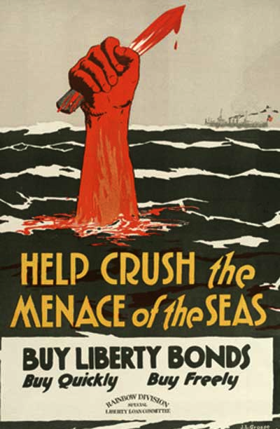
Impact of War
Women got suffrage!
Prohibition Passes - grain shortages for alcohol?
Committee on Public Information: promoted war and demonized enemy
Curtailing dissent:
Espionage Act: Post office could ban treasonable stuff from mail
Sedition Act: Can’t say “disloyal or profane” language against the government
Debs arrested
Constitutional? (Schenck v. U.S.) justified?

