Slide 1
Civil Rights Movement-Key Concepts
Mr. Winchell
APUSH
Period 8

Slide 2
Discuss how the civil rights movement evolved during the 1950s and 1960s and explain each of the three developments.
For African Americans, the path from slavery to full civil rights was long and difficult. Several developments during the 1950s and 1960s legally guaranteed them full citizenship:
Montgomery Bus Boycott
Development:
Protests
sit-ins
24th Amendment
Civil Rights
for
African Americans
Development:
Warren Court
Development:
Johnson Presidency
Brown v. Board of Education
Voting Rights Act of 1965
Civil Rights Act of 1964

Slide 3
Key Concept 8.2: New movements for civil rights and liberal efforts to expand the role of government generated a range of political and cultural responses.

Slide 4
I: Seeking to fulfill Reconstruction-era promises, civil rights activists and political leaders achieved some legal and political successes in ending segregation, although progress toward equality was slow.

Slide 5
A: During and after World War II, civil rights activists and leaders, most notably Martin Luther King Jr., combatted racial discrimination utilizing a variety of strategies, including legal challenges, direct action, and nonviolent protest tactics.

Slide 6
A. During and after World War II, civil rights activists and leaders, most notably Martin Luther King Jr., combatted racial discrimination utilizing a variety of strategies, including legal challenges, direct action, and nonviolent protest tactics.
Civil Rights Leaders in the North AND South wanted an end to Jim Crow and segregation, an end to the lack of voting and civil rights, to sharecropping, and to institutionalized racism.
A. Philip Randolph and March on Washington
Executive Order 8802 (Fair Employment Practices Commission)
Double V Campaign
Congress of Racial Equality (CORE)
Jackie Robinson
McLaurin v. Oklahoma (Thurgood Marshall-banned segregation of college students on campus)
Brown v. Board (UNANIMOUSLY overturned Plessy v. Ferguson and separate but equal on the basis of the 14th’s equal protection clause)
Rosa Parks in 1955-Montgomery Bus Boycott (SC ruled in 1956 that bus segregation was illegal)
SCLC-nonviolent efforts against racism
Sit-ins in Greensboro, NC-contagious
1960: Founding of SNCC-trained a generation of civil rights leaders

Slide 7
A. During and after World War II, civil rights activists and leaders, most notably Martin Luther King Jr., combatted racial discrimination utilizing a variety of strategies, including legal challenges, direct action, and nonviolent protest tactics.
Civil Rights Leaders in the North AND South wanted an end to Jim Crow and segregation, an end to the lack of voting and civil rights, to sharecropping, and to institutionalized racism.
CORE begins Freedom Rides-faced beatings and arrests at hands of resurgent KKK
JFK doesn’t want to but sends in federal marshals (TV coverage)
May ‘63-March on Birmingham-Bull Connor and the dogs-TV cameras change the game
Letter from a Birmingham Jail
JFK calls for a new civil rights bill-then dies-LBJ capitalizes
August ‘63-March on Washington-’I have a Dream’
1964: Freedom Summer
1965: March on Selma-Bloody Sunday-LBJ’s ‘We Shall Overcome’ Speech
Civil Rights Act of 1965 passed that summer

Slide 8
B: The three branches of the federal government used measures including desegregation of the armed services, Brown v. Board of Education, and the Civil Rights Act of 1964 to promote greater racial equality.

Slide 9
B: The three branches of the federal government used measures including desegregation of the armed services, Brown v. Board of Education, and the Civil Rights Act of 1964 to promote greater racial equality.
It took work and time from all three branches of government to respond to the activism of the Civil Rights Movement
Truman-Presidential Committee on Civil Rights-Desegregated federal bureaucracy (Black vote and personal beliefs)
Eisenhower: Brown v. Board-Little Rock 9 to force integration/protect students
1962: Congress proposed 24th Amendment-abolishing poll taxes-ratified in ‘64
JFK calls for Civil Rights Act in 1960 but failed to get one (Solid South)
Southern violence being televised changes popular opinion…can’t win a war without public support
JFK dies-LBJ pushes Civil Rights Act-bans discrimination based on race, religion, national origin, sex. Banned discrimination in schools and public facilities, enforceable
Voting Rights Act of 1965-outlawed literacy tests, enforced by fed. Gov.
LBJ: ‘We’ve lost the South for a generation’
Eventual-Forced busing

Slide 10
C: Continuing white resistance slowed efforts at desegregation, sparking social and political unrest across the nation. Debates among civil rights activists over the efficacy of nonviolence increased after 1965.

Slide 11
C: Continuing white resistance slowed efforts at desegregation, sparking social and political unrest across the nation. Debates among civil rights activists over the efficacy of nonviolence increased after 1965.
The Civil Rights Movement caused tension across the country as people resisted forced efforts at desegregation & equal right
White Southern Senators used filibusters, the KKK used violence and intimidation, school districts used local courts, communities wanted the status quo.
CRA and VRA of ‘64/’65 –Finally enforce the 14th and 15th but do not change circumstances
Race riots-Watts, Detroit, others
King becomes turning to issues of poverty, opposition to Vietnam, assassinated
Malcolm X-spokesman for black nationalism/Nation of Islam-use of violence-assassinated
Stokely Carmichael-Black Power-not integrate w/White America
Black politicians begin grassroots organization

Slide 12
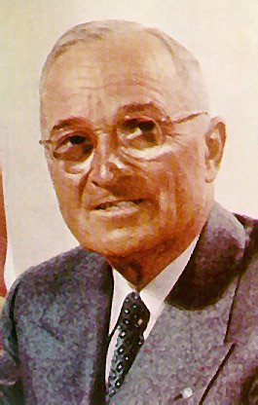
Civil Rights legal achievements
Harry Truman ordered the armed forces AND the government to be desegregated.

Slide 13
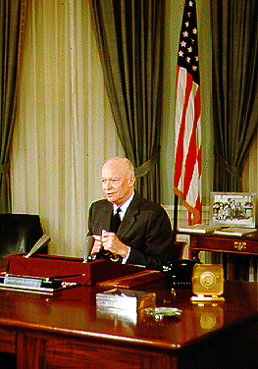
Dwight D. Eisenhower
Sent 101st airborne to Little Rock Central High School to maintain order

Slide 14
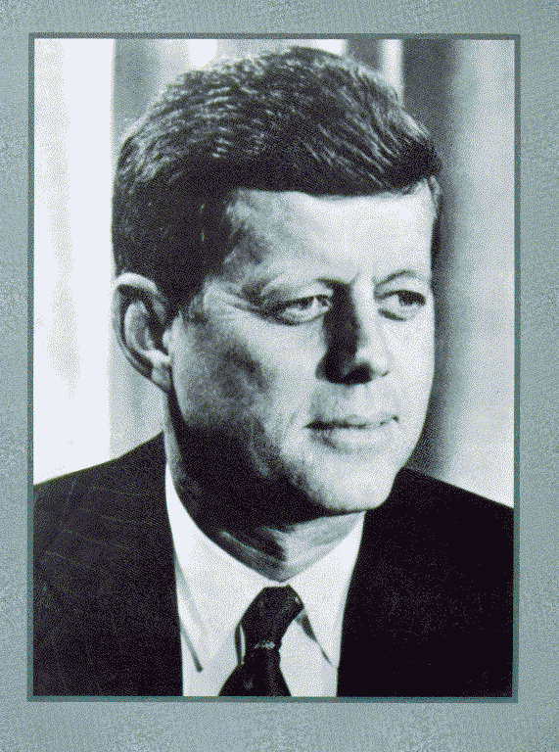
John F. Kennedy
Called Coretta Scott King to pledge support while MLK was in jail.
Eventually sent federal protection of freedom riders
Proposed need for civil rights legislation

Slide 15
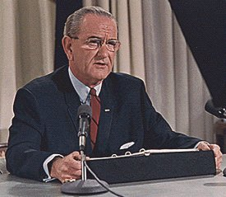
Lyndon Baines Johnson (LBJ)
Civil Rights Act of ’64
Civil Rights Act of ’68
Voting Rights Act of ’65
24th Amendment banning poll taxes

Slide 16
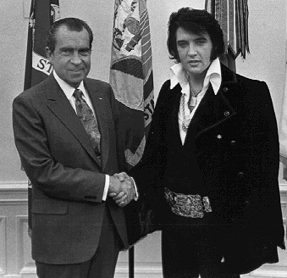
Richard Nixon 1969-1973
Nixon quietly pushed civil rights without much violence or headlines, especially housing discrimination

