Slide 1
Do Now
At what point was the Revolutionary War inevitable? Why?

Slide 2
3. Declaring and Winning Independence: A New Nation and its Ideological Roots
Mr. Winchell
APUSH 2019-2020
Period 1-2

Slide 3
AP Prompt
Evaluate the relative significance of differing causes for American independence.

Slide 4
Outline
Lead-up to Declaring Independence
Declaring Independence
Winning Independence
We Free! …Now what?

Slide 5
Lexington and Concord (April 19, 1775)
Organization of militia (Minutemen) compels Governor Gage to send 700 British soldiers to arrest rebel leaders and confiscate arms
William Dawes and Paul Revere
8 Minutemen die and 1 Redcoat wounded at Lexington
“Shot heard ‘round the world” at Concord

Slide 6
Decision for Independence
The Battle of Bunker Hill (Breed’s Hill) demonstrated that Americans were willing to stand up to a pitched battle
In early 1776, both Spain & France began shipping war supplies to colonists
The Lexington & Concord skirmish was the 1st of a series of conflicts from 1775 to 1776 before the American call for independence:
Fighting erupted around Boston, NY, Charlestown, & Quebec
The 2nd Continental Congress met to organize a war plan
King George declared the colonists in “open rebellion”
Despite growing calls for independence, the congress issued the Olive Branch Petition to King George in July 1775
King George rejected the Olive Branch Petition in August 1775
Notes:
20

Slide 7
Second Continental Congress
Delegates from 13 colonies begin meeting in May of 1775
An “illegitimate” national government dependent on state financing
Olive Branch Petition (July 1775)
Proclamation of Rebellion (August 1775)

Slide 8
Second Continental Congress
Delegates from 13 colonies begin meeting in May of 1775
Battles of Breed’s Hill and Bunker Hill (June 1775)
Olive Branch Petition (July 1775)
Proclamation of Rebellion (August 1775)
Prohibitory Act (December 1775)
Continental Army and George Washington
State Constitutions
Virginia Declaration of Rights (May 1776)
Independence Hall Debate
Declaration of Independence (July 1776)

Slide 9
Text Analysis
Virginia Declaration of Rights

Slide 10
Blacks and Slaves During the Revolution
Lord Dunmore’s Proclamation (1775)
Limited participation in Continental Army
Slavery as “necessary evil”
Northern states and abolition
Limited civil rights

Slide 11
Decision for Independence
By 1776, the 2nd Continental Congress served as an informal national gov’t for the colonies
But the majority of colonists were undecided about independence
Thomas Paine’s Common Sense proved to be the key factor in convincing Americans to support colonial independence
Challenged “royal infallibility”
Persuaded ordinary people to sever ties with England & its “royal brute”
Notes:
20

Slide 12
Thomas Paine’s Common Sense (January 1776)
“But Britain is the parent country, say some. Then the more shame upon her conduct. Even brutes do not devour their young, nor savages make war upon their families; wherefore the assertion, if true, turns to her reproach; but it happens not to be true, or only partly so and the phrase PARENT or MOTHER COUNTRY hath been jesuitically adopted by the king and his parasites, with a low papistical design of gaining an unfair bias on the credulous weakness of our minds. Europe, and not England, is the parent country of America. This new world hath been the asylum for the persecuted lovers of civil and religious liberty from EVERY PART of Europe. Hither have they fled, not from the tender embraces of the mother, but from the cruelty of the monster; and it is so far true of England, that the same tyranny which drove the first emigrants from home, pursues their descendants still.”
“As to government matters, it is not in the power of Britain to do this continent justice: The business of it will soon be too weighty, and intricate, to be managed with any tolerable degree of convenience, by a power so distant from us, and so very ignorant of us; for if they cannot conquer us, they cannot govern us. To be always running three or four thousand miles with a tale or a petition, waiting four or five months for an answer, which when obtained requires five or six more to explain it in, will in a few years be looked upon as folly and childishness--There was a time when it was proper, and there is a proper time for it to cease. Small islands not capable of protecting themselves, are the proper objects for kingdoms to take under their care; but there is something very absurd, in supposing a continent to be perpetually governed by an island. In no instance hath nature made the satellite larger than its primary planet, and as England and America, with respect to each other, reverses the common order of nature, it is evident they belong to different systems; England to Europe, America to itself. “
“Europe is too thickly planted with kingdoms to be long at peace, and whenever a war breaks out between England and any foreign power, the trade of America goes to ruin, BECAUSE OF HER CONNECTION WITH ENGLAND. The next war may not turn out like the last, and should it not, the advocates for reconciliation now, will be wishing for separation then, because, neutrality in that case, would be a safer convoy than a man of war. Every thing that is right or natural pleads for separation. The blood of the slain, the weeping voice of nature cries, 'TIS TIME TO PART. Even the distance at which the Almighty hath placed England and America, is a strong and natural proof, that the authority of the one, over the other, was never the design of Heaven. The time likewise at which the continent was discovered, adds weight to the argument, and the manner in which it was peopled increases the force of it. The reformation was preceded by the discovery of America, as if the Almighty graciously meant to open a sanctuary to the Persecuted in future years, when home should afford neither friendship nor safety. “

Slide 13
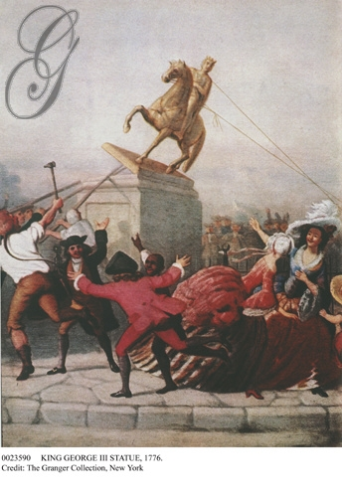
On June 7, 1776 Richard Henry Lee of VA introduced a resolution to the Continental Congress: “that these United Colonies are, and of right ought to be, free and independent States...” After several days of debate, Congress appointed a committee to draft a declaration of independence

Slide 14
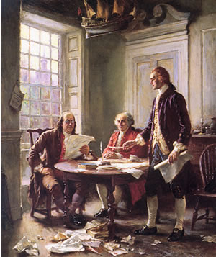
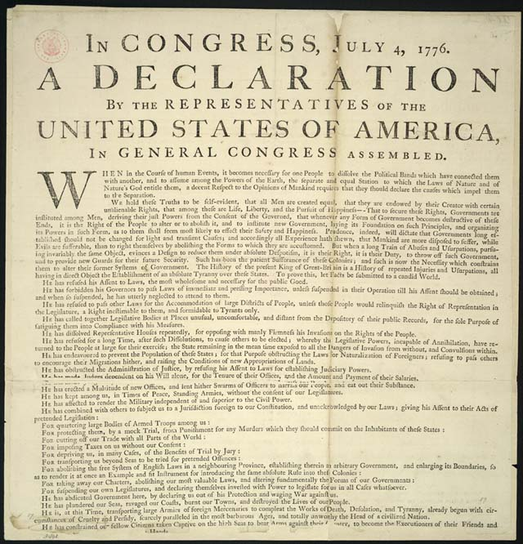
Declaration of Independence (1776)
Committee to draft the Declaration: Thomas Jefferson, Ben Franklin, John Adams, Robert Livingston, & Roger Sherman

Slide 15
Declaration of Independence (1776)
Applies laws of Nature
People’s right to revolution
“self-evident”
“all men are created equal”
Endowed…with certain unalienable rights…life, liberty, pursuit of happiness”
List of grievances against the British Empire, specifically toward George III
WHAT’S WRONG WITH THIS PICTURE IN REGARDS TO AMERICAN SOCIETY?

Slide 16
The Enlightenment
Colonists used the ideas of the Enlightenment to justify their protest
John Locke wrote that people have natural rights (life, liberty, & property) & should oppose tyranny
Rousseau believed that citizens have a social contract with their gov’t
Montesquieu argued that power should not be in the hands of a king, but separated among gov’t branches

Slide 17
Paine, Jefferson and Republicanism
While differing views existed on who should ‘run’ the new republic, if created, Paine and Jefferson SHARE the idea that representative government is foundational

Slide 18
Text Analysis
Declaration of Independence

Slide 19
America vs. Great Britain
American Advantages/Tactics
Militia’s guerilla tactics
Familiar with the territory and environment
Prolong the war
Hope for support from Britain’s enemies (France, Spain)
American Disadvantages
No well-trained regular army or officers
Insufficient funds and supplies
Small support among population (1/3 loyalists, 1/3 neutral, slaves)
British Advantages/Tactics
11 million Britons to America’s 2.5 million (1/3 slaves or loyalists)
World’s largest navy
Disciplined and experienced army
Support from Loyalists, Natives, and slaves
Entrenched forts and garrisons in America
British Disadvantages
War debt and war fatigue
American privateers (pirates) hounded British ships
Unpopular home support
Spread thin around the world

Slide 20
Patriots, Loyalists, Neutrals
Patriots (aka Whigs)
Supported independence, but may disagree on course of action (war, petition, boycott, etc.)
Advocated independence based on rhetoric and education on rights and liberties
Loyalists (aka Tories)
Loyalty to the Crown
Agreed about excess taxes, but against separation
Fear of a possible American victory
Recent British immigrants
Some neutral due to ignorance, apathy, or economic reasons

Slide 21
Building a Professional Army
Washington’s task was to defend as much territory as possible:
Relied on guerrilla tactics & avoided all-out-war with Britain
Washington’s Continental Army served as the symbol of the “republican cause”
But, colonial militias played a major role in “forcing” neutrals to support the Revolution
As long as England did not defeat the Continental Army, England could not win
Notes:
But Washington avoided “general actions” (all-out war) against Britain; understood importance of keeping Continental Army intact

Slide 22
The French Alliance
A lot of these points were negotiated by none other than Ben Franklin
And…England now has to worry about a possible (yet remote) invasion of England by France
Since 1775, the French covertly aided Americans with supplies
But after the “victory” at Saratoga:
France recognized America as a new, independent republic
France promised to pressure England to agree to American independence after war’s end
France relinquished all of its claims to territory in America
The turning point of the war!!
In 1778, England offered to remove all parliamentary legislation & vowed never to impose revenue taxes on the colonists again
The Continental Congress refused the offer
Notes:
25

Slide 23
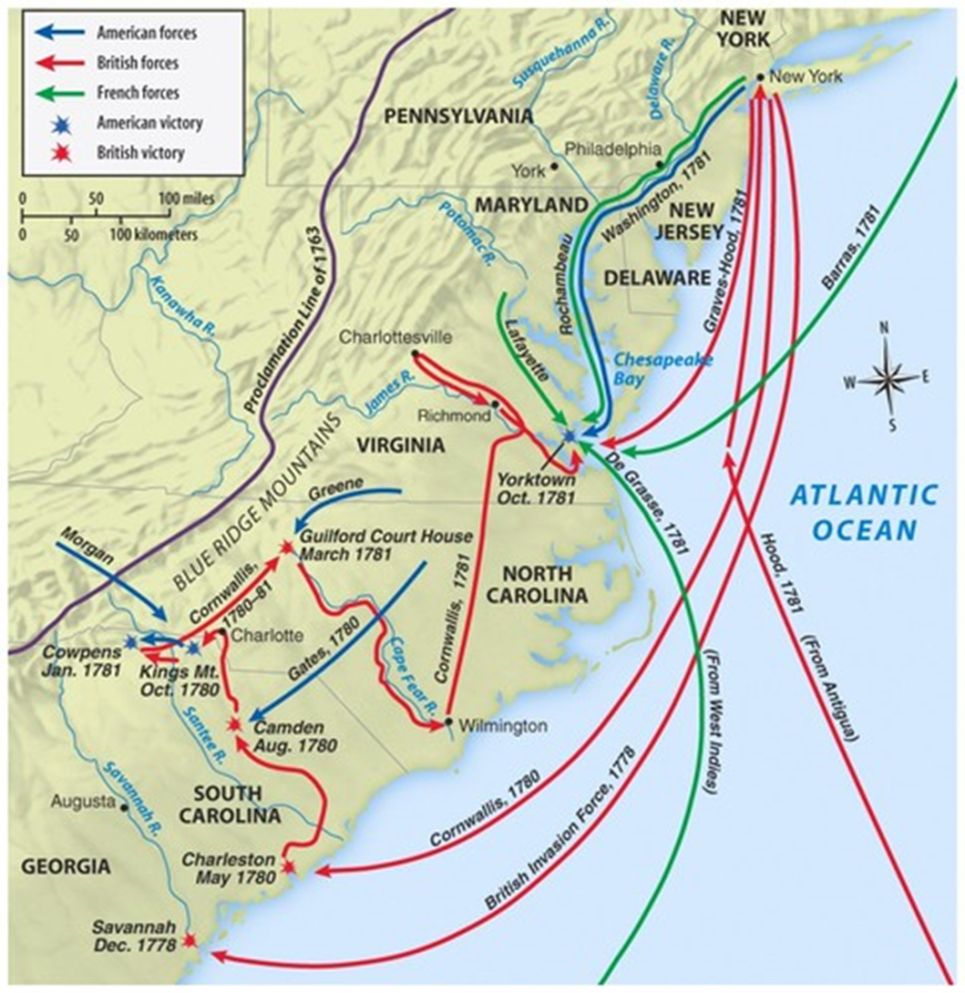
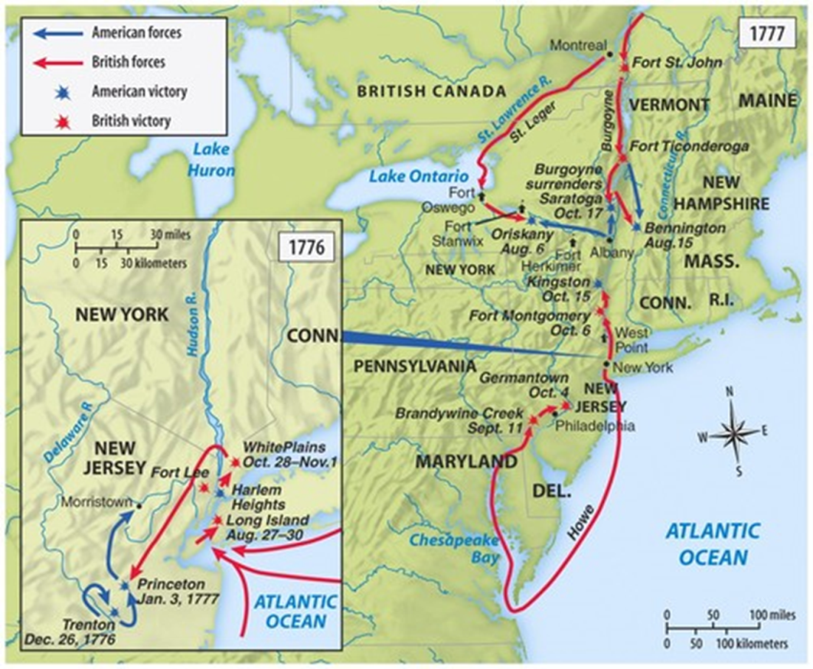
The War
In the North
Boston and New York under British control and conquest
Battles of Trenton (1776) and Princeton (1777)
Battle of Saratoga (Oct 1777)
Valley Forge (Winter 1777-78)
In the South
Lord Cornwalis’s strategy
Battle of Camden (1780)
Battle of Cowpens (1781)
Battle of Yorktown (1781)

Slide 24
The Outbreak of Revolution
In reality, England faced an impossible task:
Their long supply lines across the Atlantic would not be able to provide timely provisions
The American terrain was large
To win, the English had to find & defeat the Continental Army
Underestimated the colonial commitment to independence

Slide 25
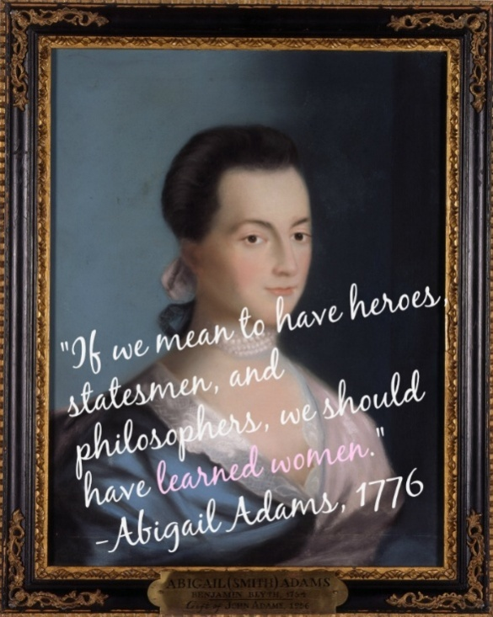
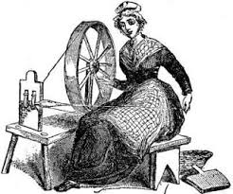
Women of the Revolution
Upper-class women promoted cause through correspondence
Participated against Stamp Act and Townshend Acts
Spinning bees
Ran households and estates during husband’s absence
Formed campaigns to promote war and funds (Mercy Otis Warren)
Abigail Adams
“…Remember the Ladies.”

Slide 26
Treaty of Paris (1783)
John Adams, Benjamin Franklin, John Jay
British recognition of USA
USA granted all lands east of the Mississippi
Natives left out of the treaty
States applying own interests led to British remaining in Northwest forts
Brand new and bigger nation… What now?
Treaty of Paris by Benjamin West

Slide 27
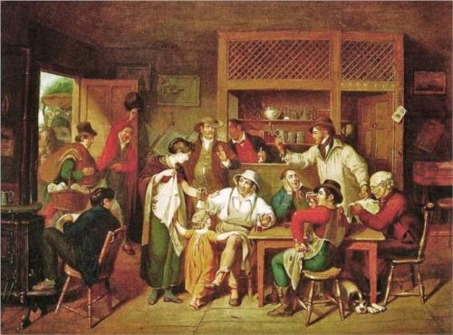
A “Revolutionary” Society
Liberalism and egalitarianism
Civil rights and private property
Republicanism and the common good
Representative government
Merits over Inheritance/Heredity
More and more self-made men participate in political leadership
Despite a new perception, the small upper class retained its status as owners of most of America’s wealth

Slide 28
North America after the Treaty of Paris, 1763

Slide 29
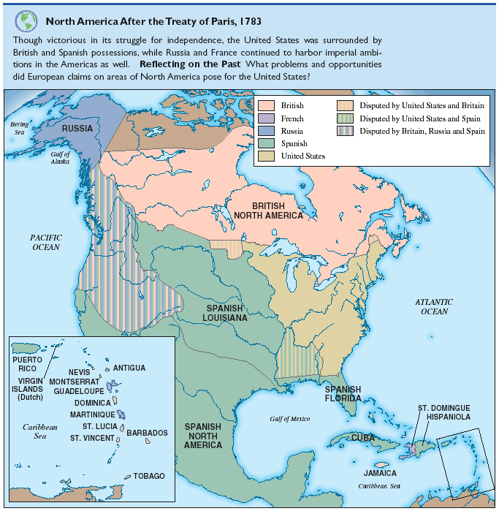
North America after the Treaty of Paris, 1783

Slide 30
The Loyalist Dilemma
Loyalists believed in liberty too, but feared that independence would breed anarchy in America
Loyalists were treated poorly:
The English never fully trusted the Loyalists
Patriots seized their property; imprisoned & executed others
More than 100,000 Loyalists left America when the war ended
Notes:
27

Slide 31
Governing the New Nation
State Constitutions
Second Continental Congress and the Articles of Confederation

Slide 32
Historiography A View on the American Revolution
Andrew Hacker, The Triumph of American Capitalism (1973)
Bernard Bailyn, The Ideological Origins of the American Revolution (1967)
The struggle was not over high-sounding political and constitutional concepts: over the power of taxation or even, in the final analysis, over natural rights. It was over colonial manufacturing, wild lands and furs, sugar, wine ,tea, and currency, all of which meant, simply, the survival or collapse of English mercantile capitalism within the imperial-colonial framework of the mercantilist system.
“The colonists believed they saw emerging from the welter of events during the decade after the Stamp Act a pattern whose meaning was unmistakable.…They saw about them, with increasing clarity, not merely mistaken, or even evil, policies violating the principles upon which freedom rested, but what appeared to be evidence of nothing less than a deliberate assault launched surreptitiously by plotters against liberty both in England and in America.…This belief transformed the meaning of the colonists’ struggle, and it added an inner accelerator to the movement of opposition.…It was this…that was signaled to the colonists after 1763, and it was this above all else that in the end propelled them to Revolution.”
Briefly explain ONE specific historical difference between Hacker’s and Bailyn’s interpretations.
Briefly explain how ONE historic event or development during the period 1750 to 1800 not explicitly mentioned in the excerpt that could be used to support Hacker’s view.
Briefly explain how ONE historic event or development during the period 1750 to 1800 not explicitly mentioned in the excerpt that could be used to support Bailyn’s view.
Notes:
Revolution as Product of Protecting Economic Interests; Revolution as Resulting from the Colonists’ Ideas about Liberty and Power

