Slide 1
Do Now
Identify some key differences in the New England (Northern) colonies from those discussed Thursday in the Chesapeake and Southern Colonies.

Slide 2
Development of New England & Middle Colonial Identity
Mr. Winchell
APUSH
Period 2

Slide 3
AP Prompt
Compare and contrast the motivations for colonization, economies, and regional identities of the New England, Middle, and Southern/Chesapeake Colonies.

Slide 4
Key Concepts
2.1.II.B:
The New England colonies, initially settled by Puritans, developed around small towns with family farms and achieved a thriving mixed economy of agriculture and commerce.
2.1.II.C:
The middle colonies supported a flourishing export economy based on cereal crops and attracted a broad range of European migrants, leading to societies with greater cultural, ethnic, and religious diversity and tolerance.

Slide 5
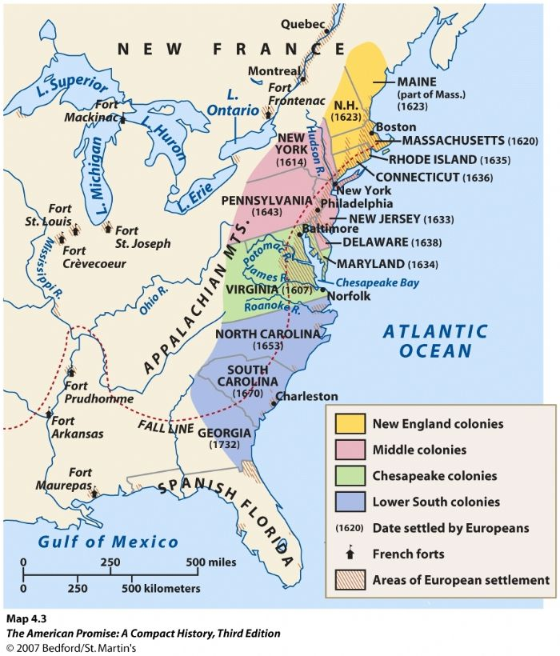

Slide 6
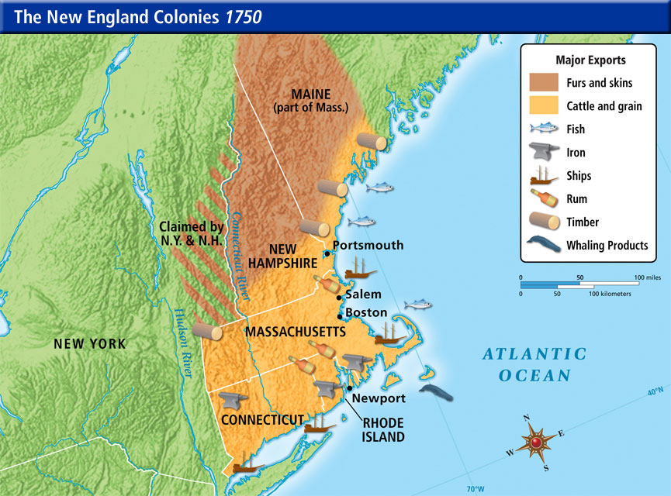

Slide 7
The Mayflower
1620 → a group of 102 people [half Separatists/half Puritans]]
Negotiated with the Virginia Company to settle in its jurisdiction.
Non-Separatists included Captain Myles Standish.
Plymouth Bay way outside the domain of the Virginia Company.
Became squatters without legal right to land & specific authority to establish a govt.
Notes:
Puritans:
Want to totally reform [purify] the Church of England.
Separatists:
Believed in a total break from the Church of England.

Slide 8
The Mayflower Compact
November 11, 1620
Written and signed before the Pilgrims disembarked from the ship.
Not a constitution, but an agreement to form a crude govt. and submit to majority rule.
Signed by 41 adult males.
Led to adult male settlers meeting in assemblies to make laws in town meetings.

Slide 9
Covenant Theology
“Covenant of Grace”:
between Puritan communities and God.
“Social Covenant”:
Between members of Puritan communities with each other.
Required mutual watchfulness.
No toleration of deviance or disorder.
No privacy.

Slide 10
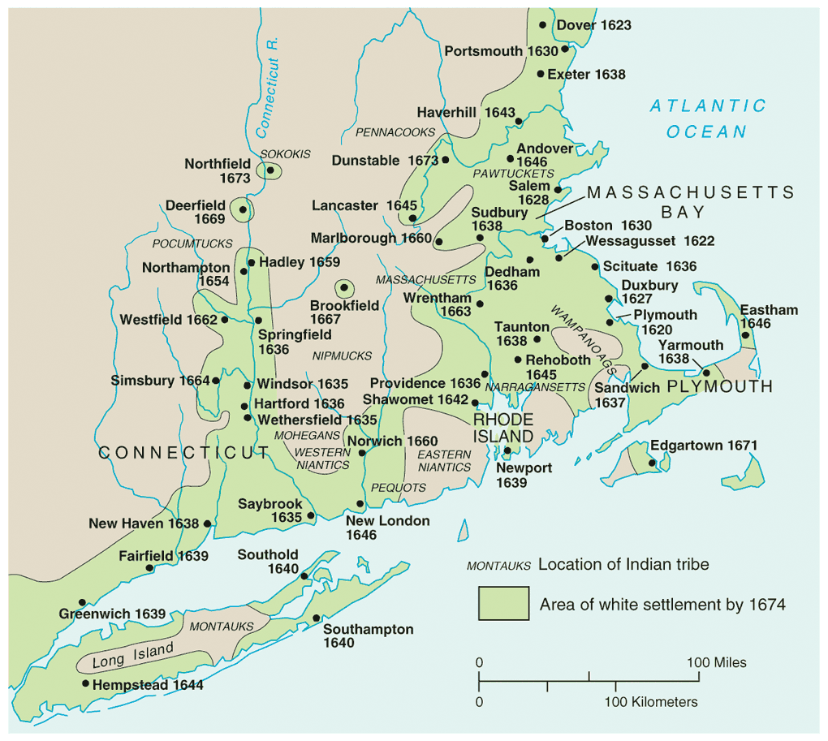

Slide 11
The Massachusetts Bay Colony
1629 → Puritans got a royal charter to form the MA Bay Co.
Wanted to escape attacks by conservatives in the Church of England.
They didn’t want to leave the Church, just its “impurities.”
1630 → 1,000 people set off in 11 well-stocked ships
Established a colony with Boston as its hub.
“Great Migration” of the 1630s
Turmoil in England [leading to the English Civil War] sent about 70,000 Puritans to America.
Not all Puritans → 20,000 came to MA.

Slide 12
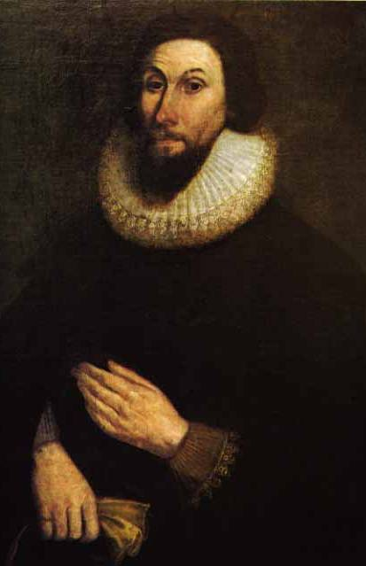
John Winthrop
Well-off attorney and manor lord in England.
Became 1st governor of Massachusetts.
Believed that he had a “calling” from God to lead there.
Served as governor or deputy-governor for 19 years.
We shall be as a city on a hill…
Notes:
Read City On A Hill

Slide 13
Characteristics of
New England Settlements
Low mortality → average life expectancy was 70 years of age.
Many extended families.
Average 6 children per family.
Average age at marriage:
Women – 22 years old
Men – 27 years old.

Slide 14
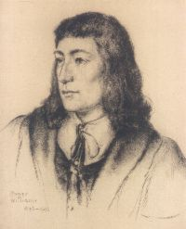
Puritan “Rebels”
Young, popular minister in Salem.
Argued for a full break with the Anglican Church.
Condemned MA Bay Charter.
Did not give fair compensation to Indians.
Denied authority of civil govt. to regulate religious behavior.
1635 → found guilty of preaching new & dangerous opinions and was exiled.
Roger Williams

Slide 15
Rhode Island
1636 → Roger Williams fled there.
MA Bay Puritans had wanted to exile him to England to prevent him from founding a competing colony.
Remarkable political freedom in Providence, RI
Universal manhood suffrage → later restricted by a property qualification.
Opposed to special privilege of any kind → freedom of opportunity for all.
RI becomes known as the “Sewer” because it is seen by the Puritans as a dumping ground for unbelievers and religious dissenters → More liberal than any other colony!

Slide 16
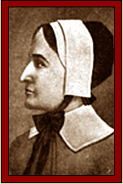
Puritan “Rebels”
Intelligent, strong-willed, well-spoken woman.
Threatened patriarchal control.
Antinomianism [direct revelation]
Means “against the law.”
Carried to logical extremes Puritan doctrine of predestination.
Holy life was no sure sign of salvation.
Truly saved didn’t need to obey the law of either God or man.
Anne Hutchinson
Notes:
Def: one who rejects a socially established morality.

Slide 17
Anne Hutchinson’s Trial
1638 → she confounded the Puritan leaders for days.
Eventually bragged that she had received her beliefs DIRECTLY from God.
Direct revelation was even more serious than the heresy of antinomianism. WHY??
Puritan leaders banished her → she & her family traveled to RI and later to NY.
She and all but one member of her family were killed in an Indian attack in Westchester County.
John Winthrop saw God’s hand in this!

Slide 18
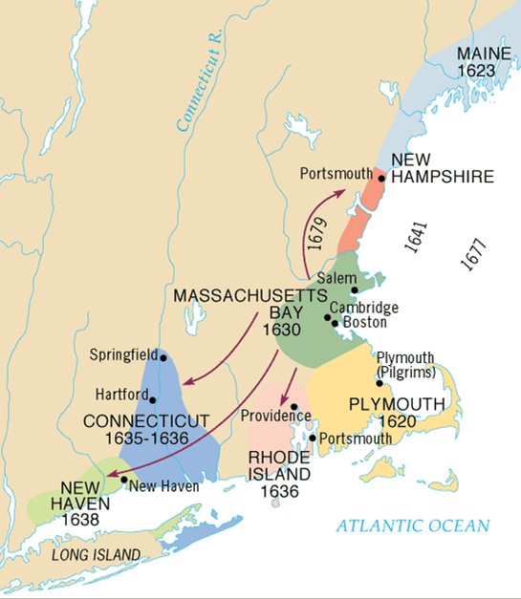

Slide 19
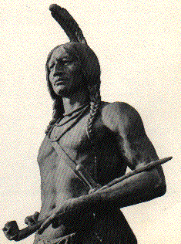
Puritans vs.
Native Americans
Indians especially weak in New England → epidemics wiped out ¾ of the native population.
Wampanoags [near Plymouth] befriended the settlers.
Cooperation between the two helped by Squanto.
1621 → Chief Massasoit signed treaty with the settlers.
Autumn, 1621 → both groups celebrated the First Thanksgiving.

Slide 20
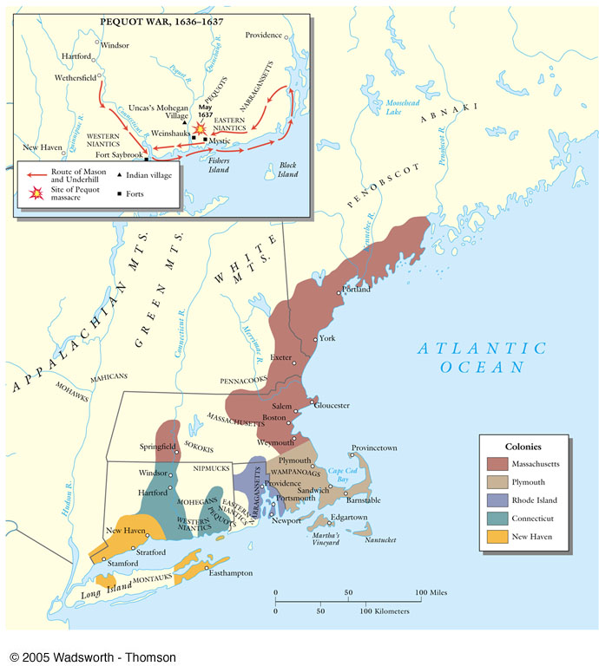
The Pequot Wars: 1636-1637
Pequots → very powerful tribe in CT river valley.
1637 → Pequot War
Whites, with Narragansett Indian allies, attacked Pequot village on Mystic River.
Whites set fire to homes & shot fleeing survivors!
Pequot tribe virtually annihilated→ an uneasy peace lasted for 40 years.

Slide 21
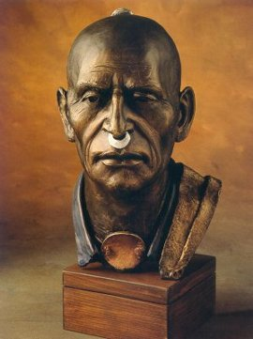
King Philip’s (Metacomet) War (1675-1676}
Only hope for Native Americans to resist white settlers was to UNITE.
Metacom (King Philip to white settlers)
Massasoit’s son united Indians and staged coordinated attacks on white settlements throughout New England.
Frontier settlements forced to retreat to Boston.

Slide 22
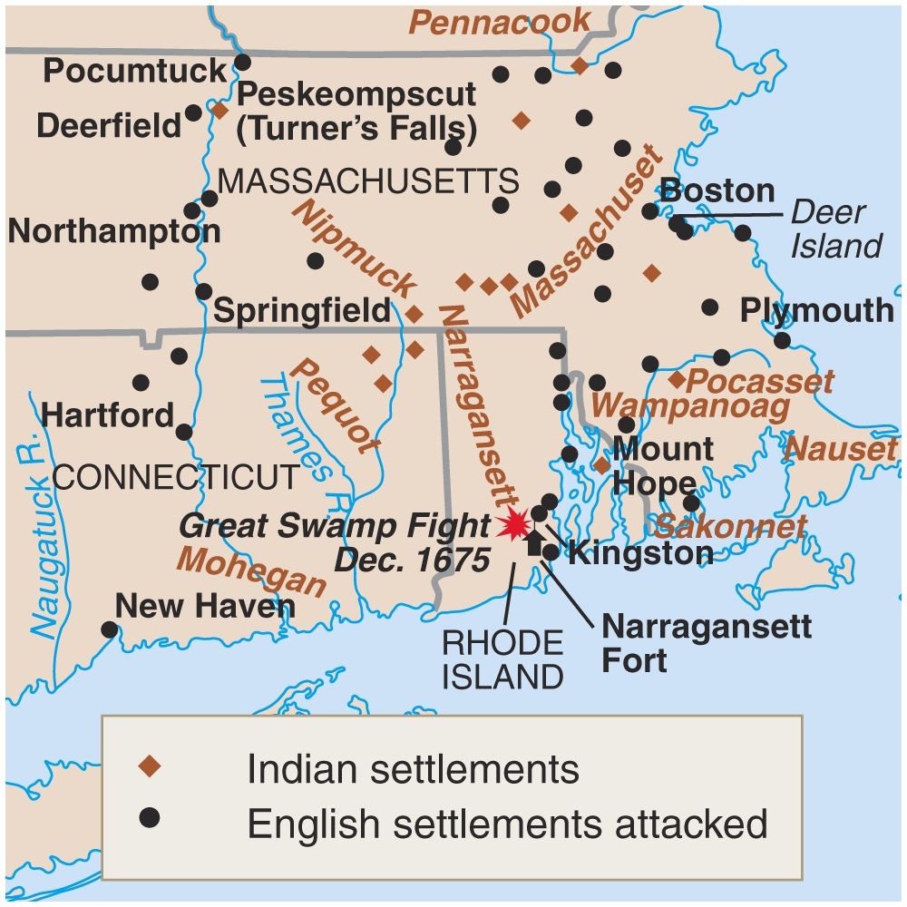
King Philip’s War (1675-1676)
The war ended in failure for the Indians
Metacom beheaded and drawn and quartered.
His son and wife sold into slavery.
Never a serious threat in New England again!!

Slide 23
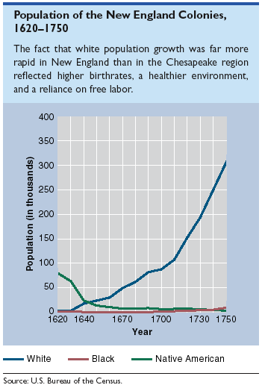

Slide 24
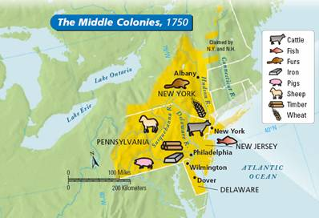
Middle Colonies Society & Economy
Shipbuilding, small-scale farming, and trading.
New York and Philadelphia grew as seaports and commercial centers
“bread basket” of colonies

Slide 25
New York
Founded
1626
Founder
Dutch settlers
Purpose
Economic gain
Economy
Fur, patroonships
Manhattan port
Hudson River farming
Government
Royal colony
Peter Stuyvesant
Ethnic/Social/Religious
Lenape & Iroquois
“New Amsterdam”
Limited slavery
English took control during Anglo-Dutch Wars
Dutch Reformed & Anglican Churches

Slide 26
New Jersey
Founded
1660
Founder
Swedish & Dutch settlers
Purpose
Economic gain
Economy
Mixed farming
Government
Royal colony

Slide 27
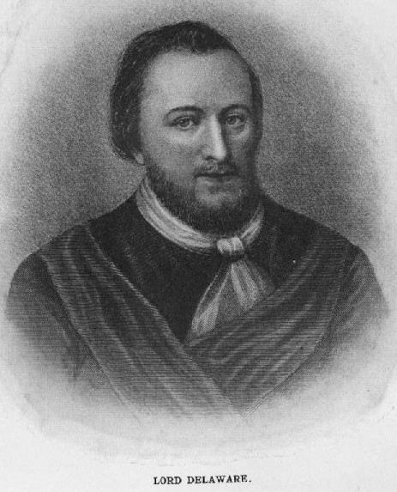
Delaware
Founded
1638
Founder
Dutch & Swedish settlers
Purpose
Economic gain
Economy
Fishing, moderate-sized plantations
Government
Proprietary colony

Slide 28
Pennsylvania
Founded
1682
Founder
William Penn
Purpose
Haven for Quakers
Economy
Wheat, oats, Philadelphia port
Government
“Restoration” colony
Ethnic/Social/Religious
Lenape, peaceful (early) Indian relations
English (later, Germans and Scots-Irish)
Tolerance: Quakers, Mennonites, Amish
Limited slavery

Slide 29
Penn's "Holy Experiment"
Quakers were persecuted in New England for their beliefs; William Penn founded Pennsylvania in 1681 as a “holy experiment”
As a society run on Quaker principles that promoted religious toleration & protection of the rights of property-less
Appealed to English, Welsh, Irish, German immigrants

Slide 30
Settling Pennsylvania
Immigration to PA led to a very ethnically, nationally, & religiously diverse population
Quarrels were common (unlike homogeneous VA & Mass Bay colonies), but PA prospered
In 1701, Penn granted self-rule to PA colonists & independence to Delaware counties

Slide 31
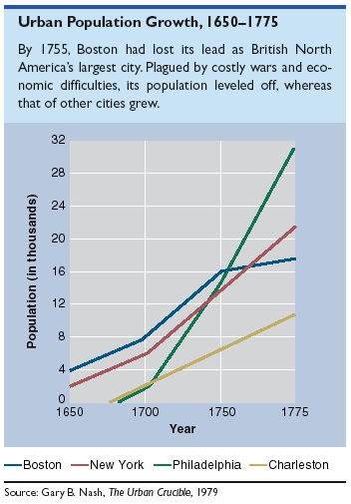
Ports & Growing Cities

Slide 32
Conclusions
All the colonies faced early an struggle to survive
Distinct regional differences intensified & persisted throughout the colonial period
It was not until the American Revolution that colonists began to see themselves as a distinct “American” people

